Slide 1
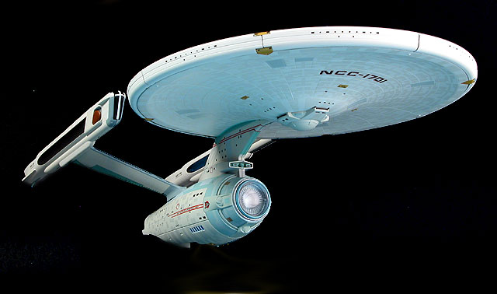
3.4 Quantum Numbers

Slide 2
Key Idea
That every electron in an atom is believed to exist in a specific orbital characterized by four quantum numbers
n, l, m_{l}, m_{s}
Each electron has a unique set of four numbers (like coordinates on a map)
All 4 quantum numbers describe the properties of the orbital an electron is associated with
Quantum numbers arose from the solutions to Schrodinger’s wave equation

Slide 3
The Principal Quantum Number, n
An integer that describes a main shell of electrons
Shell is a term to describe main energy of an electron
It describes the size and energy of an atomic orbital
The larger the value, the greater the energy
  The larger the value of n, the larger the orbital
  n = 1,2,3…

Slide 5
Journey to the Second Quantum Number
Upon closer examination of Bohr’s line spectrum for hydrogen, Albert Michelson realized that the distinct lines were actually a collection of smaller lines
Arnold Summerfield studies the lines in great detail and determined that within a shell there must be subshells or energy sublevels

Slide 6
The Secondary Quantum Number, l
describe additional electron energy sublevels, or subshells, that formed part of a main energy level
relates primarily to the shape and energy of an atomic orbital
The number of values for l equals the volume of the principal quantum number
l=n-1

Slide 7
Value of l | 0 | 1 | 2 | 3 | 4 | 5
Letter | s | p | d | f | g | h

Slide 8
The Magnetic Quantum Number, m_{l}
Determines the orientation of the orbital in space relative to other orbitals in the atom
  Orbits can have the same energy and shape but a different orientation in space
Orbits can exist at varying angles
The number of values for m_{l} is the number of independent orientations of orbits possible

Slide 9
Allowable values are from –l to +l
Table 2

Slide 10
The Spin Quantum Number, m_{s}
Refer to the two possible orientations of the spin axis of an electron
The spin value can be –1/2 or +1/2
The spins are equal in magnitude but opposite in direction
The spin would cause the electron to behave like a tiny bar magnet having a N and S pole

Slide 11
Pauli Exclusion Principle
In a given atom, no two electrons can have the same set of four quantum numbers n,l, m_{l}, m_{s}
Since the spin quantum number has only two allowable values, each orbital can only contain a maximum of two electrons

Slide 13
Home Work
Pg. 159 # 3-9

