Slide 1
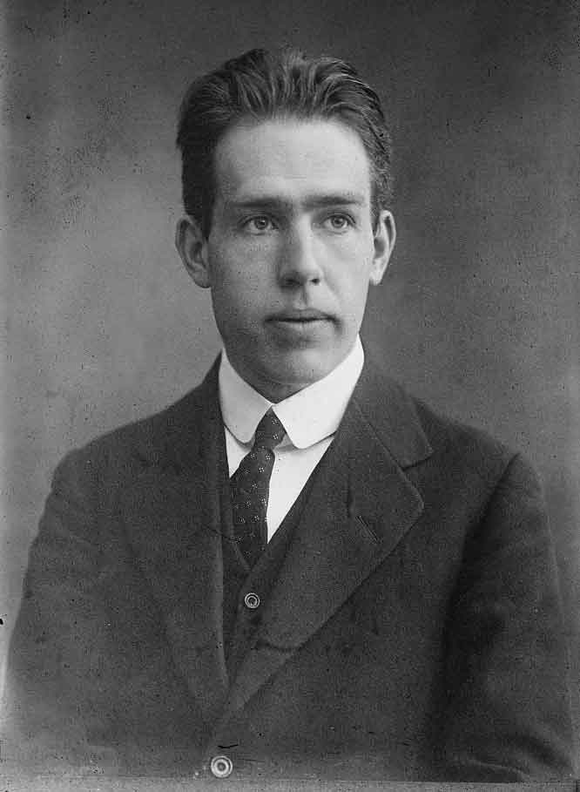
3.2 Bohr’s model of the Atom

Slide 2
Rutherford’s Atom
- an orbiting electron
should continuously emit electromagnetic
radiation, lose energy, fall into the nucleus
and collapse the atom
Fig. 1 pg. 143

Slide 3
Background Knowledge-
Atomic Spectra
spectroscopy a technique for analyzing spectra
the spectra may be visible light, infrared, ultraviolet, X-ray, and other types
bright-line spectrum a series of bright lines of light produced or emitted by a gas excited by, for example, heat or electricity

Slide 4


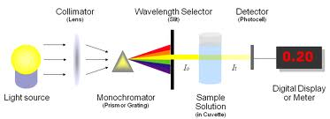
The Spectrometer

Slide 5
Spectrum Lingo
Emission spectrum: the spectrum that is emitted by an atom
Continuous Spectrum: an emission spectrum that contains all the wavelengths in a specific region of the electromagnetic spectrum
Line spectrum: an emission spectrum that contains only those wavelength characteristics of the element being studied

Slide 6
Each element has an individual line spectra
it proved as a great tool for cataloguing existing elements and finding new ones

Slide 7
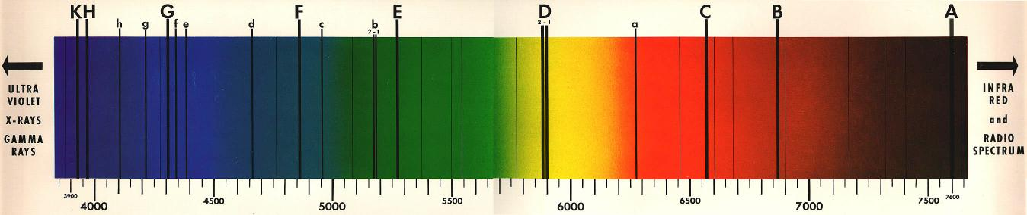
absorption or dark-line spectra is a series of dark lines (i.e., missing parts) of a continuous spectrum
that dark lines in an element’s spectrum are in the same position as the bright lines in the spectrum of the same element

Slide 8
Bohr’s Key Ideas
bright and dark-line spectra of the elements indicates that only certain quanta of light (certain photon energies) can be emitted or absorbed by an atom
thus an electron can only have certain energies

Slide 9
Bohr’s Key Ideas
Electrons do not radiate energy as they orbit the nucleus.
Each orbit corresponds to a state of constant energy (called a stationary state).
  A stationary state is a stable energy state of an atomic system that does not involve any emission of radiation

Slide 10
Bohr’s Key Ideas
Electrons can change their energy only by undergoing a transition from one stationary state to another.
Transition: the jump of an electron from one stationary state to another

Slide 11
a transition from a high energy state to a lower energy state results in energy (photons) being liberated
= bright line spectra

Slide 12
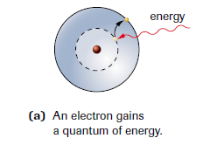
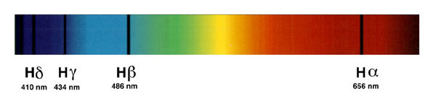
A transition for a lower energy state to a higher one requires energy to be absorbed
= dark line spectra
Absorption spectrum for hydrogen

Slide 13
In the Bohr model of the atom, electrons orbit the nucleus, as the planets orbit the Sun. However, only certain orbits are allowed, and an electron in each orbit has a specific energy.
Fig 4. p.176

Slide 14
Bohr Energy-Level Diagram
To create a Bohr Energy-Level Diagram we work from the bottom up

Slide 15
Examples

Slide 16
The Successes and Failure of the Bohr Model
Success
  explanation of Mendeleev’s periodic law
  Starting grounds for a new approach to the quantum model
Failure
  only worked for hydrogen!

Slide 17
Home work!
Pg. 147 # 1-12
See you at lunch if you need to see the safety video!
Safety contract due Monday!

