Slide 1
Office Hours this week
Today: 2:00 – 3:30 PM
Tomorrow 9:00 -10:30 AM (by appoint.)
After tomorrow AM: only reachable by email.

Slide 2
Format Final Exam
25 MCQs Total of 40 marks
9 Questions: Total of 60 marks

Slide 3
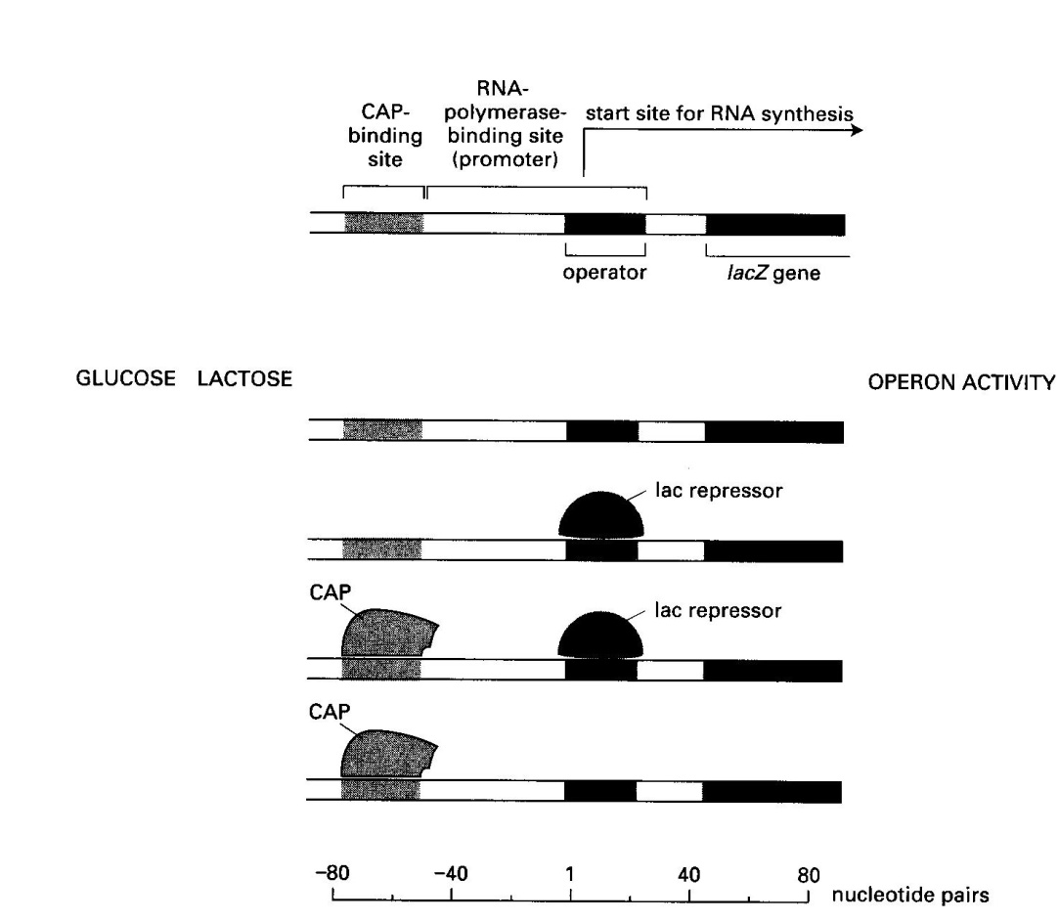
1: In the following figure which shows the regulatory region of the lactose operon, you see the different possible occupancy status for the CAP and repressor binding sites. Associate each of these situations with presence or absence of glucose and lactose in the growth media and say if the operon will be active (ON) or inactive (OFF).

Slide 4
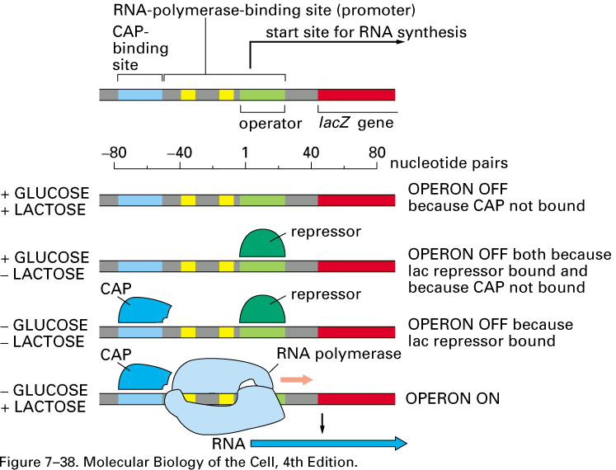

Slide 5
2. Imagine you have created a fusion between the regulatory regions of the tryptophan operon and the coding region of the lactose operon. Under which circumstances do you expect to see expression of the β-galactosidase gene ?
A) Only when glucose and lactose are absent?
B) Only when glucose and lactose are present?
C) Only when glucose is present and lactose is absent ?
D) Only when lactose is present and glucose is absent ?
E) Only when tryptophan is absent ?
F) Only when tryptophan is present ?

Slide 6
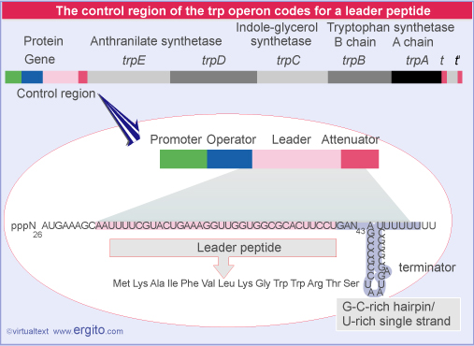

Slide 7
2. Imagine you have created a fusion between the regulatory regions of the tryptophan operon and the coding region of the lactose operon. Under which circumstances do you expect to see expression of the β-galactosidase gene ?
A) Only when glucose and lactose are absent?
B) Only when glucose and lactose are present?
C) Only when glucose is present and lactose is absent ?
D) Only when lactose is present and glucose is absent ?
E) Only when tryptophan is absent ?
F) Only when tryptophan is présent ?

Slide 8
3- Bacteriophage lambda can use the lytic pathway or the lysogeny pathway. You saw the respective roles of the cro and cI proteins. When a bacteria where the phage is currently in the lysogeny state is briefly exposed to UV, the cI protein is degraded.
a) What will happen ?
b) Is this change irreversible ?
c) How can this change be beneficial to the virus ?

Slide 9
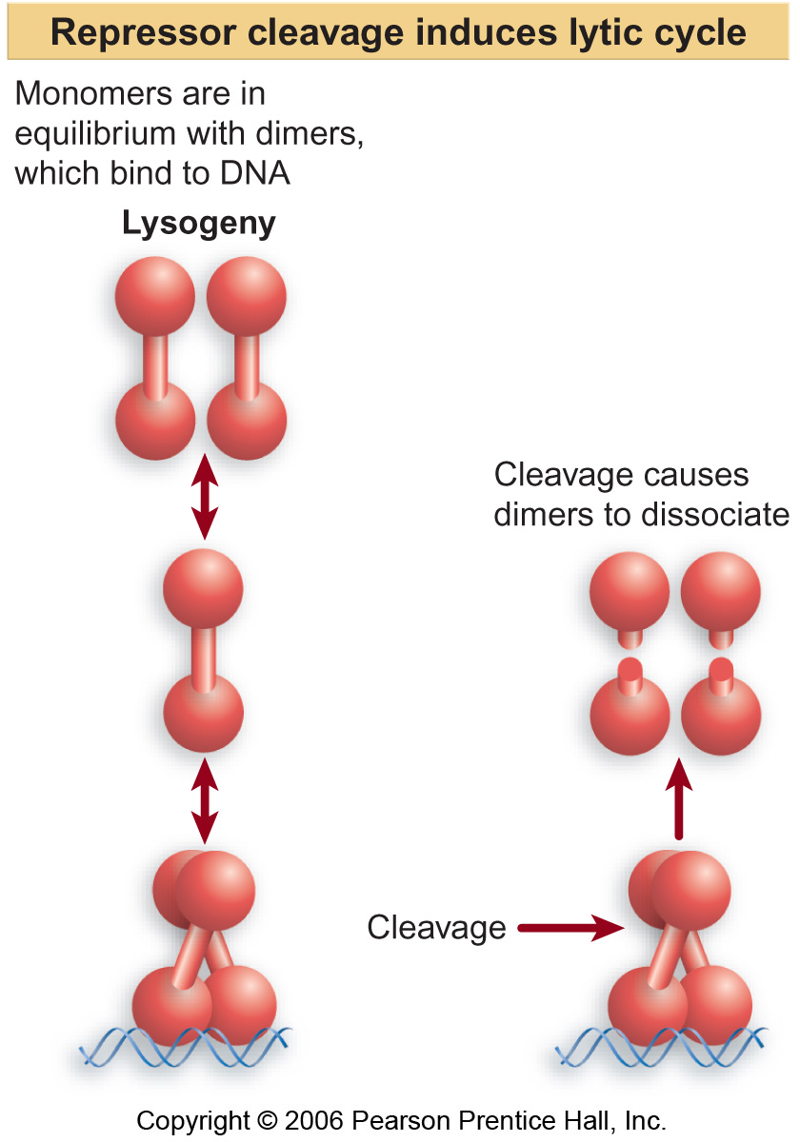

Slide 10
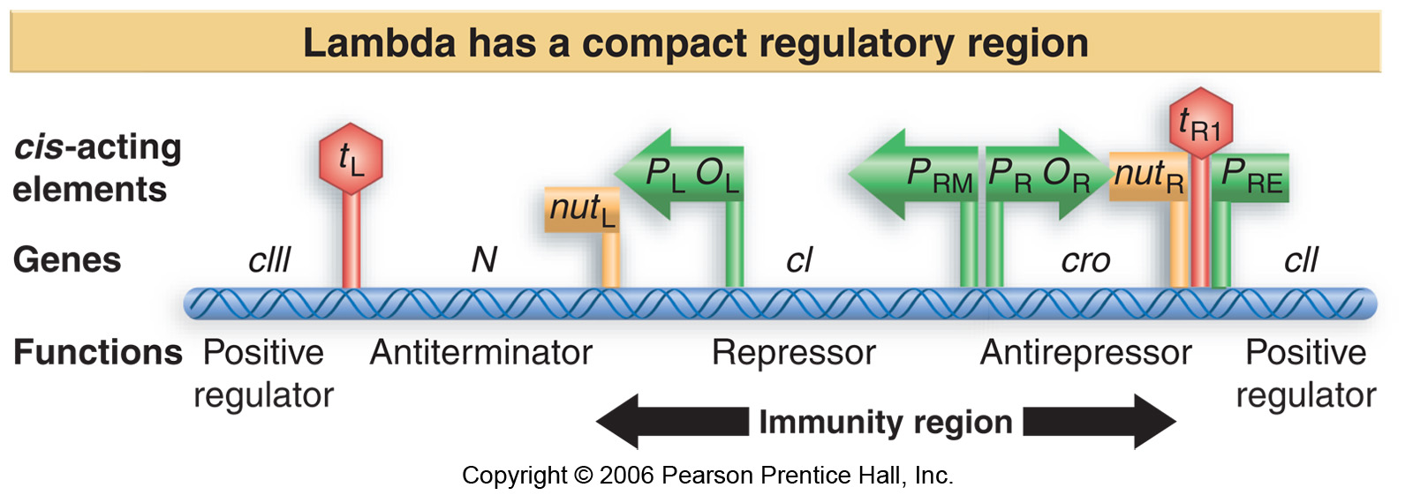

Slide 11
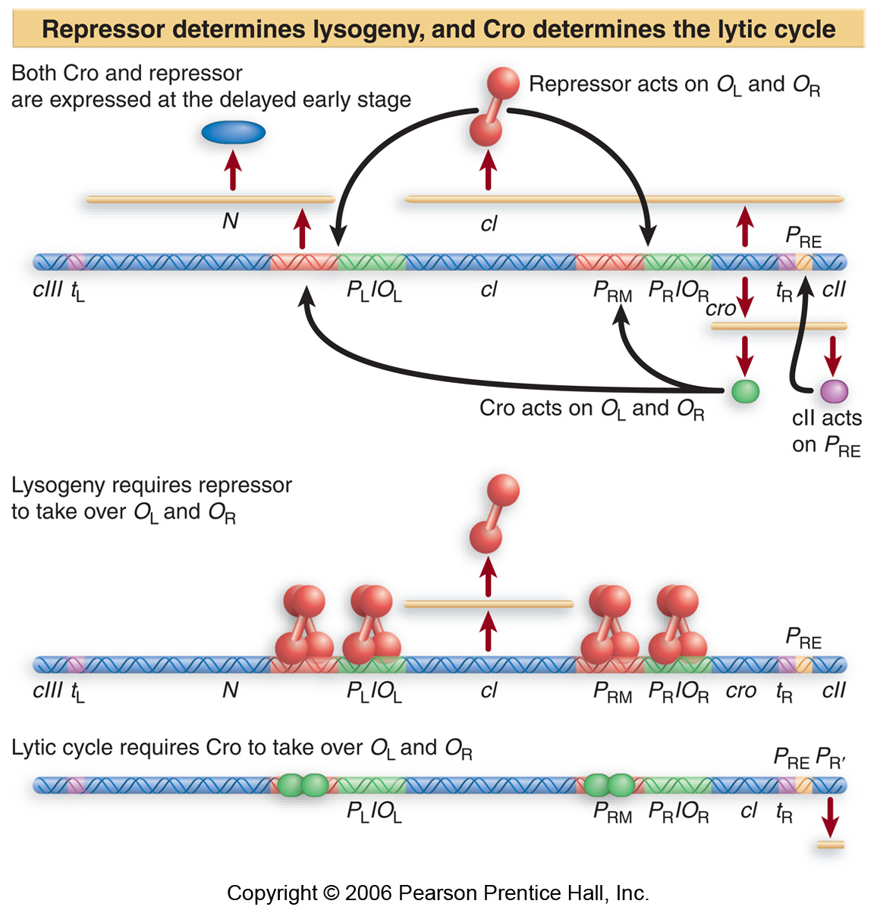

Slide 12
4. In their studies of lambda bacteriophage, Jacob and Wollman transferred a fragment of bacterial chromosome in another bacterial cell. They observed that when the transferred DNA contained the lambda under lysogeny form (prophage), and that the recipient bacteria did not contain the lambda phage, lysis was taking place. They wanted to name this phenomenon “erotic induction” but had to change the name for “zygotic induction” (true story!) before they could publish it. What can you do, this was fifty years ago. The following table shows the results
Receiving bacteria lambda- lambda+
Donnor DNA
Lambda- no lysis no lysis
Lambda+ lysis (λ is made) no lysis
a) Explain these results basing yourself on your knowledge of the phage repressor (cI).
b) Imagine a situation where, instead of having a repressor, the prophage would prevent lysis by producing an activator regulatory protein that would control the expression of an anti-lysis protein. How would the above results be affected? Explain your answer.

Slide 13
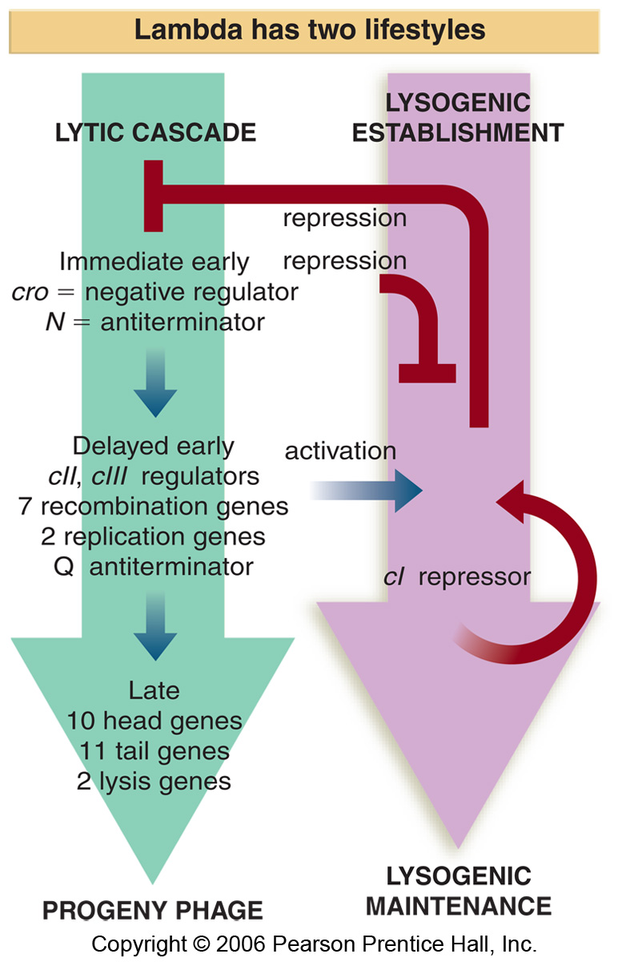
Receiving bacteria:
Lambda (-) : no cI repressor
Lambda (+): cI repressor present
Donnor DNA:
Lambda (-)
Lambda (+)

Slide 14
5. Suggest a mechanism by which protein-protein interactions that are too weak to cause formation of a multi-protein complex in solution can still lead to formation of such a complex on DNA ?

Slide 15
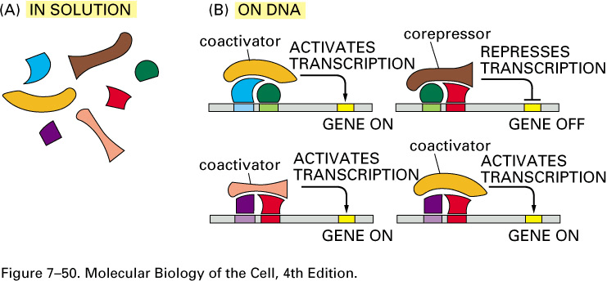
Synergy involving rDBPs, co-activators, and co-repressors

Slide 16
6- Imagine the following two situations. In type I cell, a transient signal leads to synthesis of protein A, a transcriptional activator for several target genes including itself. In type II cells, a transient signal leads to synthesis of a repressor protein that represses transcription of several target genes including itself. Is one of the two cell types susceptible to generate daughter cells that « remember » that their mother cells and gone through the initial signal? Justify your answer.

Slide 17
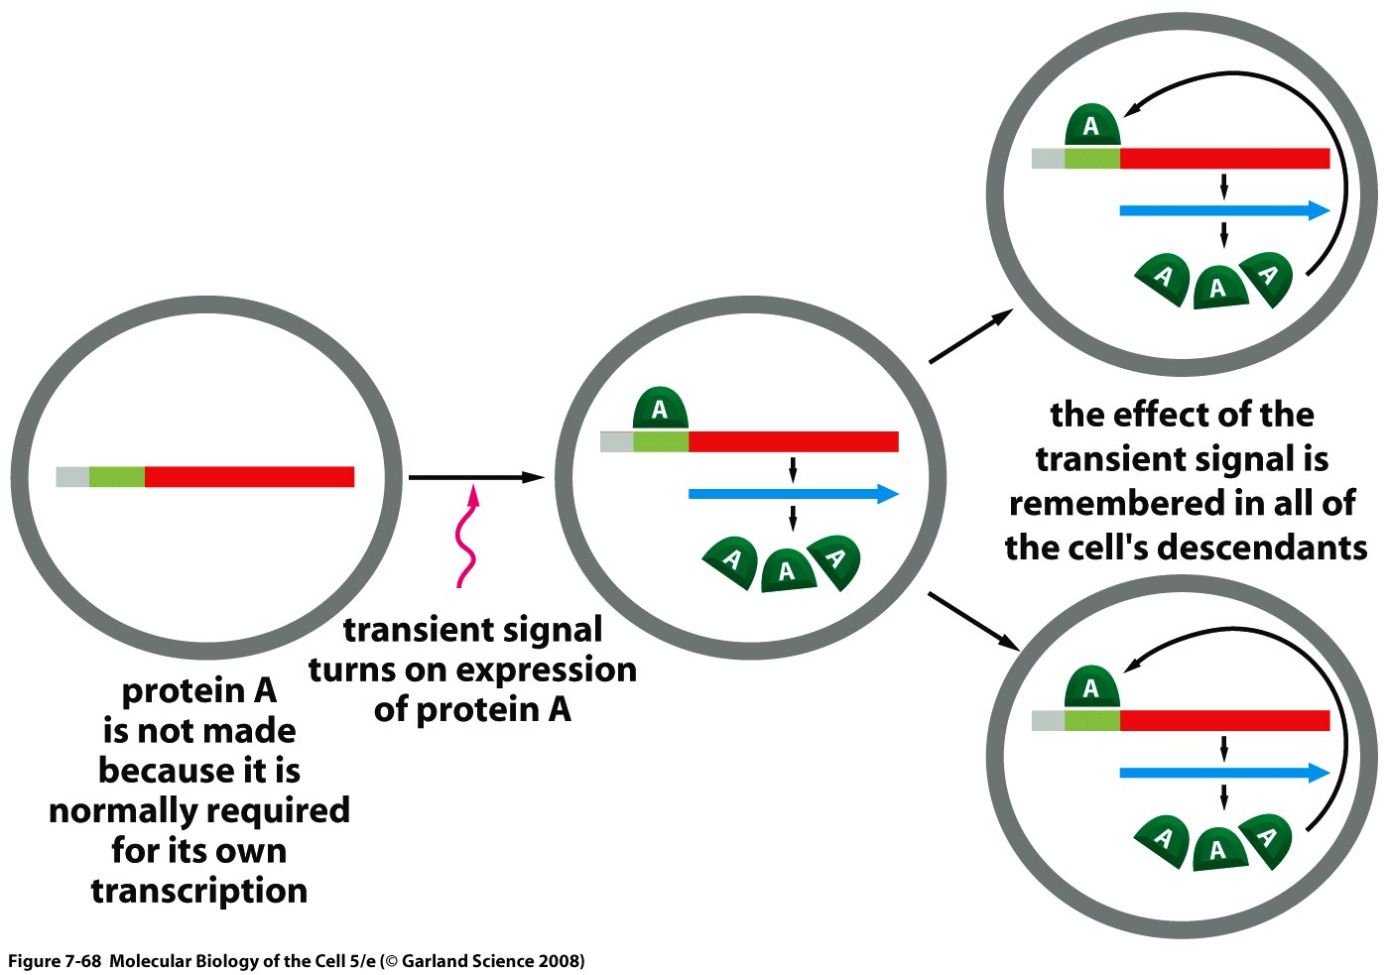
Example of positive feedback

Slide 18
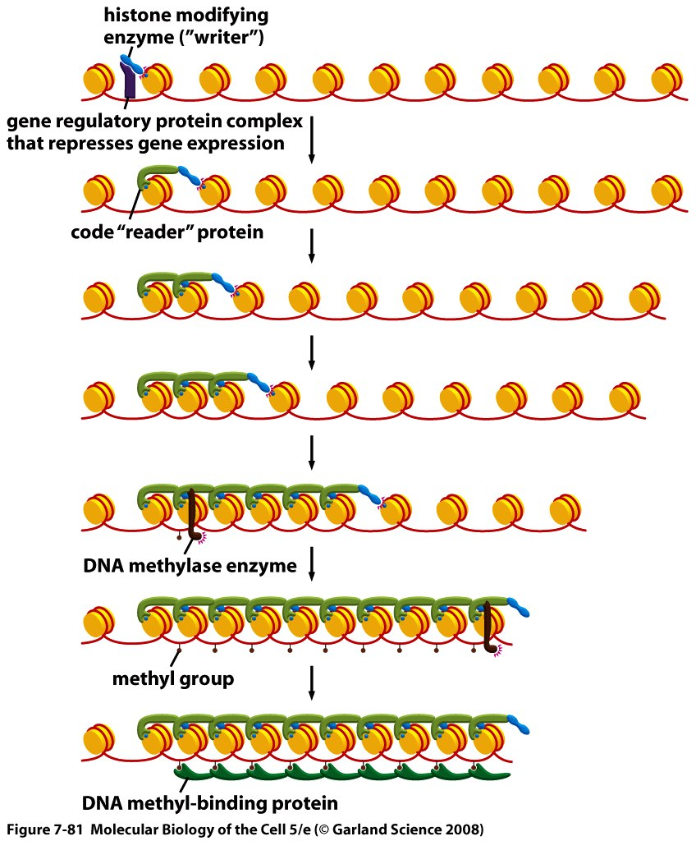
Cytosine methylation and transcriptional activity.

Slide 19
7. The human alpha-tropomyosin gene is subject to alternative splicing and produces mRNAs in different cell types. As shown in the figure below, exon 1 is used in all cases and the same applies to exons 4, 5, 6, 9, and 10. However, exons 2 and 3 are used alternatively (either one or the other) and the same applies for exons 7 and 8. Which of the following statements applies to exons 2 and 3? Is it also true for exons 7 and 8?

Slide 20
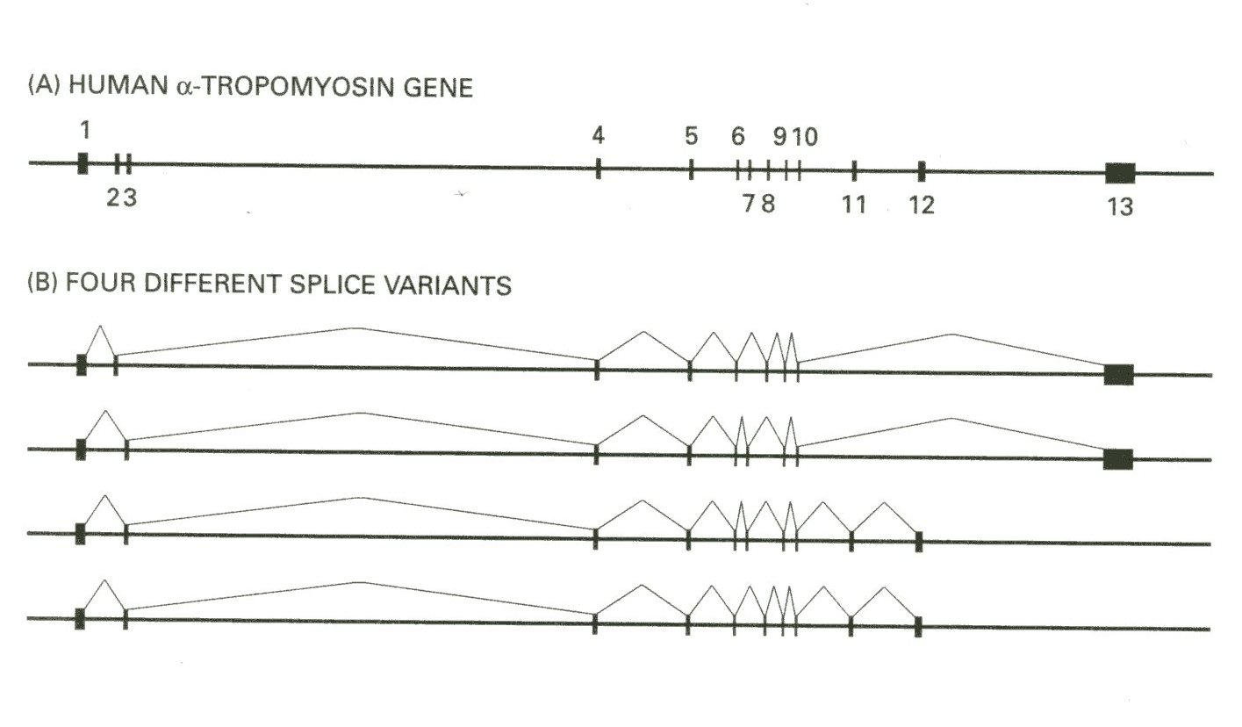
Exons 1-2-4-5 etc…
Exons 1-3-4-5 etc…
A) Exons 2 and 3 must have the same number of nucleotides.
B) Exons 2 and 3 must have nucleotide numbers that are multiple of 3.
C) Exons 2 and 3 must have a number of nucleotide which, once divided by three, give the same remainder (i.e. 0, 1 or 2).

Slide 21
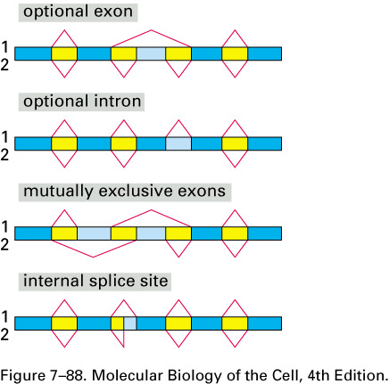

Slide 22
Exons 1-2-4-5 etc…
Exons 1-3-4-5 etc…
A) Exons 2 and 3 must have the same number of nucleotides.
B) Exons 2 and 3 must have nucleotide numbers that are multiple of 3.
C) Exons 2 and 3 must have a number of nucleotide which, once divided by three, give the same remainder (i.e. 0, 1 or 2).

Slide 23
A) Exons 2 and 3 must have the same number of nucleotides.
B) Exons 2 and 3 must have nucleotide numbers that are multiple of 3.
C) Exons 2 and 3 must have a number of nucleotide which, once divided by three, give the same remainder (i.e. 0, 1 or 2).
Answer: The only thing that matters is keeping the same reading frame. You do not need to have the same number of nucleotides to achieve this and you do not need to have an exon whose size is a multiple of 3. For example, if exon 2 has 13 nucleotides and exon 3 has16 nucleotides, their mutually exclusive use would result in 1-2-4 and 1-3-4 splicing that keep the same reading frame.

Slide 24
8.« Memorizin » is a hypothetical protein involved in memory which allows students to memorize even the most trivial details during exam season. Protein activity is undetectable people with a bad memory. DNA was isolated from a family with several individuals suffering from bad memory and its analysis showed a single nucleotide substitution compared to DNA from people with a normal memory. There were no deletions or insertions. Sequence analysis algorithms suggest that this substitution should result in the synthesis of a mature mRNA that is 193 nucleotides (nt) longer in individuals affected with a bad memory compared to normal individuals.
a) Suggest a mechanism that can explain how a single substitution can result in a mRNA that is 193 nt longer

Slide 25
Normal memory
…..
Intron size = 193 nt
splicing
…..
…..
Bad memory
…..
…..
*
Mutation in splice donor site
No splicing
…..
…..
mRNA 193 nt longer

Slide 26
b) Supposing that the 193 nt insertion falls within the protein coding sequence of the mRNA, mention two possible impacts on the synthesized protein?
c) Name one mechanism that could alleviate one of the problems mentioned in b) and explain the absence of protein activity in people with bad memory

Slide 27
b) Supposing that the 193 nt insertion falls within the protein coding sequence of the mRNA, mention two possible impacts on the synthesized protein?
Answer: 1) Abnormal protein sequence: 193 is not a multiple of three so this will change the reading frame. In addition to the abnormal amino acids introduced by the insertion, all amino acids in the downstream exons will be abnormal. 2) Truncated protein. There could be in-frame stop codons in the 193 nt insertion or in the downstream exons.
c) Name one mechanism that could alleviate one of the problems mentioned in b) and explain the absence of protein activity in people with bad memory

Slide 28
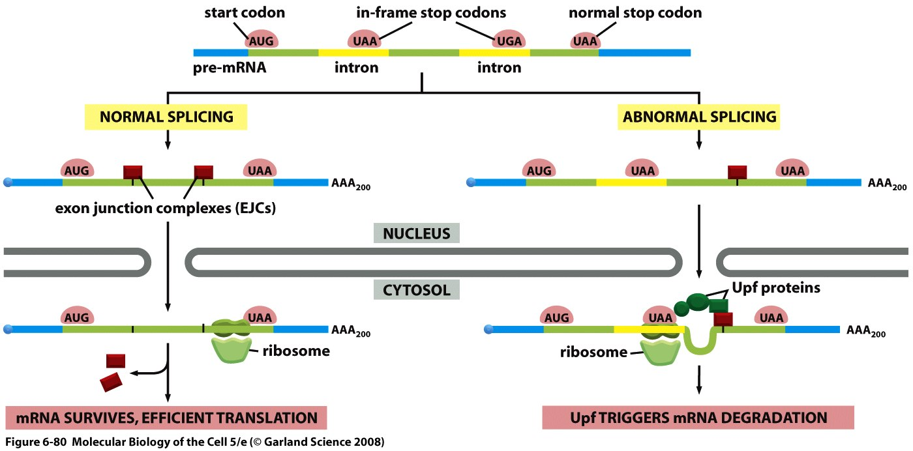
Non-sense-mediated mRNA decay

Slide 29
9- The Vg1 gene codes for a protein that plays an important role during early embryonic development. The Vg1 mRNA and the Vg1 protein are localized to the vegetal pole of the Xenopus oocyte and this localization is important for Vg1 function. One way to ensure localization is to prevent translation before localization is complete. It was previously shown that a sequence rich in U and A is located in the 3’UTR and is essential for translation control. However, if you insert an internal ribosomal entry site (IRES) upstream of the Vg1 initiator AUG, inhibition of translation is no longer possible. Suggest a mechanism to explain how translational control of Vg1 mRNA takes place.

Slide 30
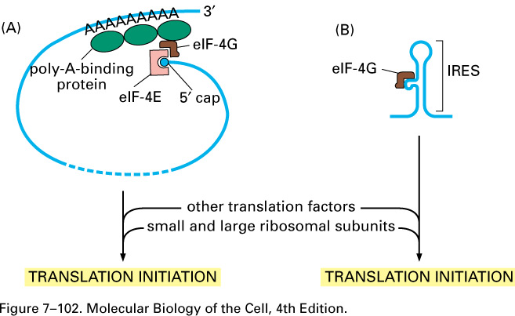
Different translation factors are involved in initiation of translation from a regular AUG and from an IRES.
The localized translation of Vg1 might involve interaction between factors binding to 3’UTR and those binding to the cap (e.g. eiF4E, normal eiF4G). The IRES might bypass this control mechanism.

