Slide 1
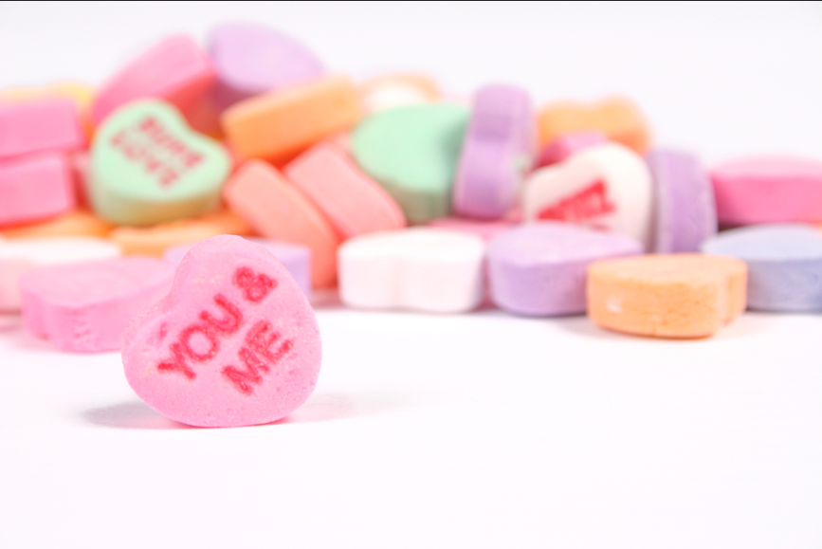
Falling in Love
Behaviour in a Social Context

Slide 2
Presentation Outline
Cover Slide:
- Title
- Name, student number, section #, professor name
Slide One: Introduce Topic of Falling in Love
Slide Two: Relevance of Studying Love in Psychology
- Maslow’s Hierarchy of Needs
- Love as a motivator: biological, psychological, philosophical
Slide Three: Define ‘Love’
- Understanding the different types of love
- How love differs among cultures
- Example: The Colour Gradient
Slide Four: Love: Nature or Nurture?
- Biological vs. Cultural phenomenon
Slide Five: Falling in Love through a Biological Perspective
- Diagram of brain centre functions

Slide 3
Presentation Outline (Cont’d)
Slide Six: Falling in Love through a Biological Perspective (cont’d)
- Neurotransmitters, hormones and pheromones
- Reproduction
Slide Seven: Falling in Love through a Cognitive Perspective
- Communication: perception, attention, language, memory, thinking
Slide Eight: Falling in Love through a Psychodynamic Perspective
- Aggressive and sexual impulses
- Early childhood experiences/relationships
Slide Nine: Falling in Love through a Behavioural Perspective
- The effects of environmental influences
- The ‘basic life path’ (determinism)
Slide Ten: Falling in Love through a Humanistic Perspective
- Love as one of the crucial human needs to achieve self-actualization

Slide 4
Presentation Outline (Cont’d)
Slide Eleven: Falling in Love through a Sociocultural Perspective
- How culture is transmitted
- Cross cultural differences and traditions
Slide Twelve: Research Studies on Falling in Love
- Falling in love hits the brain like cocaine does
Slide Thirteen: Research Studies on Falling in Love
- Helen Fisher: The Brain in Love
- The human’s physical need for romantic love / Love as a universal human drive
Slide Fourteen: Summary and Conclusion
- Love as a motivator: biological, psychological, philosophical
- Translates differently in different cultures and psychological perspectives
- Love is universal
Slide Fifteen: References
Slide Sixteen: Image References

Slide 5
References
Chapman, Heather M., "Love: A Biological, Psychological and Philosophical Study" (2011). Senior Honors Projects. Paper 254. http://digitalcommons.uri.edu/srhonorsprog/254
Cherry, K. (n.d.). Compassionate and Passionate Love. In http://psychology.about.com. Retrieved November 13, 2013, from http://psychology.about.com/od/l oveandattraction/a/ compassionate.htm
McLeod, S. (2007). Cognitive Psychology. In SimplyPsychology.com. Retrieved November 13, 2013, from http://www.simplypsychology.org/cognitive.html
McLeod, S. (2007). Humanistic Psychology. In SimplyPsychology.com. Retrieved November 13, 2013, from http://www.simplypsychology.org/humanistic.html
Nordqvist, C. (2010, October 27). Falling In Love Hits The Brain Like Cocaine Does. In MedicalNewsToday.com. Retrieved November 14, 2013, from http:// www.medicalnewstoday.com/articles/205973.php
Passer, M., Smith, R., Atkinson, M., Mitchell, J., & Darwin, M. (2005). Psychology: frontiers and applications. Toronto: McGraw-Hill Ryerson Ltd.
The Science of Love (n.d.). In BBC.co.uk. Retrieved November 14, 2013, from http://www.bbc.co.uk/ science/hottopics/love/
”Sigmund Freud." The Columbia Encyclopedia, Sixth Edition. 2008. Retrieved November 14, 2013 from Encyclopedia.com: http://www.encyclopedia.com/doc/1E1-Freud- Si.html

