Slide 1
Chapter 2
Sec 2.5 Solutions by Substitutions
By
Dr. Iman Gohar

Slide 2


Substitutions
Substitutions can be used to reduce some differential equations down to a solvable form.
The first substitution we’ll take a look at will require the differential equation to be in the form, homogeneous differential equations. Note that we will usually have to do some rewriting in order to put the differential equation into the proper form.
Then, use the following substitution

Slide 3
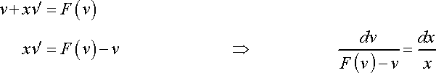

Remember that both y and v are functions of x we can use the product rule,
The differential equation is then,
With a small rewrite of the new differential equation we will have a separable differential equation after the substitution.
$$y^{′}=v+xv′$$

Slide 4

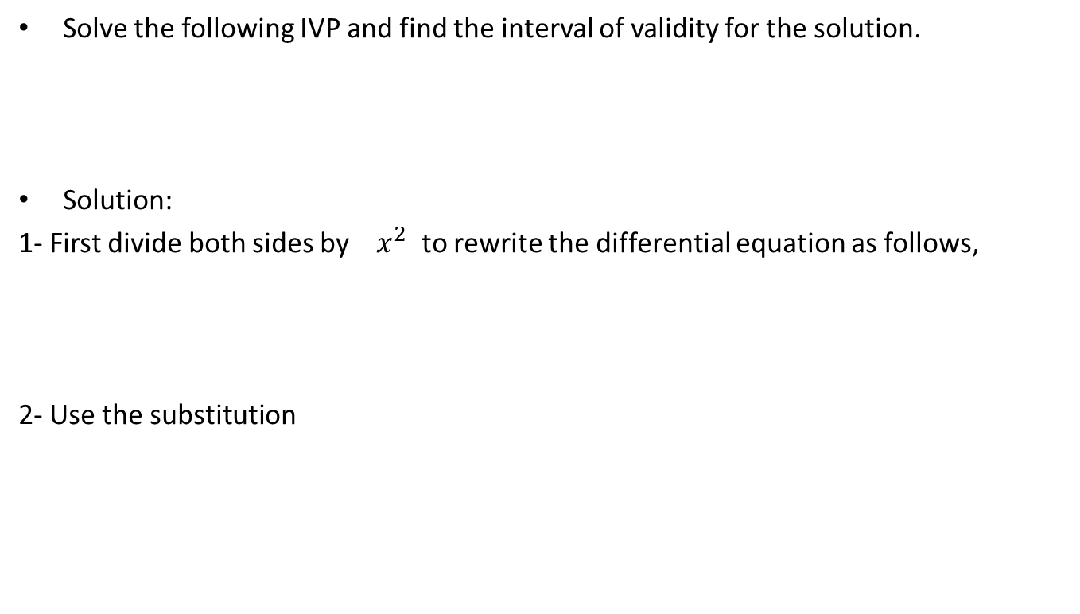

Example 1
Solve the following IVP and find the interval of validity for the solution.
Solution:
1- First divide both sides by $x^{2}$ to rewrite the differential equation as follows,
2- Use the substitution
$$y^{′}=v+xv′$$

Slide 5
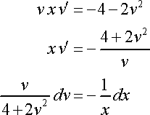

3- Plug the substitution into this form of the differential equation to get,
4- Rewrite the differential equation to get everything separated out.
5- Integrating both sides gives,

Slide 6


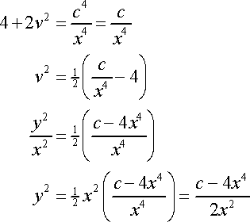
6- Use basic logarithm properties in order to be able to easily solve this for v.

Slide 7



7- Apply BC.
8- The initial condition tells us that the “- ” must be the correct sign and so the actual solution is,
9- The interval of validity
10- The actual solution to satisfy the initial condition

Slide 8
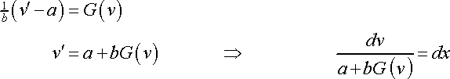
For the next substitution we’ll need the differential equation in the form,
Use the substitution,
Plugging this into the differential equation gives
A new separable differential equation that we can solve.

Slide 9
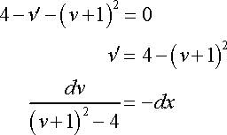
Example 5.2
Solve the following IVP and find the interval of validity for the solution.
Solution

Slide 10
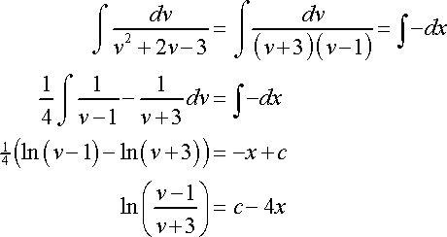
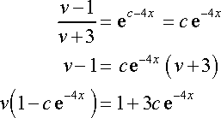
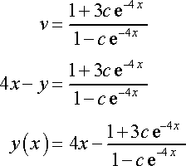

Slide 11


Apply BC.
The solution
Note that because exponentials exist everywhere and the denominator of the second term is always positive (because exponentials are always positive and adding a positive one onto that won’t change the fact that it’s positive) the interval of validity for this solution will be all real numbers.

Slide 12
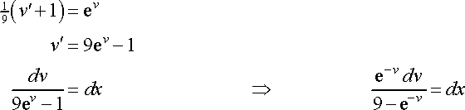

Example 5.3
Solve the following IVP and find the interval of validity for the solution.
Solution:
Multiplying the numerator and denominator by to have a simple substitution integration problem. So, upon integrating both sides we get,

Slide 13
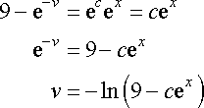


Apply the initial condition and solve for c.
interval of validity

Slide 14
Bernoulli Differential Equations
Bernoulli ‘s Equation in the form of
where p(x) and q(x) are continuous functions on the interval we’re working on and n is a real number

Slide 15

Solution Process
First divide the differential equation by to get
Use the substitution to convert this into a differential equation in terms of v.
Determine just what is . By using the chain rules
Plugging this as well as our substitution into the differential equation gives,
Solve this LDE in v , then substitute back and solve for y

Slide 16


Example 5.4
Solve the following IVP and find the interval of validity for the solution.
Solution:
So, the first thing that we need to do is get this into the “proper” form and that means dividing everything by . Doing this gives,

Slide 17


The substitution and derivative that we’ll need here is,
Solve as a first order linear differential equation
Note that we dropped the absolute value bars on the x in the logarithm because of the assumption that .

Slide 18
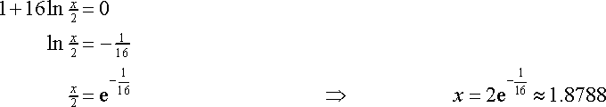

Plug the substitution back in
Apply B.C. to find the constant of the integration
The two possible intervals of validity are then
and the solution is

Slide 19
Example 5.5
Solve the following IVP and find the interval of validity for the solution.
Solution:
Multiply through by Y² and rearrange
Solve

Slide 20

Substitute,
Applying the initial condition and solving for c gives,
Interval of validity is all real numbers

Slide 21
Example 5.6
Solve the following IVP
Solution:
First get the differential equation in the proper form and then write down the substitution.
Solve

Slide 22

Substitute,
Applying the initial condition and solving for c gives,

Slide 23


Example 5.7
Solve the following IVP and find the interval of validity for the solution.
Solution:
First get the differential equation into proper form
Substitute,

Slide 24



Solve,
Applying the initial condition and solving for c gives,
Because of the root (in the second term in the numerator) and the x in the denominator we can see that in order for the solution to exist

