Slide 1
Undetermined Coefficients
BY
Dr. Iman Gohar

Slide 2

Undetermined Coefficients
The first method that can be used to find a particular solution to a non-homogeneous differential equation.
(NOTE: There is no coefficient in front of y’’)
All that we need to do is look at g(t) and make a guess as to the form of y_{P}(t) leaving the coefficient(s) undetermined.
Plug the guess into the differential equation and see if we can determine values of the coefficients.
The general solution y(t)= y_{C}+y_{p}
$$y^{′′}+p\left(t\right)y^{′}+q\left(t\right)y=g(t)$$

Slide 3
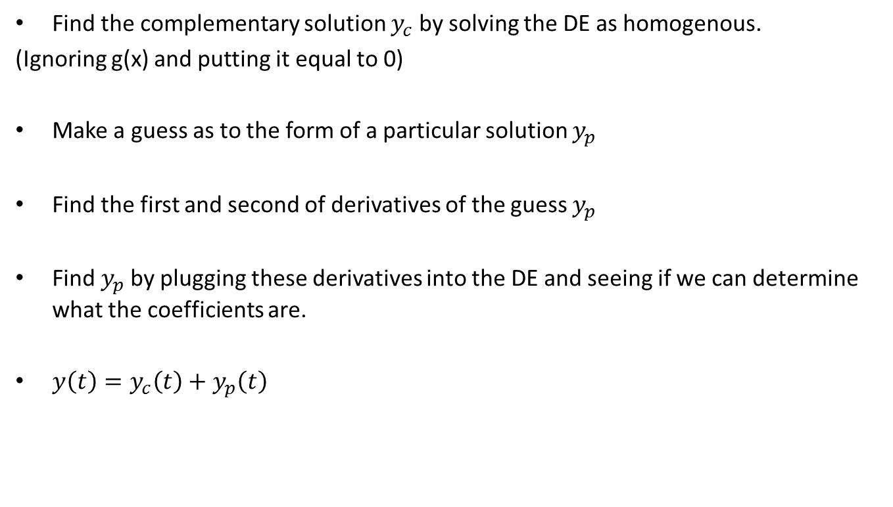
Solution Process
Find the complementary solution $y_{c}$ by solving the DE as homogenous.
(Ignoring g(x) and putting it equal to 0)
Make a guess as to the form of a particular solution $y_{p}$
Find the first and second of derivatives of the guess $y_{p}$
Find $y_{p}$by plugging these derivatives into the DE and seeing if we can determine what the coefficients are.
$y\left(t\right)=y_{c}\left(t\right)+y_{p}\left(t\right)$

Slide 4
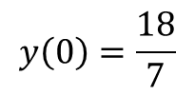




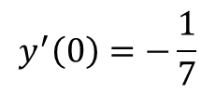
Example 1
Determine a solution to IVP
Solution
First, find the complementary solution by solving the DE as homogenous.
The characteristic equation for this differential equation and its roots are.
$$y^{′′}−4y^{′}−12y=3e^{5t}$$
$$y\left(0\right)=\frac{18}{7}$$
$$y^{′}\left(0\right)=−\frac{1}{7}$$
$$y^{′′}−4y^{′}−12y=0$$
$$r^{2}−4r−12=\left(r−6\right)\left(r+2\right)=0$$
$$r_{1}=−2, r_{2}=6$$

Slide 5


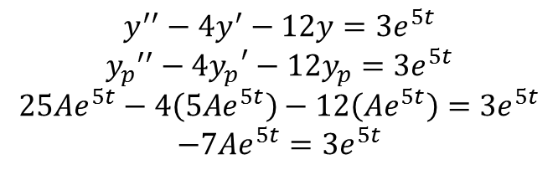


The complementary solution is
Make a guess as to the form of a particular solution, since g(t) is an exponential, the particular solution would be
Find a couple of derivatives
Plug these into the differential equation and see if we can determine what A is.
$$y_{c}\left(t\right)=c_{1}e^{−2t}+c_{2}e^{6t}$$
$$y_{p}\left(t\right)=Ae^{5t}$$
$$y_{p}^{}′\left(t\right)=5Ae^{5t}$$
$$y_{p}^{}′′\left(t\right)=25Ae^{5t}$$
$$y^{′′}−4y^{′}−12y=3e^{5t}$$
$${y_{p}^{}}^{′′}−{{4y}_{p}^{}}^{′}−12y_{p}^{}=3e^{5t}$$
$$25Ae^{5t}−4\left(5Ae^{5t}\right)−12\left(Ae^{5t}\right)=3e^{5t}$$
$$−7Ae^{5t}=3e^{5t}$$

Slide 6
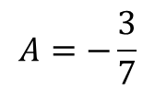

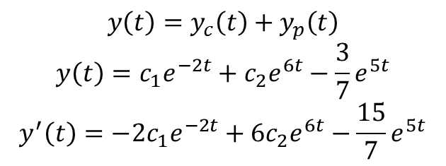
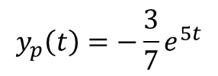
Choose A so that the coefficients of the exponentials on either side of the equal sign are the same
A particular solution is
The general solution and its derivative become,
$$−7A=3$$
$$A=−\frac{3}{7}$$
$$y_{p}\left(t\right)=−\frac{3}{7}e^{5t}$$
$$y\left(t\right)=y_{c}\left(t\right)+y_{p}\left(t\right)$$
$$y\left(t\right)=c_{1}e^{−2t}+c_{2}e^{6t}−\frac{3}{7}e^{5t}$$
$$y^{′}\left(t\right)=−2c_{1}e^{−2t}+6c_{2}e^{6t}−\frac{15}{7}e^{5t}$$

Slide 7
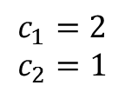
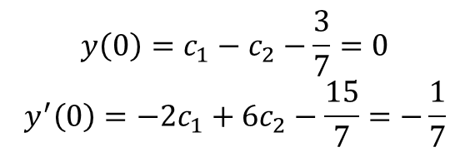
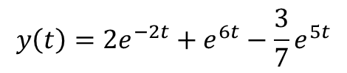
Apply the initial conditions
The actual solution is
$$y\left(0\right)=c_{1}−c_{2}−\frac{3}{7}=0$$
$$y^{′}\left(0\right)=−2c_{1}+6c_{2}−\frac{15}{7}=−\frac{1}{7}$$
$$c_{1}=2$$
$$c_{2}=1$$
$$y\left(t\right)=2e^{−2t}+e^{6t}−\frac{3}{7}e^{5t}$$

Slide 8

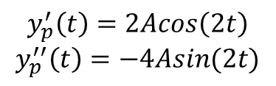


Example 2
Find a particular solution for the following differential equation.
Solution
Find the complementary solution ( same as previous example)
g(t) has a sine, try the following guess for the particular solution.
Find a couple of derivatives
$$y^{′′}−4y^{′}−12y=sin⁡(2t)$$
$$y_{c}\left(t\right)=c_{1}e^{−2t}+c_{2}e^{6t}$$
$$y_{p}\left(t\right)=Asin(2t)$$
$$y_{p}^{′}\left(t\right)=2Acos\left(2t\right)$$
$$y_{p}^{′′}\left(t\right)=−4Asin(2t)$$

Slide 9

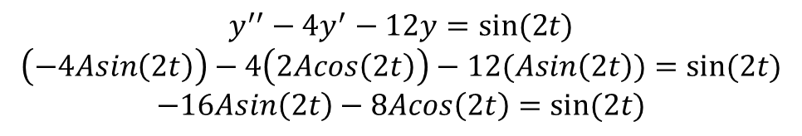

Plug the derivatives into the differential equation and see if we can determine what A is.
Notice 2 things. First, since there is no cosine on the right hand side this means that the coefficient must be zero on that side. More importantly we have a serious problem here. In order for the cosine to drop out, as it must in order for the guess to satisfy the differential equation, we need to set A = 0, but if A = 0, the sine will also drop out and that can’t happen. Likewise, choosing A to keep the sine around will also keep the cosine around.
$$y^{′′}−4y^{′}−12y=sin⁡(2t)$$
$$\left(−4Asin\left(2t\right)\right)−4\left(2Acos\left(2t\right)\right)−12(Asin\left(2t\right))=sin⁡(2t)$$
$$−16Asin\left(2t\right)−8Acos\left(2t\right)=sin⁡(2t)$$
$\cos\left(2t\right):$ $−8A=0$ $A=0$
$\sin\left(2t\right):$ $−16A=1$ $A=−\frac{1}{16}$

Slide 10

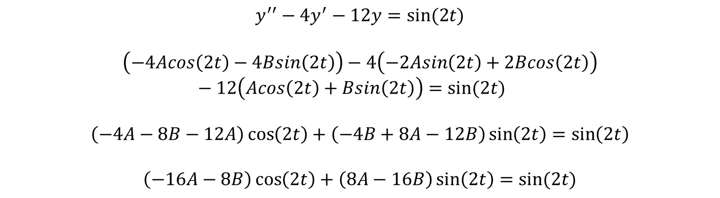
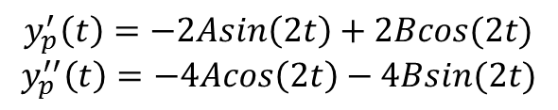
This means is that our initial guess was wrong, and the new guess
Find a couple of derivatives
Plug in these into the differential equation
$$y_{p}\left(t\right)=Acos\left(2t\right)+Bsin(2t)$$
$$y_{p}^{′}\left(t\right)=−2Asin\left(2t\right)+2Bcos(2t)$$
$$y_{p}^{′′}\left(t\right)=−4Acos\left(2t\right)−4Bsin(2t)$$
$$y^{′′}−4y^{′}−12y=sin⁡(2t)$$
$$\left(−4Acos\left(2t\right)−4Bsin\left(2t\right)\right)−4\left(−2Asin\left(2t\right)+2Bcos\left(2t\right)\right)−12\left(Acos\left(2t\right)+Bsin\left(2t\right)\right)=sin⁡(2t)$$
$$\left(−4A−8B−12A\right)\cos\left(2t\right)+\left(−4B+8A−12B\right)\sin\left(2t\right)=\sin\left(2t\right)$$
$$\left(−16A−8B\right)\cos\left(2t\right)+\left(8A−16B\right)\sin\left(2t\right)=sin⁡(2t)$$

Slide 11
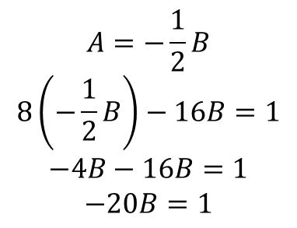
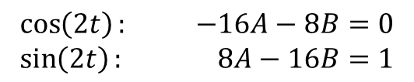
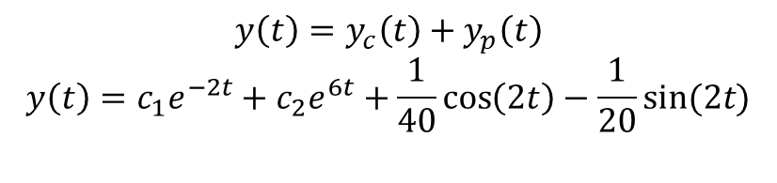
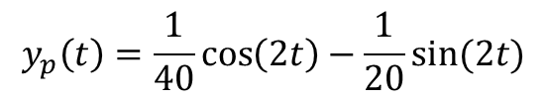
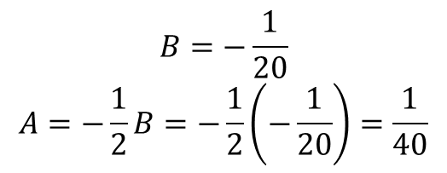
Set the coefficients equal and solve
The particular solution is
The general solution is
$$\cos\left(2t\right): −16A−8B=0$$
$$\sin\left(2t\right): 8A−16B=1$$
$$A=−\frac{1}{2}B$$
$$8\left(−\frac{1}{2}B\right)−16B=1$$
$$−4B−16B=1$$
$$−20B=1$$
$$B=−\frac{1}{20}$$
$$A=−\frac{1}{2}B=−\frac{1}{2}\left(−\frac{1}{20}\right)=\frac{1}{40}$$
$$y_{p}\left(t\right)=\frac{1}{40}\cos\left(2t\right)−\frac{1}{20}sin⁡(2t)$$
$$y\left(t\right)=y_{c}\left(t\right)+y_{p}\left(t\right)$$
$$y\left(t\right)=c_{1}e^{−2t}+c_{2}e^{6t}+\frac{1}{40}\cos\left(2t\right)−\frac{1}{20}sin⁡(2t)$$

Slide 12


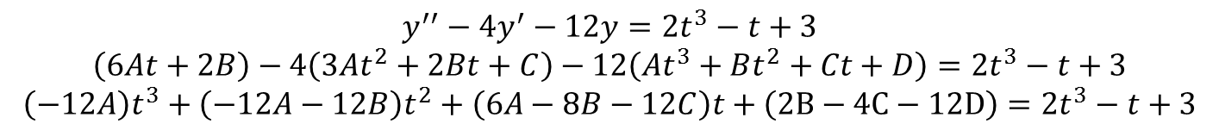
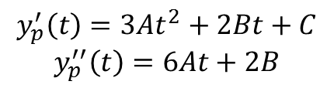
Example 3
Find the particular solution for the following differential equation.
Solution
g(t) is a cubic polynomial, try the guess for the particular solution
Find a couple of derivatives
Plug these into the differential equation.
$$y^{′′}−4y^{′}−12y=2t^{3}−t+3$$
$$y_{p}\left(t\right)={At}^{3}+Bt^{2}+Ct+D$$
$$y_{p}^{′}\left(t\right)=3At^{2}+2Bt+C$$
$$y_{p}^{′′}\left(t\right)=6At+2B$$
$$y^{′′}−4y^{′}−12y=2t^{3}−t+3$$
$$\left(6At+2B\right)−4\left(3At^{2}+2Bt+C\right)−12\left({At}^{3}+Bt^{2}+Ct+D\right)=2t^{3}−t+3$$
$$\left(−12A\right)t^{3}+\left(−12A−12B\right)t^{2}+\left(6A−8B−12C\right)t+\left(2B−4C−12D\right)=2t^{3}−t+3$$

Slide 13
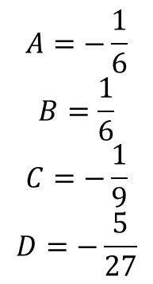
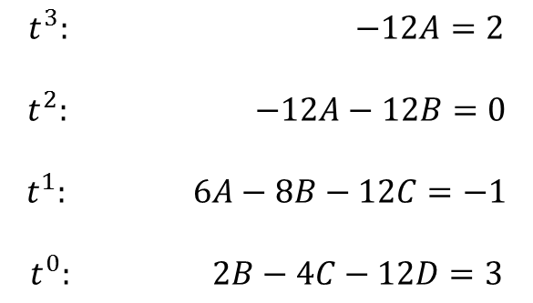
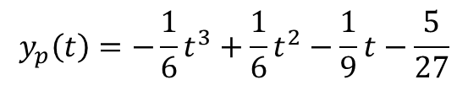
Set coefficients equal and solve
A particular solution for this differential equation is then
$$t^{3}: −12A=2$$
$$t^{2}: −12A−12B=0$$
$$t^{1}: 6A−8B−12C=−1$$
$$t^{0}: 2B−4C−12D=3$$
$$A=−\frac{1}{6}$$
$$B=\frac{1}{6}$$
$$C=−\frac{1}{9}$$
$$D=−\frac{5}{27}$$
$$y_{p}\left(t\right)=−\frac{1}{6}t^{3}+{\frac{1}{6}t}^{2}−\frac{1}{9}t−\frac{5}{27}$$

Slide 14









The basic kinds of functions
g(t) | y_{P}(t) guess
n^{th} degree polynomial
More complicated functions arise by taking products and sums of the basic kinds of functions.
$$a e^{βt}$$
$$Ae^{βt}$$
$$a\cos\left(βt\right)$$
$$Acos\left(βt\right)+Bsin(βt)$$
$$b\sin\left(βt\right)$$
$$Acos\left(βt\right)+Bsin(βt)$$
$$a\cos\left(βt\right)+b sin⁡(βt)$$
$$Acos\left(βt\right)+Bsin(βt)$$
$$A_{n}t^{n}+A_{n−1}t^{n−1}+…A_{1}t+A_{0}$$

Slide 15
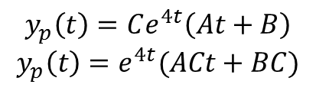


Example 4
Find a particular solution for the following differential equation
Solution
g(t) is a product of two functions, the guess of the particular solution will be the product of the two functions
But we have only 2 equations to find 3 constant, So we can rewrite
$$y^{′′}−4y^{′}−12y=te^{4t}$$
$$y_{p}\left(t\right)=Ce^{4t}\left(At+B\right)$$
$$y_{p}\left(t\right)=e^{4t}(ACt+BC)$$
$$y_{p}\left(t\right)=e^{4t}(At+B)$$

Slide 16
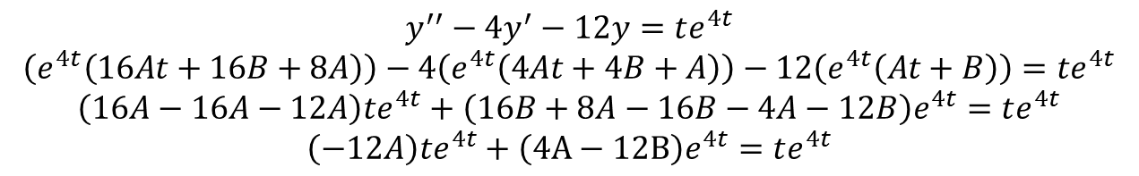
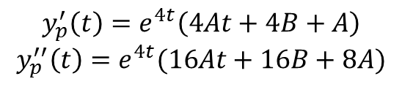
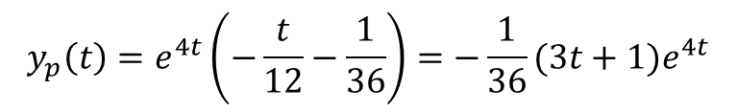
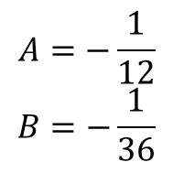
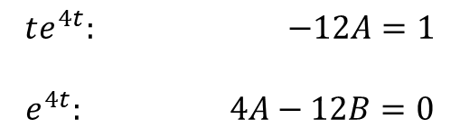
Find a couple of derivatives.
Plug into the differential equation
Set coefficients equal and solve
A particular solution
$$y_{p}^{′}\left(t\right)=e^{4t}\left(4At+4B+A\right)$$
$$y_{p}^{′′}\left(t\right)=e^{4t}(16At+16B+8A)$$
$$y^{′′}−4y^{′}−12y=te^{4t}$$
$$\left(e^{4t}\left(16At+16B+8A\right)\right)−4\left(e^{4t}\left(4At+4B+A\right)\right)−12\left(e^{4t}\left(At+B\right)\right)=te^{4t}$$
$$\left(16A−16A−12A\right)te^{4t}+\left(16B+8A−16B−4A−12B\right)e^{4t}=te^{4t}$$
$$\left(−12A\right)te^{4t}+\left(4A−12B\right)e^{4t}=te^{4t}$$
$$A=−\frac{1}{12}$$
$$B=−\frac{1}{36}$$
$$te^{4t}: −12A=1$$
$$e^{4t}: 4A−12B=0$$
$$y_{p}\left(t\right)=e^{4t}\left(−\frac{t}{12}−\frac{1}{36}\right)=−\frac{1}{36}(3t+1)e^{4t}$$

Slide 17



Fact
If Y_{P1}(t) is a particular solution for
and if Y_{P2}(t) is a particular solution for
then Y_{P1}(t)+ Y_{P2}(t) is a particular solution for
$$y^{′′}+p\left(t\right)y^{′}+q\left(t\right)y=g_{1}(t)$$
$$y^{′′}+p\left(t\right)y^{′}+q\left(t\right)y=g_{2}(t)$$
$$y^{′′}+p\left(t\right)y^{′}+q\left(t\right)y=g_{1}\left(t\right)+g_{2}(t)$$

Slide 18
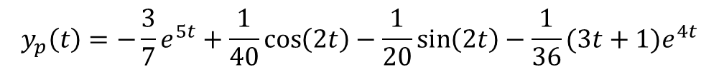

Example 5
Find a particular solution for the following differential equation.
Solution
This example is the reason that we’ve been using the same homogeneous differential equation for all the previous examples.
There is nothing to do with this problem. All that we need to do it go back to the appropriate examples above and get the particular solution from that example and add them all together.
$$y′′−4y^{′}−12y=3e^{5t}+\sin\left(2t\right)+te^{4t}$$
$$y_{p}\left(t\right)=−\frac{3}{7}e^{5t}+\frac{1}{40}\cos\left(2t\right)−\frac{1}{20}\sin\left(2t\right)−\frac{1}{36}(3t+1)e^{4t}$$

Slide 19
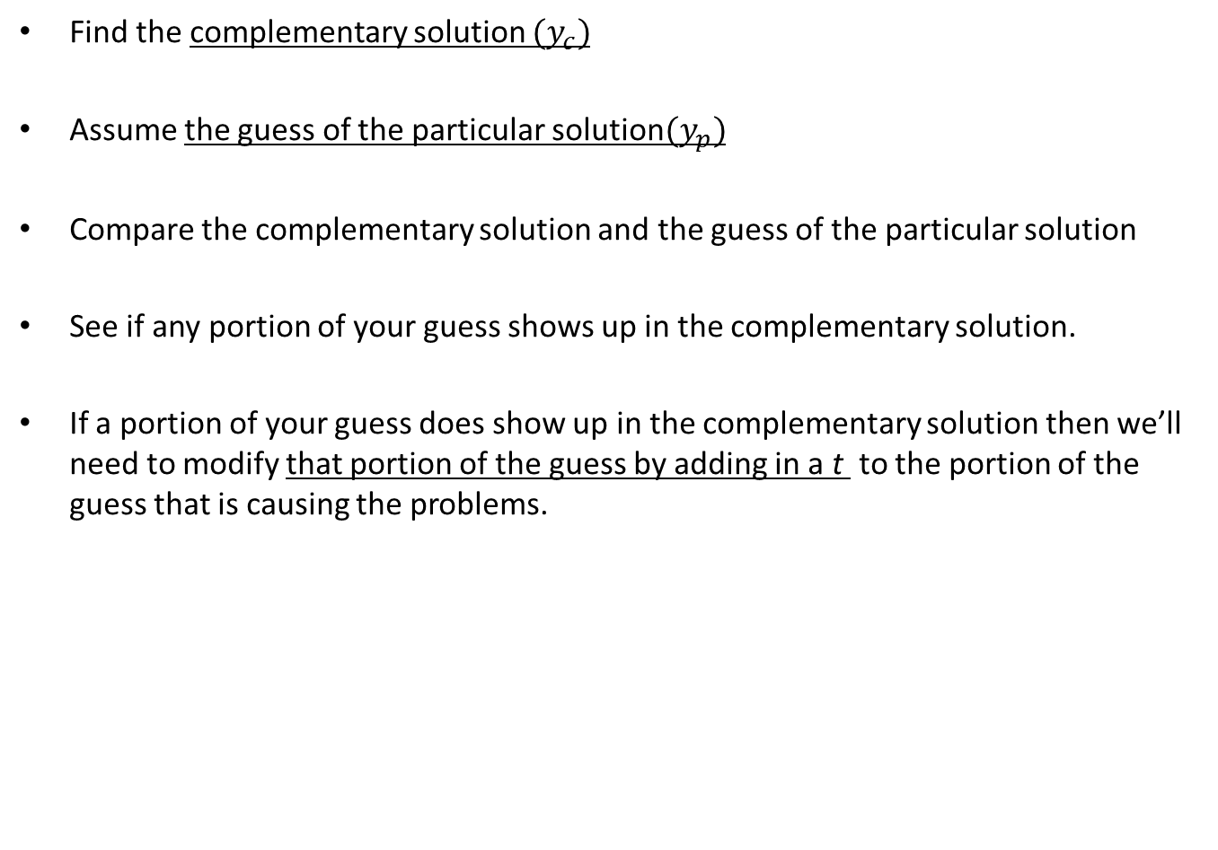
Find the complementary solution ${(y}_{c})$
Assume the guess of the particular solution${(y}_{p})$
Compare the complementary solution and the guess of the particular solution
See if any portion of your guess shows up in the complementary solution.
If a portion of your guess does show up in the complementary solution then we’ll need to modify that portion of the guess by adding in a t to the portion of the guess that is causing the problems.

Slide 20





Examples
Write down the guess for the particular solution to the given differential equation. Do not find the coefficients.
(a)
(b)
(c)
(d)
(e)
$$y^{′′}+3y^{′}−28y=7t+e^{−7t}−1$$
$$y^{′′}−100y=9t^{2}e^{10t}+cost−tsint$$
$$4y^{′′}+y=e^{−2t}\sin\left(\frac{t}{2}\right)+6tcos\left(\frac{t}{2}\right)$$
$$4y^{′′}+16y^{′}+17y=e^{−2t}\sin\left(\frac{t}{2}\right)+6tcos\left(\frac{t}{2}\right)$$
$$y^{′′}+8y^{′}+16y=e^{−4t}+(t^{2}+5)e^{−4t}$$

Slide 21




Solution:
$$y^{′′}+3y^{′}−28y=7t+e^{−7t}−1$$
(a)
The complementary solution is
A first guess for the particular solution
Notice that the last term in the guess is the last term in the complementary solution.
The first two terms in the guess however don’t appear in the complementary solution.
Therefore, we will only add a t onto the last term of the particular solution guess. The correct guess for the form of the particular solution is.
$$y_{c}\left(t\right)=c_{1}e^{4t}+c_{2}e^{−7t}$$
$$y_{p}\left(t\right)=At+B+Ce^{−7t}$$
$$y_{p}\left(t\right)=At+B+Cte^{−7t}$$

Slide 22

Solution:
$$y^{′′}−100y=9t^{2}e^{10t}+cost−tsint$$
(b)
The complementary solution is
A first guess for the particular solution is
The correct guess for the form of the particular solution
In general, if you were to multiply out a guess and if any term in the result shows up in the complementary solution, then the whole term will get a t not just the problem portion of the term.
$$y_{c}\left(t\right)=c_{1}e^{10t}+c_{2}e^{−10t}$$
$$y_{p}\left(t\right)=\left(At^{2}+Bt+C\right)e^{10t}+\left(Et+F\right)cost+\left(Gt+H\right)sint$$
$$y_{p}\left(t\right)=t\left(At^{2}+Bt+C\right)e^{10t}+\left(Et+F\right)cost+\left(Gt+H\right)sint$$

Slide 23


Solution:
$$4y^{′′}+y=e^{−2t}\sin\left(\frac{t}{2}\right)+6tcos\left(\frac{t}{2}\right)$$
(c)
The complementary solution is
The correct guess for the form of the particular solution is.
$$y_{c}\left(t\right)=c_{1}\cos\left(\frac{t}{2}\right)+c_{2}\sin\left(\frac{t}{2}\right)$$
$$y_{p}\left(t\right)=e^{−2t}\left(Acos\left(\frac{t}{2}\right)+Bsin\left(\frac{t}{2}\right)\right)+t\left(Ct+D\right)\cos\left(\frac{t}{2}\right)+t\left(Et+F\right)\sin\left(\frac{t}{2}\right)$$

Slide 24


Solution:
$$4y^{′′}+16y^{′}+17y=e^{−2t}\sin\left(\frac{t}{2}\right)+6tcos\left(\frac{t}{2}\right)$$
(d)
The complementary solution is
The correct guess for the form of the particular solution is
$y_{c}\left(t\right)=c_{1}e^{−2t}\cos\left(\frac{t}{2}\right)+c_{2}e^{−2t}\sin\left(\frac{t}{2}\right)$
$$y_{p}\left(t\right)=te^{−2t}\left(Acos\left(\frac{t}{2}\right)+Bsin\left(\frac{t}{2}\right)\right)+\left(Ct+D\right)\cos\left(\frac{t}{2}\right)+\left(Et+F\right)\sin\left(\frac{t}{2}\right)$$

Slide 25



Solution:
(e)
The complementary solution is
The correct guess for the form of the particular solution is.
$$y^{′′}+8y^{′}+16y=e^{−4t}+(t^{2}+5)e^{−4t}$$
$$y_{c}\left(t\right)=c_{1}e^{−4t}+c_{2}te^{−4t}$$
$$y_{p}\left(t\right)=t^{2}(At^{2}+Bt+C)e^{−4t}$$

Slide 26
You should have the complementary solution in hand before even writing down the first guess for the particular solution.
By doing this you can compare your guess to the complementary solution and if any of the terms from your particular solution show up you will know that you’ll have problems.
Once the problem is identified you can add a t to the problem term(s) and compare your new guess to the complementary solution.
If there are no problems you can proceed with the problem.
if there are problems add in another t and compare again.

