Slide 1
Homogeneous Linear Equations with Constant Coefficients
By
Dr. Iman Gohar

Slide 2



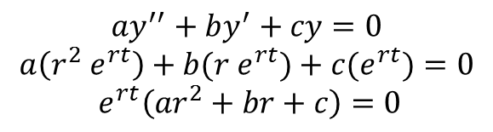


Auxiliary Equation
(characteristic equation )
Let’s assume that all solutions to
will be of the form
Plug this solution into the differential equation,
Note that exponentials are never zero,
Therefore
(characteristic equation ) or auxiliary equation
$$ay^{′′}+by^{′}+cy=0$$
$$y \left(t\right)= e^{rt}$$
$$y ′ \left(t\right)=r e^{rt}$$
$$ay^{′′}+by^{′}+cy=0$$
$$a\left(r^{2} e^{rt}\right)+b(r e^{rt})+c(e^{rt})=0$$
$$e^{rt}\left(ar^{2}+br+c\right)=0$$
$$y′′ \left(t\right)=r^{2} e^{rt}$$
$\left(ar^{2}+br+c\right)=$0

Slide 3





Solution Process
First write down the characteristic equation, for the differential equation.
Solve the quadratic equation and you should expect two roots, r₁ and r₂
The roots will have three possible forms.
Real, distinct roots
Complex root
3. Double roots
$$y_{1}\left(t\right)= e^{r_{1}t}$$
$$y_{2}\left(t\right)= e^{r_{2}t}$$
$r_{1}≠r_{2}$
$r_{1,2}=\text{λ}± μ i$
$$r_{1}=r_{2}=r$$

Slide 4




Real, Distinct Roots
The two roots are real and distinct
The two solutions are
The general solution
If IVP is given, you would be able to determine the constant C₁ and C₂.
$$r_{1}≠r_{2}$$
$$y_{1}\left(t\right)= e^{r_{1}t}$$
$$y_{2}(t)=e^{r_{2}t}$$
$$y\left(t\right)=c_{1}e^{r_{1}t}+c_{2}e^{r_{2}t}$$

Slide 5


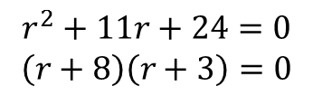
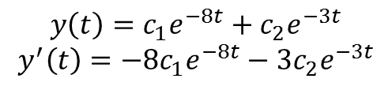

Example 1
Solve the following IVP.
Solution
The characteristic equation is
Its roots are r₁ = - 8 and r₂ = -3 and so the general solution and its derivative are
$$y^{′}+11y_{}^{′}+24 y=0$$
$$y \left(0\right)=0$$
$$y^{′}\left(0\right)=−7$$
$$r^{2}+11r+24=0$$
$$\left(r+8\right)\left(r+3\right)=0$$
$$y\left(t\right)=c_{1}e^{−8t}+c_{2}e^{−3t}$$
$$y^{′}\left(t\right)=−8c_{1}e^{−8t}−3c_{2}e^{−3t}$$

Slide 6
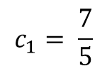
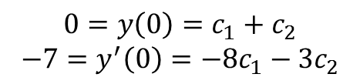
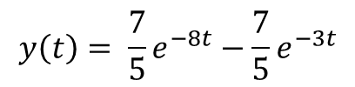
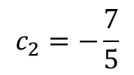
Apply the initial conditions,
The actual solution to the differential equation is then,
$$0=y\left(0\right)=c_{1}+c_{2}$$
$$−7=y^{′}\left(0\right)=−8c_{1}−3c_{2}$$
$$c_{1}= \frac{7}{5}$$
$$c_{2}=−\frac{7}{5}$$
$$y\left(t\right)= \frac{7}{5}e^{−8t}−\frac{7}{5}e^{−3t}$$

Slide 7




Complex Roots
The roots of the characteristic equation, are complex roots in the form
The solutions to the differential equation.
Use Euler’s Formula. and
$$r_{1,2}=\text{λ}± μi$$
$$y_{1}\left(t\right)= e^{\left(\text{λ}+μi\right)t}$$
$$y_{2}\left(t\right)= e^{\left(\text{λ}−μi\right)t}$$
$$e^{iθ}=cosθ+i sinθ$$
$$e^{−iθ}=\cos{(−θ)}+i\sin\left(−θ\right)=cosθ −i sinθ$$

Slide 8

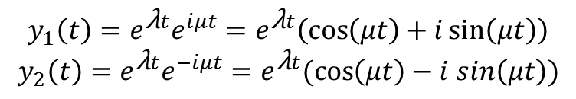
Rewrite the second exponential and the solution become
The general solution become,
Do not forget to apply IVP if given.
$$y_{1}\left(t\right)=e^{\text{λ}t}e^{iμt}=e^{\text{λ}t}\left(\cos\left(μt\right)+i\sin\left(μt\right)\right)$$
$$y_{2}\left(t\right)=e^{\text{λ}t}e^{−iμt}=e^{\text{λ}t}(\cos\left(μt\right)−i sin\left(μt\right))$$
$$y\left(t\right)=c_{1}e^{\text{λ}t}cos\left(μt\right)+c_{2}e^{\text{λ}t}sin\left(μt\right)$$

Slide 9






Example 2
Solve the following IVP.
Solution
The characteristic equation for this differential equation is.
The roots of this equation are
The general solution to the differential equation is
$$y^{′′}−4y^{′}+9y=0$$
$$y\left(0\right)=0$$
$$y^{′}\left(0\right)=−8$$
$$r^{2}−4r+9=0$$
$$r_{1,2}=2±\sqrt{5}i$$
$$y\left(t\right)=c_{1}e^{2t}\cos\left(\sqrt{5}t\right)+c_{2}e^{2t}sin⁡(\sqrt{5}t)$$

Slide 10

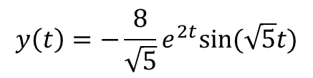

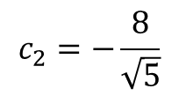


Apply the initial conditions
The actual solution is then
$$y\left(0\right)=c_{1}=0$$
$$y\left(t\right)=c_{2}e^{2t}sin⁡(\sqrt{5}t)$$
$$y^{′}\left(t\right)=2c_{2}e^{2t}\sin\left(\sqrt{5}t\right)+\sqrt{5}c_{2}e^{2t}cos⁡(\sqrt{5}t)$$
$$y^{′}\left(0\right)=\sqrt{5}c_{2}=−8$$
$$c_{2}=−\frac{8}{\sqrt{5}}$$
$$y\left(t\right)=−\frac{8}{\sqrt{5}}e^{2t}sin⁡(\sqrt{5}t)$$

Slide 11

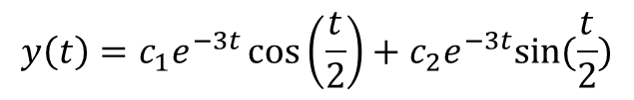

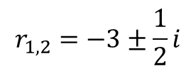


Example 3
Solve the following IVP.
Solution
The characteristic equation is.
The roots of this are
The general solution is
$$4y^{′′}+24y^{′}+37y=0$$
$$y\left(π\right)=1$$
$$y^{′}\left(π\right)=0$$
$$4r^{2}+24r+37=0$$
$$r_{1,2}=−3±\frac{1}{2}i$$
$$y\left(t\right)=c_{1}e^{−3t}\cos\left(\frac{t}{2}\right)+c_{2}e^{−3t}sin⁡(\frac{t}{2})$$

Slide 12
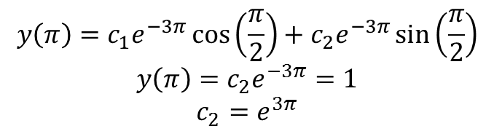
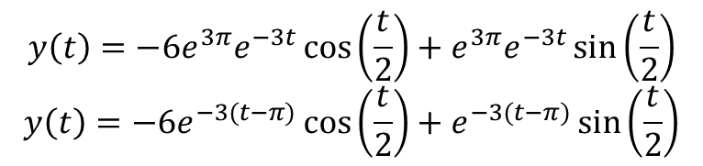
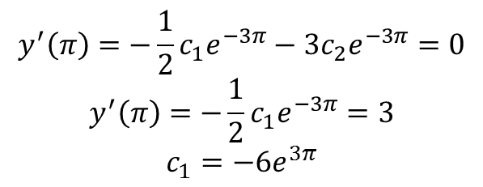
It’s derivative is
Apply the initial conditions
The actual solution to the IVP is then.
$$y^{′}\left(t\right)=−3c_{1}e^{−3t}\cos\left(\frac{t}{2}\right)−\frac{1}{2}c_{1}e^{−3t}\sin\left(\frac{t}{2}\right)−3c_{2}e^{−3t}\sin\left(\frac{t}{2}\right)+\frac{1}{2}c_{2}e^{−3t}\cos\left(\frac{t}{2}\right)$$
$$y\left(π\right)=c_{1}e^{−3π}\cos\left(\frac{π}{2}\right)+c_{2}e^{−3π}\sin\left(\frac{π}{2}\right)$$
$$y\left(π\right)=c_{2}e^{−3π}=1$$
$$c_{2}=e^{3π}$$
$$y^{′}\left(π\right)=−\frac{1}{2}c_{1}e^{−3π}−3c_{2}e^{−3π}=0$$
$$y^{′}\left(π\right)=−\frac{1}{2}c_{1}e^{−3π}=3$$
$$c_{1}=−6e^{3π}$$
$$y\left(t\right)=−6e^{3π}e^{−3t}\cos\left(\frac{t}{2}\right)+e^{3π}e^{−3t}\sin\left(\frac{t}{2}\right)$$
$$y\left(t\right)=−6e^{−3(t−π)}\cos\left(\frac{t}{2}\right)+e^{−3(t−π)}\sin\left(\frac{t}{2}\right)$$

Slide 13



Repeated Roots
The solutions to the characteristic equation are double roots r₁ = r₂ = r. The solution will be in the form of
But those solutions are one and you need two solutions. The general solution become ,
Apply IVP if given to calculate the two constants.
$$y_{1}\left(t\right)=e^{r_{1}t}=e^{rt}$$
$$y_{2}\left(t\right)=e^{r_{2}t}=e^{rt}$$
$$y\left(t\right)=c_{1}e^{rt}+c_{2}te^{rt}$$

Slide 14

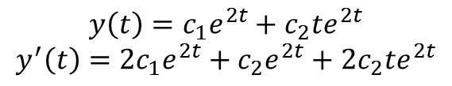




Example 4
Solve the following IVP.
Solution
The characteristic equation and its roots are.
The general solution and its derivative are
$$y^{′′}−4y^{′}+4y=0$$
$$y\left(0\right)=12$$
$$y^{′}\left(0\right)=−3$$
$$r^{2}−4r+4={\left(r−2\right)}^{2}=0$$
$$r_{1,2}=2$$
$$y\left(t\right)=c_{1}e^{2t}+c_{2}te^{2t}$$
$$y^{′}\left(t\right)=2c_{1}e^{2t}+c_{2}e^{2t}+2c_{2}te^{2t}$$

Slide 15
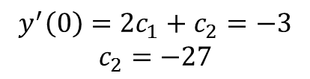


Apply the initial conditions
The actual solution to the IVP is then.
$$y\left(0\right)=c_{1}=12$$
$$y^{′}\left(0\right)=2c_{1}+c_{2}=−3$$
$$c_{2}=−27$$
$$y\left(t\right)=12e^{2t}−27{te}^{2t}$$

