Slide 1
First Order Differential Equations
Sec 2.7 Linear Models
By
Dr. Iman Gohar

Slide 2
Modeling with First Order Differential Equations
The main applications of differential equations are modeling which is the process of writing a differential equation to describe a physical situation.
Introduce you to the process of modeling and show you what is involved in modeling. There are four different situations in this section : Mixing Problems, Population Problems, Growth and Decay, and Falling Bodies.

Slide 3

Mixing Problems
start with a substance that is dissolved in a liquid. Liquid will be entering and leaving a holding tank. The liquid entering the tank may or may not contain more of the substance dissolved in it. Liquid leaving the tank will of course contain the substance dissolved in it.
The main “equation” that we’ll be using to model this situation is :
Rate of change= Input rate-Output rate
= R_{in}-R_{out}

Slide 4

Example 7.1
A 1500 gallon tank initially contains 600 gallons of water with 5 lbs of salt dissolved in it. Water enters the tank at a rate of 9 gal/hr and the water entering the tank has a salt concentration of lbs/gal. If a well mixed solution leaves the tank at a rate of 6 gal/hr, how much salt is in the tank when it overflows?

Slide 5
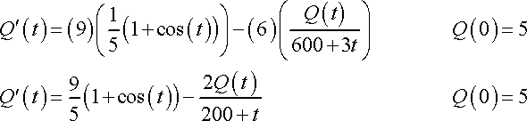
Solution:
Assume that the instant the water enters the tank it somehow instantly disperses evenly throughout the tank to give a uniform concentration of salt in the tank at every point.

Slide 6



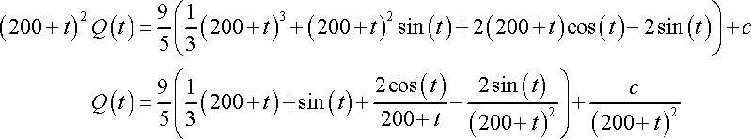


Solve the IVP:

Slide 7
Example 7.2
A 1000 gallon holding tank that catches runoff from some chemical process initially has 800 gallons of water with 2 ounces of pollution dissolved in it. Polluted water flows into the tank at a rate of 3 gal/hr and contains 5 ounces/gal of pollution in it. A well mixed solution leaves the tank at 3 gal/hr as well. When the amount of pollution in the holding tank reaches 500 ounces the inflow of polluted water is cut off and fresh water will enter the tank at a decreased rate of 2 gallons while the outflow is increased to 4 gal/hr. Determine the amount of pollution in the tank at any time t.

Slide 8
Solution:
The pollution in the tank will increase as time passes. If the amount of pollution ever reaches the maximum allowed there will be a change in the situation. You need two IVP’s for this problem. One will describe the initial situation when polluted runoff is entering the tank and one for after the maximum allowed pollution is reached and fresh water is entering the tank.

Slide 9
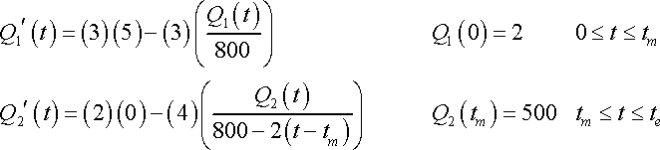
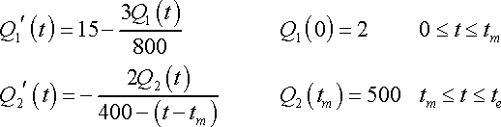

IVP’s for this problem.
Solve and you get

Slide 10

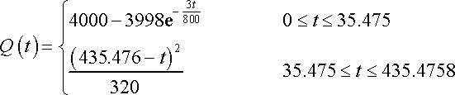
The second IVP
A solution that encompasses the complete running time of the process is

Slide 11
Population
Rate of change= Rate _{in}- Rate _{out}
Birth rate and migration into the region are examples of population enters the region.
Death rate, migration out and predation are examples of population exits the region.
Assuming that the growth rate would be a constant.

Slide 12
Example7.3
A population of insects in a region will grow at a rate that is proportional to their current population. In the absence of any outside factors the population will triple in two weeks time. On any given day there is a net migration into the area of 15 insects and 16 are eaten by the local bird population and 7 die of natural causes. If there are initially 100 insects in the area will the population survive? If not, when do they die out?

Slide 13

Solution:
The birth rate of insects is proportional to the current population and the IVP for this problem
Use the fact that the population triples in two week time to help us find r.
This differential equation is separable and linear and is a simple differential equation to solve.

Slide 14
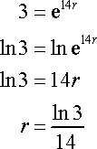


Applying the initial condition gives c = 100. Now apply the second condition.
To solve this for r. First divide both sides by 100, then take the natural log of both sides.

Slide 15
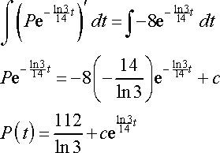

Solve the DE
The exponential has a positive exponent and so will go to plus infinity as t increases. Its coefficient, however, is negative and so the whole population will go negative eventually. Clearly, population can’t be negative. So, determine when they die out.

Slide 16
Falling Body
Newton’s Second Law of Motion.
The two forces that we’ll be looking at here are gravity and air resistance.
Define which direction will be termed the positive direction and then make sure that all your forces match that convention.

Slide 17
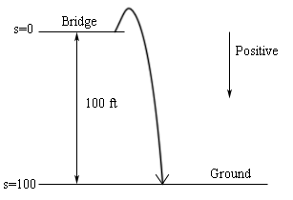
Example 7.4
A 50 kg mass is shot from a cannon straight up with an initial velocity of 10m/s off a bridge that is 100 meters above the ground. If air resistance is given by 5v determine the velocity of the mass when it hits the ground.
Solution:
Here is a sketch
of the situation.

Slide 18
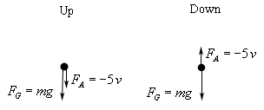

The initial phase in which the mass is rising in the air and the second phase when the mass is on its way down.
The IVP for each of these situations are.

Slide 19



Use gravity g = 9.8 m/s² .
Solve,
The position function
s(0) = 0 to find that c = -1080
To determine when the mass hits the ground

Slide 20

The growth rate of a population
The growth rate of a population depends on the population itself.
Realistic model of a population growth is given by the logistic growth equation.
r is the intrinsic growth rate , K is called either the saturation level or the carrying capacity.

Slide 21

For growth and decay phenomena,
Initial value problem will be used to solve the constant in the differential equation.
The DE is separable and linear.
For growth rate k>0 and for the decay k<0 .

