Slide 1
First Order Differential Equations
Chapter 2
By
Dr. Iman Gohar

Slide 2


2.4 Exact Equations
The solution of an exact differential equation is representing a one parameter family of curves f(x,y)=C
The first order differential equation of the form is said to be exact equation , if and only if
Note that it is important that it be in this form! There must be an “= 0” on one side and the sign separating the two terms must be a “+”.

Slide 3




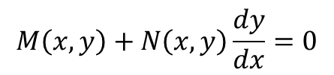
Solution Process
$$M\left(x,y\right)+N\left(x,y\right)\frac{dy}{dx}=0$$
Exact Equation in the form of
First identify M and N and check that the differential equation is exact
If true, then and
OR and
The arbitrary functions g(x) and h(y) are the constant of the integration and can be found.
Implicit solution of the equation is f(x,y)=C
Express the solution in explicit format with the valid interval I.
Apply IV , if given

Slide 4



Example 1
Solve the following IVP and find the interval of validity for the solution.
Solution:
The differential equation is exact according to the test

Slide 5





And , so differentiate the solution with respect to y and equate it to N
Implicit equation
IV x=0,y=-3

Slide 6
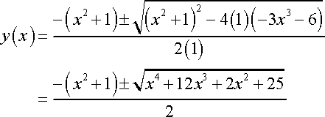
The explicit solution
Note that this is a quadratic equation in y and so we can solve for y(x) by using the quadratic formula.

Slide 7
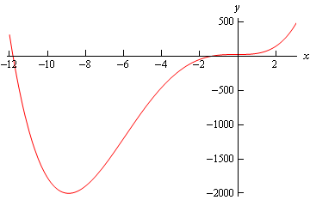

For the interval of validity
Solving this equation is zero at x =-11.81557624 and x = -1.396911133
Two interval will satisfy the equation
But the one that include the IC is

Slide 8


Example 2
Find the solution and interval of validity for the following IVP.
Solution:

Slide 9
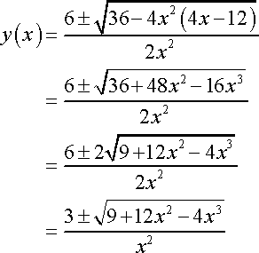
The implicit solution is
Applying the initial condition

Slide 10


Explicit solution
Interval of solution that satisfy the explicit solution
The interval of validity for this problem that contain the IV is

Slide 11

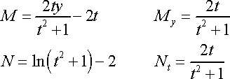


Example 3
Find the solution and interval of validity to the following IVP.
Solution:

Slide 12



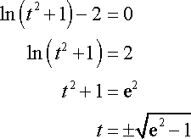

Implicit solution
Applying the initial condition
An explicit solution
Note that the term in the logarithm is always positive and you need to avoid the dominator being zero.
The interval of Validity will be

Slide 13

Example 4
Find the solution and interval of validity for the following IVP.
Solution:
The implicit solution is

Slide 14
Apply the initial condition
This is as far as we can go. There is no way to solve this for y and get an explicit solution.

Slide 15
Integrating Factors
Used to change the nonlinear first order not exact differential equation to linear first order exact differential equation.
If is a function of x alone then the integrating factor is
If is a function of y alone then the integrating factor is

Slide 16
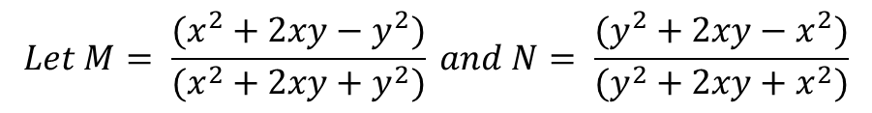
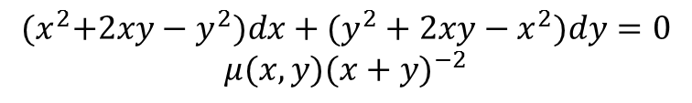
Example 5
Verify that DE is not exact , use the given integrating factor to solve
Solution
My = −4xy/(x+y)3 = Nx.
From fx =x2 + 2xy + y2 − 2y2/(x + y)2
we obtain f = x +2y2x + y+ h(y),
h(y) = −1, and h(y) = −y.
A solution of the differential equation is x2 + y2 = c(x + y).
$${(x}^{2}+2xy−y^{2})dx+(y^{2}+2xy−x^{2})dy=0$$
$$μ(x,y){(x+y)}^{−2}$$
$$Let M= \frac{(x^{2}+2xy−y^{2})}{(x^{2}+2xy+y^{2})} and N= \frac{(y^{2}+2xy−x^{2})}{(y^{2}+2xy+x^{2})}$$

