Slide 1
First Order Differential Equations
BY
Dr. Iman Gohar

Slide 2
First Order Differential Equations
1- Separable Equations
2- Linear Equations
3- Exact Equations
4- Bernoulli Differential Equations (Solutions by Substitution)
5- Modelling with first order differential equations

Slide 3

2.2 Separable Equations
A separable differential equation is any differential equation , the function f does not depend on the variable y and it can be written in the following form
In order for a differential equation to be separable
→ All the y's in the differential equation must be multiplied by the derivative
→ All the x's in the differential equation must be on the other side of the equal sign.

Slide 4

Solution Process
Rewrite the differential equation as the following
Then integrate both sides
Express the solution in an explicit format
Make sure to apply any IV , if given
Specify the interval of the solution (x in this case)

Slide 5

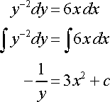
Example 1
Solve the following differential equation and determine the interval of validity for the solution.
Solution:
1- Separate the differential equation and integrate both sides.

Slide 6

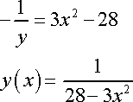

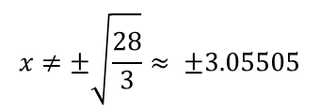
2- Find the value of the constant C by applying the initial condition.
3- Represent the solution in an explicit format.
4-
Two conditions that define an interval of validity. First, it must be a continuous interval with no breaks or holes in it.
Second it must contain the value of the independent variable in the initial condition, x = 1 in this case
The valid interval is
$$x≠±\sqrt{\frac{28}{3}}≈ ±3.05505$$

Slide 7

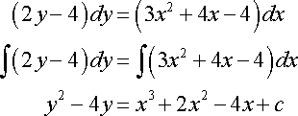




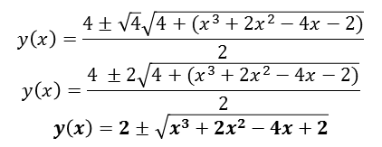

Example 2
Solve the following IVP and find the interval of validity for the solution.
Solution:
Implicit Solution
Explicit Solution
$$y\left(x\right)=\frac{−b ± \sqrt{b^{2}−4ac}}{2a}$$
$$\frac{4 ±\sqrt{16+4(x^{3}+2x^{2}−4x−2)}}{2}$$
$$y\left(x\right)=\frac{4±\sqrt{4}\sqrt{4+(x^{3}+2x^{2}−4x−2)}}{2}$$
$$y\left(x\right)=\frac{4 ±2\sqrt{4+(x^{3}+2x^{2}−4x−2)}}{2}$$
$$y\left(x\right)=2±\sqrt{x^{3}+2x^{2}−4x+2}$$
$$\frac{−\left(−4\right)± \sqrt{{(−4)}^{2}−4(1)(−x^{3}−2x^{2}+4x−2)}}{2}$$
$$\frac{4±\sqrt{4(4+x^{3}+2x^{2}−4x−2)}}{2}$$

Slide 8

The explicit solution that satisfy the initial value is
The interval of validity for the solution is when,
Solve for x . The interval of the solution is

Slide 9

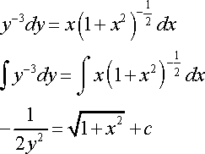


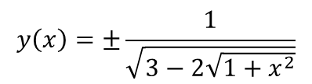
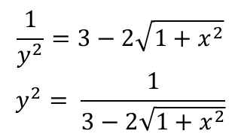
Example 3
Solve the following IVP and find the interval of validity of the solution.
Solution:
Implicit Solution
Explicit Solution
$$\frac{1}{y^{2}}=3−2\sqrt{1+x^{2}}$$
$$y^{2}= \frac{1}{3−2\sqrt{1+x^{2}}}$$
$$y\left(x\right)=±\frac{1}{\sqrt{3−2\sqrt{1+x^{2}}}}$$

Slide 10


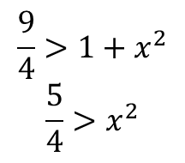
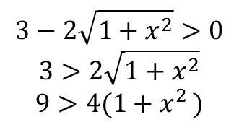
The explicit solution that satisfy the initial value is
The interval of validity of the solution is when,
The interval of the solution
$$3−2\sqrt{1+x^{2}}>0$$
$$3>2\sqrt{1+x^{2}}$$
$$9>4(1+x^{2 })$$
$$\frac{9}{4}>1+x^{2}$$
$$\frac{5}{4}>x^{2}$$

Slide 11
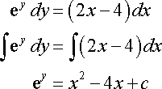

Example 4
Solve the following IVP and find the interval of validity of the solution.
Solution:
Implicit Solution
Explicit Solution

Slide 12
The interval of validity of the solution is when,
The interval of the solution

Slide 13

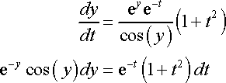
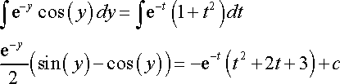

Example 5
Solve the following IVP
Solution:
Use integration by parts

Slide 14

Implicit Solution
It is not possible to find an explicit solution for this problem and so we will have to leave the solution in its implicit form.
Finding intervals of validity from implicit solutions can often be very difficult so we will also not bother with that for this problem.

Slide 15

2.3 Linear Equations
First order differential equations has a solution in two terms y = y_{c} + y_{P}
Where y_{C} is the complementary solution of the homogenous equation , y_{C} = Cy₁(x) and y₁ = (integrating factor)
Y_{p} is a particular solution for the non homogeneous equation, y_{P} = u(x) y₁(x)

Slide 16


Solution Process
Linear first order differential equation in the dependent variable y is in the form,
Put the linear equation into the standard form
where, P and f are continuous in the interval I.
Determine P(x) and the integrating factor

Slide 17

Multiply everything in the differential equation by
Verify that the left side becomes the product rule and write it as such.
Integrate both sides to solve for y. Make sure to calculate the constant of integration, c if the initial value is given and verify the interval of validation I.

Slide 18


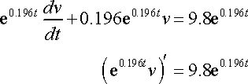
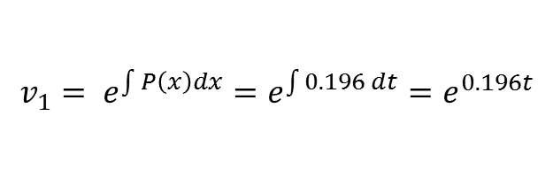
Example 1
Find the solution to the following differential equation.
Solution
1- First we need to get the differential equation in the correct form.
2- From this we can see that p(t)=0.196 and the integrating factor
3- Now multiply all the terms in the differential equation by the integrating factor and do some simplification.
$$v_{1}= e^{\int{P\left(x\right)dx}}=e^{\int{0.196 dt}}=e^{0.196t}$$

Slide 19


Integrate both sides and don't forget the constants of integration that will arise from both integrals.
Combined the two constants in one and the integration become
The general solution to the differential equation in the explicit form
Use the IV,
The actual solution to the IVP is
$$e^{0.196t}v=50e^{0.196t}+c$$

Slide 20
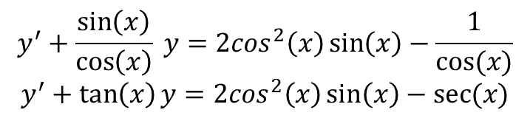
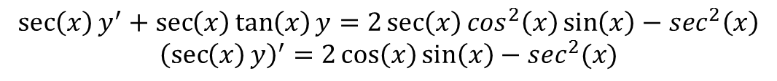
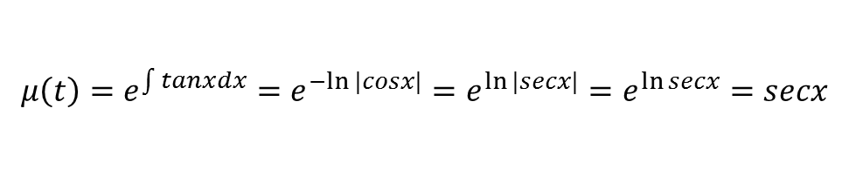
Example2
Solve the following IVP.
Solution:
$$y^{′}+\frac{\sin\left(x\right)}{\cos\left(x\right)} y=2\cos^{2}\left(x\right)\sin\left(x\right)−\frac{1}{cos⁡(x)}$$
$$y^{′}+\tan\left(x\right)y=2\cos^{2}\left(x\right)\sin\left(x\right)−sec⁡(x)$$
$$μ\left(t\right)=e^{\int{tan}xdx}=e^{−ln⁡|cosx|}=e^{ln⁡|secx|}=e^{\ln{secx}}=secx$$
$$\sec\left(x\right)y^{′}+\sec\left(x\right)\tan\left(x\right)y=2\sec\left(x\right)\cos^{2}\left(x\right)\sin\left(x\right)−\sec^{2}\left(x\right)$$
$${\left(\sec\left(x\right)y\right)}^{′}=2\cos\left(x\right)\sin\left(x\right)−\sec^{2}(x)$$

Slide 21
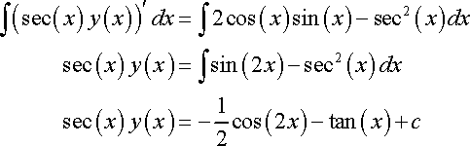
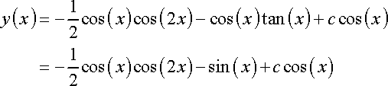
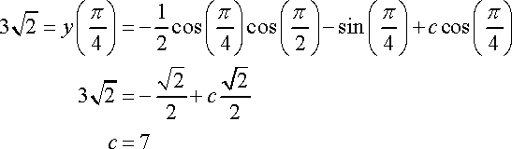
Integrate both sides
Apply the initial condition to find the value of c.

Slide 22


The solution is
Important fact that you should always remember for these type of problems
The use of the trig formula that made the integral easier

Slide 23

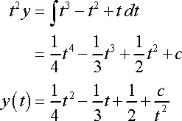
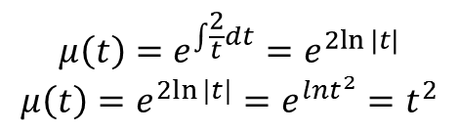
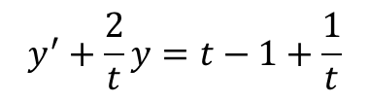
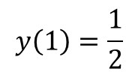

Example 3
Find the solution to the following IVP
Solution:
$$ty^{′}−2y= t^{2}−t+1$$
$$y\left(1\right)=\frac{1}{2}$$
$$y^{′}+\frac{2}{t}y=t−1+\frac{1}{t}$$
$$μ\left(t\right)=e^{\int{\frac{2}{t}dt}}=e^{2ln⁡|t|}$$
$$μ\left(t\right)=e^{2ln⁡|t|}=e^{lnt^{2}}=t^{2}$$

Slide 24


Apply IV
The solution is then,

Slide 25
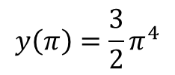
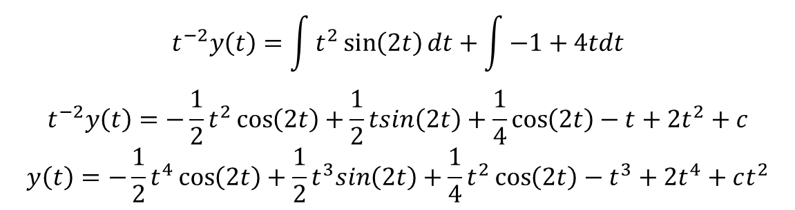


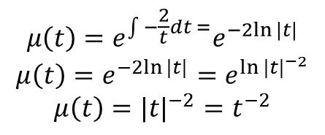
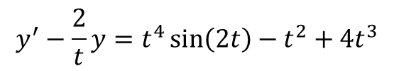
Example 4
Find the solution to the following IVP.
Solution:
$$ty^{′}−2y=t^{5}\sin\left(2t\right)−t^{3}+4t^{4}$$
$$y\left(π\right)=\frac{3}{2}π^{4}$$
$$y^{′}−\frac{2}{t}y=t^{4}\sin\left(2t\right)−t^{2}+4t^{3}$$
$$μ\left(t\right)=e^{\int{−\frac{2}{t}dt }=}e^{−2ln⁡|t|}$$
$$μ\left(t\right)=e^{−2ln⁡|t|}=e^{{ln⁡|t|}^{−2}}$$
$$μ\left(t\right)={|t|}^{−2}=t^{−2}$$
$$t^{−2}y\left(t\right)=\int{t^{2}\sin\left(2t\right)dt+\int{−1+4tdt}}$$
$$t^{−2}y\left(t\right)=−\frac{1}{2}t^{2}\cos\left(2t\right)+\frac{1}{2}tsin\left(2t\right)+\frac{1}{4}\cos\left(2t\right)−t+2t^{2}+c$$
$$y\left(t\right)=−\frac{1}{2}t^{4}\cos\left(2t\right)+\frac{1}{2}t^{3}sin\left(2t\right)+\frac{1}{4}t^{2}\cos\left(2t\right)−t^{3}+2t^{4}+ct^{2}$$
$${(t}^{−2}y)′=t^{2}sin⁡(2t)−1+4t$$

Slide 26
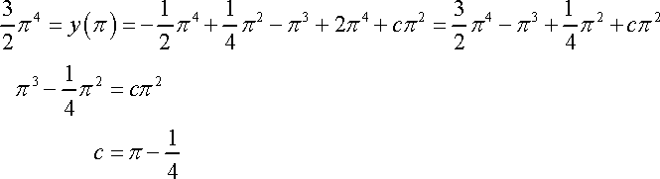
Apply the initial condition to find the value of c.
The solution is then

