Slide 1
Review course

Slide 2
Chapter 01
How are communications driving change in the workplace?
Knowledge Economy
Flatter Organizations
Business on a global scale
Diverse Employee base
Team work Environment
Advancing communication technologies

Slide 3
Chapter 01
The Communication process
  Situated
    Embedded in a particular environment or socio-cultural context
  Relational
    Involves the ability to interact effectively and ethically, according to what is needed at a given moment
  Transactional
    A cooperative activity in which people adapt to one another

Slide 4
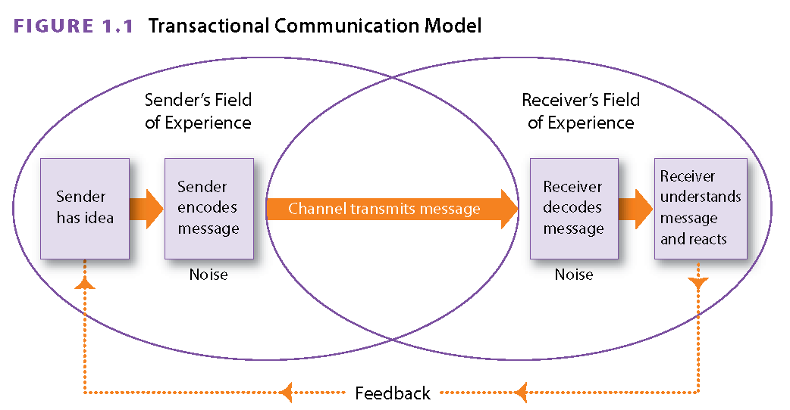
Chapter 01

Slide 5
Chapter 01
Barriers to Effective Communication
Channel Overload
Information Overload
Emotional Interference
Semantic Interference
Physical & Technical Interference
Environmental interference
Mixed messages & Channel Barriers

Slide 6
Chapter 01
Question:
  Inability of a channel to carry all transmitted messages
  You have a phone conversation with someone that lasts for 2 hours without taking notes
  Your much older boss has issues with the language used by a younger generation
Channel Overload
Information Overload
Environmental interference

Slide 7
Chapter 01
Non-Verbal Communication:
  Communication that does not use words but takes place through gestures, eye contact, and facial expressions.
Substitution
Repetition
Repeat messages that is being delivered.
Contradiction
Conflict with verbal messages
Regulation
Regulate to the conversation – tapping on shoulder
Replace verbal communication
Facial expressions

Slide 8
Chapter 01
Question:
  If I send an e-mail to my supervisor.
    What is the direction of communication?
    Within what structure of channel is this situation?
    How is the intended audience of this communication?
    Upwards
    Formal Channel
    Internal.

Slide 9
Chapter o1
What is Ethnocentrism?
  False assumptions that one’s own cultural or ethnic group is superior to other cultural or ethnic groups
    Based on limited experience

Slide 10
Questions
Flatter organizations are ones that__________
  a) have fewer middle managers
  b) have shorter communications chains
  c) require all individuals to be skilled communicators
  d) All of the above.
Which of the following is not a barrier to effective communication?
  a) Mechanical interference
  b) Channel overload
  c) Information overload
  d) Emotional interference

Slide 11
Chapter 02
Planning & Writing for business communications
Prewriting
Organizing and outlining
Drafting
Revising & editing

Slide 12
Chapter 02
Business Communication
  Purpose-driven: carried out for a reason
  Audience-focused: shape the message accordingly
  Concise: practice word economy

Slide 13
Chapter 02
Purpose
Scope
Audience Analysis
Medium or Channel
Prewriting

Slide 14
Chapter 02
Brainstorming
10 minutes of jotting down any thoughts that come to mind
After groups items based on subcaterogy
Mapping
Visual representation of clusters of information by topics and subtopics
Asking questions
The 5 W’s “Who What Why When and Where”
Add “how”
Organizing and outlining

Slide 15
Questions
Effective business communication is not ________.
  a) audience-focused
  b) purpose-driven
  c) writer-focused
  d) concise
Establishing the purpose of a message before beginning to write it allows you to ________.
  a) reduce the chance that the message will succeed
  b) overlook key components of the message
  c) organize the message effectively
  d) include only one purpose in the message

Slide 16
Chapter 03
What is business style of writing?
  the rules, conventions, and options you need to consider whenever you write.
    Key things to consider:
      Use correct grammar.
      Consider the“sound”of your words.
      Eliminate frustrating and confusing messages.

Slide 17
Chapter 03
I will be responsible for auctioning and undertake a prioritization of my commitments in terms of my daily schedule
I will arrange my daily schedule

Slide 18
Chapter 03
Plain English | -ize verb | -ion Noun
Make Communal | Communalize | Communalization
Use | Utilize | Utilization
Make best use of | Optimize | Optimization
Make real | Actualize | Actualization
Develop a business | Corporatize | Corporatization
Finish | Finalize | Finalization

Slide 19
Chapter 03
Clichés
Tighten our belts
Think outside the box
A change for the better
Push the envelope
To be perfectly honest
A perfect ballgame
Without further delay

Slide 20
Chapter 03
Keep language specific, precise, and functional.
    Provide specific details and concrete nouns to help readers act on information and requests.
    Quantify facts and avoid vague qualitative statements.
    Avoid ambiguous and non-idiomatic expressions.
    Use comparisons and analogies to clarify meaning.

Slide 21
Chapter 03
How to achieve conciseness?
Eliminate long lead-ins.
Revise noun conversions.
Eliminate redundancies.
Revise empty words and phrases.
Use precise, strong, and accurate verbs

Slide 22
Chapter 03
If you refer back to the final section of the report, you will see that recommendations suggest we should continue on with the current profit-sharing plan
During the course of the meeting, the need for mutual co-operation was brought to our attention

Slide 23
Chapter 03
Personal
First of second pronouns
Warmth & friendliness
Impersonal
Objectivity
Emphasizing facts
Detached
Engage readers

Slide 24
Chapter 03
Keeping a positive tone
  Because you failed to provide us with your postal code, we could not send you the estate-planning package you requested.
  Please tell us your postal code so that we may send you your estate-planning package

Slide 25
Questions
To incorporate a plain-language writing style, a writer should practice ________.
  a) using ambiguous language
  b) avoiding passive-voice constructions
  c) distancing the subject from the verb
  d) avoiding the use of personal pronouns
Personal style is not characterized by ________.
  a) short sentences
  b) passive voice
  c) personal pronouns
  d) first names and personal references

Slide 26
Chapter 04
Simple
Compound
Complexe
Compound Complexe

Slide 27
Effective Sentences
Simple sentences
  One independent clause
    “We love to learn about grammar.”
Simple

Slide 28
Effective Sentences
  Two independent clauses
    Communications is our favorite course, and we love to learn about grammar
Compound

Slide 29
Effective Sentences
  One dependent and one independent clause
    “When we come to class, we love to learn about grammar.”
Complex

Slide 30
Effective Sentences
  One dependent clause and two independent clauses
    “When we come to class, we learn about writing, and we learn about grammar.”
Compound-complex

Slide 31
Chapter 04
Identify the following question types
  How must we improve our product so that it meets CSA specifications?
  If we were to improve our product, what modifications would you suggest?
  Will CSA approve our newest model before production is scheduled to begin?
  In what way is our competitor’s product better then our own?
  How many similar products has CSA approved in the past five years?
  Have you considered seeking approval from Underwriter’s Laboratories in the US?

Slide 32
Chapter 04
emphasis
Underlining, boldface, and/or italics;
large font size;
capital letters;
boxes;
colors.

Slide 33
Chapter 04
Revise the following sentence to emphasize key facts:
  Date:
    The deadline is March 31st for requesting transfers to the Toronto sales office.
  Departments:
    Three departments, namely Marketing, Sales and Distribution, are participating in the pilot project.
  Appointee:
    Our current operations manager, John O’Reilly, will now head up our Montreal office

Slide 34
Chapter 04
The active voice | The passive voice
follows the order of [actor] [action] [receiver], | follows the order of [receiver] [action] [actor] (uses “to be” + past participle + by)
states good news clearly, | conceals the “do-er” of the action,
emphasizes the “do-er” of the action. | de-emphasizes negative news,
 | shows tact and sensitivity.

Slide 35
Chapter 04
How long should a paragraph be?
  Short (up to six sentences)
  Long (up to eight sentences)
What is a topic sentence?
  Topic sentences
    give the main idea of the paragraph,
    help focus and clarify paragraph content.
  Topic sentences are not as important when delivering bad news.

Slide 36
Questions
Writing techniques that add emphasis include ________.
  a) short, simple sentences
  b) bulleted lists
  c) repeated key words
  d) All of the above.
Which sentence, below, is written in active voice?
  a) The report was submitted by Georgia.
  b) Georgia was supplied feedback by the review committee.
  c) Georgia submitted revisions to the report to the review committee.
  d) The revisions were not received by the review committee.

Slide 37
Chapter 12
What is important with an oral presentation?
  Audience & Situation Analysis
    What is the reason for attending and what are the expectations?
    What is the attitude towards the subject ?
    What is your role, relationship, and rank to the audience?
    Are key decision-makers present?
    Does the audience have a prior knowledge of the topic?

Slide 38
Chapter 12
Introduction
Body
Conclusion
The three-part presentation

Slide 39
Chapter 12
What are some of the general rules for Powerpoint presentations?
  Must not dominate the presentation
  Usually not more then 12 slides per presentation
  Use constant font size – no smaller then 24
  No more then two illustrations per slide
  No more then 35 words per slide
  Each slide should have a “So what?” point
  Comment on – but do not read off your slide

Slide 40
Chapter 12
Chalkboard
Great for <30 people
Posters
Complex information
Video
Reinforce ideas
Handouts
Distribute before
Difficult & messy
Looks unprofessional
Can easily take over focus
Do not distribute during

Slide 41
Chapter 12
Manuscript
Memorization
Impromptu
Extemporaneous

Slide 42
Chapter 12
What should formal minutes always contain after a meeting?
  Name of group or committee
  Date, time, and place
  Topic and type of meeting
  List of present, absent, and regrets
  Call to order
  Approval of previous minutes
  New business and announcements
  Record of reports, discussions, resolutions, motions, votes, and key decisions
  Assignments, actions, and due dates
  Time convened, time adjourned, and location of the next meeting
  Name and signature of the recording secretary

Slide 43
Questions
To enhance a presentation with visuals, ________.
  a) allow the audience to digest your visual for a few moments before you talk about it
  b) limit the number of visuals to twelve
  c) use 20-point font
  d) include bulleted lists of no more than three items
When answering questions during a presentation ________.
  a) paraphrase the question if you need time to formulate an answer
  b) use sarcasm to quiet angry questioners
  c) never admit that you don't have an answer
  d) answer all audience questions, even if they seem irrelevant

Slide 44
Chapter 05 – 06 - 10
In class activity, you will help your colleagues with the revision process. In teams of five (5), prepare a 3 minute overview of one of the following topics.
  What should be in a short memorendum (Chapter 05)
  What are some of the rules when reading/writing your e-mails? (Chapter 05)
  What is the direct approach & what does it entail when writing routine messages (Chapter 06)
  What are the different types goodwill messages and when should they be used? (Chapter 06)
  What is the direct approach in an informal report? (Chapter 10)
  What is the difference between a conclusion & a recommendation in an informal report? (Chapter 10)

Slide 45
Chapter 10
Types of informal reports
Periodic
Incident
Investigative
Compliance
Situational
Progress

Slide 46
Chapter 10
Types of graphics
Table
Matrix
Pie Chart
Bar Chart
Picture Graphs

Slide 47
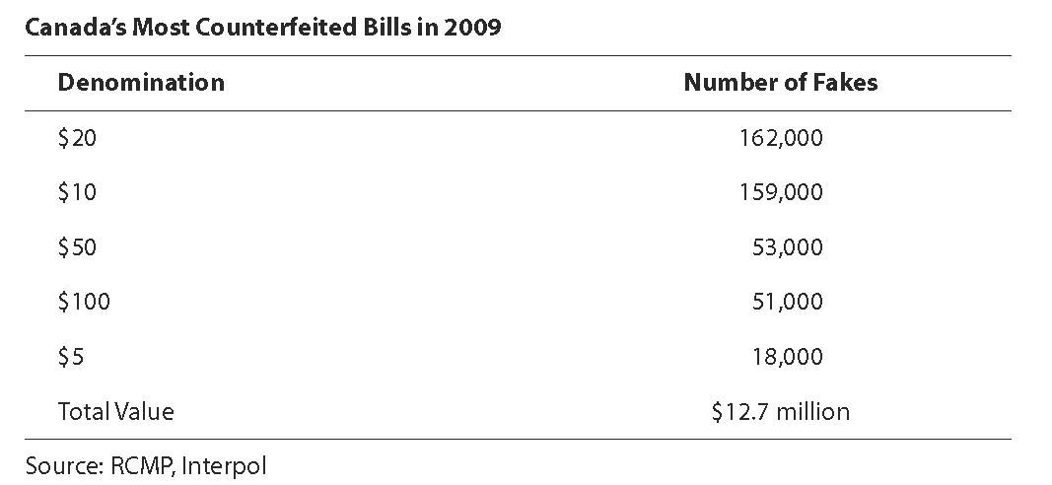
Visual Aids and Graphics
Table

Slide 48
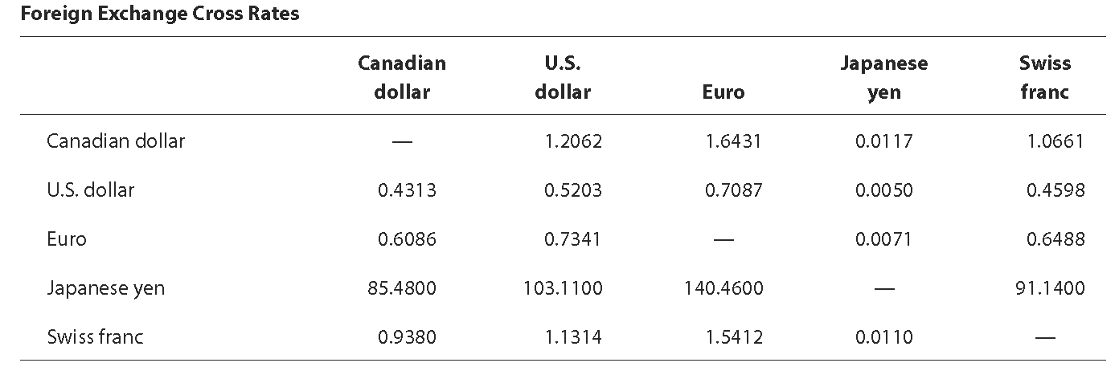
Visual Aids and Graphics
Complex Table

Slide 49
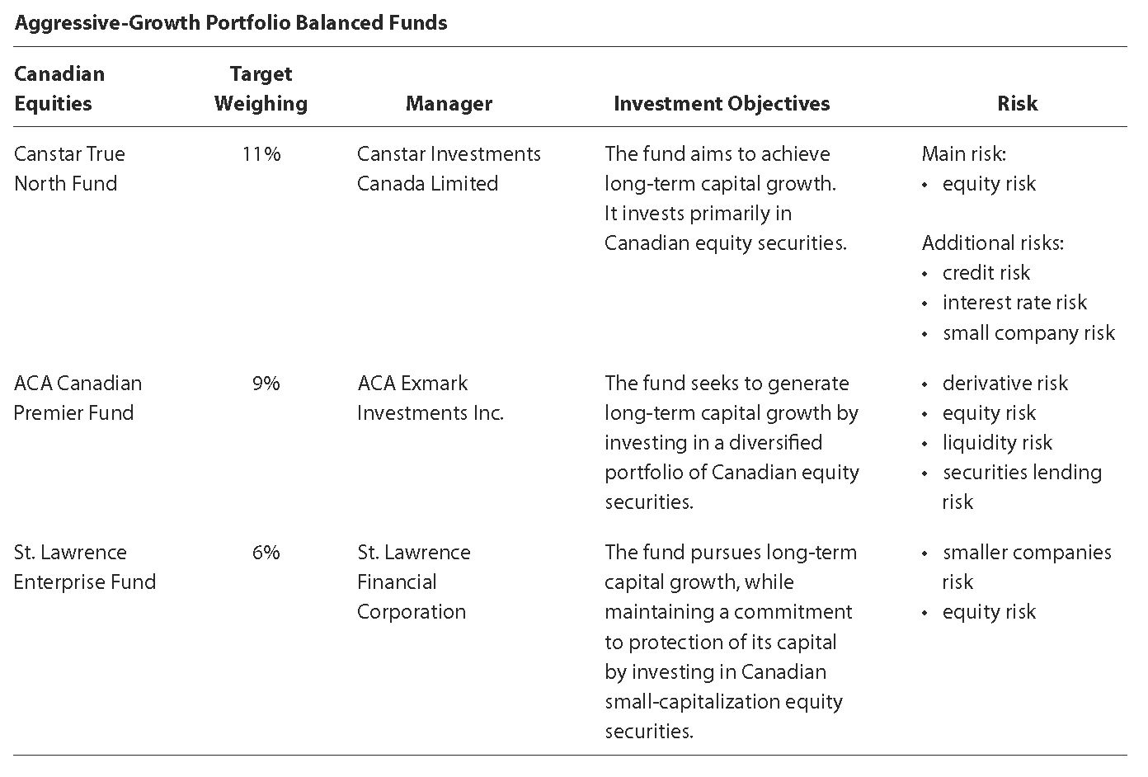
Visual Aids and Graphics
Matrix

Slide 50
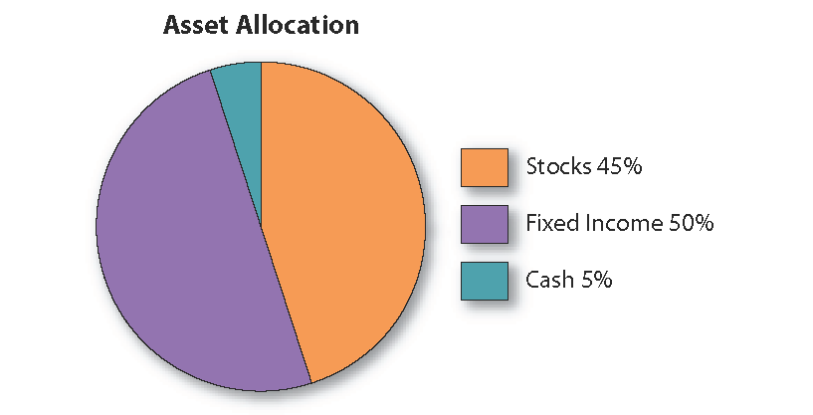
Visual Aids and Graphics
Pie Chart

Slide 51
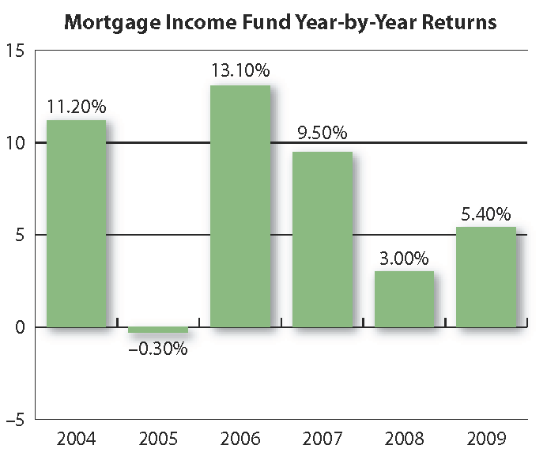
Visual Aids and Graphics
Bar Chart

Slide 52
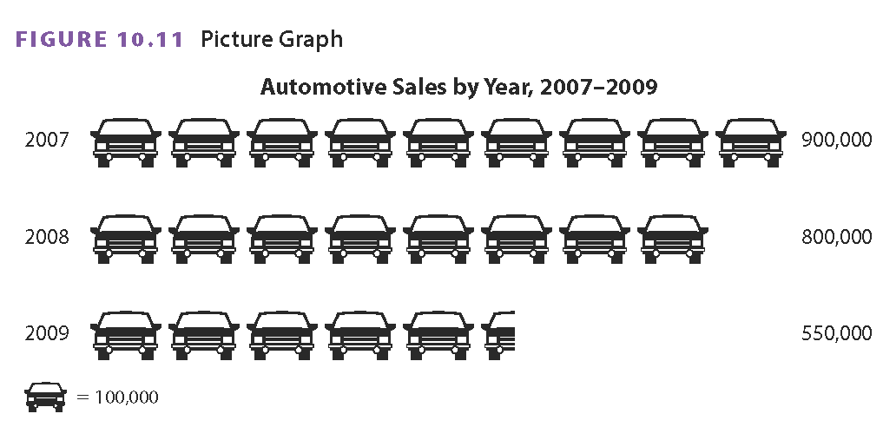
Visual Aids and Graphics
Picture Graph

Slide 53
Questions
Which of the following is not a factor in successful reports?
  a) Content
  b) Clarity
  c) Complexity
  d) Skimmability
A report must be organized using ________.
  a) the direct approach
  b) the indirect approach
  c) both the direct and the indirect approaches
  d) whichever approach best meets the writer's goals

Slide 54
Chapter 11
What is the difference between a proposal and a formal report?

Slide 55
Chapter 11
Front matter
Body
Back matter

Slide 56
Formal Report
  Copy of the Request for Proposals
  Cover letter
  Title page
  Table of contents
  List of figures
  Executive summary
Front matter

Slide 57
Formal Report
  Introduction
  Problem Statement / Purpose Statement
  Background
  Detailed proposal, method
  Schedule
  Budget or cost analysis
  Staffing
  Authorization
  Benefits, conclusion
  Recommendation
Body

Slide 58
Formal Report
References
  What is a primary source?
  What is a secondary source?
Appendicies
Back Matter

Slide 59
Questions
Including a Works Cited or a References section in a report ________.
  a) reduces allegations of plagiarism
  b) supports assertions
  c) helps readers find source material
  d) All of the above.
Which of the statements about reports, below, is false?
  a) The language should clearly indicate biases.
  b) Headings and subheadings should be parallel.
  c) Facts should be supported by evidence.
  d) Both a) and b).

Slide 60
Chapter 07 – Delivering bad news
When?
  You know the reader’s preference for directness.
  The news is expected.
  The information is critical.
  The news isn’t serious, significant, or detrimental.
  Your company’s practice is directness.
  You’re terminating the relationship.
Direct

Slide 61
Chapter 07 – Delivering bad news
When?
  You don’t know the reader well.
  The news isn’t anticipated by the reader.
  You expect a strong negative reaction.
Indirect

Slide 62
Chapter 07 – Delivering bad news
What is a buffer sentence?
Buffers are one to three sentences that:
  Neutralize bad news,
  establish rapport, and
  reduce the reader’s shock

Slide 63

Chapter 07 – Delivering bad news
Explaining bad news
  A good explanation is the key to a successful negative message. It shows that the decision is based on valid reasons.
  The explanation should be objective and give only the necessary information.
  Stick to the facts.
  Refer to, but don’t hide behind, company policy.
  Use positive or neutral words.

Slide 64
Questions
When used in negative messages, an effective buffer ________.
  a) forecasts the bad news
  b) leads the reader to think good news will follow
  c) establishes rapport with the reader
  d) increases reader surprise about the bad news
Use the direct approach for negative messages when ________.
  a) you don't know the reader well
  b) important information would otherwise be overlooked
  c) the reader isn't expecting the message
  d) the reader will likely respond negatively

Slide 65
Chapter 08 – Writing Persuasively
Know your purpose
Understand what motivates your reader
Consider Design and layout
Be positive and accurate
Anticipate objections

Slide 66
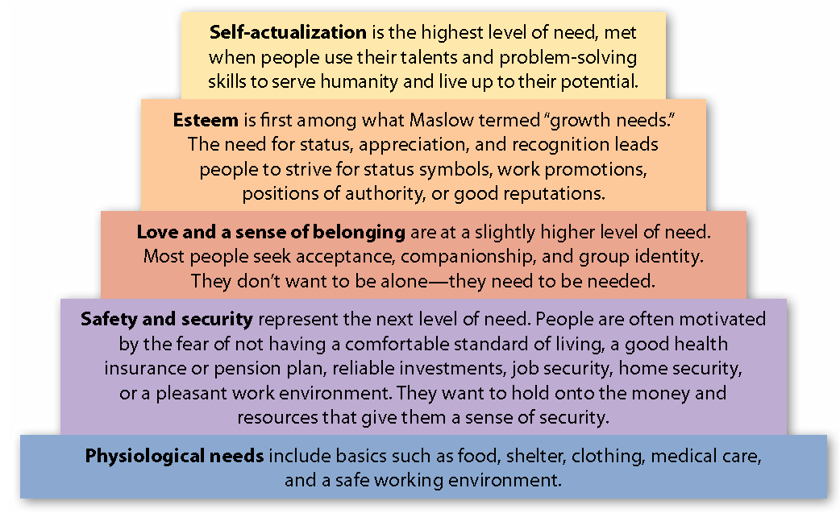
Chapter 08 – Writing Persuasively

Slide 67
Chapter 08 – Writing Persuasively
Persuasive messages appeal to the reader’s
sense of reason
emotions
sense of what is right (ethics)

Slide 68
Questions
A good sales message will avoid ________.
  a) market research to develop a reader profile
  b) a "Dear Occupant" salutation
  c) objective language and facts
  d) All of the above.
The indirect persuasive strategy does not include ________.
  a) obtaining reader interest
  b) avoiding attention-getting techniques
  c) asking for action, sometimes by a set deadline
  d) showing reader benefits

Slide 69
Thank you

