Slide 1
Control of Gene Expression in Prokaryotes III.
Notions of Systems Biology
15 November 2013
Notes:
We will look at how genes regulate others and how it is represented schematically.

Slide 2
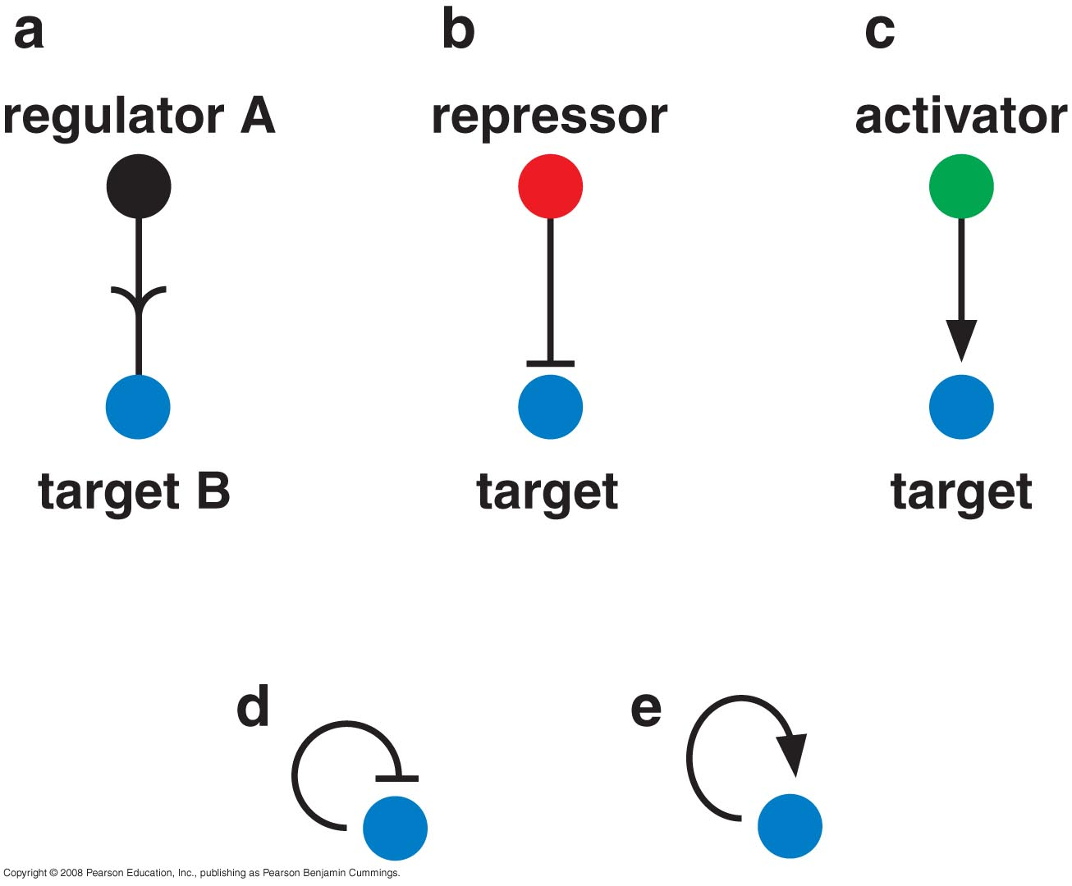
Simple Circuits
Notes:
How product of gene A will stimulate (arrow) expresscion of gene B. when the line is blocked by a horizontal line it represses gene b. and the circular arrows/ blocked lines refer to positive and negative feedback control.

Slide 3
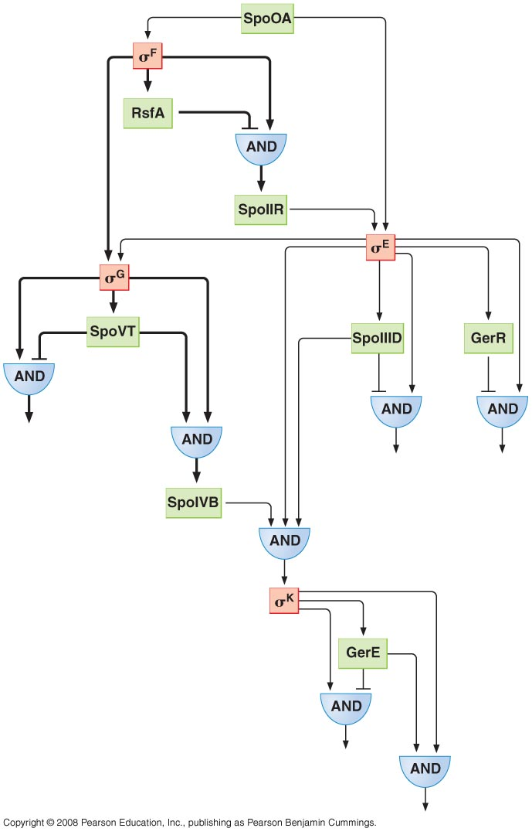
Complex Circuits

Slide 4
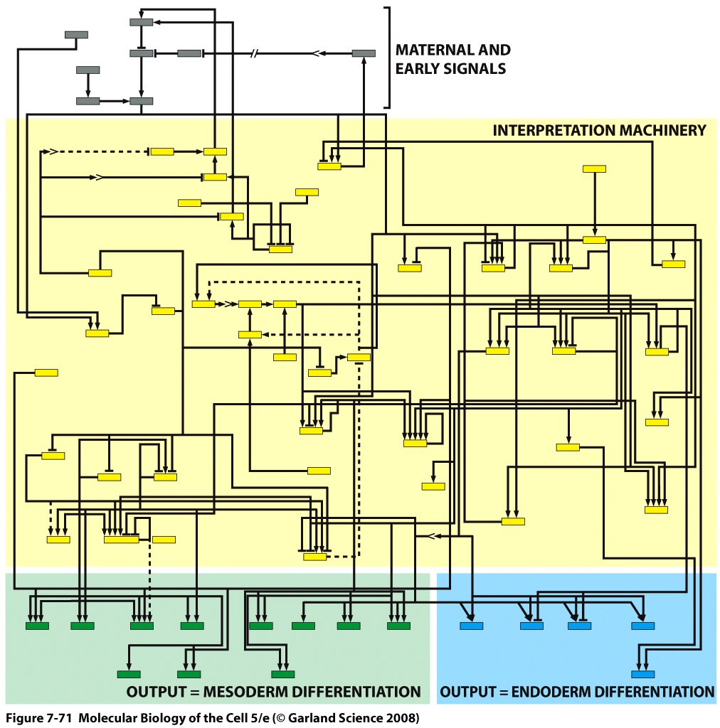
Complex Circuits

Slide 5
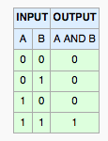

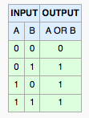

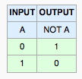

Gates
AND
OR
NOT
Notes:
Logical gates:
AND:if you have two inputs then u need both imputs A and B inorder to get the output.
OR: u need either A or B to get output.
NOT: you must not have A input to get output.

Slide 6
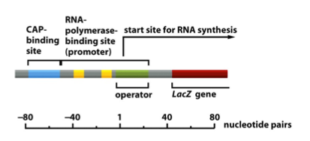
Lactose operon as a logical circuit
CAP
Operon
transcription
lac repressor
Notes:
Example lac operon.
Output is transcription of operon, input is the presence or absence of CAP protein and lac repressor.
In order for operon to function need to have presence of CAP and absence (NOT GATE) of lac repressor so these two conditions must be met and hence the AND gate.

Slide 7
AND
Transcription

Slide 8
NOT
1
0
Lac repressor

Slide 9
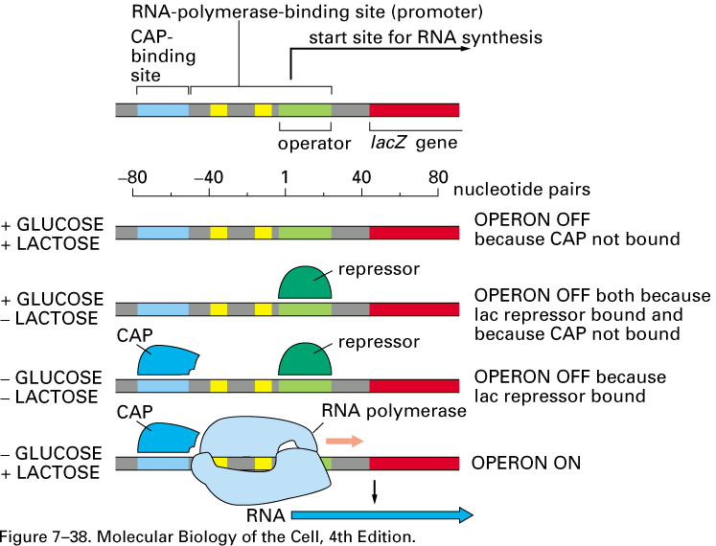
Notes:
There are triggers for this; u need presence of high concentrations of cAMP for binding of CAP and presence of lactose to detach repressor.

Slide 10
Lactose operon as a logical circuit
CAP binding
cAMP
Lac Transcription
Lactose
Lac repressor binding
X and (Not Y)
CAP at the promoter AND NOT lac at the operator

Slide 11
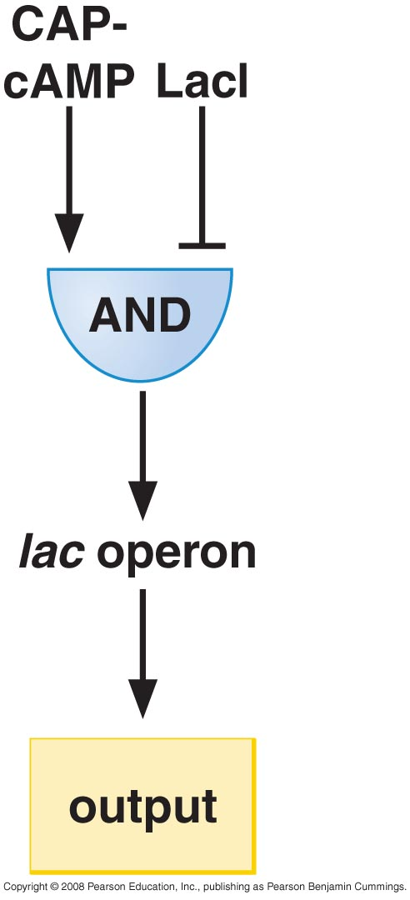
A different way of showing it
Notes:
Another way of showing this is shown here:
The presence of CAP bound to cAMP and absence of Lac I for AND gate to be fullfilled,

Slide 12

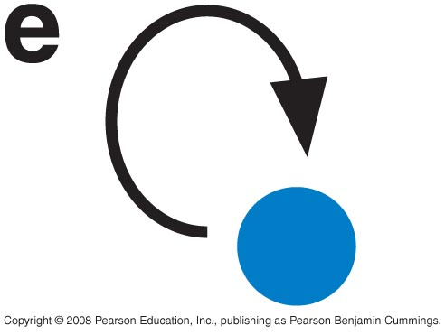
Positive and Negative Feedback
Notes:
We will see example for this today.

Slide 13
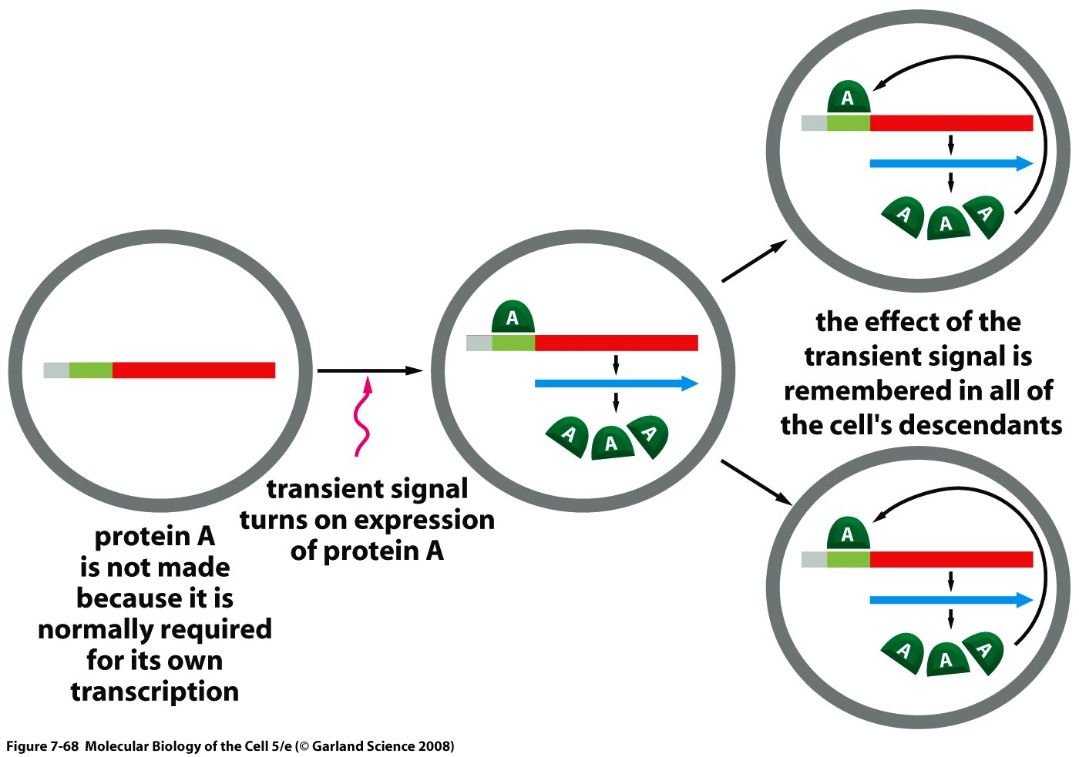
Example of positive feedback
Notes:
This is how a positive feedback loop can be useful, lets say you have a cell and there’s a gene regulated by by the A regulator and these genes are important for this cell to adopt a certain physiology and at the beginning protein A is not made because it needs a trigger. So there is a transient signal that triggers expression of A but because this protein autoregulates (influence positively it’s own expression) once it is made it will bind to regulatory sequences on dna and stimulate it’s own expression and once this cell divides there will be enough A proteins in the cell to perpetuate its own self.

Slide 14
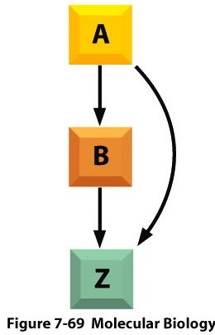
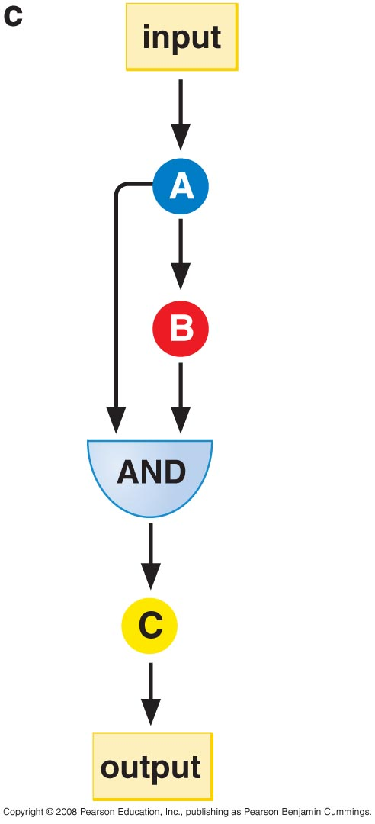
Feed-forward Loop
Notes:
This is the feed forward loop and there are two ways to represent it, shown here. In order for C to be expressed u need to have the presenc of both A and B but A is also a positive regulator of B.
The othere diagream shows the same for z.
This is useful to distinguish between the trigger that originally stimulates expression of A and an accidental input from noise.

Slide 15
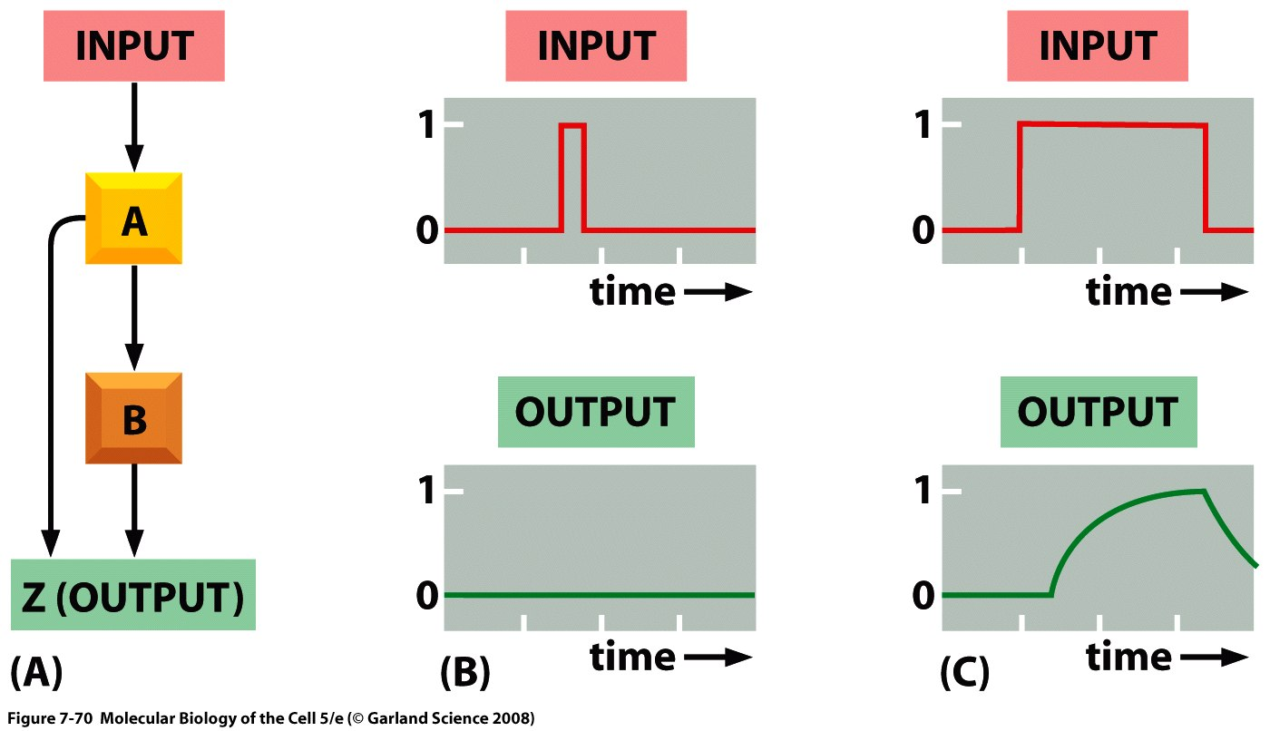
A feed-forward loop can « measure » the duration of an input
Notes:
For example here we have two scenarios: in the first one the input is short transient hence there is no output but in the second case the imput last for a long time hence there is an output because long imput stimulates A which stimulates B and hence Z. but if input is short not enough A is made to stimulate B and then stimulate Z.
This is the general principal.

Slide 16
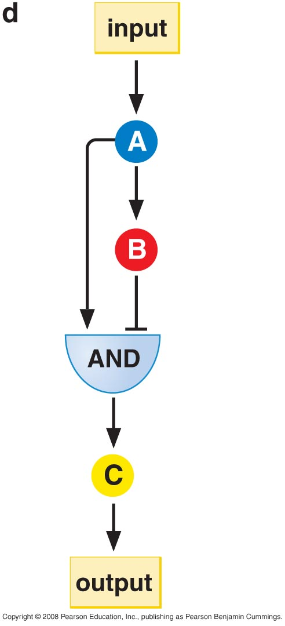
Feed-Forward Loops
Coherent Incoherent
Notes:
There are two kinds of the feed forward loops we only talked about Coherent forward. The second time is the incoherent fead forward, where A stimulates B but B represses C and this is useful if you want the affect to last only a short period of time.

Slide 17
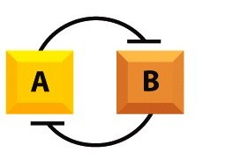
Flip-Flop
Notes:
Flip – flops are circuits where the product of the A gene will repress the B gene and the produc to B gene will repress preoducts of A genes and these are most useful in bisystems such as light switch at home because it is stable over time unless u intervene in the system.

Slide 18
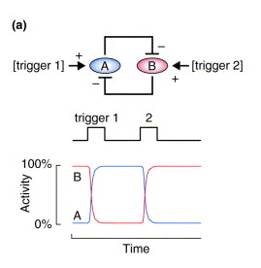
Stability conferred by negative feedback
Ferrell. 2002. Current Opinion in Cell Biology.
Notes:
U have a trigger, if expression of A is triggered by 1 it will lead to repress B the only way to change this is to have trigger 2 trigger expression of B and B will repress expression of A.

Slide 19
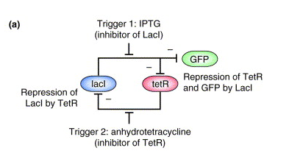
Notes:
Using such properties people have been able to build artificial gene circuits such as here.
Lac I repressor will repress tet R and GFP but tet R will only repress lacI.
IPTG will inhibit activity of lac repressor protein and inhibits the activity of the tet repressor; here GFP was off, IPTG blocked activity of lac repressor and hence was not able to repress tet R and GFP and hence GFP was expressed and we are able to see the green fluorescence protein.
If u apply anhydrotetracyclin it will inhibit tet R and hence will no longer be able to repress lac I and hence it is no longer able to express GFP. (make sure of this 35 min).

Slide 20
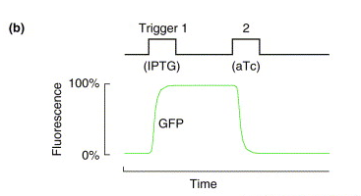

Slide 21
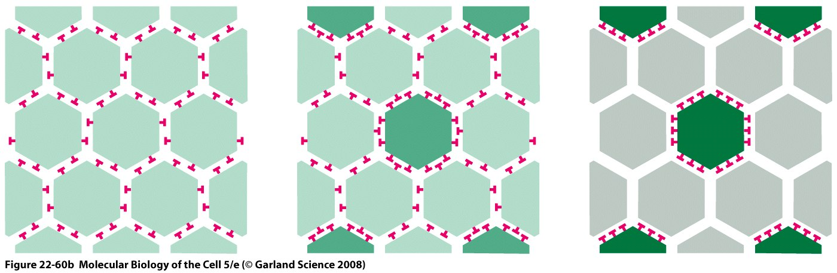
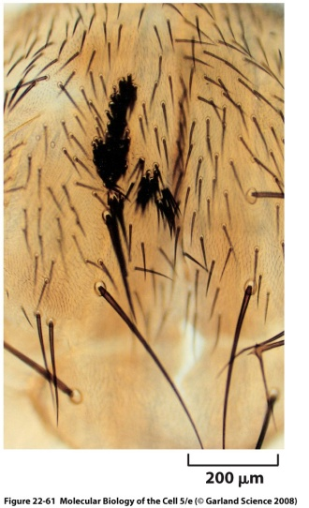
Lateral Inhibition during Development
Notes:
Don’t need to remember any of the specifics for this system only for understanding.

Slide 22
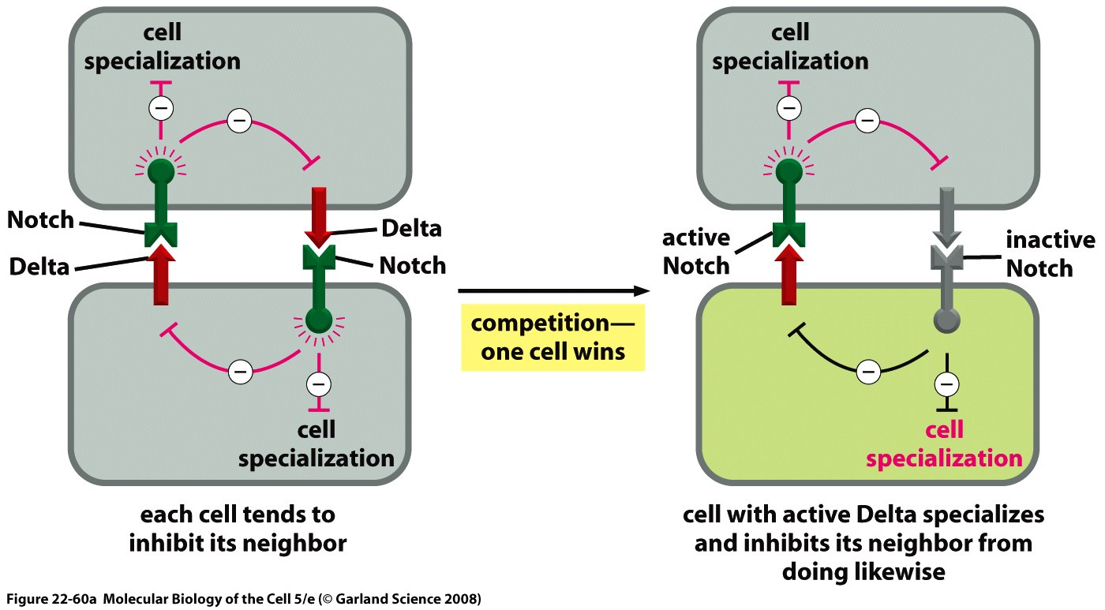
Notch-Delta signaling pathway and lateral inhibition
Notes:
Don’t need to remember this. (make sure from prof)

Slide 23
Notch-Delta signaling pathway and lateral inhibition
X
Notes:
Don’t remember this. (make sure from prof)

Slide 24
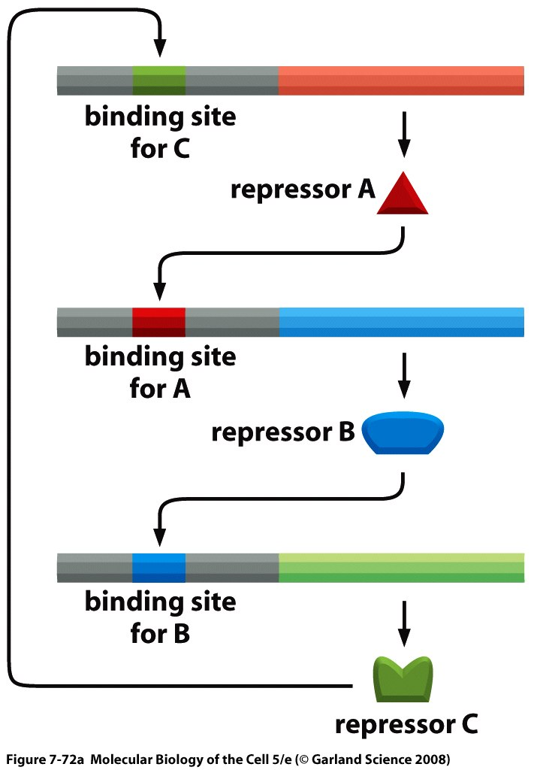
Oscillators
Notes:
This is another example of an artificial system that is made in the lab. It used three coding regions for A, B and C. If we start make repressor A it will bind to it’s site and reperess B and hence there is nothing to repress expression of C and C will bind and will repress for A and this leads to accumulation of B and so forth… and so u can predict production of these proteins here.

Slide 25
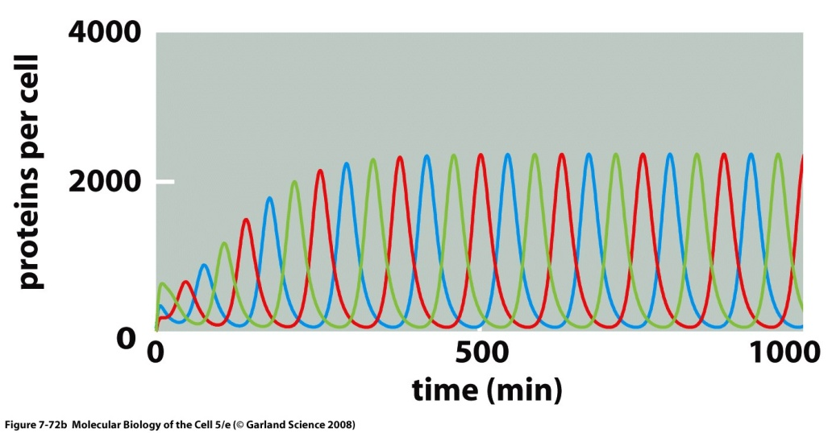
Oscillators
Notes:
When people tried to test this is sauw what happened and what was obtained is very similar to the predictions.

Slide 26
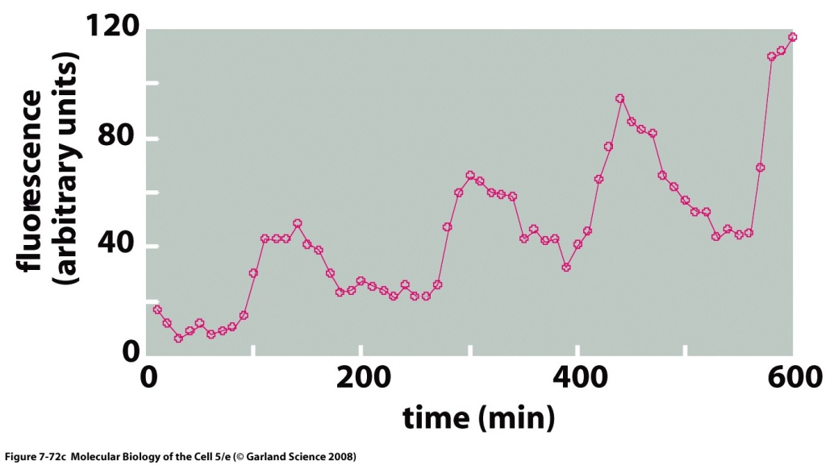
Oscillators
Notes:
For this kind of pattern to be obtained the half lives of the proteins have to be within the same order of magnitude.

Slide 27
Noise in Gene Expression
Intrinsic
Extrinsic
Notes:
In reality there is a certain amount of noise in gene expression and this can be useful. This noise can be divided into intrinsic and extrinsic noise, intrinsic is due to the fact that these regulatory interactions are not absolute and one way we know about this is we have two different alleles in a cell and we expect both to be expressed but in reality we get one expressed over the other and that’s due to the intrinsic noise in the cell.
The noise that is extrinsic will be causing slight changes in the populations of the cell that are supposed to be homogeneous. One example would be where all the cells are equivalent but one cell gets an advantage over the other and is amplified (on previous slides).
Noise is not necessarily bad but it can be bad, for example if we have noise that triggers entry into the lytic cycle the cell will dye and there is no going bad.
When a system is resistant to noise we say it is robust.

