Slide 1
Regulation of Gene Expression in Prokaryotes II.
Control of lysis and lysogeny in bacteriophage lambda
12 November 2013
Notes:
Lambda is a bacteriophage that infects bacteria.

Slide 2
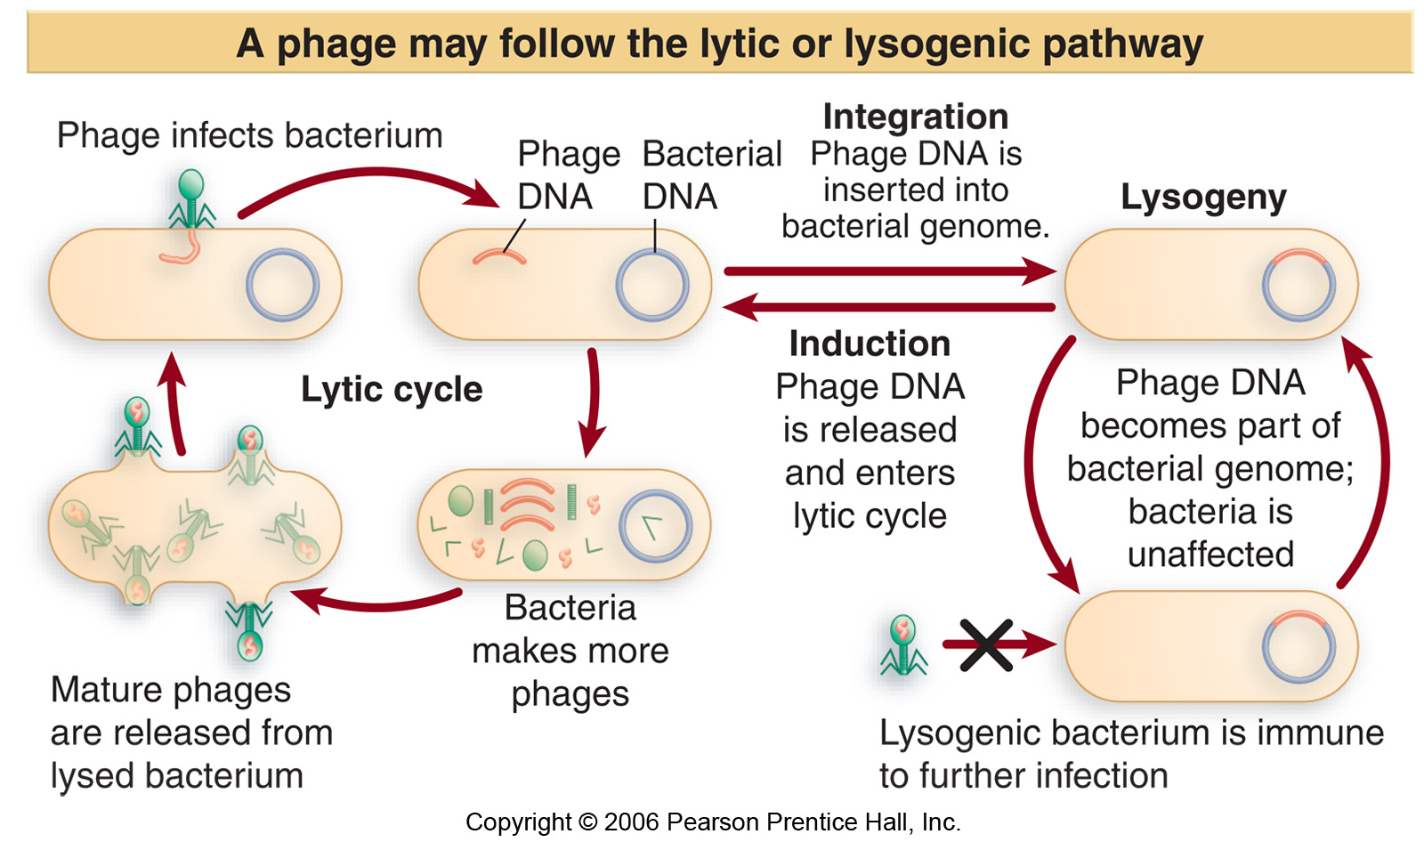
Notes:
When it attacks the bacterial cell it injects it’s dna into it, the bacteria must undergo either lysogeny or lytic cycle. In the lytic cycle what happens is that the information on the lambda dna is used to make more phage particles using the machinery from the bacterial cells and once the phage particles are made they lyse the bacterial cell and they are released and can go and infect other cells. IN lysogeny once the dna of the phage is in the bacterial cell it becomes parts of the bacterial genome and it stays there and bacteria is unaffected, the bacteria then becomes immune to infection by other phages.

Slide 3
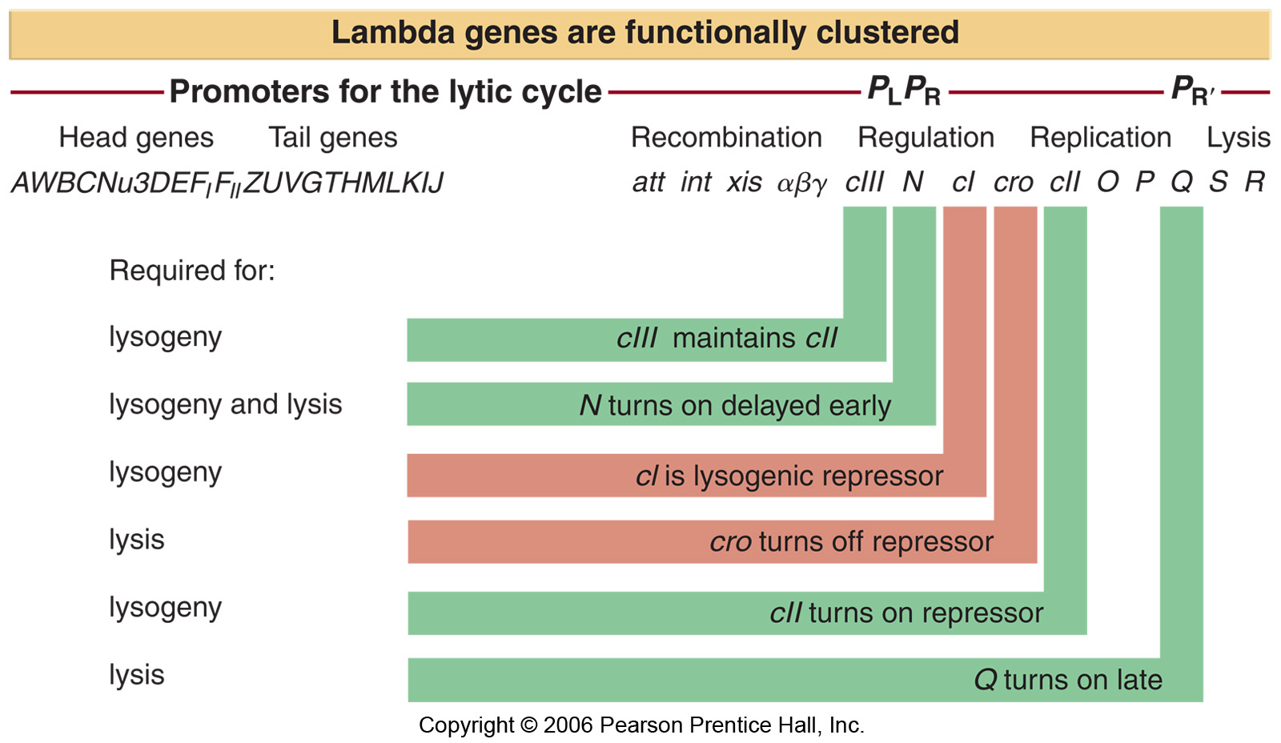
Notes:
We will talk about 6 proteins involved in this control mechanisms, they are c1, cro c2, c3, cI, N and Q is the lysogenic repressor, Cro is also a repressor, but when talking about the repressor in lambda we’re talking about cI, cro turns off cI, N and Q are anti terminators, N is necessary to turn on delayed early, and Q turns on the late face. C2 is necessary for the initial repressor C1, C3 stabilizes cII.
This figure is very important.

Slide 4
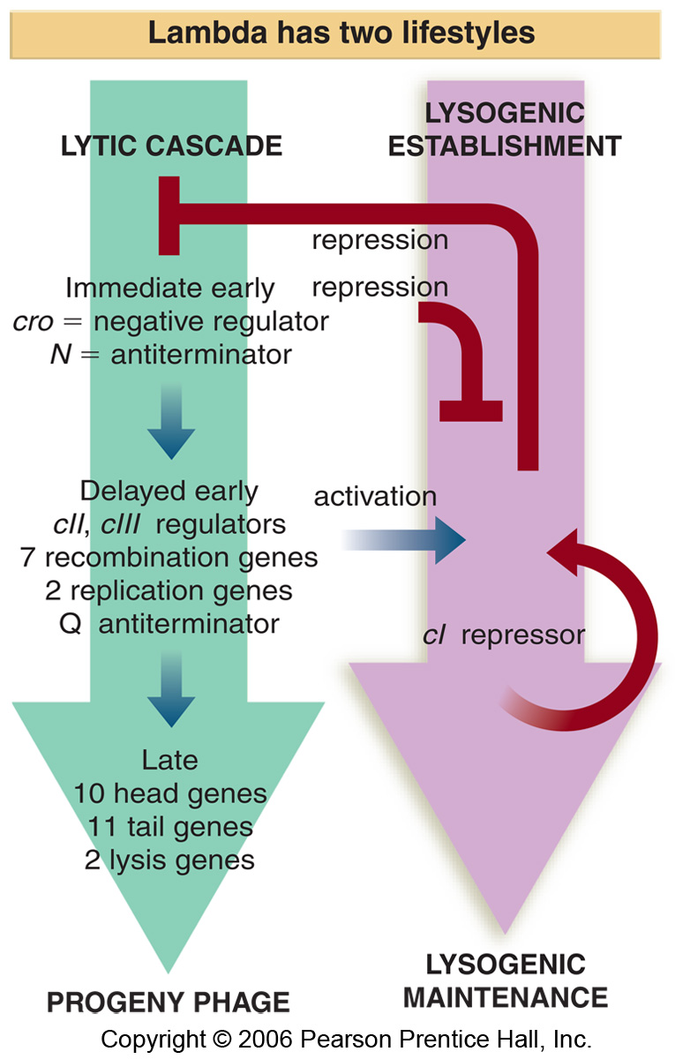
Notes:
There are three stages in the lytic cascade and underneath each of them it shows you the genes that are expressed.
What you need to know is:
in the immediate early phase there are two genes expressed: cro and N.
in the delayed early phase remember that cII and CIII and Q genes are expressed,
In the late phase u make the proteins that are necessary to make new phage particles that will lyse the cell and once u reach the late phase there is no turning back the cell will be lysed.
One thing to remember is that the first two phases of the lytic cascade are common to both pathways! And then u can either activate lysogeniy by switching on cI(lysogenic) or u can go lytic. C1 maintains it’s own expression and maintains lysogeny.

Slide 5
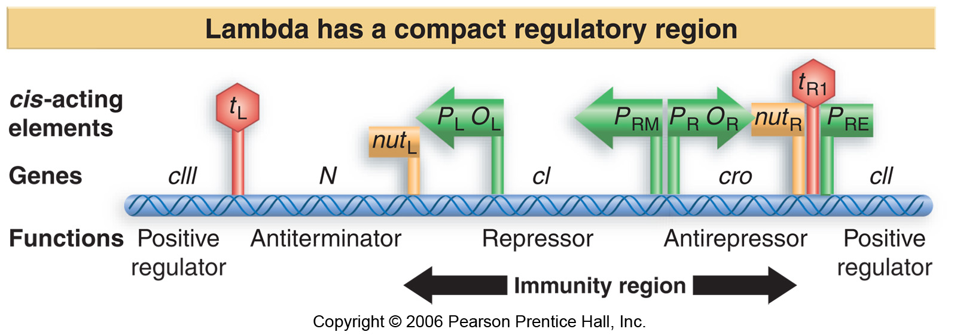
Notes:
This shows you a fraction of the dna of lambda and contains important features. It contains 4 promoters (green arrows) (the PRE arrow is pointing towards the left) PR and PL are the two main promoters, OR and OL (O for Operator where regulatory proteins bind to regulate promoters), the other two promoters are PRE(repressor establishment) and PRM(repressor maintenance),
on this figure there are two terminator sequences tR1 and tL and the sequences for utilization for N are the nutR and nutL.
There is an immunity region that is necessary for this immunity.

Slide 6
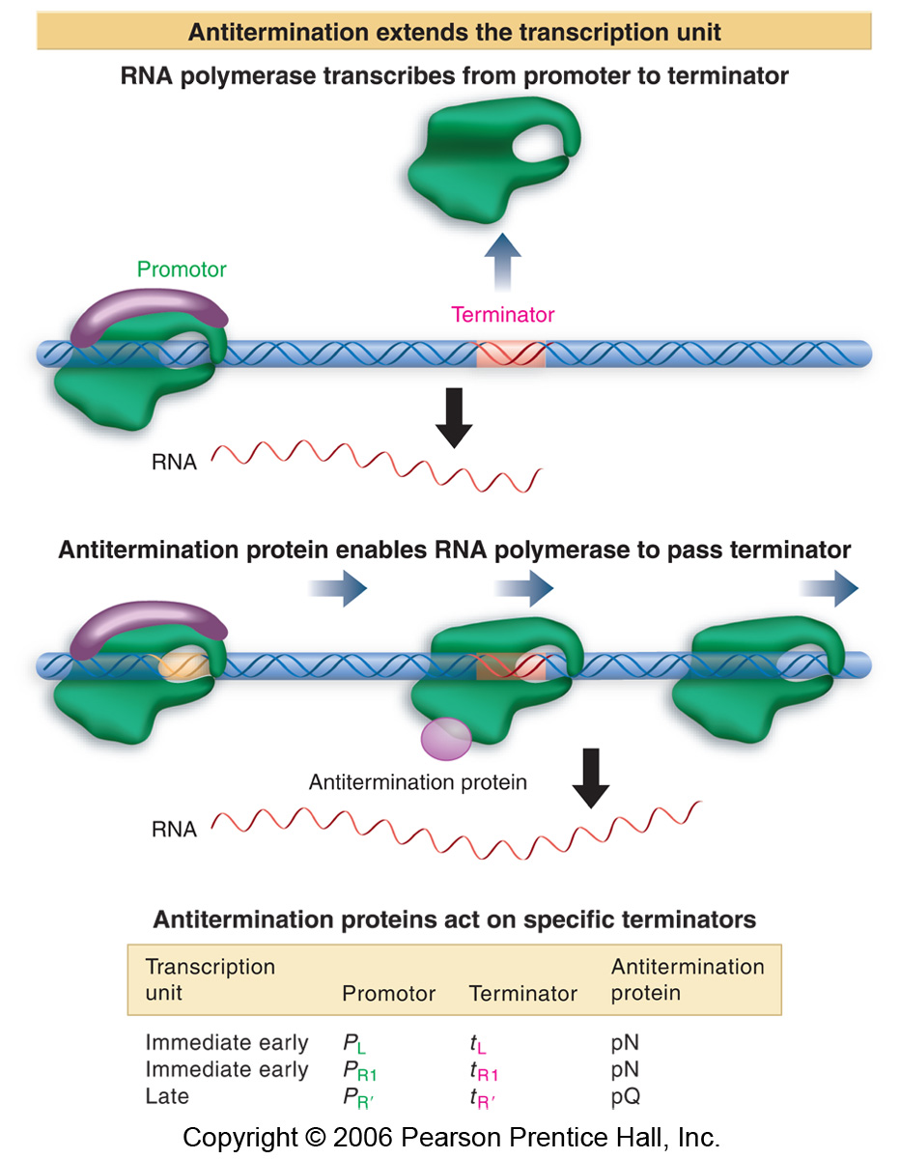
Notes:
This shows that in the presence of the anti terminator proteins (such as N) the rna polymerase will ignore the termator and continue transcription.

Slide 7
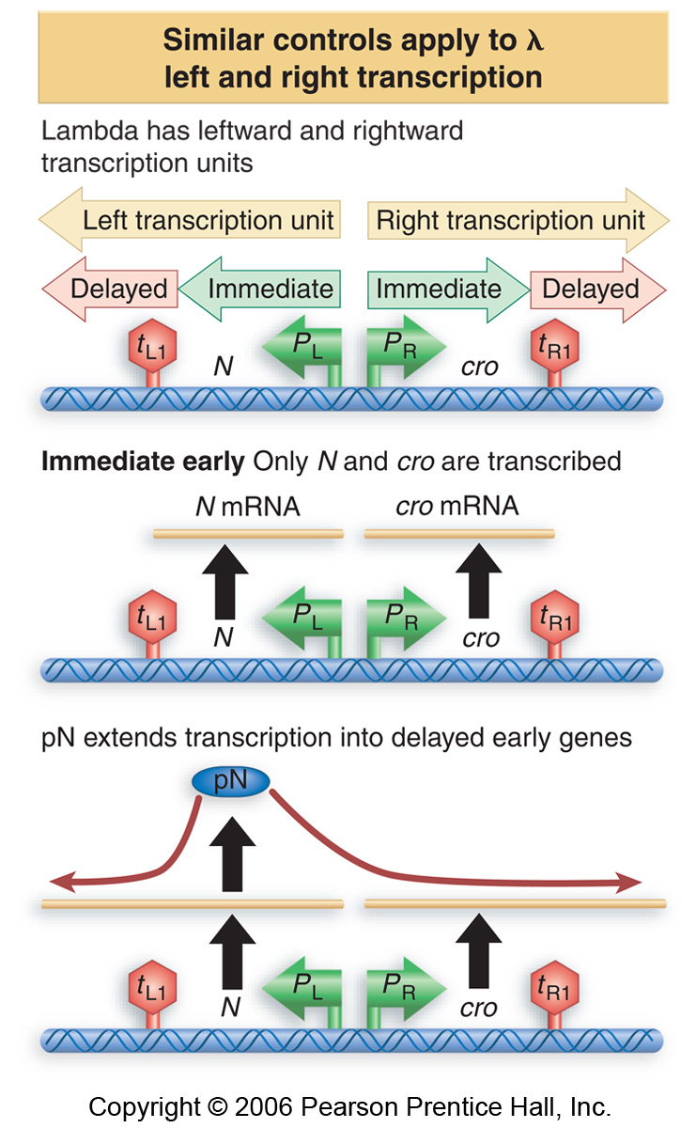
Notes:
When a phage infects a cell there is naked dna in the cell and transcription starts from PL and PR and then the N gene is transcribed and you terminate at tL and when you transcript from PR you transcribe the cro gene and terminate ate tR1. and this is the immediate early phase where only cro and N are transcribed and after a while they accumulate. N is an anti terminator which causes rna polymerase to ignore the tL1 and tR1 and contiue transcription. Then we switch from immediate phase to delayed early phase. After N accumulates we can transcribe further and so CIII will be made and on the other side if we ignore tr1 we will transcribe cII.

Slide 8
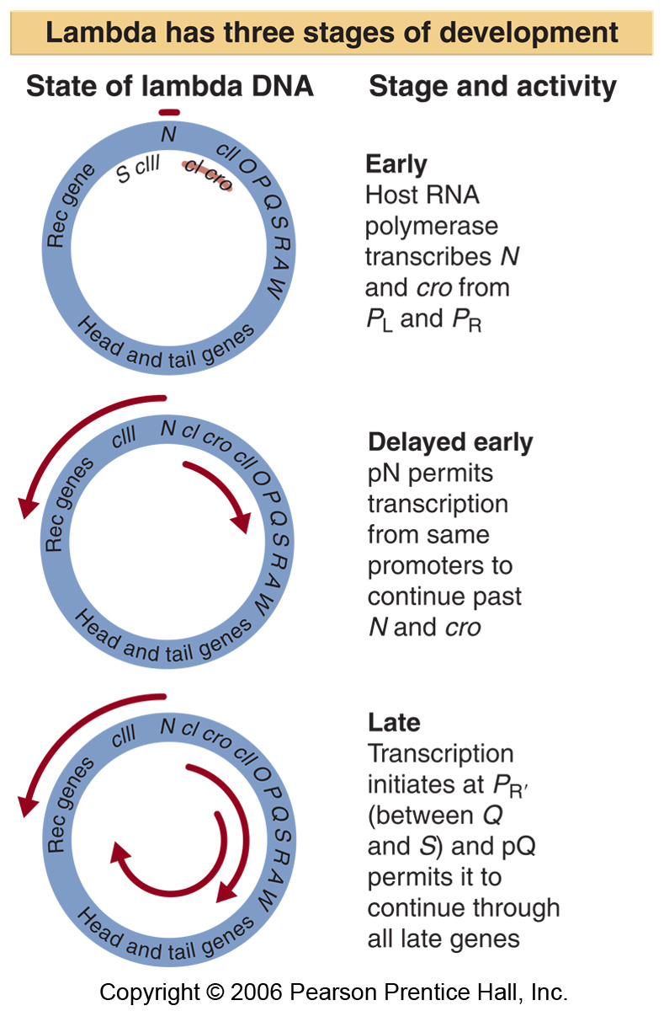
Notes:
One of the six proteins we’re studying today is Q and it is also an antiterminator, this slide shows you the circularized lambda genome. When Q protein accumulates it allows the polymerase to ignore the stop and so it continues to transcribe. So Q an antiterminator is made in delayed early and once it accumulates it allows you to go into the late phase.

Slide 9
Notes:
The c1 repressor gene is very important in lysogeny.

Slide 10
Notes:
C1 is a repressor and it is transcribed from tre or trm. And once c1 accumulates it will bind to the operators OL and Or and hence shut down transcription from the Pleft and Pright promoters.
The immunity region is a stretch of dna between the two operator sites, when u have a phage in the bacteria and it infects it, it is immune to further infection why? A new phage comes in and injects it’s dna, and as soon as dna is in the cell the c1 will bind to the OR and OL and it will shut it down, there are different kinds of phage that exist, if a different phage infects the bacteria it will be immune to it for the same reason.

Slide 11
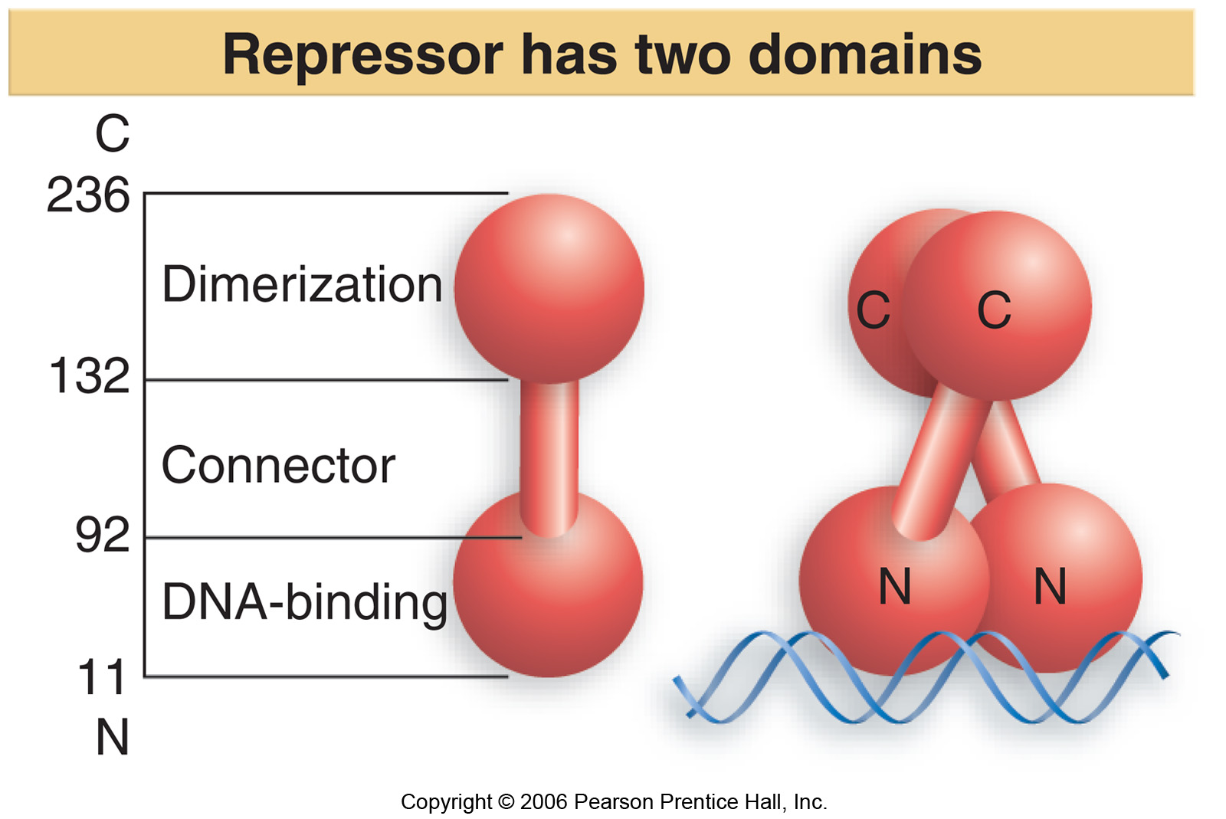
Notes:
C1 has a dna binding dna which binds dna at the operator sites, it has a dimerization domain (binds to other c1 repressors) and a connector in between. And this slide shows that repressor binds dna as an obligate dimer ie it must be a dimer in order to bind.

Slide 12
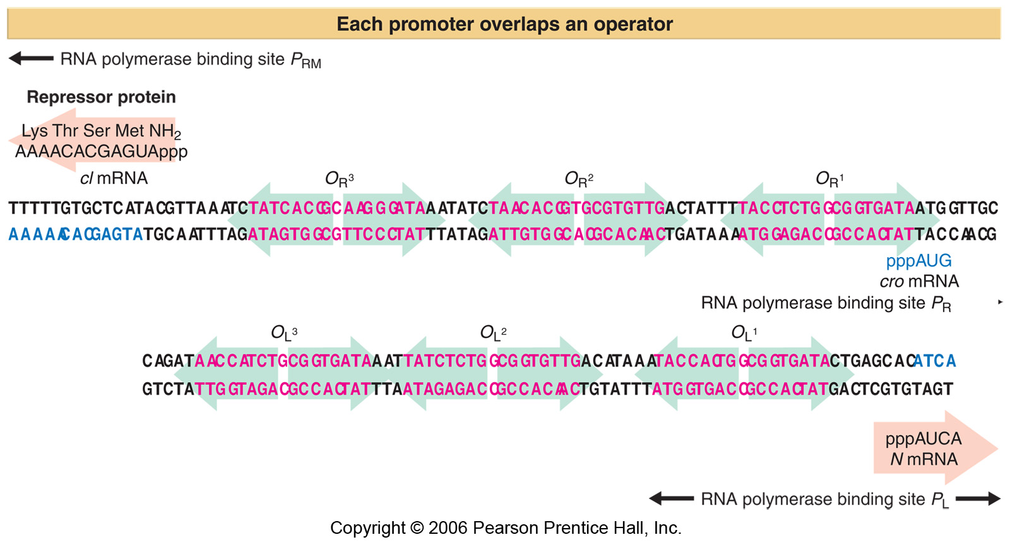
The orientation here is opposite that in previous figures
Notes:
OR is where transcription of cro starts, OL is where transcription of N starts. Each of Or and OL has three binding sites for c1 and they are acalled 1,2 and 3 with R1 being closest to the cro mrna and L1,2 and 3 where L1 is closest to the N mrna.
Repressor C1 has a differential affinity for these three sites on each operator, it has the highest affinity for the number 1 site which means at low repressor concentrations it’s the R1 and L1 sites that will be occupied first. And so c1 has lower affinity for r2 and L2 BUT when R1 and L1 are occupied this increases the affinity of c1 for r2 and L2 and this is called cooperative binding. And most of the time when c1 is made and we’re in lysogeny we’ll have L1 L2and R1 R2 occupied and ull only need to get very higher levels of c1 in the cell to occupy r3 and L3.
If you look at the top you’ll see that the Or3 and Or2 are not too far from the PR promoter and what happens is that the Prm promoter isn’t really liked by the rna polymerase however when a repressor is bound to OR2 the repressor will make contact with the polymerase and hence it stimulates transcription from the PRM promoter and so then the repressor molecules accumulate to the point that Or3 becomes occupied and when that happens the repressor bound to Or3 will impair transcription from Prm. And so this mechanism maintains repressor levels at a very defined finite level.

Slide 13
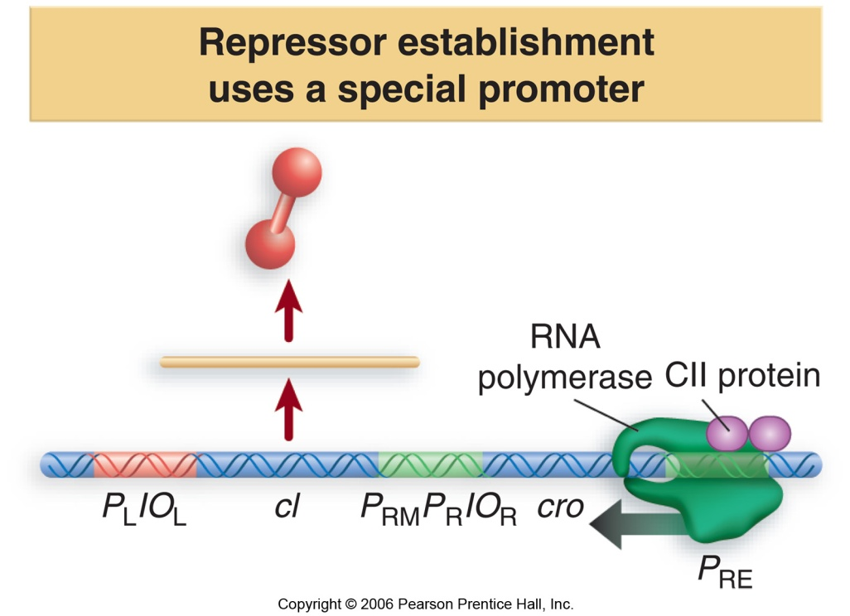
Notes:
But How do you start expression of the repressor? This happens through the Pre promoter. This promotor is only going to work once the polymerase is bound by cII repressor, cII is expressed in the dealyed early phase, and this is why we say the immediate and dealyed early phases are important for lysogeny because u need to make cII inorder to start transcription from PRE.
Cro is expressed in immediate early phase and it is also called the anti repressor because it antagonizes c1 but it is also a repressor. Cro differs from c1 in 2 respects:
Cro prefers R3 to R2 to R1 whereas C1 prefers R1 to R2 to R3. so the relative affinity for these three sites the opposite. So what happens when cro binds to R3? It blocks transcription of c1 from the PRM promoter.
cro has 8 to 10 fold lower affinity for the sites than C1 so if there is same concentration of cro and C1 in the cell than c1 will when.

Slide 14
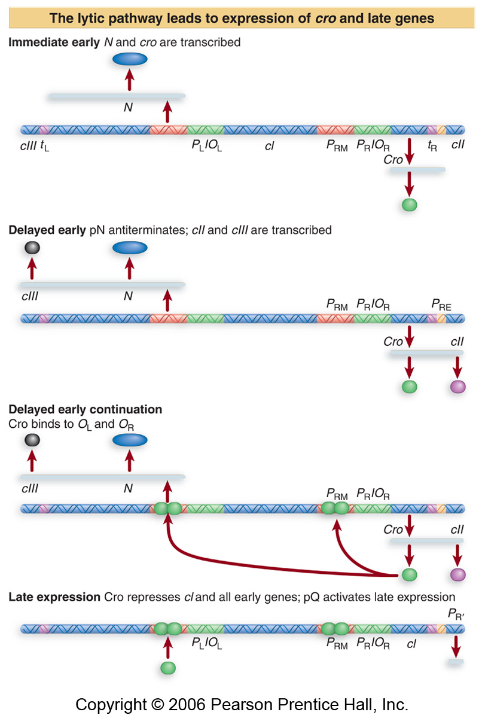
Notes:
In immediate early phase, u make cro and N and when N accumulates the terminators are ignored and hence cIII and CII are made and then cro will go and bind at PRM and PR and PL and then it will shut down everything, and we enter late expression phase, and we make new proteins and the bacteria will lyse.

Slide 15
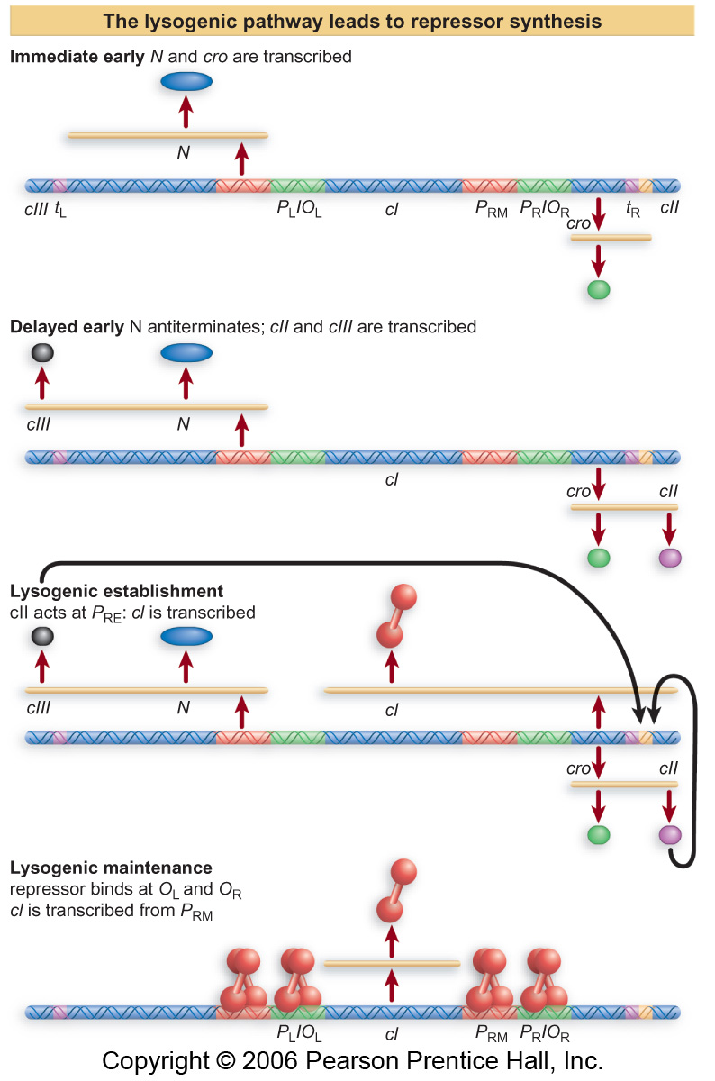
Notes:
IN lysogeny it is the same up to the point where CII goes and binds to the PRE and stimulates transcription of CI. The CI mrna s in antisense (complementary) to the cro mrna. So this actually antagonizes the translation of the cro protein, and so this is another way for CI to win.
Once it’s bound near PRM then transcription will be stimulated.

Slide 16
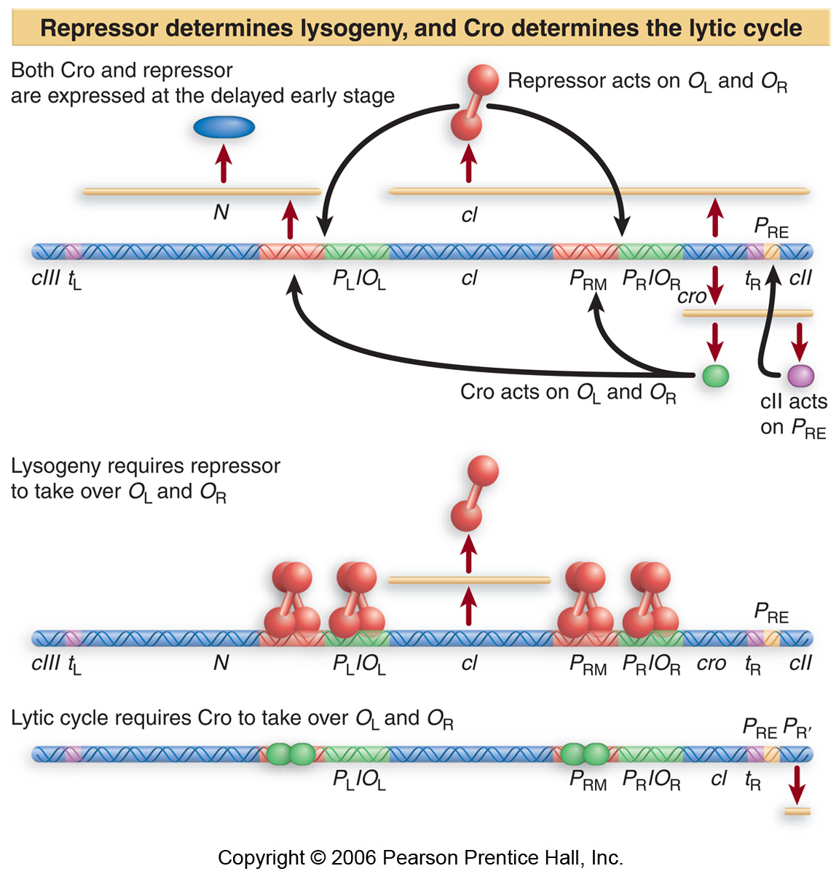
Notes:
How do you have one pathway winning over the other? When cro wins the war, there is no C1 expression because cro is bound to OR3 and it blocks transcription of c1 from prm and you’re going lytic, and when C1 wins the war ur going lysogenic. This is the antagonizing affect between cro and ci.
On pg 7 of notes in middle phage adopts the lysogeny lifestyle most of the time. Phage will go lytic when the situation for the bacteria is very good or extremely bad and will go to lysogeny when things in the bacteria are going moderately bad and so its just gonna sit there with it’s dna in the chromosome and then when it gets better it’s going to go lytic.

Slide 17
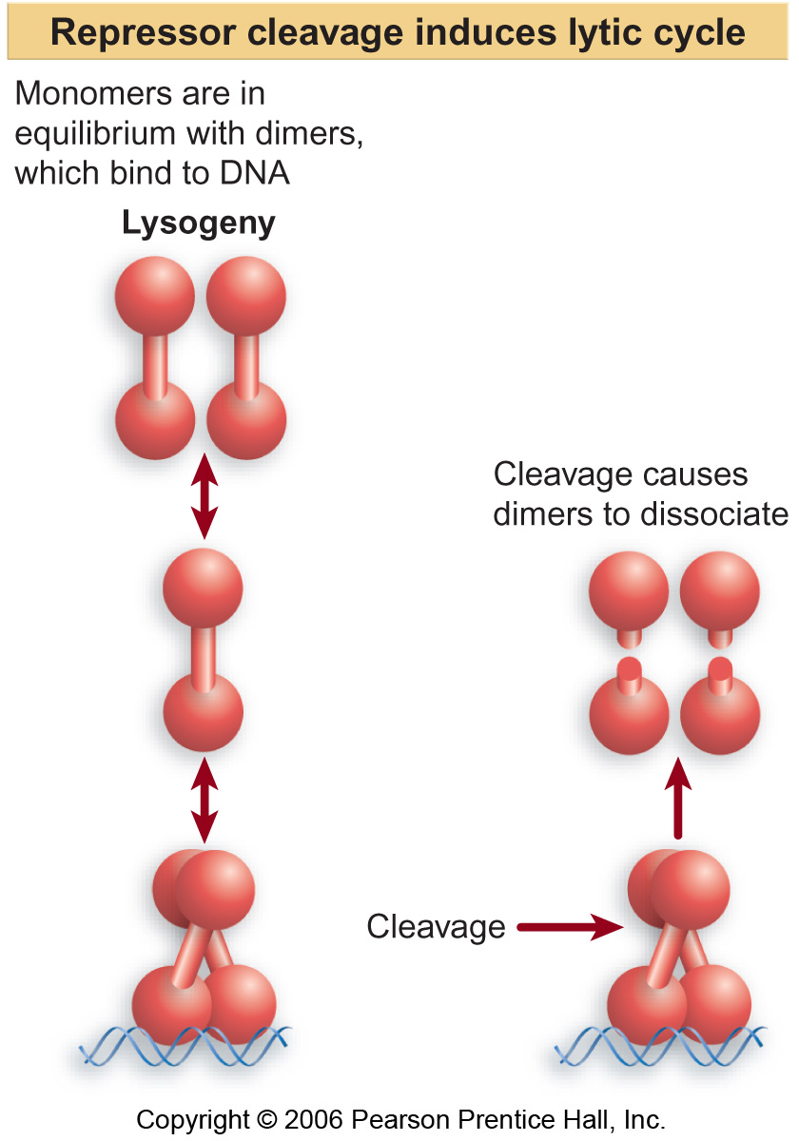
Notes:
There are proteases in the bacteria that will destroy cII and if cII is allowed to accumulate enough so that it stimulates PRE and then c1 will be transcribed and CI will win. And as soon as CI is able to stimulate transcription we’re going to lysogenic. These proteases that destroy CII are more active in bacterial cells that are growing in rich media and so there will be never enough CII to stimulate transcription from PRE and so the cell is going lytic.
If things were very bad for the bacteria: there is an SOS response that is activated and some of the genes of the sos response code for proteins that will break this connector between the dna binding domain and the dimerization domain and u can no longer make dimers and because binds as an obligate dimer there is no ci bound to the sites and so cro will when the war and so the phage or bacteria go lytic.

