Slide 1
Regulation of gene expression in Prokaryotes.
8 November 2013
Notes:
We will look at how organisms regulate gene expression to make proteins at the right time and right place, if you’re making a protein that is not needed it could have detrimental effects on the organism and it is a waste of energy. Yeast has about 6000genes and it is not necessarily using all of them at the same time only when needed. So sometimes when function of certain protein is needed u are gonna have a lot of expression and when that function is not needed than little or no expression is seen.

Slide 2
Positive and negative control: two ways to achieve the same goal.
Positive Control: Genes under positive control will only be expressed when an activator protein is present.
Negative control: Genes under negative control are expressed unless a repressor protein is present to block their transcription.
Notes:
Control at the level of transcription, question on exam about distinguishing between positive and negative control. Both methods operate in different ways but both achieve the same goal.
In positive control genes the default expression level is low.
In negative control genes the default expression level is high.

Slide 3
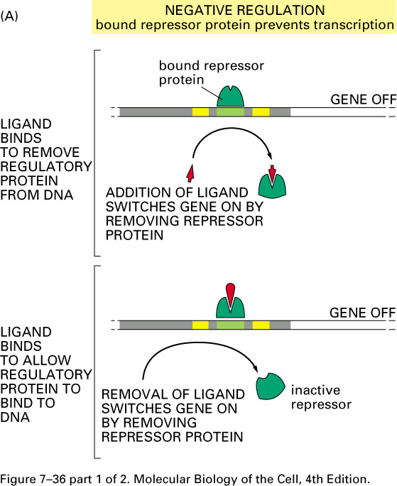
Notes:
Here you have the promoter region of the gene and in the presence of the repressor the gene will be off ( very little expression).
In the first case the repressor is bound at the operator and in the presence of a ligand( a small molecule that can bind the repressor) it binds the repressor and changes it’s affinity to the dna and hence the repressor will detach from the dna and expression of gene hence goes up. And this small ligand that causes the detachment of the repressor is called the inducer.
In the second case the presence of ligand causes high affinity of repressor to dna and and hence binds to dna and causes expression to degrease, in this case the repressor is called a corepressor.
These genes are under negative regulation and hence their default state is high expression of dna.

Slide 4
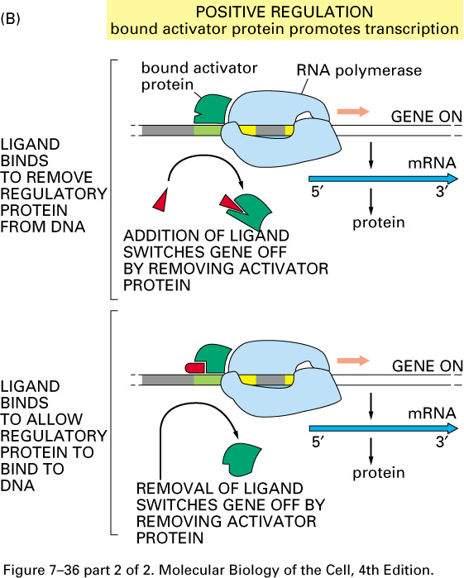
Notes:
This slide shows genes under positive control with default state of off expression.
In the bottom case; inorder for the activator to be able to bind to dna it needs the presence of a ligand ( also called the inducer).
In the upper case; absence of ligand will allow the activator to bind to dna and hence cause high expression.

Slide 5
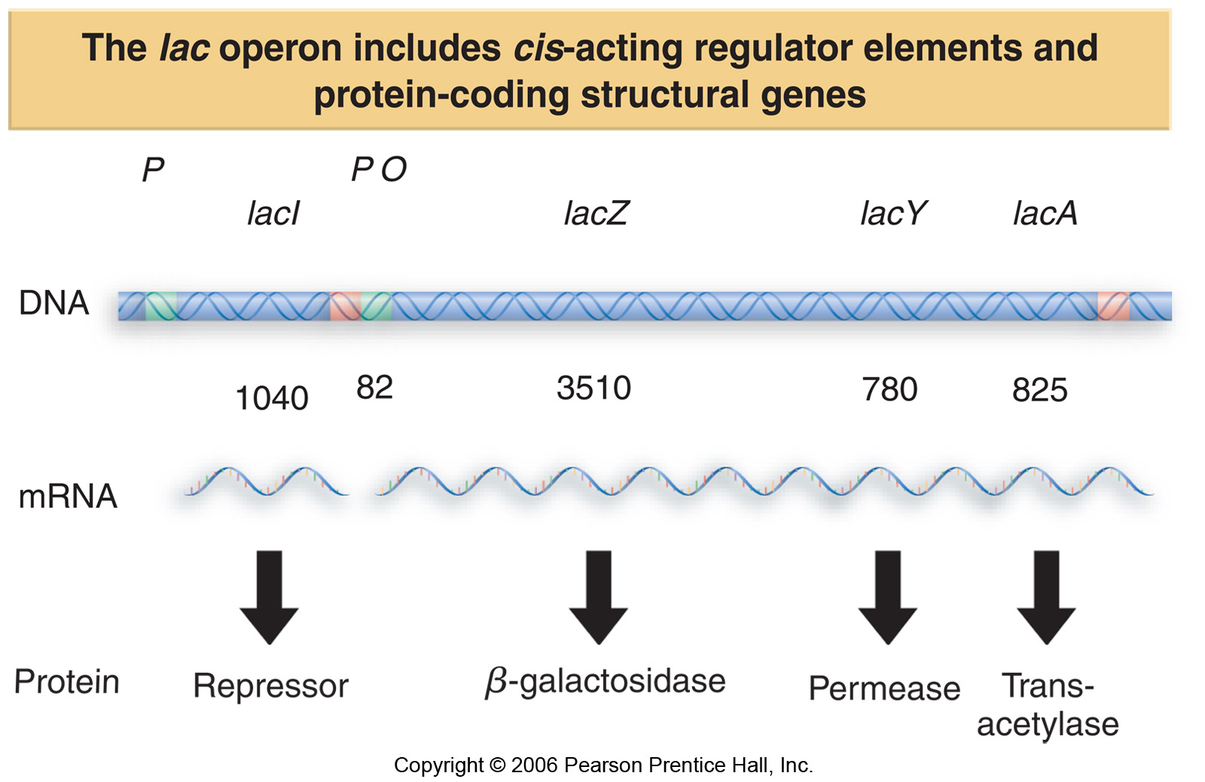
Lactose Operon
Notes:
Bacteria can grow using sugars as a source of energy; it prefers glucose however if there is no glucose it can use lactose. Inorder to do this it uses the lactose operon which contains three structural genes lac Z(codes for B-glactosidase),Y ( codes for permease) and A(codes for trans-acetylase). In addition to the three structural genes on the left you see Lac I gene which is a regulatory gene and codes for lac I repressor. The lac I gene is under weak constitutive (on all the time) promotor control.
Remember that mrna in bacteria can be polycisteronic each with their start codon and stop codon.

Slide 6
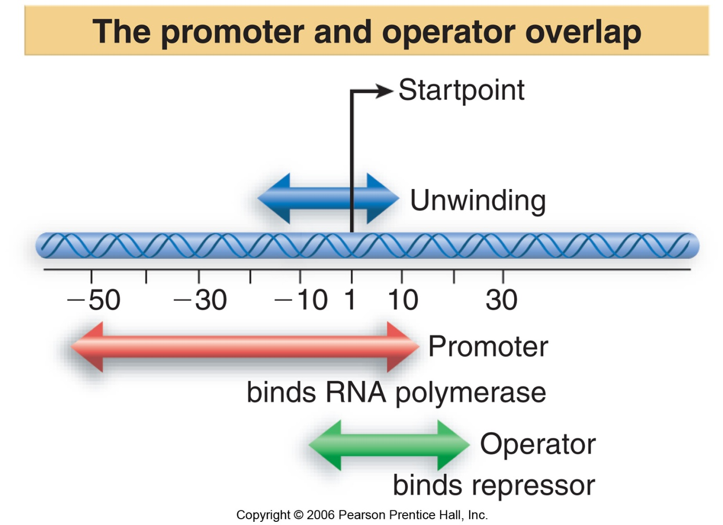
Promoter and Operator
Notes:
This is the promoter region of the lac operon; the start point is +1, and in green is the operator region (where regulatory proteins bind) so this is where the repressor is going to bind and when it does it will block transcription of the operon.

Slide 7
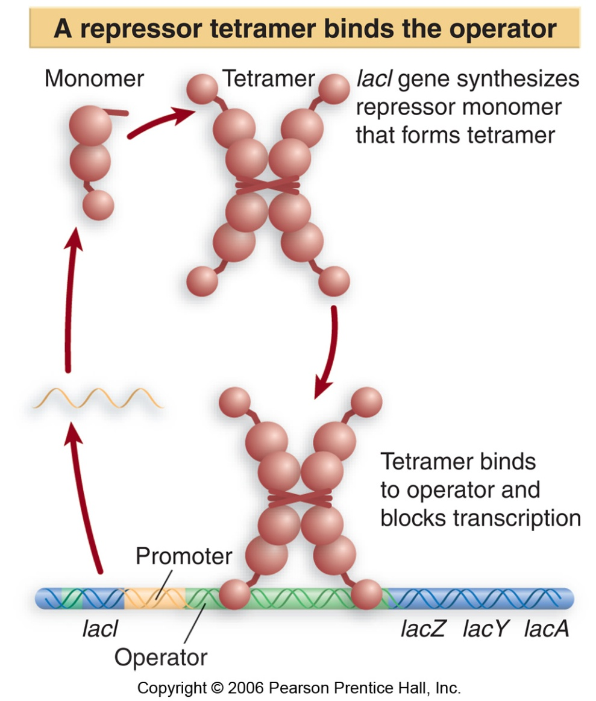
Lac Repressor
Notes:
The lac repressor is a tetramer, and at the bottom u can see that two molecules that bind to the operator of dna and causes transcription to be off.

Slide 8
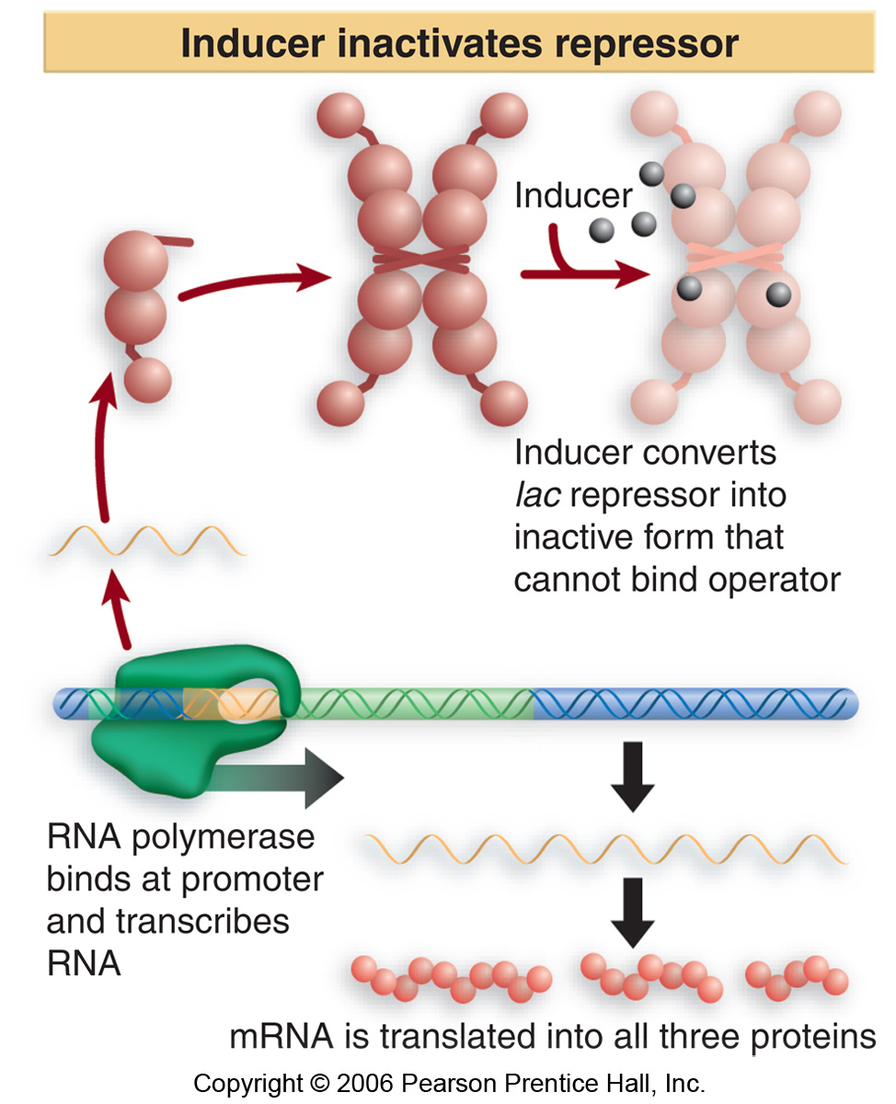
Notes:
In the presence of the inducer alo lactose, it will bind the repressor and cause it to no longer be able to bind to the operator and so the gene is transcribed and hence all the structural proteins are synthesized.
Lactose operon is under negative control.

Slide 9
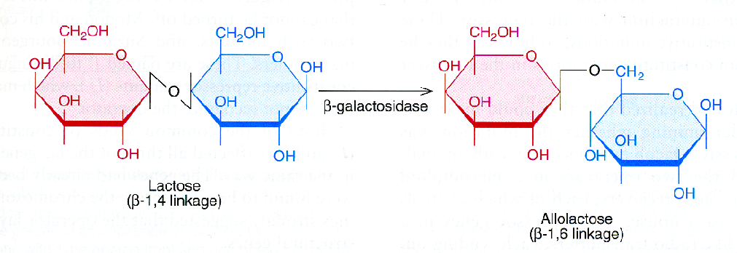
Allolactose is a side product in the β–galactosidase reaction
Notes:
Don’t need to memorize this.

Slide 10
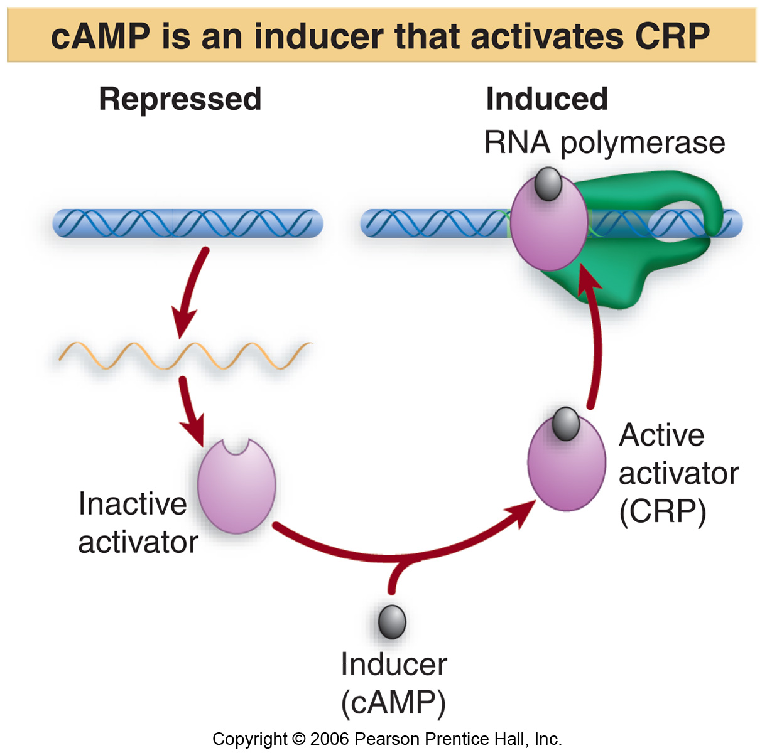
Notes:
If there is glucose bacteria will use it as a source of energy. When glucose is present bacteria will shut down all the genes that are not necessary for them. CAP is actually an activator but it can only bind to the dna when the ligand cAMP is present. So when cAMP is present it will activator the activator CRP which will bind to dna polymerase and stimulate transcription. When glucocapse concentration is high CRP concentration is low, and when there absence of glucose there will be high enough levels of cAMP to activate CRP? and cause expression of lac operon. So in this case the gene is under positive control. So this gene is under both negative (repressor example) and positive (inducer) control.

Slide 11
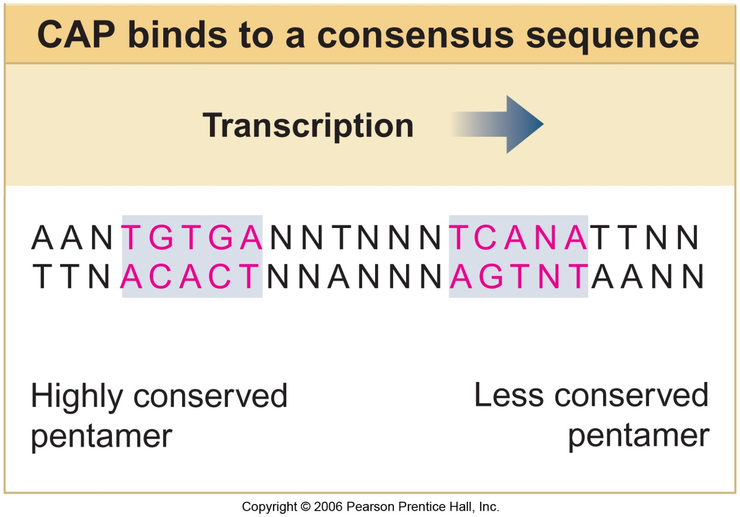
Notes:
1) CaP is a protein that binds dna at a specific sequence(all activators and repressors bind to specific sequences) and the target sequence for CAP is an imperfect palindrome; it has 5 nucleotides and has same another 5 nucleotides on the reverse strand but here there is N which can be any nucleotide (hence imperfect).
2) Another rule for proteins is that they have their favourite sequence but their affinity is not absolute (they will be choosy)

Slide 12
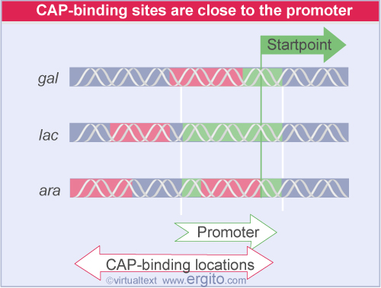
Notes:
Bacteria will make sure that genes that are used to utilize sugars glactose, lactose and arabinose contain cap/CRP-binding sites and are only expressed when there is low glucose concentration.
The same regulator CAP can control the expression of different genes (property of regulators)
U can have one or more binding sites for the regulator within the gene.

Slide 13
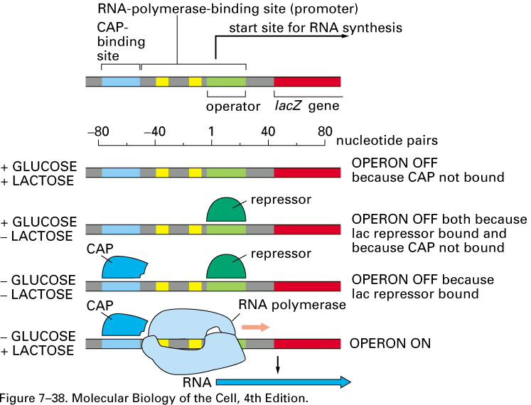
Summary
Notes:
There is always a few question on the final exam so study this and understand this well. The binding site for the represssor is in gerren and that for CAP is in blue. Remember if there is glucose in medium the bacteria will not use lac operon.
If there is glucose lac operon is not used and so camp is low and so CAP is not bound and because there is lactose than there is alolactose and so repressor will be off and because cap is not boudn the operon is off.
if there is glucose, camp is low and CAP is not bound but absence of lactose causes absence of alolactose which means repressor is bound and so operon is off.
if there is no glucose and no lactose, the camp levels are high and so CAP is activated and so is bound and the alo lactose levels are low and hence repressor will bind to dna and hence operon will still be off.
low glucose causes high camp levels which causes CAP to bind and presence of lactose causes absence of alo lactose which means repressor is detached and hence rna polymerase is bound and the operon is on.

Slide 14
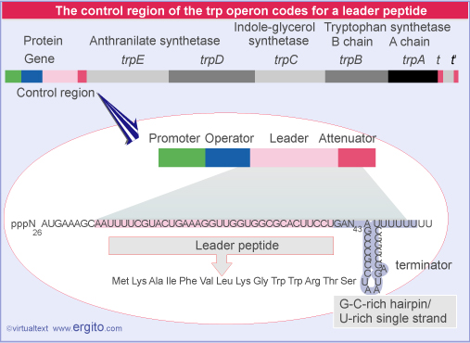
Notes:
This is a tryptophan operon, bacteria can synthesize all amino acids however when some of these are present in the media, the genes that are used to synthesize them will be off.
The trp operon is a polycistoronic mrna that will code for 5 different structural genes, there is a control region bolown up here, it contains the promotor where rna pol will bind to transcribe, the operator which is a binding site for the repressor, coding region that codes for the leader peptide, followed by attenuator sequence.
The bacteria will control this operon with 1) repression 2) attenuation.

Slide 15
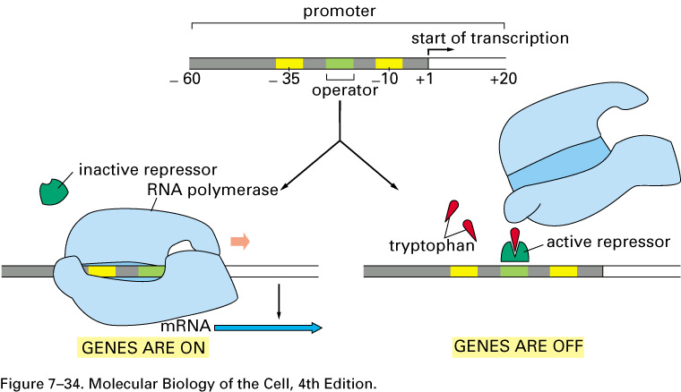
Repression of the tryptophan operon
Notes:
In the presence of an active repressor it will bind to the operator and polymerase is not able to bind and transcribe. The main difference between here and lac operon is that the repressor requires a corepressor instead of an inducer, the ligand tryptophan in red binds to the repressor inorder to be able to bind to dna in the case of lac operon it was the opposite; in the absence of allolactose the repressoror was bound.

Slide 16
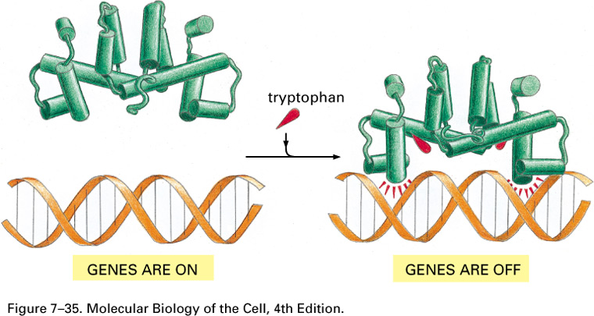
Tryptophan induces a conformational change of the repressor
Notes:
This shows that ligand tryptophan binding causes conformation change in repressor and hence it is able to bind dna.
If there is tryptophan in the media than the bacteria will not need to synthesize it and hence the operon is not transcribed.

Slide 17
Notes:
The second method is attenuation control .
Remember:
In bacteria transcription and translation can occur simultaneously.
Binding of ribosome to the shine delgarno sequences is independent to one another.
The leader region is transcribed and translated, it does not code to any protein, it is just a participant in the regulation mechanism.
The leader peptide codes for an amino acid sequence, notice that it codes for two consecutive trp codons.

Slide 18
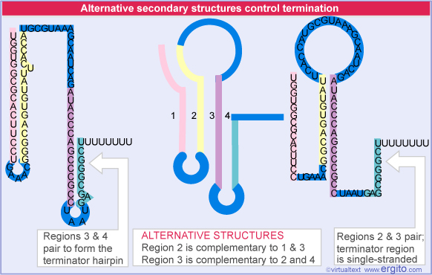
Attenuator Region in the tryptophan operon
Notes:
Regions 1234 can participate in base pairings to form stem structures, it can do it in different ways as shown above.
The pairing of region1 with 2 and pairing of 3 and 4 creates the terminator hairpin, and hence termination of transcription.

Slide 19
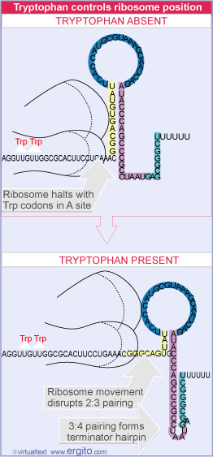
Notes:
Transcription of the operon starts and the leader is made, translation begins, and the ribosomes try to synthesize the leader peptide and why will happen next depends on concentration of trp in the cell.
If the trp is little, none will be loaded on trna and so trna can’t bind to a site of ribosome, and so ribosome will pause at the place where there is two trp codons in the leader and this causes region 2 to pair with 3 and rna polymerase will transcribe the rest of the operon this is possible because there are many shine delgarno sequences and hence ribosomes can bind despite that there is one already stalled.
However when trp is present region 3 pairs with 4 and the transcription terminator is created and hence transcription stops.
In the absence of trp the polymerase is able to transcribe the entire operon, in the presence of the trp the pol will encounter the hairpin and detach.

Slide 20
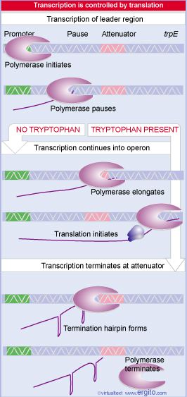
Notes:
don’t need to remember the number of folds caused by repression and induction.

Slide 21
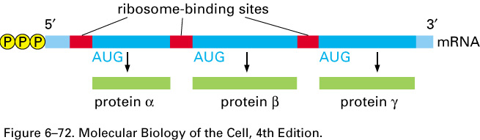
Polycistronic mRNA in bacteria
Shine-Dalgarno sequence: AGGAGGU

Slide 22
END

Slide 23
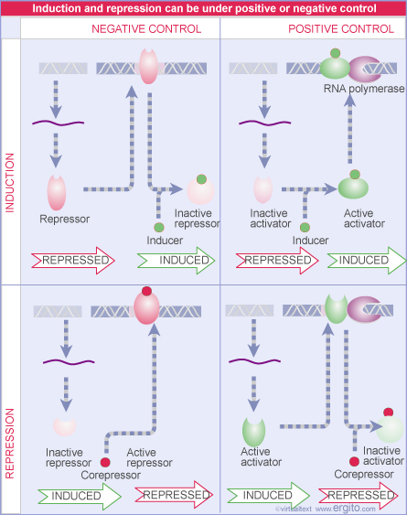

Slide 24
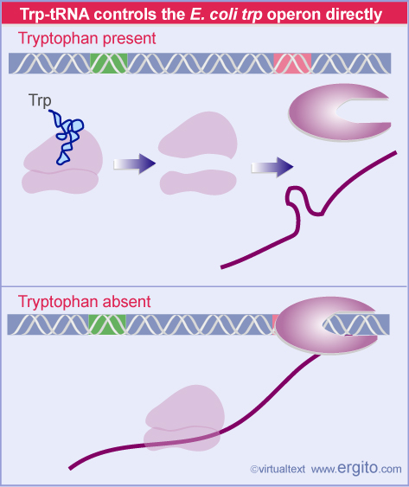

Slide 25
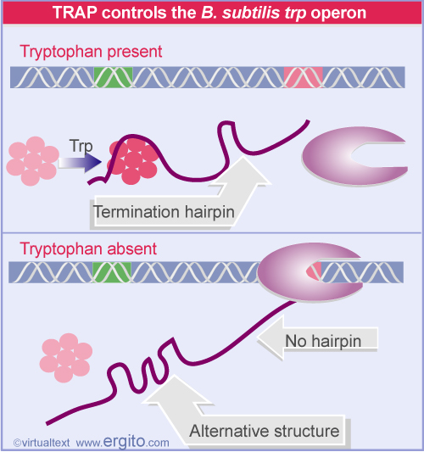

Slide 26
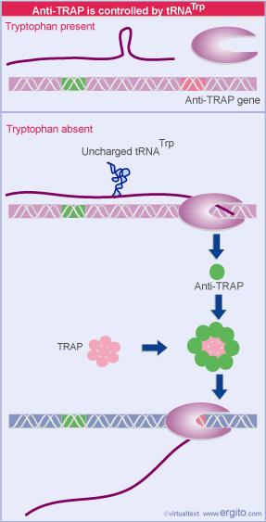

Slide 27


