Slide 1
Regulation of gene expression in eukaryotes III.
26 November 2013

Slide 2
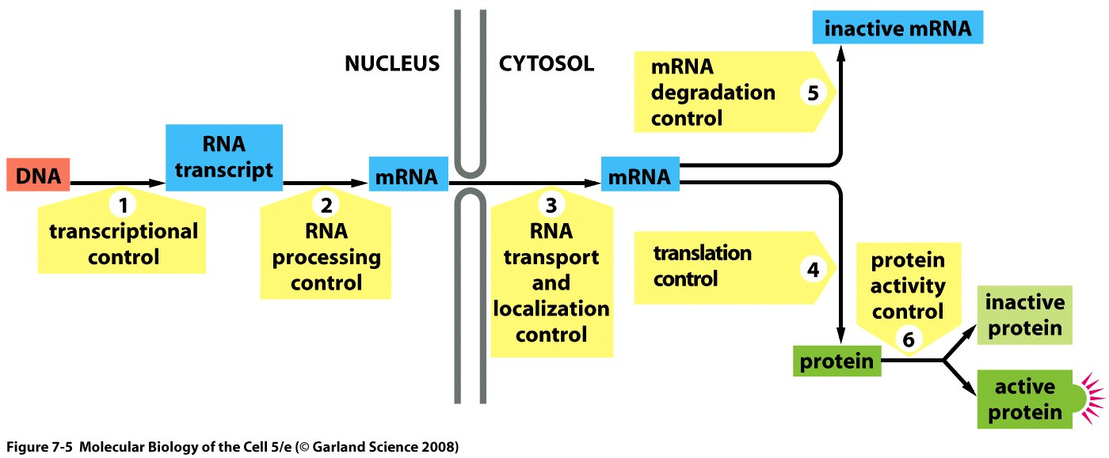
On overview of regulation of gene expression in eukaryotes
Notes:
Today we talk about Control mechansims that effect RNA processing and transport.

Slide 3
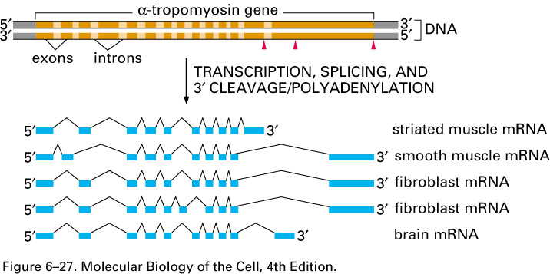
Alternative splicing
Notes:
Here is an example of an a-tropomyosin gene, and depending on the type of cell u are in will use different exons and hence this is an example of alternative splicing. So u can see how many proteins we can create from one mrna precursor.

Slide 4
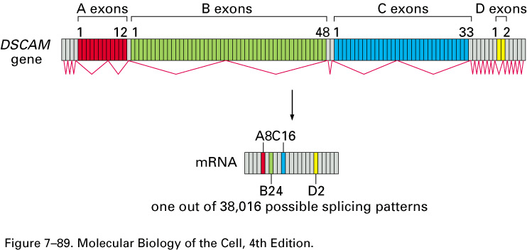
A complex alternative splicing (!)
Notes:
There are four different scenarios

Slide 5
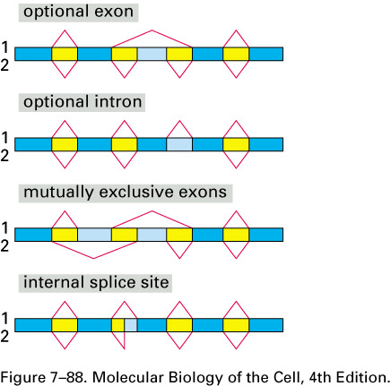
4 scenarios for alternative splicing
Notes:
The reason for this is because the sequences are consensus sequences and there are splice sites that will match the conseus sequences and others that will not match very well and this will make a difference in whether the splice site will be used or not.
Blue is found in the mature mrna and if box is yellow it will never be found in the mature mrna and if box is light blue it may or may not be found in the mature mrna.
The first scenario is called the optional exon, in option 2 u have 4 blue boxes and one light blue box, however option 1 you have 4 blue boxes only.
the second scenario is the optional intron; if we splice as in option 1 we end up with 5 exons and option 2 we have 5 blue boxes and one light blue and this is called the optional intron cz the light blue sequence sometimes behaves as an intron.
the third scenario is the one in a-tropomyosin and is called the mutually excluesive exons; it is when u can either use this light blue box as an exon or this one but never both of them and never neither of them it’s always one or the other. In the first option the the the first light blue box will be in the mature mrna and in the second option the second light blue box is in the mature mrna.
in the fourth scenario called the internal splice site; where in possiblityis 1 and 2 we use the same 5’ splice site but different 3’ splice site.

Slide 6
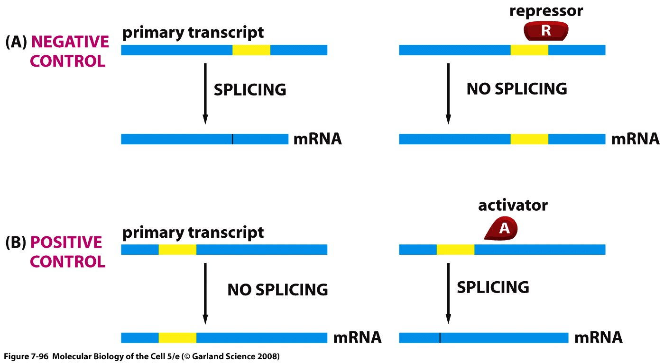
Positive and Negative Control of Alternative Splicing
Notes:
Alternative splicing can be split into two catigories: constitutive and regulatory. In the regulatory one the use of some of the splice sites will either be improved or repressed depending on what proteins bind to it.
In this slide->
Regulated alternative splicing: we can use proteins that can either repress or activate splicing;
A) so proteins with an negative activity will cause no splicing to occur and so the mature mrna will contain the yellow box and in the absense of this repressor protein the splicing will occur and the yellow box will dissappear.
B) The activator causes splicing and in the absense of the activator the site is not recognized as a good splice site and the no splicing occurs.
Constitutive: whether or not a splice site will be used will be influenced by how good or bad this splice site is but it will not change in different cells types. So it is only dictated by how good of a splice site it is.
Why does this occur?
We can control what the proteins in a given cell type will be and this can be done by regulating the alternative splicing mechanism.

Slide 7
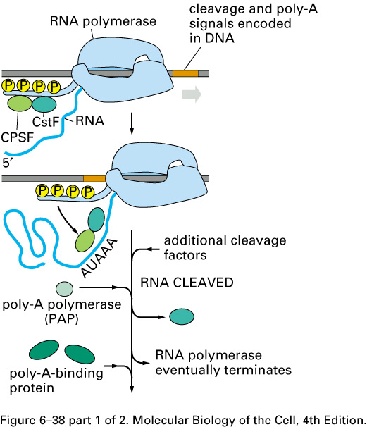
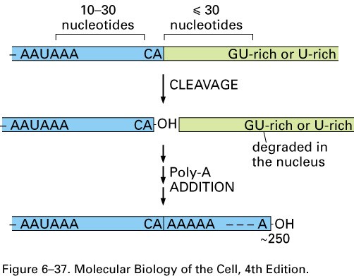
Polyadenylation.
Notes:
This is a real life example. This is to remind us the the mrna is cleaved before it is polyadenylated and this process needs CSTF and by playing on the actifity of this protein we can control.

Slide 8
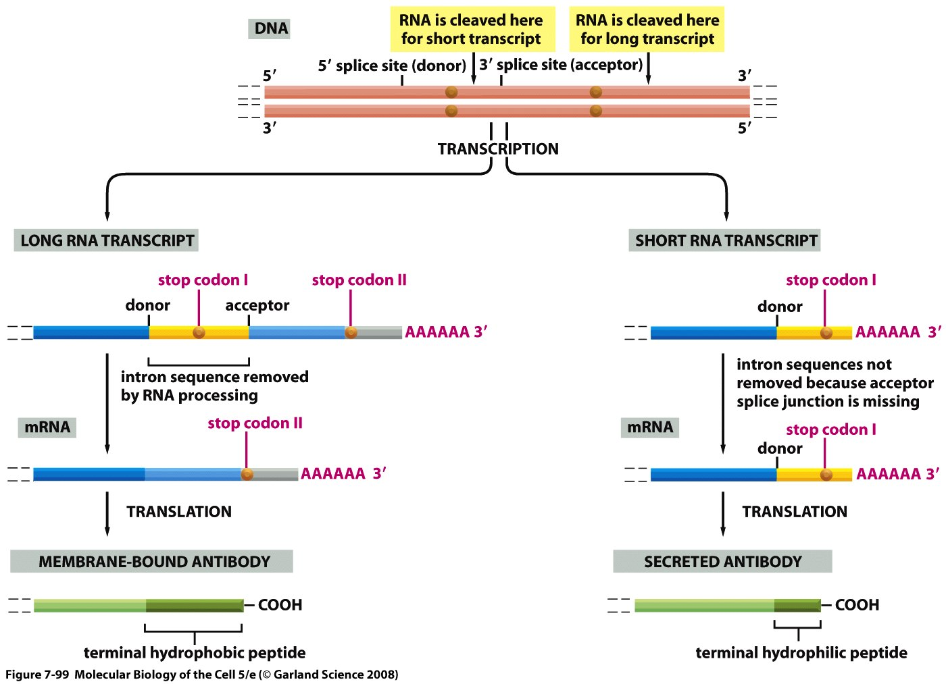
Control of cleavage + polyadenylation in antibody secretion
Notes:
The top part shows us the structure of this gene and we see a number of splice sites and two possible cleavage sites and what happens is that this cleavage site is not a good one so when CSTF is limited the first cleavage site is ignored and cleavage occurs at the second cleavage site, and we end up with the light blue region in the mature mrna which has a hydrophobic region and hence we end up with a membrane bound antibody.
However when the B lymphosyte is stimulataed it causes CSTF amounts to increase which leads to cleavage at the first cleavage site and hence the yello sequence is incluede in the mature mrna and this region is hyrophilic and hence this will create the secreted antibody.
Therefore by controlling cleavage of the mrna we control whether a membrane bound or secreted antibody is produced.

Slide 9
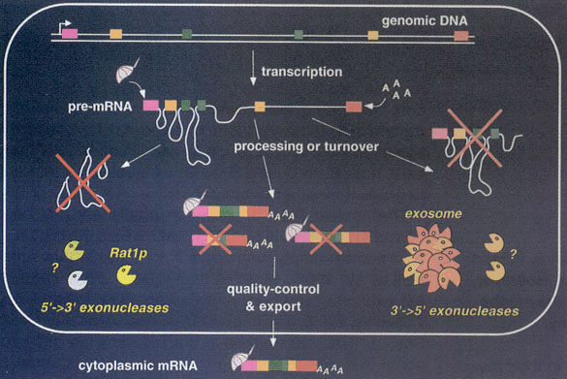
Notes:
Before mrna is exported to cytoplasm a number of quality control steps that occur. If mrna is not capped and polyadenylated the exonucleaseas will come and degrade the mrna.

Slide 10
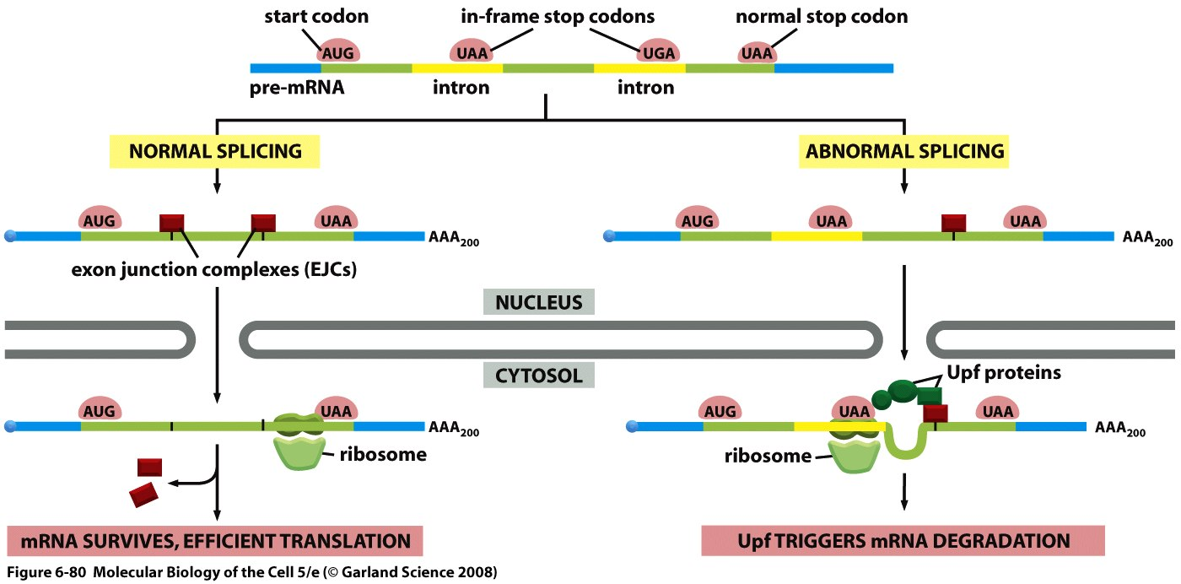
Nonsense-mediated mRNA decay
Notes:
A special case of qyality control that takes place right before mrna leaves nucleaus to go to the cytoplasm. This mechansim of nonsense- mediated mrna dacay evolved to get rid of splicing errors. We noticed that the stop codon is always in the last exon and this due to this mechanism and so this mechansim is a proofreeading mechanism and it involves a trial run of translation at the moment mrna wants to leave the nucleaus.
In this slide we see a precursor mrna there are a couple of introns and they contain in frame introns and then there is the normal stop codon in the last exon. During normal splicing the introns will be spliced out and when this happens there are exon junction complex proteins that will bind to the junctions and when this mrna leaves the nucleus the ribosome will translate and as it moves along it kicks out those EJCs and then meats the stop codon. .
In abnormal spling the first intron is not spliced and when the mrna will undergo the trial run of translation in cytoplasm the ribosome will stop at the in fram stop codon and will cause Upf to bring in the decapping proteins that will remove the cap of this mrna and the mrna will be degraded. So because the ribosome stalled at the stop codon before it reached the EJC Upf proteisn come and bind and cause degradation.

Slide 11
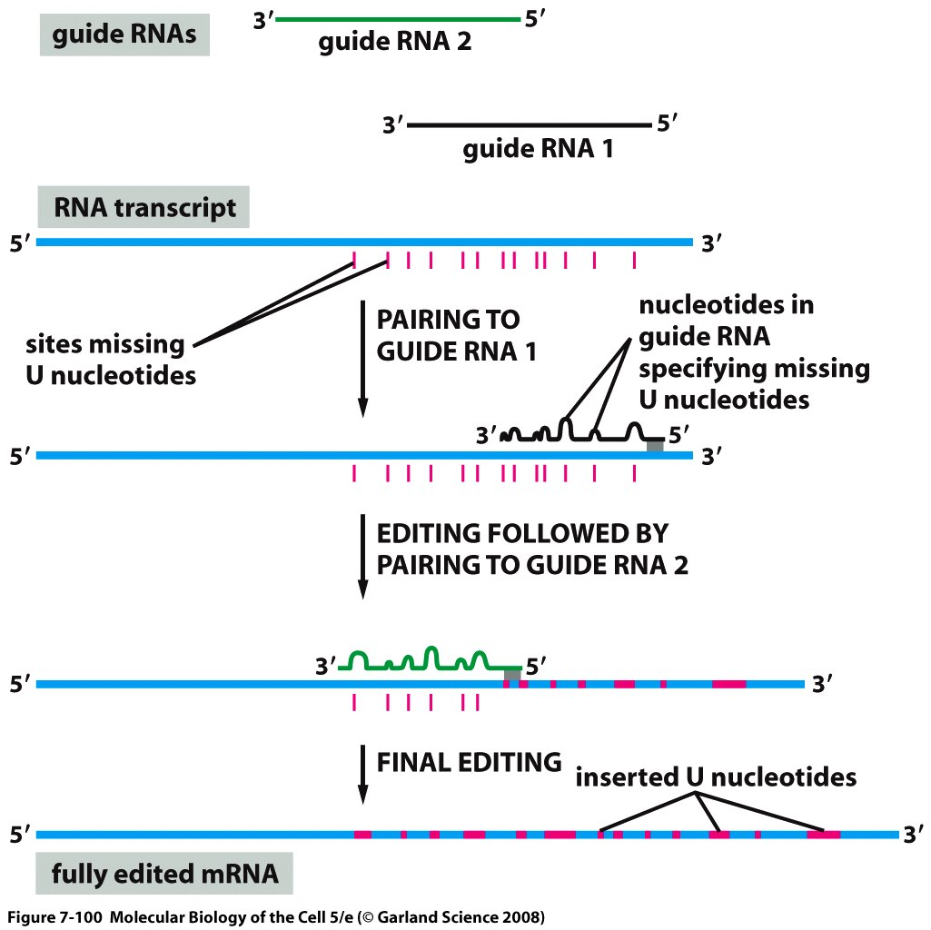
mRNA editing
Notes:
Mechansims that will edit your mrna. There are rare instances where the mrna could be edited and they can be divided in two categories and the first one is mrna editing that acts in the mitochondria and that is the one that we will describe today.
In this mrna editing that happens in tripanosomes in mitochondria, what happens is that there are alot of U’s added or sometimes removed in the precursor mrna which affects the sequence and hence protein means. The pink parts are the sites where editing will occur and this editing requires the help or assistence from guide rnas and several of them can be involved on the same rna. And when there are more than one guide rna the first one to act is the one that is binding closer to the 3’ end. Once it’s done the second guide will do the editing and the mature mrna will look like this.
the complementarity is not perfect!

Slide 12
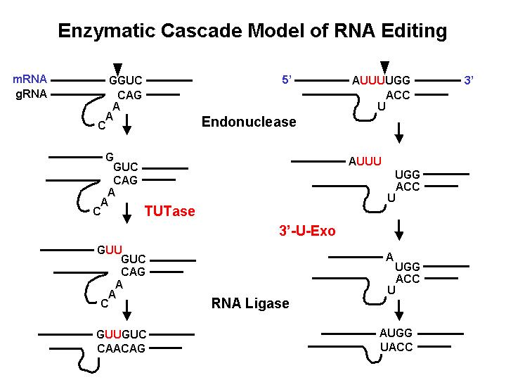
Notes:
Nucleotide adding on the left and nuleotide removal on the right. Here we see the base complementarit betwen the mrna and grna and once grna is bound to the mrna an endonuclease will cut the first bound 5’ to the last base that is complementary and the cut is shown here. The second enzyme to act is the terminal uridynal terminase and willl add U’s such that it will be complementary to the A’s in the grna. And once it has added the U’s a third enzyme rna ligase will glue together the two ends as shown here and then there will be good complementarity between the grna and the edited mrna. The mechansim by which u remove u’s is similar, it starts with endonulcease cutting at the first noncomplementary base and then it will remove U’s until it reachtes the next nucleotide which will be complementary to that in the grna and this is done by 3’ – exonuclease. And then the two ends are joined together by dna ligase.

Slide 13
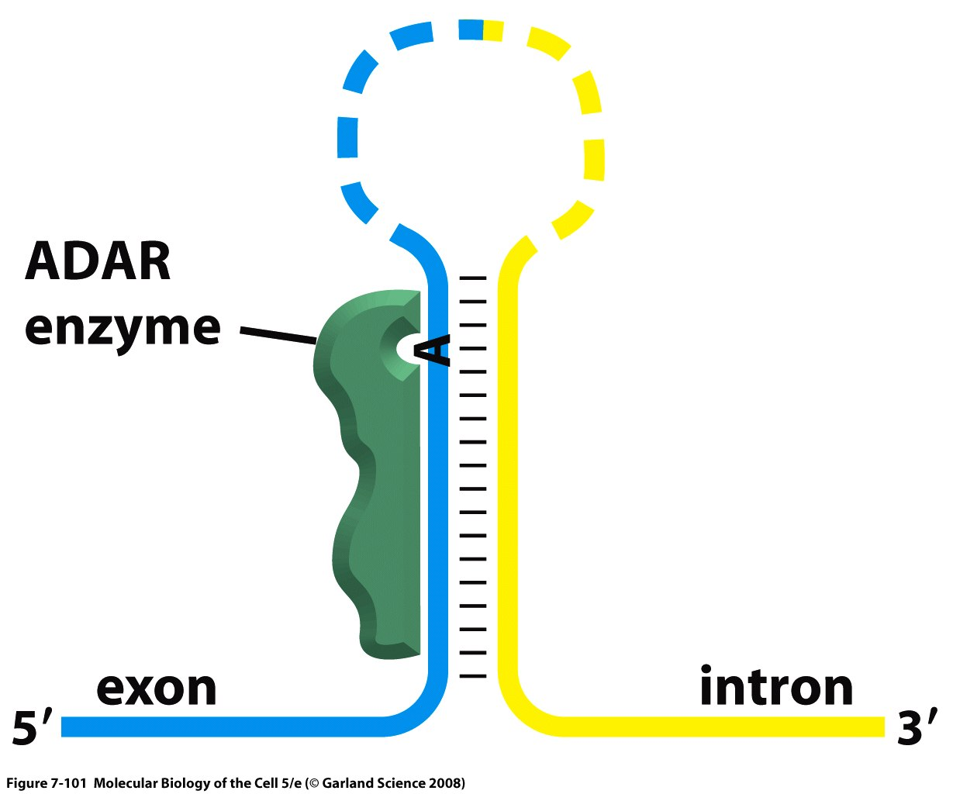
Adenosine Deaminase Acting on RNA
Notes:
This is extremely rare but when know that this rna editing can have big consequences. Here there are two editing mechanisms known as the deamination of A into and I and the other one is the deamination of a C nucleutide into a U. the one depicted here is the ADAR and the way this enzyme works is that it recognizes the secondary structure of rna and it will attract the ADAR enzyme and what it wil do is change this A into and I and because of Wobble pairing it can change the amino acid that is encoded by the mrrna. We know this is important because we identifide the genes coding for ADAR enzyme and when u do an knockout experiment in mice u end up withe mice that have epilipsy because one of the mrnas that this ADAR works up codes for glutamate.
Remember that this editing with ADAR affects a very small percentage of mammalian genes.

Slide 14
On overview of regulation of gene expression in eukaryotes
Notes:
Now we talk about mrna transport and localization in eukaryotes. RNA’s can localize to special areas in the cell depending on the need of the cell for this protein.

Slide 15
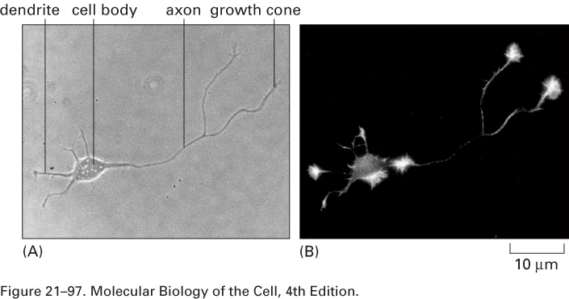
Accumulation of β-actin mRNA in neuronal processes
Notes:
For example the accumulation of B-actin mrna in neurons and we see the signals are found at the nerve endings preferentially and so if we need the proteins at the nerve endings the accumulation of mrna will be there.

Slide 16
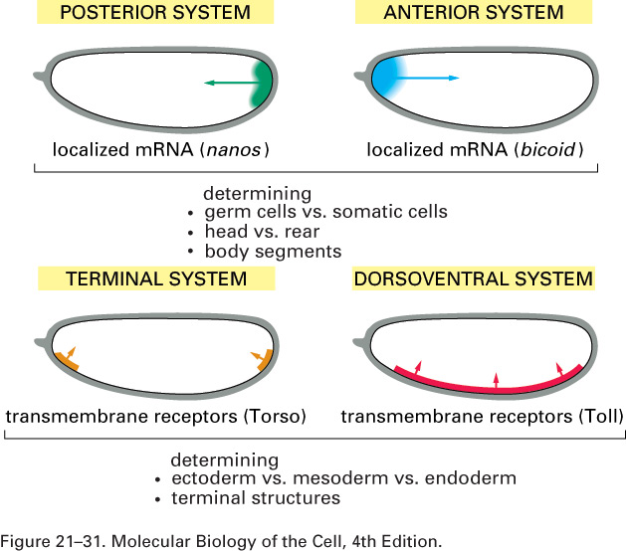
Polarized distribution during embryonic development
Notes:
Don’t need to remember any of this.

Slide 17
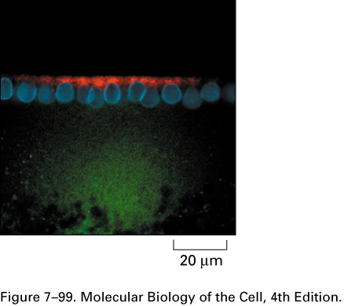
Importance of the 3’-UTR
(hairy gene, Drosophila)
with 3’UTR
without 3’UTR
nuclei
Notes:
There are specific sequences in the 3’ untranslated region will be important for the localization of the mrna. And in this experiment they synthesyzed the mrna for hairy gene to be flourescent and they mde one with a 3’ UTR and and without the 3’ UTR and the micrograph photos show that the mrna with the 3’ UTR will localize at the end however the mrna without 3’ UTR causes the mrna to be all over the place.

Slide 18
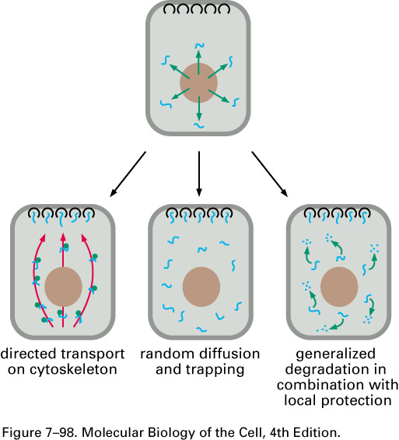
Three mechanisms to localize mRNAs
Notes:
This is the ways localization of mrna can take place. In the first one we use the proteins that are apart of the cytoskeleton which will interact with the 3’ UTR of the mrna and the mrna will travel along until it reaches the site of localization. The second one is a random distribution of mrnas. And in the third one shows that mrna’s are unstable and can be degraded but once the mrna is bound to thier target at the site of localization they are protected from degredation.

