Slide 1
Regulation of gene expression in eukaryotes II.
22 November 2013

Slide 2
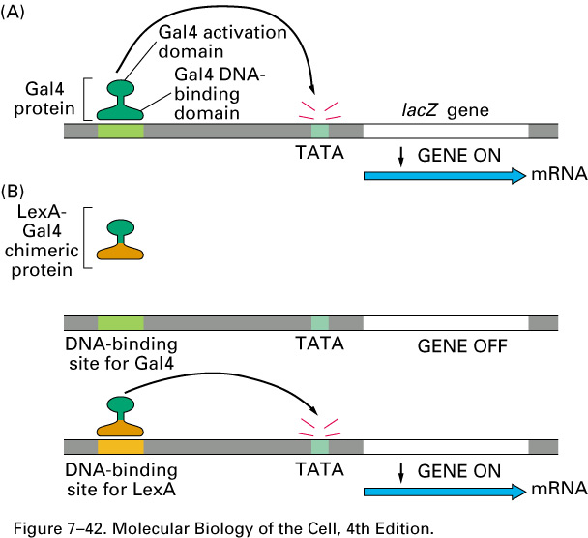
Modular nature of RDBPs
Notes:
Some general characteristics of RDBPs:
1) They are modular in nature; so the domains can be separated experimentally. This is an experiment used to do this. Gal 4 protein in yeast is a transcriptional activator; with the activation domain on top. Providing a dna construct and the Gal 4 protein will make Gal4 bind to its binding site and activate transcription. IN B they linked the activation domain of Al 4 linked to lex A binding domain; notice that that it will not bind to the gal 4 dna binding site and hence no transcription however if we use a similar dna construct with a lexA binding site instead it will bind to it and we will get beta glactosidase made. So this experiment shows that the domains can be seperated and linked together.

Slide 3
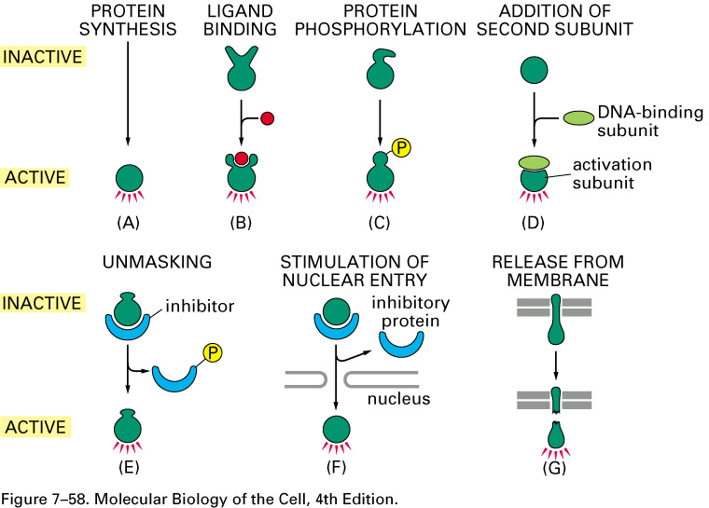
Different ways the activity of RDBPs can be modulated
Notes:
Some of these ways are shown here:
A protein synthesized and goes to nucleus and binds dna
B ligand activates proteins which than binds dna
C phosphorylation acctivates protein and hence it can exert it’s function.
D subunits must be assembled before RDBP can function.
E inhibitor is phosphorylated and hence detatches the RDBP and frees it to do it’s function.
F RDBP is made in cytoplasm than sequestered in cytoplasm by inhibitor and only once it is freed from inhibitor it can go to nucleus.
G RDBP is bound to memebrane and is sequestered there but then cell sends signals and cleaves RDBP and allows it to get to nucleus and accomplish it’s function.

Slide 4
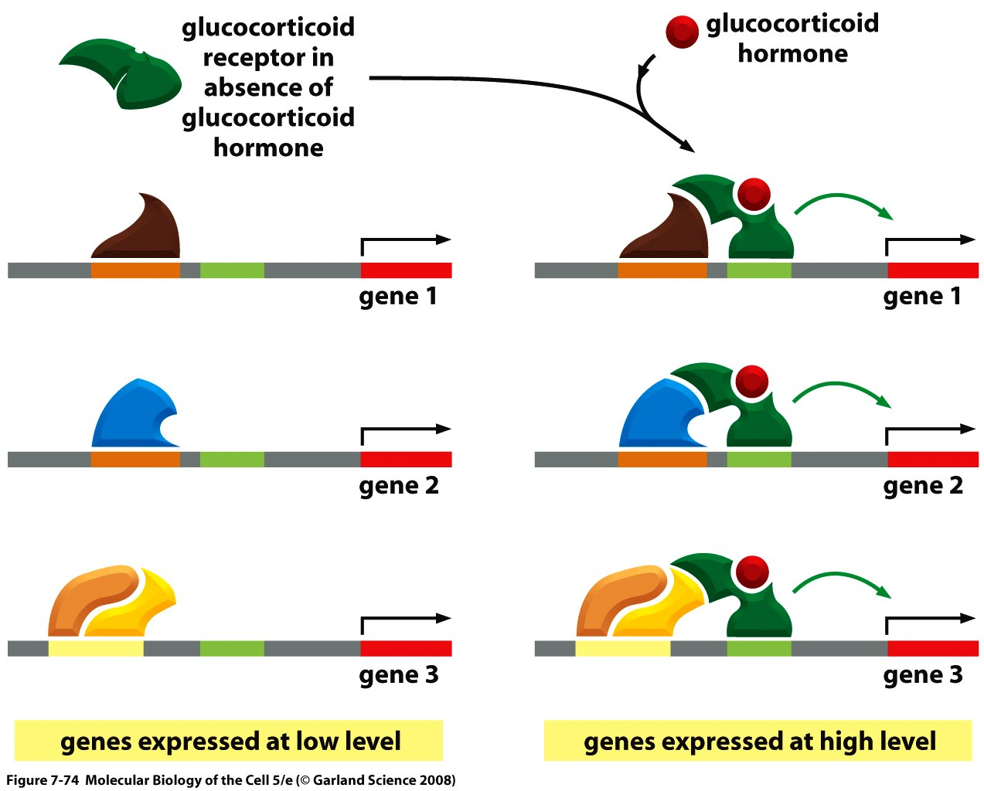
The same RDBP can activate multiple genes
Notes:
The various mechansims can be combined.
The Gr receptor is sequestered in the cytoplasm and upone ligand binding it is freed to go bind and accomplish it’s function.
Through interaction of other proteins it can further stimulate the target genes 1,2, and 3

Slide 5
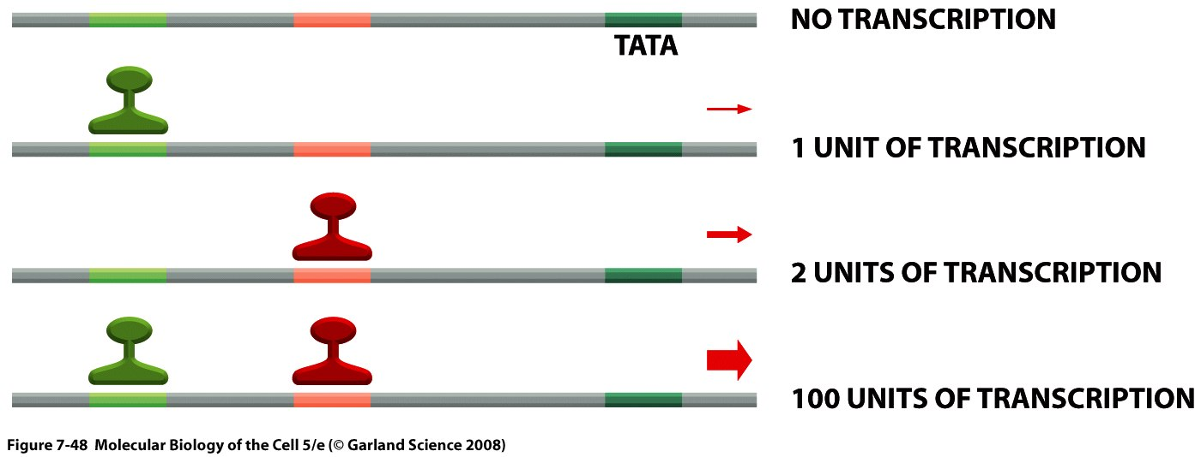
Additive synergy of activator RDBPs
Notes:
The whole is more than the sum of the parts.

Slide 6
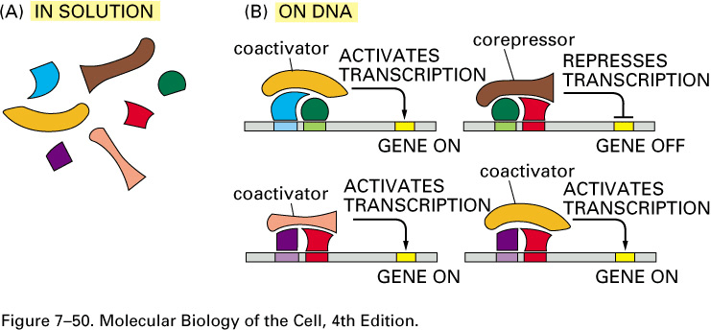
Fine-tuning of regulation involving RDBPs, co-activators, and co-repressors
Notes:
This slide is very schematic and illustrates a number of properties of RDBPs: heere we see that the green and blue proteins bound to their sites and it attracts the coactivator which activates transcription,
The red and and green proteins bound to their sites attract the co repressor and hence represses transcription.
So notice that the green protein can participate both in repression and activation.
At the botthom we see a similar situations but the different combinations bring about different levels of activation.
So the botthom line here is that with a small number of players we can generate a large number of pathways and mechanisms.

Slide 7
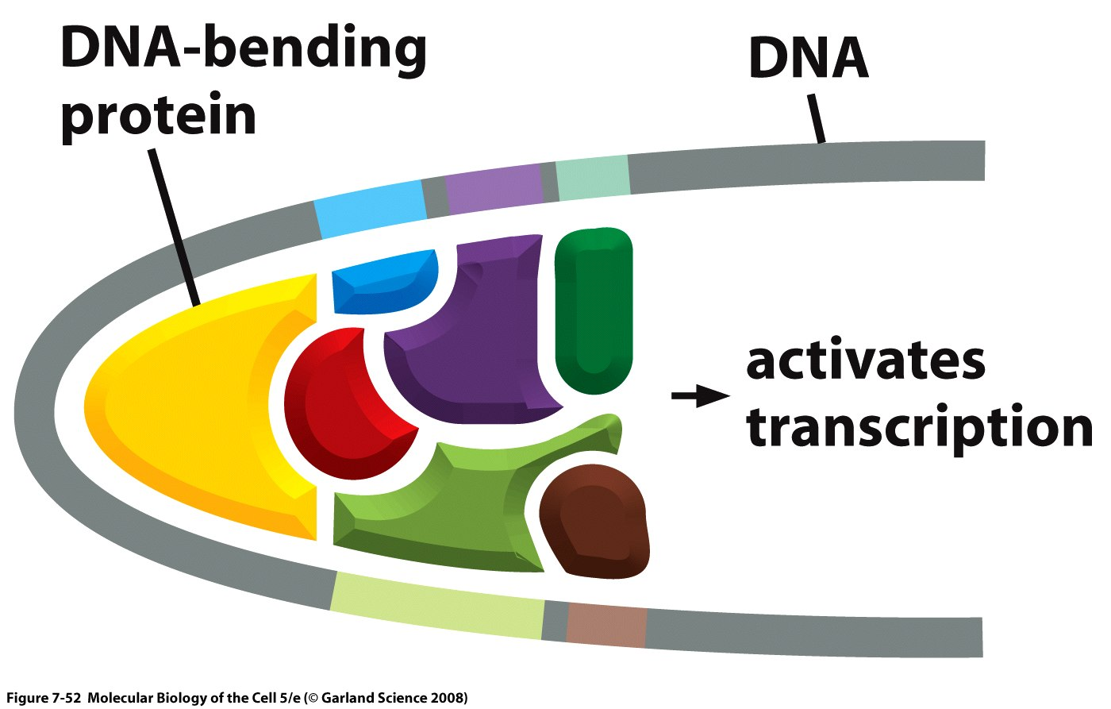
Global input involving the various RDBPs bound to an enhancer sequence
Notes:
There are proteins that exis and whos role is to facilitate this bending of DNA.

Slide 8
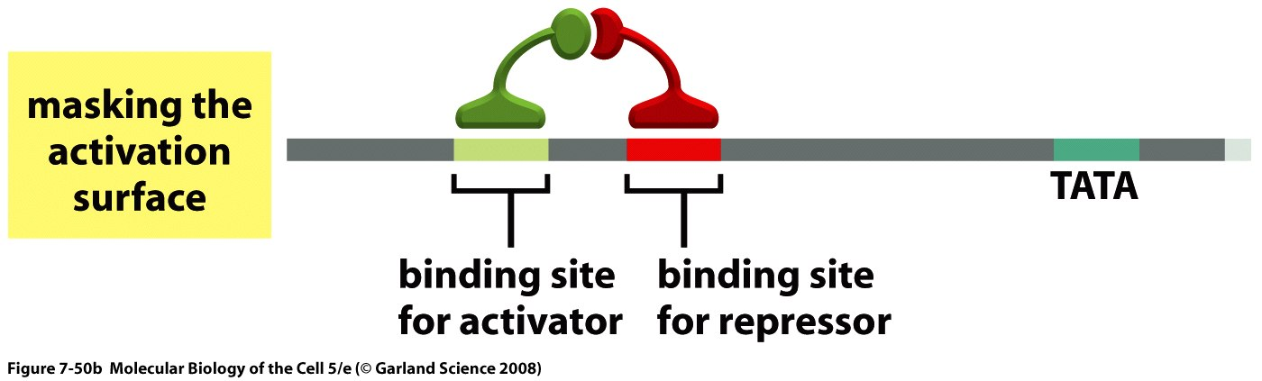
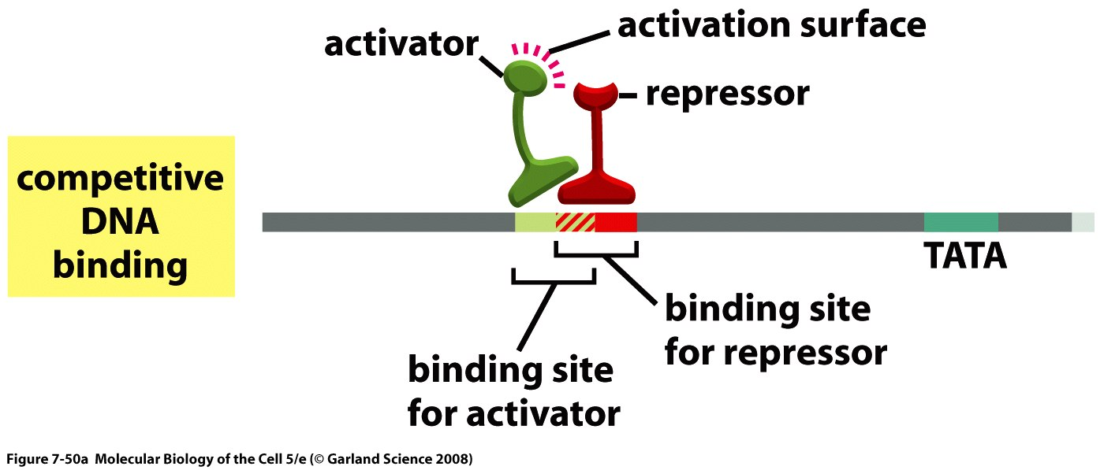
Repressor RDBPs reduce transcriptional activity in several possible manners.
Notes:
There are six ways by which repressor RDBPS can function.
On top the activator is bound to it’s target sequence and the repressor is bound to it’s target sequence. And the job of the repressor is to mask the activation domain of the activator. Such that the activator cannot activate.
On the bottom: the binding site of the repressor and the activator are very close together and binding of repressor to it’s target site will prevent binding of the activator to it’s target site.

Slide 9
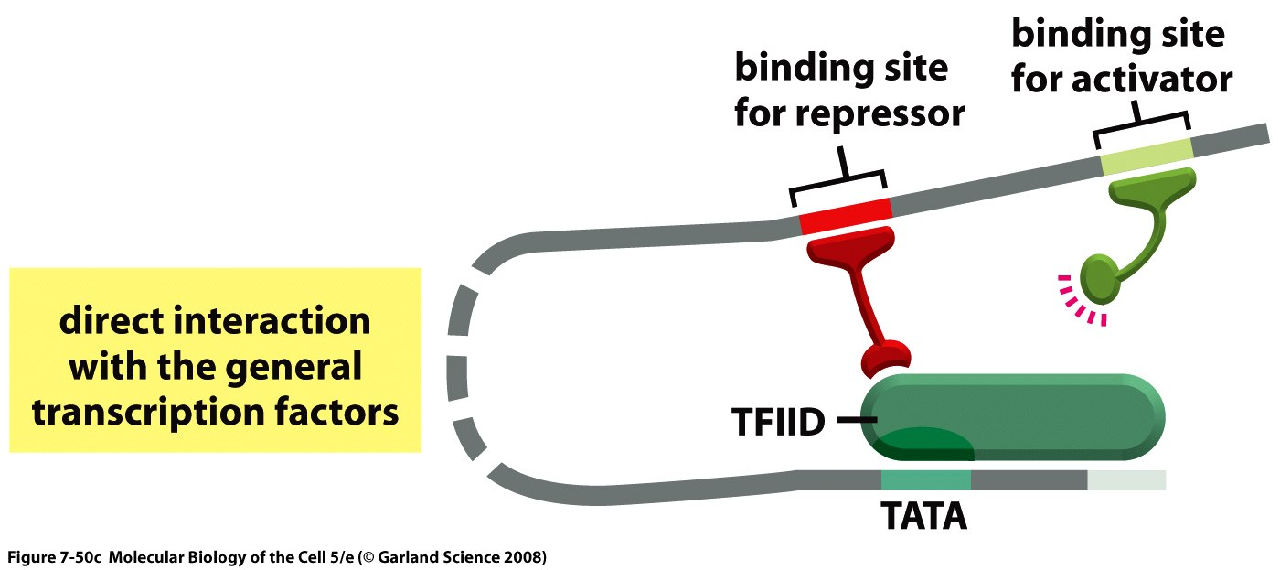
Repressor RDBPs reduce transcriptional activity in several possible manners.
Notes:
In mechansim three: once repressor is bound to it’s site it will interact with TFIID and hence competitively prevent the activator from interacting with TFIID to allow activation.

Slide 10
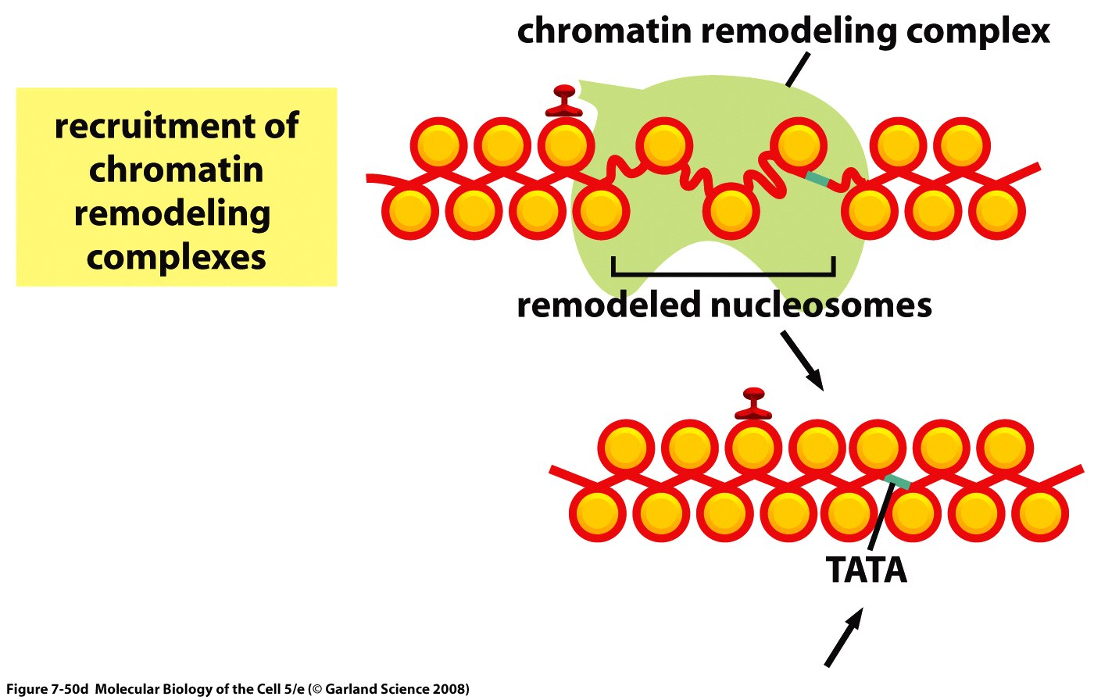
Repressor RDBPs reduce transcriptional activity in several possible manners.
Notes:
The fourth mechanism: the chromatin remodeling complex is brought I n and hence will modify chromatin in such a way that it is no longer available for transcriptional proteins.

Slide 11
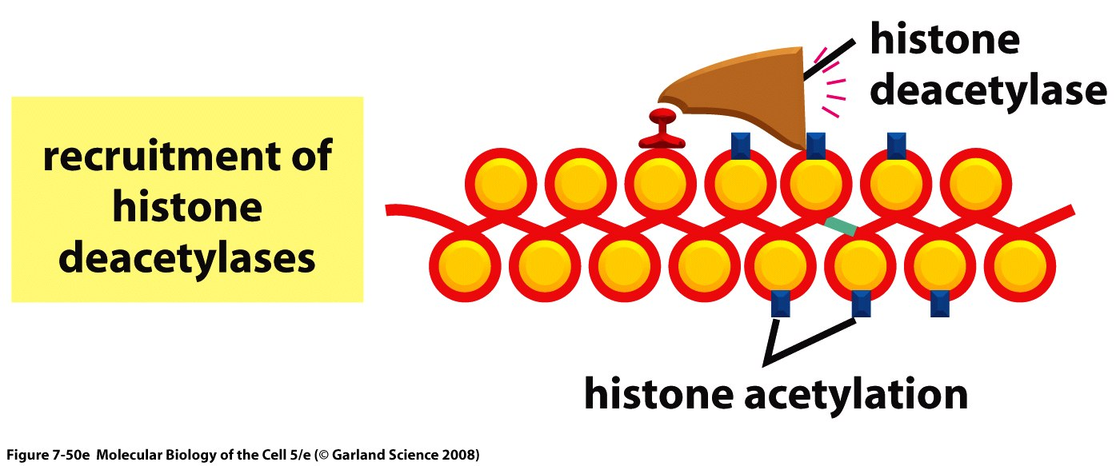
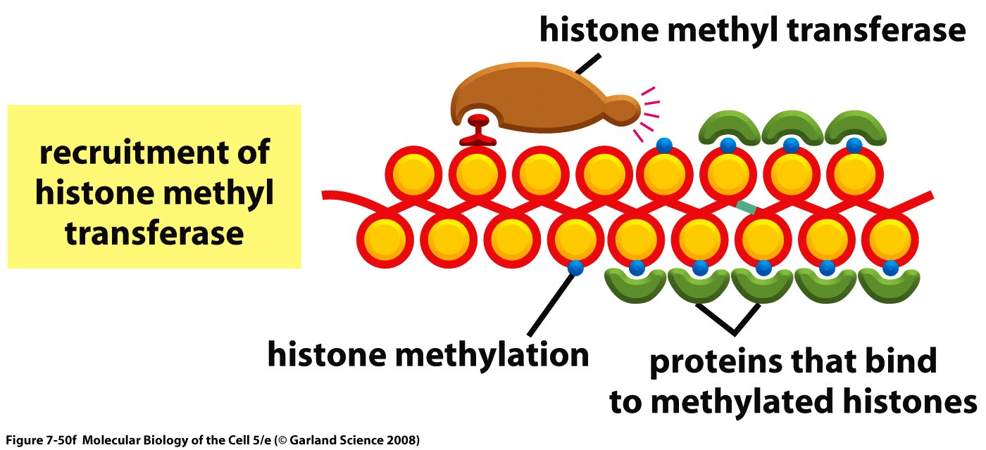
Repressor RDBPs reduce transcriptional activity in several possible manners.
Notes:
5:RDBPs attract histone deacetylase will remove acetylation and hence will make chromatin unfavourable for transcription.
6: RDBPs attract histone methyltransferase will methylate chromatin and unfavour transcription.

Slide 12
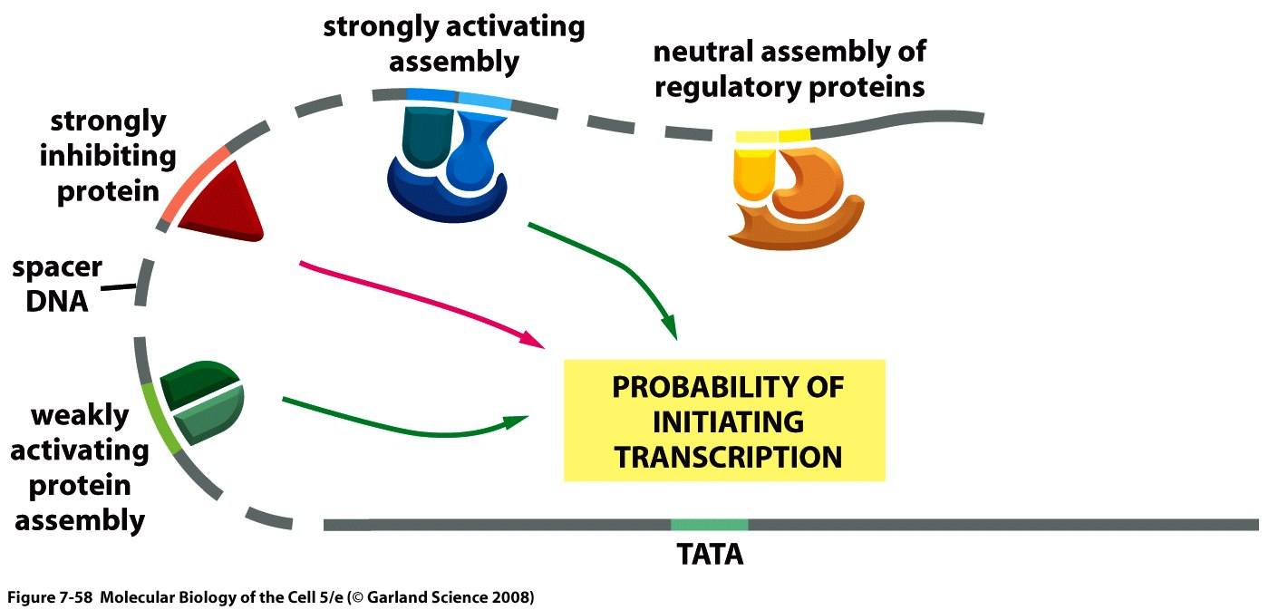
Integration of regulatory inputs at the promoter.
Notes:
The transcriptional macheniery will integrate all of the regulatory inputs provided by the regulatory proteins bound to their sites and come up with an output.

Slide 13
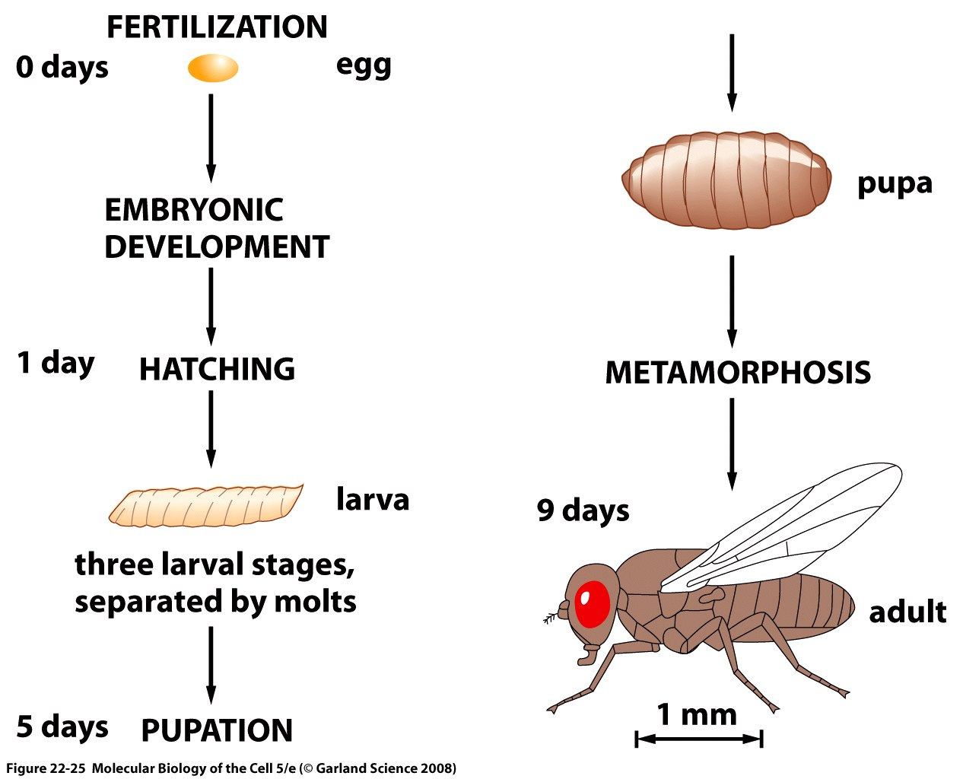
Notes:
Do not have to study.

Slide 14
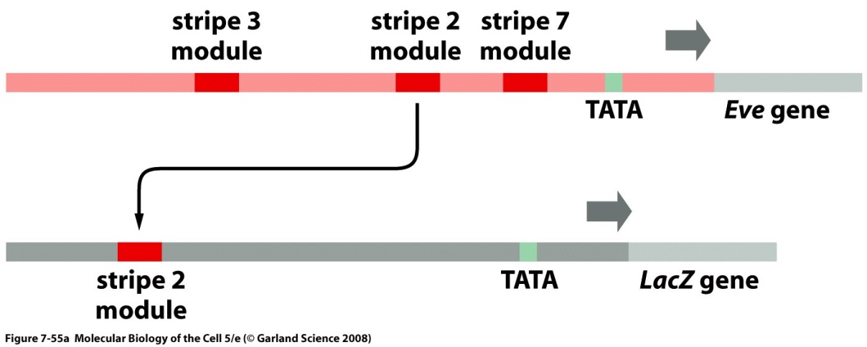
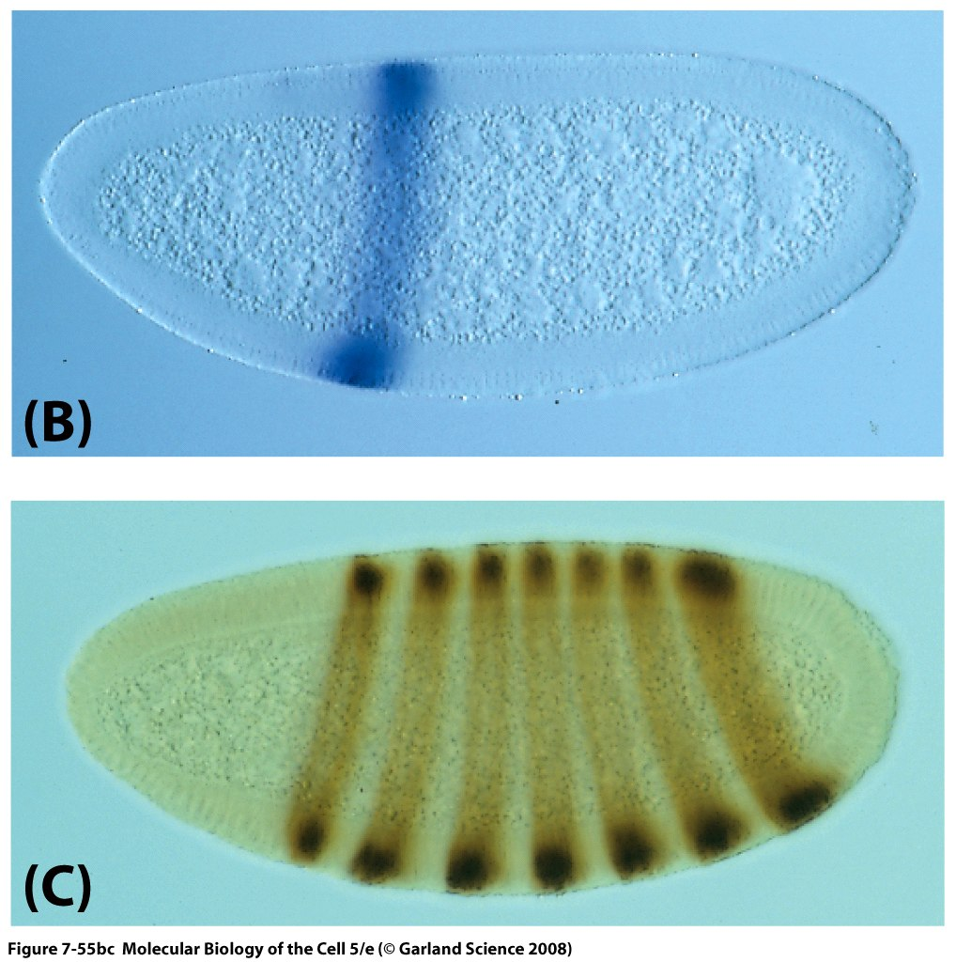
Stripe 2 module driving beta-gal
7 stripes of even-skipped expression
Notes:
Do not have to study.

Slide 15
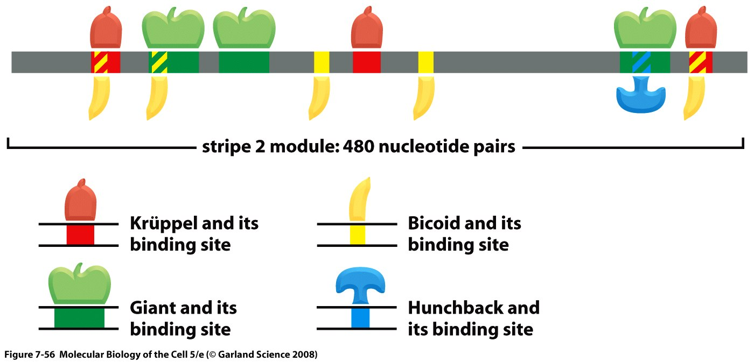
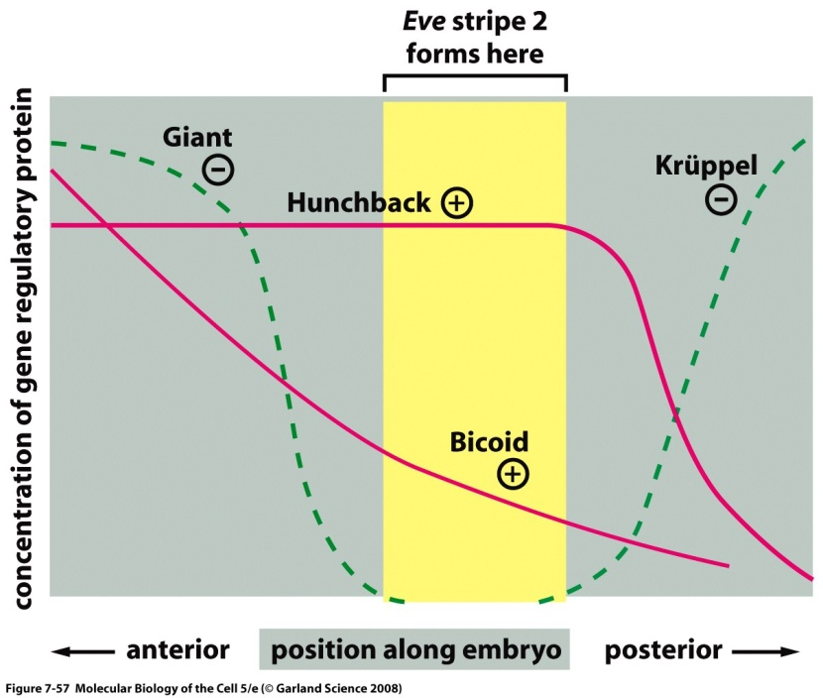
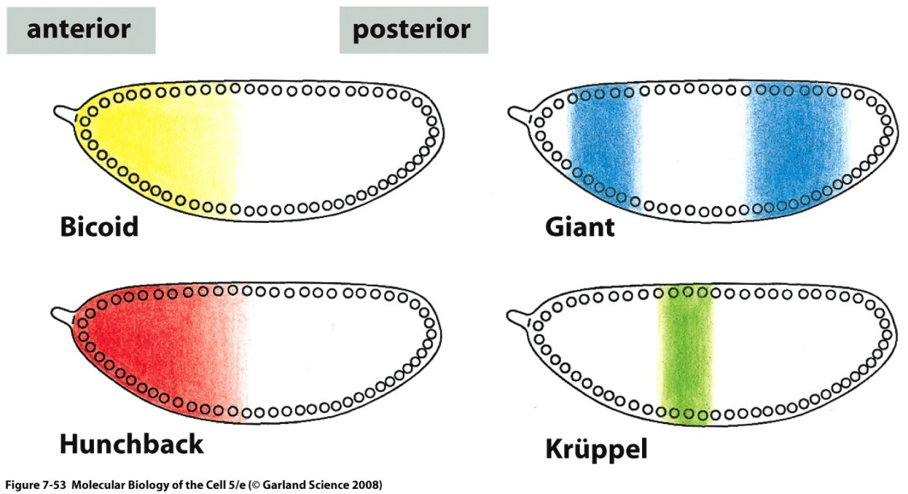
Notes:
Do nut have to study.

Slide 16
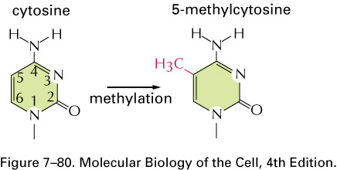
Cytosine methylation
Notes:
Na methylation occurs largely on cytosines to give you 5-methyl cytosines and it happens when cytosine is on the dna molecule followed by a guanine so its called a a 5’ CpG 3’ dinucleotide which are not common. Methylation of dna on the G is usually associated with no expression and absence of methylation is association with expression.

Slide 17
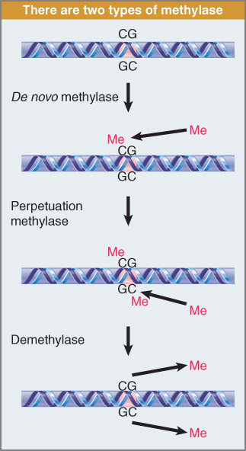
DNA methyltransferases
(methylases)
De novo methylases: Dnmt3A
DNmt3B
Maintenance methylase: Dnmt1
Notes:
Dna methyltransferases methylate dna and they are split into two categoreies:
De novovo: to methylate dna that is not methylated on either strand.
Maintenance: to methylate dna that is methylated on one strand and go and methylate the other strand; and these are needed after replication; the parental strand will be methylated and the newly synthesized one is not and hence it is methylated by maintenance methylases.
Remember difference between de novo and maintenance bit not names.

Slide 18
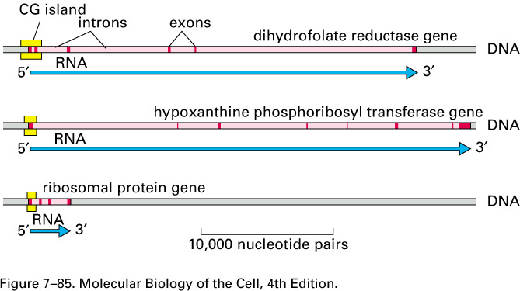
CpG islands
Notes:
The CpG islands are usually found in the immediate 5’ flanking region or promoter region. And that was very useful for us because that was an indication that we were in the 5’ region.

Slide 19
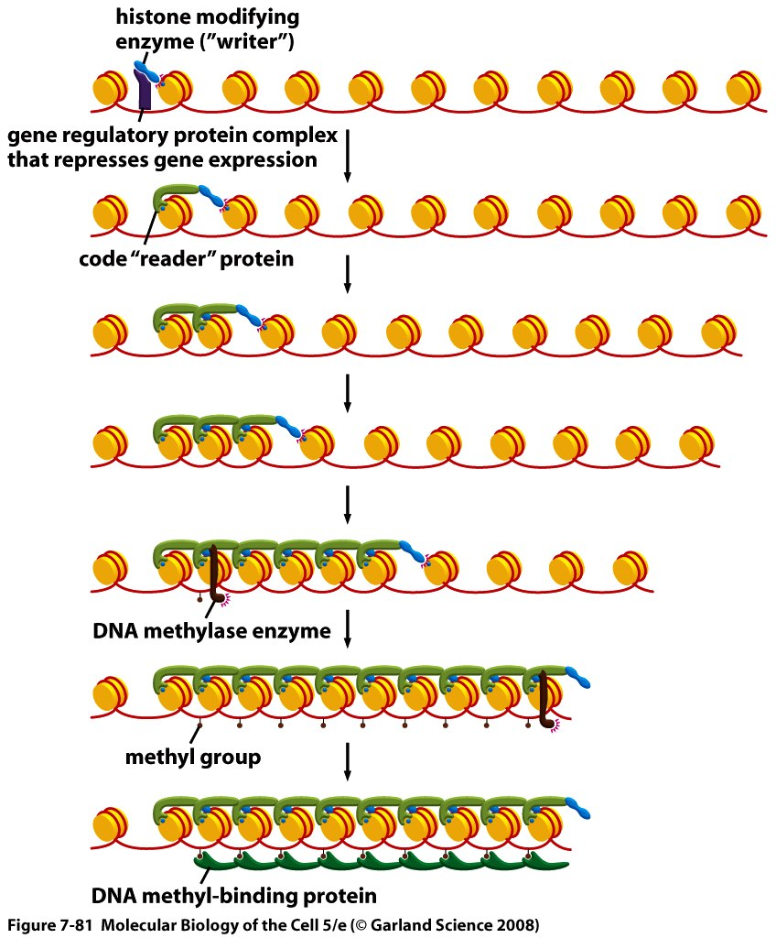
Cytosine methylation and transcriptional activity.
Notes:
Whether a CG site is methylated is important information. This is a slide that shows you how dna methylation mechansims interact with other events to create a closed situation.
Writer will methylate; reader and writer complex will copy this onto other histones, and this inturn will bring in special proteins that will bind methylated CG’s to ccreate a compact chromatin that is condensed and unfavourable for transcription.

Slide 20
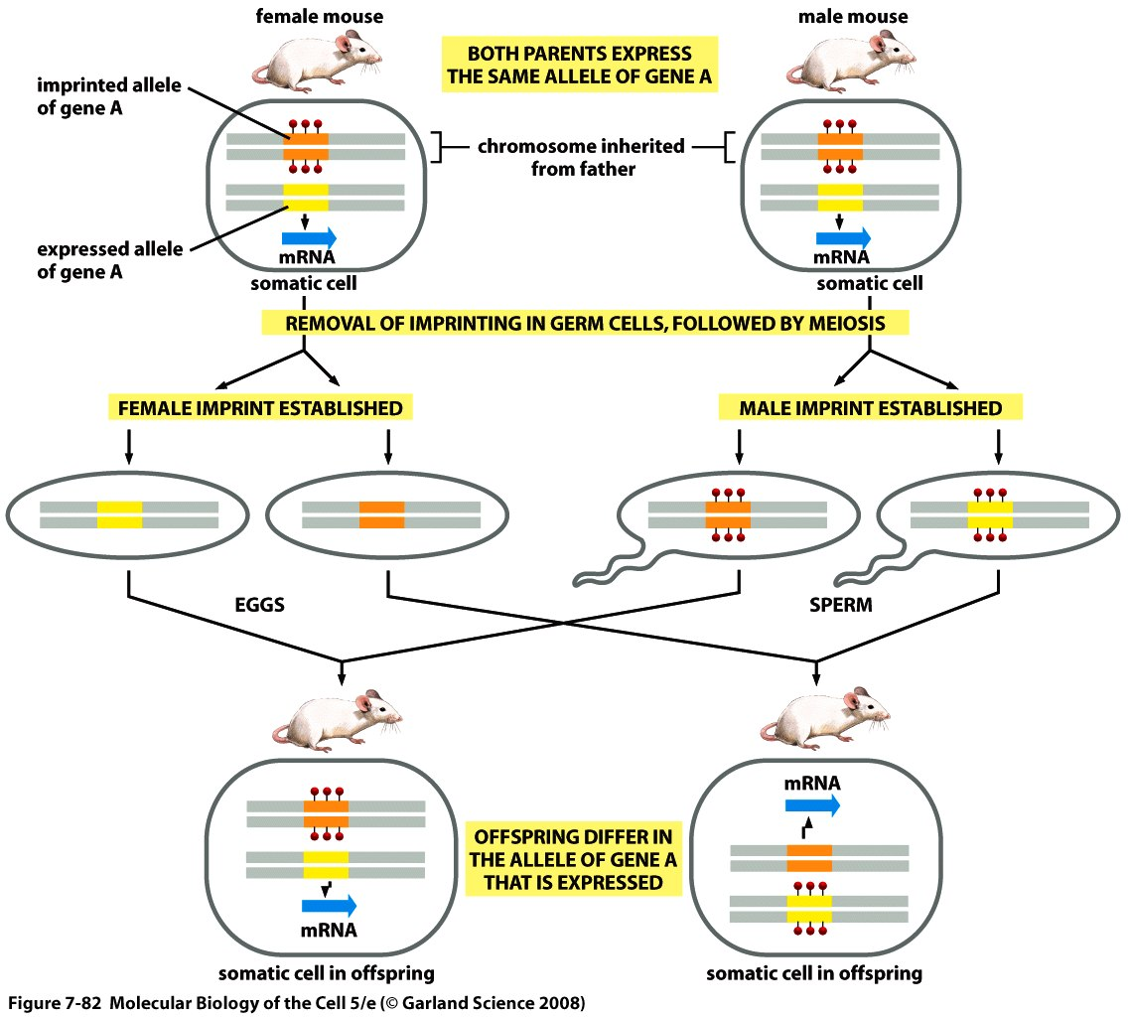
Imprinting
Notes:
Remember:
1)Genomic imprinting will only affect a very small percentage of genes. And we are diploids and so we have two alleles of each genes; and those genes that are imprinted whether it will be expressed or not will depend on whether u got it from ur mother or ur father. U have two mice a yellow allele and an orange allele; the yellow allele is expressed but orange is not in both or our male and female parents. They mate and make gamets: during gametogenesis the methylation imprint is erased and reestablished as shown abouve. So the eggs have alleles unmethylated and the sperms have alleles methylated. And so in the offsprings we end up with the shown results. So in the first mouse the yellow is expressed (unmethylated) and the second one has the orange expressed one. And in both cases the allele is that is expressed is inherited from the mother.
2) The alleles expressed depends on whether u got it from ur mother or father and it is associated with methylation status
3) The imprint is established during gametogenesis or early embroyonic life.

Slide 21
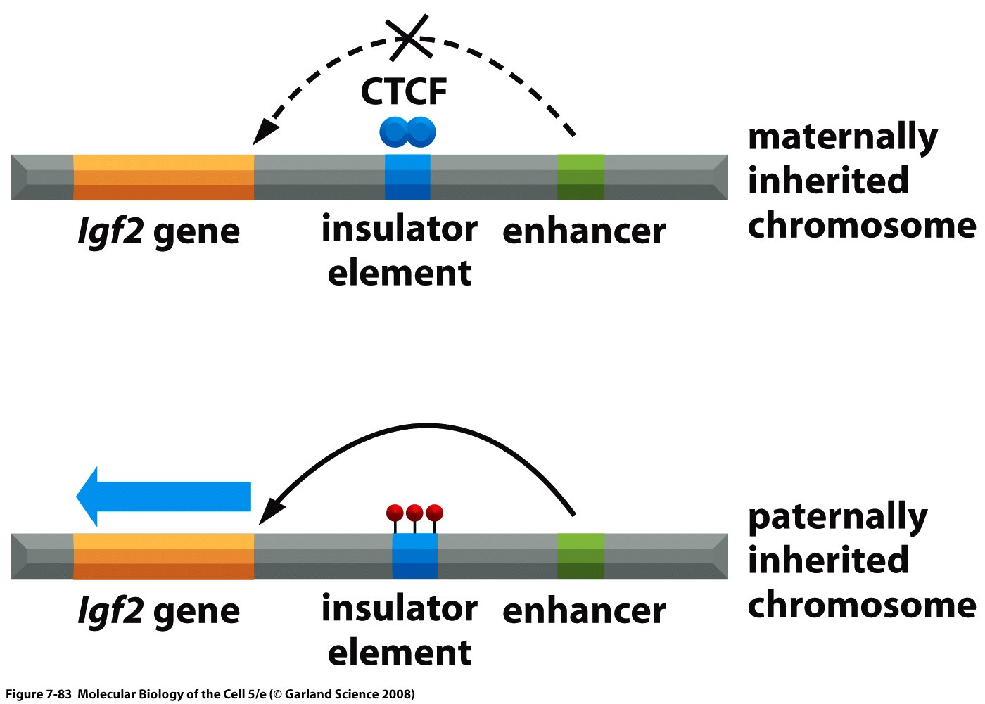
Imprinting
A well known exception.
Notes:
Imprinting status of insulin growth factor 2. the insulator element functions by binding of protein ctcF which prevents the enhancer from acting on the Igf2 promoter, this case is similar to the previous one is that the materinal allele is not methylated and the paternal allele is methylated on the insulater element and this prevents binding of CTCF on the insulateor and hence it can no longer prevent the enhancer from acting on the Igf2 gene promoter. And hence this is an exception to the rule because here methylation leads to expression.

Slide 22
CpG Islands- Why?
Notes:
Remember that house keeping genes are expressed in all cells but not all genes are expressed in all cells.

Slide 23
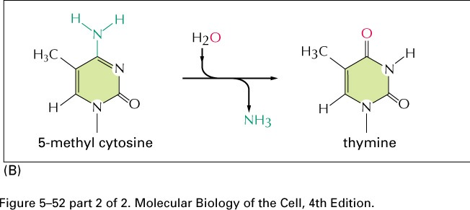
Deamination of 5-methylcytosine produces thymine
Notes:
If 5-methyl cytocine is deaminated into a thymine it will pair with an A instead of a G the repair mechansim for this is not very efficient and hence AG can no longer be methylated.

Slide 24
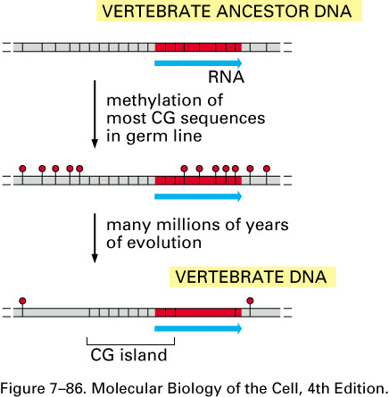
A model for the origin of CpG islands
CGs
5-methyl C
Most CG sites methylated except those in proximal promoter
Deamination of 5-methylC gives you a T and the CG has become TG
Notes:
Do not study.

Slide 25
CpG Islands

Slide 26
« active » chromatin vs « inactive » chromatin
ACTIVE CHROMATIN:
Decondensed structure, absence of histone H1
Reduced methyl-cytosine (5meC) content.
High proportion of hyperacetylated histones
« Open » promoter region (free, accessible and RDBPs are bound and they are generally activators)
Higher sensibility to nucleases (i.e. DNAse I – presence of hypersensitive DNAse I sites).
Notes:
Active and inactive chromatin is not the same ase euchromatin and heterochromatin. Basically we’re dealling with two different kinds fo euchromatin.

Slide 27
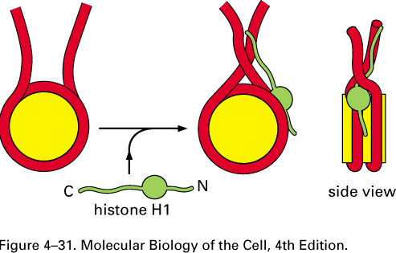
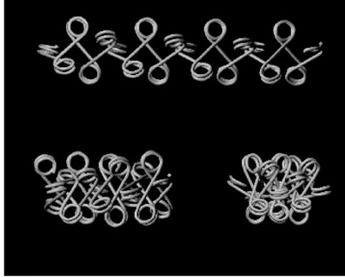
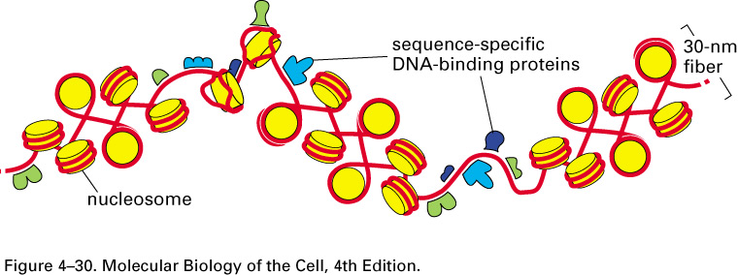
Role of Histone H1
Notes:
The first on: is the the decondenced version of chromatin which lacks H1 and hence cannot form the 30nm fiber. This is active chromatin. And hence expressed chromatin.

Slide 28
« active » chromatin vs « inactive » chromatin
ACTIVE CHROMATIN:
Decondensed structure, absence of histone H1
Reduced methyl-cytosine (5meC) content.
High proportion of hyperacetylated histones
« Open » promoter region (free, accessible)
Higher sensibility to nucleases (i.e. DNAse I – presence of hypersensitive DNAse I sites).

Slide 29
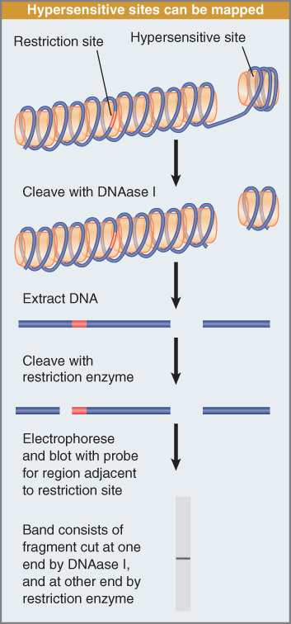
DNase I Hypersensitive sites
Notes:
Don’t need to remember figure here.

Slide 30
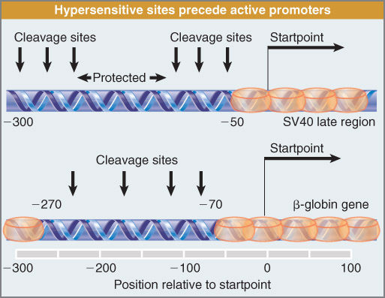
DNase I Hypersensitive sites

Slide 31
« active » chromatin vs « inactive » chromatin
ACTIVE CHROMATIN:
Decondensed structure, absence of histone H1
Reduced methyl-cytosine (5meC) content.
High proportion of hyperacetylated histones
« Open » promoter region (free, accessible)
Higher sensibility to nucleases (i.e. DNAse I – presence of hypersensitive DNAse I sites).

