Slide 1
Control of Gene Expression in Eukaryotes I
19 November 2013
Notes:
More complicated than prokaryotes.

Slide 2
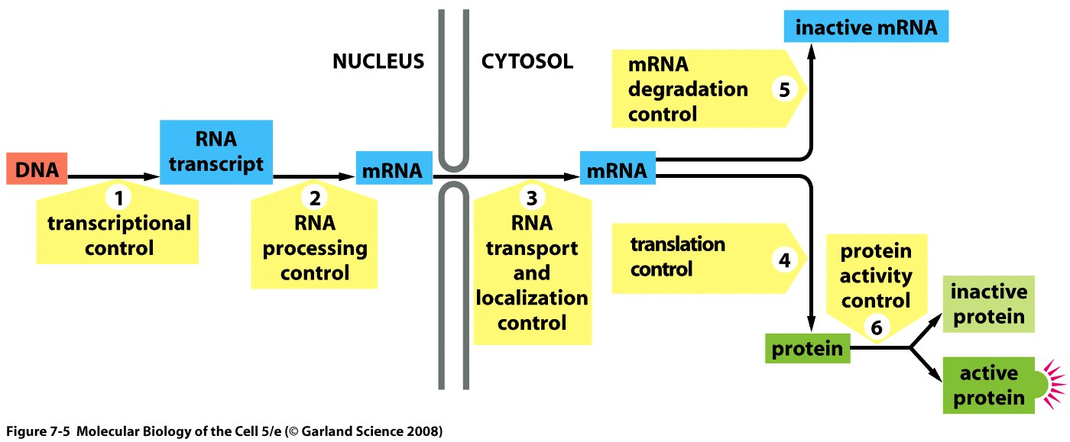
On overview of regulation of gene expression in eukaryotes
Notes:
Slide is very useful to u, shows you the various levels from which you can control gene expression in eukaryotes. A lot of control occurs at the level of transcription in order to not waste your time and energy.

Slide 3
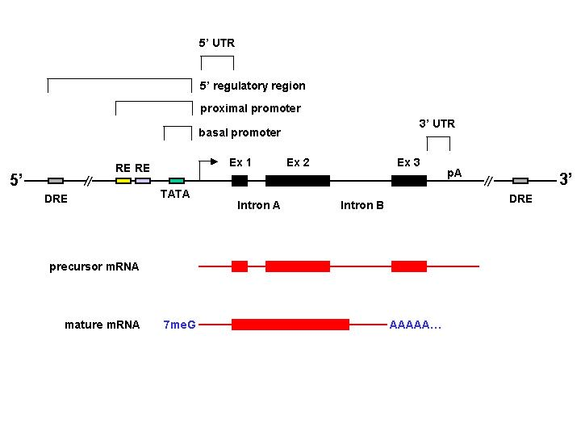
Notes:
This is the eukaryotic gene. This is dna and it is orientid same as mrna from 5’ to 3’ and control of level of transcription is going to be by the special sequences on the dna where proteins will bind and influence transcription. They are divided into 5 special sequences.
1)The basal promor needed for transcriptional machinery is built and rna polymerase starts transcription
2) The proximal promoter sequences from +1 to +350 unstream from the start point and it contains regulatory elements RE where regulatory proteins will bind size of these elements will vary if we experimentally we change position or orientation of these RE’s then regulation will be affected.
3) 5’ regulatory region (and the broken bars indicate that they can go very far away) they will contain DRE (distal regulatory elements) which can be found in the far 5’regulatory region but can also be found in the far 3’ end of gene and can be found in introns and exons too. DRE’s function is independent of position and orientation unlike the RE’s;
4)

Slide 4
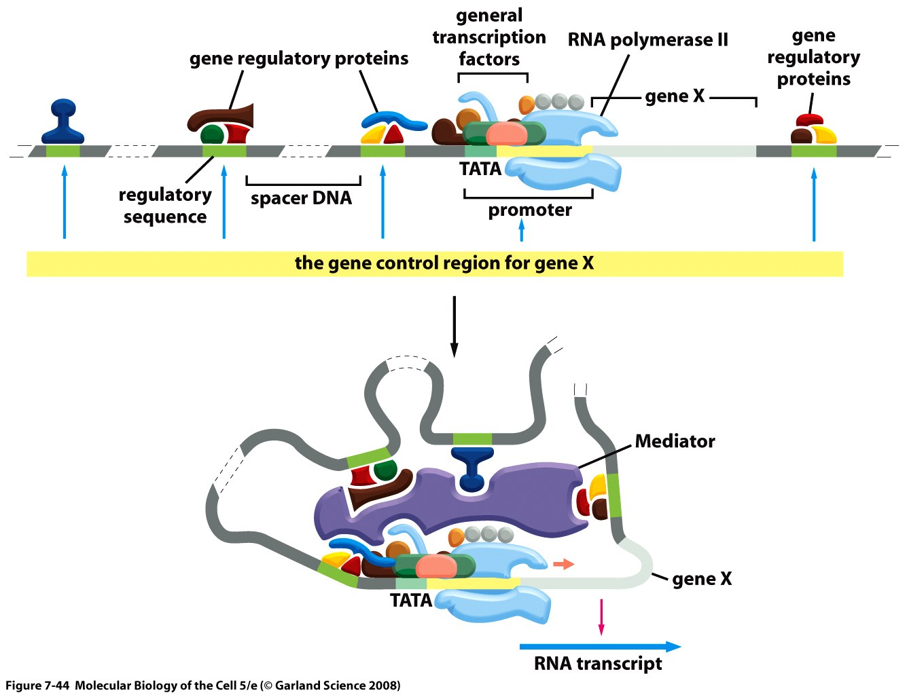
A typical eukaryotic gene
Notes:
This is a typical eukaryotic gene, (the dashed lines indicate large regions of dna). In space the dna will be bent and all those bound regulatory proteins will be brought in proximity with the help of the mediator complex but because distances on dna can be large the exact positions don’t really mattes because they offer flexibility in bending and hence the dna will bend to accommodate the position or orientation of the DRE. But in the RE elements is within short distances and hence orientation and position will influence it.

Slide 5
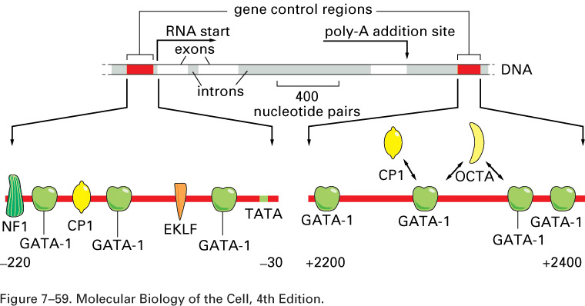
The human beta-globin gene
Notes:
Two specific regulatory elements for the beta globin gene, one is in the proximal region from -220 and -30 and the other is further away. (Don’t remember names of figures) so this one will be an RE and this one a DRE.
In the regulatory elements for beta globin gene is that there are several binding sites for GATA-1 which is a property of regulatory elements.
Another feature is that there are several binding sites for different proteins.
The arrows mean that there are often factors That compete for binding on the dna.

Slide 6
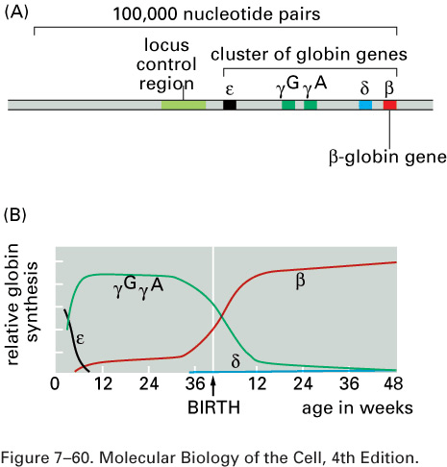
Locus Control Region: The cluster of beta-globin genes (human)
Notes:
We’re still talking about these sequences in DNA.
Two special cases of DRE’s:
the locus control region will control a bunch of genes at the same time; the diagram on the top shows the genes around the globin genes in dna and these genes are all expressed but not all at the same time. Beta globin goes up at birth while y goes down at birth. So these genes have in common that they are expressed on same cells but different times and each of them has their own regulatory elements (we’ve seen the ones for B globin on previous slide). The locus control region will open this cluster of genes for business in the right cell type, it will make it accessible to the factors that will bind to the regulatory elements and this will open the chromatin domain and once it is open the factors are gonna fine tune the control of the genes.

Slide 7
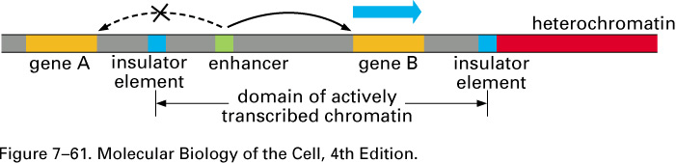
Insulators
Notes:
2) The second special case is the insulator sequences which will modulate the activity of the enhancer sequences (a kind of DRE) so in theory if u have two genes A and B and enhancer between them it will be able to act on both promoters for genes A and B because it can act over long distances and in real life u wanna be able to control this. This can be done with the insulator element which blocks the action of enhancer on gene A and hence the enhancer only acts on gene B.

Slide 8
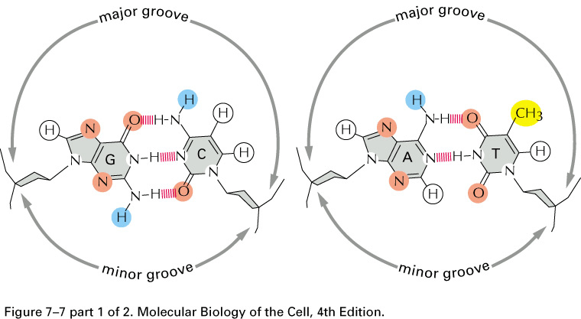
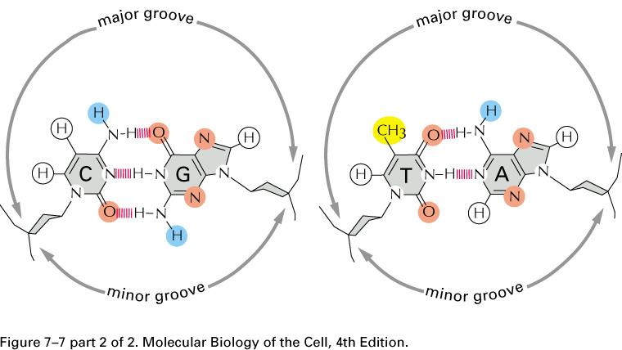
How regulatory proteins make contact with DNA
Notes:
In lecture notes on page 9 he named a few proteins and the sequences they bind with- don’t have to remember any of it except for the fact that each regulatory protein likes a specific sequence.
Proteins like to bind in the major groove, here we’re looking at GC and AT pairs

Slide 9
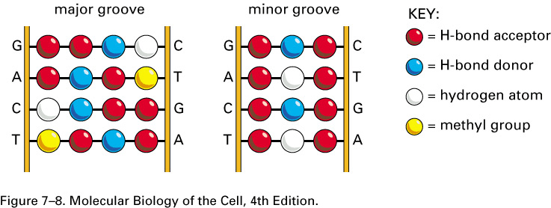
A wider variety of DNA recognition “codes” in the major groove
Notes:
What this figure shows is that a protein that binds dna will see a wider variety of groups or atoms if it binds on the major groove.

Slide 10
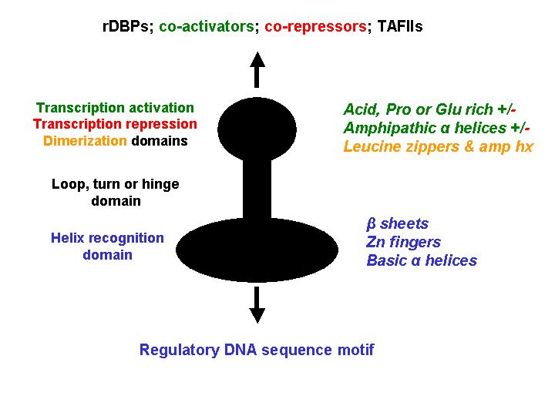
A RDBP generally has more than one protein domain
Notes:
This figure is a very schematic representation of those proteins that bind dna: regulatory dna binding proteins. It has a dna binding domain and a connector region and other protein domains that can do different things and some of those things can be dimerization (eg in phage) but it can also be for activation, repression, etc.

Slide 11
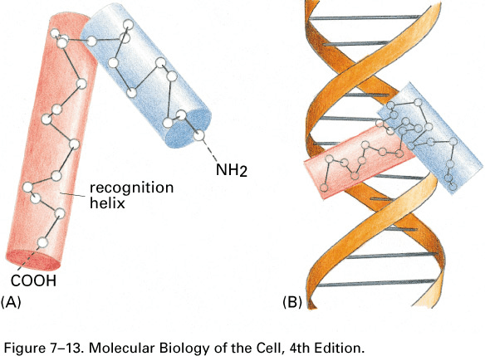
The Helix-Turn-Helix motif
Notes:
We will talk about these RDBP for the rest of the lecture. Our first family is the helix-turn- helix motif and the left part shows only the dna binding domain part of the protein. The first helix (blue) and the second is red will make contact in the major groove and these contacts will involve basic amino acids.

Slide 12
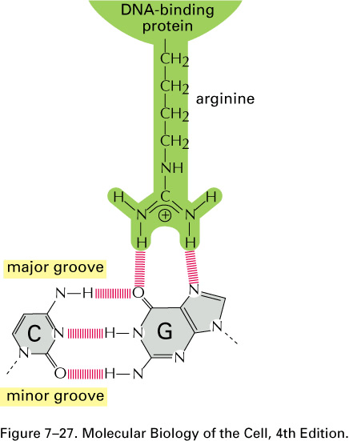
Example of contact between amino acid (from a protein) and DNA
Notes:
This is shown here basic amino acids such as argining lysine etc. important is RDBP are often rich in basic amino acids and hence make contact with dna, don’t need to know how to draw.

Slide 13
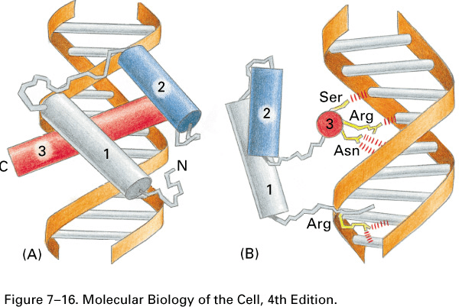
Binding of a homeodomain protein to DNA
Notes:
This is called a homeodomain it is basically a sophisticated helix turn helix motif. The red helix here will also make contact with the major groove just like helix turn helix motif. The difference is that helix 1 will make contact in the minor groove as shown above in the homeodomain. And this additional contact makes binding more specific. This homeodomain is found in many developmental genes.

Slide 14
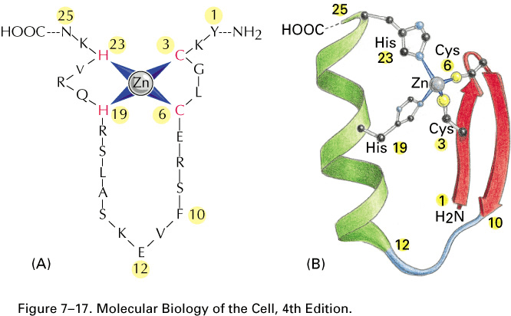
The zinc finger motif
Notes:
The third family is the zinc finger motif which contains a central zinc atom wich makes contacts between cysteines and histidines. It contains 2 beta sheets and an alpha helix.

Slide 15
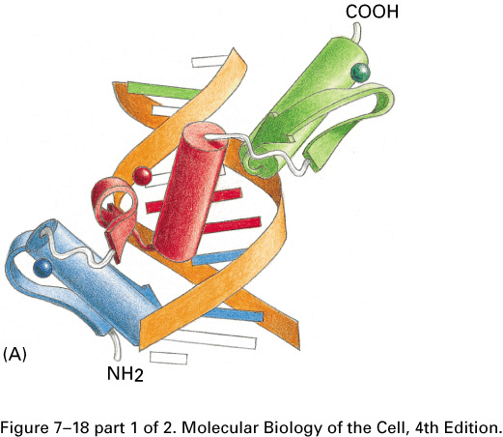
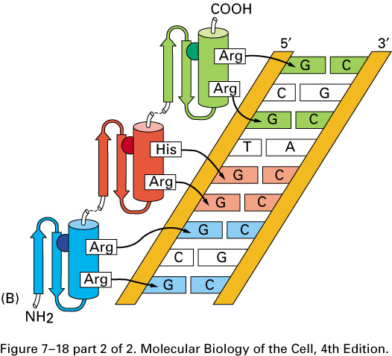
DNA binding by zinc finger motifs
Notes:
Here we’re seeing a part of a protein that contains three zinc fingers and each will have it’s own specificity of binding and so the three different zinc fingers will increase the specifity of the protein to the sequences in the dna.

Slide 16
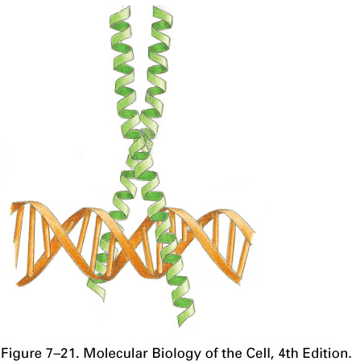
The Leucine Zipper motif
Notes:
The fourth category is the leucin zipper motif and the family is made up of proteins that will bind to dna as dimers. And they are called leucine zippers because they will have leucing amino acids that will make hydrophobic interactions that will contribute to the formation of the dimer structure. Each of the monomers will also bind to dna in the major grooves to basic amino acids.

Slide 17
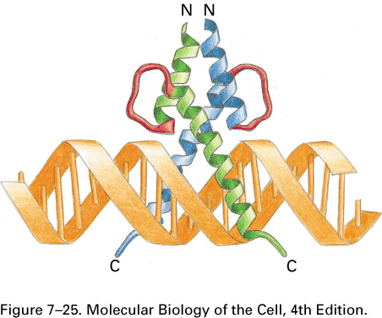
The Helix-Loop-Helix motif
Notes:
Here is the fifth group. The helix- loop-helix motif which will also bind dna as dimers and each monomer will bind the major groove with the basic amino acids on the dna. Now these proteins bind dna as obligate dimers. We can play with that property in the next slide. This is the binding of a heterodimer.

Slide 18
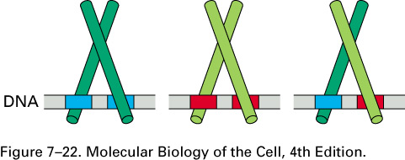
Dimerization of rDBPs
Notes:
Helix loop helix can bind as homodimer or as heterodimers. Each of those monomers will prefer a different dna sequence. So from three different binding binding proteins than they can bind to 3 different binding sites. So the take home message here is that having the ability to form homo or heterodimers increases the variety of binding sites u can have in the genome. This can also be true for the leucine zipper.

Slide 19
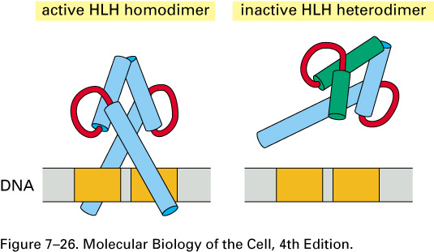
Truncated HLH proteins
Notes:
So HLH proteins need to bind as dimers and nature has used a method to control this by the existence of truncated HLH dimers. IN green we have a truncated hlh protein thus will not be able to make contact to dna however once it dimerizes with a blue helix it ends up with a protein that has affinity to only one region but will not be able to bind to dna because it binds only as an obligate dimer.
This is useful in situations where: truncated green helix will be made excessively which will compete to bind with blue helix to form dimer and hence will not be able to bind to dna and hence expression of that gene seazes.

