Slide 1
Transcription in Eukaryotes Processing and transport of mRNA
11 October 2013

Slide 2
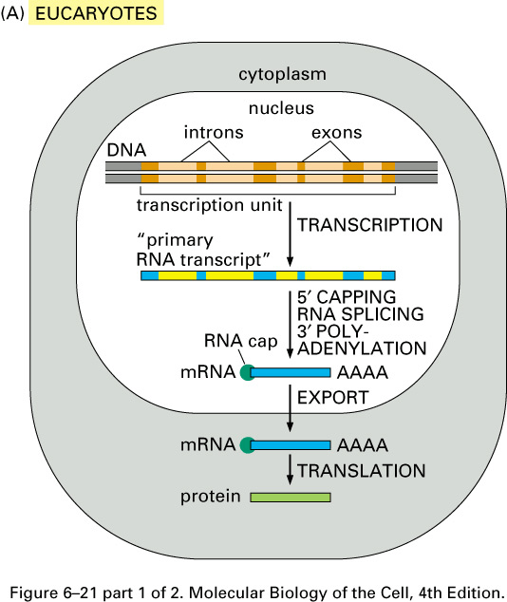
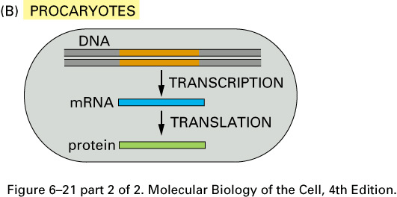
Notes:
Mrna’s are first generated as precursurs and then they are modified in three ways:1 capping, polyadenylation and splicing

Slide 3
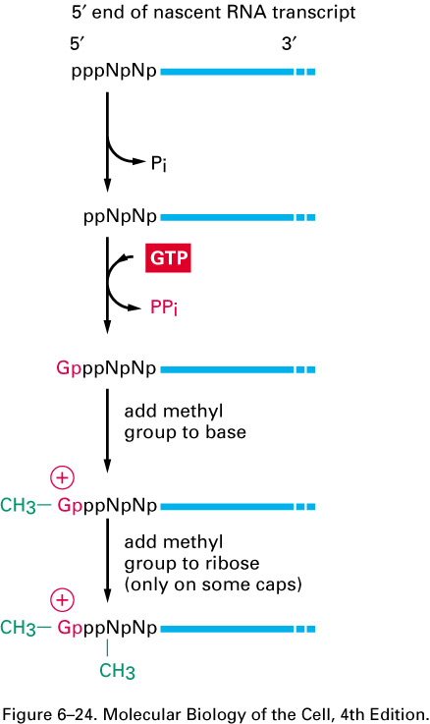
Cap addition
phosphatase
Guanyl-transferase
Notes:
The first one is capping at the 5’ end, the first thing that happens is that it loses one of the three phosphates through the action of phosphatase leaving two phosphates, the second thing that happens is that guanyl-transferase takes GTP and then links it to the two phosphates making a special kind of link shown in diagram. So the GTP has has two phosphates are removed which leaves one phosphate on GTP that links to the two phosphates on mrna in a 5’-5’ end which provides an advantage in that the exonucleases cannot recognize this link and hence the capping protects mrna from being degraded. Then there are a few methylation steps that hppen and the first one is the one we should remember, we put a methyl on the guanine.

Slide 4
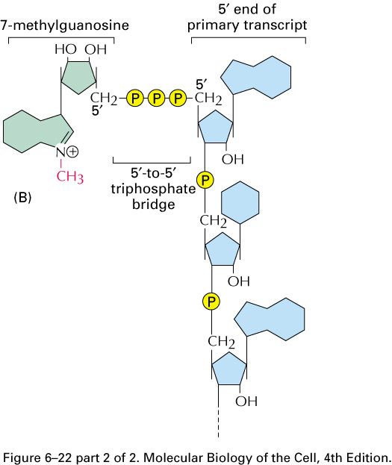

Slide 5
Cap addition
Guanyl-transferase
Notes:
Another advantage of capping is that there are proteins that specifically recognize the cap structure and will bind the cap(cap binding proteins). Finally the presence of a cap is specific to those genes that are transcribed by rna polymerase II. So in total there are three advantages of capping.

Slide 6
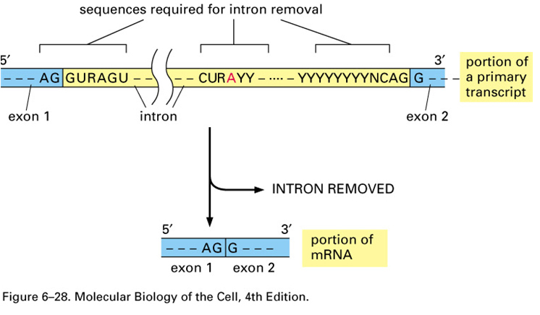
Splicing
Branching motif
Donor site
Acceptor site
Notes: R = A or G Y= C or U
Branching motif consensus: also UACUAAC, YURAC
Notes:
The second modification is splicing, exons are in blue and introns are in yellow and splicing is the removal of the intron sequence and the adjoining of the exons. There are sequences where splicing is specific and these three sites are donor (5’ splice) site and acceptor (3’ splice ) site and branching motif. The branching motif is fairly close to the acceptor site and is at large distance from the donor (5’) site, there are consenus sequences for all of them you don’t need to remember them, the only thing he wants us to know is that there is and Adeninine nucleotide at the branching motif.

Slide 7
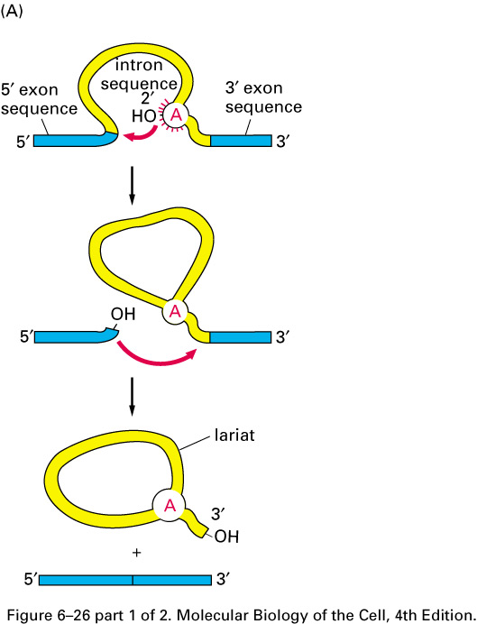
Splicing
1st trans-esterification
2nd transesterification
lasso
Notes:
This the most often used (major form) splicing method.the splicing reaction is a series of transesterification( simultaneous exchange of a phosphodiester bond for another) reactions. There are two of these esterfication reactions; in the first one the bulging A in the branching motif will attack the 5’ splice site as shown with the arrow and as it breaks the phosphodiester bond between the last nucleotide of exon and first nucleotide of intron and forms a phosphodiester bond between the 3’ nucleotide with the other exon and the intron will be released in the shape of a lasso which characteristic of the major splice system.

Slide 8
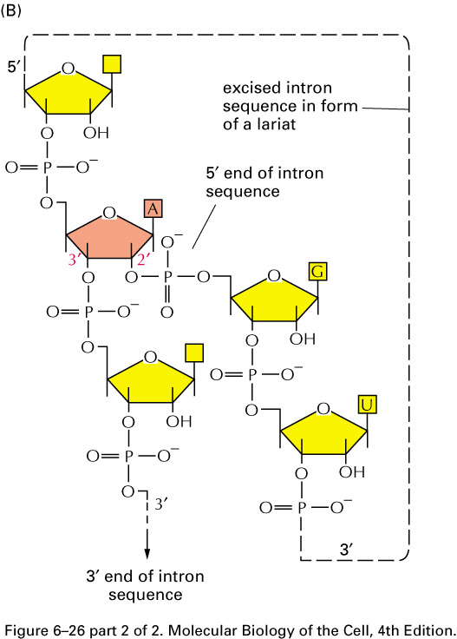
Splicing
5’-2’ phosphodiester bond
5’
Notes:
The bulgin A will create a special 5’-2’ phosphodiester bond when it attacks the last nucleotide of the exon.

Slide 9
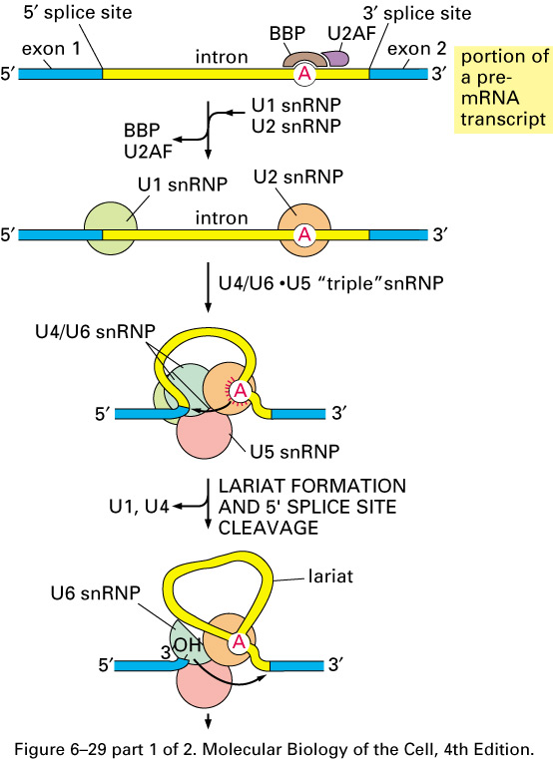
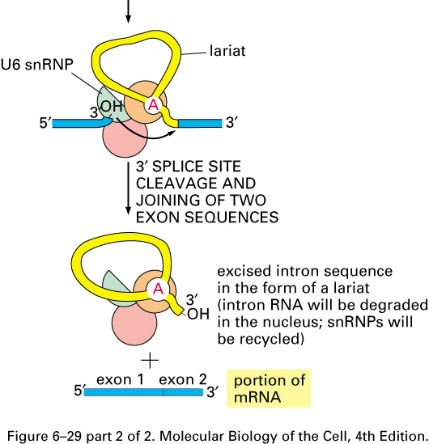
Spliceosome
Notes:
The major splicing mechanism occurs with the help of a spliceosome. The spliceosome is made of special proteins and snRNPs and the SNRNPs are made of two components an: RNA component(small nuclear RNAs there are 5 of them U1,U2,U4,U5, and U6 [there is no U3]) and a protein component. This slide shows u the various steps of splicing but it’s not accurate, it shows here that the first step is the BBP protein binds the bulging A and th other protein U2AF binds, and then the second step the U1 snRNP binds at the 5’ splice site and the BBP and U2AF are replaced by the U2snRNP. When the U5 U4/U6 triple snRNP is brough in the exons are brought tegerther and then the U4 and U1 snrNPs are gone the first transesterification reaction occurs and then the lassol is just degrade in the cell.

Slide 10
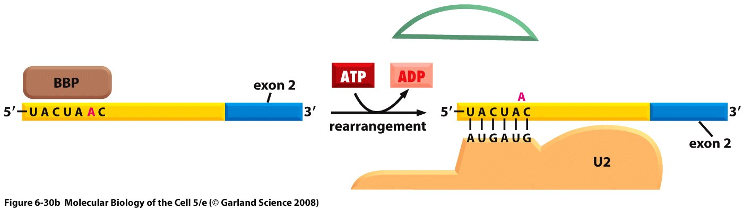
Role of snurps
Notes:
This is the exchange of the BBP for the U2 snurp step. The intron sequence at the branch point base pairs with U2 and the U2 is not too far from the 3’ splice site, the energy for this is brought by ATP hydrolysis.

Slide 11
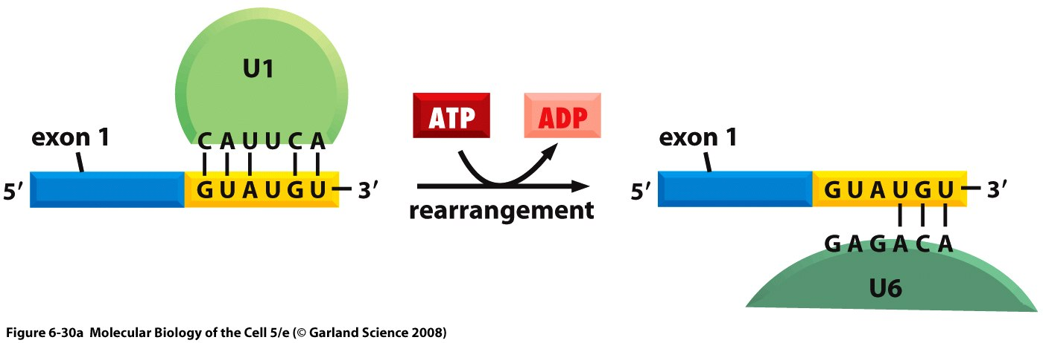
Role of snurps
Notes:
The step of exchange of U1 by U6; again the RNA component of of U1 and U6 base pairs with the mrna. The reason for this exchange of components is probably an error reducing method. One of the reasons why the spliceosome may have a hard time to recognize sequences is because some consensus sequences are strong and some are weak.

Slide 12
Spliceosome
Notes:
U2 is bround the the bulgin A and U6/U4 brings the bulgin A and the othe other end for the first transesterification reaction after that there are rearrangements that allow the the 3’ end and 5’ of exons to be brought close togetherr which facilitates the second transesterification reaction.

Slide 13
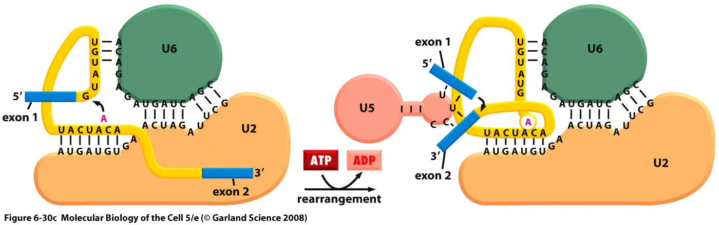
Role of snurps
Notes:
So this step here is where the first transesterificatin reaction occurs and then bringing the two exons close together.

Slide 14
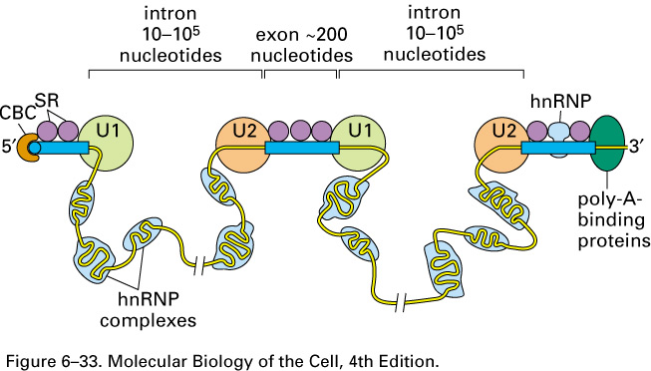
Exon definition hypothesis
Notes:
Exon size in eukaryotes is very constant at 100-200 nucleotides whereas intron size varies alot. Splicing is error prone and its important for the components to recognize the splice sites. The exon definition hypothesis is the bringing in of U1 at this splicing event helps bring in the other components(such as U2) at the other splicing events and the way it does that involves SR proteins ( rich in amino acids serine and aRginine) and for this to happen u need exons that are not too big. While we’re talking about his we’re involving another complex hnRNP shown in bluee that will bind mainly intron sequences that can be very large and that helps in recognition (not being recognized as incorrect splicesites) but as the picture shows u can also have hnRNPs bound to exons also.

Slide 15
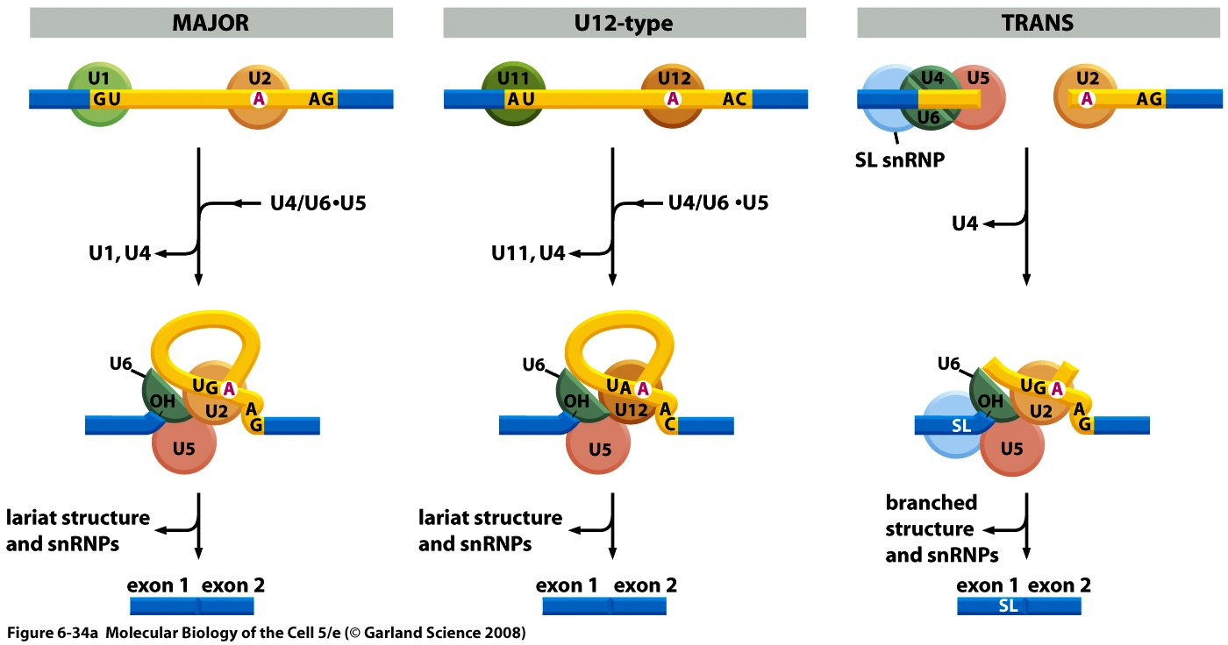
Other forms of Splicing
Notes:
There are many genes with many introns ans they are not necessary spliced in order. There are two kinds of minor forms of splicing the first one is the U12 type and it’s very similar to the major form the only difference is that it uses different snurps. And this one is minor so happens less frequently. Within the same mrna u can have major and minor splicing methods happening. The other type is trans splicing where u have two different RNA molecules brought together by the snurps and this is rare and happens only in some species such as nematode sealagans and in trans splicing there is a region of the genome which wil synthesize the splice leader sequence shown here which has an exon and an intron and this will be brought next to the 5’ end of the precursor mrna’s of a bunch of genes and the process will occur as shown and it’s actually similar to the major form but at the end you get a Y shaped intron instead of lasso like in the major form. So the same splice leader sequence in trans form of splicing can work with a bunch of different RNAs of from the same specie.

Slide 16
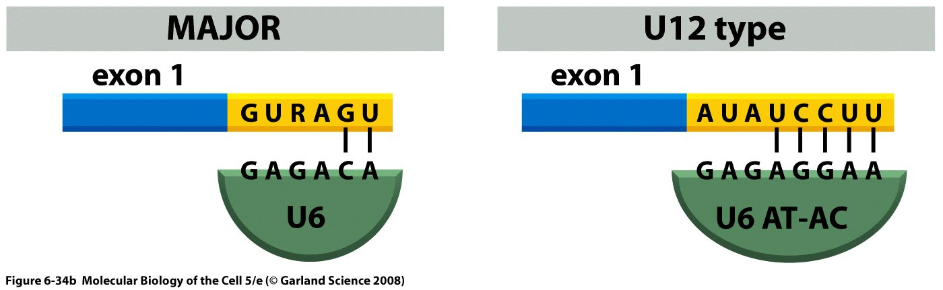
Other forms of Splicing

Slide 17
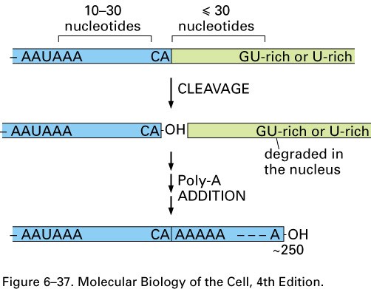
Consensus sequences for polyadenylation.
Notes:
The third modification is the process of polyadenylation and again for this u need a certain number of consensus sequences. The region that will be kept is shown in blue and the region degraded is in green. You need three different consensus sequences for poly adenylation; AAUAAA for polyadenylation signal and not too far downstream there is a CA dinucleotide sequence and then there is the GU/u rich region.
So the first step of polyadenylation is cleavage and the next step is the addition of a poly A tail at the CA.
The green part is degraded because it has no cap.

Slide 18
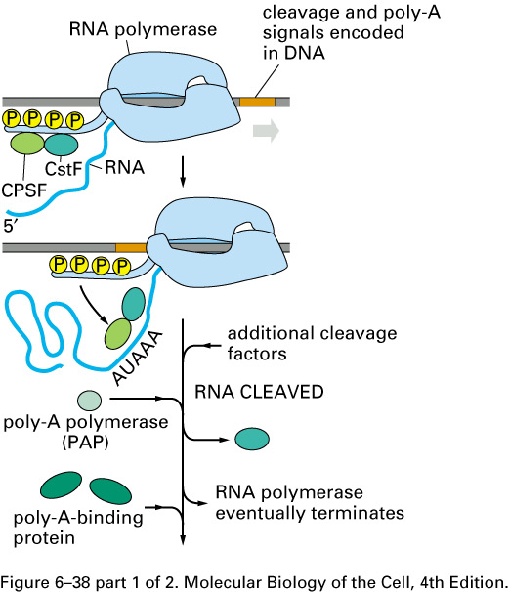
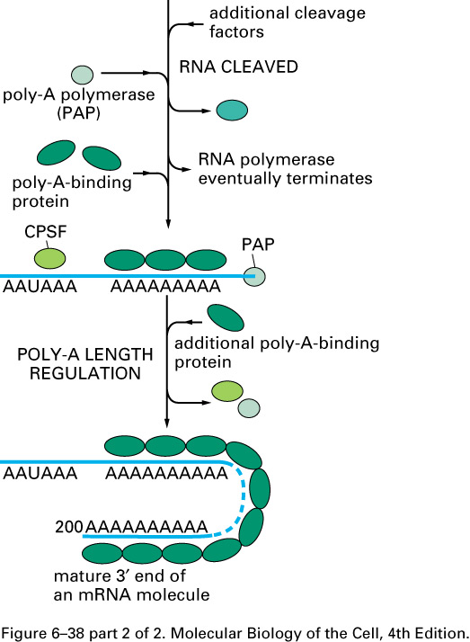
Polyadenylation
Notes:
This RNA polymerase with it’s Cterminal domain phosphorylated which helps recruit factors that are required for poly adenylation these are CPSF and CsF and they are transfered from the C terminal to the RNA, cleavage then occurs. And there are PAP proteins that bind the poly A tail and that helps protect the mrna from exonucleases that have a tendency to degrade it from it’s 3’ end.
There are other factors but we’re not going through them.

Slide 19
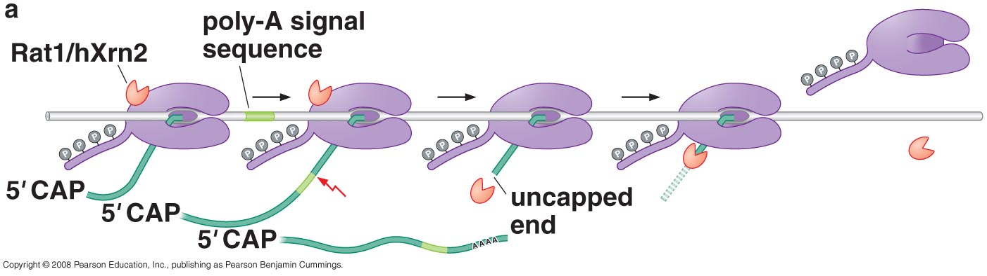
“Torpedo” model for transcription termination
Notes:
Termination of transcription in eukaryotes is less understood, this is one model for it. This is the exonuclease and it will just chew the exonuclease and once it reaches the RNA polymerase it causes it to stop synthesizing and be released, and the precursor rna is degraded quickly.
There’s another model but it won’t be required.

Slide 20
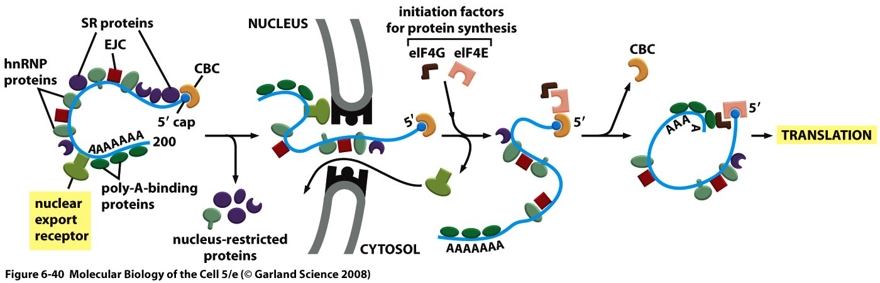
Packaging and export of mature mRNA
Notes:
Thre are exon junchtion complex proteins. EJCP and they will bind where two exons join together and the reason for them is that they will have a quality control function. One importanch exchange that takes place is the exchagne of the cap binding complex CBC for the two initiation factors eIF4G and eIF4E which will both initiate translation and protect rna against degredation.

Slide 21
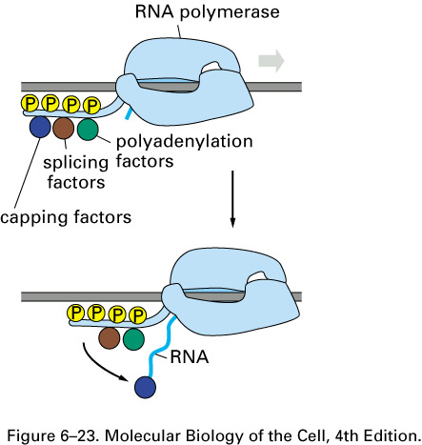
Function of the RNA polymerase II C-terminal domain (CTD)
Heptamer
Tyr-Ser-Pro-Thr-Ser-Pro-Ser
Serine 5 phosphorylated first. Recruitment of capping factors.
Notes:
All the modifications happen while the polymerase is synthesizing. And one role of the CTD is to recruit the factors necessary for these processes(capping and splicing and polyA factors). Thre are two positions Serin5 and Serine 2 are important. Serine 5 sis phosphoryilated first and so it recruits the capping factors and allows the pol II to be released from the promotor.

Slide 22
Function of the RNA polymerase II C-terminal domain (CTD)
Heptamer
Tyr-Ser-Pro-Thr-Ser-Pro-Ser
Serine 2 phosphorylated later. Recruitment of splicing factors.
Notes:
Next ser 2 is phosphorylated and it involves the trascription factor 2S which is important for eleongation. This phosphorylation causeses recruitment of splicing factors.

Slide 23
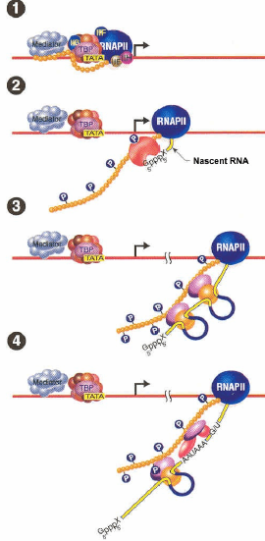
Notes:
Viewing pleasure. Notice how all these things happen simultaneously.

Slide 24


