Slide 1
Transcription in Prokaryotes
4 October 2013

Slide 2
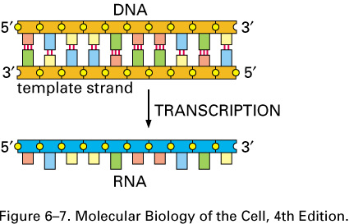
Notes:
Transcription is the process by which u make a single stranded RNA molecule from a double stranded DNA molecule. By convention we will always have the 5’ end of the RNA on the left. One of the double stranded dna strands will be used as the template strand from which rna is made.

Slide 3
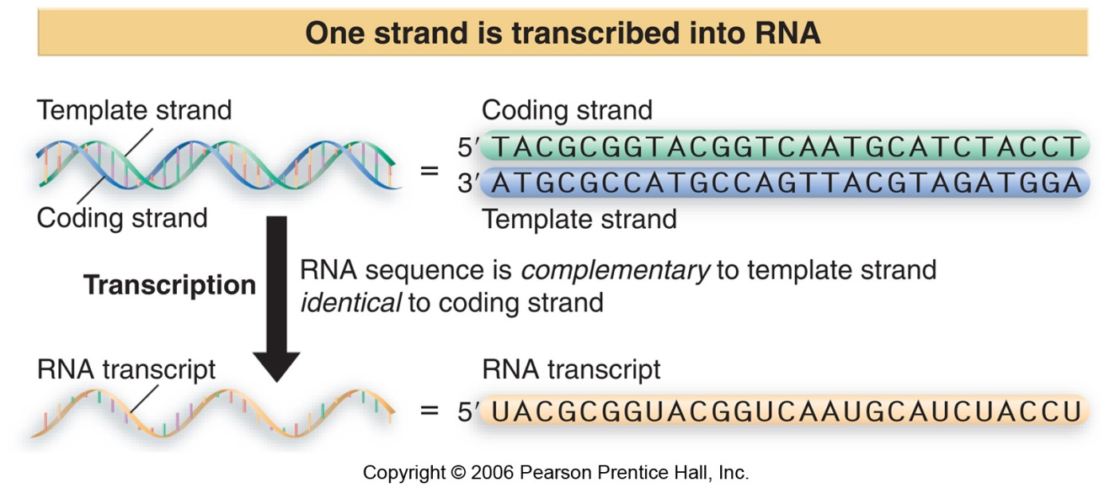
Definitions/Conventions
Transcription
  Template strand: 3’ towards 5’ (right to left)
  Non-template strand (coding): 5’ towards 3’ (left to right)
Notes:
Non-template strand is the coding strand which is the 5’ to 3’ strand that is not used as a template, the sequence of this strand is exactly the same as the RNA transcript made except for the T’s are converted to U’s .

Slide 4
RNA content
Type % at equilibrium Synthesis capacity
(% of total RNA synthesis)
rRNA 83 58
tRNA 14 10
mRNA 3-5 32
Notes:
There are 3 kinds fo RNAs in prokaryotes, and they are all synthesized by the same RNA polymerase. This table shows the % of total rna tha u can see at equilibrium in the left column and notice that the majority is the ribosomal rna, also note that despite having only 3-5% of mRNA at equilibrium about a third of the time the rna polymerase is synthesizing it which tells us that mRNA is not very stable!

Slide 5
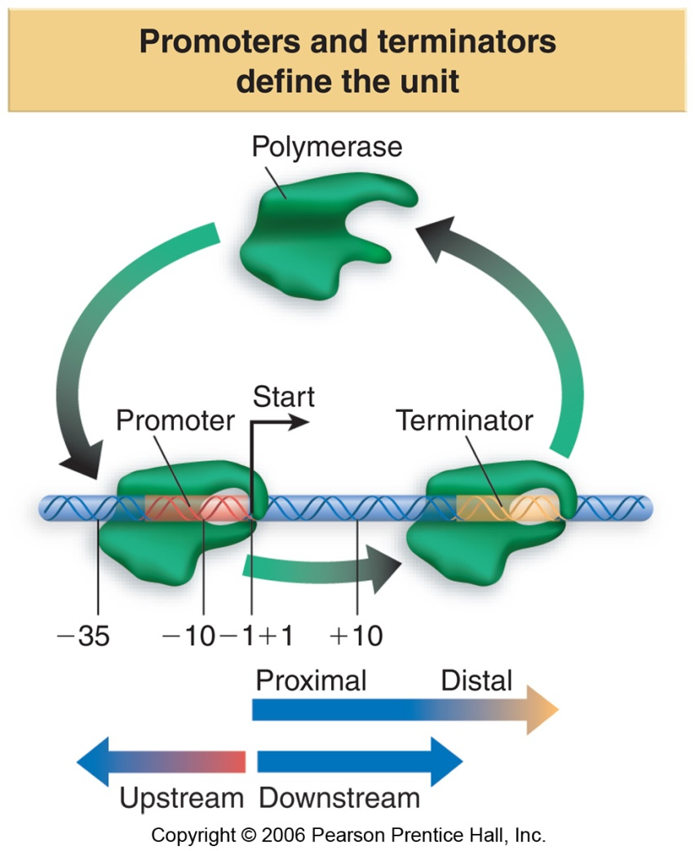
Transcriptional Unit
  Promoter
  Start site (+1)
  Terminator
Notes:
We will talk about definitions that we need: know them!
1) Transcriptional unit can be defined on DNA as the distance between where transcription starts and where it ends. ON the DNA molecule we give positions with respect to the arrow at +1 (showing where transcription will start from left to right (downstream)), there is no position 0, the nucleotide on the left of plus 1 is -1 and so on (upstream) .
2)Promoter is the the region on DNA where RNA polymerase binds to initiate transcription, it is more than one base pair and it always covers the position +1.

Slide 6
The 4 steps of transcription
Promoter recognition
Initiation
Elongation
Termination
Notes:
Promoters are very precise regions and the rna polymerase needs to bind to it inorder to transcribe things it needs.

Slide 7
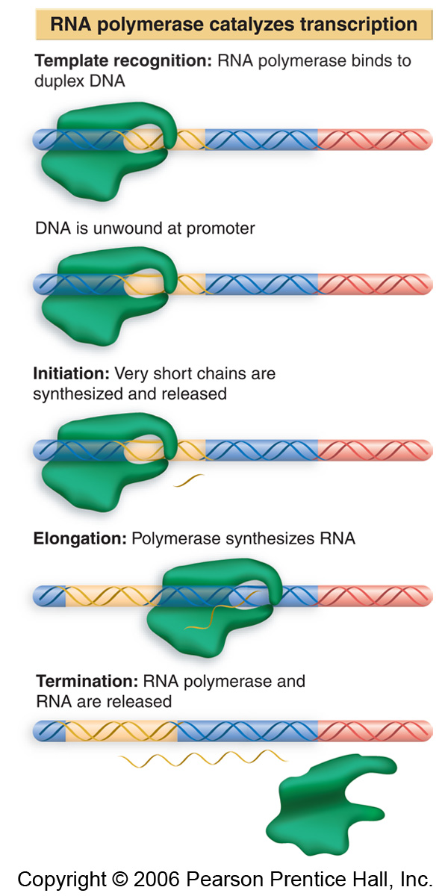
Notes:
The polymerase binds at the promoter, then there will be an opening of the double helix and polymerase initiates transcription. The polymerase has a high affinity to the promoter because it needs to be able to recognize it easily however it also needs to keep on moving to transcribe the rna which is difficult because of this high affinity. One consequence of that is that it synthesizes very short mrna chains when it is sitting at the promoter ( usually less than 10 bp) and then it will either leave or continue to sit at the promoter. AT one point it will leave the promoter and the chain of rna synthesized will be longer and it will continue until it meets the terminator sequence and when it stops the rna is released and the polymerase is released aswell.

Slide 8
RNA polymerase
Makes phosphodiester bonds
Notes:
RNA polymerase usess ribonucleotides as building blocks and uses phosphodiester bonds between them.

Slide 9
RNA polymerase
Phosphodiester bond formation
RNA-OH +NMP → RNA-NMP + H₂0 ΔG°’ = + 6.0 kcal/mol
H₂0 + NTP → NMP +Ppi ΔG°’ = -8.6 kcal/mol
_____________________________________________________
RNA-OH +NTP → RNA-NMP + Ppi ΔG°’ = -2.6 kcal/mol
Notes:
You need to know the overall chemical reaction for this! ( the one at the bottom) RNA synthesis with a 3’ OH plus NTP will elongate the RNA by one nucleotide and will release a pyrophosphate. The delta G for this is overall negative so it is energetically favorable.
The first reaction on top is not favorable, and the second one is so overall u get -2.6kcal/mol so it is the hydrolysis of NTP that provides the energy for this overall reaction to be energetically favorable. This energy is needed by the rna polymerase in order to move along during elongation of transcription.
All kinds of RNA’s in prokaryotes are synthesized by a single kind of RNA polymerase in prokaryotes.
RNA polymerase doesn’t need a primer, it starts at position +1.

Slide 10
RNA Polymerase (465 kDa)
α subunits (2X)
β et β’ subunits Catalytic center
ω subunit
The above subunits constitute the Core Enzyme
σ (sigma) subunit Promoter recognition
Notes:
Don’t need to remember size but remember that rna polymerase is split into two parts and
One of them is the core enzyme which contains two a subunits and B and B’ subunits and the omega subunit. And remember that B and B’ are the largest and they comprise the catalytic center and they’re what synthesizes.
If u add the sigma subunit than u get the holoenzyme which is needed to recognize the promoter.

Slide 11
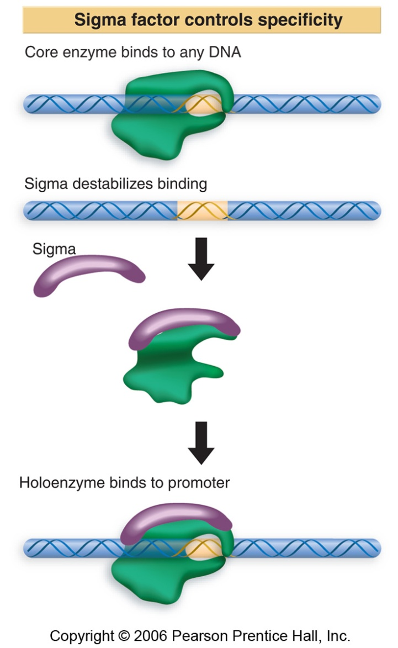
Sigma modifies the DNA affinity of the core enzyme
Notes:
Sigma is very important because that is what allows the POLYMERASE enzyme to recognize the promoter. So in these figures core enzyme is in green and sigma is shown in purple so here you have the holoenzyme, the coreenzyme has the same affinity for dna but it cannot distinguish between sequences in dna that are promotors and the sequences that are not promoters, however when sigma binds the core to form the holoenzyme, it causes 2 consequences: 1) it decreseas the affinity of the corenzyme to non promoter sequences 2) it increases the affinity of the corenzyme for sequences that are promotors.

Slide 12
Sigma modifies the DNA affinity of the core enzyme
sigma
  Reduces the affinity of the core enzyme for sequences that are not promoters.
  Increases the affinity of the core enzyme for promoter sequences.

Slide 13
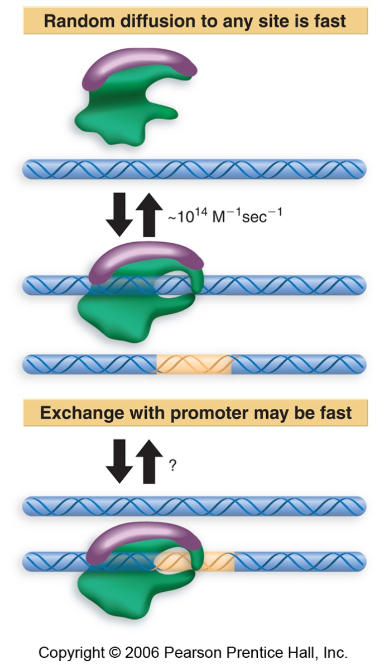
How does RNA polymerase find the promoter?
Different models
  Diffusion
  Exchange
Notes:
How does rna polymerase leave the promotor? By releasing sigma, it is able to leave the promotor and go into elongation phase.
In order for RNA polymerase to recognize the promoter it needs sigma but how does it do this exactly? Three models have been proposed that we have to know and two of them are shown on this slide. Here we have the holoenzyme and in the first model it is called diffusion, the holoenzyme binds weakly at random and sees if it’s a promotor if not than it it will go back to the mileu and do this again and again until it finds the promotor which it has a high affinity to and then it will stick to it. The binding, unbinding, binding and unbinding is too slow for this model to be realistic.
The second model is called Exchange and inorder to understand it u have to know that the bacterial dna is circular but in real life it is all over the place and so in the exchange model the holoenzyme also binds the dna weakly at random but because the dna is close to each other it sees the other sequences and if it finds a sequence that it likes bettr than it will exchange the old one for the new one and in this model exchange is simultaneous ( it does not go back to the melieu not binding unbinding etc). This model is the most likely to be correct(exam question)
In the third model it scans linearly along the dna molecule and does not bind until it finds the promotor molecule. This model has no evidence that it exists.

Slide 14
Transcriptional Unit
  Promoter
  Start site (+1)
  Terminator
Notes:
We will talk about some features of the dna at the promotor. The positions indicated on the dna on this slide are important positions in prokaryotic transcription. A typical bacterial promotor has two consensus sequences.

Slide 15
Promoter
Two consensus sequences
Structural changes
Activators and repressors
TTGACA------------------------TATAAT------------ +1
(-35) 16-19 bp (-10) 5-9 pb
Notes:
At the positions shown above, . Remember positions and stuff.

Slide 16
Consensus Sequence
T₈₀A₉₅T₄₅A₆₀A₅₀T₉₆
Notes:
This figure is one way of representing the TATAAT. What do the numbers mean? When they did a survey they found that the consensus is not perfect, they found that 96% of the time it finishes with a T and 95% of the time the second one is an A .. So this is a convention for the consensus sequence. This sequence is at -10 position. This will always be 6 letters but not always these letters. This sequence on the slide is the BEST -10 sequence which means the polymerase will like it most and bind to it most strongly, but if it one letter is different binding might be less strong and this is useful because not all promotors are equal, there are strong ones and weaker ones, and in the cell we don’t need to make all proteins at the same level and that’s why in real life we don’t always have this sequence exactly. These sequences are consensus but they are not inveriable

Slide 17
Mutations in promoters
“down” mutation:
  Decreases transcription efficiency.
  The sequence is further away (differs more) from the consensus sequences.
“up” mutation (not as frequent)
  Increases transcription efficiency
  The sequence is closer to (resembles more closely) the consensus sequence.
Notes:
Mutations can affect promotors, and when we’re talking about a mutation that makes the sequence further away from the ideal sequence than it would be a down mutation and this would decrease transcription efficiency.
Up mutation is when u start with a sequence that is not perfect and a mutaion makes it more like the ideal increasing transcription efficiency as polymerase binds more.

Slide 18
Different sigma factors
Factor Sequence –35 Sequence –10 Used for
___________________________________________________________
σ⁷⁰ TTGACA TATAAT general
σ³² CCCTTGAA CCCGATNT heath shock
σ^{E} ? ? heath shock
σ⁵⁴ CTGGNA TTGCA nitrogen metabolism
σ²⁸ CTAAA GCCCGATAA flagellae
Notes:
There are different kinds of sigma factiors,
each one recognizes a distinct set of core sequences,
these are sequences or promotors used for different cellular functions
Don’t need to remember anything else.

Slide 19
DNA winding and unwinding
- Supercoiling.

Slide 20
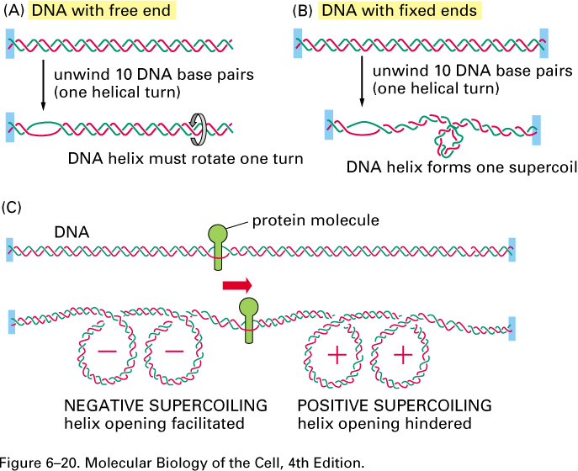
Notes:
When rna polymerase moves along the molecule it opens it and creates tension. On the top we have a dna molecule that is fixed at one end and when you open the helix supercoiling occurs as shown, this can be positive or negative, and what is positive and negative is purely arbitrary. So in one case it supercoils to the front and the other case it supercoils to the back.

Slide 21
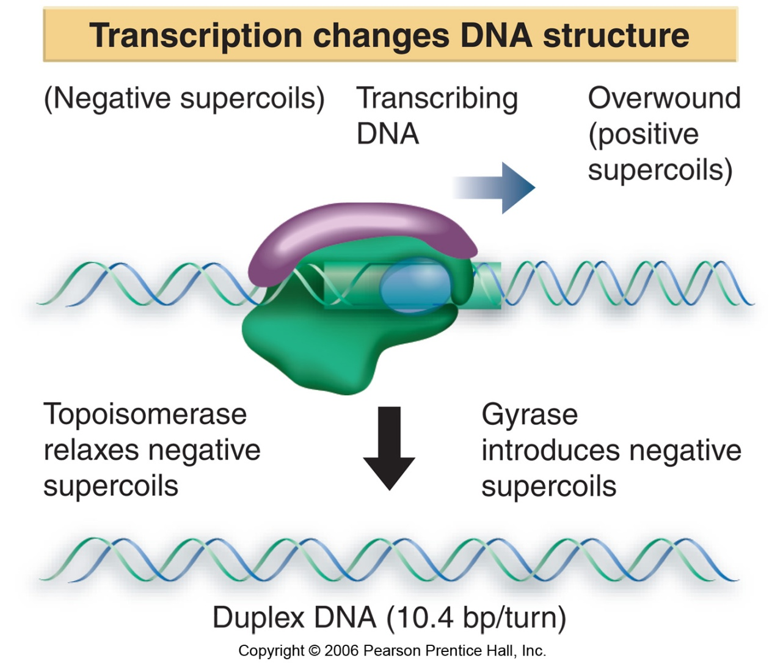
Notes:
In this slide it shows you dna that is fixed at both ends, RNA polymerase in elongation mode creates positive supercoiling in the front and negative supercoils at the back. The dna in bacterial cell is naturally negatively supercoiled which is thought to help the movement of rna polymerase. Gyrase will introduce more negative supercoiling, so at this point the dna has excessive negative supercoiling so the topoisomerase will bring the dna back to it’s natural negative supercoiled state.

Slide 22
DNA winding and unwinding
DNA gyrase introduces negative supercoiling.
Topoisomerase 1 decreases negative supercoiling.

Slide 23
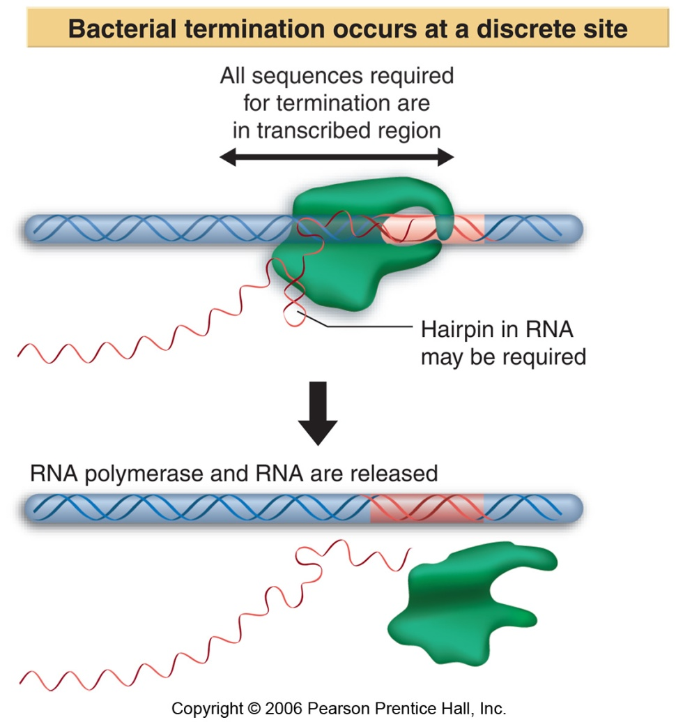
Transcription Termination
Notes:
Termination is the last of the 4 steps of transcription, and termination occurs when the polymerase reaches the terminator. Termination in prokaryotes is a lot better understood than eukaryotes.

Slide 24
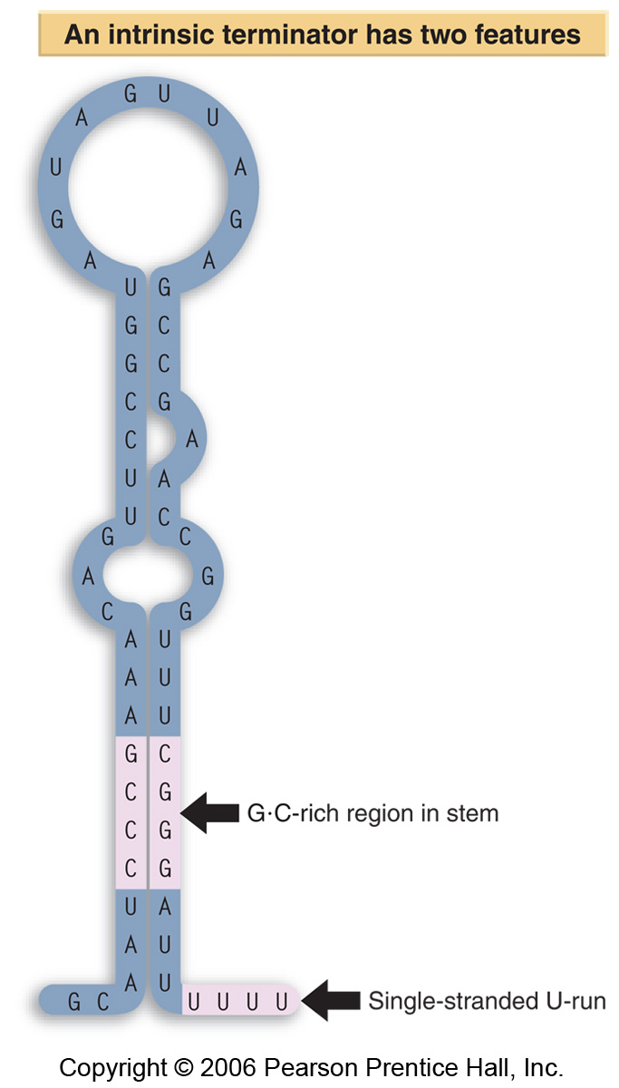
Transcription
Termination
Intrinsic terminator
Notes:
There are two kinds of terminators in prokaryotes: 1) intrinsic terminators and 2) Rho dependent terminators.
Intrinsic is because the information for termination is intrinsic in the rna, It is part of an rna molecule that’s in a hairpin structure. It has a loop and a GC rich region and single stranded U-run, this signals that rna polymerase to stop transcription.

Slide 25
Transcription Termination
Rho-dependent terminators
  Rho: 46 kDa proteins that forms hexamers.
  Termination sequence (for Rho binding): 50 to 90 nt.
  Has ATPase activity and helicase activity that separates the RNA-DNA hybrid.

Slide 26
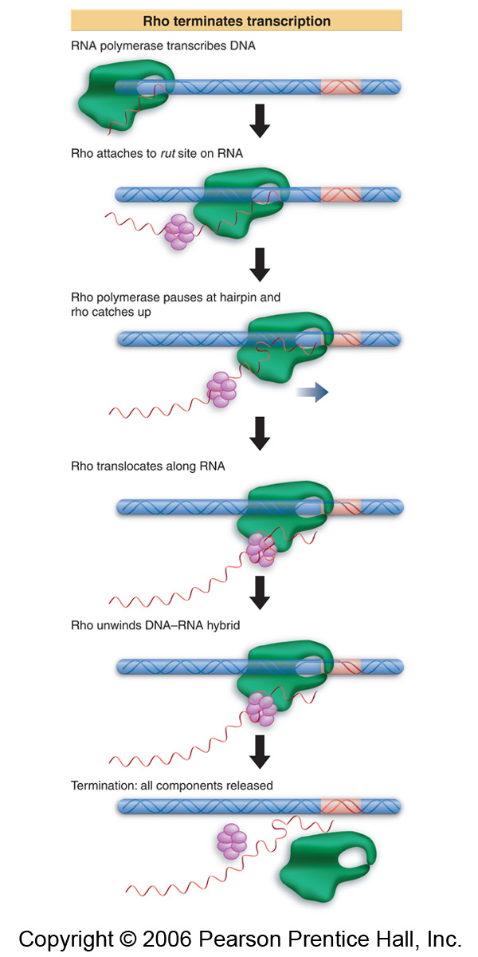
Notes:
Rho is a protein, which forms hexamers and has helicase activity. And it works like this. It synthesises a sequence for which rho hexamer has affinity. Once rho sees it it binds to it and it starts chasing the polymerase and once it reaches the polymerase it’s helicase activity melts the binding of rna polymerase to dna and so the dna is released. So there is a certain sequence within the rna that attracts the rho which brings about termination here.

Slide 27
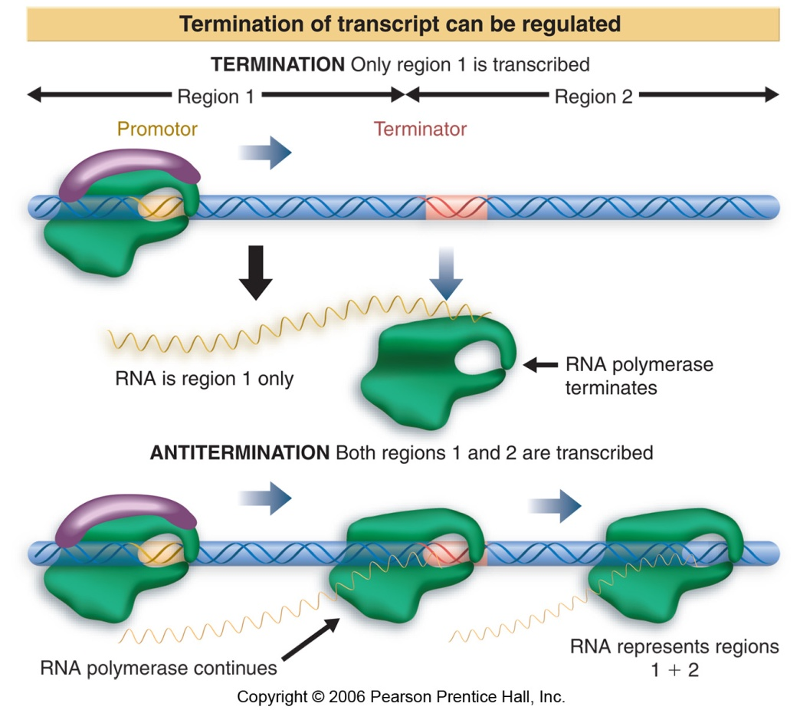
Transcription Termination
Anti-termination
Notes:
So what we’ve seen with the intrinsic and rho terminators the polymerase reaches the terminator and stops but there will be times in the cell where the polymerase will ignore the terminator and will make a longer rna molecule. The anti termination process involves the binding of protein that allows the polymerase to ignore the terminator sequence.

Slide 28


