Slide 1
Transcription in Eukaryotes I
8 October 2013

Slide 2
The various types of RNA
mRNA messenger RNA
rRNA ribosomal RNA
tRNA Transfer RNA
snRNA small nuclear RNA
snoRNA small nucleolar RNA
siRNA****
microRNA
ncRNA other non-coding RNAs
Notes:
There are different kinds of RNAs in eukaryotes that are not found in prokaryotes. snRNA involved in splicing, snoRNA synthesis of rna, siRNA (not really endogenous to eukaryotic cell), microRNA are endogenous to the cell

Slide 3
RNA polymerases in eukaryotes
Enzyme Localization Transcribed genes
RNA pol I nucleolus rRNA 5.8S, 18S & 28S
RNA pol II nucleoplasm proteins, snoRNA,
some snRNA, miRNAs,
RNA pol III nucleoplasm rRNA 5S, tRNA, some snRNA
Notes:
There are three rna polymerases in eukaryoutes, versus one in prokaryotes. Need to know which polymerase synthesises which gene or RNA. Pol II synthesises mrna and hence protein.

Slide 4
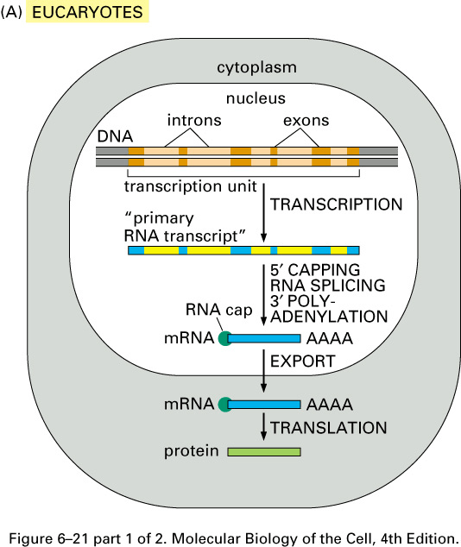
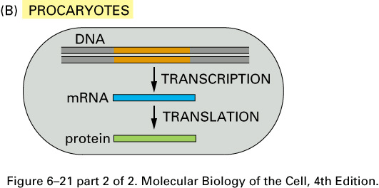
Notes:
Another difference is that mrna transcription takes place in nucleus and the fully mature mrna is exported to cytoplasm where it is translated into proteins, in prokaryotes transcription and translation occur in cytoplasm because there is no compartmentalization and hence it can not occur simultaneously.

Slide 5
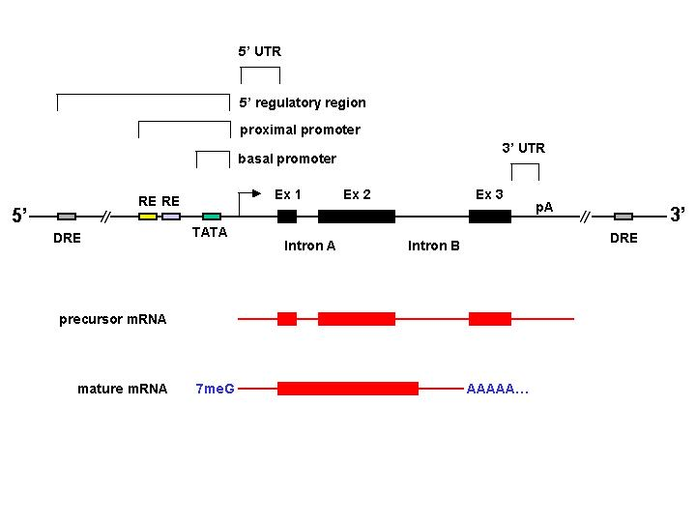
The RNA polymerase II transcription unit
Notes:
1) This is a transcriptional unit for a gene transcribed by rna pol II and the arrow indicates where transcription starts at position +1 , the black boxes are exons, we have a region of 5’untranslated region and there is a region called the 3’ untranslated region and they do not code for proteins but they are also a part of the exons. So wehn this region of dna is transcribed we get precursor mrna whcih will undergo modifications such as splicing of introns, addition of 5’cap and addition of 3’ tail on the right.

Slide 6
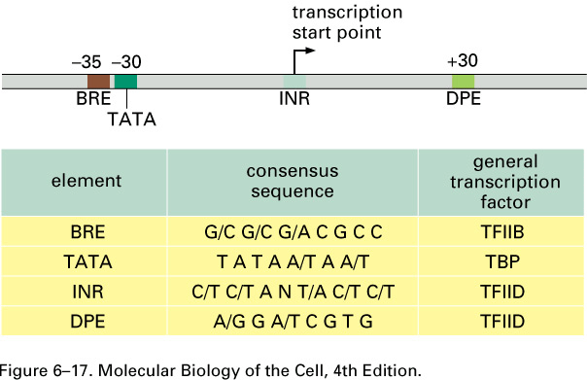
Consensus Sequences at the Basal Promoter
INR: initiator
DPE: downstream promoter element
Notes:
So the region that surrounds the start site (where the arrow is) is called the basal (or core) promotor, which is where the transcriptional machinery assembles which includes RNA polymerase, this core promotor contains a number of consensus sequences. We will talk about 4 of them, u need to know thier names, and positions. The best known is the TATA box but not all promotors have the TATA element, BRE is at -35 and INR is called initiator and it is at +1 and DPE downstream promotor element is at +30. Each of these four elements make contact with the transcriptional machinery. You need to know which transcriptional factor makes contact with which promotor but you don’t need to memorize the consensus sequence.

Slide 7
RNA polymerase II-associated transcriptional machinery in eukaryotes.
RNA polymerase II
General transcription factors
Mediator complex
Chromatin remodeling complex
Histones acetylases
Elongation factors
Capping, splicing, and polyadenylation factors.
Notes:
The transcriptional machinery includes all the above.

Slide 8
RNA polymerase II-associated transcriptional machinery
More than 95 subunits
More than 2,5 million daltons.
Notes:
Don’t need to remember number of subunits or size.

Slide 9
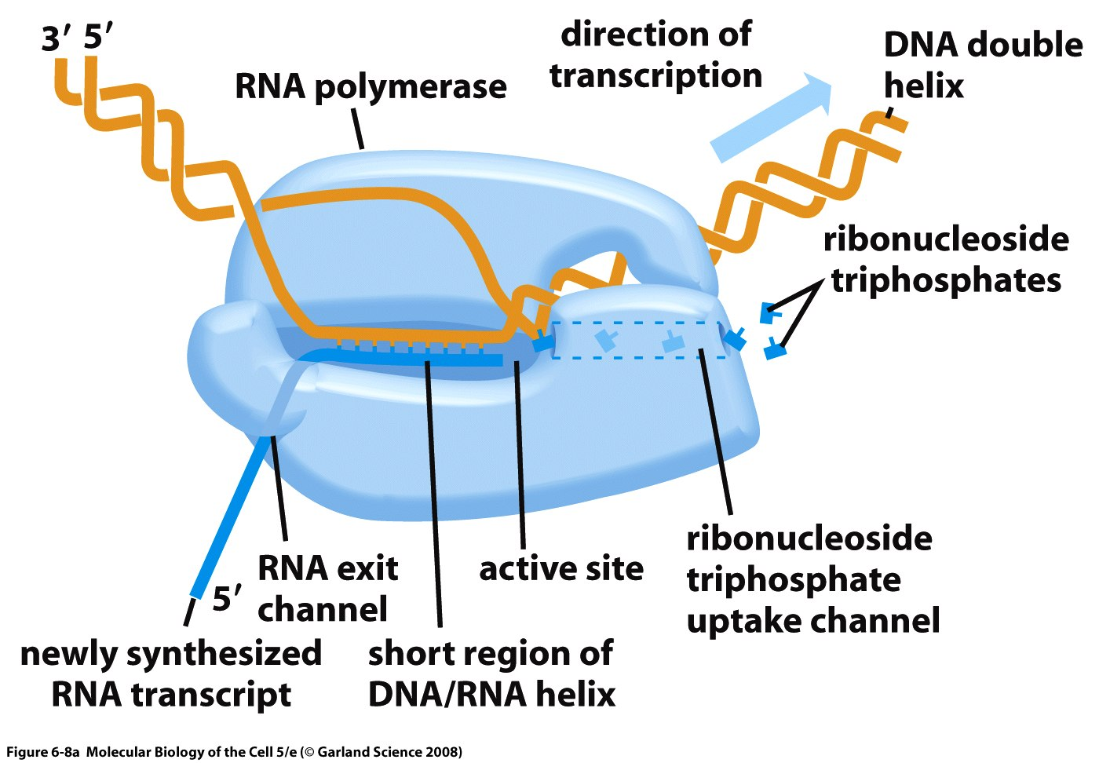
RNA polymerase
Notes:
DNA double helix is opened up and creates a transcriptional bubble and the bottom strand is the template strand and the top one is the non-template strand. RTP’s enter at a specific site and at the active site they are introduced one by by at the growing RNA chain shown in blue. The overall movement of the rna pol II is towards the right.

Slide 10
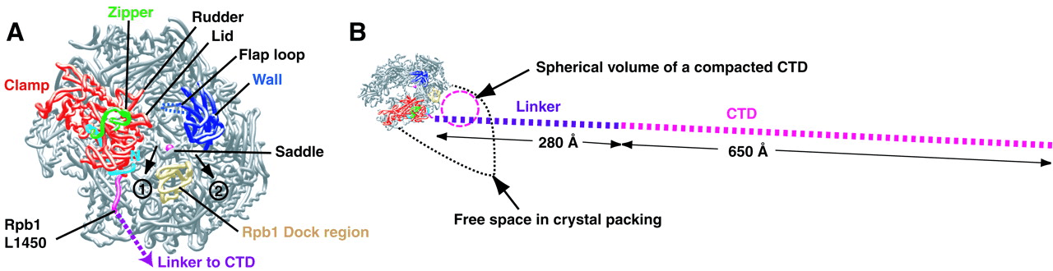
C-terminal Domain
Heptamer motif in C-terminal domain:
Tyr-Ser-Pro-Thr-Ser-Pro-Ser
Notes:
The C-terminal domain is shown on the right and can exist in two different configurations, the first one is just like a purple or pink circle, or it can exist in an extended configuration which takes up a lot of space, and this CTD contains a stretch of 7 amino acids, don’t need to remember the exact heptamer sequence but need to know the two serines one at position 2 and one at position 5. CTD going from compact to extended form allowst the rna polymerase to leave transcription.

Slide 11
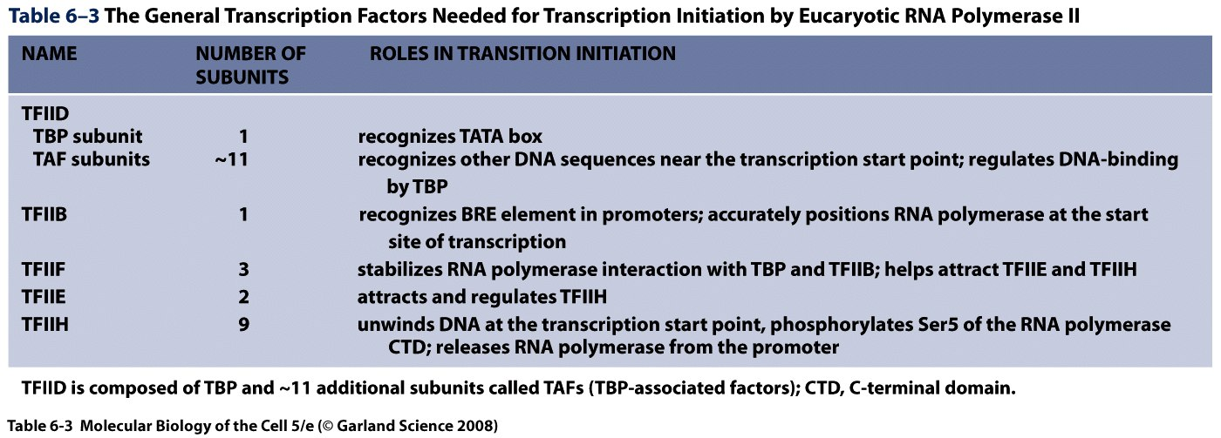
General Transcription Factors (GTF)
Notes:
GTFs are proteins that can be found at all promotors that use rna pol II. The order in which they have been placed in the table is the order by which they assemble for transcription. Need to remember everything except the number of subunits.

Slide 12
TFIID
TBP plus about 11 associated factors: TAF
Notes:
TFIID is devided into tow components th tata binding protein TBP and the associated factors called TAF.
TBP binds the TATA element in the core promotor. TAF in TFIID one of thier function is to associate with other promotors other than tata. The usefulness of these is that all promotors have a tata element so u do not necessarily find all four elements on each promotor.

Slide 13
TBP
TATA-binding protein
Saddle shape
Creates bending of the DNA at the level of the TATA motif.
Facilitates binding of TFIIB
Could also help prevent nucleosome formation.

Slide 14
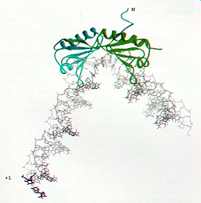
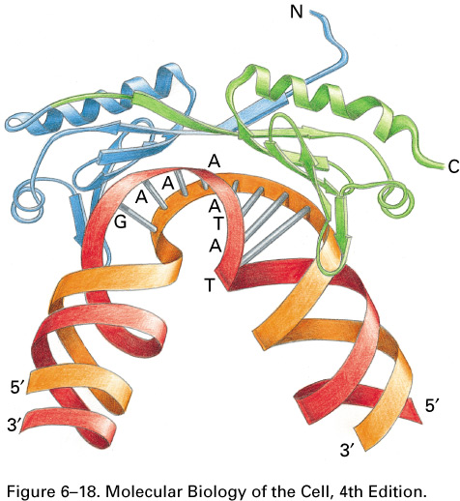
Bending of the double helix by TBP
Notes:
It creates a bend in the double helix. There are other functions that are thought to be associated to TBP and one of them is to facilitate the binding of TFIIB and the bend in dna that it creates maybe useful to prevent the formation of nucleosomes which can be an obstacle to transcription.

Slide 15
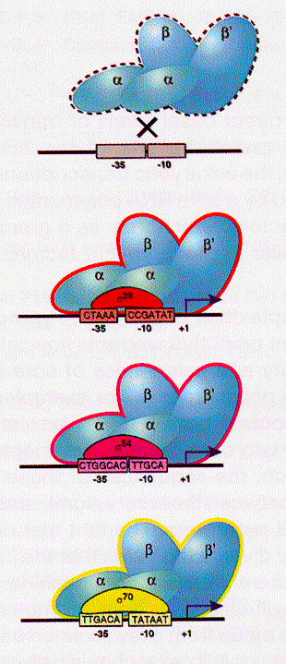
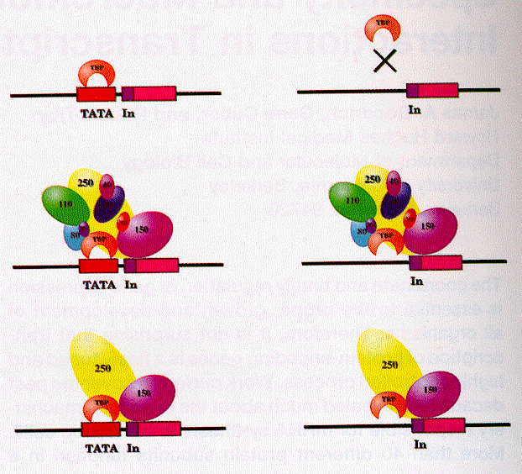
Analogy between the roles of TAF (eukaryotes) and sigma subunits (bacteria)
Notes:
This slide shows the tata element and the inr elements and here the tata is bound by TBP and here on the right if there is no tata TBP cant’ bind. In the second one we see that TAF can actually make contact with other components on promotors and this is true if there is a tata or if there is no tata. The balls are the TAFs. There are different kinds of sigma factors which can recognized different consensus sequences in prokaryotes and in analogy to TAFs in eukaryotes, different TAFs can recognize different core promotors.

Slide 16
TFIIB
Single Polypeptide.
Binds DNA. Recognizes the BRE element and orients the transcriptional complex.
Notes:
The next GTF is TFIIB and it binds the BRE element on the core promotor. One very important function of TFIIb is that it orients the transcriptional machinery. And the relative position of BRE has a determining affect on which direction is to be taken to transcribe.

Slide 17
Consensus sequences at the basal promoter
INR: initiator
DPE: downstream promoter element

Slide 18
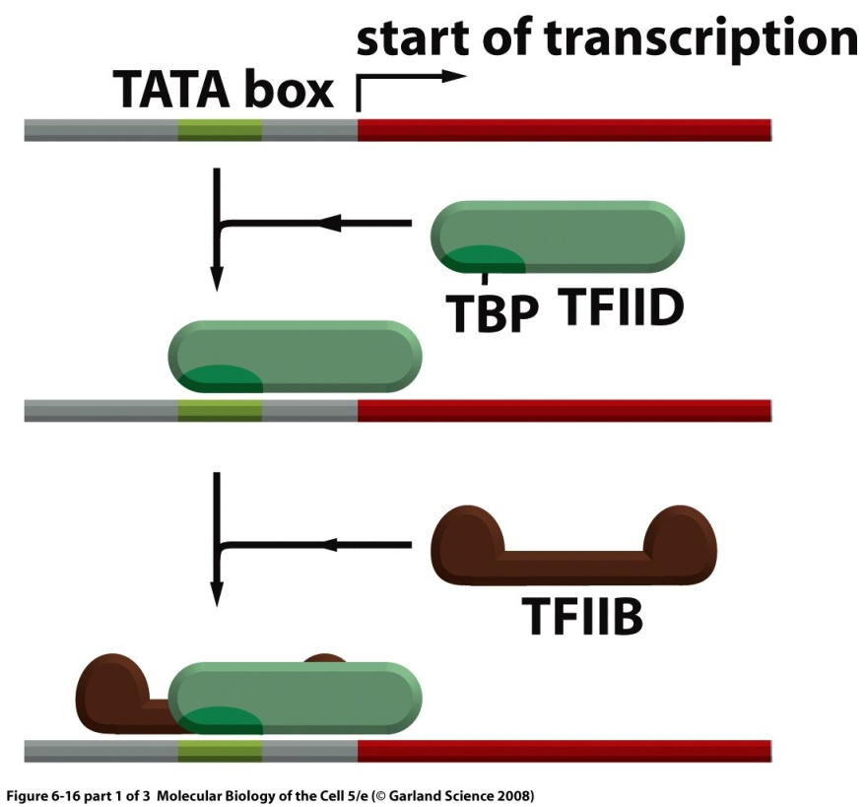
Assembly of the Transcription Initiation Complex
Notes:
That’s shown on this slide.

Slide 19
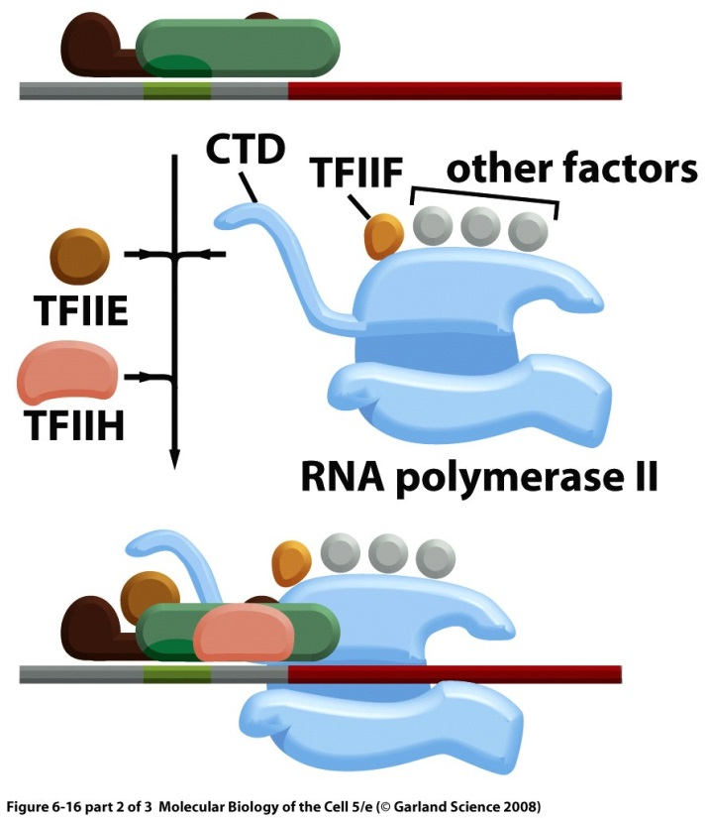
Assembly of the Transcription Initiation Complex

Slide 20
TFIIH
8-9 subunits
Enzymatic activities
  ATP-dependent DNA helicase to open the double helix
  Protein kinase activity that phosphorylates the C-terminal domain. This step is crucial for the switch to the elongation phase.
Notes:
TFIIH has helicase activity that opens dna to create bubble and also has protein kinase activity which phosphorylates the CTD which is important for it it take the elongated form which is important for RNA polII to leave the promotor and start elongation.

Slide 21
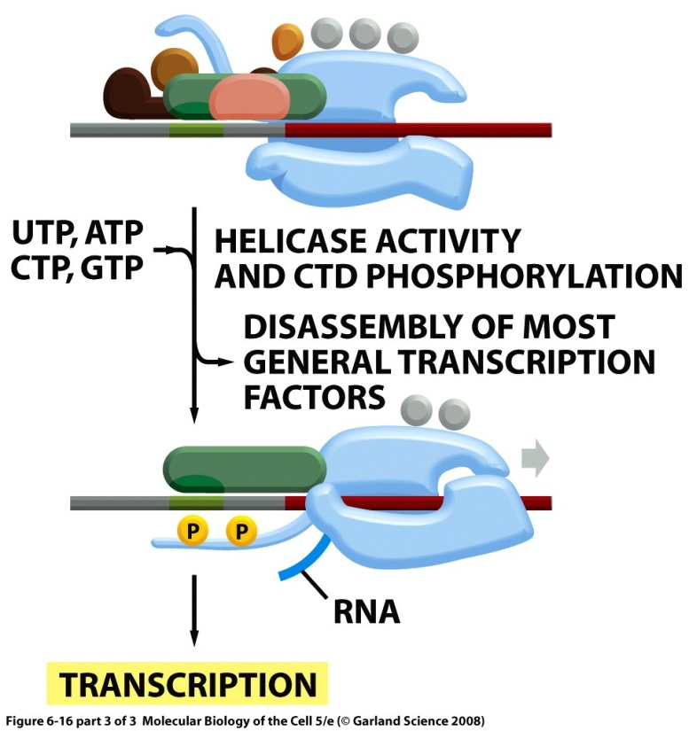
Assembly of the Transcription Initiation Complex
Notes:
This is RNA polymerase II and it has its CTD fully extended (top left) , this is a mistake at this stage it should be compact and already bound to the polymerase when it enters, TFIIH is the biggest of all GTF dont remember subunits. At the end the CTD is extended and phosphorylated and rna pol II is going to elongation stage.

Slide 22
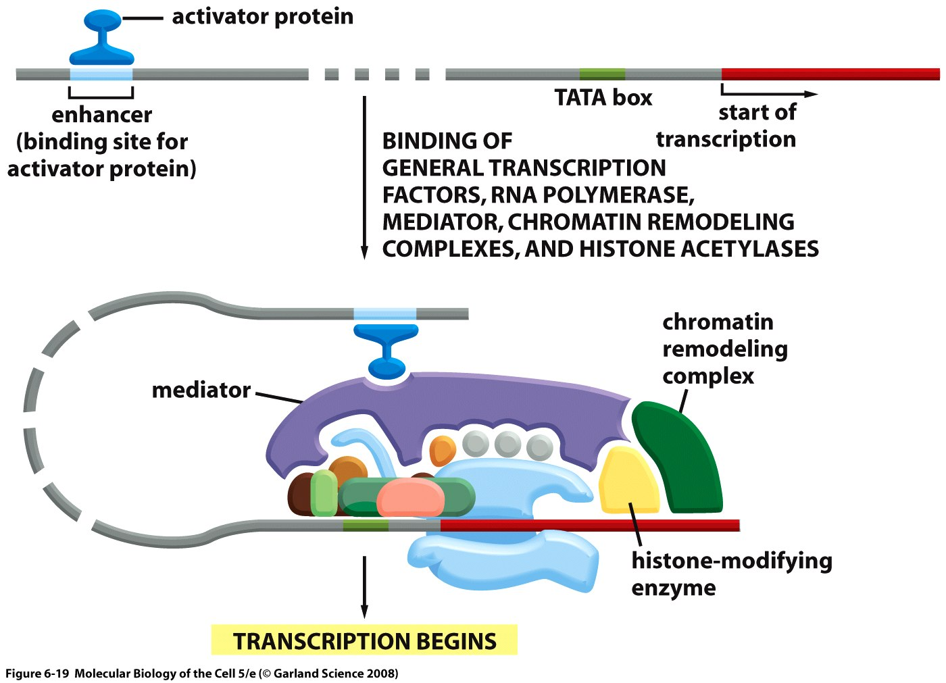
Mediator Complex
Notes:
Mediator complex a bunch of proteins that does not make any contact with the dna what it does is mediate and make bridges between the transcriptional machinery. It makes contacts with activator proteins and the chromatin remodeling complex etc.

Slide 23
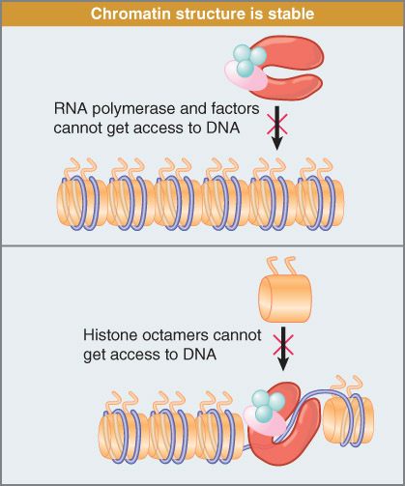
Chromatin structure creates problems for transcription.
B. Lewin, Genes IX, chapt 30
Notes:
Nucleosomes create an impedement for transcription and so the transcriptional machinery needs to deal with this. Inorder for the polymerase to get to the dna there needs to be changes in the chromatin structure, which is done by chromatin remodeling complexes shown in green in the next slide.

Slide 24
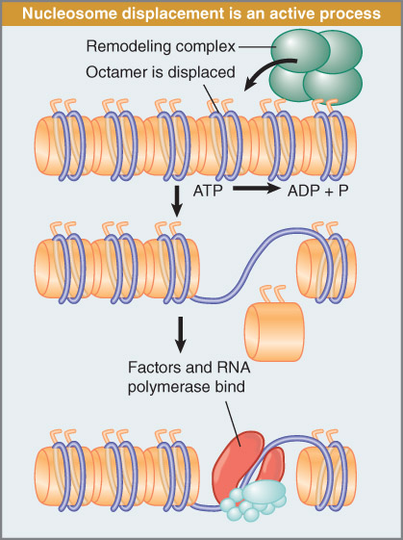
Some form of nucleosome displacement is necessary
B. Lewin, Genes IX, chapt 30
Notes:
The chromatin remodeling complex displaces the octamer and allows the the rna polymerase complex to have access to the dna.

Slide 25
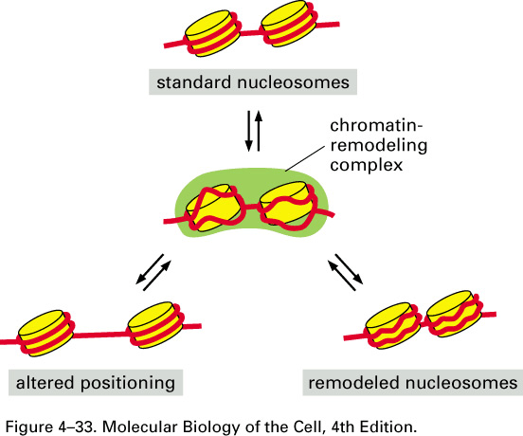
Chromatin remodeling
ATP-dependent remodeling complex
Notes:
Go to initial notes for this.

Slide 26
Chromatin Remodeling Complexes
SWI/SNF: modify the path of DNA around the nucleosome and/or cause nucleosome displacement.
ISWI: displace nucleosomes without changing their structure.
SWR: replace H2A-H2B dimers of nucleosomes with H2A.Z-H2B variant dimers
Notes:
There are many different kinds of chromatin remodeling complexes. They are split into three categories. In the third category the replacement with h2Az-h2b varian dimers will make this region more desirable for transcription.

Slide 27
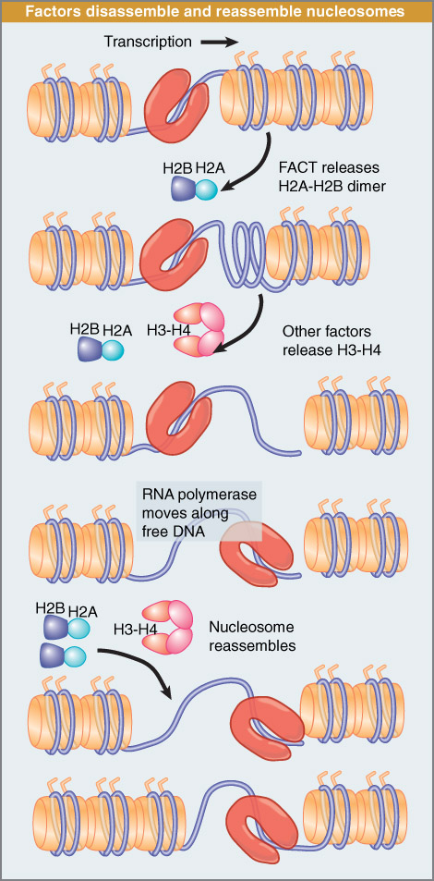
Nucleosome disassembly during elongation
B. Lewin, Genes IX, chapt 29
Notes:
There is a fourth catergory of remodeling complexe category called the FAT remodeling complexes: and what they do is facilitate elongation. What they do is release the H2A h2B dimbers and then other factors will release the tetromers and then make a nucleosome free region that can be transcribed and after transcription is done they reassemble back.
There are activator proteins that bind to specific sequences on dna, where they help attract chromatin remodeling complexes to remove nucleosomes and allow transcription.

Slide 28
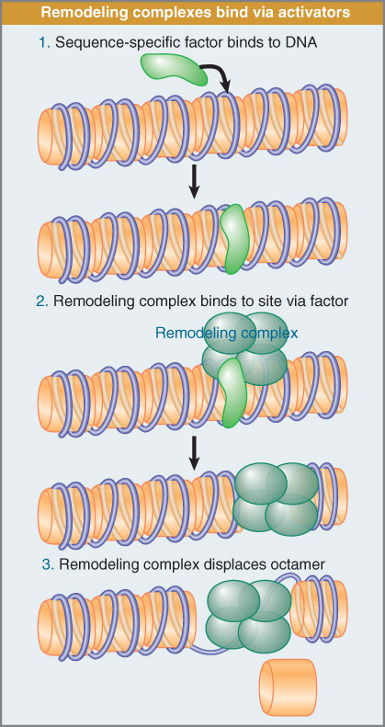
Transcriptional activators help bring in remodeling complex
B. Lewin, Genes IX, chapt 30

Slide 29
Histone acetyltransferases
Acetylate histone tails using acetyl-coA as substrate.
Create a histone code that helps bring in general transcription factors.
Notes:
Histone acetyltransferases are enzymes that make chromatin more favourable for transcription as above. GTF will be brought in to the promotor due to the histone code.

Slide 30
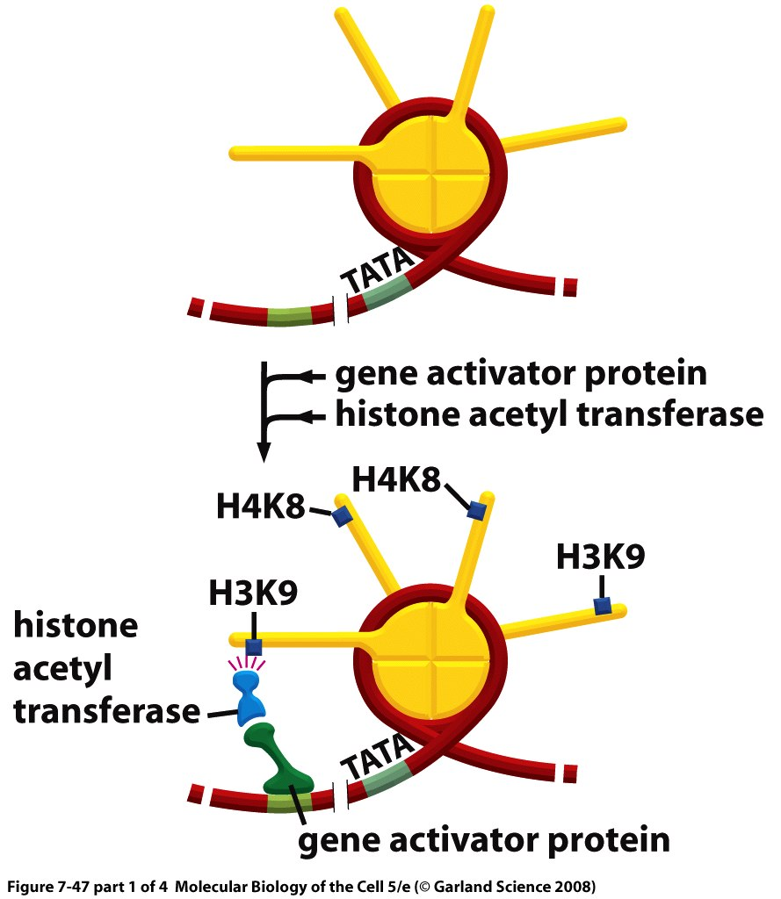
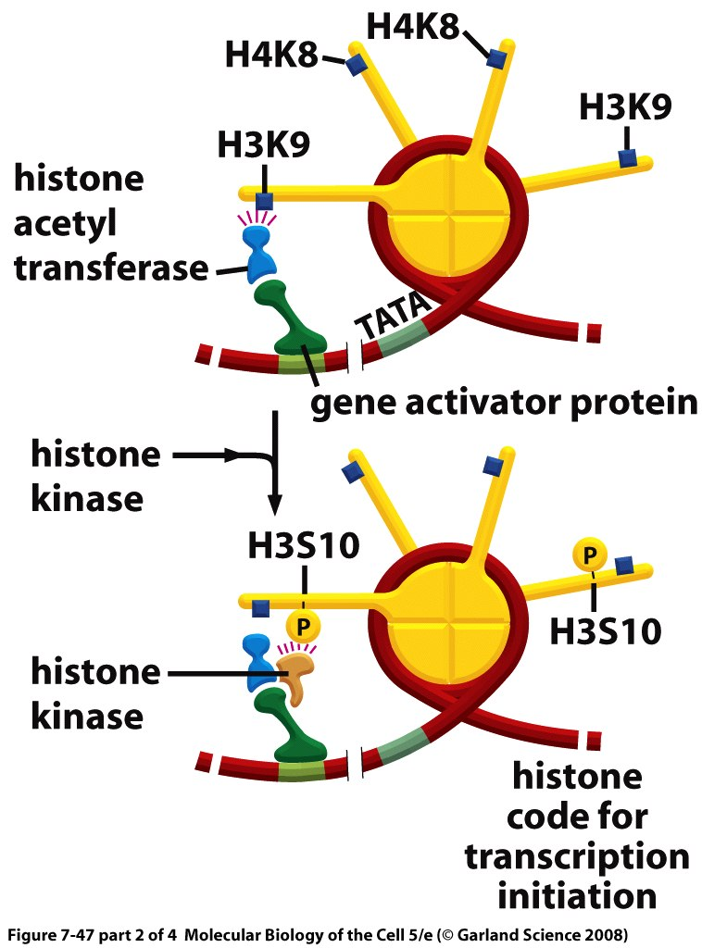
Sequence of events at a specific promoter
Notes:
This is a sequence of events that could take place on a promotor. The green sequence is a sequence that is 1)specifically bound by gene activator protein and one of the ways that these can work is by attracting histone acetyl transferase whcih can acetylate specific residues on the histone tails (don’t need to remember exact positions in diagram) these can also can bring histone kinase which phosphorylates and there will be a number of these modifications taking place showwn in blue squares. These histon modifications will bring a number of proteins which can bring the chromatin remodeling complex shown in green. They can also bring TFIID which is the first binds to the tata element. And then the othere transcription factors assemble here and transcription can start

Slide 31
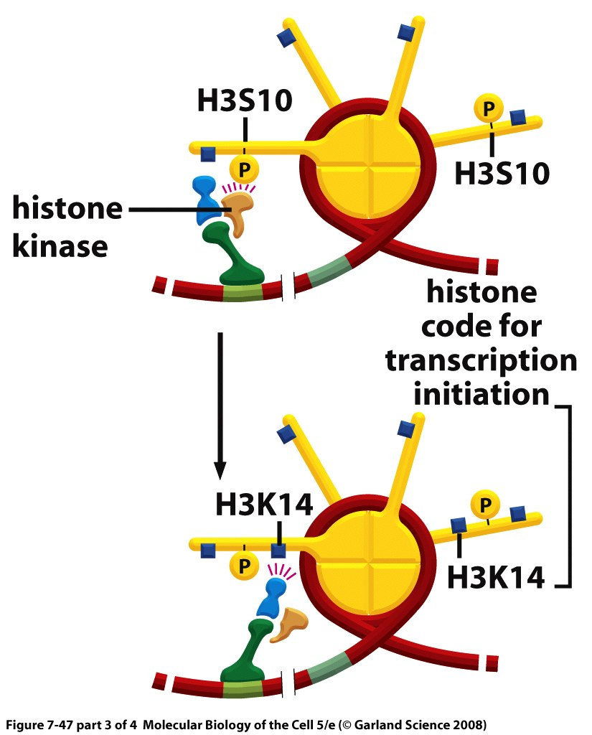
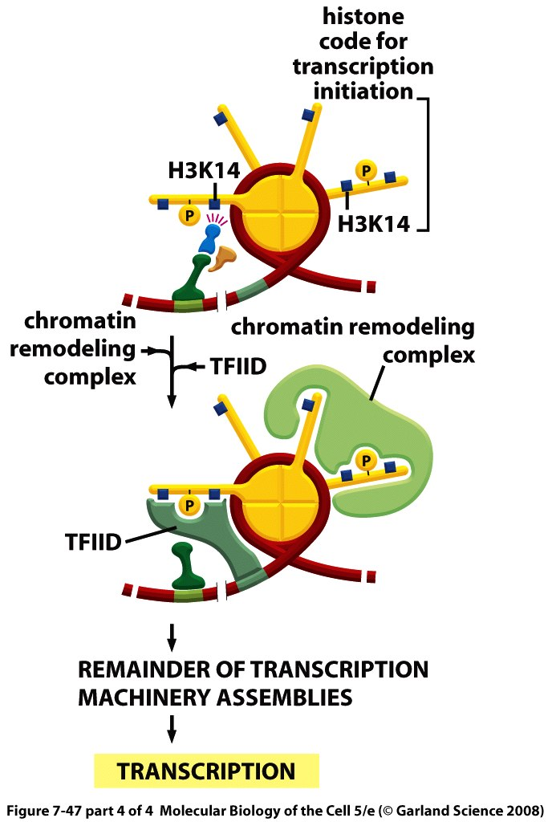
Sequence of events at a specific promoter

Slide 32
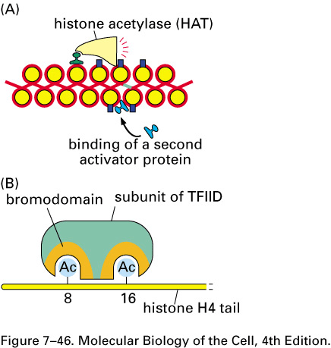
Bromodomain on TFIID
Notes:
Factors like TFIID can bind to acetylated histone tailes because they contain a bromodomain which has affinity for this acetylation.

