Slide 1
Office Hours this Week
Tuesday Oct 29 2:30-4:30 PM
Thursday Oct 31 2:30-4:30 PM

Slide 2
RNA: Structure and Functions
29 October 2013

Slide 3
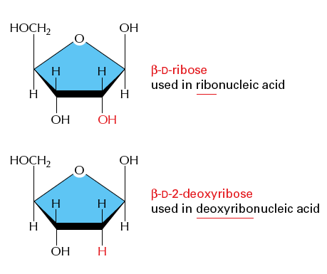
Notes:
Rna has ribose (has a hydroxyl group on C2 unlike dna) and this makes rna particularly unstable because under basic conditions the rna is particularly fragile because of the hydroxyl group

Slide 4
The OH group makes all the difference
Notes:
Don’t remember

Slide 5
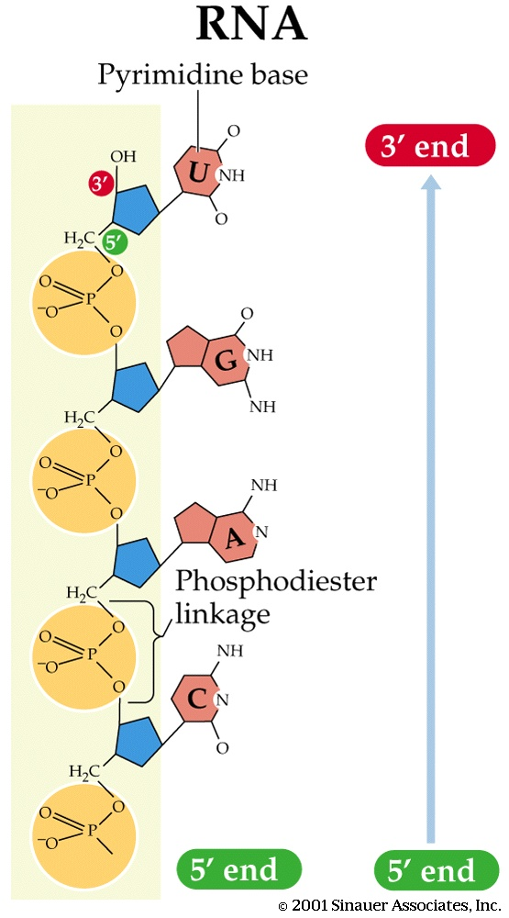
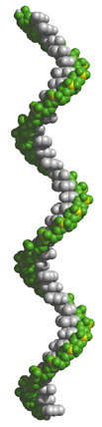
Stacking of single strand RNA
grey = bases
yellow = phosphorus
green = oxygen atoms on phosphate groups
Notes:
Rna is single stranded but it can exist in parts that are double stranded pairings

Slide 6
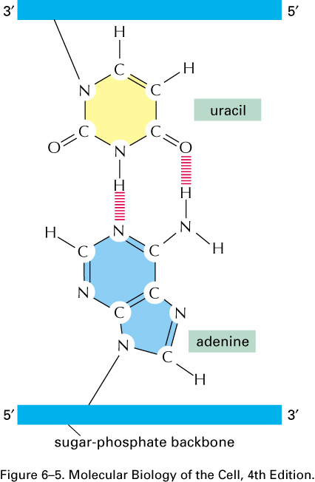
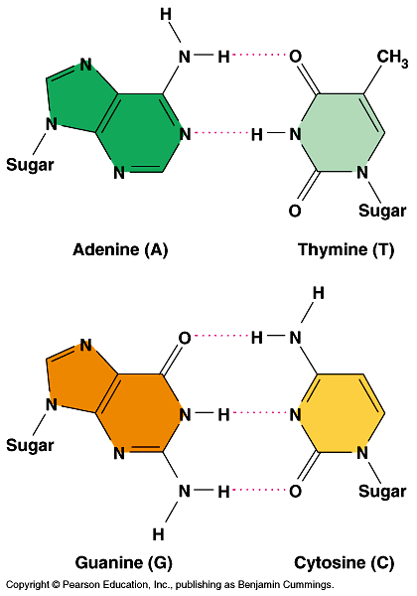
Notes:
These are the base pairings

Slide 7
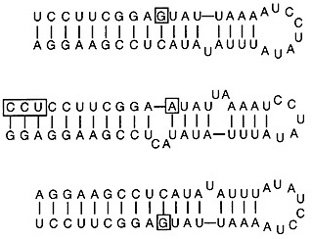
RNA structure
Stems and Loops are commonly found in RNA
Stem
Stems are double-stranded structures contain A-form helices
(DNA adopts B form).
Loop
Notes:
The double stranded part is the step and the single stranded part is the loop and when rna is in a ddstranded structure it will form a helix

Slide 8
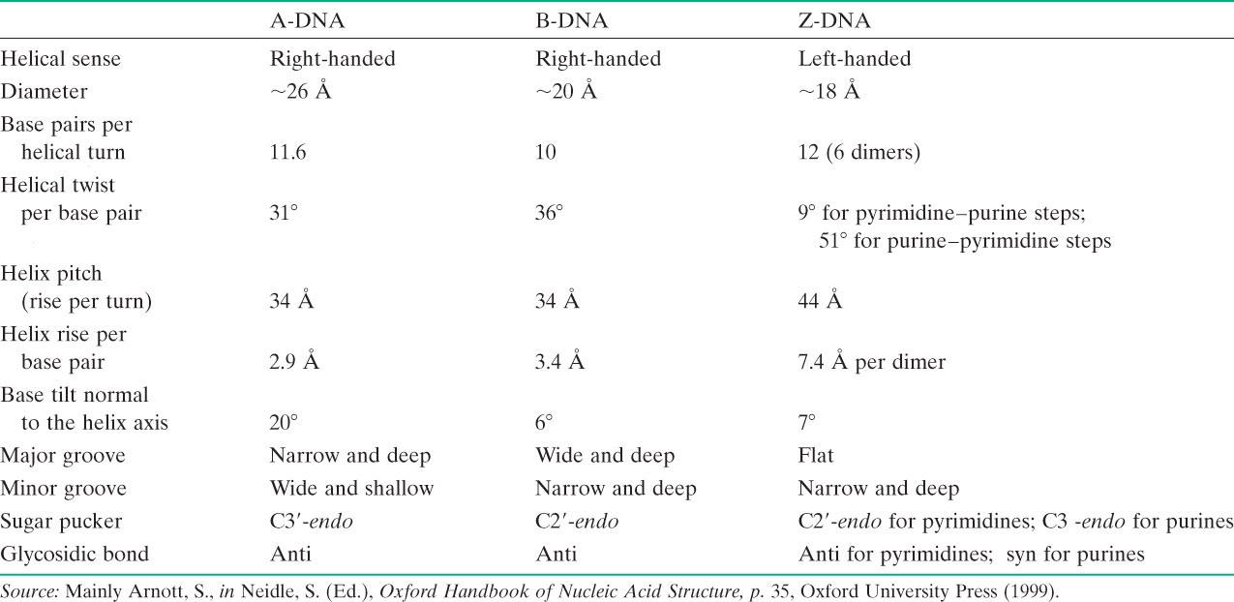
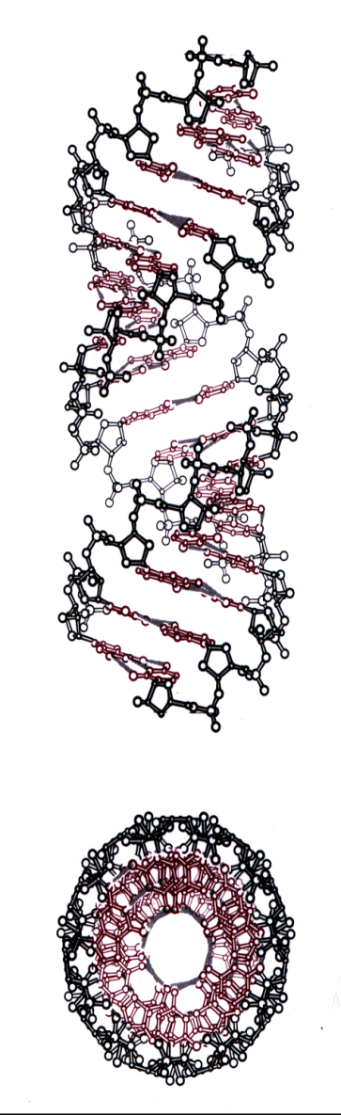
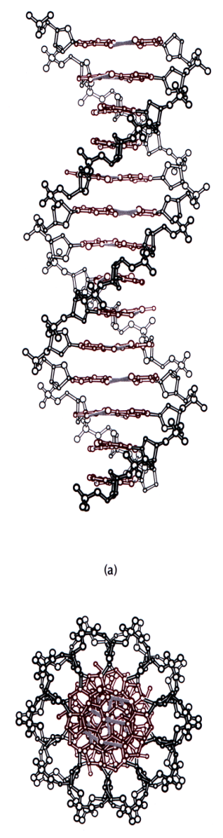
A-RNA
B-DNA
Notes:
This helix will be called the A form in rna whereas in dna is the B form. The difference is that the major and minor grooves are different. Memorize the details of these major and minor grooves.

Slide 9
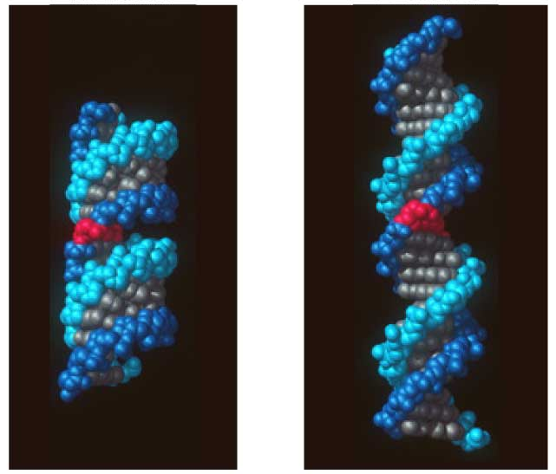
RNA in A form versus DNA in B form
A
B
RNA- A form
Major groove thin and deep
Minor groove not very deep

Slide 10
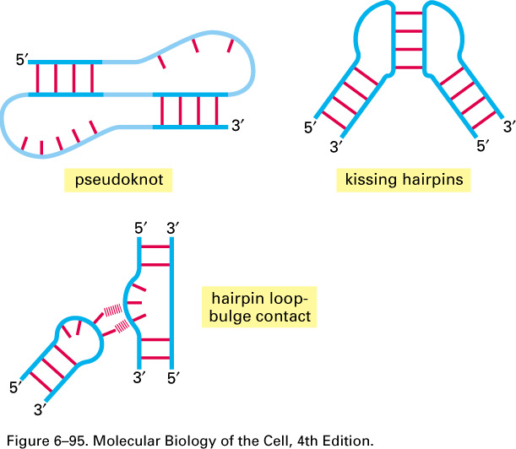
More complex pairing
Notes:
There are other forms that double stranded rna can exist, don’t draw but remember that there are different forms.

Slide 11
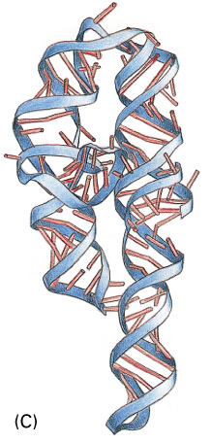
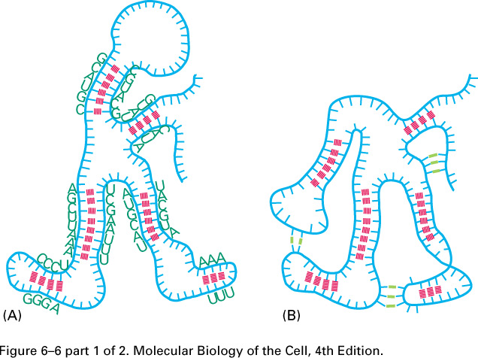

Slide 12
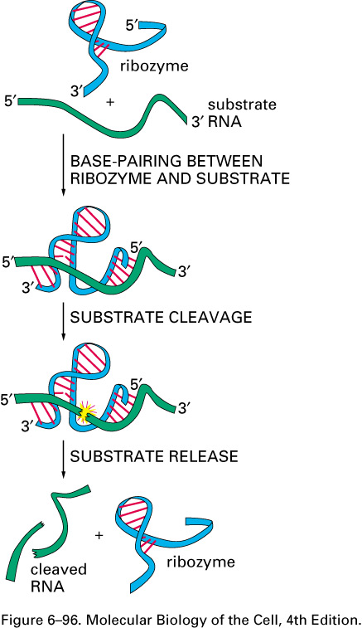
Ribozyme
Notes:
Rna can have catalytic activity for example the ribozyme which is the catalytic site information of polypoptide chain. The ribozyme is a polyribonucleotide that has catalytic activity. Ribozyme here has cleavage activity and will act on the rna substrate and cleave it and ribozyme will be left intact itself.

Slide 13
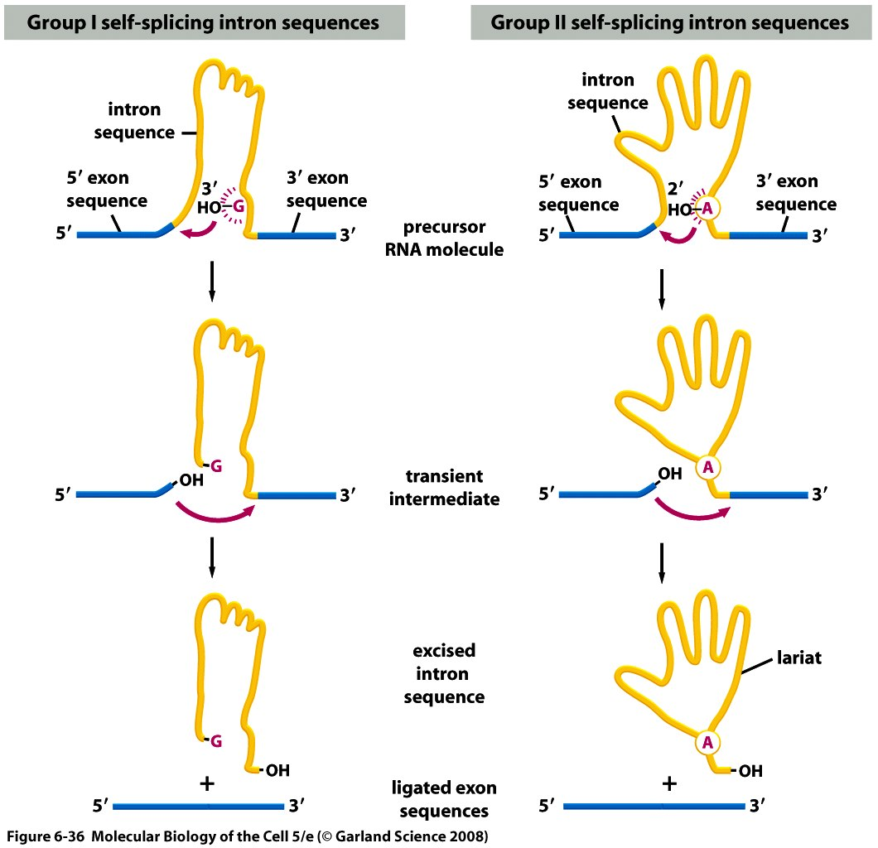
Intron self-splicing
Notes:
Introns that are able to self-splice.here rna’s that are able to splice without snurps and this has been able to be demonstrated in vitro. But in vivo there are proteins that are probaboly facilitating this. This is rare and mainly found in mitochondria and chloroplasts.
Group II: splicing reaction involves an A nucleotide at the branch point that will attack the 5’ exon-intron junction and form a laso structure and after the first transesterification reaction takes place then the free exon end will create the second transesterification reaction to join the exons. The sequences that make up the intron matter and they are specific (unlike in normal major splicing where the snurps are the ones that provide specificity to the process) and these are what makes Group II splicing happen.
Group I:self splicing of Group I is different, it starts with a G which is free floating in the Rna, it will carry out the first transesterification reaction freeing the 3’ end of the exon which will in turn react with the other end and join the two exons and the intron is released in a linear form unlike in group II.
Intron structure also does matter

Slide 14
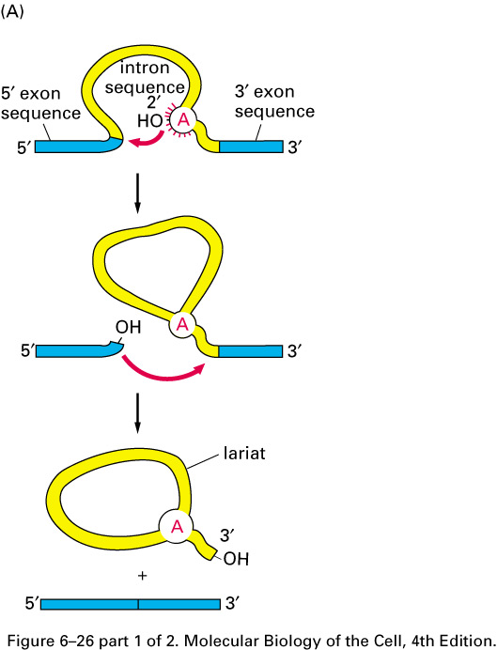
Splicing
1st trans-esterification
2nd trans-esterification
lasso

Slide 15
Intron self-splicing

Slide 16
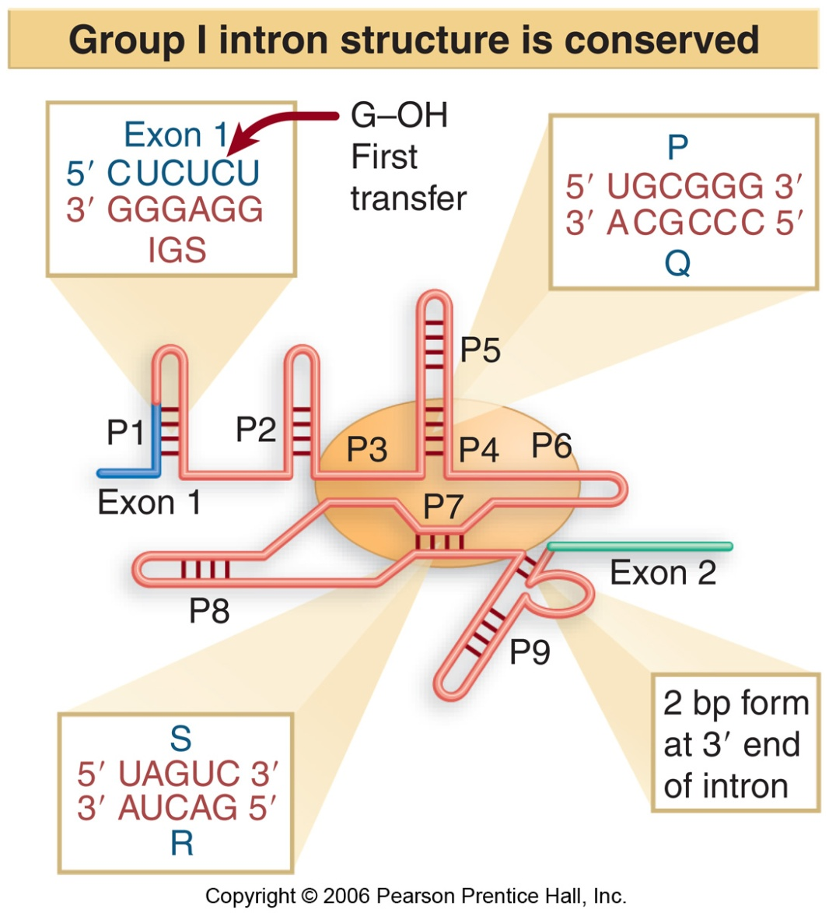
Conserved structure of type I introns
Notes:
Just remember that the sequences that the sequences inside the intron does matter and that this type of arrangement is fairly conserved.
And remember self splicing is mainly present in organeles of karyotes.

Slide 17
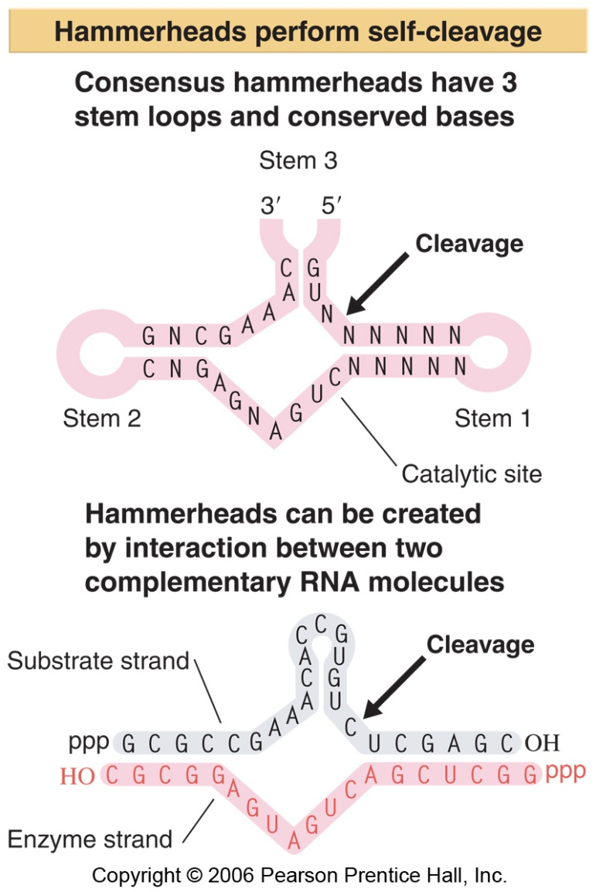
Auto-cleavage of viroïds et virusoïds
Notes:
Another example of rna that has catalytic activity are viroids(no capsid) and virusoids (infect plants, exist in capsid). They have rnas that have a specific hammerhead structure which leads to the cleavage of this rna molecule and occurs at this particular site. People have characterized structure and have been able to recreate this structure in vitro. They created this structure by adding one rna molecule shown in grey and a second one that can base pair with the grey one and they found that it creates the hammer head structure and cleaves at the equivalent site too. What is interesting though is that when this happens this structure breaks and the grey molecule that is now cleaved is freed and the red one is able to base pair to another grey molecule and so it works just like an enzyme and so the red one is called the enzyme strand and the grey on the substrate strand.

Slide 18
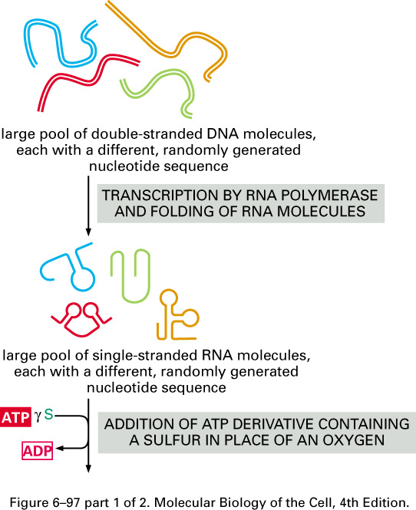
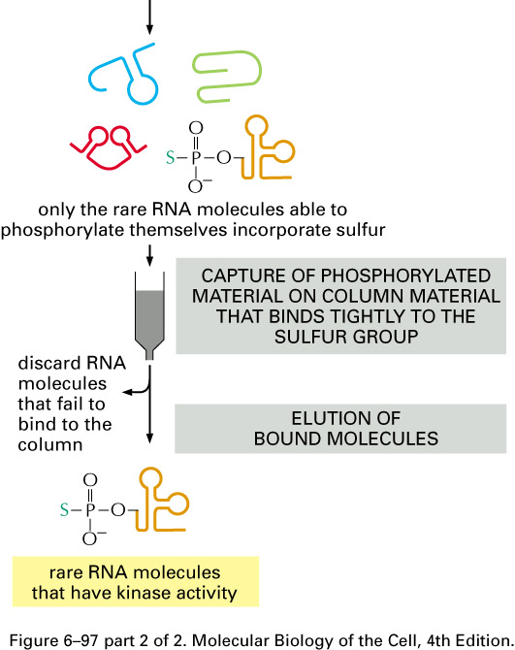
Notes:
The reason this is interesting is because ppl think that by designing an artifical rna of hammerhead structure it could specifically target unwanted rnas in the cell.
This is an experiment was to see if we could identify an enzyme to have a kinase activity (add phosphate group to rna): so they generated a large sequecne of dnas at random then they transcribed them and some of them adopted many secondary structures and then they designed an assay that will allow you to show the existence of this kinase activity and in this assay they used a modified form of ATP as a phosphate donor in which one of the oxygen molecules was replaced with a Sulfur atom on the y-phophate (which will be transferred to the rna molecule) and if there is kinase activity than one of the rna molecule will have a phosphate molecule with a sulfur atom, then they took this mixture and passed it in a column that will bind the compound that contains the modified phosphate, the rest will go through, then we will elute the boudn molecules and have the compound with a modified phosphate. (just an example don’t have to memorize)

Slide 19
RNA in human cell (equilibrium)
Exons
?RNA?
Introns
Notes:
If we take all rna in human cell in equeilibrium, the ones that represeon exons is a very small proportion and little more for introns but there is also a lot of rna that are not coding for protiens. The function of the non coding rnas is being studied.

Slide 20
Non-coding RNAs have diverse and essential roles.
Can be the relic of an ancient life form based on RNA
Several cellular processes rely on non-coding RNA
    Ribosome rRNA
    Spliceosome snRNA (U1,U2,U4,U5,U6)
    Telomerase telomeric RNA

Slide 21
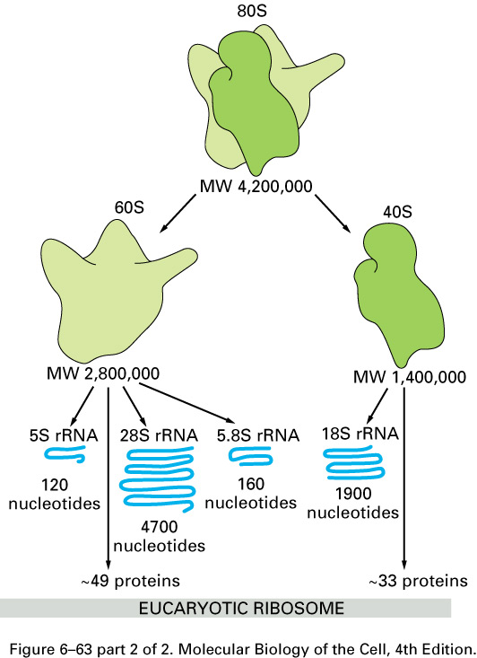
Reminder: Ribosome structure
(eukaryotes)
Notes:
There are four rrna components 18s,28s,5.8s and 5s. Three of them 18s,28s,5.8s are synthesized as a large precursor shown here. rRNAs are synthesized from a precursor that are transcribed from many many genes fround in the genome (so man genes transcribed fewer times)

Slide 22
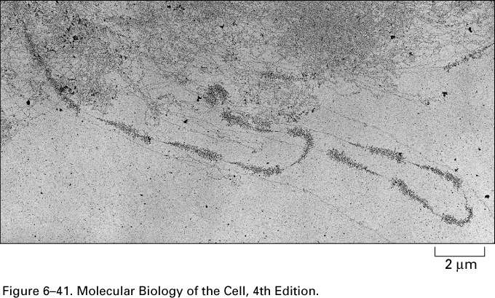
Ribosomal RNA transcription as seen with an electron microscope
Notes:
Large number of rRNAs organized in clusters .

Slide 23
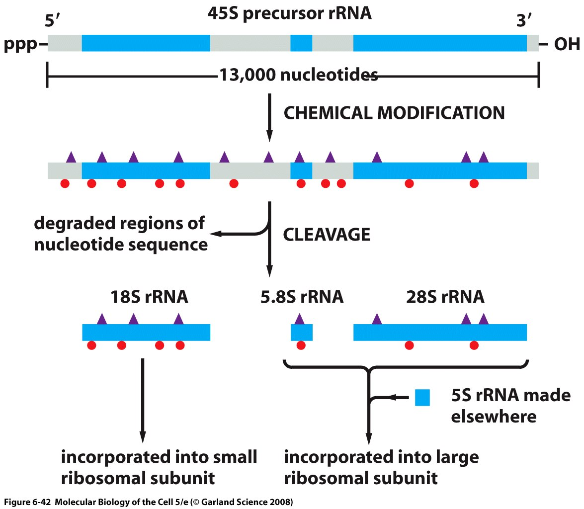
Modification and cleavage of ribosomal RNA
Notes:
This is the initial precursor 45s that will result in 18s 28s and 5.8s rRNAs. The precursor is synthesized by RNA polymerase number I whearas this guy here is syntheisized by polymerase III. After chemical modifications took place the precursor is cleaved to form the rRNAs.

Slide 24
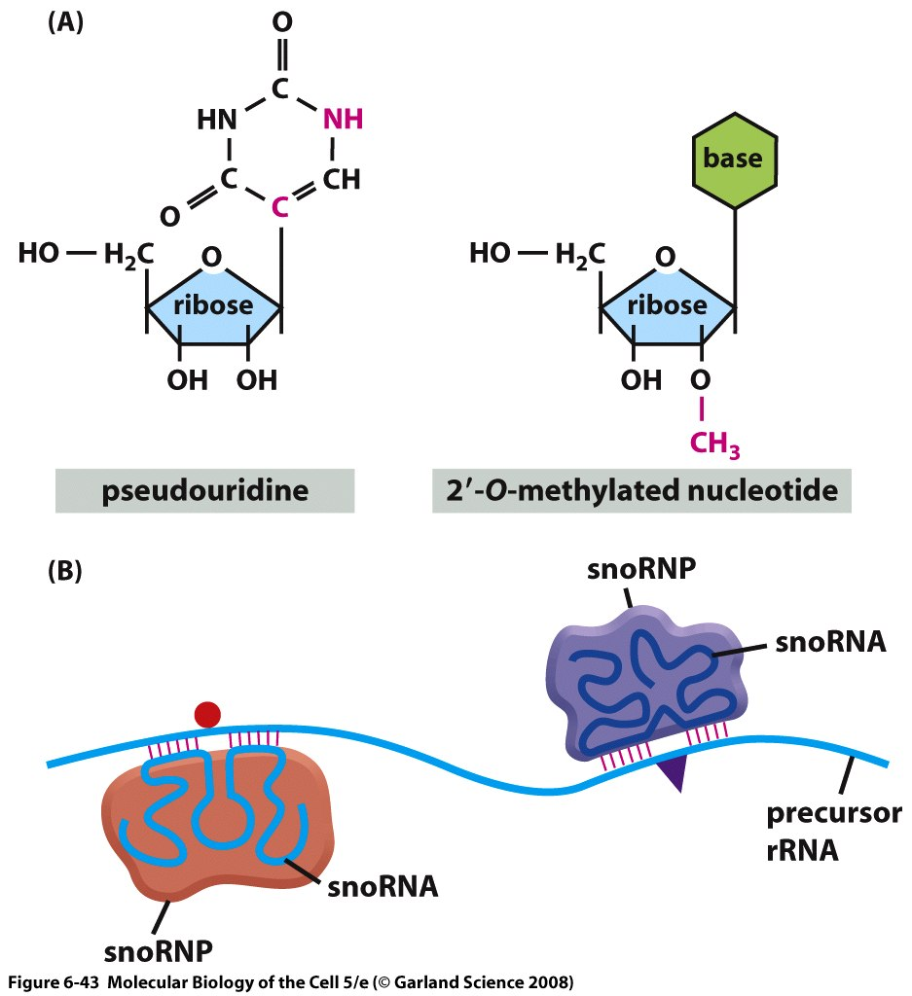
Chemical modification of ribosomal RNA by snoRNA
Notes:
The two chemical modifications are the methylation of ribose and isomerization of uridine to form pseudo uridine. These modifications are done at specific sites on the precursor and where they occur depends on a complex made of proteins and the small nucleolar RNAs which will make base pairing at the precursor where modifications need to be made.

Slide 25
To have a little fun with Translation
(topic of last Friday’s lecture)
http://www.youtube.com/watch?v=u9dhO0iCLww
Note: Paul Berg, the man who speaks at the beginning, is a Nobel Prize winner.

