Slide 1
Format 2nd midterm
16 MCQs 32 marks
7 questions 68 marks

Slide 2
Additional Office Hours
Monday (Nov 4) 9:30 AM-11AM

Slide 3
Q1 : You treat cells with a mutagen and you identify two mutants. One contains alanine and the other methionine, at a position where you would normally find a valine. You treat both mutants again with the mutagen and you obtain two new mutants. In both cases, you now have a threonine in the above position. If all mutations are single base pair changes, please give the sequence of each codon.

Slide 4
Met
AUG
Val
GUN
Ala
GCN

Slide 5
Met
AUG
Val
GUG
Ala
GCG

Slide 6
Met
AUG
Val
GUG
Thr
ACG
Ala
GCG

Slide 7
Q2 In an astute experiment carried out in 1962, cysteine, already bound to its tRNA (tRNA^{cys}), was chemically modified into an alanine. We put these alanine-tRNA^{cys} in an in vitro translation reaction (from which all cystein-tRNA^{cys} had been removed). It was observed that all proteins resulting from the in vitro reaction had incorporated alanine where they should have normally incorporated cystein. What does this experiment tell you about the role/importance of aminoacyl tRNA synthetase?

Slide 8
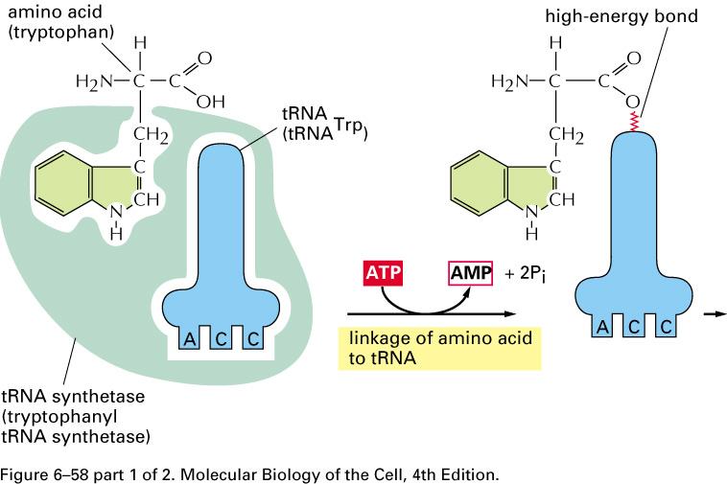
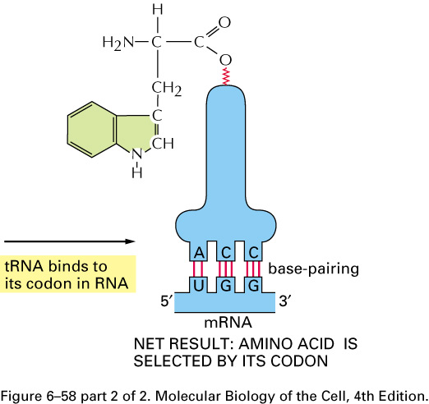
Recognition of the aminoacyl-tRNA by the ribosome only depends upon pairing the codon and the anti-codon. The ribosome does not care which amino acid is on the tRNA.

Slide 9
Therefore, loading of the correct amino acid on the tRNA, a task carried out by aminoacyl tRNA synthetase, is crucial to ensure accurate transmission of genetic information.

Slide 10
Q 3: You isolated a new antibiotic: edein. Edein inhibit protein synthesis but has no effect on DNA or RNA synthesis. In a currently ongoing in vitro translation reaction, you add edein and it blocks protein synthesis after a certain delay. Using ultracentrifugation, you isolate mRNA which is found in a 40S complex that contains rRNA and tRNA.
a) Which step in translation is blocked by edein ? Be specific in your answer.
b) Why is there a delay before protein synthesis stops?
Notes:
B) Will not be asked.

Slide 11
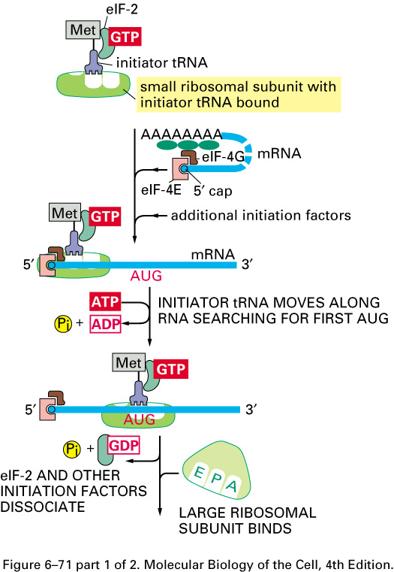
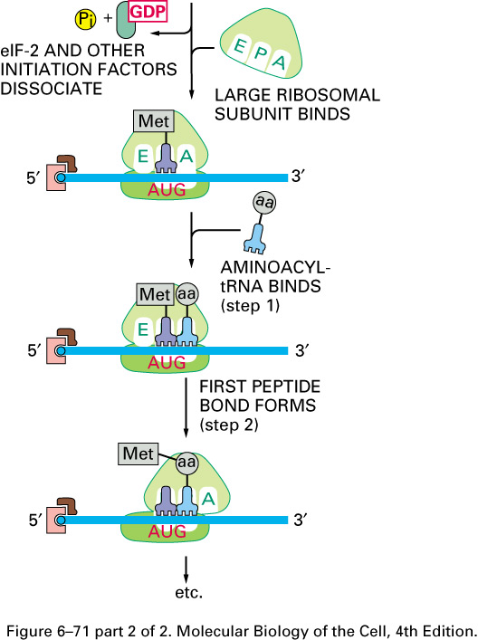
Initiation - eukaryotes
Notes:
THE INITIATION STEP because the large subunit was not able to bind. (40s is the small subunit) so initiation phase was not completed.

Slide 12
Q4 : In an in vitro translation reaction, the polynucleotide 5’-AUGUUUUUUUUU-3’ should be translated in Met-Phe-Phe-Phe. Jokomycin, a new antibiotic isolated from a fluorescent mushroom of Antarctica block synthesis at Met-Phe. What is the mechanism of action of jokomycin?
A- It blocks formation of the 80S ribosomal complex that contains tRNA and both ribosome subunits.
B- It blocks binding of aminoacyl-tRNA to the large subunit of the ribosome.
C- It inactivates the peptidyl-transferase acitivity of the large ribosomal subunit.
D- It blocks translocation of peptidyl-tRNA from the A site to the P site.
E- It blocks termination and release of the peptide.

Slide 13
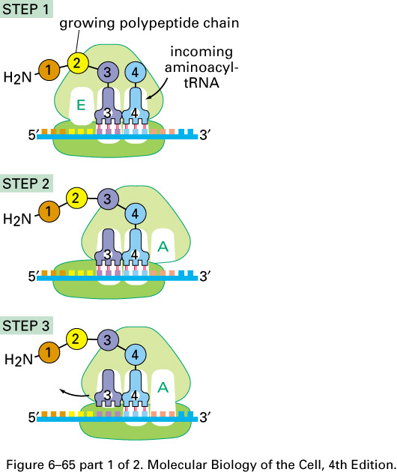
Notes:
D. Initiation took place and the methionine is in the A site and the peptide bond is created but we can’t create a free A site for the next amino acid to move in.
Why didn’t it block after methionin? Because the first amino acid methionine enters the P site and the E site is already free and so enters there.

Slide 14
Q5. True or False ? Eukaryotic mRNAs have free OH group on ribose at both their 5’ and 3’ ends. Explain your answer.
Notes:
No true or flase.
This is true because additon of cap involves 5’-5’ bond which means then theres the usual 3’ OH.

Slide 15
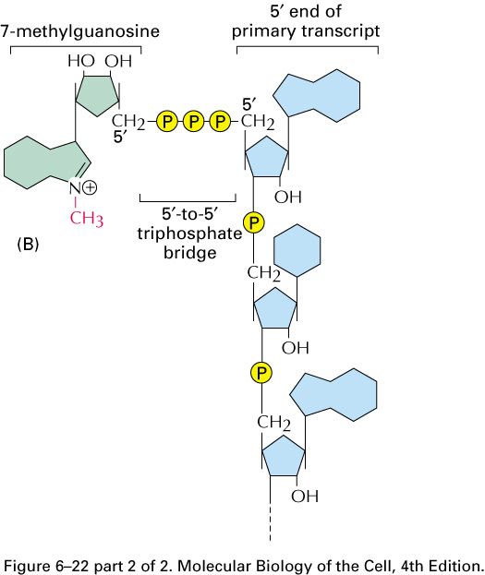

Slide 16
Q6. True or False: As intron sequences are mostly genetic junk, it is not essential to splice them with precision. Explain your answer.
Notes:
False cz if not spliced accurately there will be frame shift and hence mutation.

Slide 17
Q7. A frozen mammoth is found in excellent state of preservation in the Kamchatka peninsula. DNA from this mammoth could be partly sequenced. According to bioinformaticians, the following sequence:
5’-AACUUGAAAAUACCC-3’
would be found in the middle of a mRNA coding for a large protein.
A- Using the above sequence information and remembering it is in the middle of a protein, could you tell, unambiguously (without a doubt), which of the three possible reading frames will be used. Please decode all three possible reading frames and justify your answer
Notes:
Asked before: Decode according to the three reading frame and see if u could get all three frames.

Slide 18
Reading frame #1
AAC UUG AAA AUA CCC
Asn Leu Lys Ile Pro
Reading Frame #2
A ACU UGA AAA UAC CC
Thr Stop
Reading Frame #3
AA CUU GAA AAU ACC C
Leu Glu Asn Ser
Notes:
In one of them u get a UGA for stop (no stop in intron so can’t be 2) can u tell whether it’s #1 or #3? NO both are possible.

Slide 19
B- The mammoth tissues are so well preserved that you could microsequence proteins. You are surprised to find that the above sequence encodes for the peptide Thr-SeCys- Lys Tyr Pro (SeCys: selenocystein). Please explain this finding in two or three lines.
Notes:
Translational recoding: where the AUG was recognized as coding for Selono cystein by seleonicystein trna and hence serine was loaded then changed to seleonocystein enzymatically and loaded on ribosome with the help of selenocysteine translation factor bound to GTP .
This is extremely unlikely. Mention this.

Slide 20
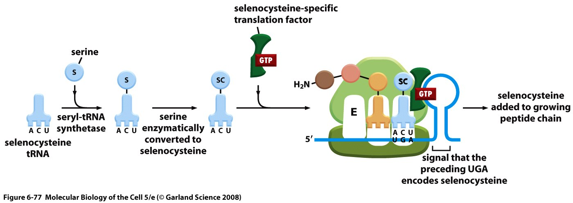
Translational recoding

Slide 21
1. By which process does the RNA polymerase of prokaryotes becomes able to free itself from the promoter for transcription elongation to take place ?
a) By releasing the sigma subunit.
b) By increasing its affinity for promoter sequences.
c) By increasing its affinity for any DNA sequence.
d) By decreasing its affinity for sequences other than the promoter
e) None of the above.

Slide 22
1. By which process does the RNA polymerase of prokaryotes becomes able to free itself from the promoter for transcription elongation to take place ?
a) By releasing the sigma subunit.
b) By increasing its affinity for promoter sequences.
c) By increasing its affinity for any DNA sequence.
d) By decreasing its affinity for sequences other than the promoter
e) None of the above.

Slide 23
2. Identify the correct statement regarding the rho factor:
A. rho binds the DNA template
B. rho binds RNA polymerase directly
C. rho recognizes a transcription stop signal on the DNA.
D. rho recognizes a stem-loop (hairpin) structure on the RNA
E. rho recognizes a sequence that is C-rich and G-poor on the RNA

Slide 24
2. Identify the correct statement regarding the rho factor:
A. rho binds the DNA template
B. rho binds RNA polymerase directly
C. rho recognizes a transcription stop signal on the DNA.
D. rho recognizes a stem-loop (hairpin) structure on the RNA
E. rho recognizes a sequence that is C-rich and G-poor on the RNA

Slide 25
3. Which statement is CORRECT regarding transfer RNA (tRNA)?
A. Loading of the amino acid on the tRNA requires GTP.
B. The D and TΨC loops are not the only ones where you can find modified bases (bases other than A,C, G, or U).
C. The number of different tRNA in E. coli is equal to 61
D. The amino acid is linked to the tRNA by a phosphodiester bond.
E. The secondary structure of the tRNA is shaped like the letter “L”.

Slide 26
3. Which statement is CORRECT regarding transfer RNA (tRNA)?
A. Loading of the amino acid on the tRNA requires GTP.
B. The D and TΨC loops are not the only ones where you can find modified bases (bases other than A,C, G, or U).
C. The number of different tRNA in E. coli is equal to 61
D. The amino acid is linked to the tRNA by a phosphodiester bond.
E. The secondary structure of the tRNA is shaped like the letter “L”.
Notes:
In the anticodon you could have inosine.

Slide 27
4. Using the genetic codes provided on the last page and your knowledge of wobble rules, suggest the most likely anticodon (written below in their 5’-to 3’ orientation) for histidine in eukaryotes :
A. UUG
B. GUG
C. GUI
D. CAU
E. GUA

Slide 28
4. Using the genetic codes provided on the last page and your knowledge of wobble rules, suggest the most likely anticodon (written below in their 5’-to 3’ orientation) for histidine in eukaryotes :
A. UUG
B. GUG
C. GUI
D. CAU
E. GUA

Slide 29
5. What is the mechanism by which the antibiotic puromycin inhibits protein synthesis in prokaryotes?
A. By inhibiting the peptidyl-transferase activity of the ribosome.
B. By forming an amide link with the polypeptide chain, causing its premature release.
C. By causing the release of the large subunit of the ribosome
D. By blocking translocation movements of the ribosome
E. By breaking the link between the peptide chain and the ribosome.

Slide 30
5. What is the mechanism by which the antibiotic puromycin inhibits protein synthesis in prokaryotes?
A. By inhibiting the peptidyl-transferase activity of the ribosome.
B. By forming an amide link with the polypeptide chain, causing its premature release.
C. By causing the release of the large subunit of the ribosome
D. By blocking translocation movements of the ribosome
E. By breaking the link between the peptide chain and the ribosome.

