Slide 1
Protein Synthesis and the Genetic Code I
22 October 2013

Slide 2

Peptide bond
Notes:
Proteins are made of amino acids and they have an amino group and a carboxyl group and an R group, they are linked by an amide linkange which will make a linear chain.

Slide 3
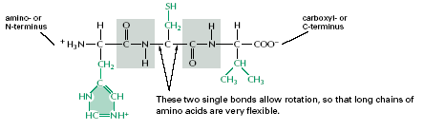
Peptide bond
Notes:
Amino acids are added according to the information on the mRNA which is decoded with the Genetic code.

Slide 4
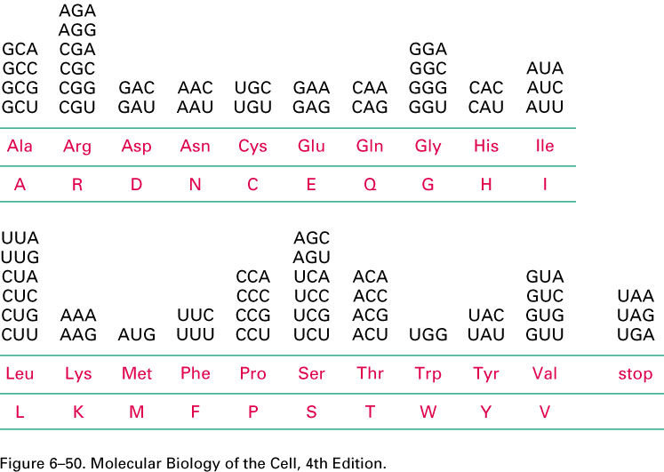
Genetic Code
Notes:
Don’t need to memorize but be familiar.
Here we see the three letter code of the amino acids and the various triplet codons.
Some codons are used as stop signals for translation memorize these! UAA UAG and UGA

Slide 5
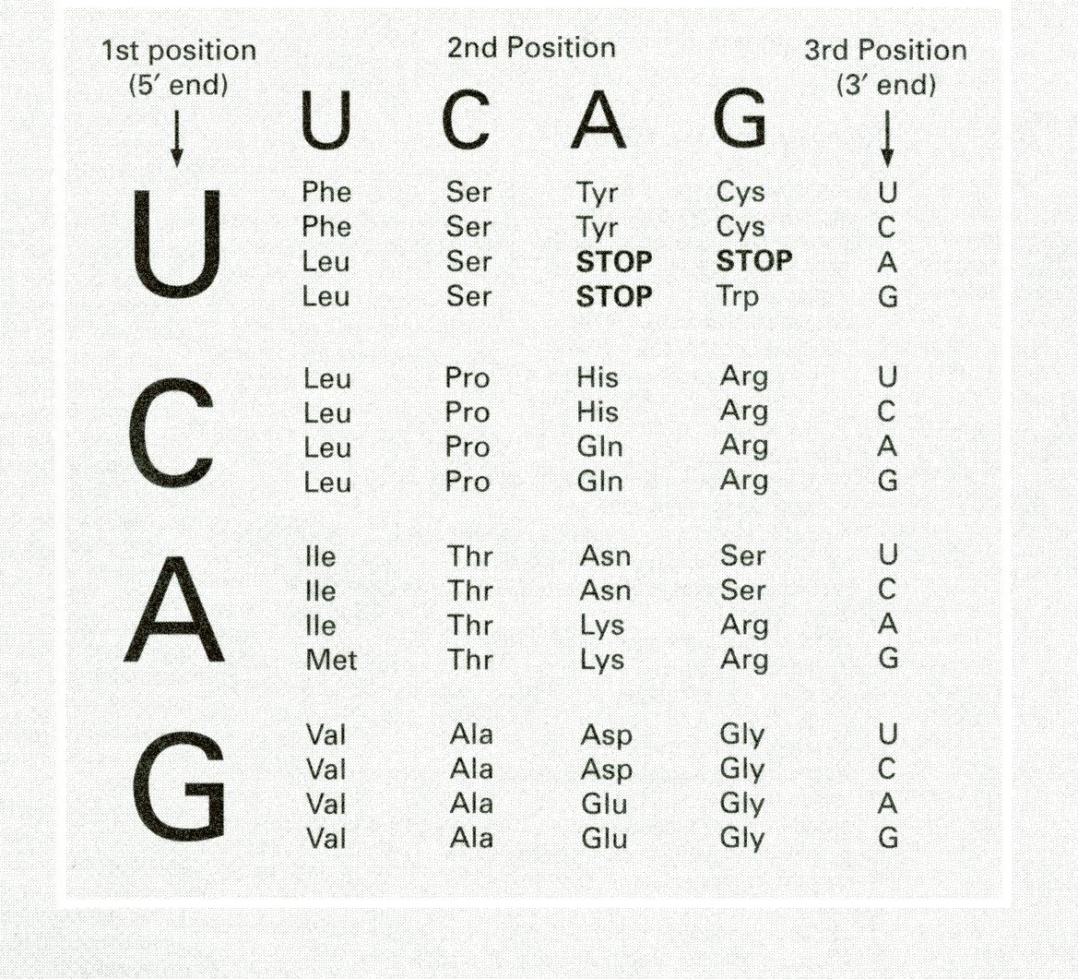
Genetic Code (another table)
Notes:
Don’t memorize but be familiar.
You need to know that AUG is a start codon and Methionine is a start signal.

Slide 6
Genetic Code
1) Unequivocal : Each codon corresponds to only one amino acid.
2) Degenerate : For any given amino acid, there is often more than one codon.
3) The first two nucleotides of a codon play an important role in determining the amino acid.
4) Codons related in sequence often encode for amino acids with similar chemical or structural properties.
Notes:
1)Unequivocal means only one meaning so each codon corresponds to only one amino acids.
2) But keep in mind an amino acid can be coded by many codons.

Slide 7
Genetic Code
Notes:
When ever there is a sequence of codon always 5’-3’ just like mrna.

Slide 8
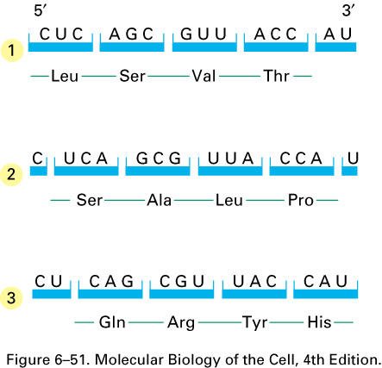
Three reading frames
Notes:
The different reading frame determine the different proteins. So if the reading frame is changed it will have an impact on the protein formed and there fore an impact on the function of the protein.

Slide 9
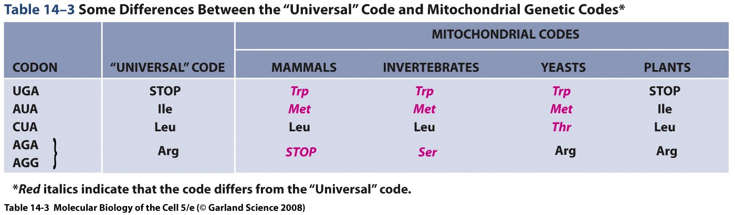
Genetic code of mitochondria
Notes:
Leucine is encoded by 6 possible codons but not all of them are used with the same frequency in the celll. This relative use will vary between species and we don’t know why.

Slide 10
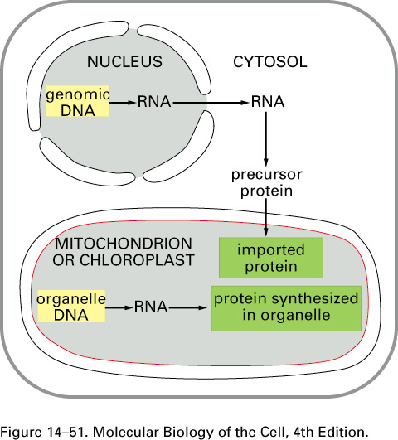
Protein synthesis in mitochondria
Notes:
Most of RNA is made from the genomic DNA in the nucleos but as we can see mitochondria has it’s onw dna and hence some proteins are synthesized from that.

Slide 11
Genetic code of mitochondria
Notes:
The genetic code is called the universal genetic code but the universality is not absolute, there are exceptions to this rule and one exception is for the DNA in the mitochondria in eokaryotes and that this code for mitochondrial DNA will differ between the various kinds of karyotes . Don’t have to memorize this table.

Slide 12
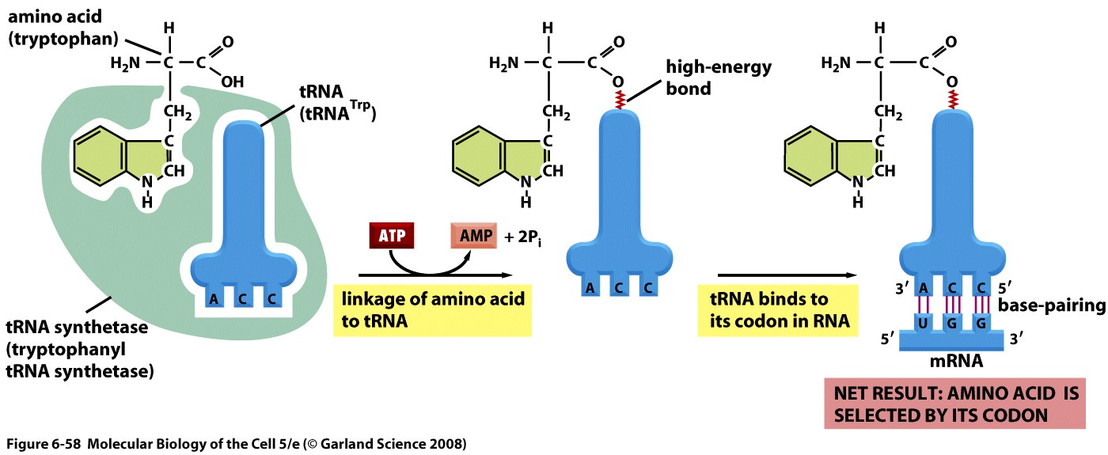
Amino Acid addition:
Overall view
Notes:
The information on the mrna is decoded into proteins and trna is needed for this. The trna will load the amino acids and they are incorporated in the right order.
Remember that

Slide 13
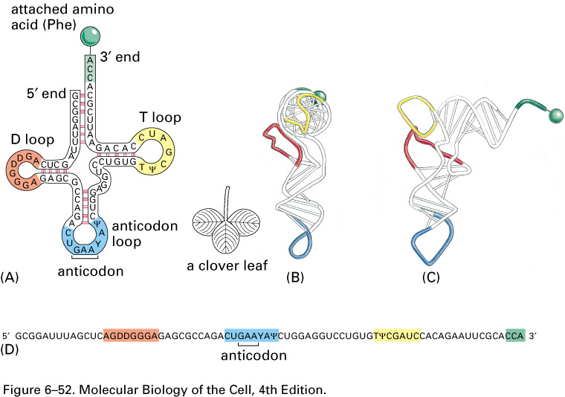
Transfer RNA (tRNA)
Notes:
Linear sequence for trna with the 5’ end to the left and the 3’ end to the right, this the secondary structure because trna is single stranded and it internally base pairs making stems and and loops, it has the acceptor arm 3’ end where the amino acid will be bound and then there is the anticodon loop which contains the anticodon(triplet of nucleotides that will base pair with codon on mrna) and then we have the T and D loops and also the variable loop and these are named because they contain unusual modified nucleotides.
It will make additional interactions that will make a tertiary structure in the shape of an L ©

Slide 14
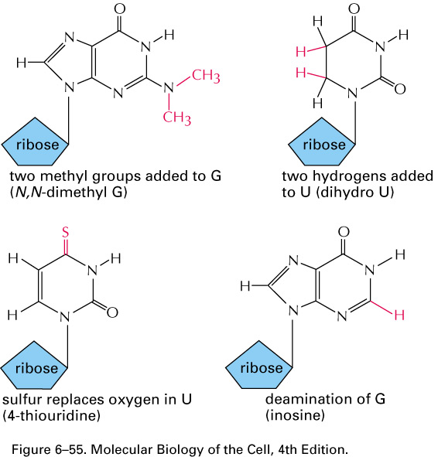
Notes:
Now we talk about the mechanism by which we load the amino acids on the trna. This is important because this is what i=ensures the correct sequence in proteins.

Slide 15
Loading the amino acid on the tRNA
Amino acid + tRNA + ATP → aminoacyl-tRNA +AMP + PPi
Can be decomposed into two reactions :
1) Amino acid + ATP → aminoacyl-AMP + PPi
2) aminoacyl-AMP + tRNA → aminoacyl-tRNA + AMP

Slide 16
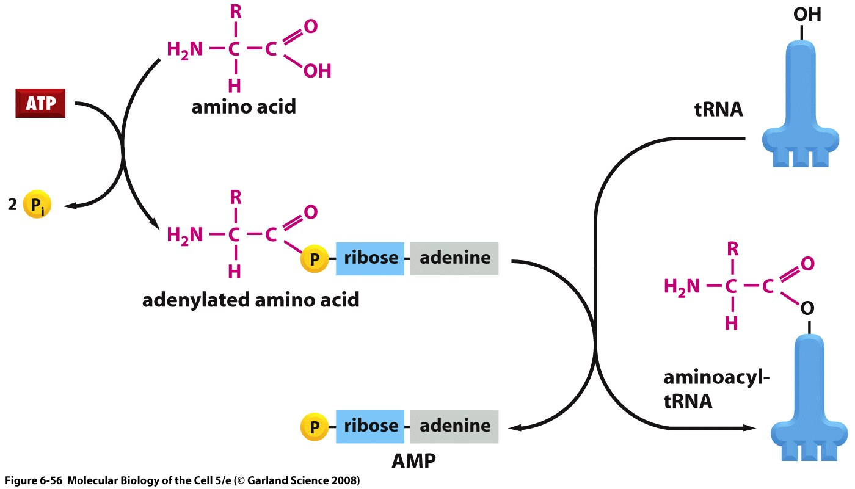
Loading the amino acid on the tRNA
Notes:
Amino acid plus ATP gives us out loaded amino acid . And this reacts with the trna and amp is released and the amino acyl trna is formed.

Slide 17
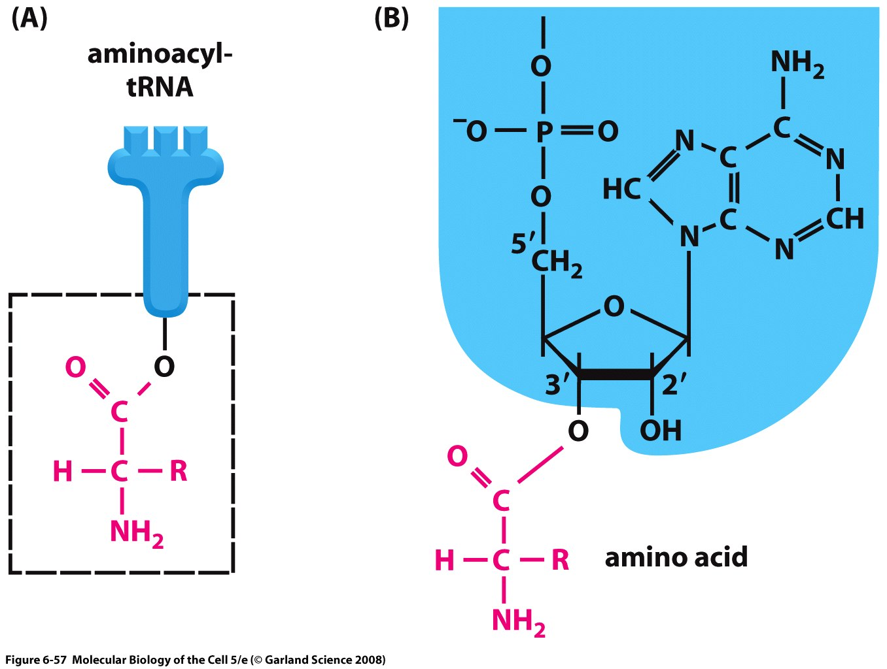
Notes:
This slide shows the link made between the amino acid and the 3’C of sugar on the trna.

Slide 18
Loading the amino acid on the tRNA
Notes:
The loading is carried out by the aminoacyl trna synthetase and as a general rule there a different amino acyl trna synthetase for each amino acid so 20 in total.

Slide 19
Overall view
Making a mistake in loading the amino acid on the tRNA will result in the wrong AA incorporated into a protein.
Notes:
This is important because it ensures the accuracy of translation.

Slide 20
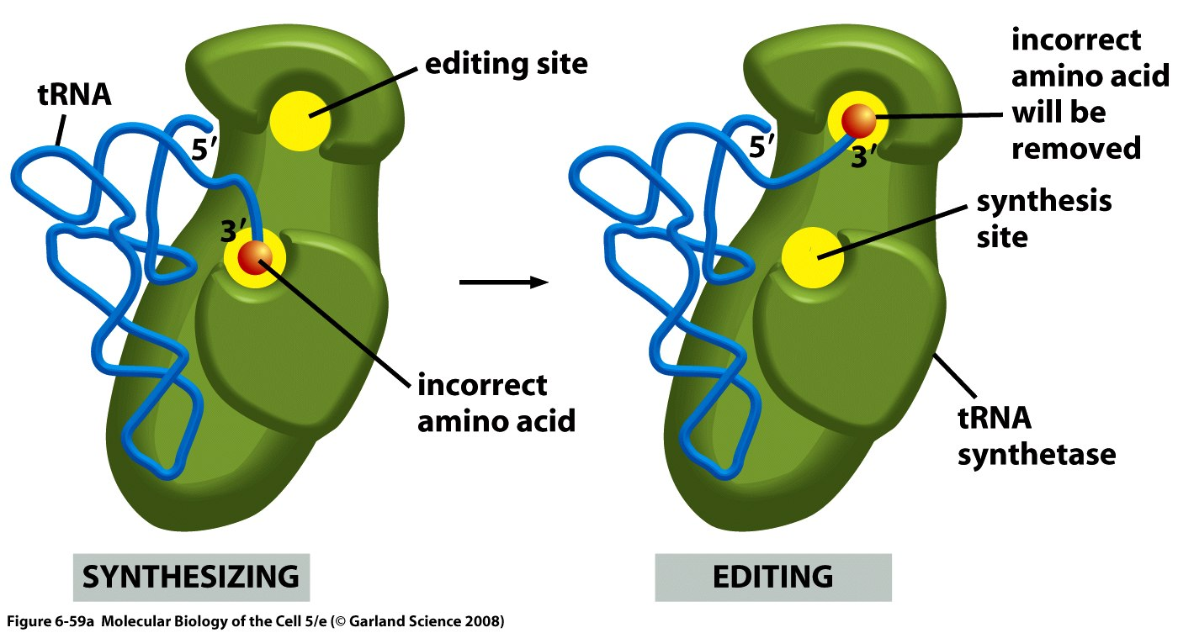
Hydrolytic editing
Notes:
We don’t want the aminoacyl trna synthetase to make mistakes and it does this by the fact that the correct synthetase has the highest infinity for it’s corresponding amino acid and hence we have 20 different aminoacyl trna synthetases. If the incorrect amino acid is added it will be transferred to the editing site which will remove the amino acid and the process is repeated until the correct amino acid is added into the synthesis site.

Slide 21
Genetic code
Notes:
There are 4x4x4 =64 codons for 20 amino acids and hence more codons than we need.

Slide 22
Genetic code
As there are often multiple codons for a single amino acid, this implies:
  Either the existence of distinct tRNAs for each codon.
  That a single tRNA can recognize more than one codon.

Slide 23
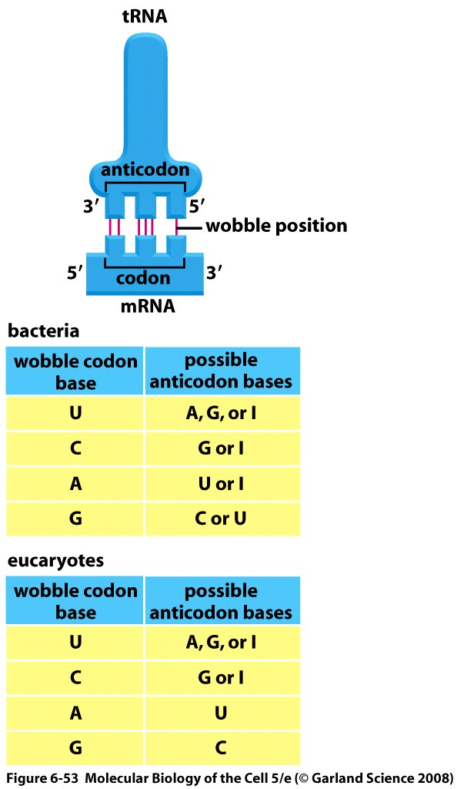
Wobble
Notes:
The trna that will bind the codon where there is an anticodon sequence. The anticodon is able to recognize more than one codon. Base pairing between anticodon and codon are antiparellel and so that of the anticodon is 3’-5’ and the codon is 5’-3’.
The wabble hypothesis: the third position of anti codon is more variable so its able to make unusual interactions with the first positon of the codon. And so the wobble pairing is somewhat weaker. Remember tables by heart. And what you need to be able to do is that if he gives us an anticodon sequence he needs to be able to deduce the possibe sequences and also deduce the possible amino acids.
I= inosine

Slide 24
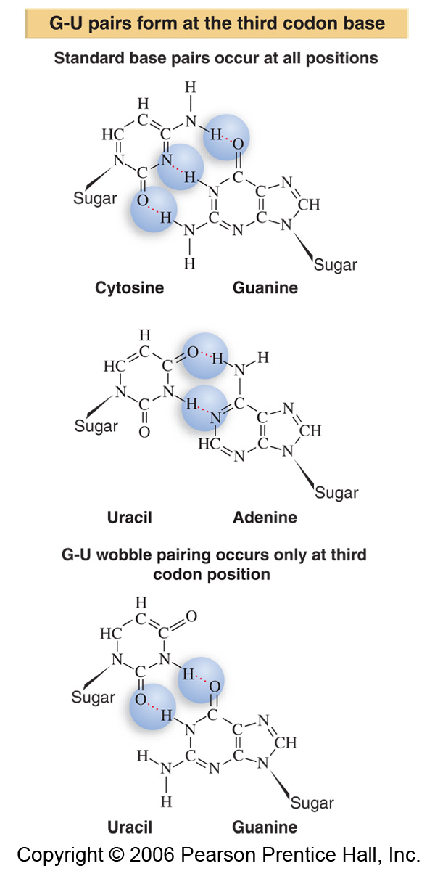
Normal pairing
“wobble” pairing
Notes:
Don’t need to be able to draw structures but need to know which pairings are possible.

Slide 25
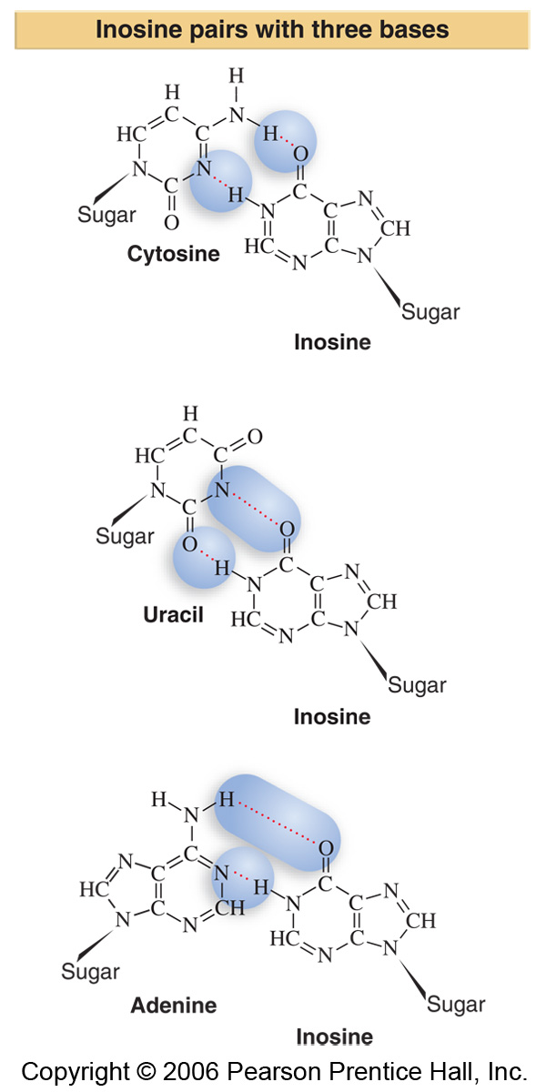
Paring with inosine
Notes:
Don’t need to be able to draw structures but need to know which pairings are possible.

