Slide 1
Protein Synthesis and the Genetic Code II
25 October 2013

Slide 2
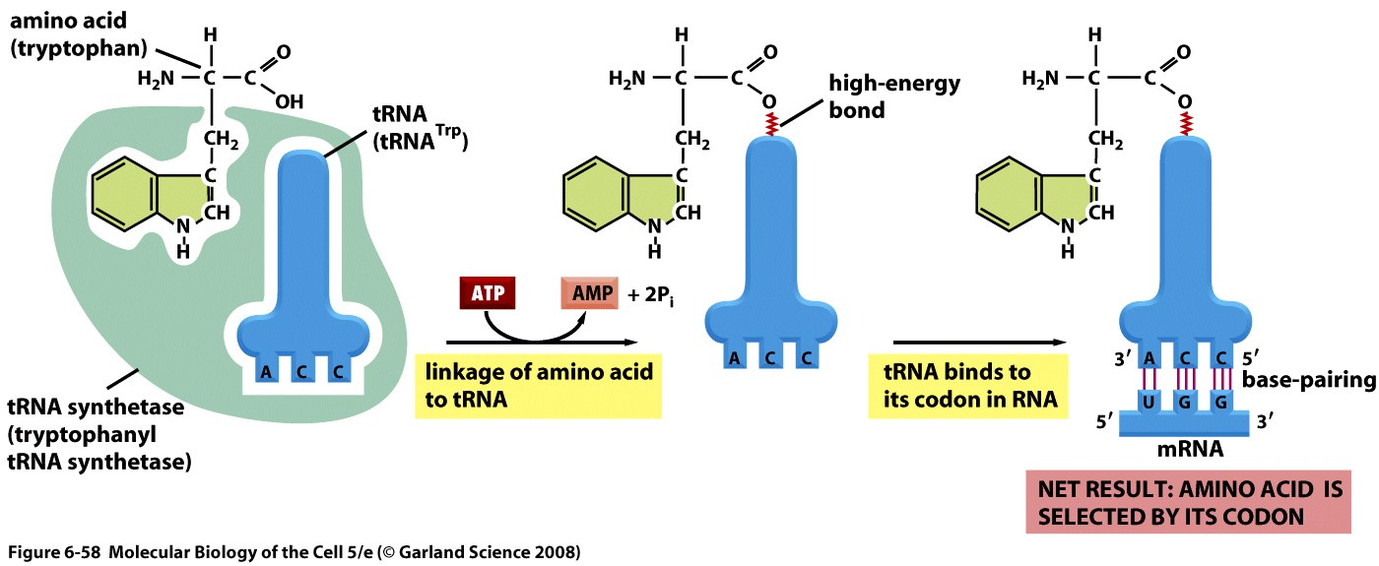

Slide 3
The three steps of translation
Initiation
Elongation
Termination
Notes:
This occurs on a ribosome.

Slide 4
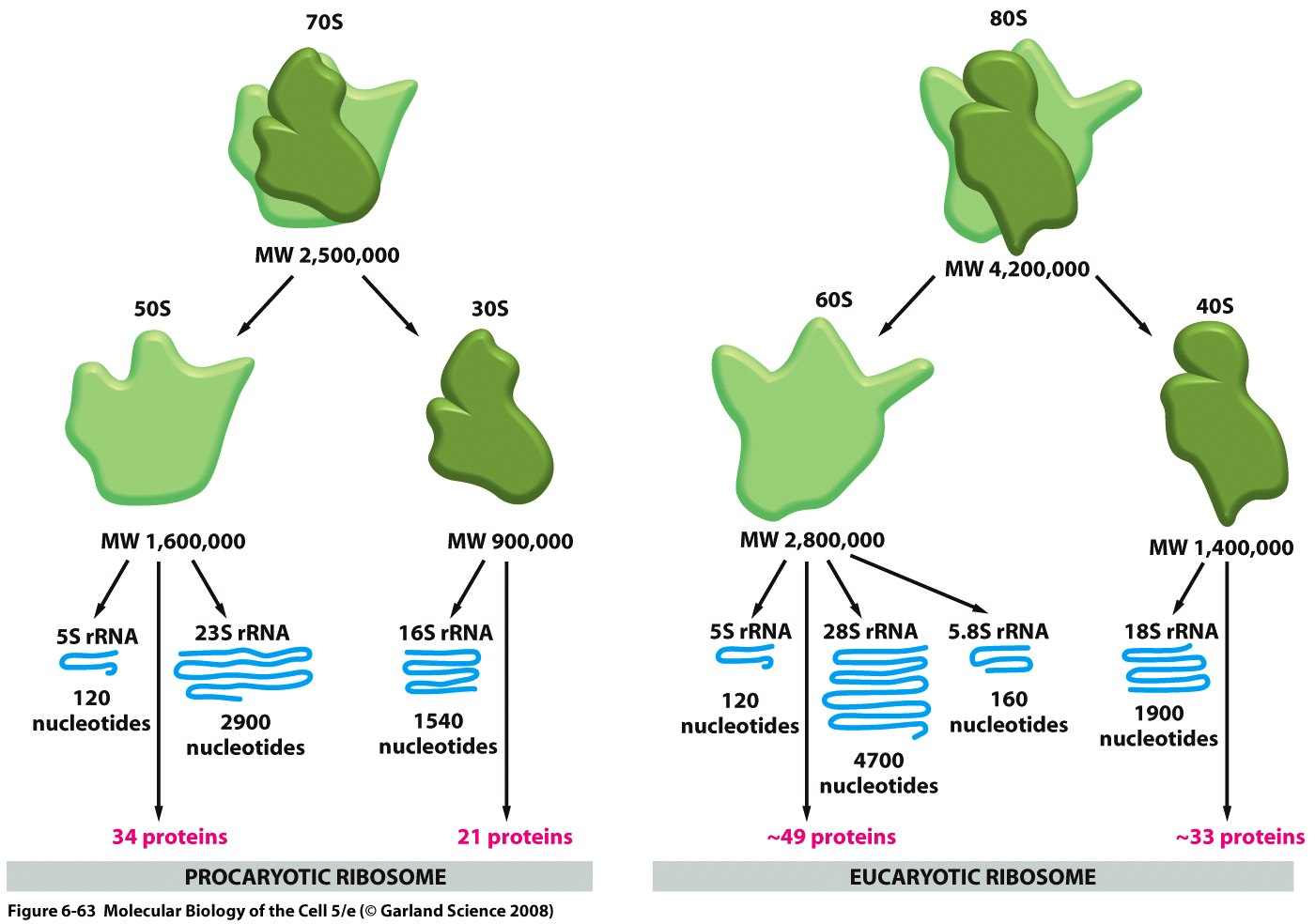
Reminder: Ribosome structure
Notes:
The left is prokaryotic ribosome (70S = 50S+ 30S) and the right is eucaryotic ribosome(80S=60S+40S), they are made of 2 subunits and they are made of rrna and proteins. The large and small subunits are due to the sedimentation properties in the centrifuge.

Slide 5
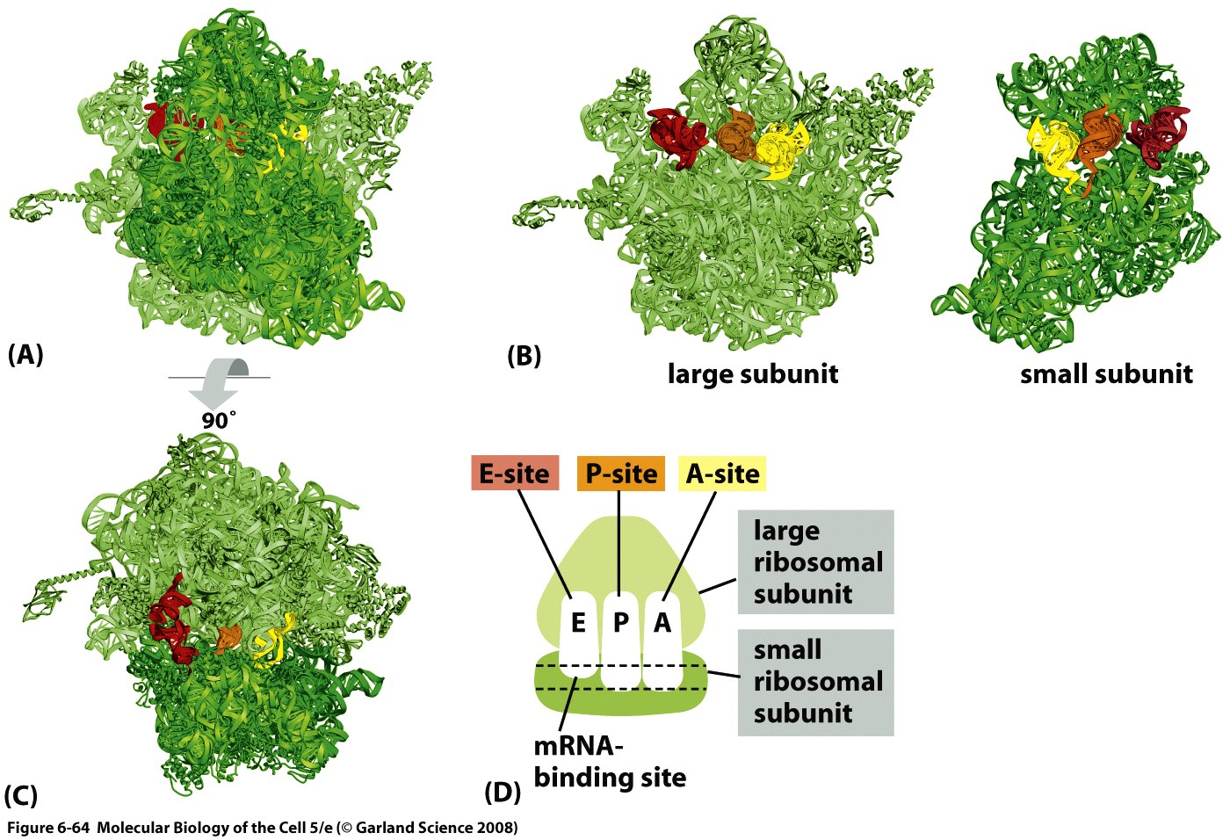
Notes:
There are sites in the ribosome. Three of them, be familiar with them.

Slide 6
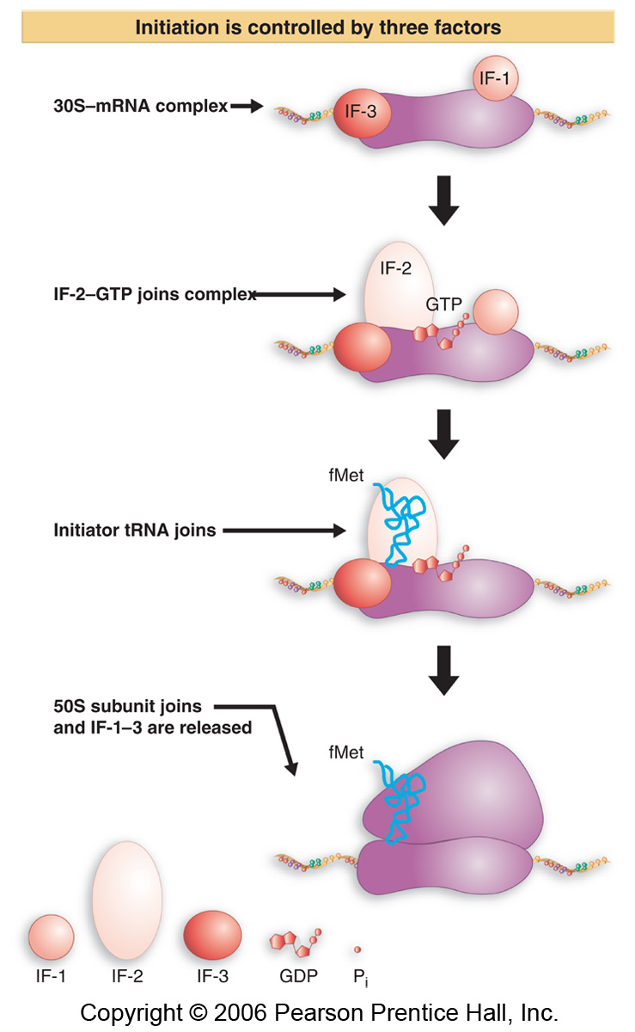
Initiation - Prokaryotes
Notes:
So first initiation in prokaryotes, he will emphasize the parts he wants us to remember. On top of the is the small subunit of ribosome and the mrna and two initiation factors 1 and 3, so we know that before the mrna is bound to the small subunit the IF3 is already linked to it and one of it’s roles is to prevent the small subunit to assemble with the large one. The mrna then binds (this occurs differently in prokaryotes and eukaryotes).

Slide 7
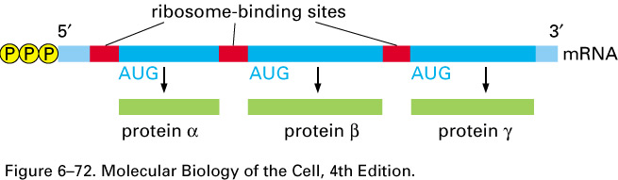
Polycistronic mRNA in bacteria
Shine-Dalgarno sequence: AGGAGGU
Notes:
In prokaryotes a single mrna can code for more than one protein and they can be consecutively organized on mrna and that’s schematized here. And so here we see the the start codons for the three different proteins, the blocks shown in red are sequences on mrna that are responsible for binding to the small subunit in ribosomes, and these sequences are rich in purines called the Shite-Dalgarno sequence. So it is this sequence that is responsible for binding of ribosome. And one way to distinguish it from eukaryotes is to say it binds internally to the mrna.
The shine dalgarno sequence interacts with one of the small protein components and if we have too much of these proteins they will be able to bind the sequence and compete with the small subunit for the shine dalgarno sequence which will cause a decrease in translation.

Slide 8
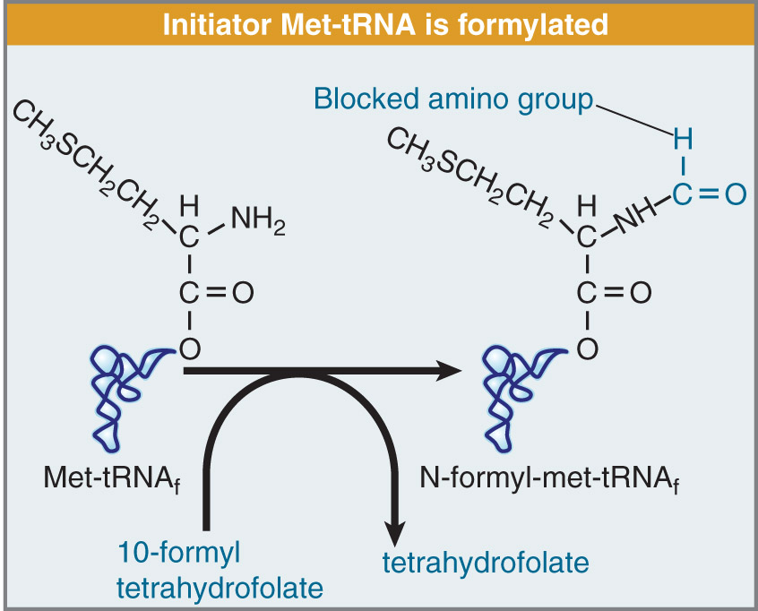
Notes:
Now that the shine delgarno sequence is bound, IF2 comes in and will bind the first trna which is bound to the first amino acid methionine and there will also be a molecule of GTP shown here. And this methionine in prokaryotes has a formyl group that blocks the amino group of the amino acid and this is peculiar to prokaryotes. And so we call it F-met and it is loaded on the trna. Once you have all that u r ready to make intire ribosome and there is is GTP hydrolysis which causes conformational changes in the ribosome which allows u to bind the large subunit.

Slide 9
Initiation - Prokaryotes
Notes:
What is not shown on this slide is that the first amino acid methionine goes into the p site. And this is initiation of translation in prokaryotes.

Slide 10
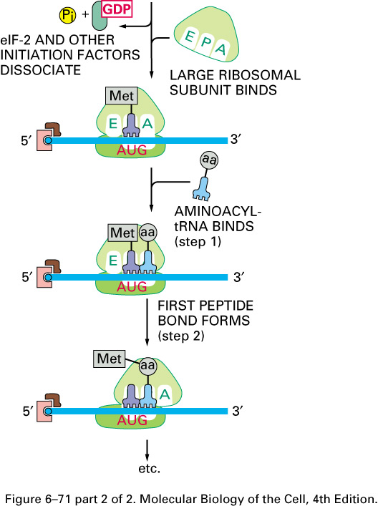
Initiation and addition of 2nd AA
Notes:
Okay so now it reached the the AUG and then there is GTP hydrolysis and then the large subunit can come in and the first trna loaded with trna is in the p-site
And this is initiation of translation in eukaryotes.

Slide 11
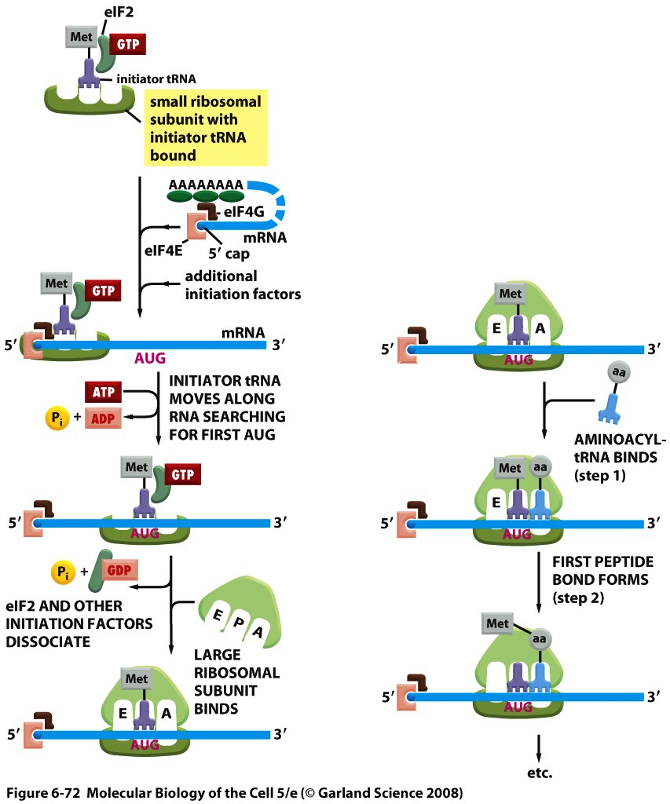
Initiation - eukaryotes
Notes:
There are many similarieties but also important differences, heres the small subunit of ribosome and eIF2 bount to GTP and notice how the methionine is not formulated in eukaryotes. the main difference though is that the small subunit of the ribosome binds the mrna at it’s 5’ end instead at the shine delgarno sequences in prokaryotes. And then what happens is that small subunit scans mrn which uses up ATP hydrolysis. And what seperates the 5’ end and the AUG is the 5’UTR and in eukaryotes it is generally short and when the small subunit scans it generally picks up the first AUG it encounters ( if it were long more chances of mutations), not all AUG’s are equal some are more favorable and if it is found within a Kozak context it likes it more but it generally picks up the first one. The first amino acid in the p-site and the second trna with the second AA enters at the A-site and then a peptide bond is made between the first amino acid methionne and the second one.

Slide 12
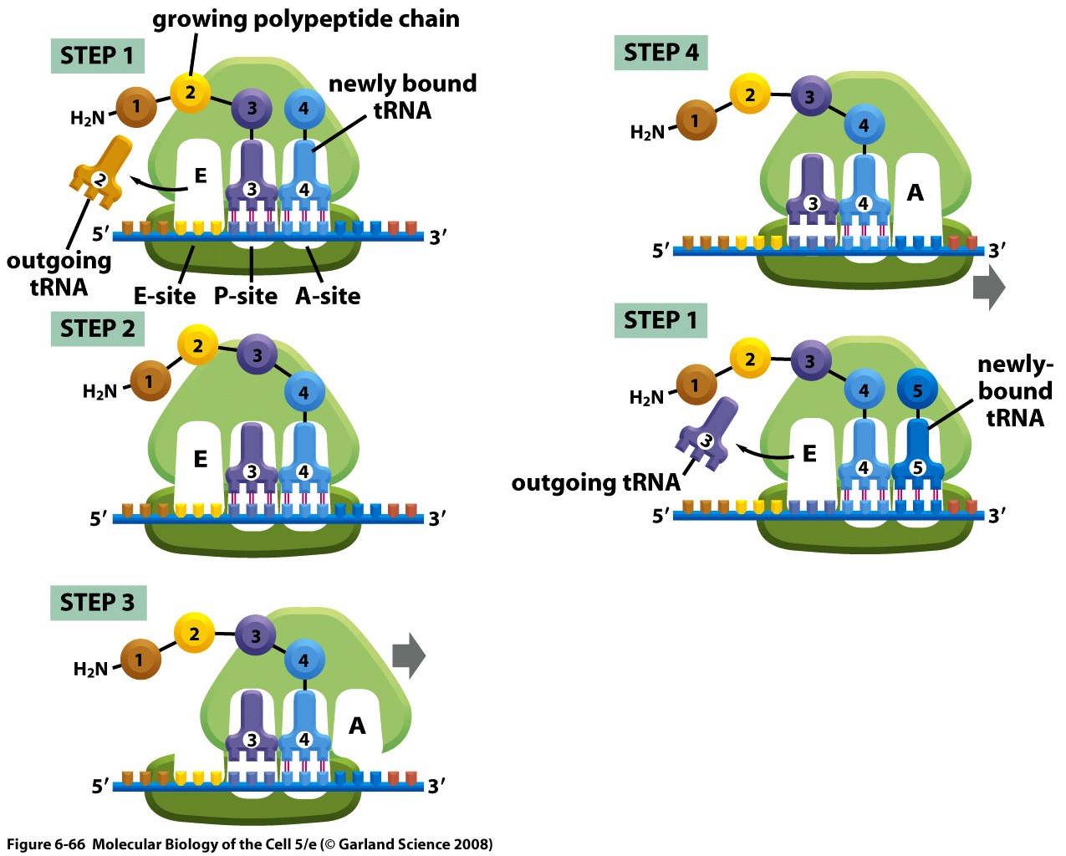
Elongation Cycle
Notes:
Now elongation.

Slide 13
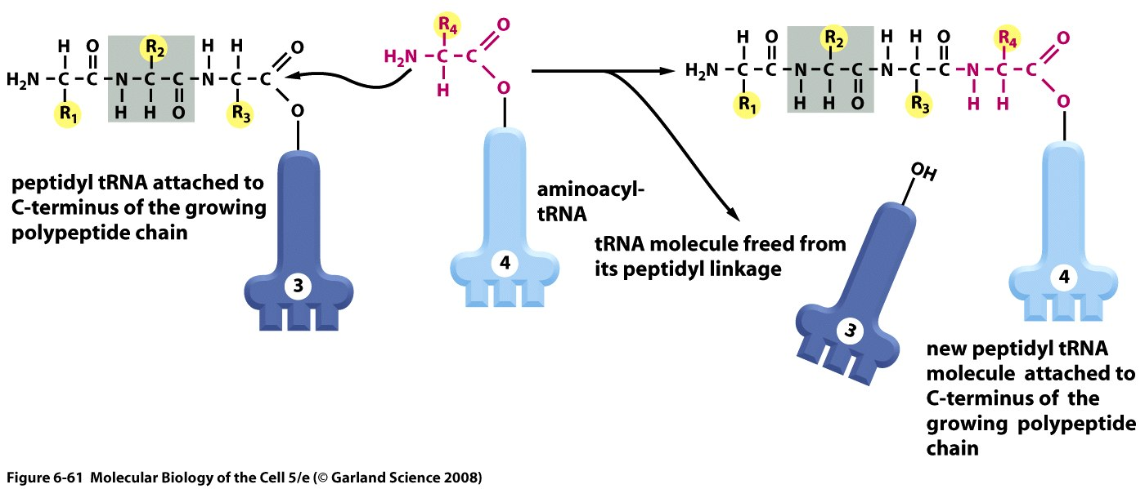
Peptide Bond Formation
Notes:
This protein already has three amino acis and the incoming 4th one will have a reaction between the incoming amino gorup with the carboxyl group of the first one and the peptide bond is formed and the third trna leaves . This continues on. This is catalyzed by rna in the rbosome, rrna .

Slide 14
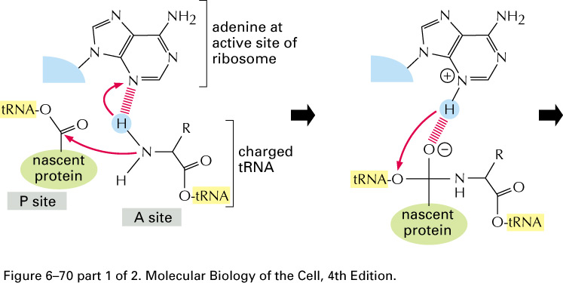
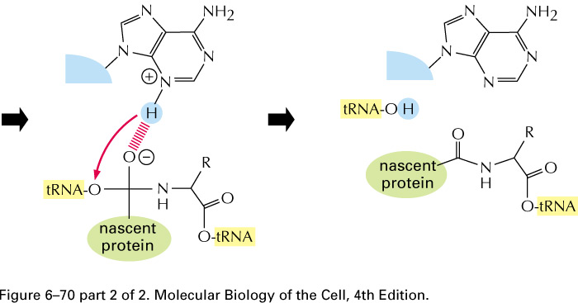
Catalytic site on the rRNA
Notes:
This is an example of rrna with catalytic activity and w’ell call this ribosyme. Don’t learn precise reaction.

Slide 15
Elongation Cycle
Notes:
The new amino acid enter on it’s trna on the Asite and once that is done peptide bond forms, and the link between AA3 and trna is broken and the chain is now linked to trna4 and when this bond has been made there are series of movements of the parts of the structure. In step 3 the large subunit moves to the right with respect to the mrna and small subunit and that frees up part of the A site that is in the large subunit of the ribosome. And in step 4 the small subunit of ribosome moves to the right and the large subunit and mrna remain in place, this creates a full empty available A site and then another amino acid trna comes in and it starts over again .

Slide 16
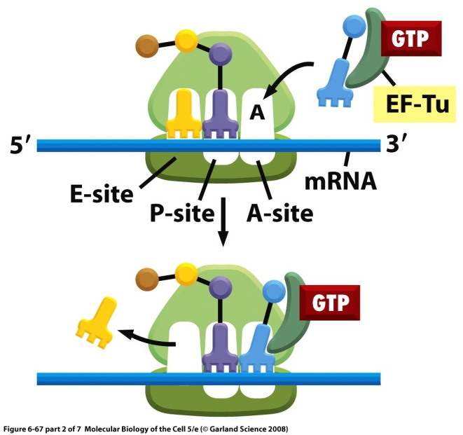
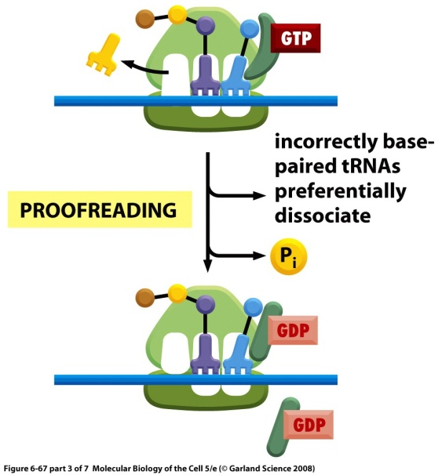
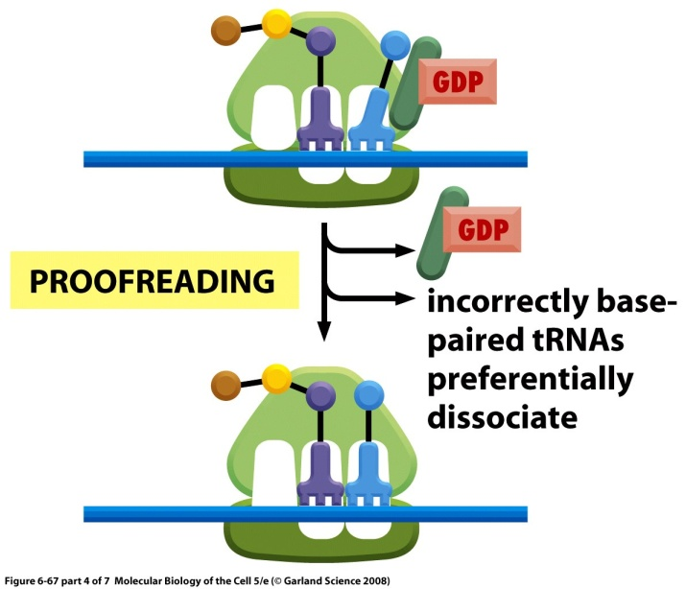
Role of EF-Tu
Notes:
There are a number of factors that help make the process efficient and accurate and there are two of them EF-Tu and EF-G. the incoming trna are bound to ef-tu in green which is bound to GTP and this complex goes into the A site but notice that the trna is kinked so it’s not exactly in thhe A site and what happens then is a delay which is occompainied by hydrolysis of GTP which is released and then the trna is correctly positioned into the A site, this whole process is proofreading that the right trna is in the correct catalytic site in large subunit of the ribosome because once trna is positioned correctly into the site it is irriversible- this is an accuracy site mechanism.

Slide 17
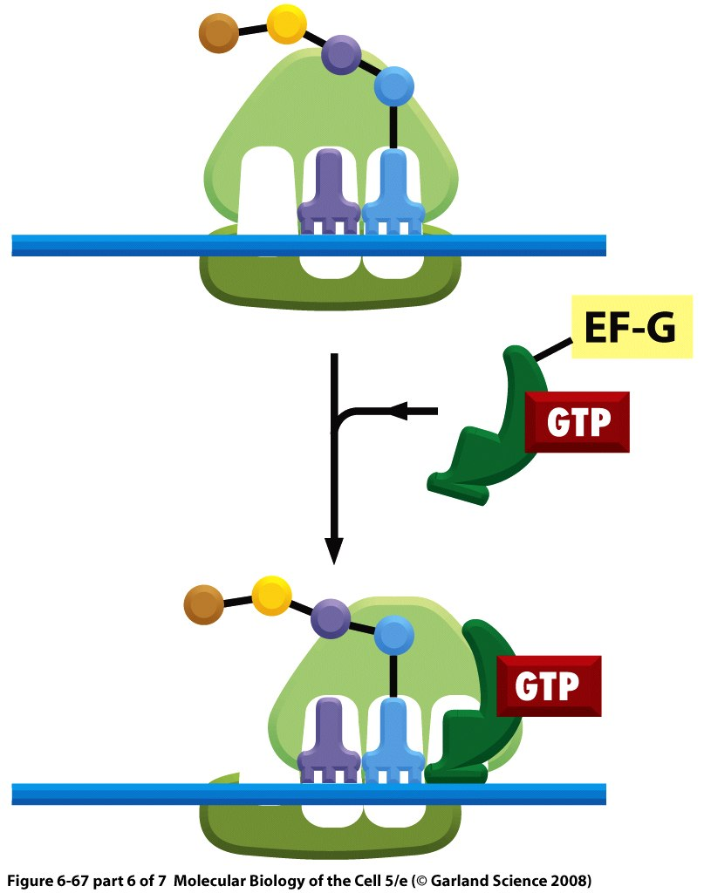
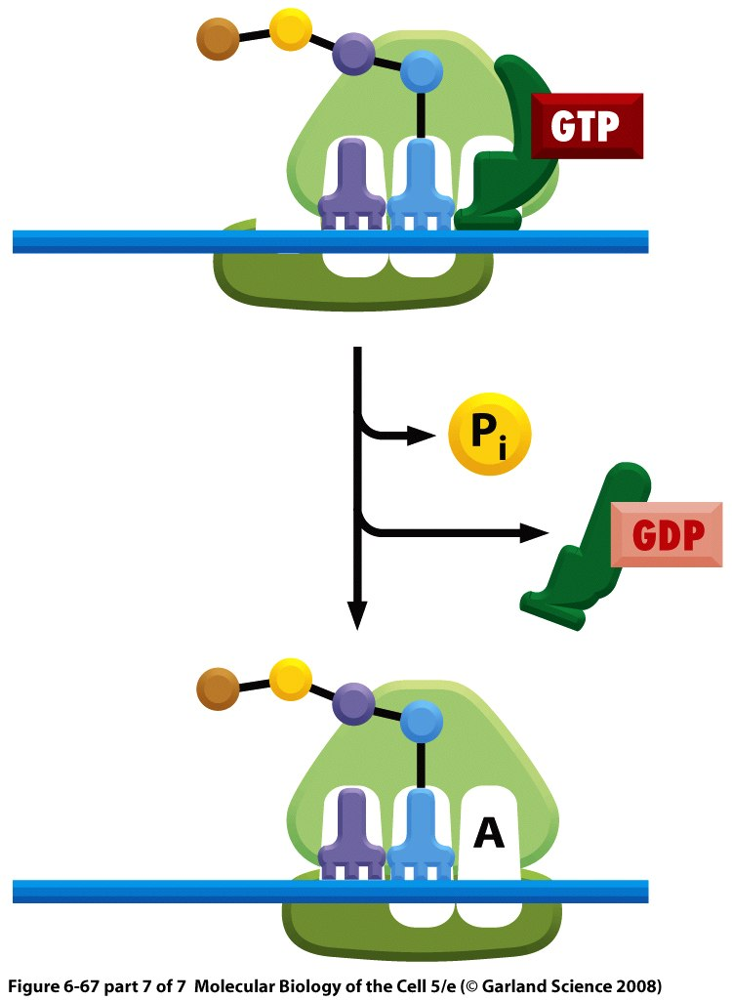
Role of EF-G
Notes:
The next one is EF-G: has two roles; one shown here. During the cycle when the large subunit moves to the right half of the A site is free on the right and what we want is to get another movement by the small subunit to create a full A site and that’s facilitated by EF-G. and then there is hydrolysis of GTP into GDP and then the translocation movement occurs and the full A site is created.

Slide 18
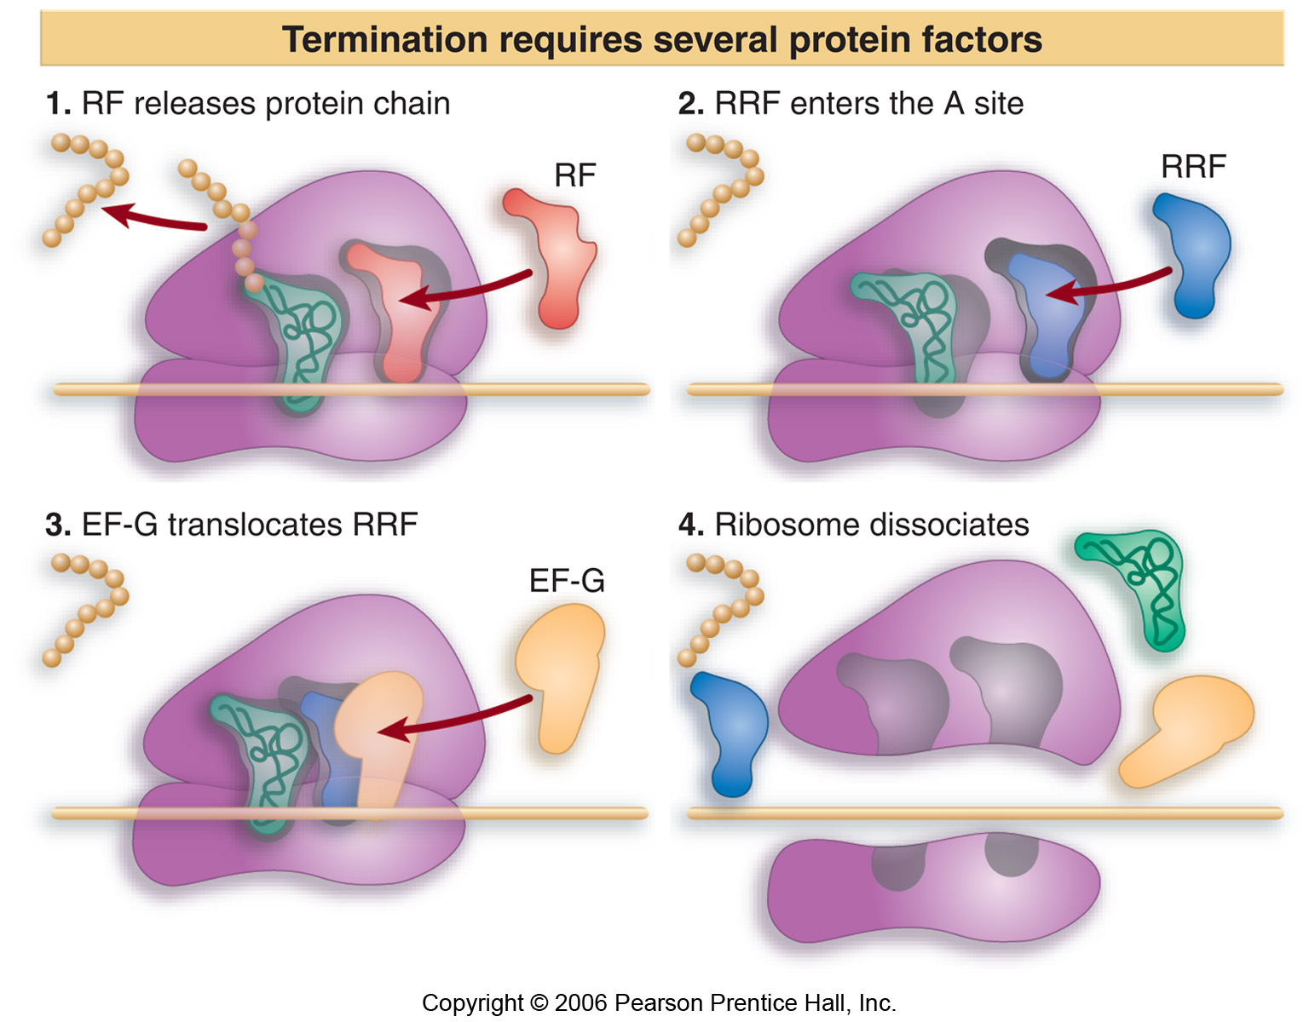
Termination
RRF: ribosome release factor
Notes:
Now termination of transcription: we have a free A-site but we have a termination codon in it. And there is no trna that recognizes this which causes the whole system to pause. When the pause happens it allows a release factor to enter the free A-site, and the entrance of this factor causes the hydrolysis of the link between the last trna and the polypeptide chain and so it is release the last trna ends up in the E site and when the whole complex dissociates it is expelled. A ribosome release factor will enter and then elongation factor G (second role) will bind to this complex and cause the whole complex to dissociate.

Slide 19
Termination in more detail
RRF: ribosome release factor
Notes:
One thing that’s not shown here is that in the last step when everything dissociates, the small subunit will bind to intiation factor 3 IF3 which will prevent it from binding the large subunit again. So then the whole process starts again for a new protein.
IF3 and IF2 are the most important toi remember.

Slide 20
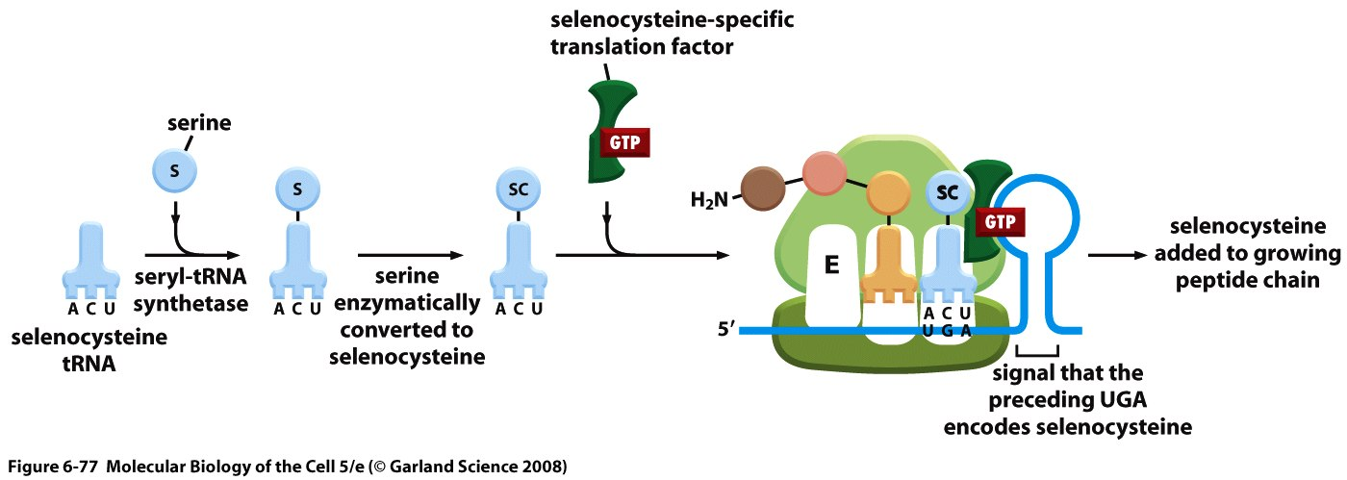
Translational recoding
Notes:
There are two very minor exceptions to this translation method. The first one is called translational recoding. There are some very rare amino acids such as selenocysteine which looks like systeine but it has slenium atom which can be used in some enzymes. The incorporation of selenocystein into protein requires a special slenocystein trna with the anti codon 5’UCA3’ (remember convention) which corresponds to the 5’UGA3’ codon on mrna which is actually a stop codon (and this is the only trna that can recognize the stop codon) this trna will load serine which will be enzymatically converted to selenocysteine, this special trna has special affinity for a protein which is a specific translation factor for selenocysteine, this complex will enter the A site of the ribosome but you don’t want it to enter in every stop codon, so what happens is that there is a stem loop structure which attracts the initiation factor for SC bound to the trna which ensures the SC is entered into the polypeptide. Without the stem loop structure there is no SC entered and the codon will be enterpreted as a normal stop codon.

Slide 21
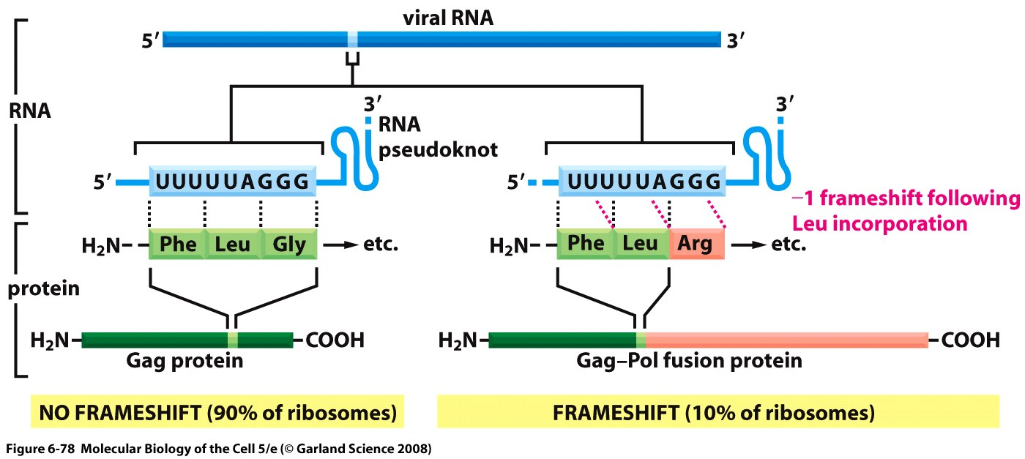
Translational frameshift
Notes:
The second exception is translational frameshift which will apply to viral mrna mainly. GAG protein in viruses is abundant and the other one is pol but the virus doesn’t need much of this unlike gag. Virus will use the same mrna to make a lot of gag (90%) and a little of pol (10% because of the presence of pseudokow the phe than leu is put in and the n the ribosome will slip one nucleotide and it will insert Arg and a frame shift will occur and the rest of the protein will be different from the Gag protein and so a gag- polymerase protein results ) .
The mrna has a pseudoknot secondary structure that allows it to frameshift 10% of the time randomly.
Gag is a structural protein that is needed a lot and pol is polymerase that is only needed a little bit.

Slide 22
Antibiotics and Translation
Tetracyclin : blocks binding of aminoacyl-tRNA to the ribosome.
Chloramphenicol : Inhibits peptidyl-transferase activity of the ribosome
Erythromycin : Blocks ribosome translocation movements.
Notes:
There are differences between prokaryotic and euckaryotic ribosomes, and there antiboiotics that will interfere with translation in one catogary of organisms without the other one. There are three examples here.

Slide 23
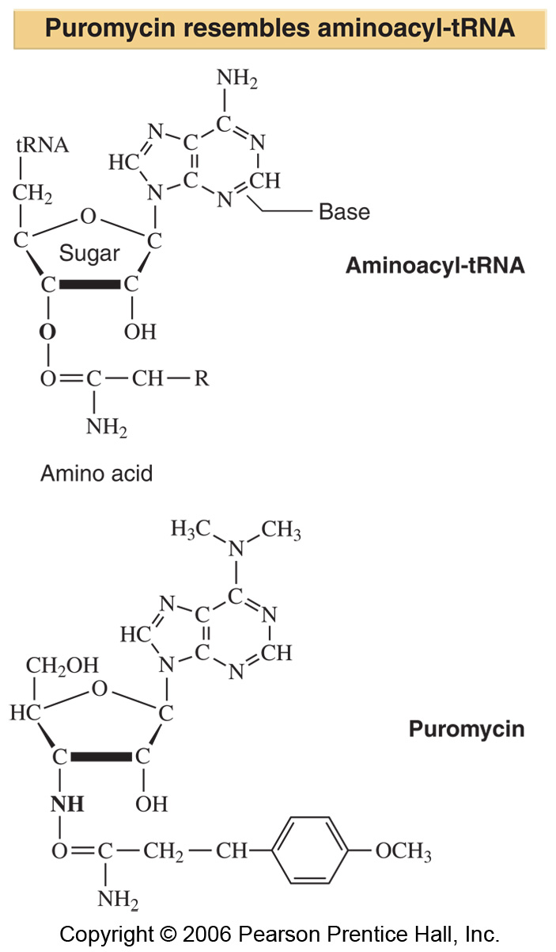
Puromycin resembles an aminoacyl-tRNA
Notes:
And the last example is here but puromycin has the same affect on both eukaryotes and prokaryotes so it cannot be used to fight off bacterial infection. Puromycin will cause premature release of polypeptide chain so it will end translation.

