Slide 1
Office Hours
(midterm #1)
Wednesday Sept 25, 2 PM to 4 PM
Friday Sept 27, 9:30-11:30 AM
Monday Sept 30, 2 PM to 4 PM

Slide 2
DNA Replication II
+
DNA Repair
20 September 2013

Slide 3
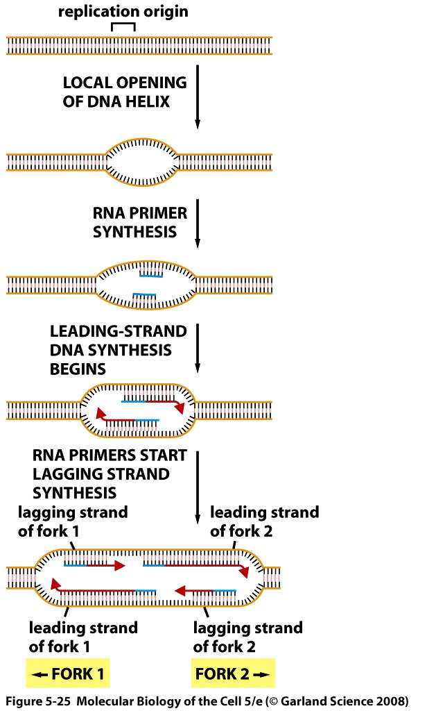
Replication Origin
Important points:
Two forks moving in opposite directions.
For each DNA strand, replication is continuous (leading strand) for one fork and discontinuous (lagging strand) for the other fork.
Notes:
Where replication starts, at the origin there is a replication bubble and synthesis of DNA will occur in anti parallel fashion. We have two forks one generally moving to the right and the other to the left.

Slide 4
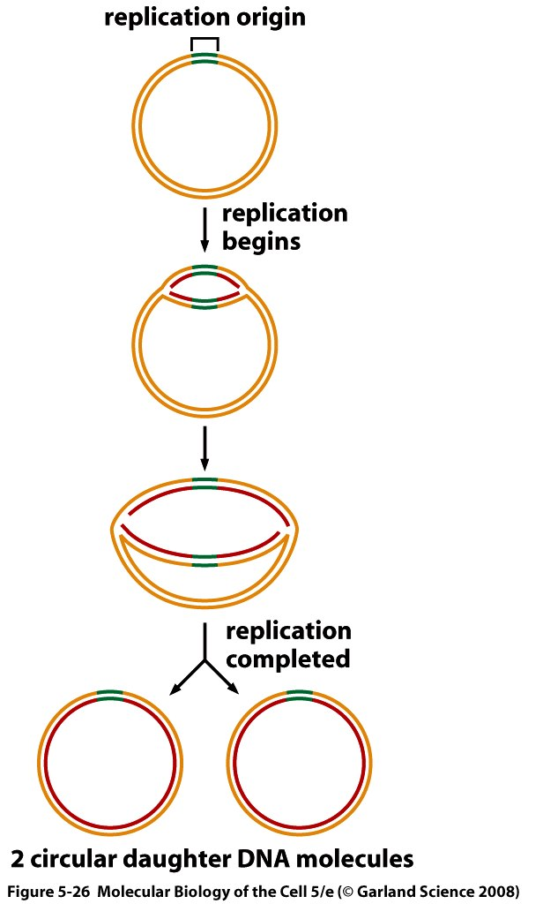
Replication of bacterial chromosome
Notes:
Most bacteria has circular DNA and a single replication bubble. This is the situation in prokaryotes.

Slide 5
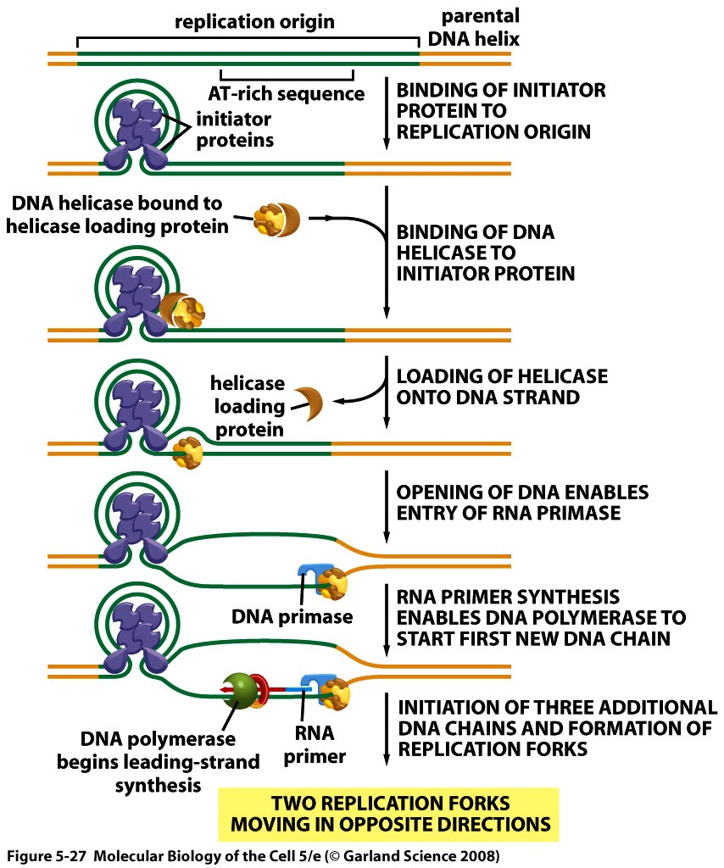
Initiation of replication in bacteria
Notes:
At the molecular level this is how replication occurs. There are sequences that will attract initiator proteins (shown in blue ) and the origin will als have AT rich sequences (so interaction is relatively weaker and hence easier to open), these two features are present at the replication origin of both prokaryotes and eukaryotes. The helicase will be attracted to the protein complex formed and open the dna and then the rna primase will synthesizes the primer followed by DNA polymerase synthesizing DNA. Eukaryotes have many replication origins to help replicate entire genome the replication origins are organized in groups of origins and replication at a given group of origins will function simultaneously but not all groups of origins will be replicating simultaneously. Regions of expressed genes will be replicated earlier and heterochromatin will be replicated relatively later.

Slide 6
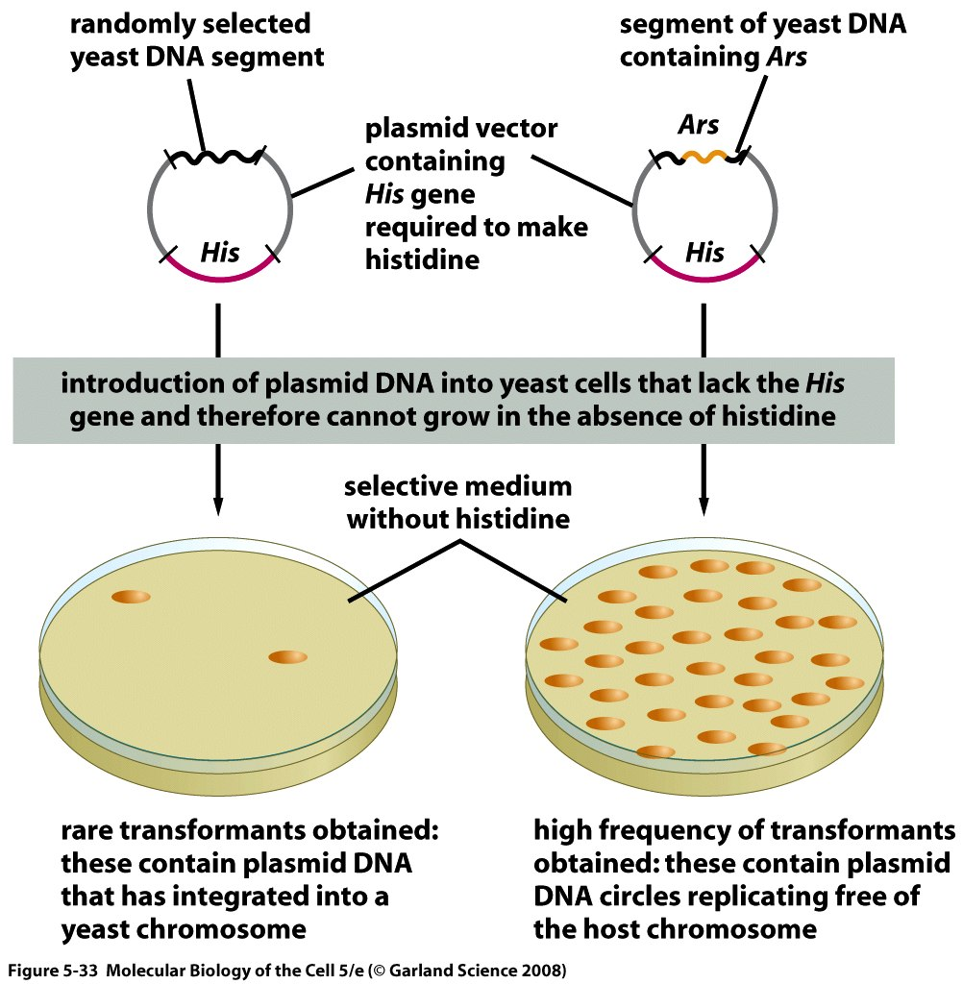
Strategy to clone replication origins in yeast
Notes:
Replication origins in eukaryotes are harder to find. This experiment, they used short circular dna molecules called plasmids, these plasmids contain a certain number of features, first it contains the coding region of a gene called His which allows the cell to make amino acid histidine which allows the cell to survive in a medium that lacks histidine, than they used the kind of yeast that cannot grow in a medium that lacks histidine because it lacks His. Another feature of this plasmid is that it contains a region that can insert/clone random dna segments. This kind of cloning is called cloning based on function. Because we’re looking for a certain function and in this case we are looking at at the cloned dna insert that was taken in at random and it’s ability to direct plasmid replication Once it is in a yeast cell. IN other words a plasmid that contains a sequence other than it’s replication origin will not be able replicate autonomously once u’ve inserted it into the yeast.
Initially each yeast cell is happy and can grow in medium but after it divides, only one will survive in the medium; the one that gets the plasmid. IN this particular example one the cell divides the dna of the plasmid will also be replicated so both daughter yeast cells will have the plasmid and will be able to survive. And produce colonies and they all have have the plasmid that contains a replication origin. But the one on the left is the control that shows that without the plasmid the yeast cannot survive.

Slide 7
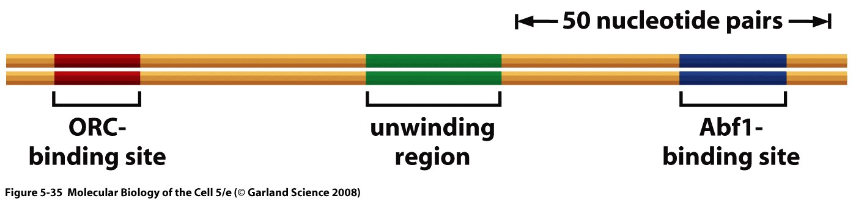
Replication origins in yeast
Notes:
Once you have the colonies in the last slide you prepare the DNA and sequence it and see what the sequence looks like at the origin and when you do that you see it will look like this in yeast. It has some specific sequences, pay attention to the ORC-binding site. It also has a region that is easy to open called the unwinding region analogous to the AT rich region in bacteria.
You can repeat the experiment shown before to better define your origin in yeast.

Slide 8
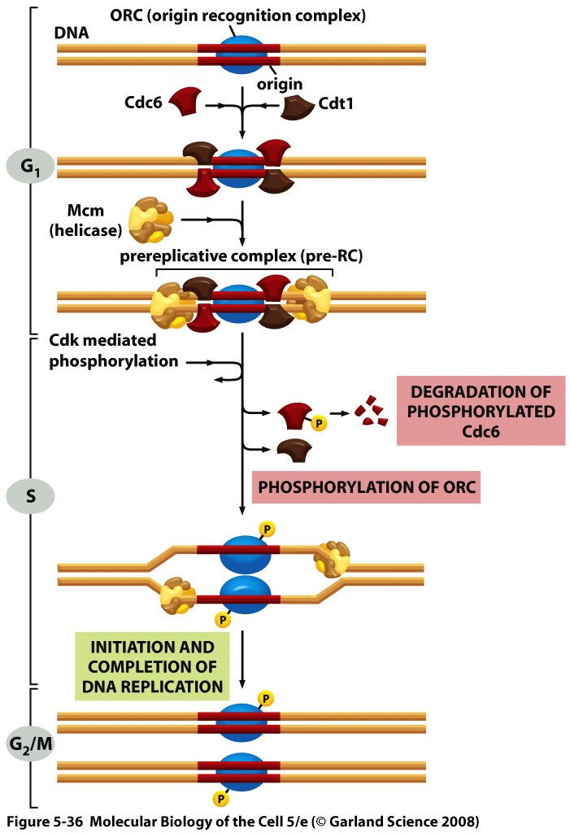
A replication origin is activated only once per cell cycle
Prereplicative complex is formed
S phase: cdc6 is phosphorylated and degraded.
Replication can start.
Notes:
In this slide we’re showing what happens in eukaryotes. Here we have Origin recognition complex ORC and then you have other proteins like Cdc6 and cdt1 which assemble at the ORC to attract the helicase. Then the helicase comes in and we have what’s called prereplicative complex; so all the proteins are there but replication has not begun yet, this is happening during the G 1 phase of the cell cycle . In the S phase, there are events that lead to phosphorylation of cdc6 which causes detachement and degradation of cdc6 which activates the prereplicative complex and helicase is able to do its job at this point. The proteins of the ORC (in blue) are also phosphorylated for a while which prevents the reformation of the prereplicative complex so during G2 and M it cannot be reformed, only in the next cell cycle in G1 that the prereplicative complex can be formed.

Slide 9
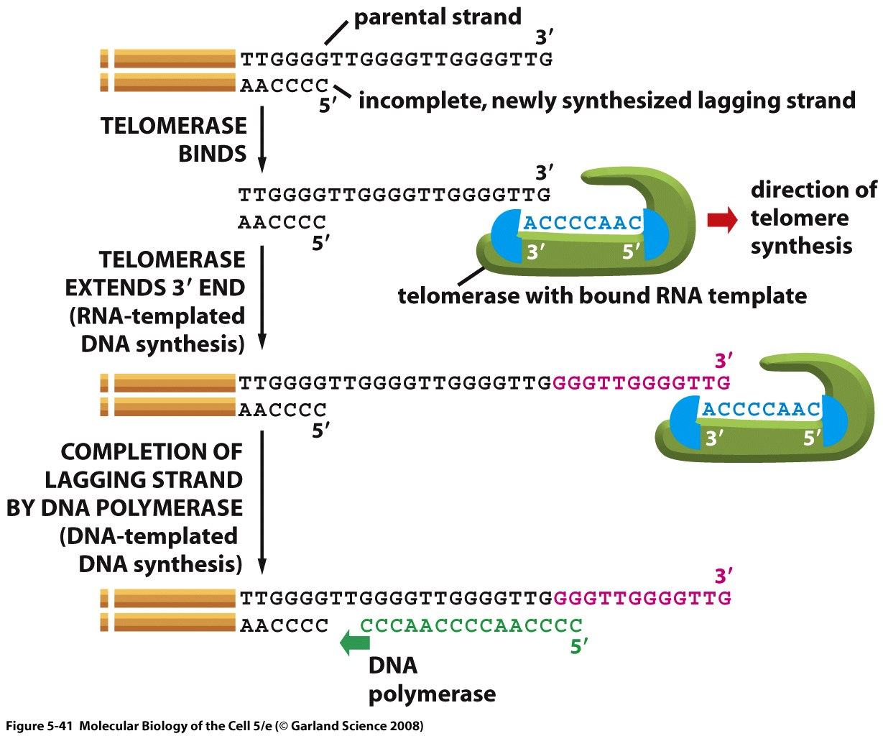
Telomere synthesis
Notes:
Telomerase is an enzyme that contains both a protein and an RNA component. This RNA component serves as a template to elongate the parental copy (not newly formed copy) and then the lagging strand machinery makes the lagging strand, at the very end there will be a small stretch of parental DNA that is not paired to anything corresponding to the last place the primer was added in lagging strand synthesis.

Slide 10
Video suggestion
http://www.youtube.com/watch?v=AJNoTmWsE0s&feature=related

Slide 11
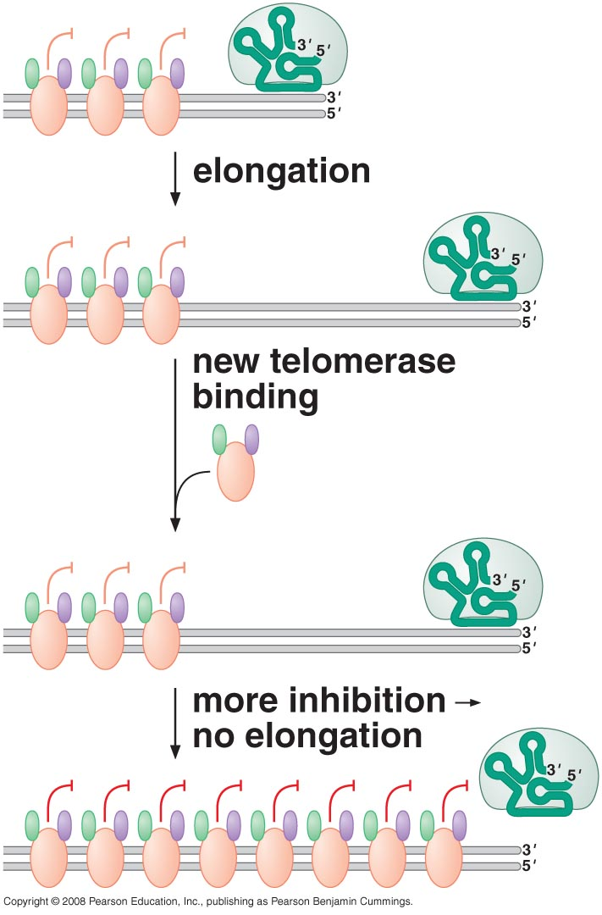
What stops telomerase?
Notes:
There are a bunch of different proteins that is added to the telomere, the longer telomere the more protein u can add, each of these proteins has a small inhibitory effect so at one point you have too much of these proteins and hence too much inhibition and so the telemorase stops.
If ends of chromosomes don’t have telomeres because they shortened after every cell division then chromosome can get degraded and cell dies. The telomeres can be used as a method to show the age of cells. Cancer cells are an exception have increased telomerase activity.

Slide 12
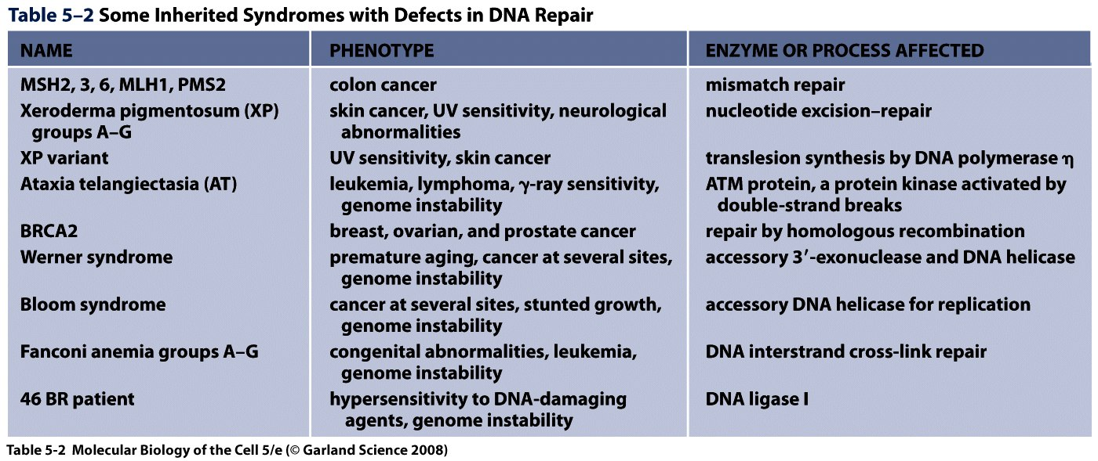
DNA repair and inherited syndromes
Notes:
Don’t memorize.
Only need to Remember that impaired function of DNA repair enzymes can often be associated with cancer.

Slide 13
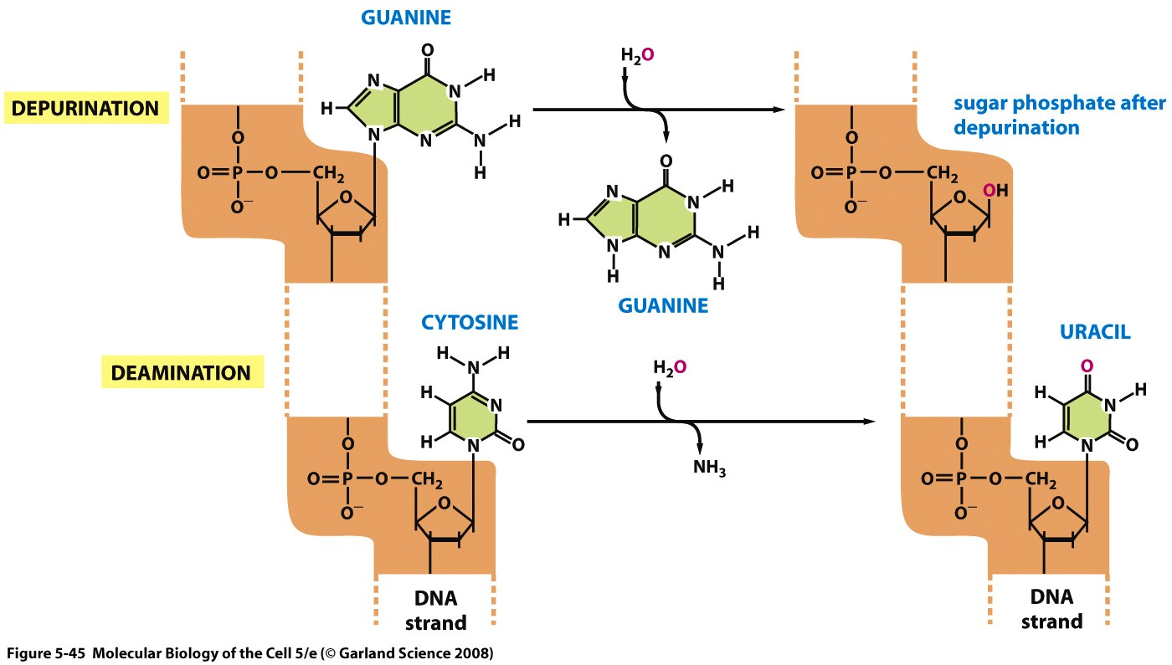
Depurination and deamination
Notes:
DNA repair: There are changes in dna that are happening spontaneously but also exposure to uv light or some alkylating agents will affect dna. We’re talking about mutations that occur either spontaneously or by certain chemicals here. This slide shows you the two of the spontaneous changes happening in dna, the first one is depurination which is the loss of a purine so you have a sugar without a base on it.

Slide 14
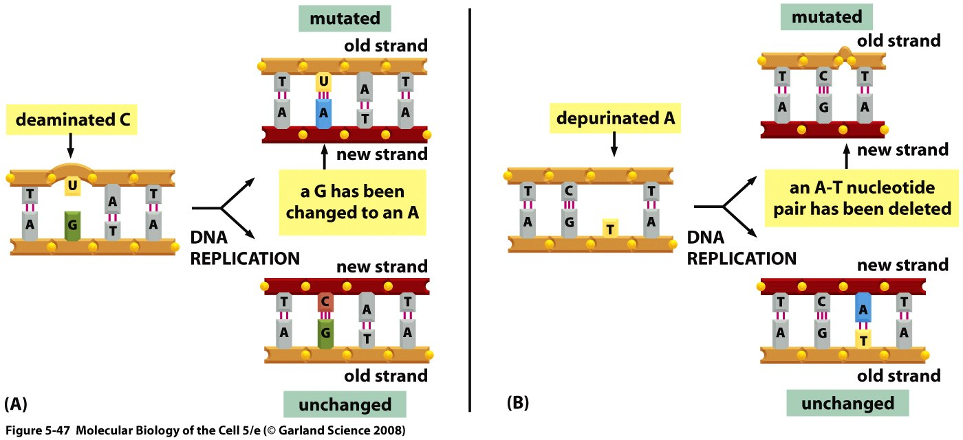
Consequences of deamination and depurination
Notes:
If the machinery

Slide 15
Depurination and deamination
Notes:
The second one is the deamination, it is the loss of that amino group on cytosine and it turns into U. So net consequence is that instend of incorporating a G it will incorporate and an A and this will be maintained as the cell divides.

Slide 16
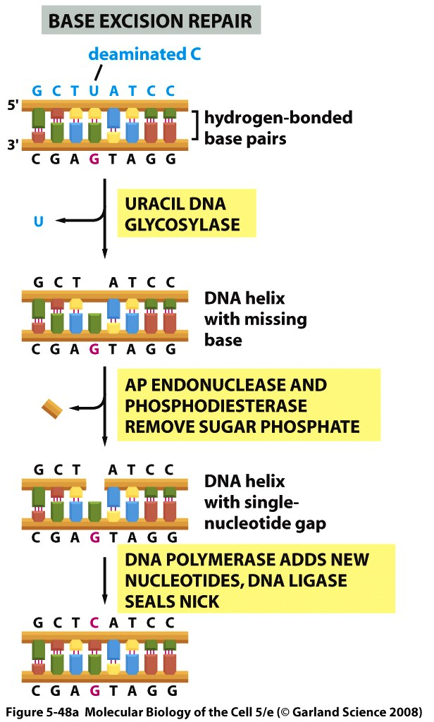
Base Excision Repair
Notes:
These can be fixed by base excision repair, here delaminated C turned in U (normal no U’s in DNA) the repair machinery uses glycosylases will recognize an altered base through a base flipping mechanism, and will remove it. There is a special endonuclease that breaks DNA from the inside, which removes the sugar phosphate that was previously attached to U, and the DNA polymerase adds the new nucleotides and DNA ligase seals the nick.

Slide 17
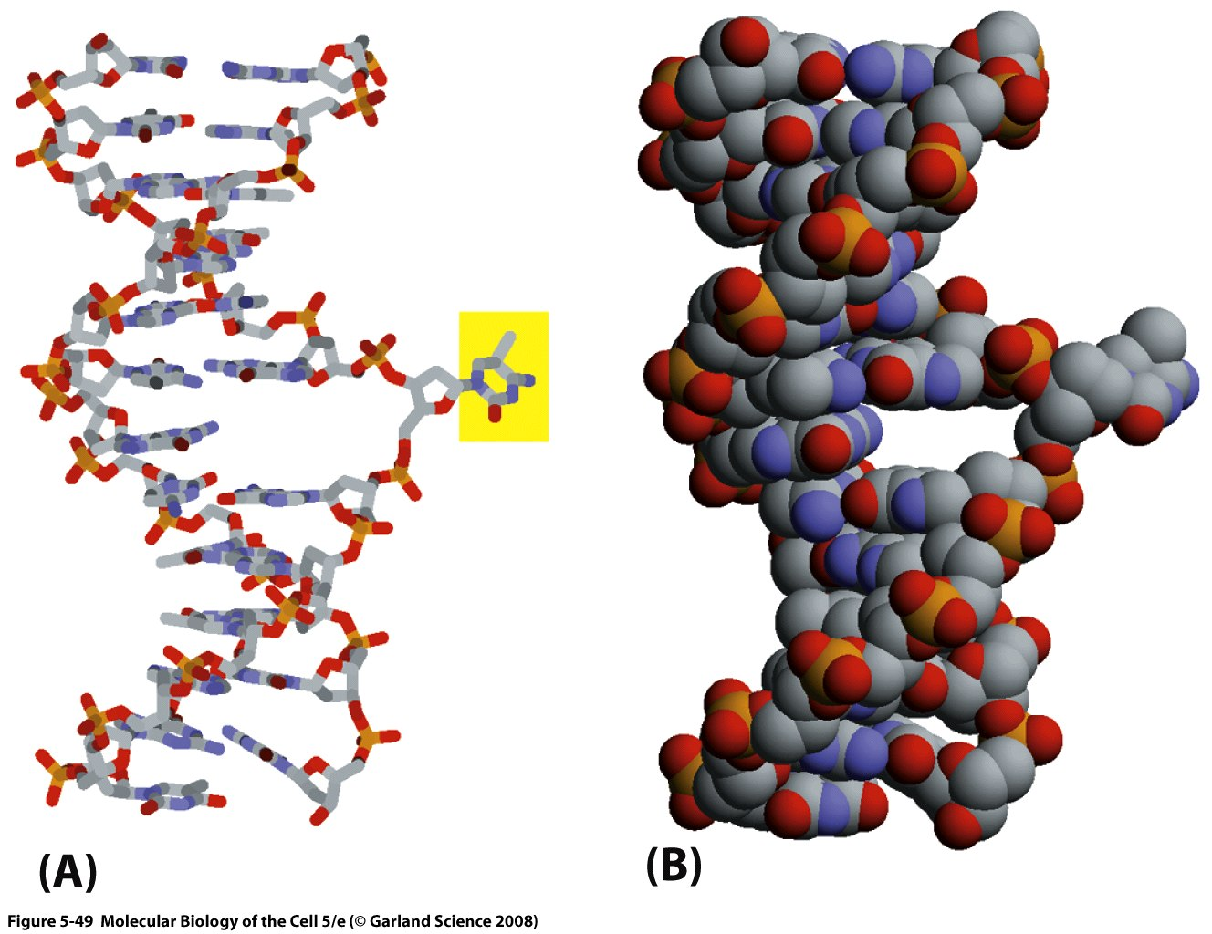
Abnormal nucleotide is recognized by base flipping

Slide 18
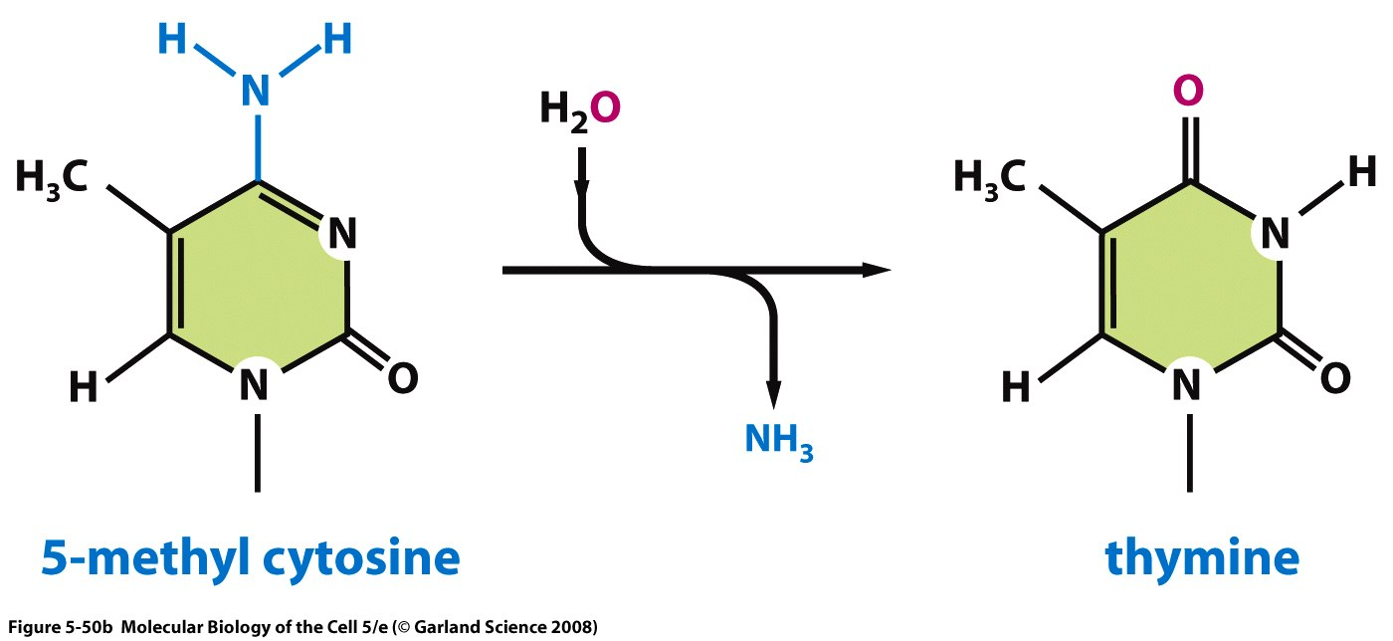
Deamination of methyl-cytosine
Notes:
One special case, there are some bases in dna that are methylated especially cytosine in eukaryotes to form 5-methyl cytosine. When deamination of 5-meythyl cytocine it leads to thymine. There is a glycosylases that can fix this but it’s efficiency is less than the previous ones, and although this base is not frequent it is associated with many cases of disease.

Slide 19
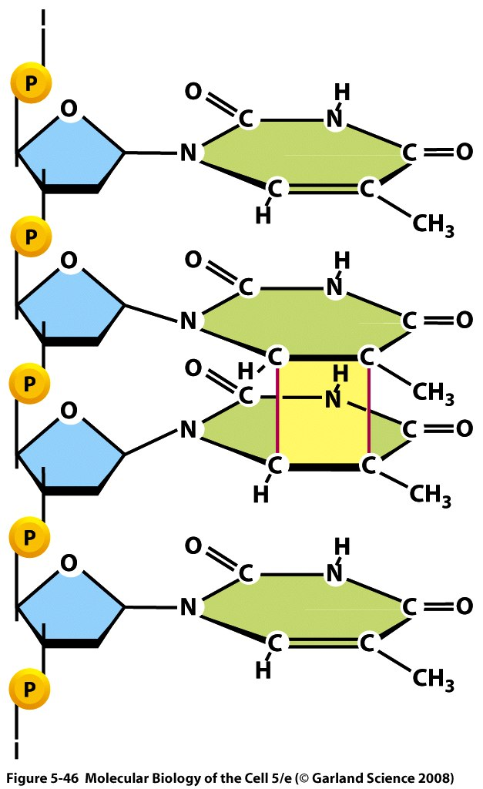
Pyrimidine dimers
Notes:
Now we talk about a mechanism that will fix more extensive DNA changes, a classic example is the formation of pyramidine dimers. Sometimes through exposure of uv light there will be a covalent bond formed between two consecutive bases which must be repared.

Slide 20
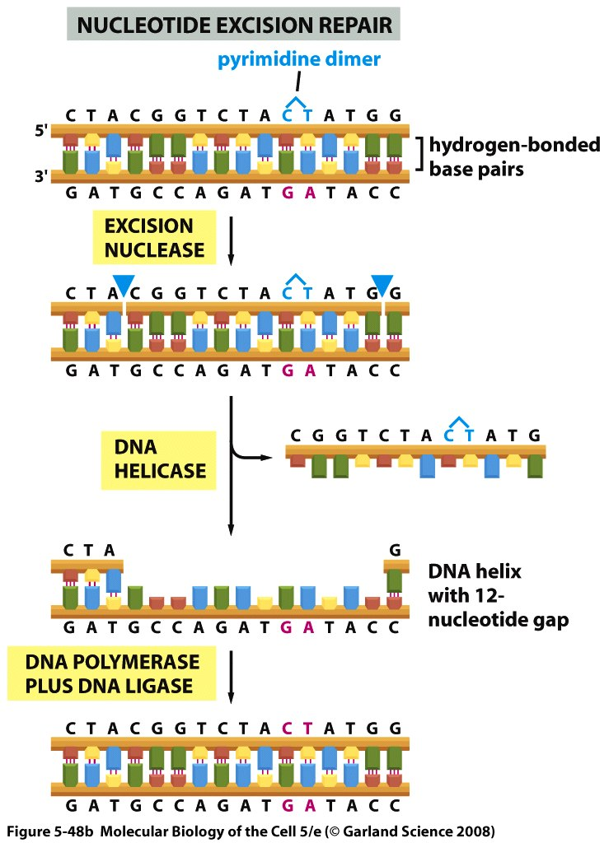
Nucleotide Excision Repair
Notes:
This is repaired by nucleotide excision repair, the dimer was formed between C and T, nuclease will cut both sides of the lesion and will only cut on one strand as shown in the diagram then a dna helicase will remove the singles stranded fragment leaving a 12 nucleotide gap (bacteria) and DNA polymerase will replace the nucleotides and ligase will come in and seal the nick.

Slide 21
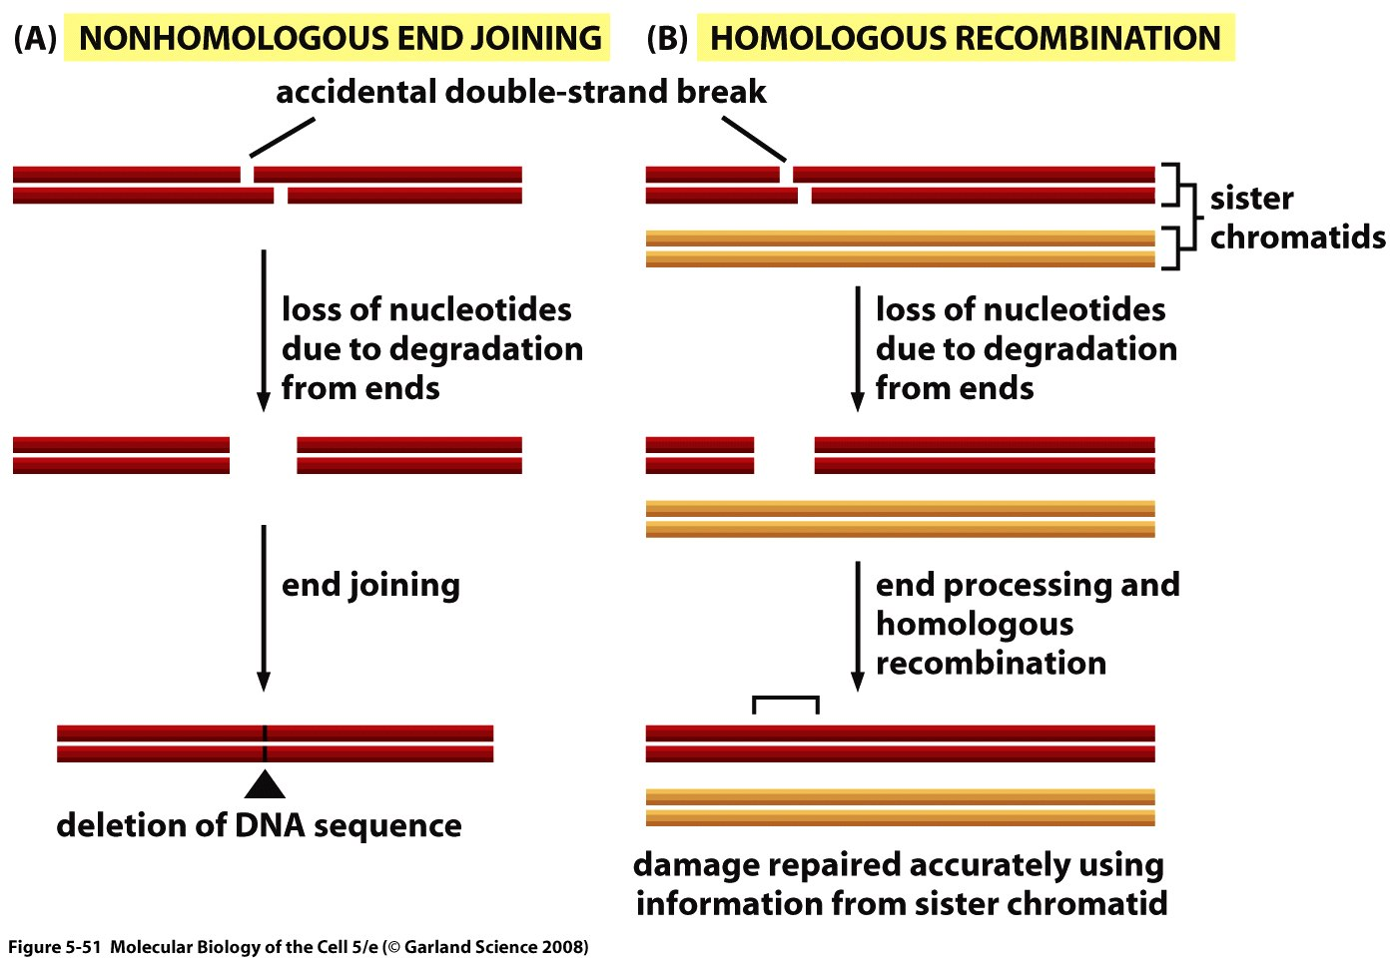
Double Strand Break Repair
Notes:
Nucleotide and base excision repair mechanisms both used the intact DNA strand to restore the proper sequence. However with double strand break repair u cut both strands and so u don’t have an intact strand to fix it. Homologous Recombination uses the sister chromatid during mitosis to fix the sequence. Non-homologous end joining doesn’t used a sequence to do the job, what happens is some proteins come and flush the two ends and then the ends are joined so they introduce a mutation.

Slide 22
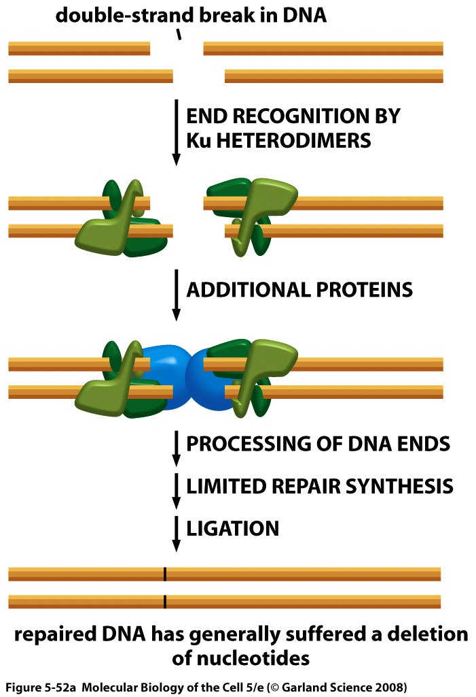
Non-Homologous End Joining (NHEJ)
Notes:
Ku70-80 dimers recognize these breaks and attract additional proteins and facilitate the joining of the ends. Telomeres protect chromosomes from KU heterodimers. Non-homologous joining is less faithful than homologous recombination. Mammals mainly use non-homologous end joining to repair (remember) DNA and so each time they make a repair like this they introduce a mutation but the protein coding region of the human genome is 1.5% so nearly most of the time the introduced mutation may occur in “junk” dna and so will have no consequence. Yeast uses a lot of homologous recombination.

