Slide 1
Office Hours
(midterm #1)
Wednesday Sept 25, 2 PM to 4 PM
Friday Sept 27, 9:30-11:30 AM
Monday Sept 30, 2 PM to 4 PM

Slide 2
DNA recombination
General Recombination
Site Specific Recombination
24 September 2013
Notes:
DNA recombination can be divided into two large categories.

Slide 3
General Recombination
Notes:
Example is crossing over during meiosis.

Slide 4
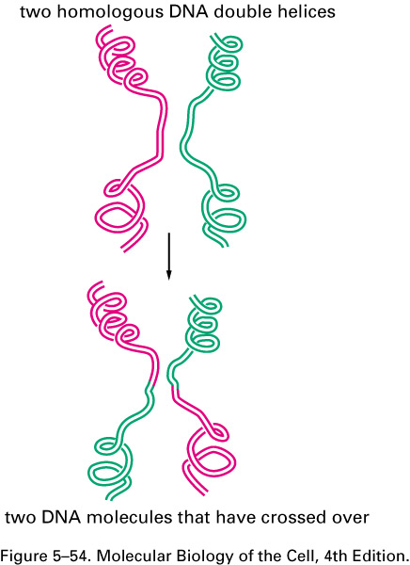
Recombination during meiosis
Notes:
This is only a subset of the recombination that can occur in cells.

Slide 5
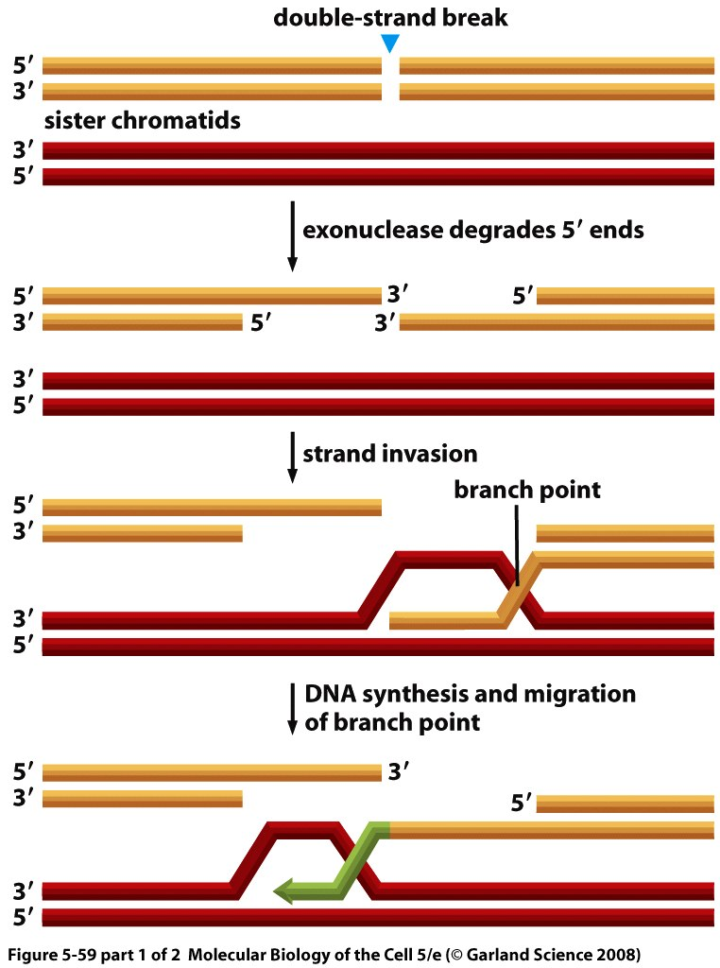
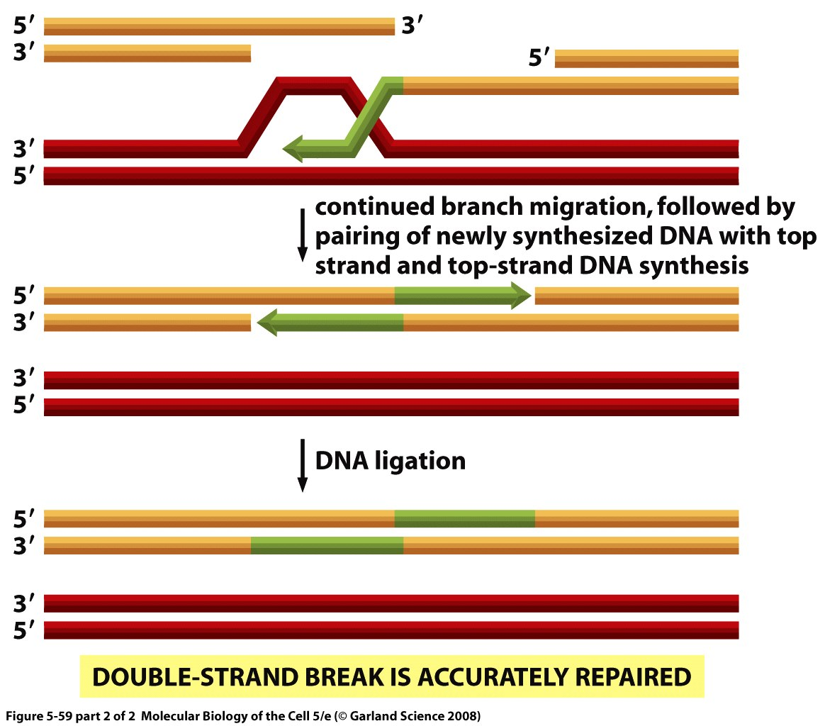
Recombination and double strand break repair
Notes:
Two homologous sequences, one of them has undergone a double strand break. There are enzymes that are going to chew the 5’ ends on both strands which will lead to protruding 3’ ends that will stick out. One of those 3’ dends will invade the other dna molecule and will pair with complementary bases, so when it has invaded the other one will stick out and at some point the two strands will reach a branch point. This branch pint can move and it is accompanied by synthesis of DNA using the red strand as a template so it will be more similar to a red chromosome than the orange chromosom. Most of the time they are the same but this also means that this can introduce changes into the orange dna. the New dna synthesis using the information on the red dna is shown in green. This is an overall review of recombination and double strand break repair.

Slide 6
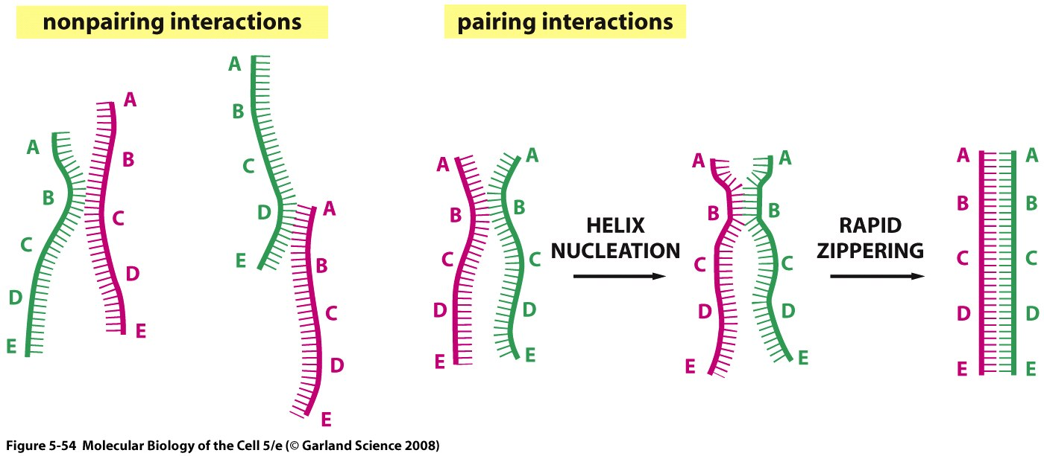
Pairing of DNA strands
Notes:
Now we will look at some steps in detail, when this single strand 3’ end crosses over to the red dna it needs to find a complementary sequence, there will be several interactions randomly until a good pairing is found then when found it will anneal like a zipper efficiently.

Slide 7
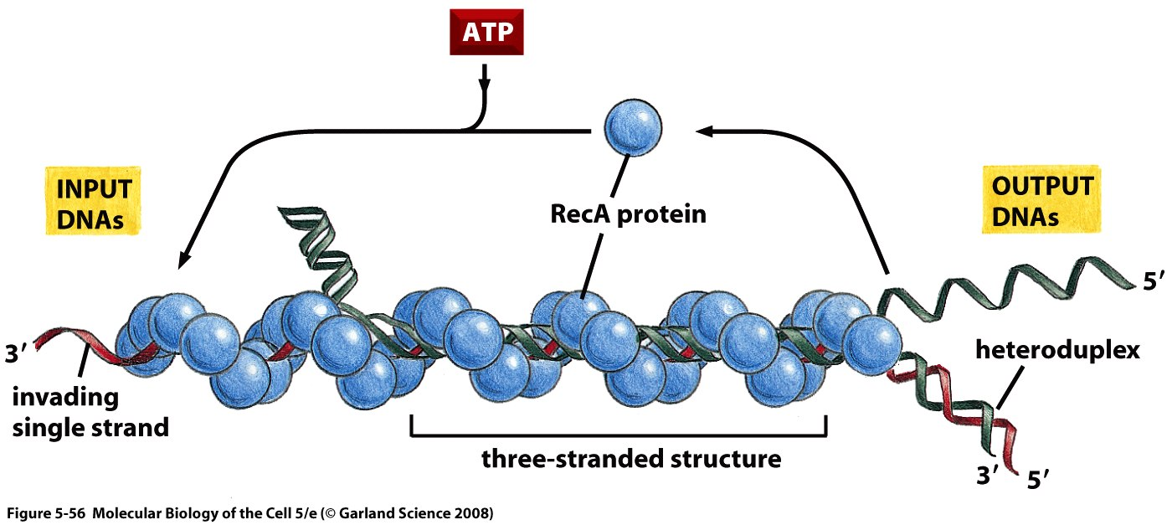
RecA protein and heteroduplex formation
Notes:
This process by which the strand invades and pairs with the other dna molecule and by which the branch point moves is helped by Rec A protein in bacteria or Rad 51 in eukaryotes.

Slide 8
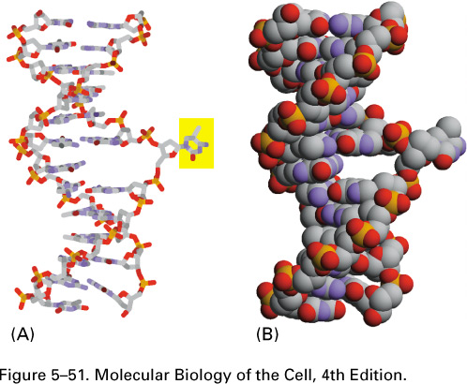
Base flipping
Notes:
Base flipping has a way of facilitating the sthree stranded structure shown in the previous slide.

Slide 9
RecA protein and heteroduplex formation
Notes:
This uses energy in the form of ATP. What comes out of this process is a green single strand and a heteroduplex (one red and one green),

Slide 10
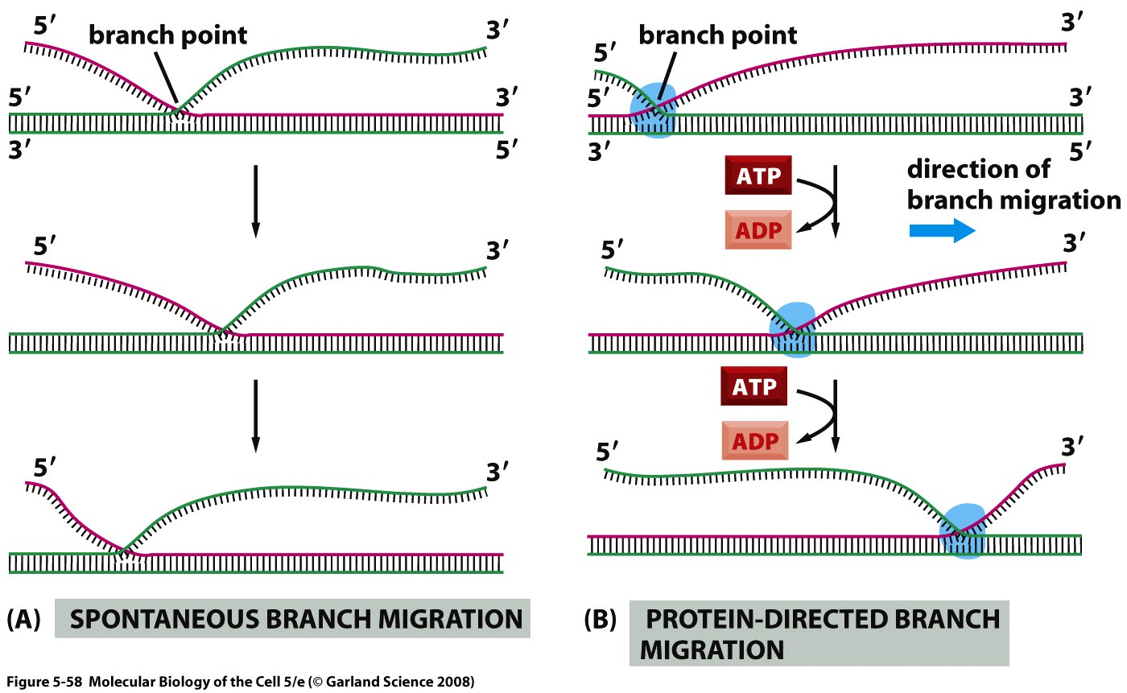
Branch Migration
Notes:
Branch point can move, here to the left, this is called branch migration, double stranded green and single stranded red comes in and the end result is hetorduplex with single stranded red. You can see the branch migration happening spontaneously, in cell this will need energy provided through ATP hydrolysis.

Slide 11
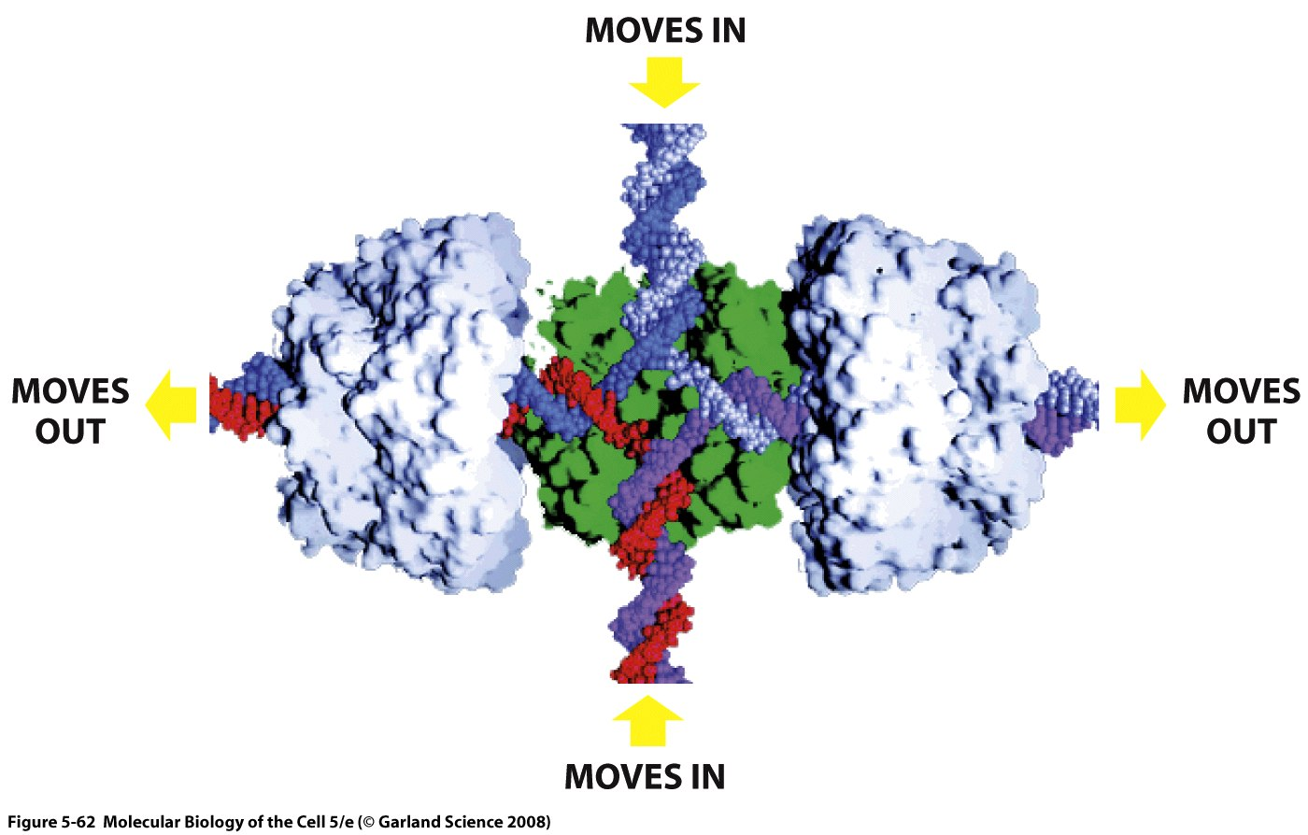
Heteroduplex moves
Notes:
just extra! Just remember that there are two structures and that this thing would come in like this and come out like that.

Slide 12
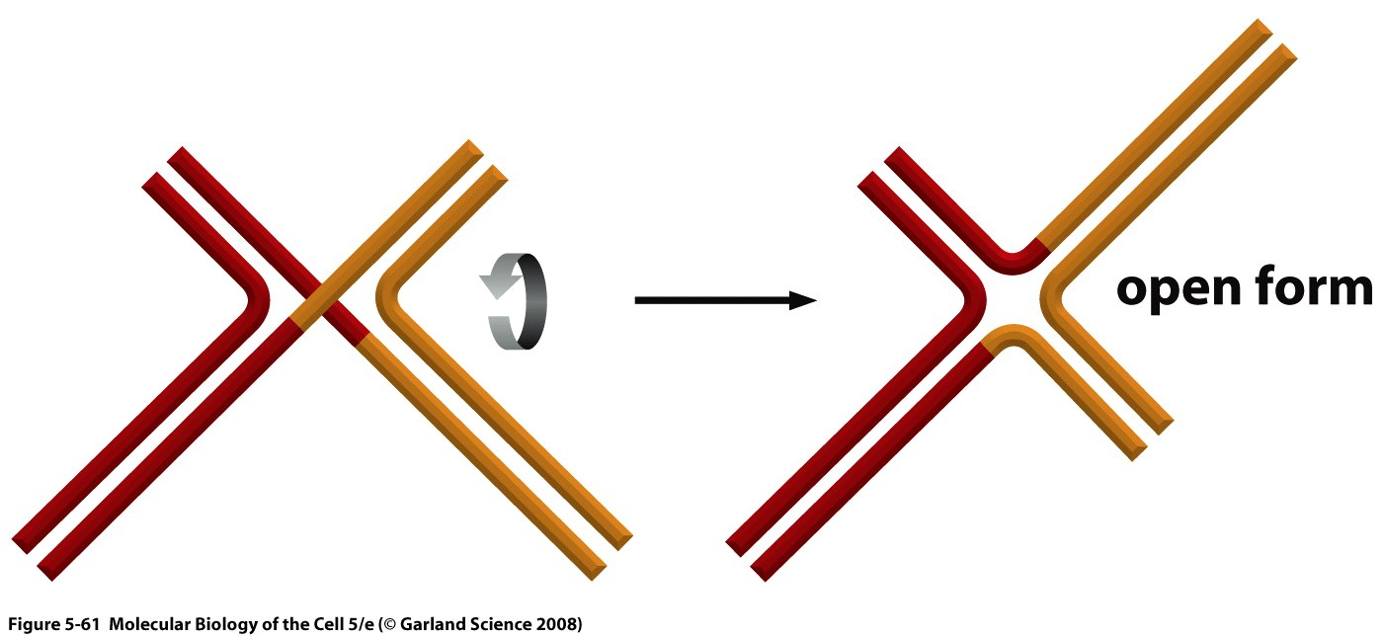
Holliday Junction
Notes:
Here we have the two double stranded dna molecules that crossed each other that gives us a structure that has two strands that are not crossing and two strands that are crossing. This is the holliday junction.

Slide 13
Holliday Junction
When DNA is cut as indicated by green arrows: no crossing-over
Notes:
If you cut vertically, no crossing over occurs.

Slide 14
Jonction de Holliday
When DNA is cut as indicated by blue arrows: crossing-over
Notes:
oNe way to resolve the holday junction vertically ending up with no crossing over
The second way is to cut horizontally as shown and u’ll end up with both molecules that have red on left and orange on the right. This is with crossing over.
Mitosis-> no crossing over!
Meosis-> crosing over but the two scenarios are possible.

Slide 15
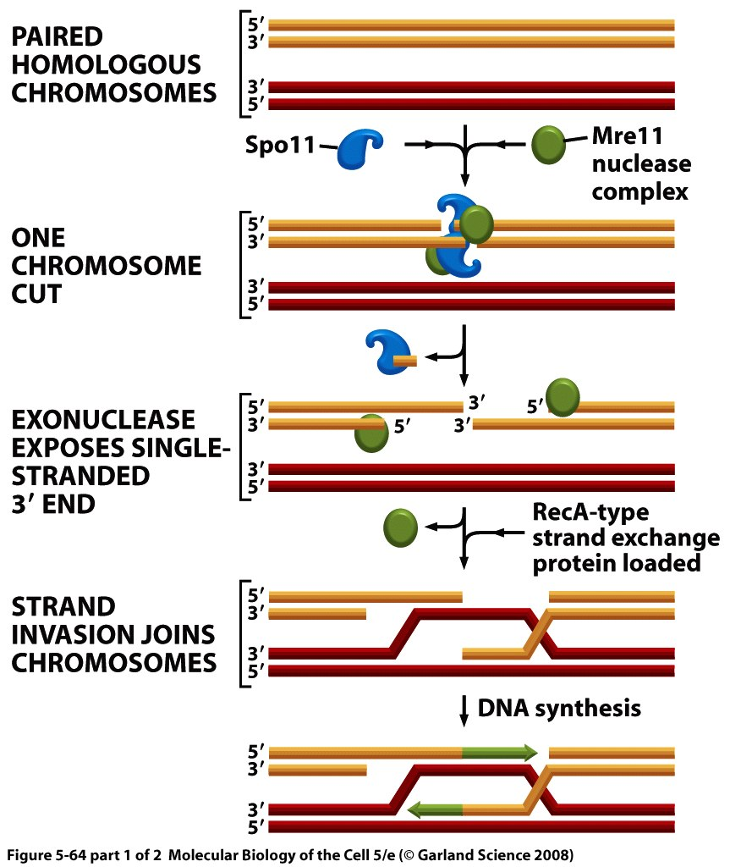
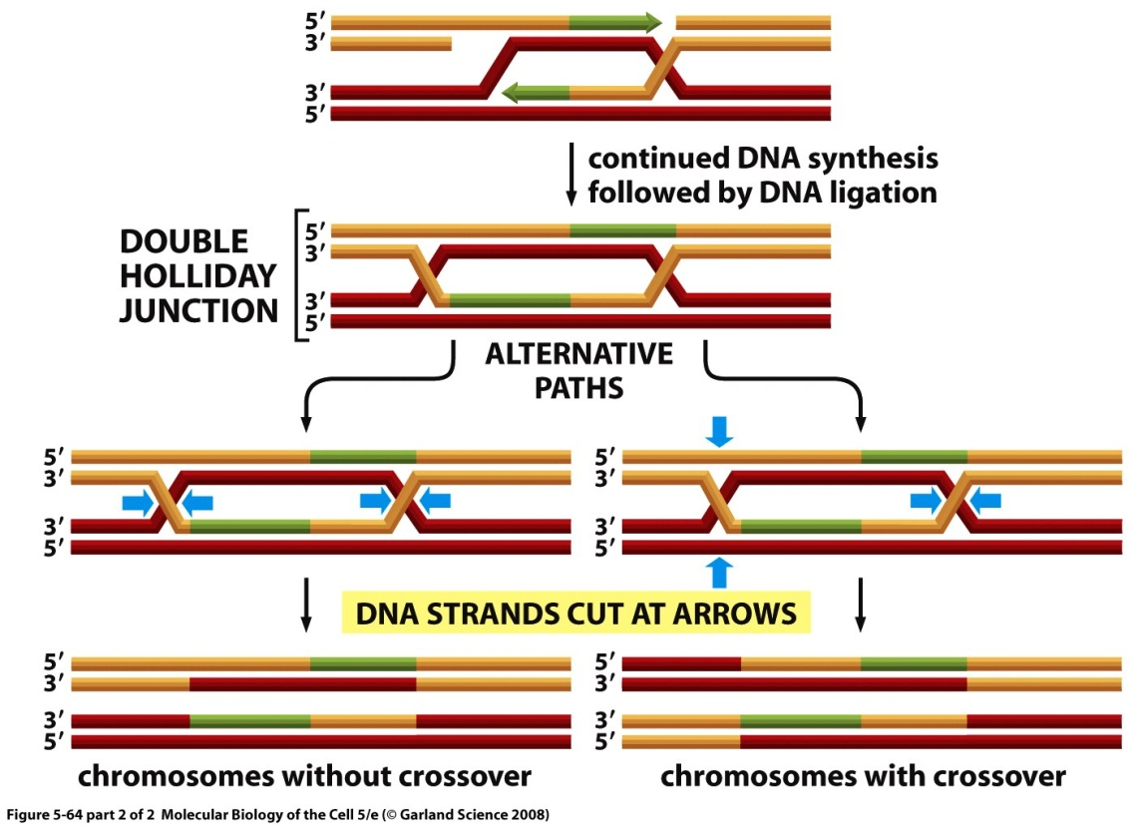
Honmologous recombiantion during meiosis
Notes:
There are proteins that can bind to the chromosome randomly, however there are regions on the chromosome (hot spots) where it’s more likely to see recombination events because these proteins bind and induce the crossing over event.
After constituting the chromosome u end up with two holiday junctions that are not two far away from each other, which can either be resolved with two horizontal cuts u end up with chromosomes that have no crossing over and this method will occur 90% of the time in meiosis. On the right is the other scenario where thiere is one horizonal cut and one vertical cut and you end up with chromosomes with crossing over.

Slide 16
Video suggestion
http://www.youtube.com/watch?v=3qgBKrAZCLg&feature=related

Slide 17
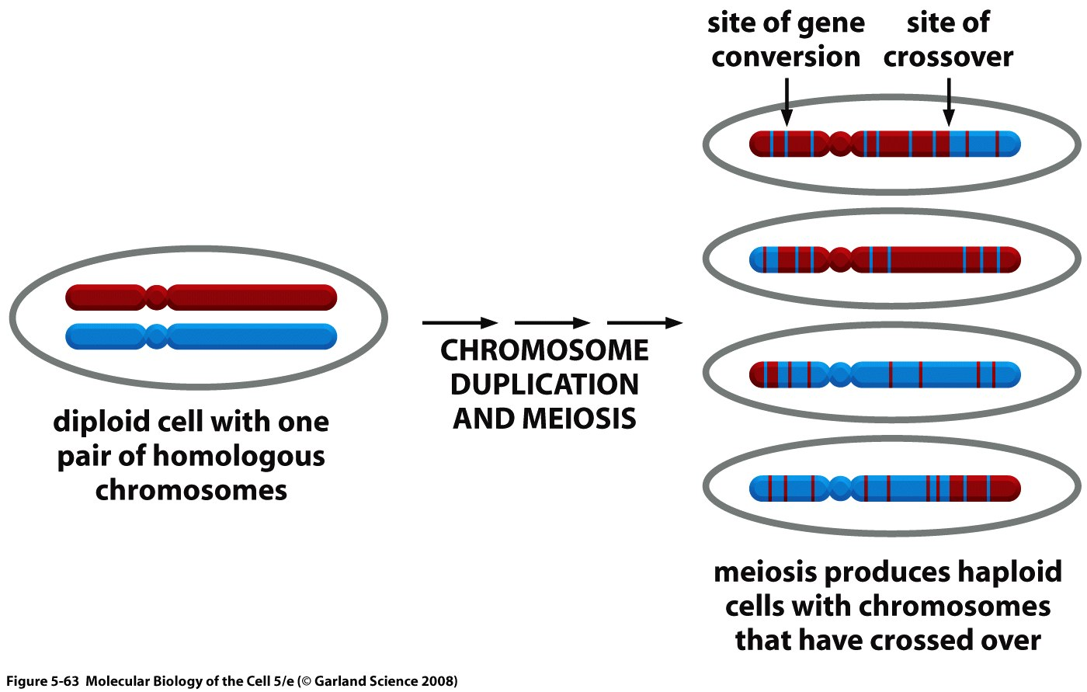
Crossing over and Gene Conversion during meiosis
Notes:
The two regions in the hetero duplex are almost the same but there are some difference.
During meiosis we get 4 haploid cells and we get some crossing over and on average there is about two crossing over events on each chromosome in a meotic division, but in addition if u look closely u see that there are some stripes and these are the regions where gene conversion took place .

Slide 18
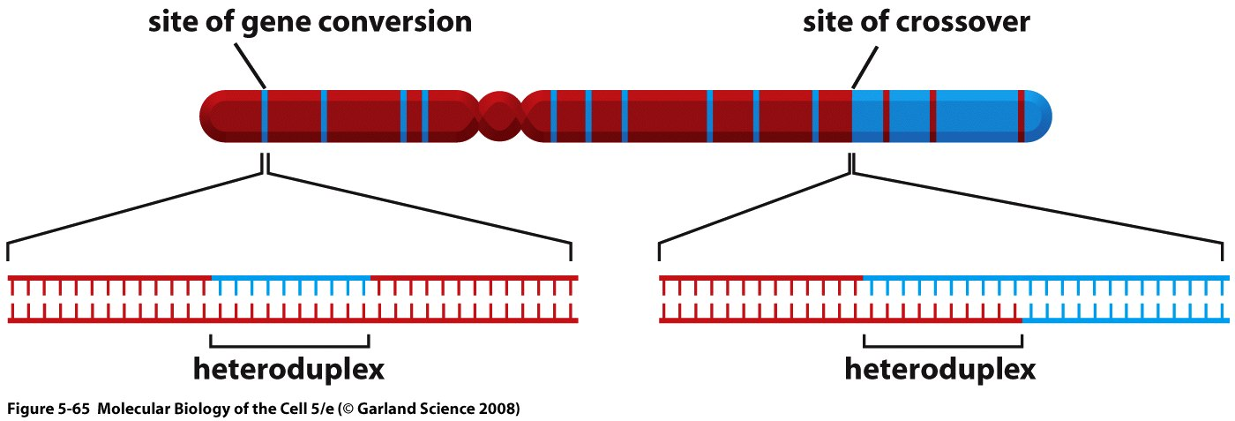
Formation of heteroduplexes during meiosis
Notes:
And the reaseon gene conversion occurs is because of the heteroduplex event

Slide 19
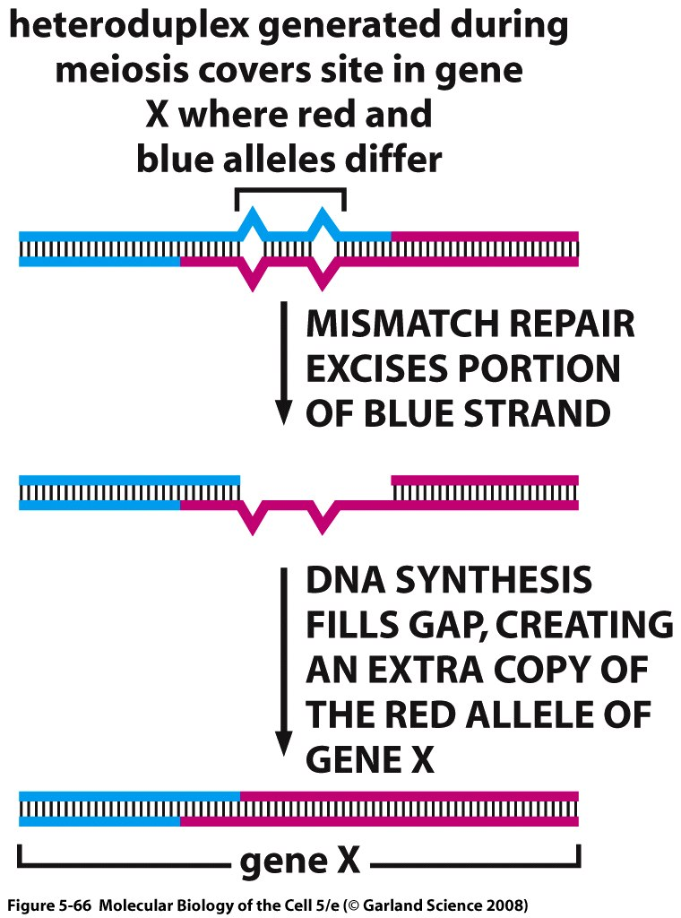
Gene Conversion
Notes:
And this is also shown here showing the bubble schematic. The strand directing mismatich repair will fix these small differences. Mismatich repair in recombination is different than in replication in that it will choose one strand and excises it at random. It will use the other strand as a template and that’s how gene conversion occurs.

Slide 20
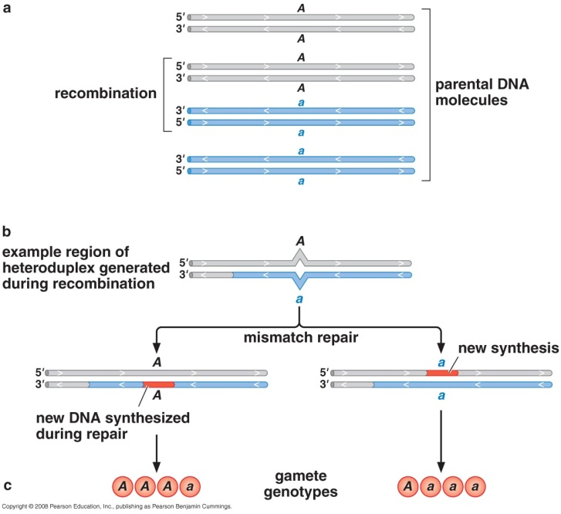
Gene Conversion
Notes:
37:37

Slide 21
Site-Specific Recombination

Slide 22
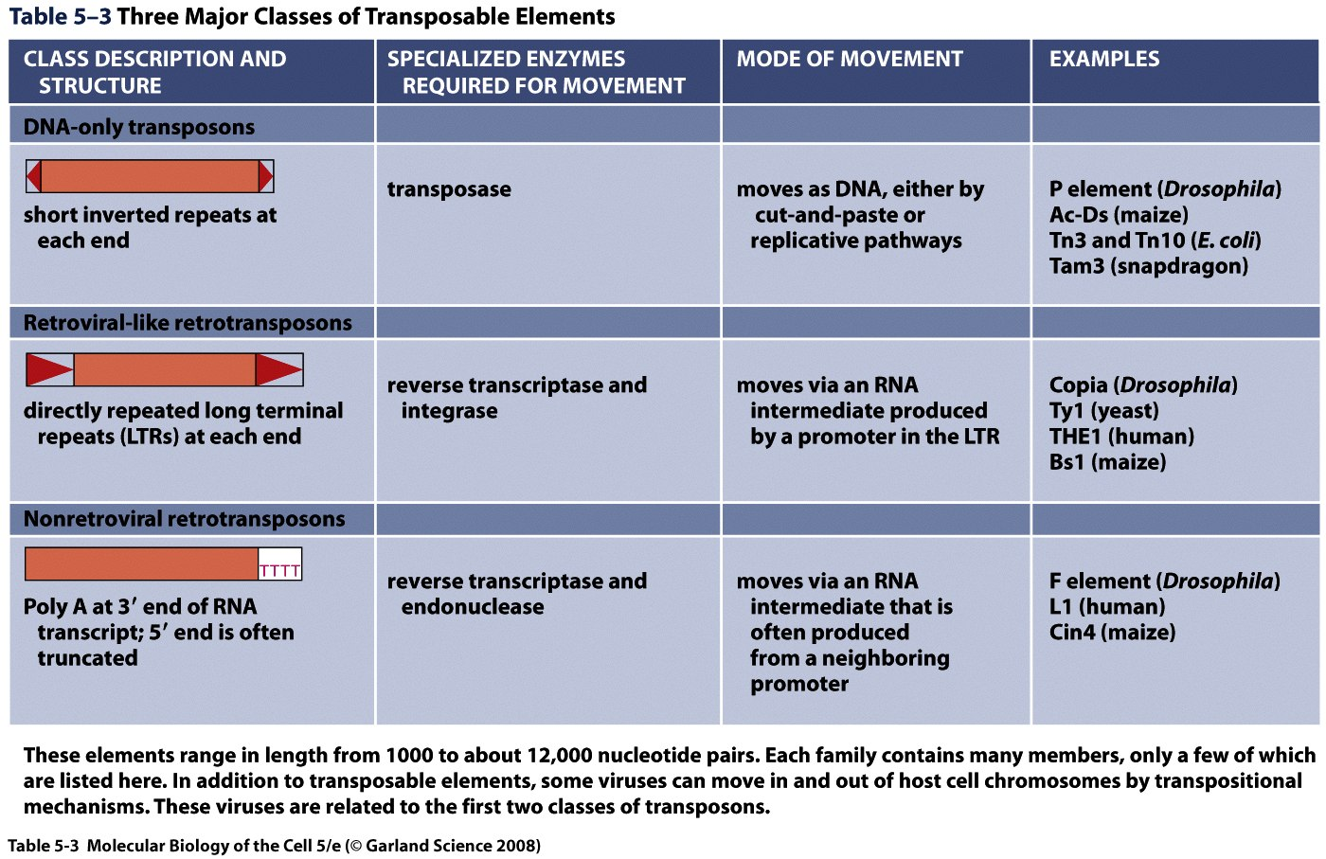

Slide 23
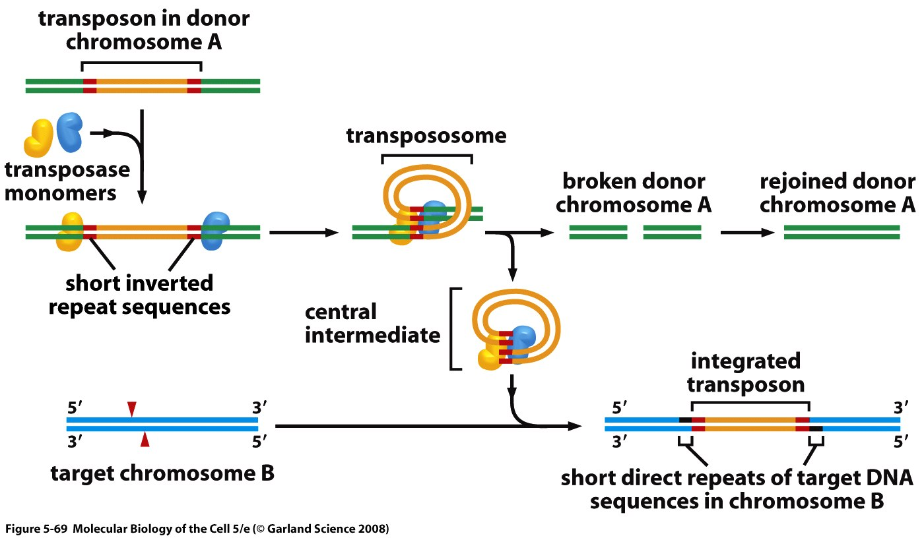
Transposons
(True transposons; DNA transposons)

Slide 24
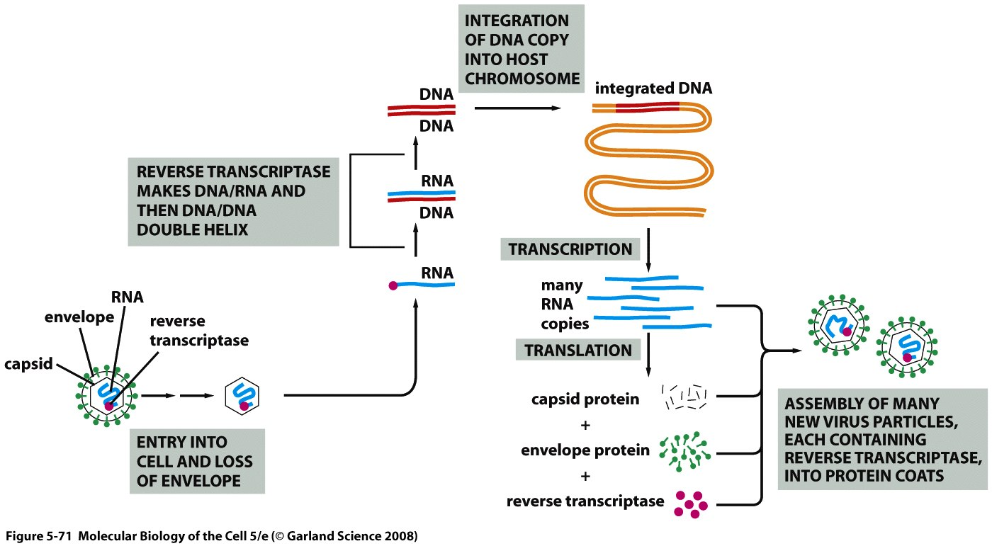
Cell cycle of a retrovirus

Slide 25
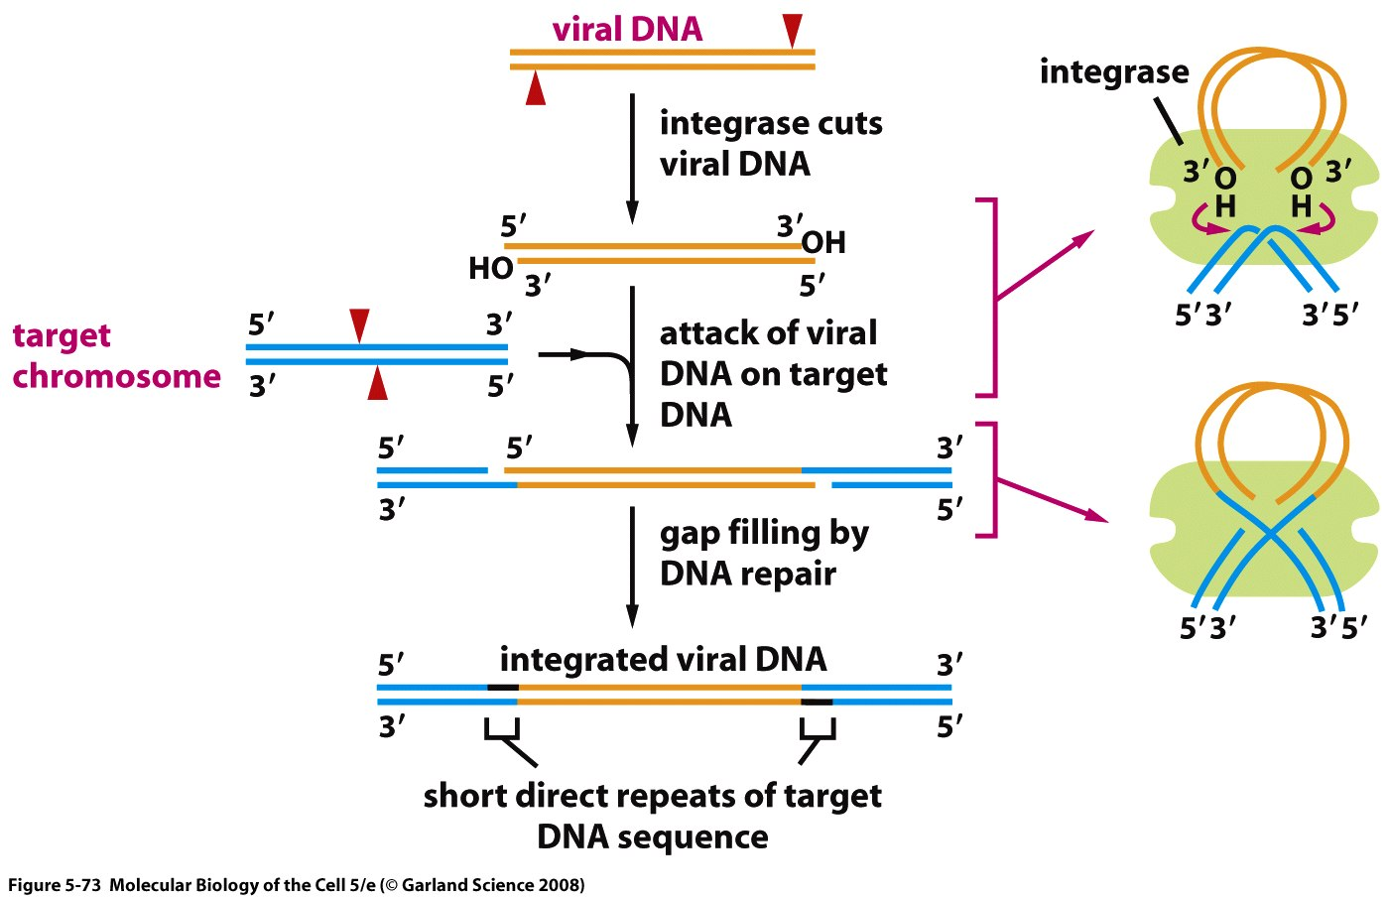
Transposition of a retrovirus or of a retroviral-like retrotransposon

Slide 26
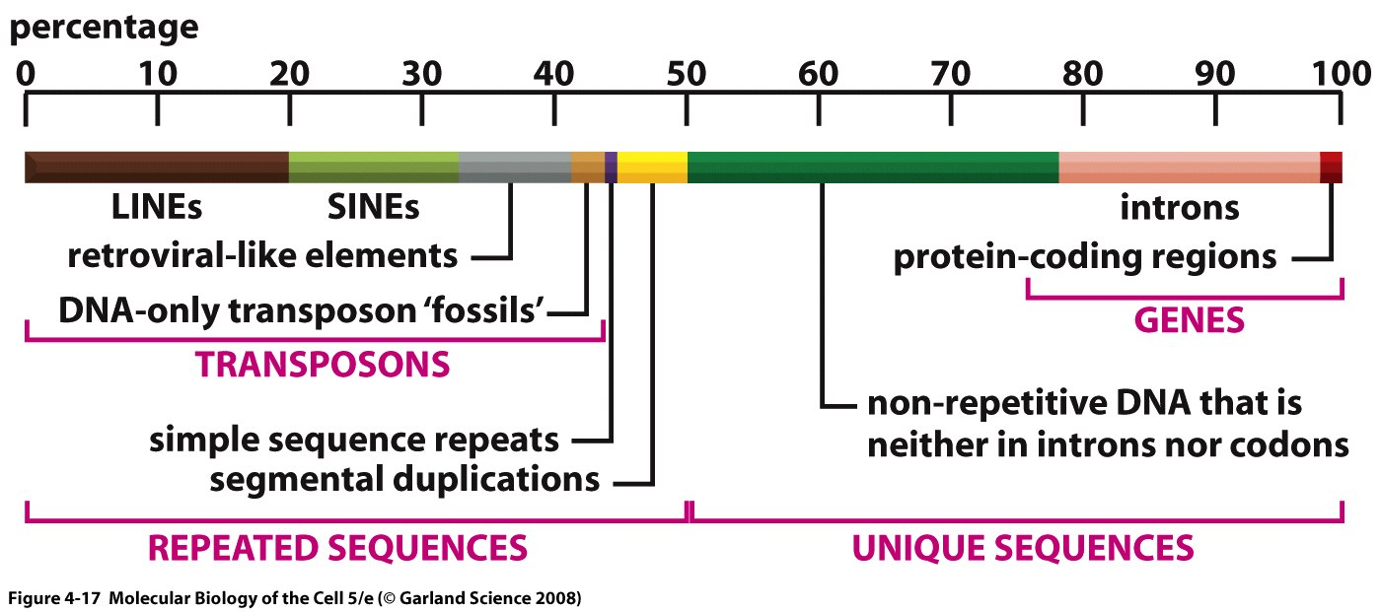
Different kinds of sequences in the human genome

Slide 27
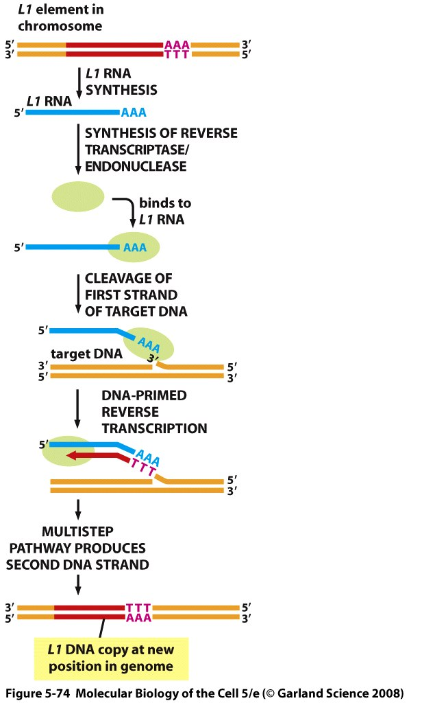
Transposition of a L1 element

Slide 28
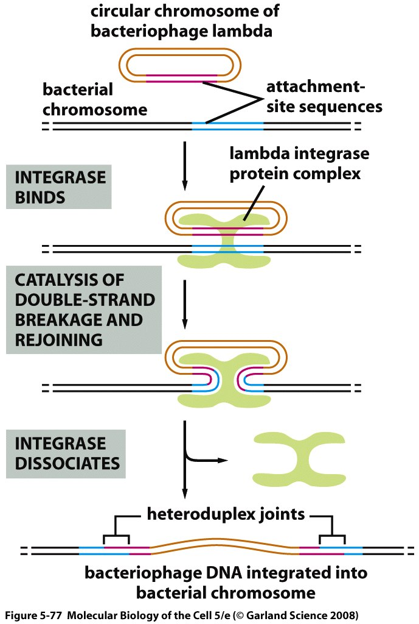
Integration of bacteriophage lambda

Slide 29
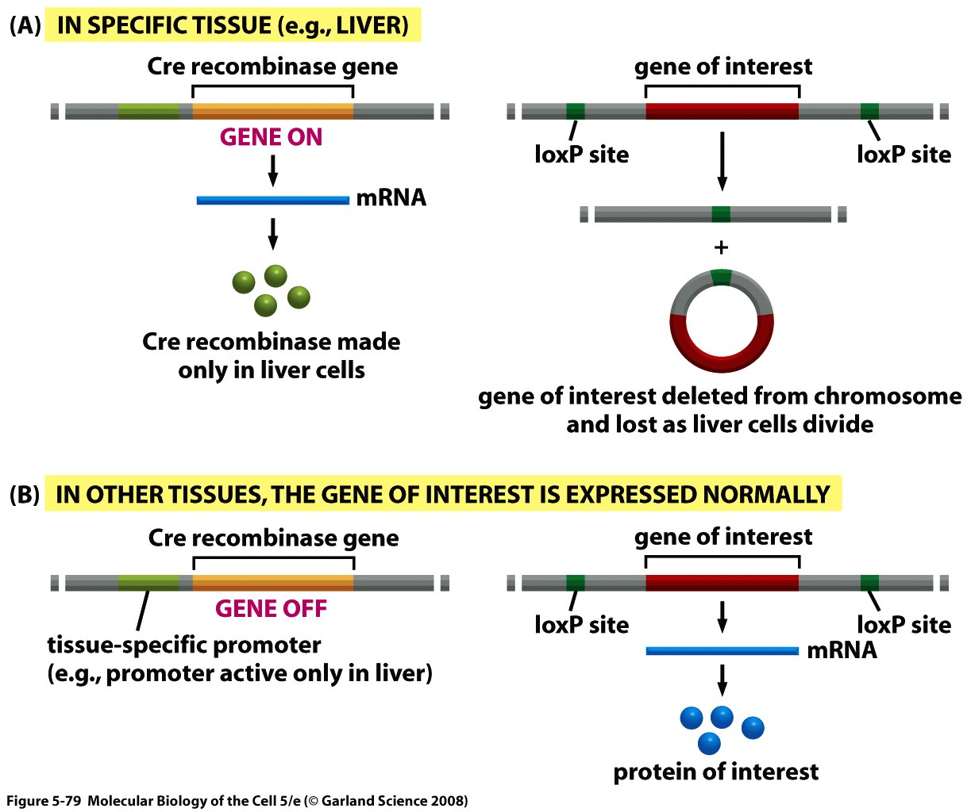
Recombination in experimental genetics

