Slide 1
DNA Replication
17 September 2013

Slide 2
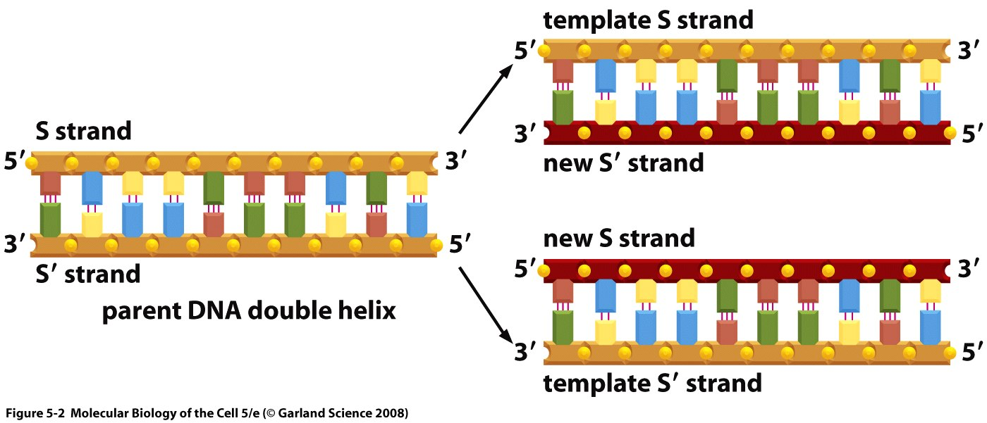
Note: On all figures:
Template strand (parental DNA) in orange
Primer strand (newly synthesized DNA) in red.
Notes:
We make primer strand from template strand, it’s called primer strand because you need a primer to start the synthesis, dna is a polymer of nucleotides

Slide 3
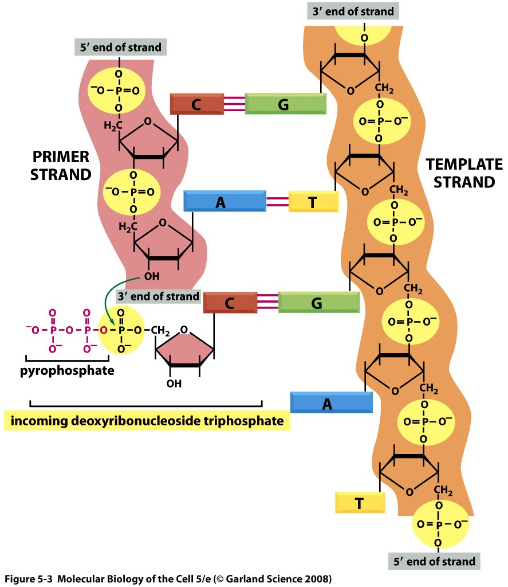
DNA Synthesis Reaction
Notes:
Pay attention to the fact that the incoming base of the incoming nucleotide is complementary to the base on the template strand and to the fact that two phosphates will be cleaved to make pyrophosphate which will make the 5’3’ phosphodiester bond. The two phosphates cleaved are inorganic phosphate molecules. You need these three phosphates to provide energy, the hydrolysis of pyrophosphate releases energy so the overall process of adding a nucleotide provides energy and this energy is needed by the DNA polymerase inoreder to proceed.

Slide 4
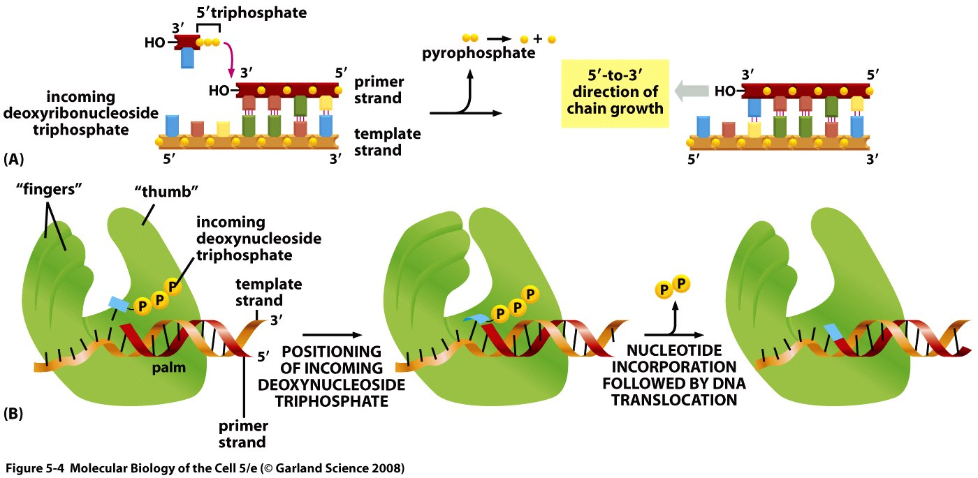
Adding one nucleotide
High energy bond is cleaved
Pyrophosphate is hydrolyzed into 2 inorganic phosphates
Notes:
Replication is semiconservative so if u have one ddna parental molecule and you make two daughter ddna, on strand in each daughter molecule will be a parental strand and the other will be newly synthesized.

Slide 5
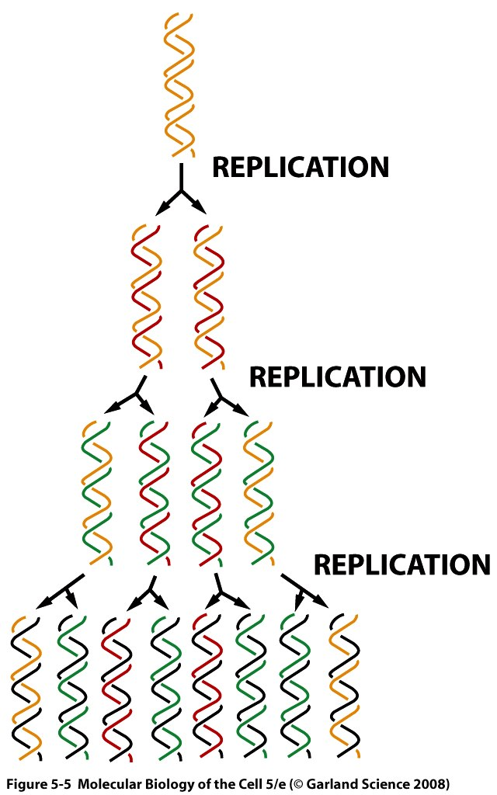
Replication is semi-conservative

Slide 6
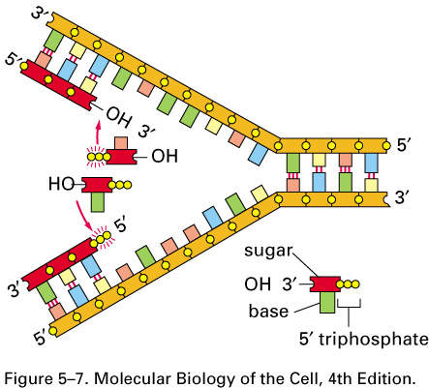
Replication Fork
(incorrect mechanism)
Notes:
Addition of nucleotides occurs in the 5’ to 3’ position; so the last nucleotide added will have its 3’ end free. Replication occurs throguh a replication fork mechansism, remember that the strands are antiparellel and so the general movement of opening the parental dna molecule (orange) will be to the right. In this diagram the bottom part is incorrect! SYNTHESIS ONLY OCCURS IN 5’3’ DIRECTION NOT OTHER WAY AROUND!! The synthesis on the top is continuous and hence the this is called the leading strand or the countinuous strand, but the one on the bottom is called the lagging strand or the discontinuous strand because it will be synthesized in okazaki fragments.

Slide 7
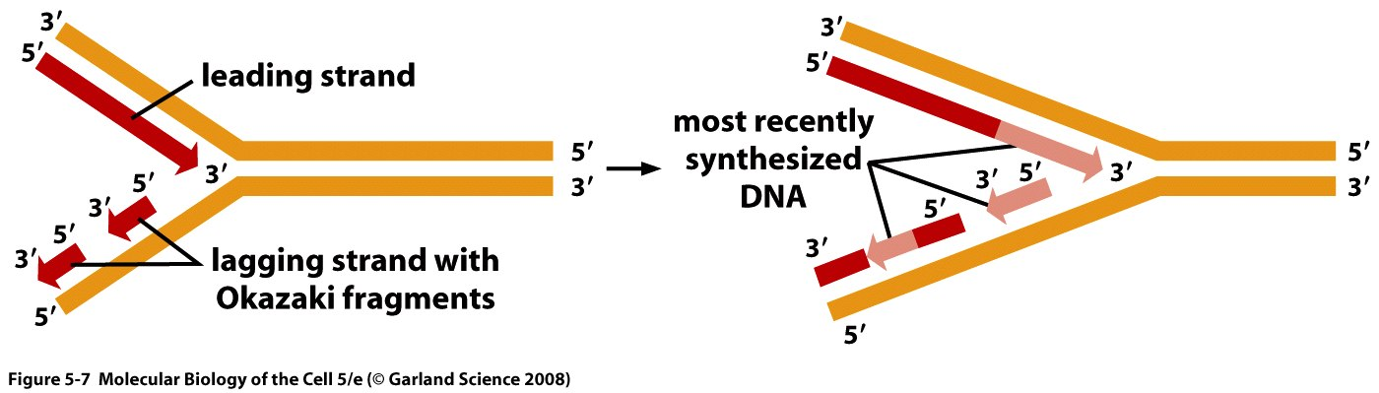
Replication Fork
Notes:
Okazaki fragments are shown here.

Slide 8
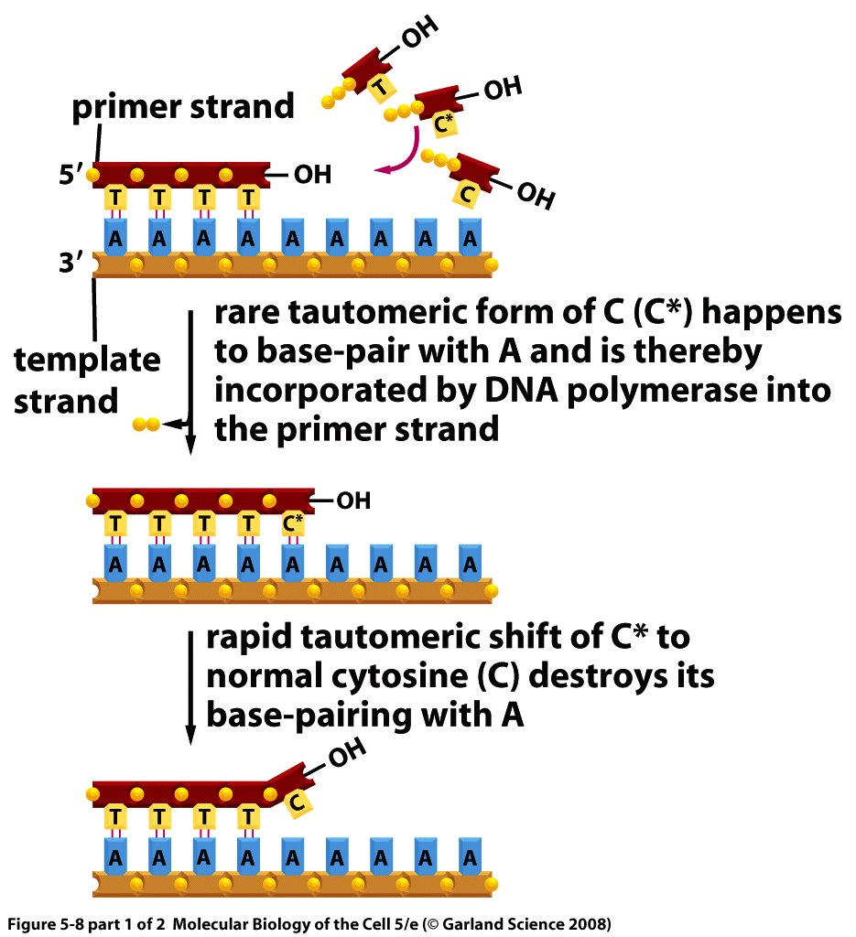
Editing by DNA Polymerase
Notes:
DNA polymerase has very small error rate (1 in 100000 ntds will be added incorrectly) but if mistake is made it can be corrected by several ways.

Slide 9
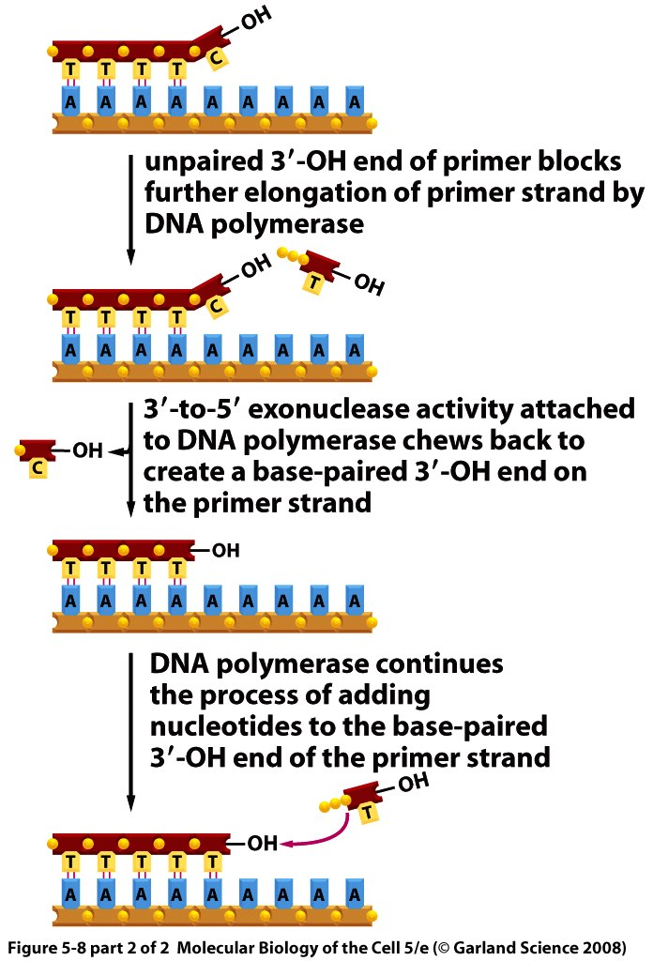
Editing by DNA Polymerase
Notes:
First one is editing by dna polymerase, the rare tautomeric form of C can anneal with A and in this case DNA polymerase will incorporate it in the primer strand. Most of the time this rare tautomeric form of C will revert back and no annealing occurs and so DNA polymerase will stall and will not be able to add another nucleotide and what it will do is hydrolize and remove the incorrect nucleotide using exonuclease activity which is located in its editing active site and will get rid of the incorrectly incorporated C and will instead incorporate a new nucleotide in this case will be T. but if C doesn’t revert the DNA polymerase will form the covalent bond. This editing property of DNA polymerase is another reason why DNA synthesis needs to occur in 5’3’ direction, in the editing process this will be removed and there is a free 3’ end and a new nucleotide is added.

Slide 10
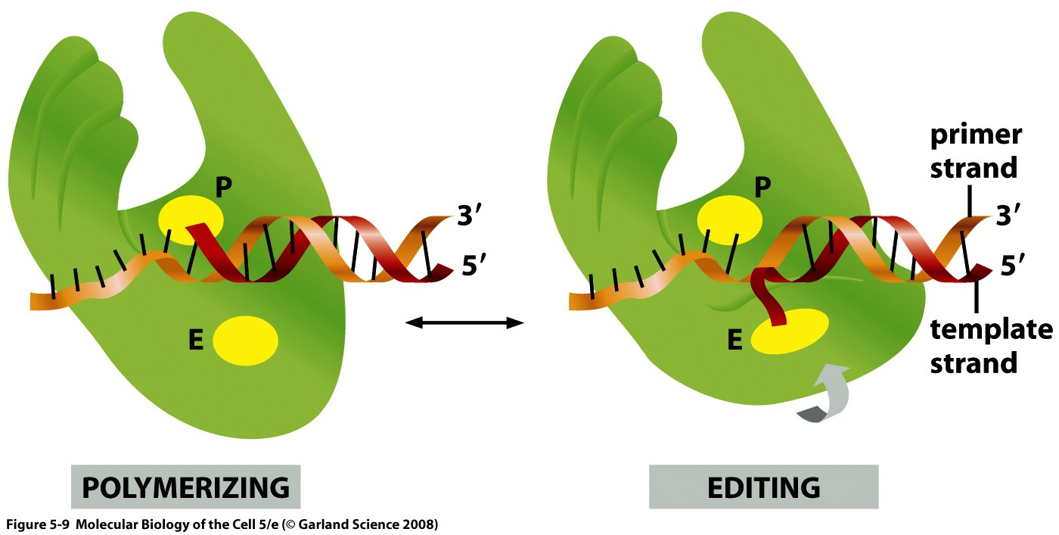
Editing Sites in DNA Polymerase

Slide 11
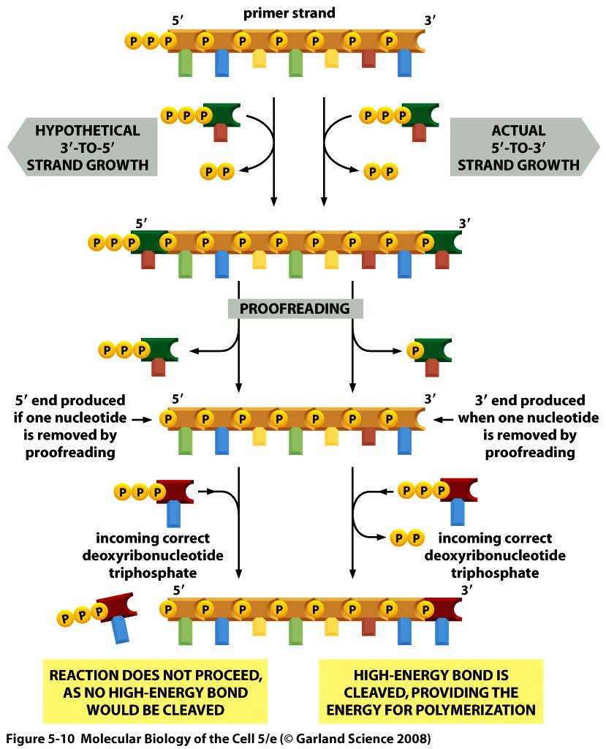
Proofreading: another reason why 3’ to 5’ synthesis is not possible
Note: To make a phosphodiester bond, you need 3 phosphates, two of which are eliminated.
Notes:
In the 5’3’ direction the 5’ end only has one phosphate and so this does not provide enough energy for adding another nucleotide and so this is another reaseon why synthesis cannot occur in this direction.

Slide 12
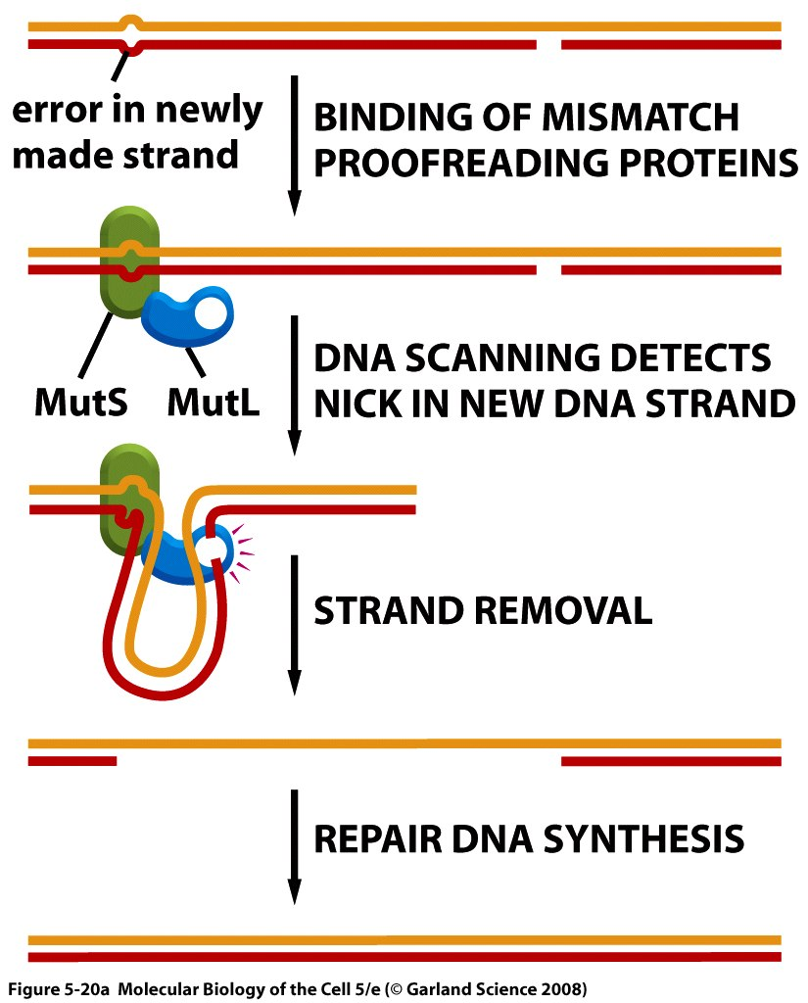
Site-directed mismatch repair
Notes:
Sometimes DNA polymerase will slip and create this bubble which will be recognized by protein MUtS and another enzyme MutL will cleave and thus a gap will be created which will be filled up using DNA polymerase and DNA ligase. How does the system recognize which strand is the parental strand (correct) and the primer strand ( that includes the mismatch mistake. This picture shows what happens in eukaryotes, but in prokaryotes the parental strand is methylated while the primer strand is not yet methylated and a third enzyme MutH will recognize the methylated and will give the primer strand to Mut L ot chew. IN eukaryotes use nicks, a third protein that is not shown here will recognize the nick and will chew the area between the nick and the bubble where the mistake occurred ( in bacteria, this occurs between the methylated sequence and the bubble).

Slide 13
Video Suggestions
http://www.youtube.com/watch?v=dgPh1qigv7s
http://www.youtube.com/watch?v=HYS6EKnQcv0
Notes:
This process is tightly linked to replication, happens almost at the same time (not exactly same time) as replication whereas other processes happen at other times than replication.

Slide 14
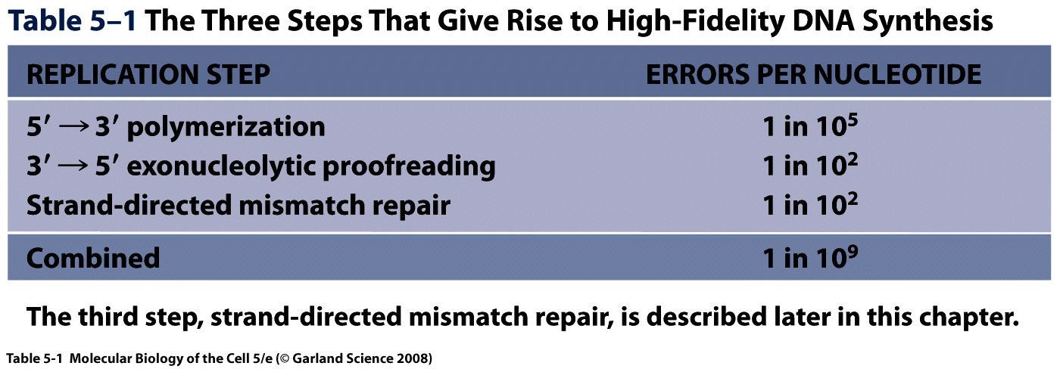
Notes:
So over all we have 1 error in a billion. Exonuclease cuts from an end, it cannot cut in the middle so if the parental strand is intact it cannot cut.

Slide 15
Replication machinery

Slide 16
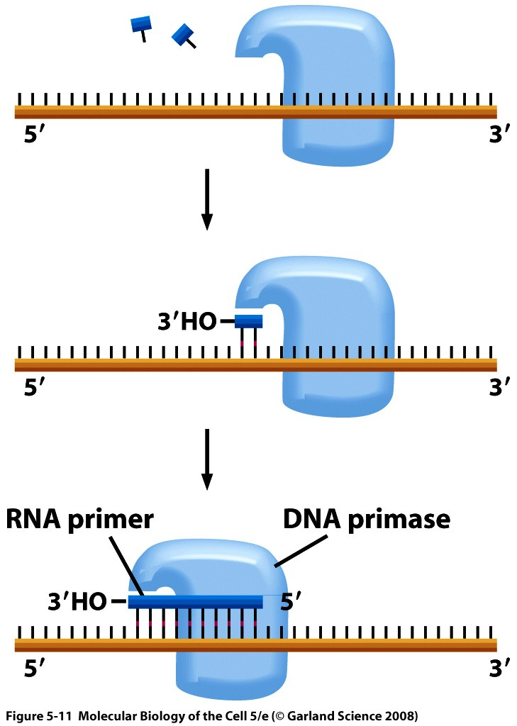
Making primers
Notes:
You start DNA synthesis by making short RNA primers (about ten ntds ) using enzyme primase, providing the substrate needed for DNA synthesis.

Slide 17
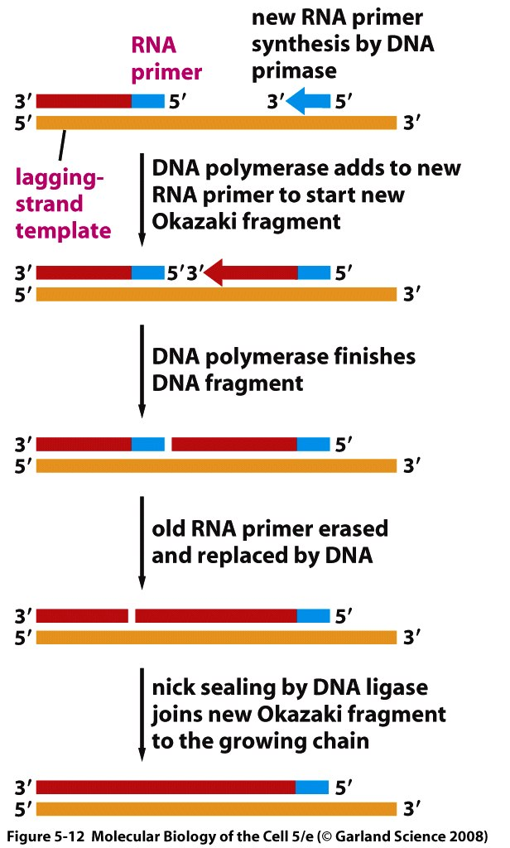
Okazaki Fragment Synthesis
Prokaryotes: DNA Polymerase I removes RNA primers.
Eukaryotes: FLAP endonuclease (FEN-1) removes RNA primers.
Notes:
In bacteria, exonuclease activity of DNA polymerase 1 is the one that removes primers and in eukaryotes FLAP endonucleas removes primers. DNA ligase seals the nicks.

Slide 18
The three main DNA Polymerases in E. coli.
  DNA Polymerase I : Fills the gaps during DNA repair.
  DNA Polymerase II : repairs a fork that is stalled because of DNA damage
  DNA Polymerase III : Is responsible for DNA replication.
Notes:
-DNA Polymerase I is in bacteria and it also removes primers.
-need to know function of all three!

Slide 19
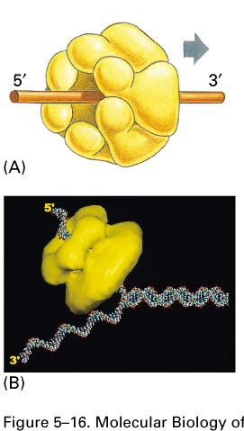
DNA Helicase
Notes:
DNA double helix is opened by DNA helicase, as it is opened, on the leading strand things go fast but on the lagging strand things are slower.

Slide 20
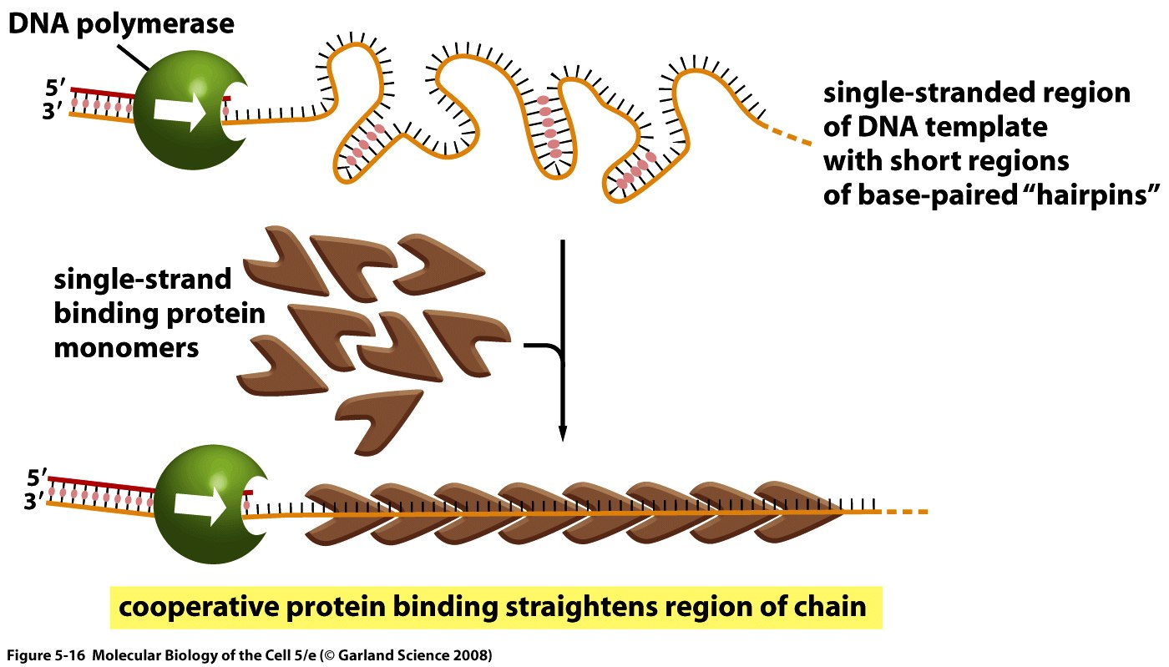
SSB Proteins
Notes:
DNA tends to fold on itself which will impede replication machinery so there are single stranded binding proteins that will bind this single stretch of DNA and straighten it out.

Slide 21
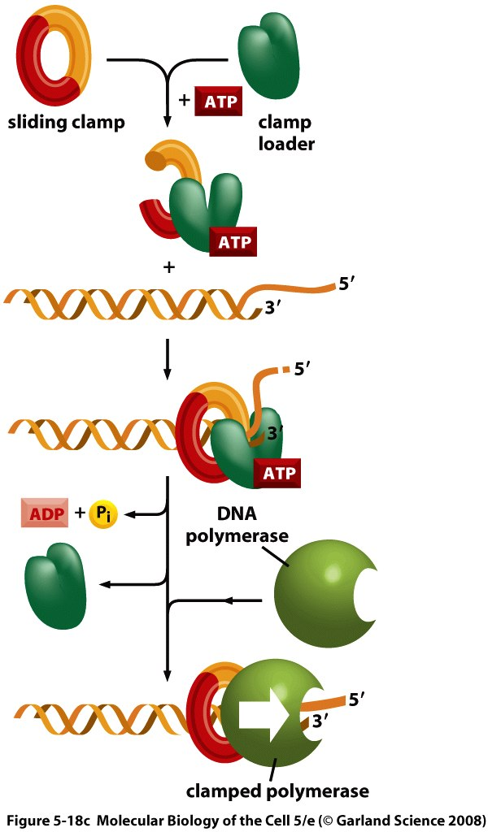
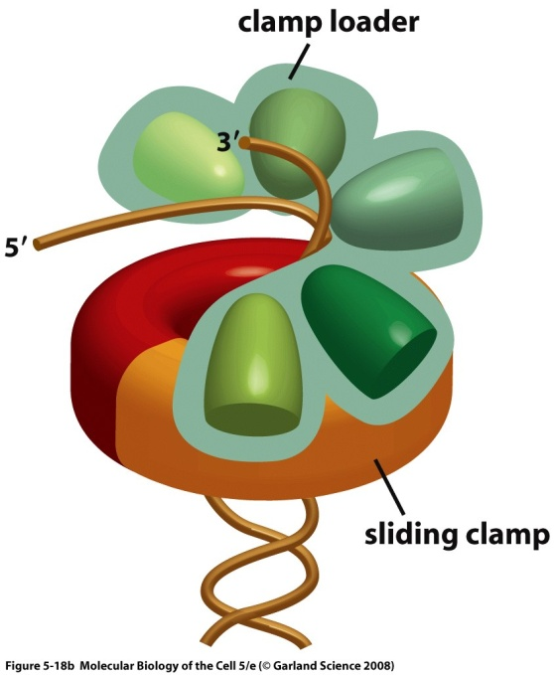
Sliding Clamp
Notes:
The sliding clamp-> DNA polymerase has a certain affinity to DNA; it likes to bind DNA but you don’t want this affinity to be too strong because when okazaki fragments are made DNA polymerase has to detach in order to make the next fragment. The sliding clamp will bind to the clamp loader and then the DNA polymerase and the DNA and help keep the DNA polymerase attached to the DNA until it’s finished synthesis.

Slide 22
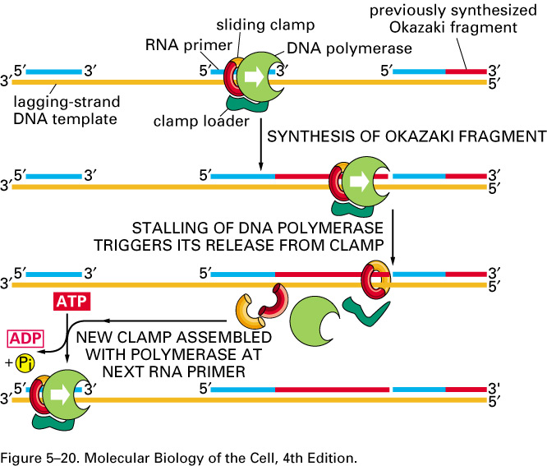
Okazaki Fragment Synthesis
Notes:
Once the replication complex reaches the end of the okazaki fragment it detaches and then reassemples at the other okazaki fragment.

Slide 23
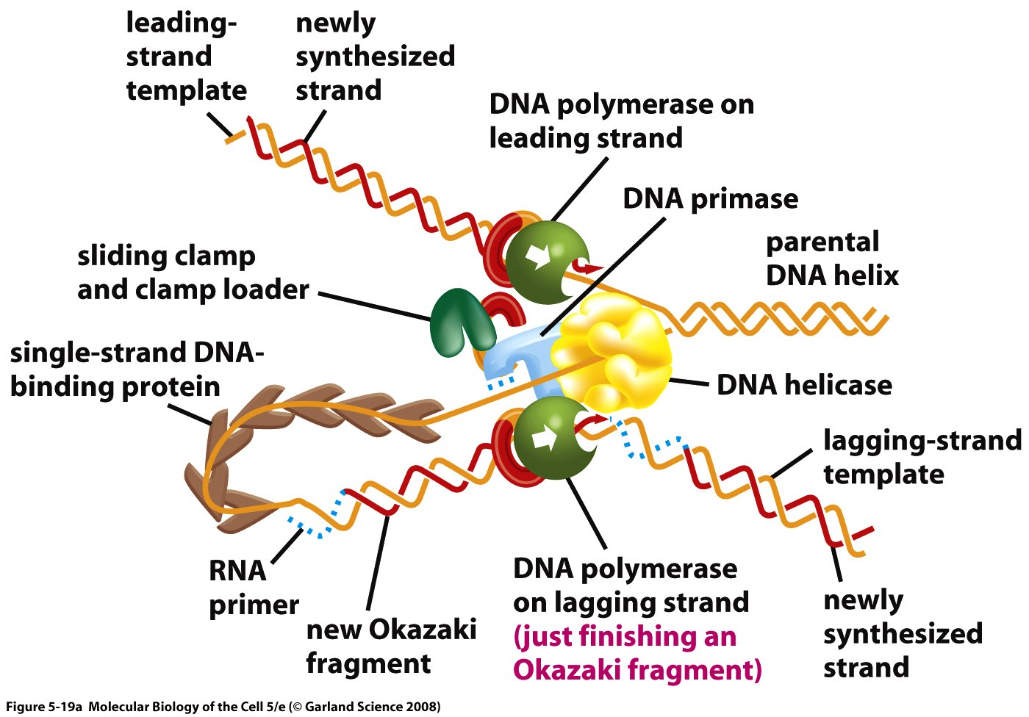
Replication machinery in prokaryotes
Notes:
Inorder to open the ddna u need helicase. In prokaryotes, the helicase forms a complex with the dna primase, this complex is called the primosome. In leading strand synthesis is countinuous and linear like previous slide. But in lagging strand there is a loop like shown here, and okazaki fragments are synthesized discontinously.

Slide 24
Video suggestion
http://www.youtube.com/watch?v=-mtLXpgjHL0&feature=related

Slide 25
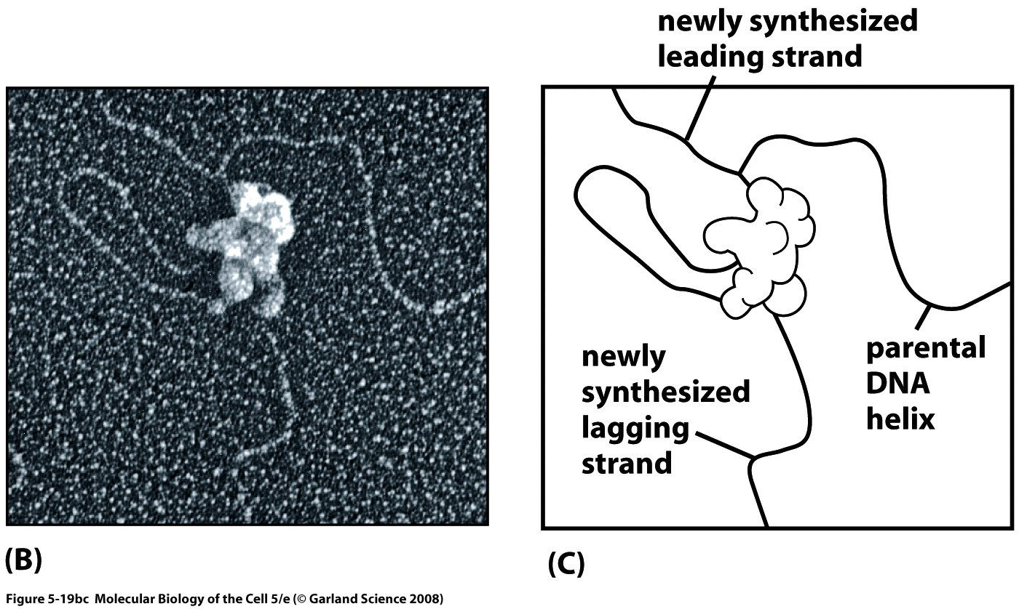
Replication machinery in prokaryotes
Notes:
Just for viewing pleasure.

Slide 26
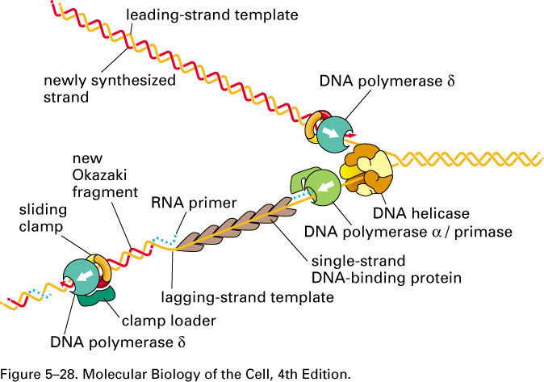
Replication machinery in eukaryotes
ε
Notes:
Most of termenology that we used are from bacteria, eukaryotes are a little more complicated the differences between them are illustrated in this slide, u only need to remember three components of the replication machinery for eukaryotes. DNA plymerase epsilon does most of the replication on the leading strand and there is a protein complex called dna polymerase a/primase is to make the primers and initiate the synthesis and finally the third dna polymeras delta and it does most of the synthesis on the LAGGING strand.

Slide 27
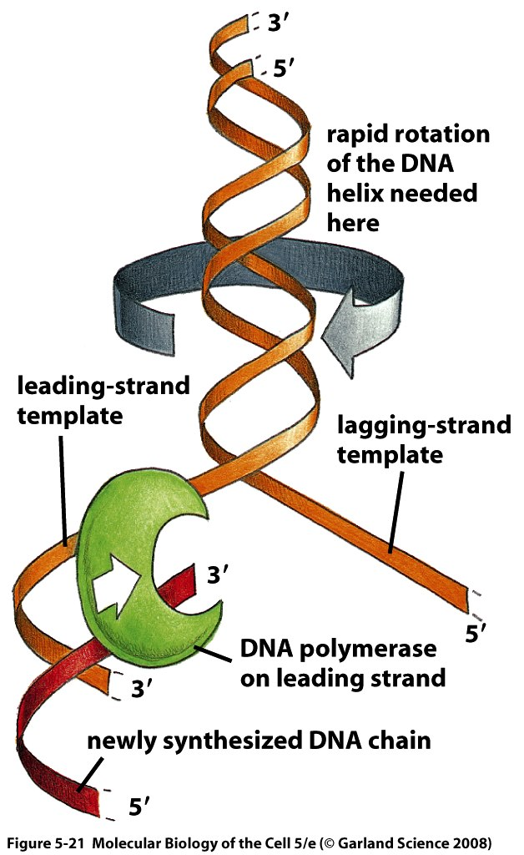
Unwinding of the double helix and replication
Replication speed (bacteria): 500 nucleotides per second. Need to unwind 50 turns of the double helix per second.
Notes:
DNA topoisomerase will release tension after unwinding by helicase.

Slide 28
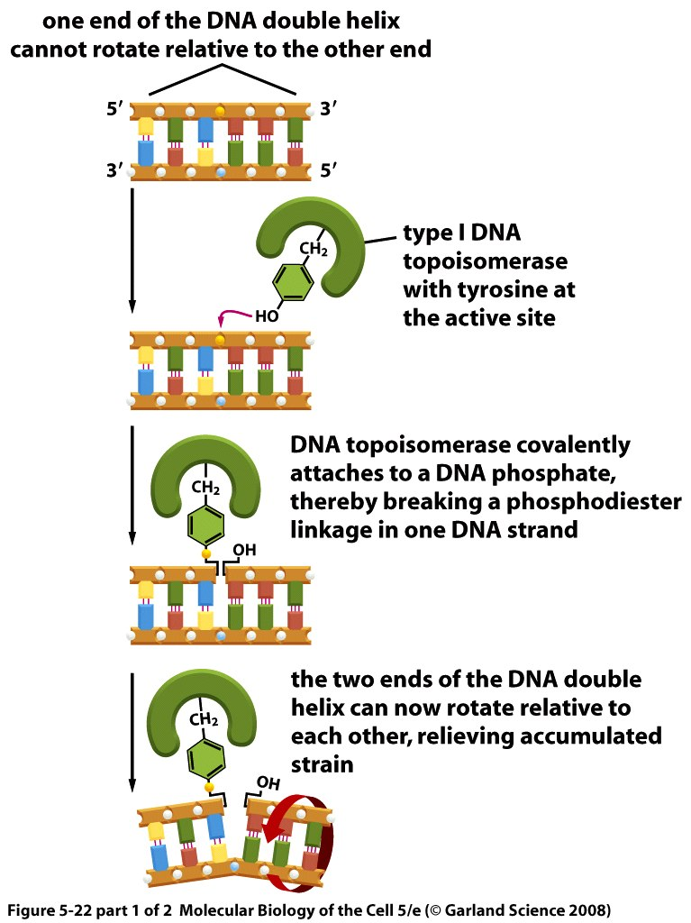
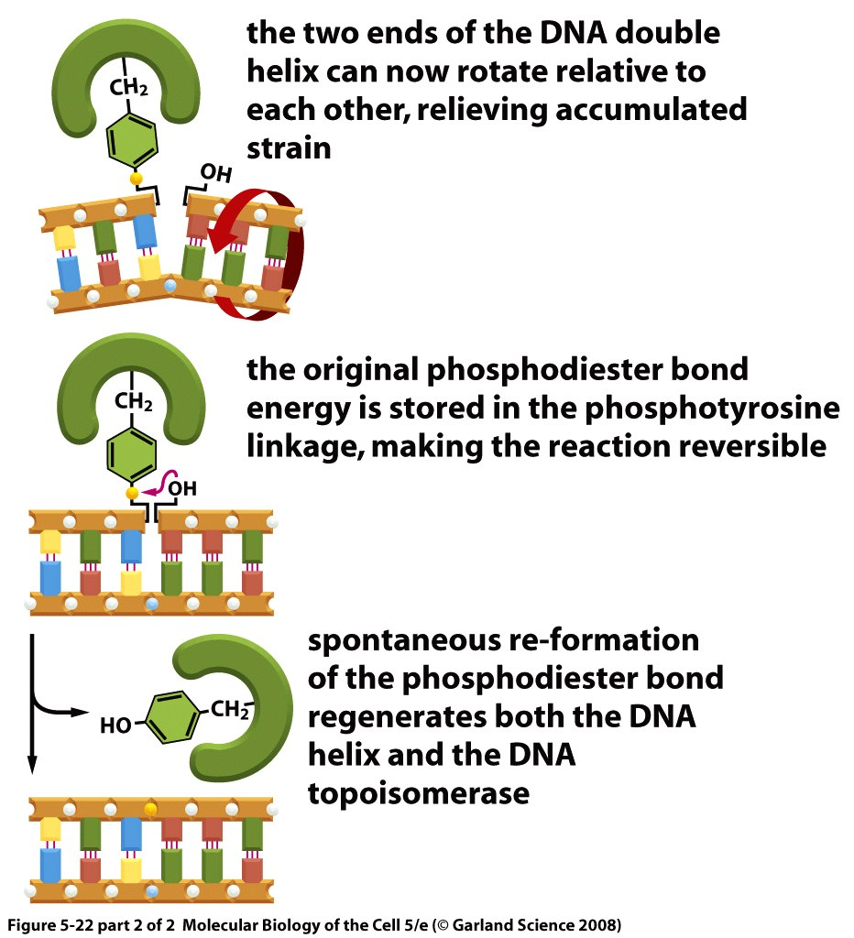
Topoisomerase I: mechanism of action
Notes:
The way topoisomerase works is shown here: it has a tyrosine amino acid in it’s active site, the hydroxide in the tyrosine will attack a phosphodiester bond and causes it’s breakage while tyrosine remains in contact with one side of the molecule, because one of the strands is broken it can freely rotate, after rotation the original phosphodiester bond is reformed and the strain is released.

Slide 29
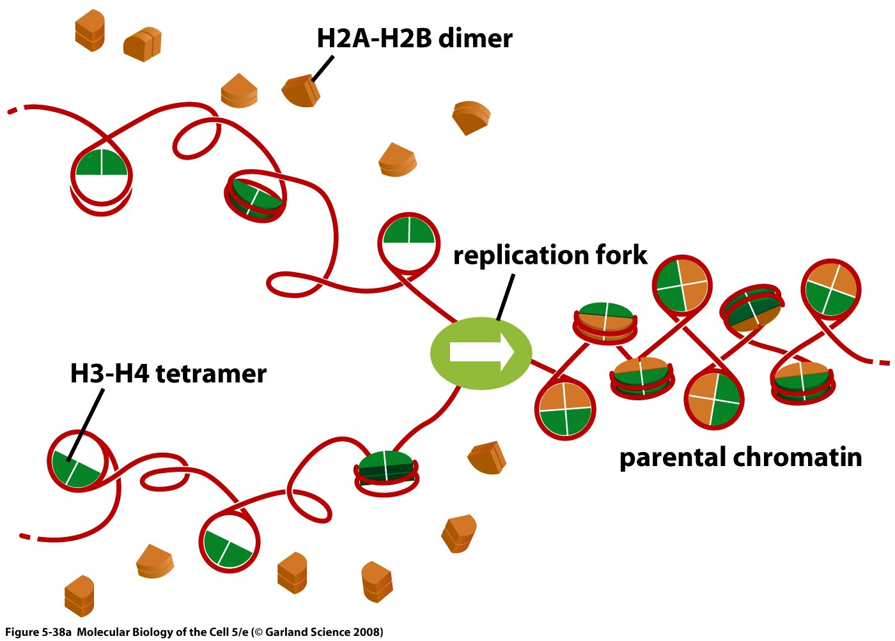
Histones and Replication
Notes:
We’re talking about eukaryotes here, DNA is organized into chromatin wrapped around histones. This is the replication fork and as the dna is replicated, first the H2A-H2B dimers are released (last week we mentioned that they are the last to come in so they are the first to leave and last to come in), second the H3-H4 tetramers are about equally distributed on the two newly made molecules and inorder to reconstitute the tetramers u need to synthesize new h3-h4 tetramers to replace missing ones and then h2a-h2b dimers will come in and make up the nucleosome.

Slide 30
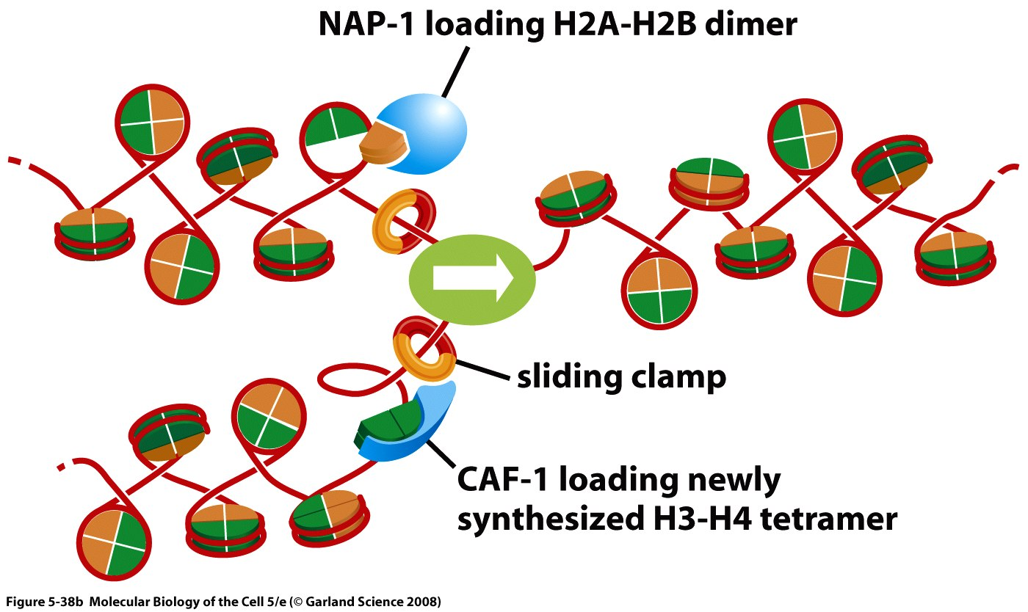
Histones and Replication
Notes:
Here are two examples of histone chaperones, NAP1 helps load h2a-h2b dimers and CAF-1 loads newly synthesized H3-H4 tetramer it also interacts with the sliding clamp. So this is another role for sliding clamp that it interacts with various proteins.

Slide 31
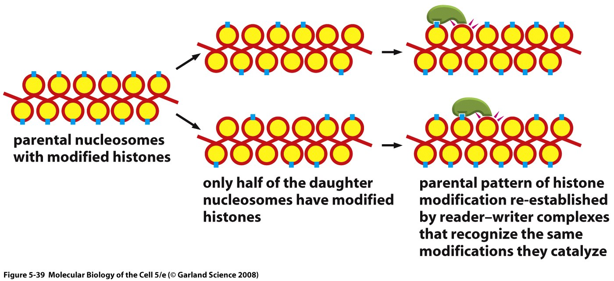
Histone modifications are copied during replication.
Notes:
There are modifications that take place on histones, shown as blue dots, these are important so they need to be copied as well during replication. Inorder to reinstall all the modifications correctly the reader writer system will copy the modification on one nucleosme on the next one.

