Slide 1
Weygandt-Kimmel-Kieso-Aly
12

Slide 2
12
Standard Costs and
Balanced Scorecard
Study Objectives
Differentiate between a standard and a budget and identify the advantages of standard costs.
Describe how companies set standards.
State the formulas for determining direct materials variances.
State the formulas for determining direct labour variances.
State the formulas for determining total manufacturing overhead variances.
Discuss the reporting of variances.
Prepare an income statement for management under a standard cost system.
Describe the balanced scorecard approach to performance evaluation.
Identify the features of a standard cost accounting system
12

Slide 3
The Need for Standards
Standards:
  Are common in business
  Are often imposed by government agencies (and called regulations)
Standard costs:
  Are predetermined unit costs
  Used as measures of performance

Slide 4
Distinguishing Between Standards and Budgets
Standards and budgets are both:
Pre-determined costs
Part of management planning and control
A standard is a unit amount whereas a budget is a total amount
Budget data are not journalized in cost accounting systems.
Standard costs may be incorporated into a cost accounting system

Slide 5
Advantages of Standard Costs
Facilitate management planning
Promote greater economy by making employees more “cost-conscious”
Help set selling prices
Contribute to management control by providing basis for evaluation of cost control
Help highlight variances in management by exception
Simplify costing of inventories and reduce clerical costs

Slide 6
Let’s Review
What are the essential differences between a standard and a budget?
A standard is total amount and a budget is a unit amount.
A standard and a budget are essentially the same.
A standard is a unit amount and a budget is a total amount.
Both b. and c. are correct.

Slide 7
Let’s Review: Solution
What are the essential differences between a standard and a budget?
A standard is total amount and a budget is a unit amount.
A standard and a budget are essentially the same.
A standard is a unit amount and a budget is a total amount.
Both b. and c. are correct.

Slide 8
Setting Standard Costs
Setting standard costs:
Requires input from all persons who have responsibility for costs and quantities
Standards costs need to be current and should be under continuous review
There are two levels of standard costs:
Ideal standards represent optimum levels of performance under perfect operating conditions
Normal standards represent efficient levels of performance attainable under expected operating conditions (rigorous but attainable)

Slide 9
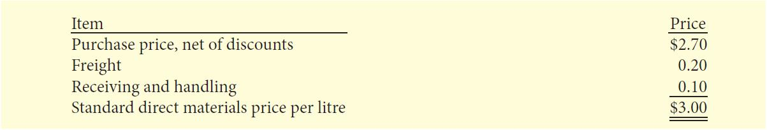
Direct Materials Price Standard
Direct materials price standard is the Cost per unit of direct materials that should be incurred
Based on the purchasing department’s best estimate of the cost of raw materials
Includes related costs such as receiving, storing, and handling

Slide 10
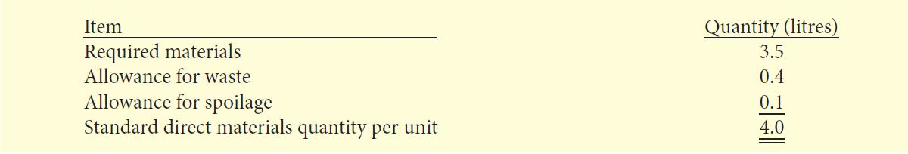
Direct Materials Quantity Standard
Direct materials quantity standard is the quantity of direct materials that should be used per unit of finished goods
Based on physical measure such as pounds, barrels, etc.
  Considers both the quantity and quality of materials required
Includes allowances for unavoidable waste and normal storage

Slide 11
Standard Direct Materials Cost/Unit
The standard direct materials cost per unit is calculated as follows:
The standard direct materials cost per kilogram
is $12.00 ($3.00 X 4 litres)
STANDARD
DIRECT
MATERIALS
PRICE
STANDARD
DIRECT
MATERIALS
QUANTITY
STANDARD
DIRECT
MATERIALS COST
PER UNIT
x
=

Slide 12
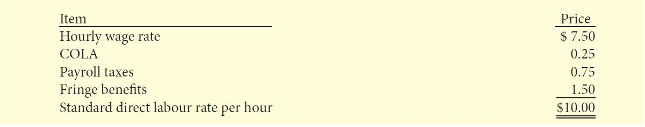
Direct Labour Price Standard
Direct labour price standard
  Rate per hour that should be incurred for direct labour
  Based on current wage rates adjusted for anticipated changes, such as cost of living adjustments
  Includes employer payroll taxes, and benefits such as holidays and paid vacation

Slide 13
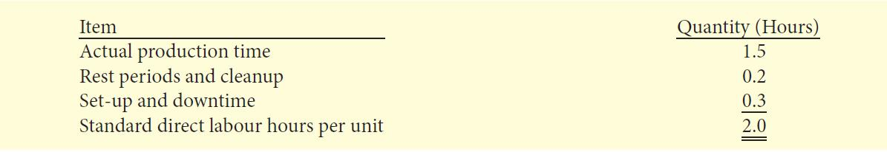
Direct Labour Quantity Standard
Direct labour quantity standard
  Time that should be required to make one unit of the product
  Critical in labour-intensive companies
  Allowances should be made for rest periods, cleanup, machine setup, and machine downtime

Slide 14
Standard Direct Labour
Cost Per Unit
The standard direct labour cost per unit is calculated as follows:
The standard direct labour cost per litre
is $20 ($10.00 X 2 hours).
STANDARD
DIRECT
LABOUR RATE
STANDARD
DIRECT
LABOUR HOURS
STANDARD
DIRECT
LABOUR COST
PER UNIT
x
=

Slide 15
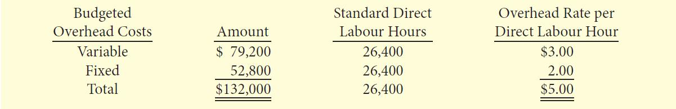
Manufacturing Overhead Standard
For manufacturing overhead, a standard predetermined overhead rate is used
  The predetermined rate is computed by dividing budgeted overhead costs by an expected standard activity index
    Standard direct labour hours and standard machine hours are two examples of standard activity indexes.

Slide 16
Manufacturing Overhead Standard
The standard manufacturing overhead rate per unit is the predetermined overhead rate times the activity index quantity standard
(for example, direct labour hours)
The standard manufacturing overhead rate per kilogram is $10 ($5 X 2 hours).

Slide 17
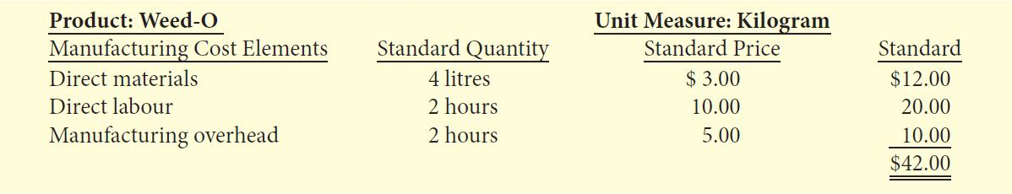
Total Standard Cost Per Unit
Total Standard cost per unit:
  Sum of the standard costs for direct materials, direct labour, and manufacturing overhead
  Is determined for each product and often recorded on a standard cost card which provides the basis for determining variances from standards

Slide 18
Variances from Standards
Variances from standards
  Differences between total actual costs and total standard costs
When actual costs are higher than standard costs, the variance is unfavourable. Unfavourable variances occur when too much is paid for materials and labour or when there are inefficiencies in using materials and labour
When actual costs are less than standard costs, the variance is favourable. Favourable variances occur when there are efficiencies in incurring costs and in using materials and labour
  A variance is not favourable if quality control standards are sacrificed

Slide 19
Example Data for Direct Materials
Xonic Inc. has the following direct material standard to manufacture one kilogram of Weed-O
  4 litres per unit at $3 per litre
Actually, 4,200 litres of material was purchased and used to make 1,000 kilograms. The material cost a total of $13,020.

Slide 20
Let’s Review
Who does management consult in order to set standard costs for direct materials?
Usually management hires cost accountants.
Standard costs are established by repetitive process.
Management may have to consult purchase agents, product managers and quality controls engineers.
Only engineers are required to set standard costs for direct materials.

Slide 21
Let’s Review: Solution
Who does management consult in order to set standard costs for direct materials?
Usually management hires cost accountants.
Standard costs are established by repetitive process.
Management may have to consult purchase agents, product managers and quality controls engineers.
Only engineers are required to set standard costs for direct materials.

Slide 22
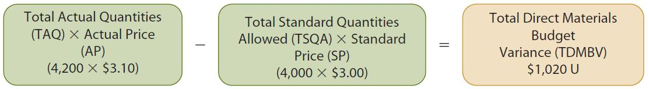
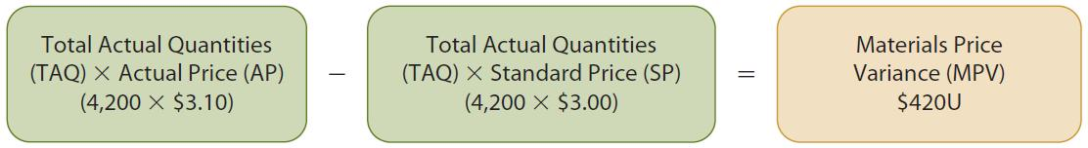
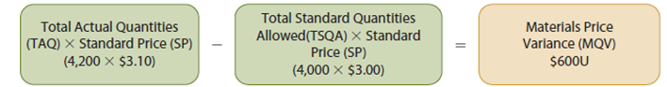
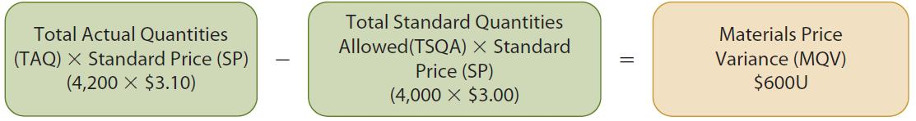
Direct Material Variances
The total direct materials budget variance (TDMBV) calculation:
Next, the total variance is analyzed to determine the amount that is attributable to price (costs) and to quantities (use).
The materials price variance calculation:
The materials quantity variance calculation:

Slide 23
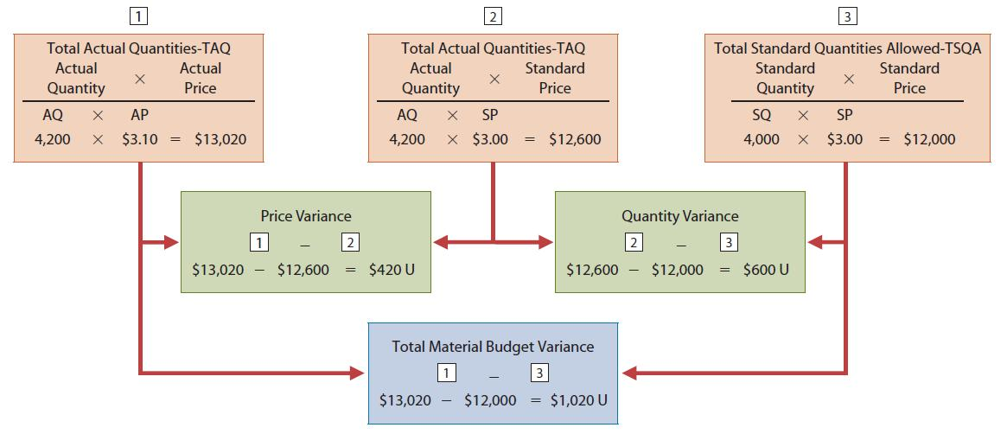
Materials Variance Matrix

Slide 24
Causes of Materials Variances
Materials variances may be caused by a variety of factors, including both internal and external factors
Investigating materials price variances begins in the purchasing department, but the variance may be beyond the control of purchasing (for example, prices rise faster than expected)
Investigating materials quantity variance begins in the production department, but the variance may be beyond the control of production (for example, faulty machinery)

Slide 25
Let’s Review
What are some of the causes of material variances?
Causes may be internal and external.
Cause could be in the purchasing dept.
Cause could arise from the supplier changing prices.
All of the above

Slide 26
Let’s Review: Solution
What are some of the causes of material variances?
Causes may be internal and external.
Cause could be in the purchasing dept.
Cause could arise from the supplier changing prices.
All of the above

Slide 27
Example Data for Direct Labour
Xonic Inc. has the following direct labour standard to manufacture one kilogram of Weed-O
  2 hours per unit at $10 per hour
Total labour hours worked amounted to 2,100 to produce 1,000 kilogram. The labour cost was $20,580.

Slide 28
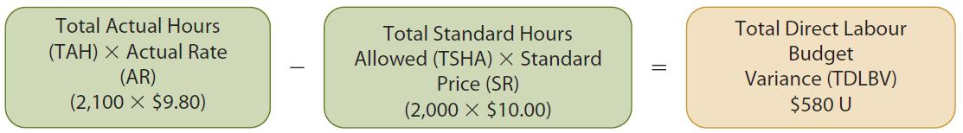
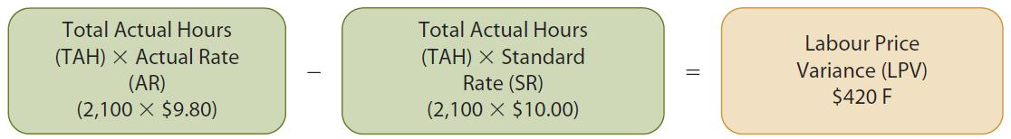
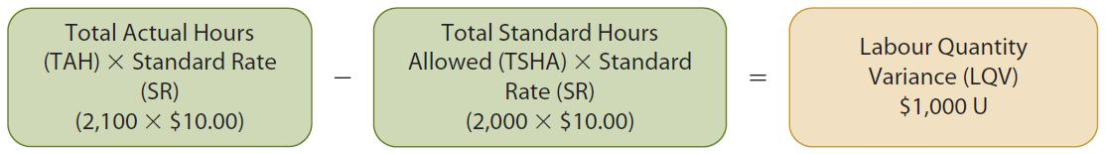
Direct Labour Variances
The total direct labour budget variance (TDLBV) calculation:
Next, the total variance is analyzed to determine the amount that is attributable to price (rate) and to quantities (hours).
The labour price variance calculation:
The labour quantity variance calculation:

Slide 29
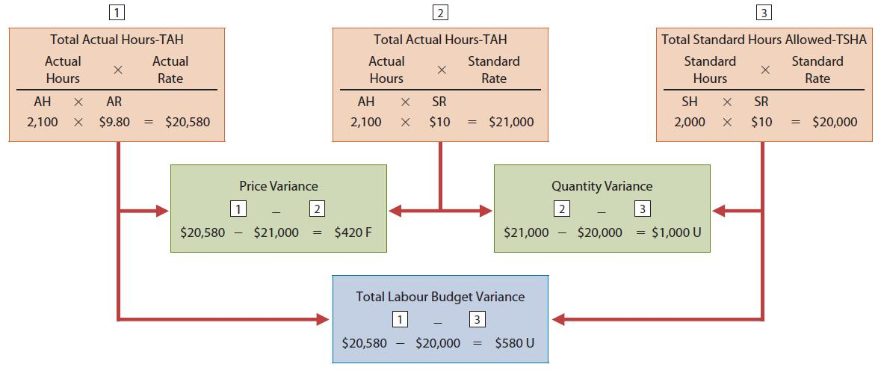
Labour Variances Matrix

Slide 30
Causes Of Labour Variances
Labour variances may be caused by a variety of factors
Labour price variances usually result from either paying workers higher wages than expected or misallocating workers (for ex., using skilled workers in place of unskilled workers)
Labour quantity variances relate to the efficiency of workers and are usually related to the production department

Slide 31
Let’s Review
What are some of the causes of an unfavourable labour quantity variance?
Newly hired employees are not properly trained.
Poor material had to be reworked.
Poor scheduling and carelessness on the part of management.
All of the above are causes.

Slide 32
Let’s Review: Solution
What are some of the causes of an unfavourable labour quantity variance?
Newly hired employees are not properly trained.
Poor material had to be reworked.
Poor scheduling and carelessness on the part of management.
All of the above are causes.

Slide 33
Total Overhead Variance
For manufacturing overhead, a standard predetermined overhead rate is used in setting the standard. This overhead rate is determined by dividing budgeted overhead costs by an expected standard activity index.
Standard direct labour hours is used as the activity index

Slide 34
Example Data for Overhead
Xonic Inc. has the following manufacturing overhead standard based on expected production of 13,200 kilograms of Weed-O:
Variable Overheads | $79,200
Fixed Overheads | $52,800
Total Overheads | $132,000
Overheads were to applied on the basis of $ 5 per labour hour calculated as follows:
$132,000 ÷ (13,200 kilograms x 2 Labour hours per kilogram)

Slide 35
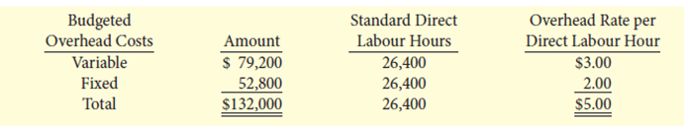
Total Overhead Variance
The standard predetermined overhead rates are calculated as shown below:

Slide 36
Total Overhead Variance: Continued
For the 1,000-unit order, the total standard hours allowed are 2,000 hours (1,000 units X 2 hours).
We then apply the predetermined overhead rate to the 2,000 standard hours allowed.
As show in the previous slide, the predetermined rate is $5, composed of a variable overhead rate of $3 and a fixed rate of $2.
Overhead applied is $10,000 (2,000 hours X $5)

Slide 37
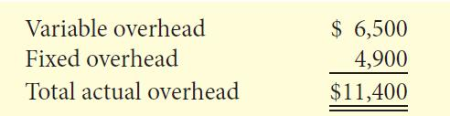
Total Overhead Variance: Continued
Actual overhead costs are:

Slide 38
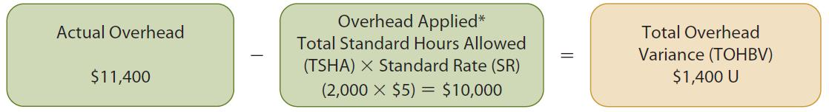
Total Overhead Variance: Continued
The total overhead variance is the difference between actual overhead costs and the overhead costs applied to work done
The total overhead variance is generally analyzed by examining the variable overhead variance and the fixed overhead variance.

Slide 39
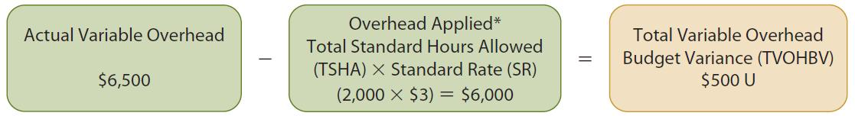
Total Variable Overhead
Budget Variance
The formula for the total variable overhead budget variance is:
This total variable overhead budget variance (TVOHBV) can be analyzed into a spending (price) variance and an efficiency (quantity) variance

Slide 40
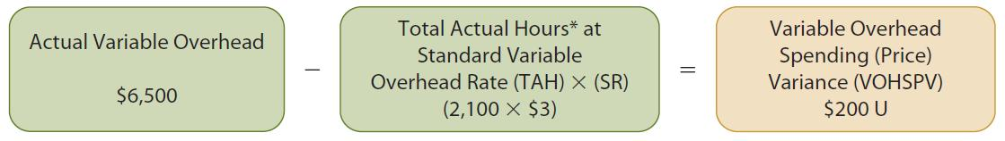
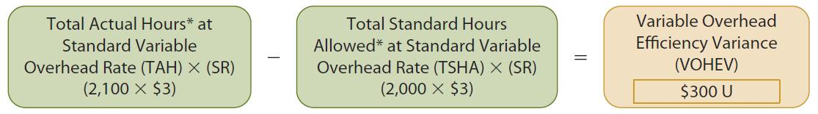
Total Variable Overhead
Budget Variance
The formula for the spending (price) variance is:
The formula for the efficiency (quantity) variance is:

Slide 41
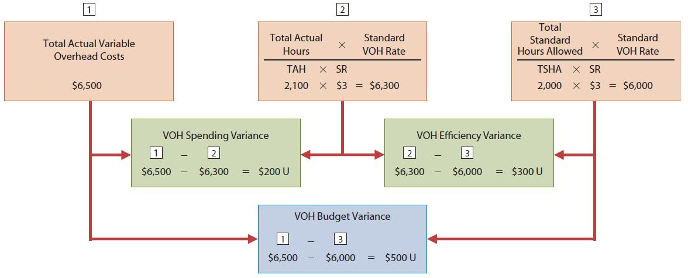
Variable Overhead Variances Matrix
_
=
_
=
_
=

Slide 42
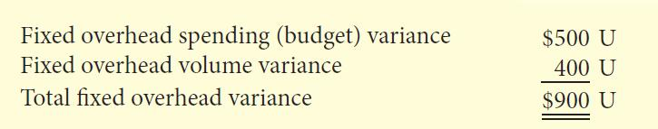
Total Fixed Overhead Variances
The total fixed overhead variance is the difference between the actual fixed overhead and the total standard hours allowed multiplied by the fixed overhead rate.
This fixed overhead (FOH) variance can also be analyzed into a spending (budget) variance and a volume variance.

Slide 43
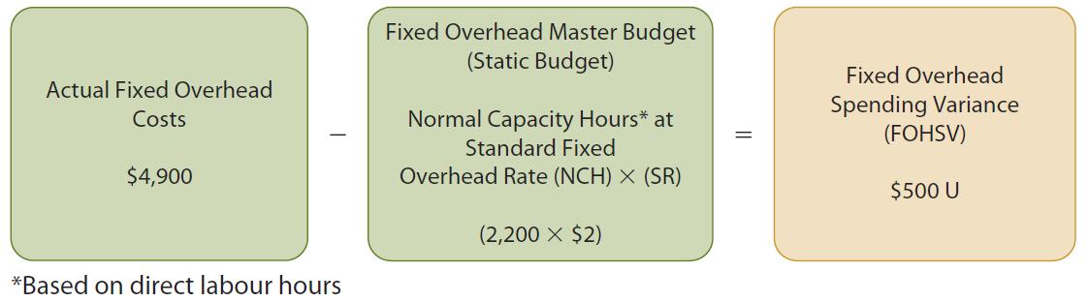
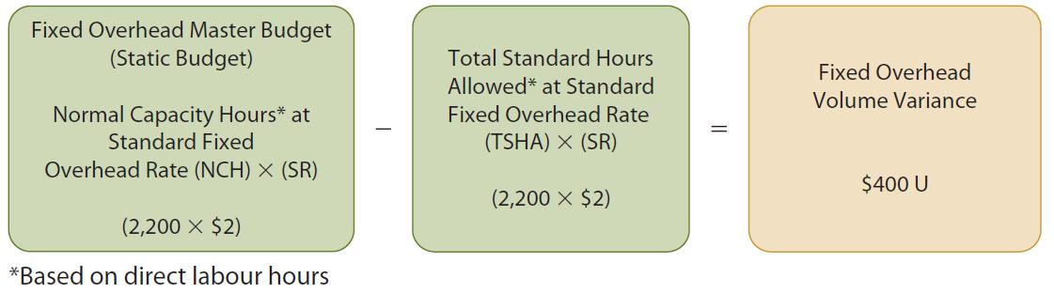
Total Fixed Overhead Variance
The formula for the spending (budget) variance is:
The formula for the volume variance is:
(2,000 x $2)

Slide 44
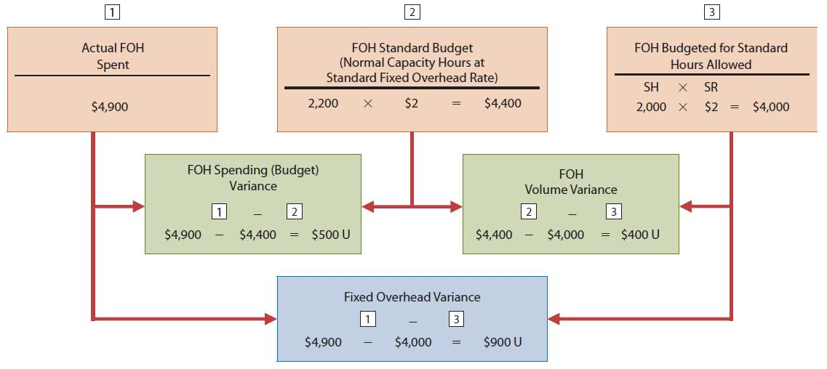
Fixed Overhead Variances Matrix
_
=
_
=
_
=

Slide 45
Causes of Manufacturing
Overhead Variances
Manufacturing overhead variances may be caused by a variety of factors
The controllable variance relates to variable manufacturing costs and usually is the responsibility of the production department
  May result from either higher than expected use of indirect materials, indirect labour or supplies, or increases in indirect manufacturing costs such as fuel
The volume variance may be the responsibility of the production department (inefficient use of direct labour hours) or may come from outside the production department (lack of sales orders)

Slide 46
Let’s Review
Manufacturing overhead costs are applied to work in process on the basis of:
actual hours worked.
standard hours allowed.
ratio of actual variable to fixed costs.
actual overhead costs incurred.

Slide 47
Let’s Review: Solution
Manufacturing overhead costs are applied to work in process on the basis of:
actual hours worked.
standard hours allowed.
ratio of actual variable to fixed costs.
actual overhead costs incurred.

Slide 48
Reporting Variances
All variances should be reported to appropriate levels of management as soon as possible so that corrective action can be taken
The form, content, and frequency of variance reports vary considerably among companies
Variance reports facilitate the principle of “management by exception”
In using variance reports, top management normally looks for significant variances

Slide 49
Let’s Review
All of the following variances are reported to the production department EXCEPT the:
labour price variance.
materials price variance.
overhead controllable variance.
labour price and materials price variances.

Slide 50
Let’s Review: Solution
All of the following variances are reported to the production department EXCEPT the:
labour price variance.
materials price variance.
overhead controllable variance.
labour price and materials price variances.

Slide 51
Statement Presentation of Variances
In income statements prepared for management under a standard cost accounting system, the cost of goods sold is stated at standard cost and the variances are disclosed separately
Inventories may be reported at standard costs when there are no significant differences between standard and actual costs. If there are significant differences between actual and standard costs, inventories and the cost of goods sold must be reported at actual costs.
Variances can also be shown in an income statement prepared in the contribution margin format.

Slide 52
Let’s Review
Income statements prepared internally for management often show cost of goods sold at standard cost and variances are:
separately disclosed.
deducted as other expenses and revenues.
added to cost of goods sold.
closed directly to retained earnings.

Slide 53
Let’s Review: Solution
Income statements prepared internally for management often show cost of goods sold at standard cost and variances are:
separately disclosed.
deducted as other expenses and revenues.
added to cost of goods sold.
closed directly to retained earnings.

Slide 54
Balanced Scorecard
Many companies supplement financial measures of performance (such as ROI and variances) with non-financial measures
Non-financial measures may assist management in assessing performance and anticipating future results
The balanced scorecard incorporates both financial and non-financial measures
  Is a very popular tool for evaluating company performance

Slide 55
Balanced Scorecard
Evaluates company performance from a series of perspectives
Financial perspective
  Uses common financial measures such as ROI
Customer perspective
  Evaluates price, quality, customer service
Internal process perspective
  Evaluates product development, production, delivery
Learning and growth perspective
  Evaluates employee skills and satisfaction, training sessions

Slide 56
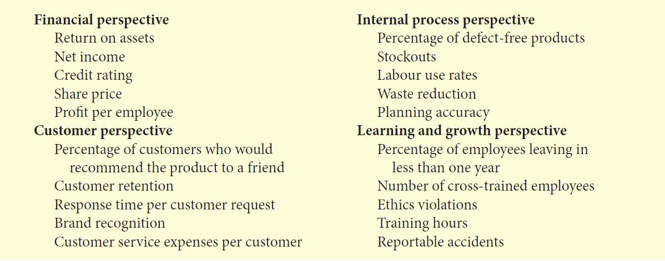
Balanced Scorecard
Within each perspective, objectives are identified which would contribute to attaining goals

Slide 57
Balanced Scorecard
Objectives are linked across perspectives in order to achieve company goals
  Financial objectives are normally set first, the objectives from the other perspectives are set in order to accomplish the financial objectives
The balanced scorecard does the following:
  Employs both financial and non-financial measures (e.g., ROI is a financial measure; employee turnover is a non-financial measure).
  Creates links so that high-level corporate goals can be communicated all the way down to the shop floor.
  Provides measurable objectives for such non-financial measures as product quality, rather than vague statements such as “We would like to improve quality.”
  Integrates all of the company’s goals into a single performance measurement system, so that too much weight will not be placed on any single goal.

Slide 58
Let’s Review
The balanced scorecard would measure:
financial measures against internal measures.
past outcomes against forward-looking measures.
hard objective measures against financial measures.
short-term objectives against soft subjective measures.

Slide 59
Let’s Review: Solution
The balanced scorecard would measure:
financial measures against internal measures.
past outcomes against forward-looking measures.
hard objective measures against financial measures.
short-term objectives against soft subjective measures.

Slide 60
Standard Cost Accounting System
A standard cost accounting system:
  Is a double-entry system of accounting
  Uses standard costs for entries
  Can be used with either job order cost or process cost systems
  Has two important assumptions:
    Variances from standards will be recognized at the earliest opportunity
    The work in process account is maintained at standard cost

Slide 61
Let’s Review
Each of the following accounts is recorded at standard cost EXCEPT:
Factory Labour.
Raw Materials Inventory.
Wages Payable.
Work in Process Inventory.

Slide 62
Let’s Review: Solution
Each of the following accounts is recorded at standard cost EXCEPT:
Factory Labour.
Raw Materials Inventory.
Wages Payable.
Work in Process Inventory.

Slide 63

Copyright
Copyright © 2012 John Wiley & Sons Canada, Ltd. All rights reserved. Reproduction or translation of this work beyond that permitted by Access Copyright (The Canadian Copyright Licensing Agency) is unlawful. Requests for further information should be addressed to the Permissions Department, John Wiley & Sons Canada, Ltd. The purchaser may make back-up copies for his or her own use only and not for distribution or resale. The author and the publisher assume no responsibility for errors, omissions, or damages caused by the use of these programs or from the use of the information contained herein.
12

