Slide 1
Weygandt-Kimmel-Kieso-Aly
11

Slide 2
11
Budgetary Control
and Responsibility Accounting
Study Objectives
Describe the concept of budgetary control.
Evaluate the usefulness of static budget reports.
Explain the development of flexible budgets and the usefulness of flexible budget reports.
Describe the concept of responsibility accounting.
Indicate the features of responsibility reports for cost centres.
Identify the content of responsibility reports for profit centres.
Explain the basis and formula used for evaluating performance in investment centres.
Explain the difference between ROI and residual income
11

Slide 3
Budgetary Control
A major function of management is to control operations
Takes place by means of budget reports which compare actual results with planned objectives
Provides management with feedback on operations
Develop
Budgets
Analyze difference
between actual
and budget
Take
corrective
actions
Modify
future
plans

Slide 4
Budgetary Control
Works best when a company has a formalized reporting system which:
  Identifies the name of the budget report (such as the sales budget or the manufacturing overhead budget)
  States the frequency of the report (weekly or monthly)
  Specifies the purpose of the report
  Indicates recipient of the report

Slide 5
Budgetary Control
Schedule on next slide illustrates a partial budgetary control system for a manufacturing company.
Note the frequency of reports and their emphasis on control.

Slide 6
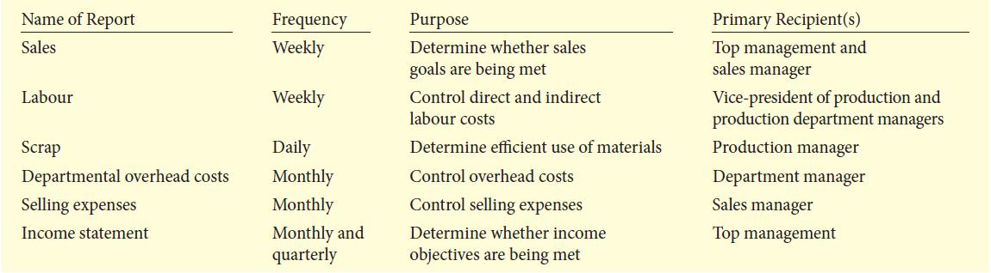
Budgetary Control

Slide 7
Let’s Review
Without a well-conceived plan against which to compare actual performance
  it is difficult to determine how a company is doing.
  it is difficult to determine what a company could do to improve.
  a company will not be able to make a profit.
  both a. and b.

Slide 8
Let’s Review: Solution
Without a well-conceived plan against which to compare actual performance
  it is difficult to determine how a company is doing.
  it is difficult to determine what a company could do to improve.
  a company will not be able to make a profit.
  both a. and b.

Slide 9
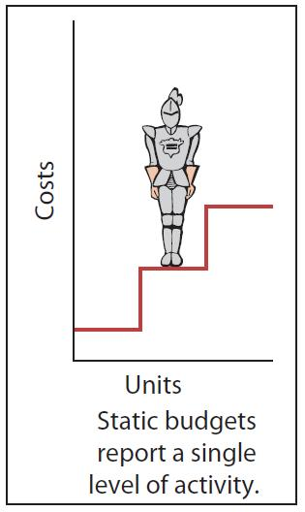
Static Budget Reports
Projection of budget data at one level of activity
Ignores data for different levels of activity
Always compares actual results with the budget data at the activity level used in the master budget

Slide 10
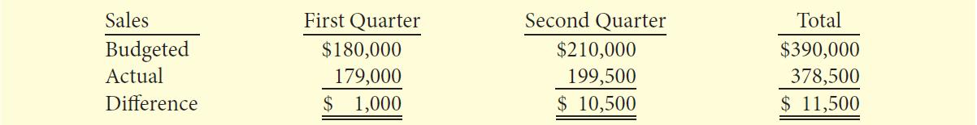
Static Budget Reports
Hayes Company – Example
We will use selected data for Hayes Company that provides budget and actual sales data for the Kitchen-mate product in the first and second quarters of 2012.

Slide 11
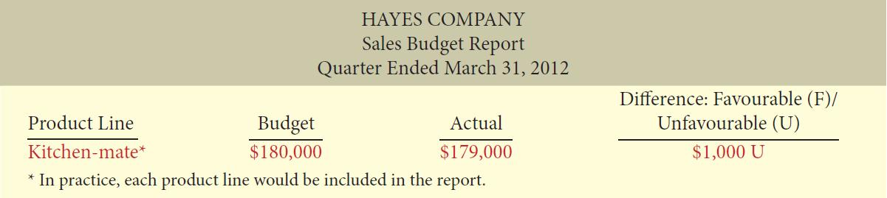
Static Budget Reports
Hayes Company – Example
The sales budget report for Hayes Company’s first quarter is below. The rightmost column reports the difference between the budgeted and actual amounts.

Slide 12
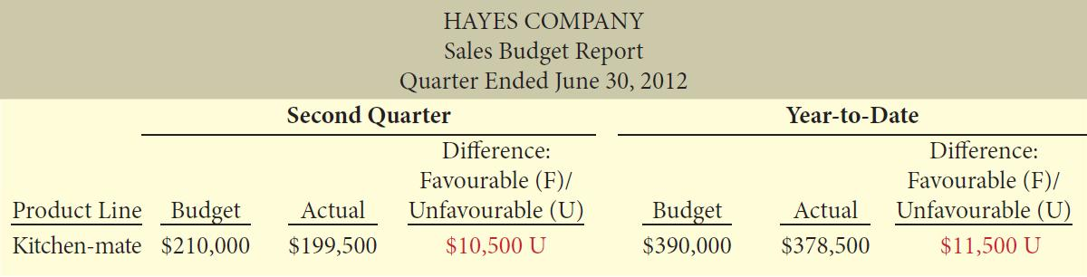
Static Budget Reports
Hayes Company –
Example: Continued
The difference of $1,000 is immaterial in this case, we will assume that Hayes Company’s management takes no specific corrective action. Below is the budget report for the second quarter. It has cumulative year-to-date information.
This report indicates that sales for the second quarter were $10,500 below budget (5% of budgeted sales of $210,000). Top management may now conclude that the difference between budgeted and actual sales requires investigation.

Slide 13
Static Budget Reports
Uses and Limitations
Appropriate for evaluating a manager’s effectiveness in controlling costs when:
  Actual level of activity closely approximates the master budget activity level
  Behaviour of the costs is fixed in response to changes in activity
Appropriate for fixed costs
Not appropriate for variable costs

Slide 14
Let’s Review
The limitation of a static budget is:
  timeliness.
  timeliness and specificity.
  data at one level of activity.
  data at many levels of activity.

Slide 15
Let’s Review: Solution
The limitation of a static budget is:
  timeliness.
  timeliness and specificity.
  data at one level of activity.
  data at many levels of activity.

Slide 16
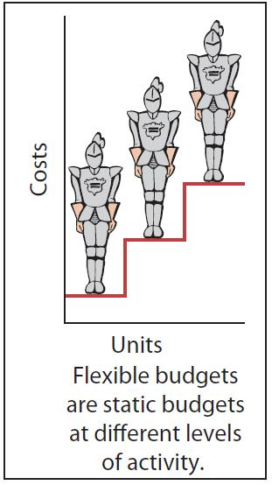
Flexible Budgets
Projects budget data for various levels of activity
Essentially, a series of static budgets at different activity levels
Budgetary process more useful if it is adaptable to changes in operating conditions
Can be prepared for each type of budget in the master budget

Slide 17
Developing the Flexible Budget
Steps
Identify the activity index and the relevant range of activity.
Identify the variable costs and determine the budgeted variable cost per unit of activity for each cost.
Identify the fixed costs and determine the budgeted amount for each cost.
Prepare the budget for selected increments of activity within the relevant range.

Slide 18
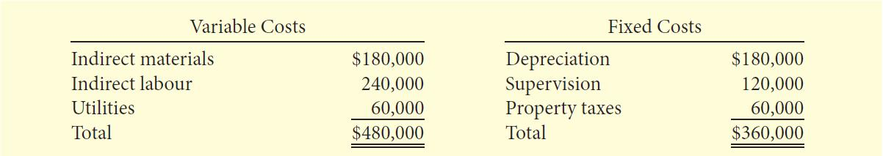
Flexible Budget
Fox Manufacturing Co. –
Example
Monthly comparisons of actual and budgeted manufacturing overhead costs for Finishing Department
2012 master budget:
  Expected operating capacity of 120,000 direct labour hours
  Overhead costs:

Slide 19
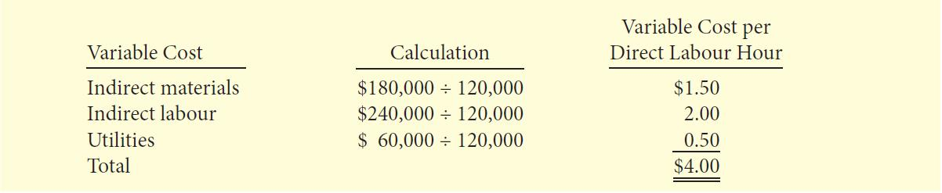
Flexible Budget
Fox Manufacturing Co. –
Example: Continued
Identify the activity index and the relevant range:
  activity index: direct labour hours
  relevant range: 8,000 – 12,000 direct labour hours per month
Identify the variable costs and determine the budgeted variable cost per unit of activity for each cost

Slide 20
Flexible Budget
Fox Manufacturing Co. –
Example: Continued
Identify the fixed costs and determine the budgeted amount for each cost:
  Three fixed costs per month:
  Amortization $15,000
  Property taxes $ 5,000
  Supervision $10,000
Prepare the budget for selected increments of activity within the relevant range:
  Prepared in increments of 1,000 direct labour hours

Slide 21
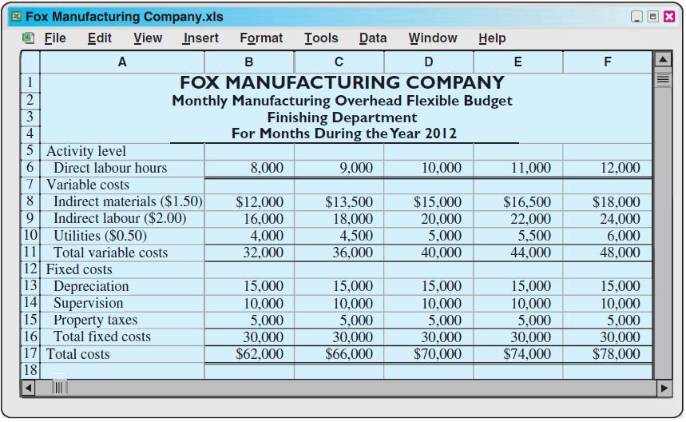
Flexible Budget
Fox Manufacturing Co. –
Example: Continued

Slide 22
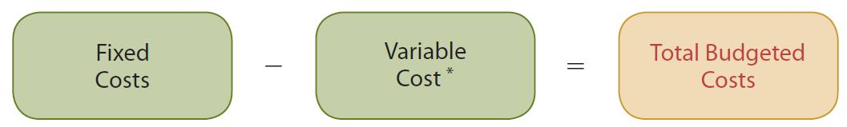
Flexible Budget
Fox Manufacturing Co. –
Example: Continued
Using the budget data, management can use this formula to determine the total budgeted costs at any level of activity.

Slide 23
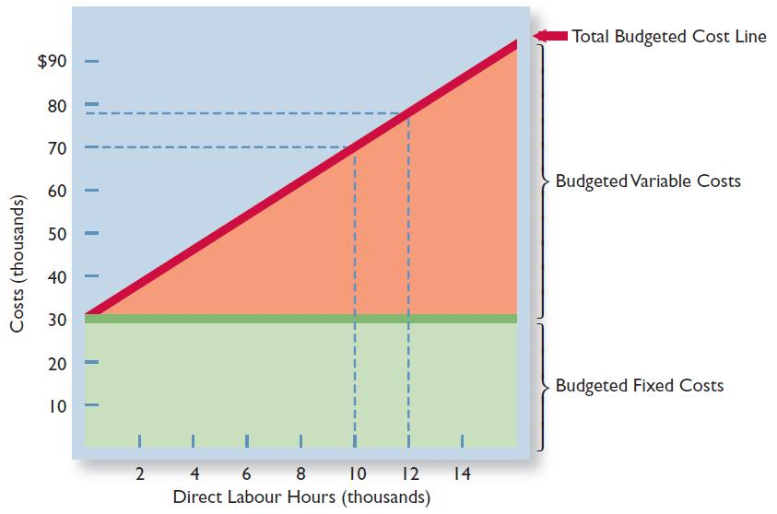
Flexible Budget
Fox Manufacturing Co. –
Example: Continued
Graphic flexible budget data highlighting 10,000 and 12,000 activity levels

Slide 24
Flexible Budget Reports
A type of internal report
Consists of two sections:
  Production data for a selected activity index, such as direct labour hours
  Cost data for variable and fixed costs
Widely used in production and service departments to evaluate a manager’s performance in production control and cost control
A budget report for the Finishing Department for the month of January follows

Slide 25
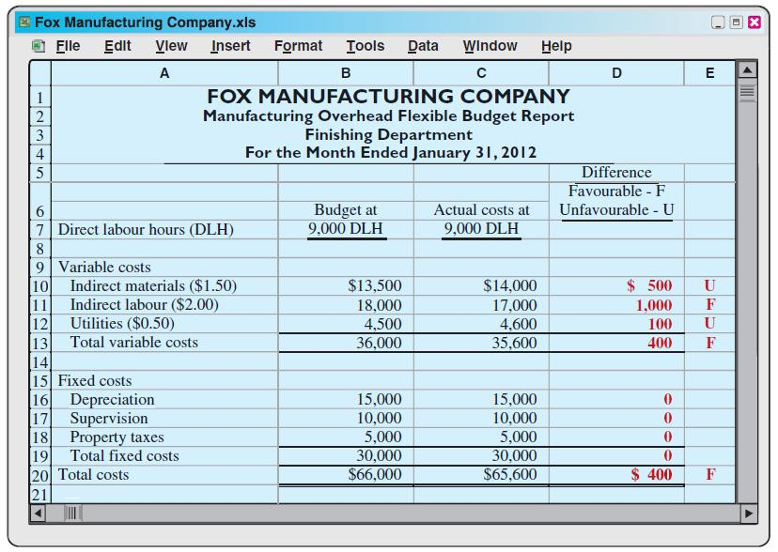
Flexible Budget Report

Slide 26
Management by Exception
Focus of top management’s review of a budget report:
Differences between actual and planned results
Able to focus on problem areas
Investigate only material and controllable exceptions:
    Express materiality as a percentage difference from budget
    Controllability relates to those items controllable by the manager

Slide 27
Let’s Review
To develop the flexible budget management should take the following steps:
  Identify the activity index and the relevant range of activity.
  Identify the variable costs, and determine the budgeted variable cost per unit of activity for each cost.
  Identify the fixed costs, and determine the budgeted amount for each cost.
  All of the above

Slide 28
Let’s Review: Solution
To develop the flexible budget management should take the following steps:
  Identify the activity index and the relevant range of activity.
  Identify the variable costs, and determine the budgeted variable cost per unit of activity for each cost.
  Identify the fixed costs, and determine the budgeted amount for each cost.
  All of the above

Slide 29
The Concept of
Responsibility Accounting
Involves accumulating and reporting costs on the basis of the manager who has the authority to make the day-to-day decisions about the items
Means a manager's performance is evaluated on the matters directly under the manager's control
There are different levels of responsibility

Slide 30
The Concept of
Responsibility Accounting
Conditions for using responsibility accounting:
  Costs and revenues can be directly associated with the specific level of management responsibility
  The costs and revenues are controllable at the level of responsibility with which they are associated
  Budget data can be developed for evaluating the manager's effectiveness in controlling the costs and revenues

Slide 31
The Concept of
Responsibility Accounting
Responsibility centre - any individual who has control and is accountable
May extend from the lowest levels of management to the top strata of management
Responsibility accounting is especially valuable in a decentralized company with control of operations delegated to many managers throughout the organization
Applies to both profit and not-for-profit entities:
  Profit entities: maximize net income
  Not-for-profit: minimize cost of providing services

Slide 32
Controllable versus Noncontrollable
Revenues and Costs
All costs controllable by top management
Fewer costs controllable as one moves down to lower levels of management
Controllable costs – costs incurred directly by a level of responsibility that are controllable at that level
Noncontrollable costs – costs incurred indirectly which are allocated to a responsibility level

Slide 33
Responsibility Reporting System
Involves preparation of a report for each level of responsibility in the company's organization chart
Begins with the lowest level of responsibility and moves upward to higher levels
Permits management by exception at each level of responsibility
Permits comparative evaluations
Plant manager can rank the department manager’s effectiveness in controlling manufacturing costs
Comparative ranking provides incentive for a manager to control costs

Slide 34
Principles of Performance Evaluation
Performance evaluation under responsibility accounting should be based on certain reporting principles. These principles relate mostly to the internal reports that provide the basis for evaluating performance. Performance reports should:
  Contain only data that are controllable by the manager of the responsibility centre,
  Provide accurate and reliable budget data to measure performance,
  Highlight significant differences between actual results and budget goals,
  Be tailor-made for the intended evaluation, and
  Be prepared at reasonable intervals.

Slide 35
Principles of Performance Evaluation Behavioural Principles
Human factor is critical in performance evaluation
Behavioural principles:
  Managers of responsibility centres should have direct input into the process of establishing budget goals for their area of responsibility
  The evaluation of performance should be based entirely on matters that are controllable by the manager being evaluated
  Top management should support the evaluation process
  The evaluation process must allow managers to respond to their evaluations
  The evaluation should identify both good and poor performance

Slide 36
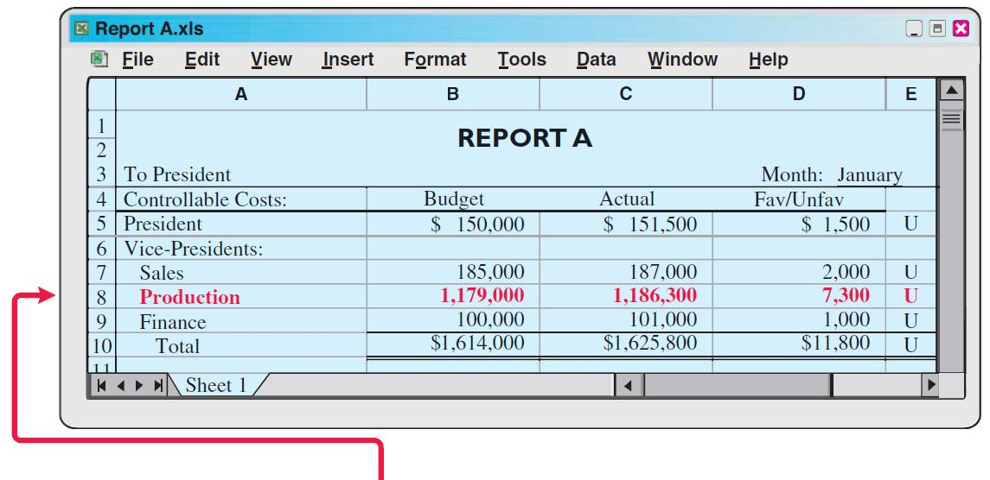
Responsibility Reporting System
Continued in report B

Slide 37
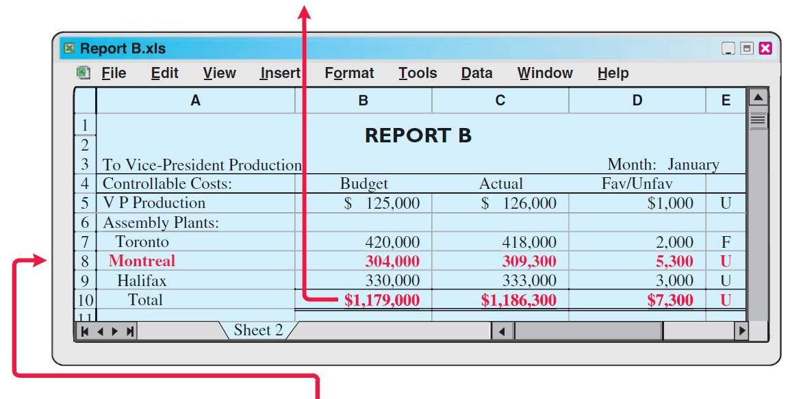
Responsibility Reporting System: Continued
Continued from report A
Continued in report C

Slide 38
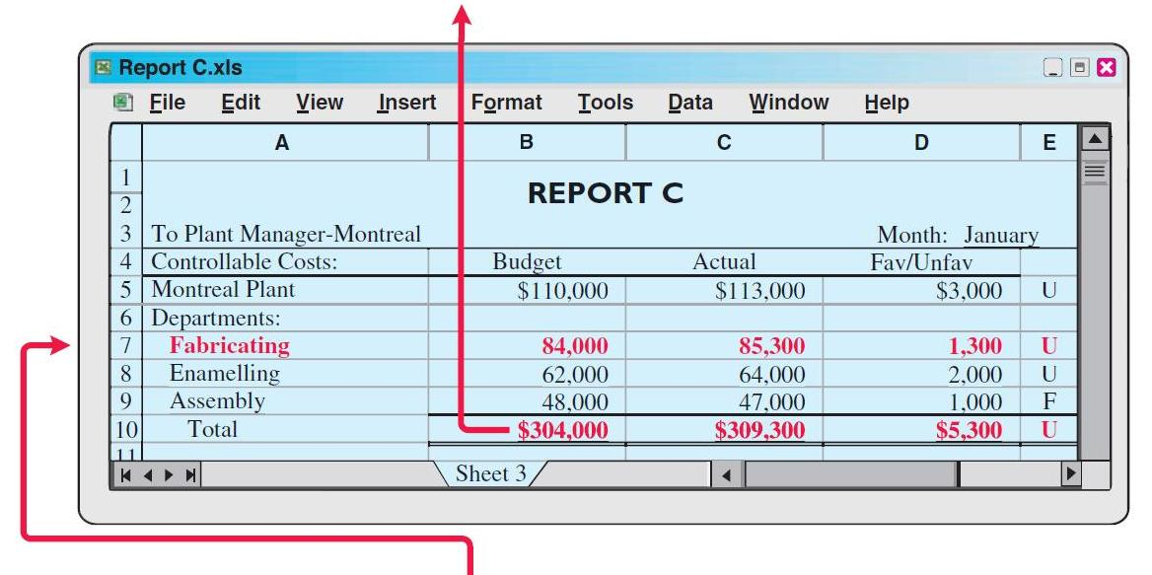
Responsibility Reporting System: Continued
Continued from report B
Continued in report D

Slide 39
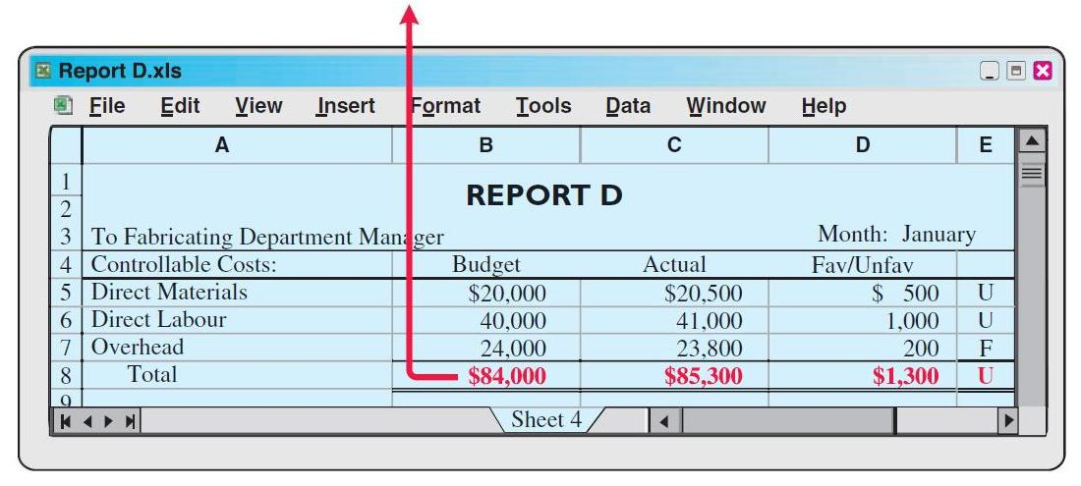
Responsibility Reporting System: Continued
Continued from report C

Slide 40
Responsibility Reporting System: Continued
Report D is typical of reports that go to managers at the lowest level of responsibility shown in the organization chart—department managers. Similar reports are prepared for the managers of the fabricating, assembling, and enamelling departments.
Report C is an example of reports that are sent to plant managers. It shows the costs of the Montreal plant that are controllable at the second level of responsibility. In addition, Report C shows summary data for each department that the plant manager controls. Similar reports are prepared for the Toronto and Halifax plant managers.

Slide 41
Responsibility Reporting System: Continued
Report B is a report at the third level of responsibility. It shows the controllable costs of the vice-president of production and summary data on the three assembly plants that this officer is responsible for.
Report A is typical of the reports that go to the top level of responsibility—the president. This report shows the controllable costs and expenses of this position and summary data on the vice-presidents who are accountable to the president.

Slide 42
Let’s Review
Which of the following is NOT a common form of a responsibility centre?
  Cost centre
  Investment centre
  Division centre
  Profit centre

Slide 43
Let’s Review: Solution
Which of the following is NOT a common form of a responsibility centre?
  Cost centre
  Investment centre
  Division centre
  Profit centre

Slide 44
Types of Responsibility Centres
Three basic types:
  Cost centres - Responsible for Expenses
    Example: Production centre or service department
  Profit centres - Responsible for Revenue and Expenses
    Example: Individual retail store, bank branch
  Investment centres - Responsible for: Revenue, Expenses and Return on Investment
    Example: Subsidiary company

Slide 45
Responsibility Accounting for
Cost Centres
Based on a manager’s ability to meet budgeted goals for controllable costs
Results in responsibility reports which compare actual controllable costs with flexible budget data:
  Include only controllable costs in reports
  No distinction between variable and fixed costs

Slide 46
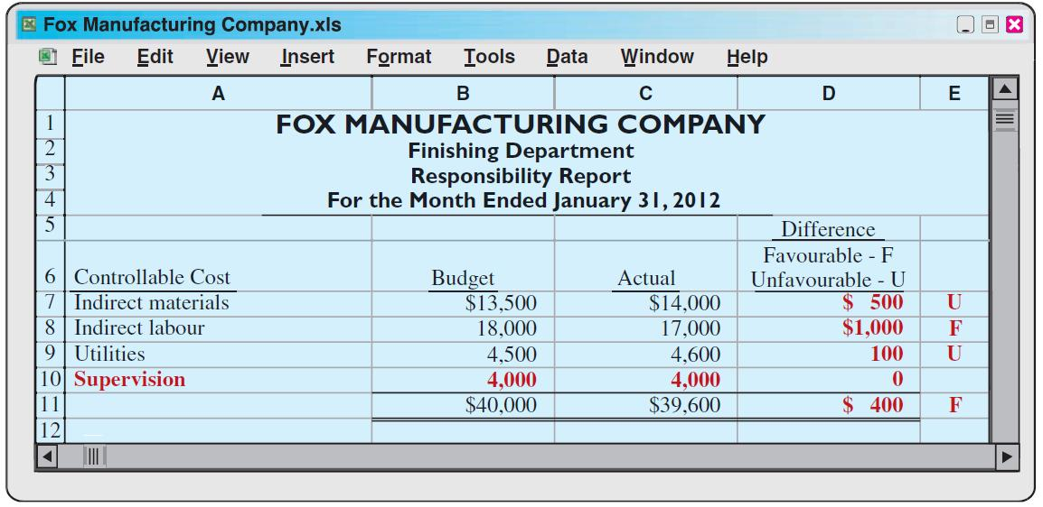
Responsibility Accounting for
Cost Centres
Fox Manufacturing Co. – Example
Assumes department manager can control all manufacturing overhead costs except depreciation, property taxes, and his own monthly salary of $4,000

Slide 47
Let’s Review
Responsibility reports for cost centres compare actual controllable costs with flexible budget data. The main feature of a Responsibility report is to:
  identify areas where management would like to receive more information.
  identify costs where management would like more analytical information on Favourable or Unfavourable variances.
  identify costs where management would like to analyze the Unfavourable variances.
  identify costs where management would like to analyze the Favourable variances.

Slide 48
Let’s Review: Solution
Responsibility reports for cost centres compare actual controllable costs with flexible budget data. The main feature of a Responsibility report is to:
  identify areas where management would like to receive more information.
  identify costs where management would like more analytical information on Favourable or Unfavourable variances.
  identify costs where management would like to analyze the Unfavourable variances.
  identify costs where management would like to analyze the Favourable variances.

Slide 49
Responsibility Accounting for
Profit Centres
Based on detailed information from both controllable revenues and controllable costs
Manager controls operating revenues earned, such as sales
Manager controls all variable costs (and expenses) incurred by the centre because they vary with sales

Slide 50
Responsibility Accounting for
Profit Centres
Direct and Indirect Fixed Costs
May have both direct and indirect fixed costs
Direct fixed costs (also called traceable costs):
  Relate specifically to a responsibility centre
  Incurred for the sole benefit of the centre
  Mostly controllable by the profit centre manager
Indirect fixed costs:
  Pertain to a company's overall operating activities
  Incurred for the benefit of more than one profit centre
  Mostly not controllable by the profit centre manager

Slide 51
Profit Centres
Responsibility Reports
Shows budgeted and actual controllable revenues and costs
Prepared using the cost-volume-profit income statement format:
  Deduct controllable fixed costs from the contribution margin
  Controllable margin - excess of contribution margin over controllable fixed costs – best measure of manager’s performance in controlling revenues and costs
  Do not report noncontrollable fixed costs

Slide 52
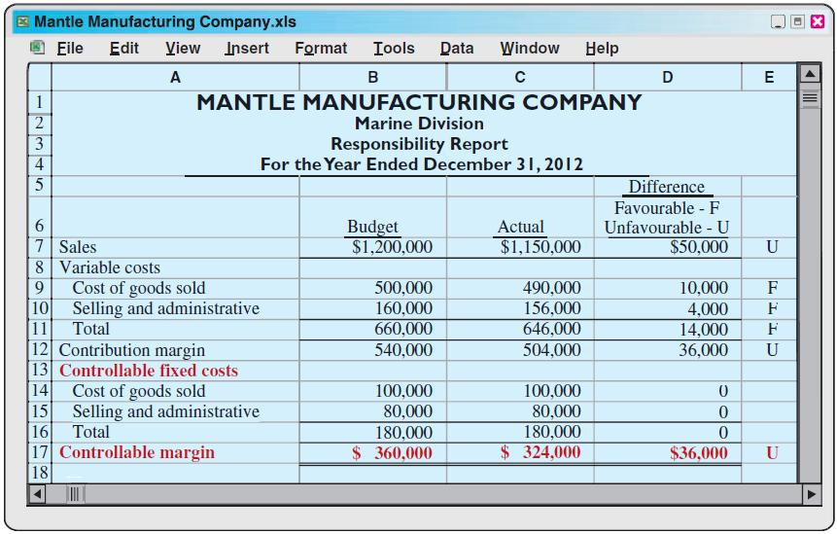
Profit Centres
Responsibility Reports
Marine Division – Example
* $60,000 of indirect fixed costs are not controllable
by manager and not shown

Slide 53
Let’s Review
What are the types of costs that a Profit Centre may have?
  A profit centre may have both direct and indirect fixed costs.
  A profit centre may have only controllable costs such as fixed costs.
  A profit centre may control its uncontrollable costs, if the costs are small enough.
  A profit centre will always include uncontrollable fixed costs.

Slide 54
Let’s Review: Solution
What are the types of costs that a Profit Centre may have?
  A profit centre may have both direct and indirect fixed costs.
  A profit centre may have only controllable costs such as fixed costs.
  A profit centre may control its uncontrollable costs, if the costs are small enough.
  A profit centre will always include uncontrollable fixed costs.

Slide 55
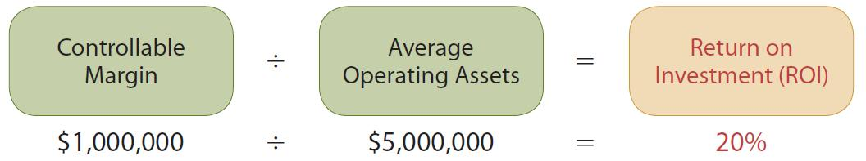
Responsibility Accounting for Investment Centres - ROI
ROI shows the effectiveness of the manager in utilizing the assets at his or her disposal
ROI is calculated as follows:
  Operating assets include current assets and plant assets used in operations by the centre
    Exclude non-operating assets such as idle plant assets and land held for future use
  Base average operating assets on the beginning and ending cost or book values of the assets

Slide 56
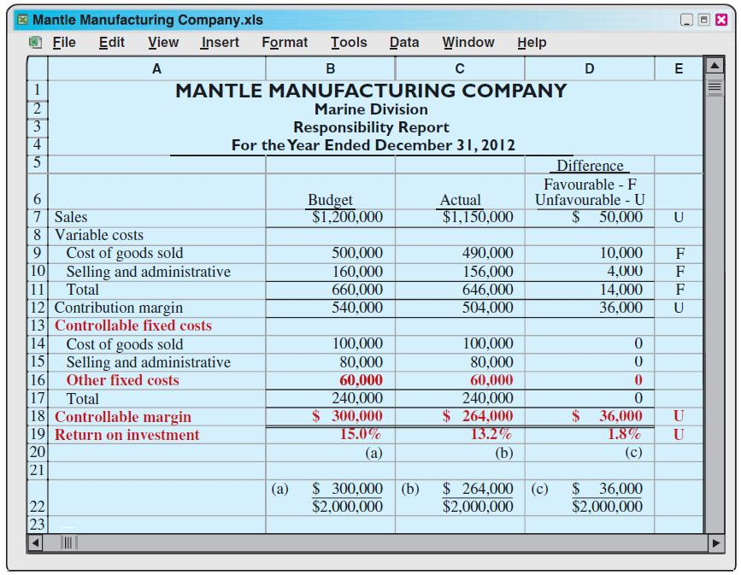
Investment Centres
Responsibility Report
Marine Division – Example
All fixed costs
are
controllable
by manager

Slide 57
Judgemental Factors in ROI
Valuation of operating assets:
  May be valued at acquisition cost, book value, appraised value, or market value
Margin (income) measure:
  May be controllable margin, income from operations, or net income

Slide 58
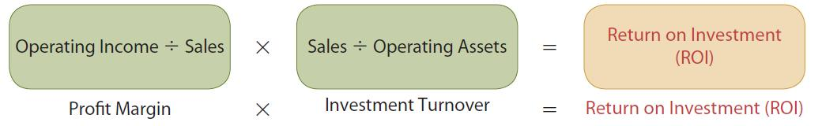
Improving ROI
ROI can be improved by:
  Increasing controllable margin or
  Reducing average operating assets
Expanded formula of ROI:
Profit margin shows how the operating margin can be improved by increasing the margin on each dollar of sales.
Investment turnover shows how investment turnover can be improved by generating more sales for each dollar invested.

Slide 59
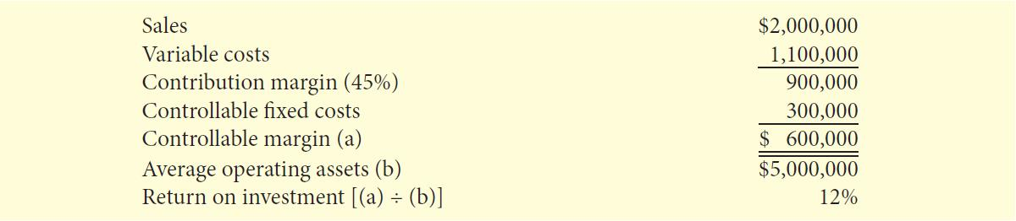
Improving ROI
Marine Division – Example
Assume the following data for Marine Division of Mantle Manufacturing:

Slide 60
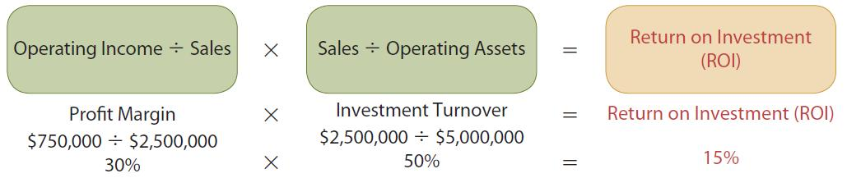
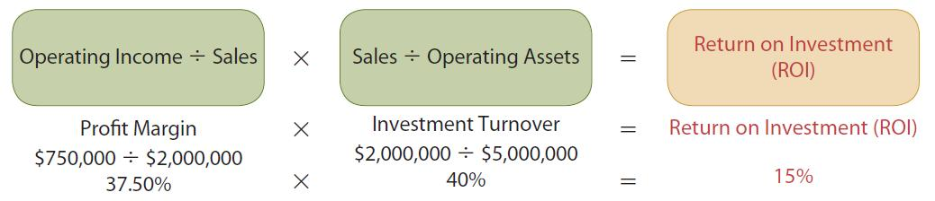
Improving ROI
Marine Division – Example
Increasing sales by 25%
Decrease variable and fixed costs by 10.72%.

Slide 61
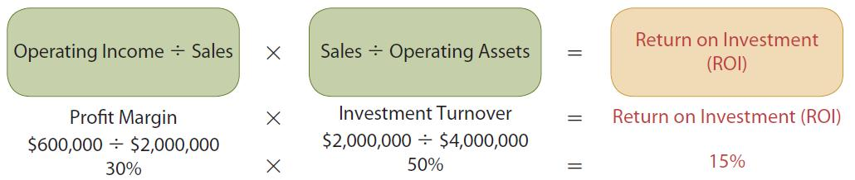
Improving ROI
Marine Division – Example
Reducing average operating assets by 20%

Slide 62
Let’s Review
The formula for calculating the ROI for an investment centre is:
  Operating Income X Sales/Operating Assets = ROI.
  (Operating Income /Sales) X (Sales /Operating Assets) = ROI.
  Controllable Margin /Average Operating Assets = ROI.
  Both b. and c. are correct

Slide 63
Let’s Review: Solution
The formula for calculating the ROI for an investment centre is:
  Operating Income X Sales/Operating Assets = ROI.
  (Operating Income /Sales) X (Sales /Operating Assets) = ROI.
  Controllable Margin /Average Operating Assets = ROI.
  Both b. and c. are correct

Slide 64
Residual Income – Another Performance Measurement
Most companies use ROI to evaluate investment performance
Significant disadvantage – ignores the minimum rate of return on operating assets
  Rate at which cost are covered and a profit earned

Slide 65
Residual Income Compared to ROI
Use the residual income approach to evaluate performance using the minimum rate of return
Residual Income: The income that remains after subtracting from controllable margin the minimum rate of return on average operating assets

Slide 66
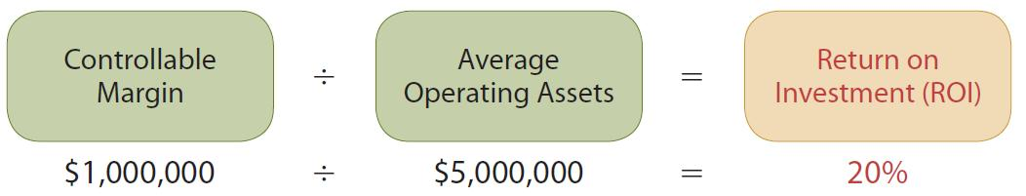
Residual Income –
Another Performance Measurement
– Example
Electronics Division has the following ROI:
Considering producing a new product – Tracker
To produce the product, operating assets increase $2,000,000
Tracker expected to generate an additional $260,000 of controllable margin

Slide 67
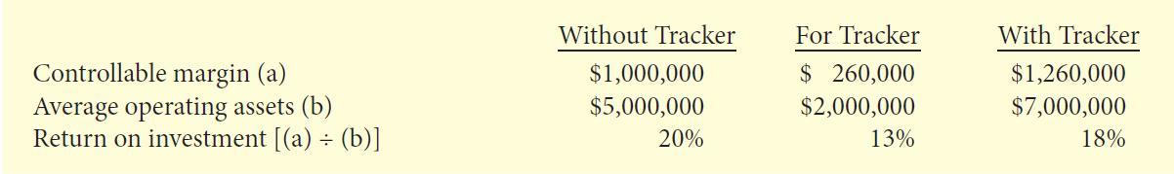
Residual Income –
Another Performance Measurement
– Example: Continued
Making Tracker reduces ROI from 20% to 18%:
If Electronics only uses ROI, they would not produce Tracker
However, if Electronics has a minimum rate of return of 10%, Tracker would be produced because its ROI, 13%, is greater

Slide 68
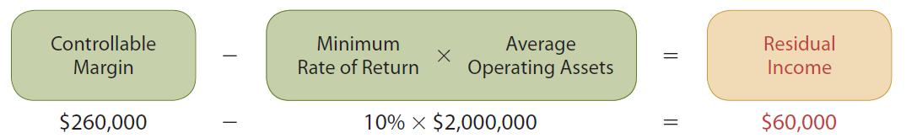
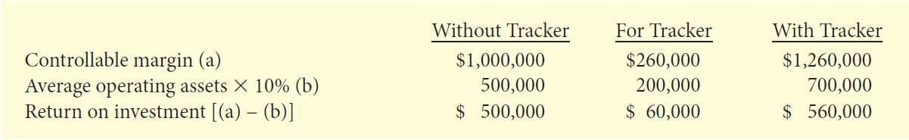
Residual Income –
Another Performance Measurement
– Example: Continued
The residual income for Tracker:
With Tracker, Electronics’ residual income increases:
Thus, ROI can be misleading by rejecting a project that actually increases income

Slide 69
Residual Income Weakness
Attempting to evaluate a company only on maximizing residual income ignores the fact that one division might use substantially fewer assets to attain the same level of residual income
Electronics Division used $2,000,000 of average operating assets to generate $260,000 of residual income
Can a different division use fewer operating assets to generate a greater amount of residual income?

Slide 70
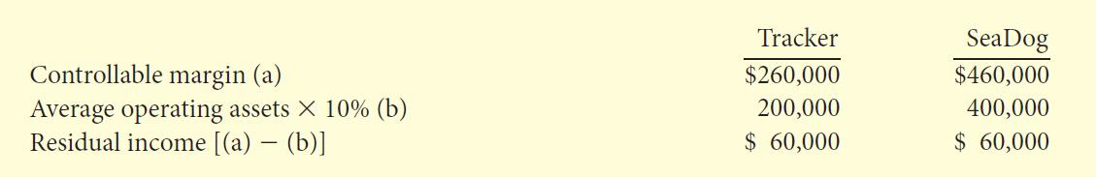
Residual Income Weakness
Electronics Division versus
Seadog Division – Example
Seadog used $4,000,000 to generate $460,000 of controllable margin
Using the residual income approach, both investments are equal
However, this ignores the fact that Seadog required twice as many operating assets to achieve the same level of residual income

Slide 71
Let’s Review
For what purpose do companies calculate residual income?
  To determine whether decentralization is possible or not
  To motivate managers through possible termination
  To evaluate management performance
  To measure company profits

Slide 72
Let’s Review: Solution
For what purpose do companies calculate residual income?
  To determine whether decentralization is possible or not
  To motivate managers through possible termination
  To evaluate management performance
  To measure company profits

Slide 73

Copyright
Copyright © 2012 John Wiley & Sons Canada, Ltd. All rights reserved. Reproduction or translation of this work beyond that permitted by Access Copyright (The Canadian Copyright Licensing Agency) is unlawful. Requests for further information should be addressed to the Permissions Department, John Wiley & Sons Canada, Ltd. The purchaser may make back-up copies for his or her own use only and not for distribution or resale. The author and the publisher assume no responsibility for errors, omissions, or damages caused by the use of these programs or from the use of the information contained herein.
11

