Slide 1
Weygandt-Kimmel-Kieso-Aly
10

Slide 2
10
Budgetary Planning
Study Objectives
Explain how management uses budgeting as a planning tool.
Prepare the various operating budgets and identify the sources for preparing the budgeted income statement.
Prepare the cash budget and the budgeted balance sheet.
Explain the applicability of budgeting in non-manufacturing companies.
10

Slide 3
Budgeting Basics
Budget
A formal written statement of management’s plans for a specified future time period, expressed in financial terms
Primary way to communicate agreed-upon objectives to all parts of the company
Promotes efficiency
Control device - important basis for performance evaluation once adopted

Slide 4
Budgeting Basics
Role of Accounting
Historical accounting data on revenues, costs, and expenses help in formulating future budgets
Accountants are normally responsible for presenting management’s budgeting goals in financial terms
The budget and its administration are, however, entirely management’s responsibility

Slide 5
Budgeting Basics
Benefits of Budgeting
Requires all levels of management to plan ahead and formalize goals on a recurring basis
Provides definite objectives for evaluating performance at each level of responsibility
Creates an early warning system for potential problems
Facilitates coordination of activities within the business
Results in greater management awareness of the entity’s overall operations and the impact of external factors
Motivates personnel throughout organization to meet planned objectives

Slide 6
Budgeting Basics
A budget is an aid to management not a substitute for management.
Effective Budget
Depends on a sound organizational structure with authority and responsibility for all phases of operations clearly defined
Is based on research and analysis with realistic goals
Is accepted by all levels of management

Slide 7
Budgeting Basics
Length of Budget Period
May be prepared for any period of time
  Most common - one year
  Supplement with monthly and quarterly budgets
  Different budgets may cover different time periods
Long enough to provide an attainable goal and minimize seasonal or cyclical fluctuations
Short enough for reliable estimates
Continuous twelve-month budget
  Drop the month just ended and add a future month
  Keeps management planning a full year ahead

Slide 8
Budgeting Basics
Budgeting Process
Base budget goals on past performance
  Collect data from organizational units
  Begins several months before end of current year
Develop budget within the framework of a sales forecast
  Shows potential industry sales
  Shows company’s expected share

Slide 9
Budgeting Basics
Budgeting Process
Factors considered in Sales Forecasting:
  General economic conditions
  Industry trends
  Market research studies
  Anticipated advertising and promotion
  Previous market share
  Price changes
  Technological developments

Slide 10
Budgeting Basics
Budgeting Process
Usually informal in small companies
Assigned to a budget committee in larger companies
  Include the president, treasurer, chief accountant (controller), and management personnel from each major area of the company
  Review board where managers defend budget goals and requests

Slide 11
Budgeting Basics
Budgeting and Human Behaviour
May inspire higher levels of performance or discourage additional effort
Depends on how budget developed and administered
Invite each level of management to participate
This “bottom-to-top” approach is called
Participative Budgeting

Slide 12
Budgeting Basics
Budgeting and Human Behaviour
Participative Budgeting
Advantages:
  More accurate budget estimates because lower level managers have more detailed knowledge of their area
  Tendency to perceive process as fair due to involvement of lower level management
Overall goal - produce a budget considered fair and achievable by managers while still meeting corporate goals
Risk of unreliable budgets greater when they are “top-down”

Slide 13
Budgeting Basics
Budgeting and Human Behaviour
Participative Budgeting
Disadvantages:
  Can be time consuming and costly
  Can foster budgetary “gaming” through budgetary slack
    Situation where managers intentionally under-estimate budgeted revenues or overestimate budgeted expenses so that budget goals are easier to meet

Slide 14
Budgeting Basics
Budgeting and Long-Range Planning
Differences | Budgeting | Long range Planning
Time period involved | Short-term – usually one year | Usually at least five years
Emphasis | Achievement of specific short-term goals | Identifies long term goals, selects strategies to achieve goals, and develops policies and plans to implement strategies
Detail presented | Very detailed | Contain less detail review of progress toward long term goals

Slide 15
Budgeting Basics
The Master Budget
A set of interrelated budgets that constitutes a plan of action for a specified time period
Contains two classes of budgets:
  Operating budgets:
  Individual budgets that result in the preparation of the budgeted income statement – establish goals for sales and production personnel
  Financial budgets:
  The capital expenditures budget, the cash budget, and the budgeted balance sheet – focus primarily on cash needs to fund operations and capital expenditures

Slide 16
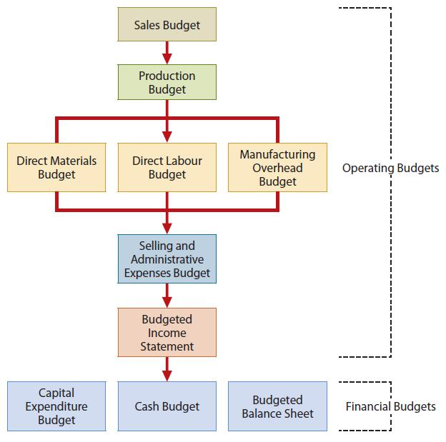
Budgeting Basics
The Master Budget – Components

Slide 17
Let’s Review
Which of the following is NOT a reason why firms use budgets?
  Performance evaluation
  Coordination
  Planning
  Operating leverage

Slide 18
Let’s Review: Solution
Which of the following is NOT a reason why firms use budgets?
  Performance evaluation
  Coordination
  Planning
  Operating leverage

Slide 19
Operating Budgets
Sales Budget
First budget prepared
Derived from the sales forecast
  Management’s best estimate of sales revenue for the budget period
  Every other budget depends on the sales budget
Prepared by multiplying expected unit sales volume for each product and anticipated unit selling price

Slide 20
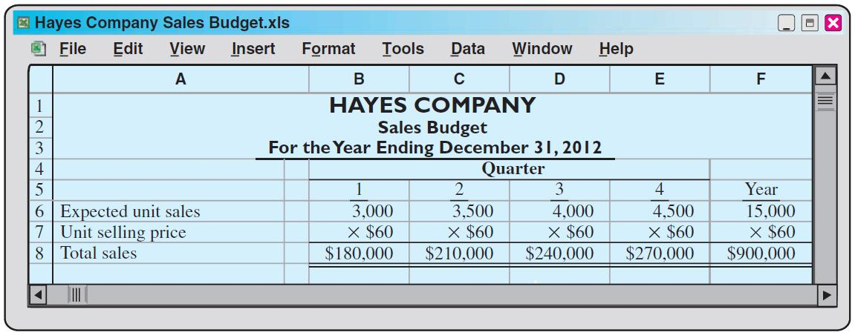
Operating Budgets
Sales Budget
Hayes Company – Example
  Expected sales volume: 3,000 units in the first quarter with 500-unit increments for each following quarter
  Sales price: $60 per unit

Slide 21
Operating Budgets
Production Budget
Shows the units that must be produced to meet anticipated sales
Derived from sales budget plus the desired change in ending finished goods (ending finished goods less the beginning finished goods units)
Required production in units formula:
Desired Sales Units | + | Desired Ending Finished Goods Units | - | Beginning Finished Goods Units | = | Required Production Units

Slide 22
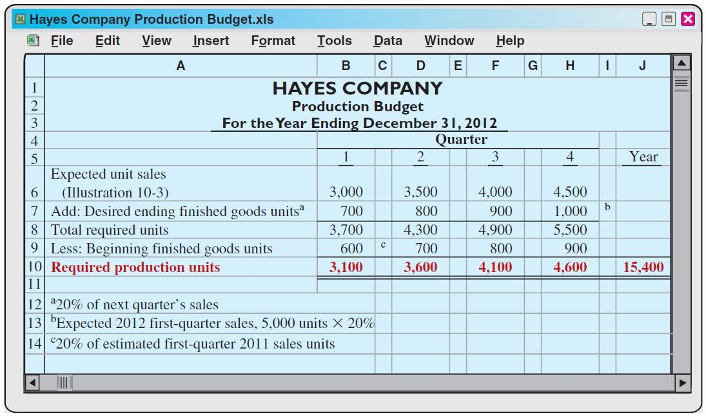
Operating Budgets
Production Budget
Hayes Company – Example: Continued
Hayes Co. believes it can meet future sales needs with an ending inventory of 20% of next quarter’s sales

Slide 23
Operating Budgets
Direct Materials Budget
Shows both the quantity and cost of direct materials to be purchased
Derived from the direct materials units required for production (from the production budget) plus the desired change in ending direct materials units
Budgeted cost of direct materials to be purchased = required units of direct materials X anticipated cost per unit
Units Required for Production | + | Desired Ending Direct Materials Units | - | Beginning Direct Materials Units | = | Required Direct Materials Units to be Purchased

Slide 24
Operating Budgets
Direct Materials Budget
Hayes Company – Example: Continued
An ending inventory of 10% of next quarter’s production requirements is sufficient
The manufacturing of each unit requires 2 pounds of raw materials at an expected price of $4 per pound

Slide 25
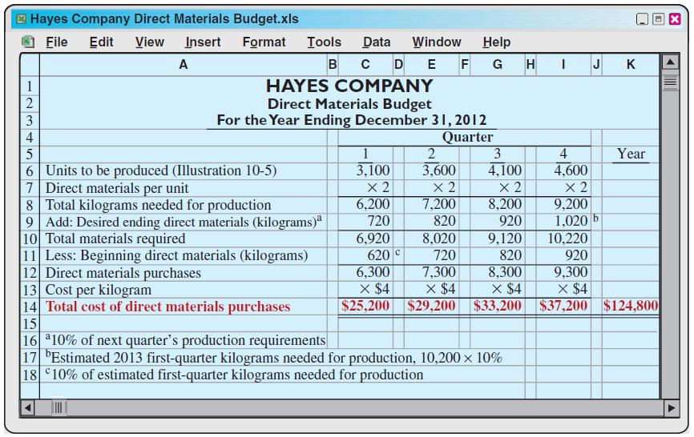
Operating Budgets
Direct Materials Budget
Hayes Company – Example: Continued

Slide 26
Operating Budgets
Direct Labour Budget
Shows both the quantity of hours and cost of direct labour necessary to meet production requirements
Critical in maintaining a labour force that can meet expected production
Total direct labour cost formula:
Units to be Produced | x | Direct Labour Time per Unit | x | Direct Labour Cost per Hour | = | Total Direct Labour Cost

Slide 27
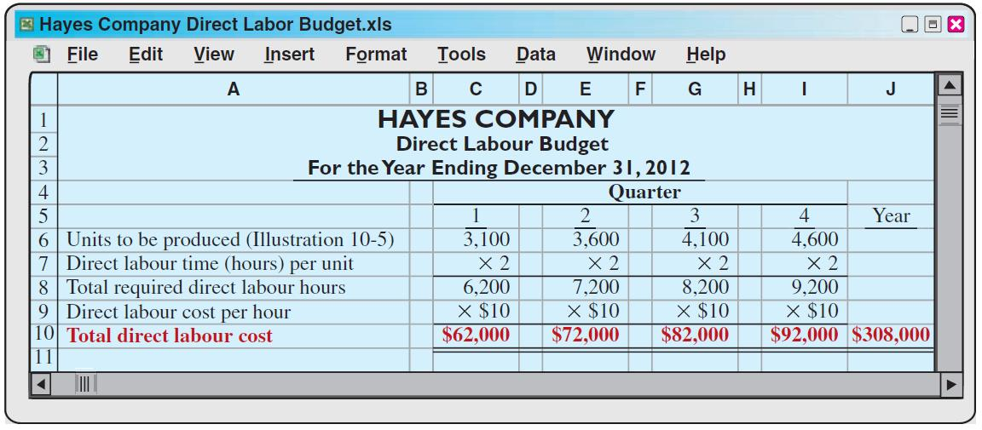
Operating Budgets
Direct Labour Budget
Hayes Company – Example: Continued
Direct labour hours from the production budget
Two hours of direct labour required for each unit
Hourly wage rate $10

Slide 28
Operating Budgets
Manufacturing Overhead Budget
Shows the expected manufacturing overhead costs for the budget period
Distinguishes between fixed and variable overhead costs

Slide 29
Operating Budgets
Manufacturing Overhead Budget
Hayes Company – Example: Continued
  Fixed cost amounts are assumed
  Expected variable costs per direct labour hour:
    Indirect materials: $1.00
    Indirect labour: $1.40
    Utilities: $0.40
    Maintenance: $0.20

Slide 30
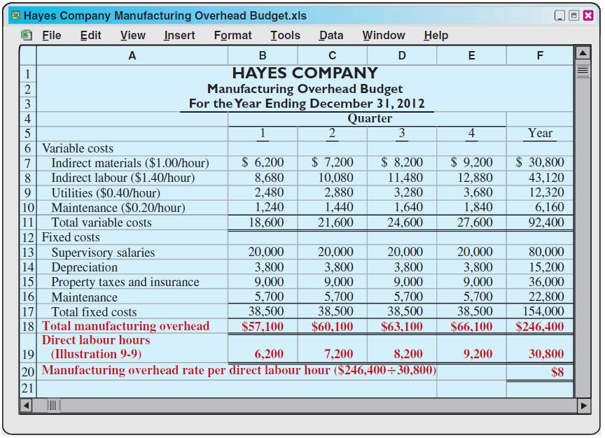
Hayes Company
Manufacturing Overhead Budget
Hayes Company – Example: Continued

Slide 31
Operating Budgets
Selling & Administrative Expense Budget
Projection of anticipated operating expenses
Distinguishes between fixed and variable costs

Slide 32
Operating Budgets
Selling & Administrative Expense Budget
Hayes Company – Example: Continued
Fixed cost amounts are assumed
Expected variable costs per unit sold (from sales budget):
    Sales commissions: $3.00
    Freight-out: $1.00

Slide 33
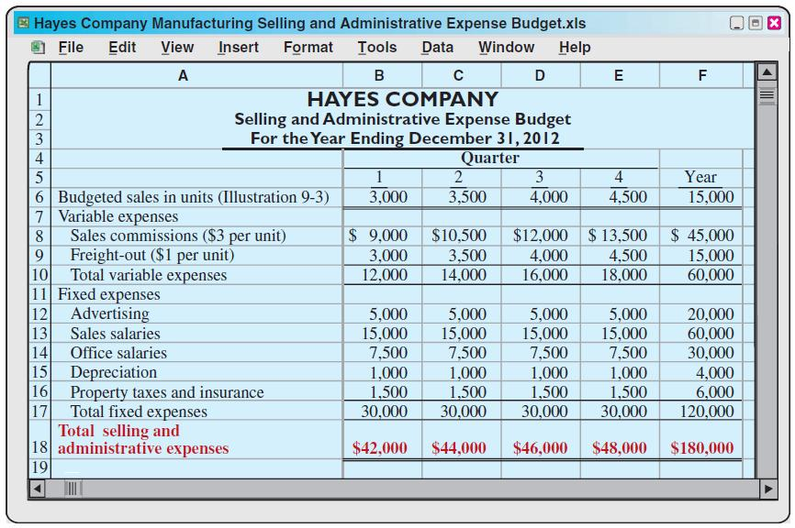
Operating Budgets
Selling & Administrative Expense Budget
Hayes Company – Example: Continued

Slide 34
Operating Budgets
Budgeted Income Statement
  Important end-product of the operating budgets
  Indicates expected profitability of operations
  Provides a basis for evaluating company performance
  Prepared from the operating budgets
    Sales Budget
    Production Budget
    Direct Materials Budget
    Direct Labour Budget
    Manufacturing Overhead Budget
    Selling and Administrative Expense Budget

Slide 35
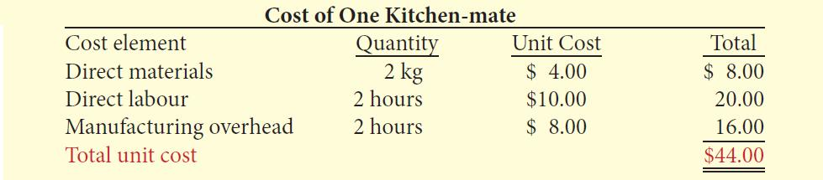
Operating Budgets
Budgeted Income Statement
Hayes Company – Example: Continued
  To find cost of goods sold:
    First determine the unit cost of one Kitchen-mate
    Determine Cost of goods sold by multiplying units sold times unit cost:
  15,000 units X $44 = $660,000

Slide 36
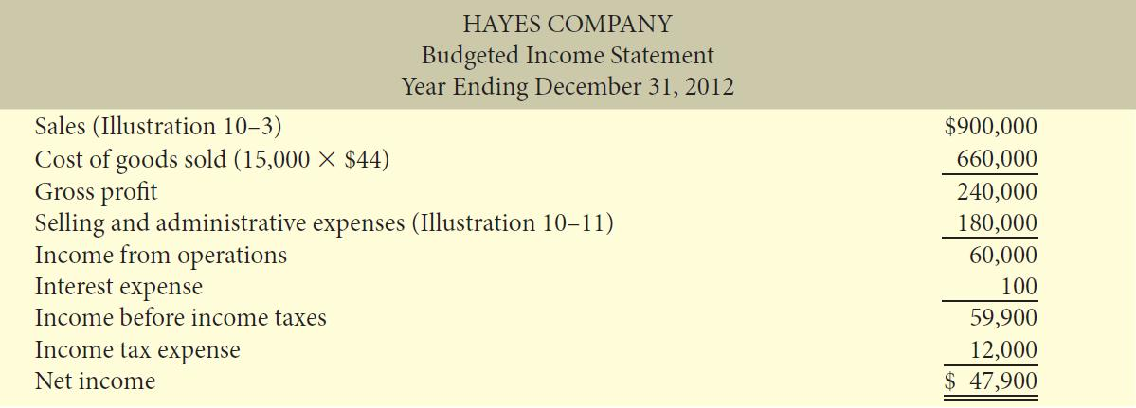
Operating Budgets
Budgeted Income Statement
Hayes Company – Example: Continued
  Additional estimated data for budgeted income statement:
    Interest expense - $100
    Income taxes - $12,000

Slide 37
Let’s Review
The production budget is used to derive the budgets for which of the following?
  Materials budget
  Labour budget
  Overhead budget
  All of the above

Slide 38
Let’s Review: Solution
The production budget is used to derive the budgets for which of the following?
  Materials budget
  Labour budget
  Overhead budget
  All of the above

Slide 39
Financial Budgets
Cash Budget
Shows anticipated cash flows
Often considered to be the most important output in preparing financial budgets
Contains three sections:
    Cash receipts
    Cash disbursements
    Financing
Shows beginning and ending cash balances

Slide 40
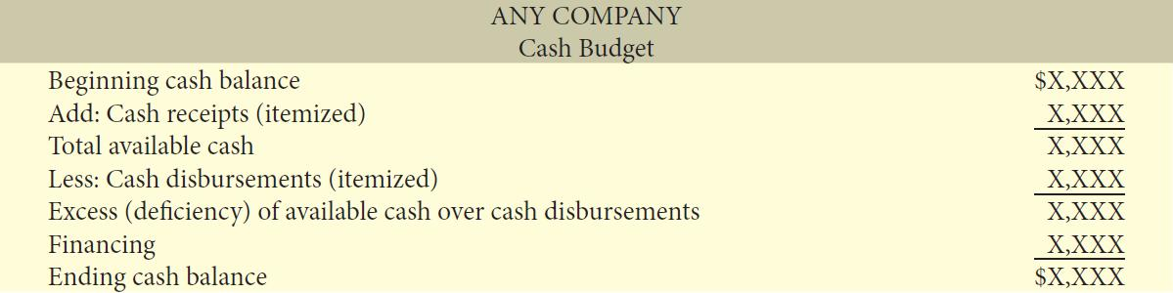
Financial Budgets
Cash Budget
Basic Format

Slide 41
Financial Budgets
Cash Budget
Cash receipts section
  Includes expected receipts from the principal sources of revenue – usually cash sales and collections on credit sales
  Shows expected interest and dividend receipts, as well as proceeds from planned sales of investments, plant assets, and capital stock
Cash disbursements section
  Includes expected cash payments for direct materials and labour, taxes, dividends, plant assets, etc.
Financing section
  Shows expected borrowings and repayments of borrowed funds plus interest

Slide 42
Financial Budgets
Cash Budget
Must prepare in sequence
Ending cash balance of one period = beginning cash balance for next
Obtain information from other budgets and from management
Often prepared for the year on a monthly basis

Slide 43
Financial Budgets
Cash Budget
Hayes Company – Example: Continued
Assumptions
January 1, 2009 cash balance: $38,000
Sales: collect 60% in quarter sold; 40% in next quarter
Collect $60,000 in Accounts Receivable at December 31, 2004, in Qtr 1
Expected sale of short term investments: $2,000 in Qtr 1
Direct Materials: pay 50% in quarter purchased; 50% in next
Pay $10,600 in Accts Payable at December 31, 2008, in Qtr 1
Direct Labour: pay 100% in quarter incurred

Slide 44
Financial Budgets
Cash Budget
Hayes Company – Example: Continued
Manufacturing Overhead and Selling/Administrative Expenses: Pay (except amortization) in quarter incurred
Expected purchase of truck: $10,000 cash in Quarter 2
Estimated annual income taxes: Equal payment each quarter
Loans: Pay in earliest quarter with sufficient cash (i.e., cash on hand exceeds the $15,000 minimum required balance)

Slide 45
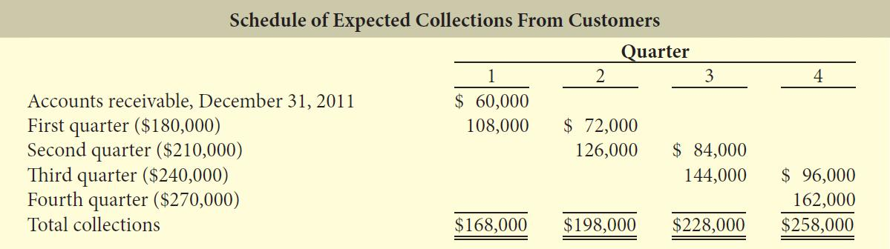
Financial Budgets
Cash Budget
Hayes Company – Example: Continued
Usually prepare schedule of collections from customers:

Slide 46
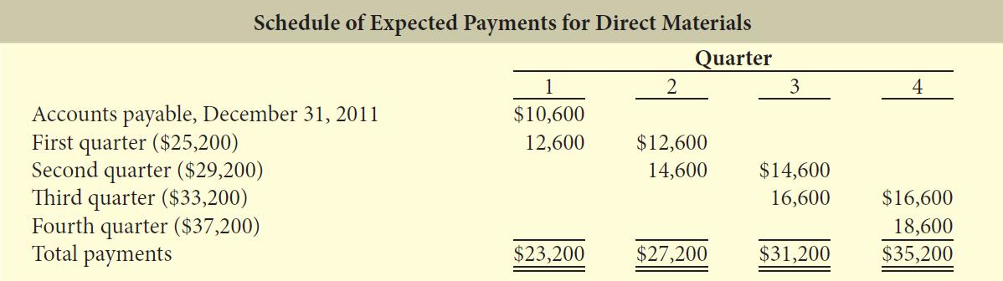
Financial Budgets
Cash Budget
Hayes Company – Example: Continued
Prepare schedule of cash payments for direct materials:
Now prepare the Cash Budget based on the assumptions and the preceding schedules

Slide 47
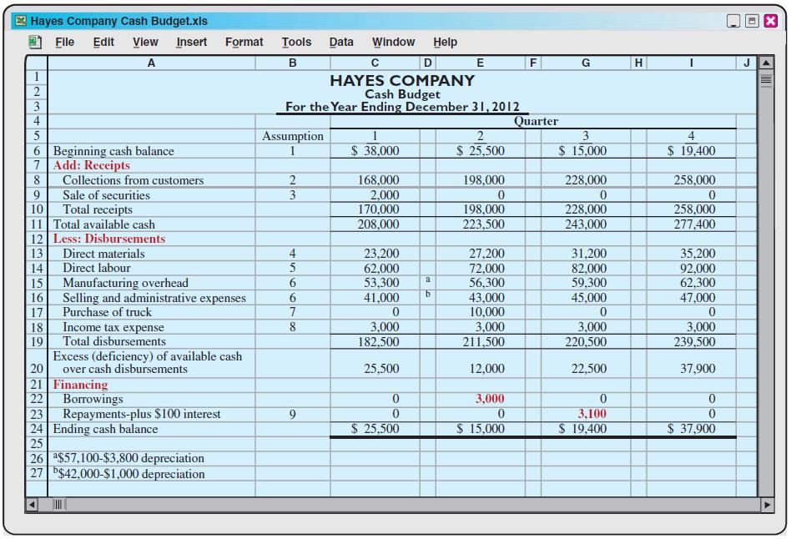
Financial Budgets
Cash Budget
Hayes Company – Example: Continued

Slide 48
Financial Budgets
Cash Budget
Contributes to more effective cash management
Shows managers need for additional financing before actual need arises
Indicates when excess cash will be available

Slide 49
Financial Budgets
Budgeted Balance Sheet
A projection of financial position at the end of the budget period
Developed from the budgeted balance sheet for the preceding year and the budgets for the current year

Slide 50
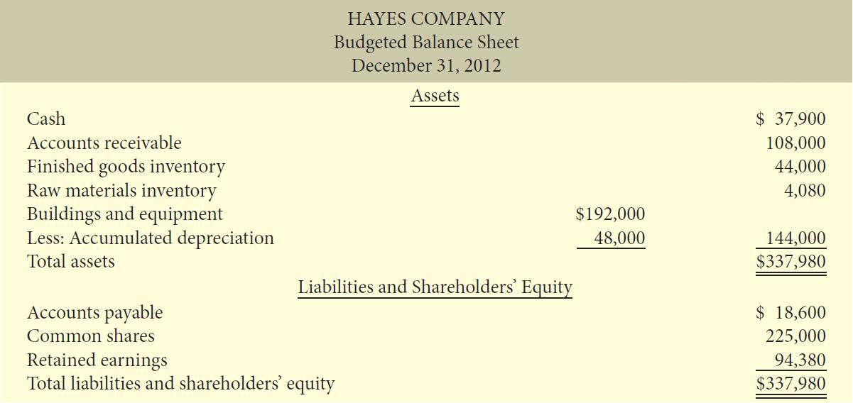
Financial Budgets
Budgeted Balance Sheet
Hayes Company – Example: Continued
Additional data:
Buildings and equipment $182,000 Common shares $225,000
Accumulated amortization 28,800 Retained earnings 46,480

Slide 51
Financial Budgets
Budgeted Balance Sheet
Hayes Company – Example: Continued
The calculations and sources of the amounts are as follows:
Cash: Ending cash balance of $37,900, shown in the cash budget
Accounts receivable: 40% of fourth-quarter sales of $270,000, shown in the schedule of expected collections from customers
Finished goods inventory: Desired ending inventory of 1,000 units, shown in the production budget times the total cost per unit of $44
Raw materials inventory: Desired ending inventory of 1,020 kg, times the cost per kilogram of $4, shown in the direct materials budget
Buildings and equipment: December 31, 2011, balance of $182,000, plus the purchase of a truck for $10,000.

Slide 52
Financial Budgets
Budgeted Balance Sheet
Hayes Company – Example: Continued
Accumulated depreciation: December 31, 2011, balance of $28,800, plus $15,200 of depreciation shown in the manufacturing overhead budget and $4,000 of depreciation shown in the selling and administrative expenses budget
Accounts payable: 50% of fourth-quarter purchases of $37,200, shown in the schedule of expected payments for direct materials
Common shares: Unchanged from the beginning of the year.
Retained earnings: December 31, 2011, balance of $46,480, plus net income of $47,900, shown in the budgeted income statement

Slide 53
Let’s Review
Which one of the following items would NEVER appear on a cash budget?
  Delivery expense
  Depreciation expense
  Cost of material purchases
  Cash received from customers

Slide 54
Let’s Review: Solution
Which one of the following items would NEVER appear on a cash budget?
  Delivery expense
  Depreciation expense
  Cost of material purchases
  Cash received from customers

Slide 55
Budgeting
Merchandisers
Sales Budget: starting point and key factor in developing master budget
Use a purchases budget instead of a production budget
Does not use the manufacturing budgets (direct materials, direct labour, and manufacturing overhead)
To determine budgeted merchandise purchases:
Budgeted Cost of Goods Sold | + | Desired Ending Merchandise Inventory | ― | Beginning Merchandise Inventory | = | Required Merchandise Purchases

Slide 56
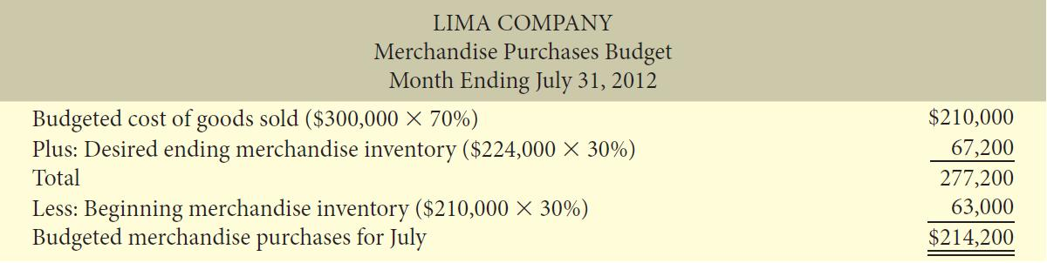
Budgeting
Merchandisers
Lima Company – Example
Budgeted sales for July $300,000 and August $320,000
Cost of goods sold: 70% of sales
Desired ending inventory: 30% of next month’s cost of goods sold

Slide 57
Budgeting
Service Companies
Critical factor in budgeting is coordinating professional staff needs with anticipated services
Problems if overstaffed:
    Disproportionately high labour costs
    Lower profits due to additional salaries
    Increased staff turnover due to no challenging work
Problems if understaffed:
    Lost revenue because existing and prospective client needs for service cannot be met
    Loss of professional staff due to excessive work loads

Slide 58
Budgeting
Not-for-Profit Companies
Important process that differs significantly from that of a profit-oriented company
Budget on the basis of cash flows (expenditures and receipts), rather than on a revenue and expense basis
The starting point is expenditures, not receipts
Significantly different activity index

Slide 59
Let’s Review
The budget for a merchandiser differs from a budget for a manufacturer because:
  A merchandise purchases budget replaces the production budget.
  The manufacturing budgets are not applicable.
  None of the above.
  Both a. and b. above.

Slide 60
Let’s Review: Solution
The budget for a merchandiser differs from a budget for a manufacturer because:
  A merchandise purchases budget replaces the production budget.
  The manufacturing budgets are not applicable.
  None of the above
  Both a. and b. above

Slide 61

Copyright
Copyright © 2012 John Wiley & Sons Canada, Ltd. All rights reserved. Reproduction or translation of this work beyond that permitted by Access Copyright (The Canadian Copyright Licensing Agency) is unlawful. Requests for further information should be addressed to the Permissions Department, John Wiley & Sons Canada, Ltd. The purchaser may make back-up copies for his or her own use only and not for distribution or resale. The author and the publisher assume no responsibility for errors, omissions, or damages caused by the use of these programs or from the use of the information contained herein.
10

