Slide 1
Weygandt-Kimmel-Kieso-Aly
9

Slide 2
9
Pricing
Study Objectives
Calculate a target cost when the market determines a product’s price.
Calculate a target selling price using full cost-plus pricing.
Calculate a target selling price using absorption cost-plus pricing.
Calculate a target selling price using variable cost-plus pricing.
Use time-and-material pricing to determine the cost of services provided.
Define transfer price and its role in an organization.
Determine a transfer price using the negotiated, cost-based, and market-based approaches.
Explain issues involved in transferring goods between divisions in different countries with different tax rates.
9

Slide 3
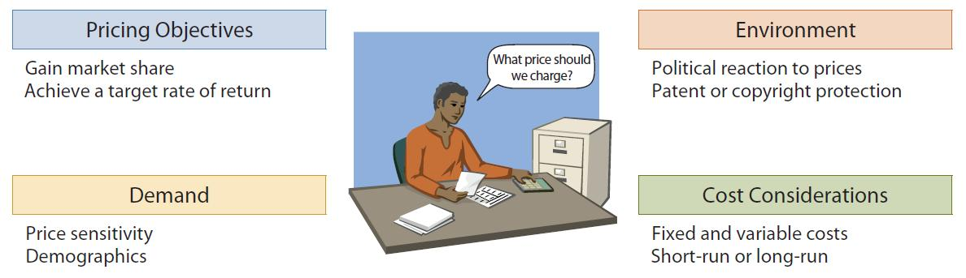
External Sales
Many factors affect price
Product price should cover costs and earn a
reasonable profit
Must have a good understanding of market forces for appropriate price

Slide 4
External Sales: Continued
A company (price taker) can accept the price as set by the competitive market (supply and demand)
Market sets price when product cannot be easily differentiated from competing products
  Examples: farm products and minerals
A company can set the price when
  Product is specially made
  One of a kind
    No one else produces the product
    Company can differentiate its product from others
  Examples: Designer dress and patent or copyright on a unique process

Slide 5
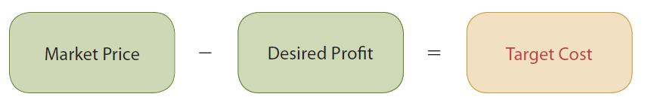
Target Costing
In a highly competitive market, price is largely determined by supply and demand
Must control costs to earn a profit
Target cost – cost that provides the desired profit on a product when the seller does not have control over the product’s price

Slide 6
Target Costing Steps
Find market niche
  Select segment to compete in, for example, luxury goods or economy goods
Determine target price: Price that company believes would place it in the optimal position for its target audience
  Use market research
Determine target cost: Difference between target price and desired profit
  Includes all product and period costs necessary to make and market the product
Assemble expert team:
  Includes production, operations, marketing, finance
  Design and develop a product that meets quality specifications while not exceeding target cost

Slide 7
Let’s Review
Return on Investment (ROI):
  is an effective summary of business profitability.
  can foster overinvestment.
  is easy to compare the performance of investment centres of different size.
  both a. and c.

Slide 8
Let’s Review: Solution
Return on Investment (ROI):
  is an effective summary of business profitability.
  can foster overinvestment.
  is easy to compare the performance of investment centres of different size.
  both a. and c.

Slide 9
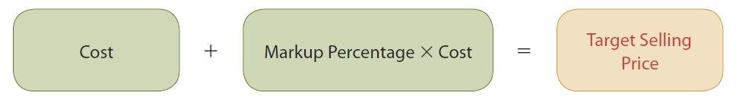
Full Cost-Plus Pricing
May have to set own price where there is little or no competition
Price typically a function of product cost
Steps:
  Establish a cost base
  Add a markup based on desired operating income or return on investment (ROI)

Slide 10
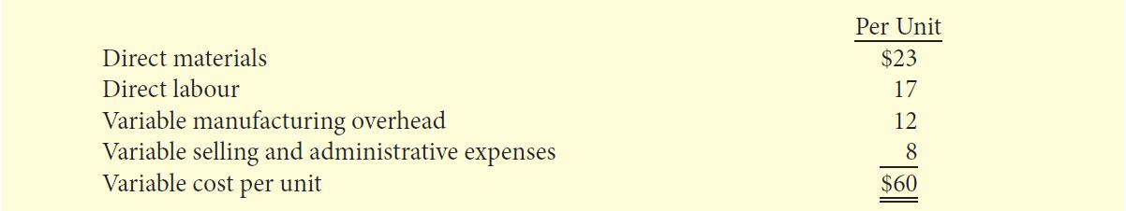
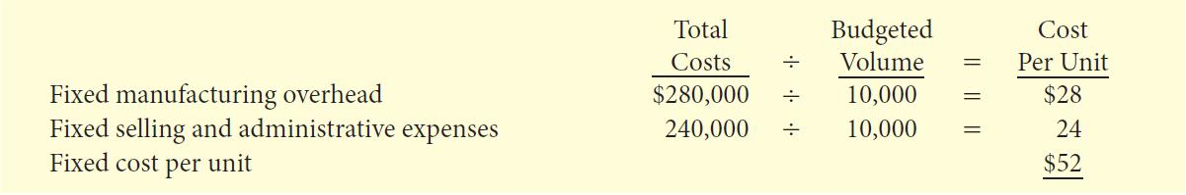
Cost-Plus Pricing
Cleanmore Products – Example
Cleanmore Products, manufactures of wet/dry shop vacuums has following Cost data at budgeted sales volume of 10,000 Units.
Cleanmore has decided to price its new shop vacuum to earn a 20-percent return on its investment (ROI) of $1 million.

Slide 11
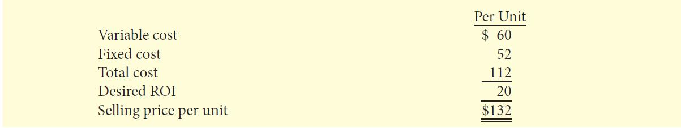
Cost-Plus Pricing
Cleanmore Products –
Example: Continued
Total fixed cost per unit: (280,000+240,000) ÷ 10,000 = 52
Expected ROI: 20% ROI of $1,000,000 = $200,000
Expected ROI per unit: $200,000 ÷ 10,000 units = 20
Expected Selling Price: 60+ 52 + 20 = $132 per unit

Slide 12
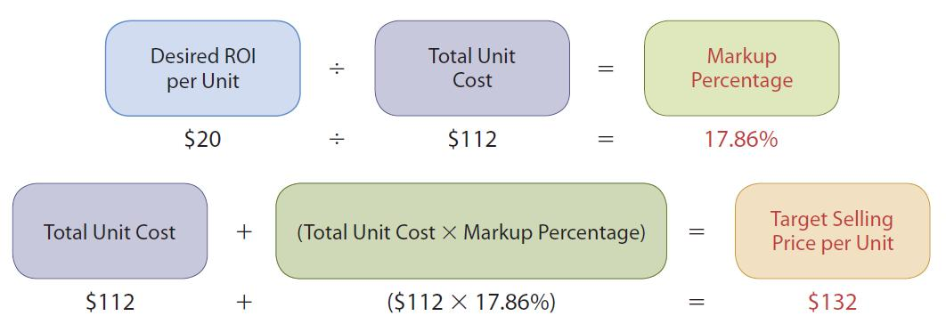
Cost-Plus Pricing
Cleanmore Products –
Example: Continued
Cleanmore can also use a percentage markup on the product’s cost to determine the selling price.

Slide 13
Cost-Plus Pricing
Advantages and Disadvantages
Advantage
Easy to calculate
Disadvantages:
  Does not consider demand side
  Will the customer pay the price?
  Fixed cost per unit changes with change in volume
  At lower sales volume, company must charge higher price to meet desired ROI

Slide 14
Let’s Review
When a company is attempting to increase return on investment (ROI) it should work to:
  decrease sales.
  decrease profits.
  increase costs.
  decrease operating assets.

Slide 15
Let’s Review: Solution
When a company is attempting to increase return on investment (ROI) it should work to:
  decrease sales.
  decrease profits.
  increase costs.
  decrease operating assets.

Slide 16
Absorption
Cost-Plus Pricing
Absorption cost-plus pricing approach is consistent with generally accepted accounting principles (GAAP) because it defines the cost base as the manufacturing cost.
Both the variable and fixed selling and administrative costs are excluded from this cost base.
Companies must somehow provide for selling and administrative costs plus the target ROI, which they do through the markup.

Slide 17
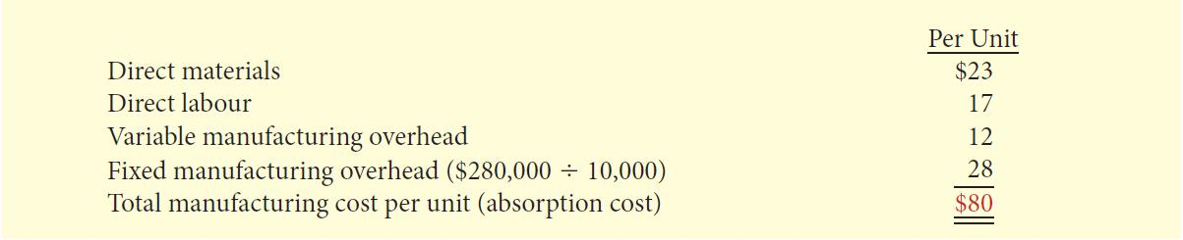
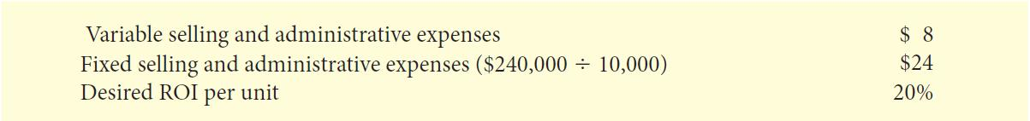
Absorption
Cost-Plus Pricing – Example
The first step in the absorption-cost approach is to calculate the manufacturing cost per unit. For Cleanmore Products, Inc., this amounts to $80 per unit at a volume of 10,000 units.
Selling and administrative expenses per unit and the desired ROI per unit:

Slide 18
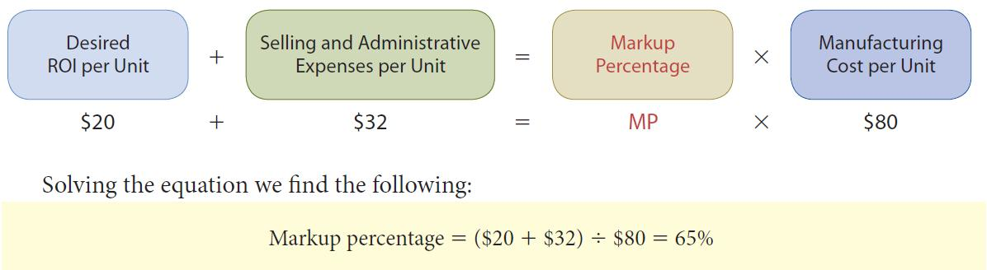
Absorption Cost-Plus Pricing –
Example: Continued
The second step in the absorption-cost approach is to calculate the markup percentage

Slide 19
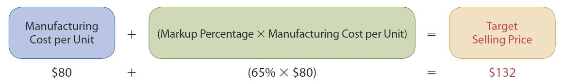
Absorption Cost-Plus Pricing –
Example: Continued
The third and final step is to set the target selling price.
Using a target price of $132 will produce the desired 20% return on investment for Cleanmore Products on its three-horsepower, wet/dry shop vacuum at a sales volume level of 10,000 units

Slide 20
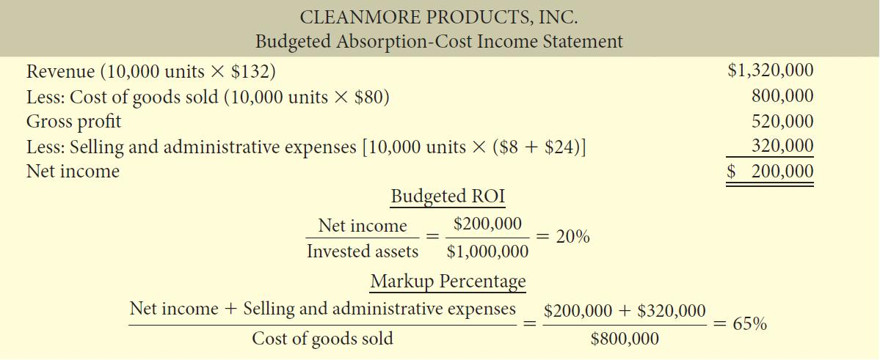
Absorption Cost-Plus Pricing –
Example: Continued

Slide 21
Let’s Review
In the absorption cost approach, the mark-up percentage covers the
  desired ROI only.
  desired ROI and selling and administrative expenses.
  desired ROI and fixed costs.
  selling and administrative expenses only.

Slide 22
Let’s Review: Solution
In the absorption cost approach, the mark-up percentage covers the
  desired ROI only.
  desired ROI and selling and administrative expenses.
  desired ROI and fixed costs.
  selling and administrative expenses only.

Slide 23
Variable Cost-Plus Pricing
Under variable cost-plus pricing, the cost base consists of all of the variable costs associated with a product, including the variable selling and administrative costs.
Because fixed costs are not included in the base, the markup must cover fixed costs (manufacturing, as well as selling and administrative) and the target ROI.
Variable cost-plus pricing is more useful for making short term decisions because it considers variable-cost and fixed-cost behaviour patterns separately.

Slide 24
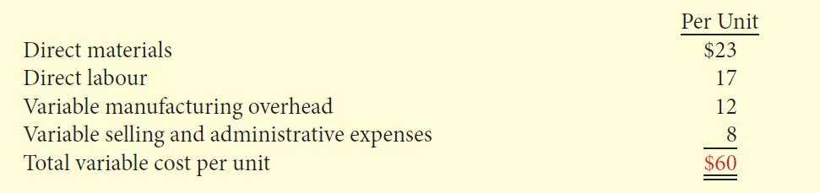
Variable Cost-Plus Pricing – Example
The first step in the variable-cost approach is to calculate the variable cost per unit. For Cleanmore Products, Inc., this amounts to $60 per unit.

Slide 25
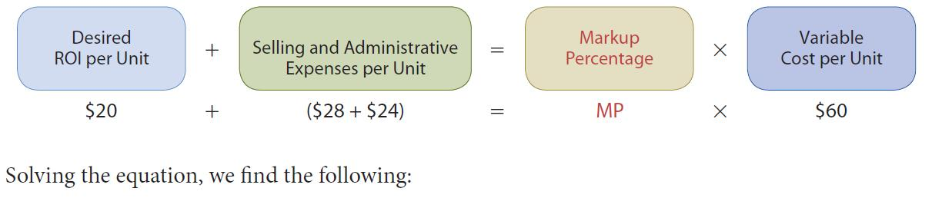
Variable Cost-Plus Pricing –
Example: Continued
The second step in the variable-cost approach is to calculate the markup percentage
Markup Percentage = ^{$20 + ($28 + $24)} = 120%
^{$60}
Fixed

Slide 26
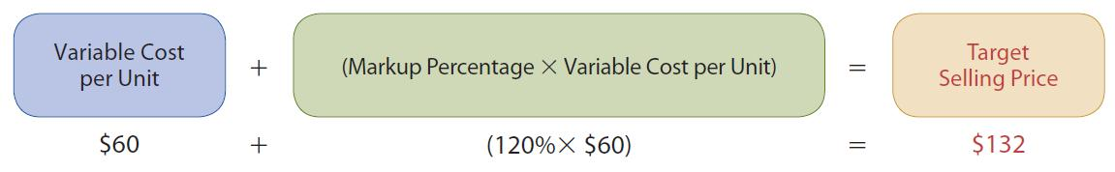
Variable Cost-Plus Pricing –
Example: Continued
The third and final step is to set the target selling price.
Using a target price of $132 will produce the desired 20% return on investment for Cleanmore Products on its three-horsepower, wet/dry shop vacuum at a sales volume level of 10,000 units

Slide 27
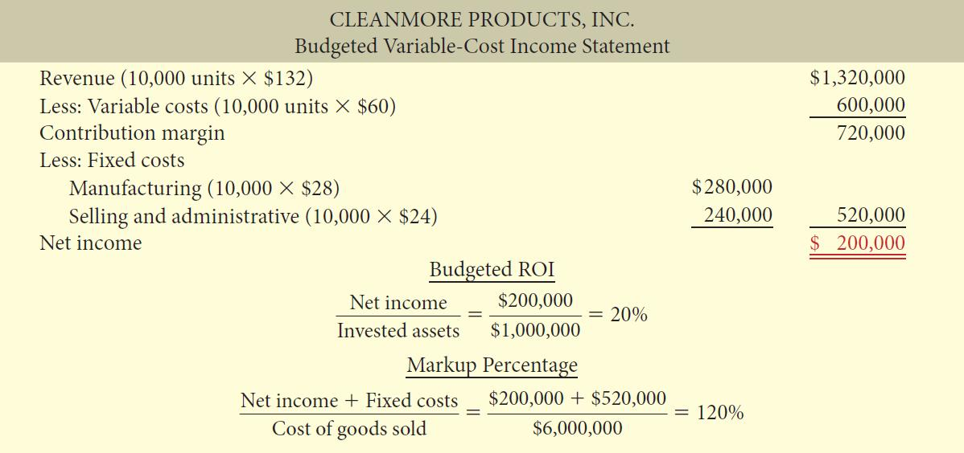
Variable Cost-Plus Pricing –
Example: Continued

Slide 28
Let’s Review
In the contribution approach, the mark-up percentage covers the
  desired ROI only.
  desired ROI and fixed costs.
  desired ROI and selling and administrative expenses.
  fixed costs only.

Slide 29
Let’s Review: Solution
In the contribution approach, the mark-up percentage covers the
  desired ROI only.
  desired ROI and fixed costs.
  desired ROI and selling and administrative expenses.
  fixed costs only.

Slide 30
Time and Material Pricing
An approach to cost-plus pricing in which the company uses two pricing rates:
  One for the labour used on a job
  One for the material
Widely used in service industries, especially professional firms
  Public accounting
  Law
  Engineering

Slide 31
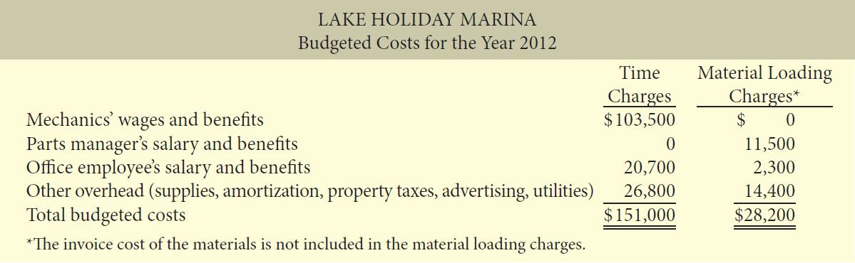
Time and Material Pricing
Lake Holiday Marina – Example

Slide 32
Time and Material Pricing
Lake Holiday Marina –
Example: Continued
Determine a charge for labour time
Express as a rate per hour of labour; Rate includes:
    Direct labour cost of employees (includes fringe benefits)
    Selling, administrative, and similar overhead costs
    Allowance for desired profit (ROI) per hour of employee time
Labour rate for Lake Holiday Marina for 2012 based on:
    5,000 hours of repair time
    Desired profit margin of $8 per hour

Slide 33
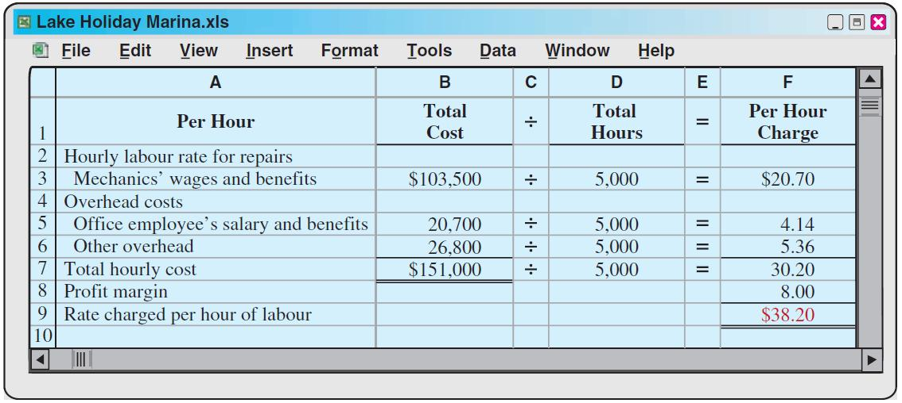
Time and Material Pricing
Lake Holiday Marina –
Example: Continued

Slide 34
Time and Material Pricing
Lake Holiday Marina –
Example: Continued
2. Calculate the Material Loading Charge
  Material loading charge added to invoice price of materials to determine materials price
  Estimated annual costs of purchasing, receiving, handling, storing + desired profit margin on materials
  Expressed as a percentage of estimated annual parts and materials cost:
Estimated purchasing, receiving, handing, storing costs | + | Desired profit margin on materials
Estimated costs of parts/materials

Slide 35
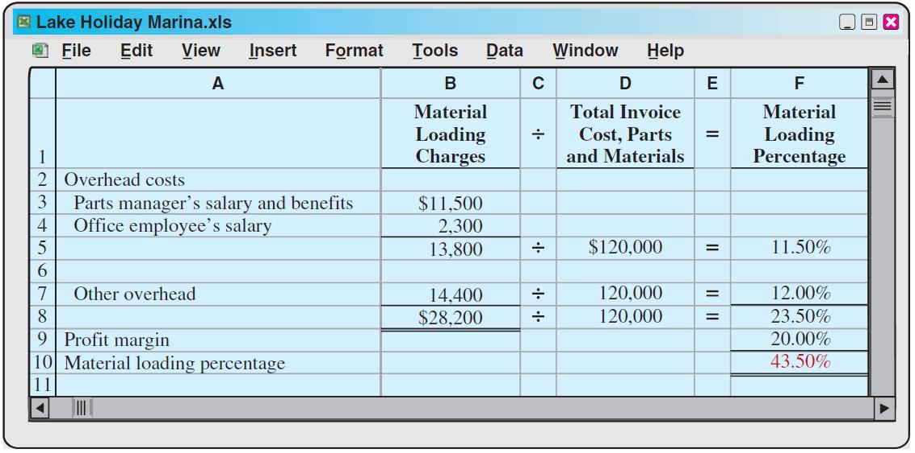
Time and Material Pricing
Lake Holiday Marina –
Example: Continued

Slide 36
Time and Material Pricing
Lake Holiday Marina –
Example: Continued
Calculate Charges for a Particular Job =
  Labour charges
      +
  Material charges
      +
  Material loading charge

Slide 37
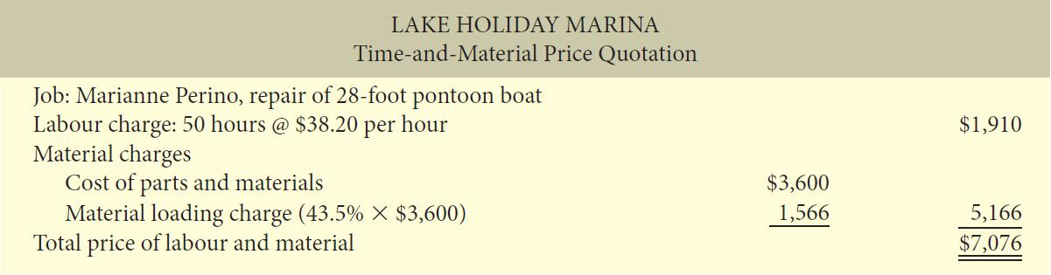
Time and Material Pricing
Lake Holiday Marina –
Example: Continued
  Determine a price quote to refurbish a pontoon boat:
  Estimated 50 hours of labour
  Estimated $3,600 parts and materials

Slide 38
Let’s Review
Time-and-material pricing includes the following items:
  company sets two pricing rates.
  company sets two pricing rates one for labour and another for advertising.
  company sets two pricing rates one for labour and another for materials.
  company sets two pricing rates one for labour and another for overhead.

Slide 39
Let’s Review: Solution
Time-and-material pricing includes the following items:
  company sets two pricing rates.
  company sets two pricing rates one for labour and another for advertising.
  company sets two pricing rates one for labour and another for materials.
  company sets two pricing rates one for labour and another for overhead.

Slide 40
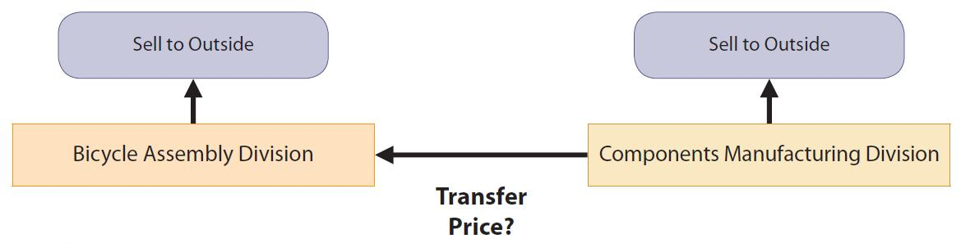
Internal Sales
Vertically integrated companies – grow in direction of customers or supplies
Frequently transfer goods to other divisions as well as outside customers
How do you price goods when they are “sold” within the company?

Slide 41
Internal Sales
Transfer price – price used to record the transfer between two divisions of a company
Ways to determine a transfer price:
  Negotiated transfer prices
  Cost-based transfer prices
  Market-based transfer prices
  Negotiated transfer price is determined by agreement of division managers when no external market price is available
Conceptually - a negotiated transfer price is best
Due to practical considerations, the other two methods are more widely used

Slide 42
Let’s Review
Which transfer pricing approach is used for a short-term problem in which the selling division has excess capacity?
  Market-based transfer pricing
  Full cost-based transfer pricing
  Variable cost-based transfer pricing
  Negotiated transfer pricing

Slide 43
Let’s Review: Solution
Which transfer pricing approach is used for a short-term problem in which the selling division has excess capacity?
  Market-based transfer pricing
  Full cost-based transfer pricing
  Variable cost-based transfer pricing
  Negotiated transfer pricing

Slide 44
Negotiated Transfer Price
Alberta Company – Example
Sells hiking boots as well as soles for work & hiking boots
Structured into two divisions: Boot and Sole
  Sole Division - sells soles externally
  Boot Division - makes leather uppers for hiking boots which are attached to purchased soles
Each Division Manager compensated on division profitability
Management now wants Sole Division to provide at least some soles to the Boot Division

Slide 45
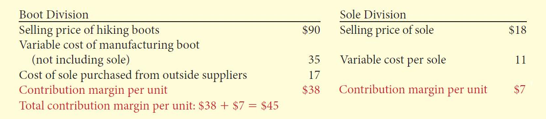
Negotiated Transfer Price
Alberta Company –
Example: Continued
Divisional Contribution Margin Per Unit
(Boot Division purchases soles from outsiders)
What would be a fair transfer price if the Sole Division sold 10,000 soles to the Boot Division?

Slide 46
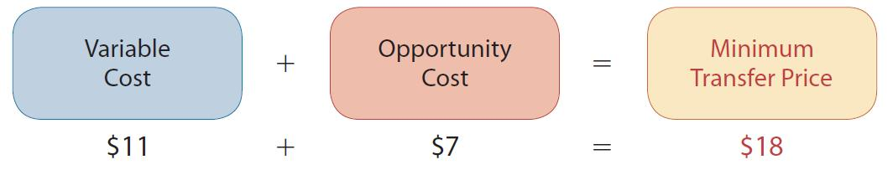
Negotiated Transfer Price
Alberta Company –
Example: Continued
Sole Division has no excess capacity
  If Sole sells to Boot, payment must at least cover variable cost per unit plus its lost contribution margin per sole (opportunity cost)
  The minimum transfer price acceptable to Sole:
Maximum Boot Division will pay is what the sole would cost from an outside buyer ($17)

Slide 47
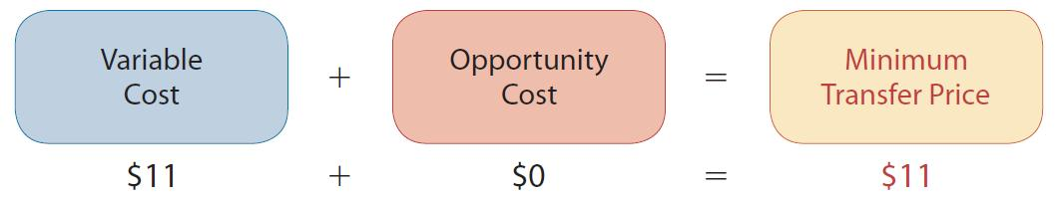
Negotiated Transfer Price
Alberta Company –
Example: Continued
Sole Division has excess capacity
Can produce 80,000 soles, but can sell only 70,000
Available capacity of 10,000 soles
Contribution margin is not lost
The minimum transfer price acceptable to Sole:
Negotiate a transfer price between $11 (minimum acceptable to Sole) and $17 (maximum acceptable to Boot)

Slide 48
Negotiated Transfer Price
Variable Costs
In the minimum transfer price formula, variable cost is the variable cost of units sold internally
May differ – higher or lower – for units sold internally versus those sold externally
The minimum transfer pricing formula can still be used – just use the internal variable costs

Slide 49
Negotiated Transfer Price
Summary
Transfer prices established:
  Minimum by selling division
  Maximum by the buying division
Often not used because:
  Market price information sometimes not available
  Lack of trust between the two divisions
  Different pricing strategies between divisions
Therefore, companies often use cost or market based information to develop transfer prices

Slide 50
Cost-Based Transfer Prices
Uses costs incurred by the division producing the goods as its foundation
May be based on variable costs or variable costs plus fixed costs
Markup may also be added
Can result in improper transfer prices causing:
  Loss of profitability for company
  Unfair evaluation of division performance

Slide 51
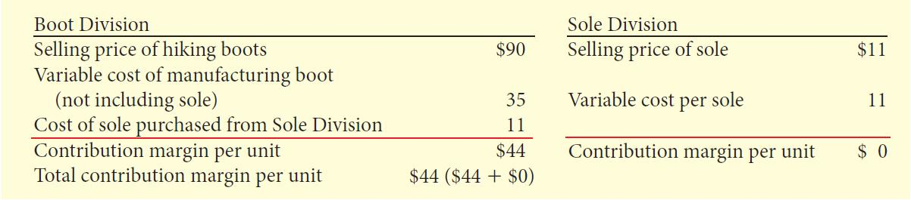
Cost-Based Transfer Prices
Alberta Company – Example
Base transfer price on variable cost of sole and no excess capacity
Bad deal for Sole Division – no profit on transfer of 10,000 soles and loses profit of $70,000 on external sales.
Boot Division increases contribution margin
by $6 per sole

Slide 52
Cost-Based Transfer Prices
Alberta Company –
Example: Continued
Sole Division has excess capacity:
Continues to report zero profit but does not lose the $7 per unit due to excess capacity
Boot Division gains $6
Overall, company is better off by
$60,000 (10,000 X 6)
Does not reflect Sole Division’s true profitability

Slide 53
Cost-Based Transfer Prices
Summary
Disadvantages
  Does not reflect a division’s true profitability
  Does not provide an incentive to control costs which are passed on to the next division
Advantages
  Simple to understand
  Easy to use due to availability of information
  Market information often not available
Most common method

Slide 54
Market-Based Transfer Prices
Based on actual market prices of competing products
Often considered best approach because:
  Objective
  Economic incentives
Indifferent between selling internally and externally if can charge/pay market price
Can lead to bad decisions if have excess capacity
Why? No opportunity cost.
Where there is not a well-defined market price, companies use cost-based systems

Slide 55
Effect of Outsourcing on
Transfer Prices
Contracting with an external party to provide a good or service, rather than doing the work internally
Virtual Companies outsource all of their production
As outsourcing increases, fewer components are transferred internally between divisions
Use incremental analysis to determine if outsourcing is profitable

Slide 56
Let’s Review
The negotiated transfer price is determined as follows:
  decision taken by the Board of Directors.
  negotiated by division managers.
  based on market conditions.
  none of the above.

Slide 57
Let’s Review: Solution
The negotiated transfer price is determined as follows:
  decision taken by the Board of Directors.
  negotiated by division managers.
  based on market conditions.
  none of the above.

Slide 58
Transfers between Divisions in
Different Countries
Going global increases transfers between divisions located in different countries
60% of trade between countries estimated to be transfers between divisions
Different tax rates make determining appropriate transfer price more difficult

Slide 59
Transfers between Divisions in
Different Countries
Alberta Company – Example
Boot Division is in a country with 10% tax rate
Sole Division is located in a country with a 30% rate
The before-tax total contribution margin is $44 regardless of whether the transfer price is $18 or $11
The after-tax total is
  $38.20 using the $18 transfer price, and
  $39.60 using the $11 transfer price
  Why? More of the contribution margin is attributed to the division in the country with the lower tax rate.

Slide 60
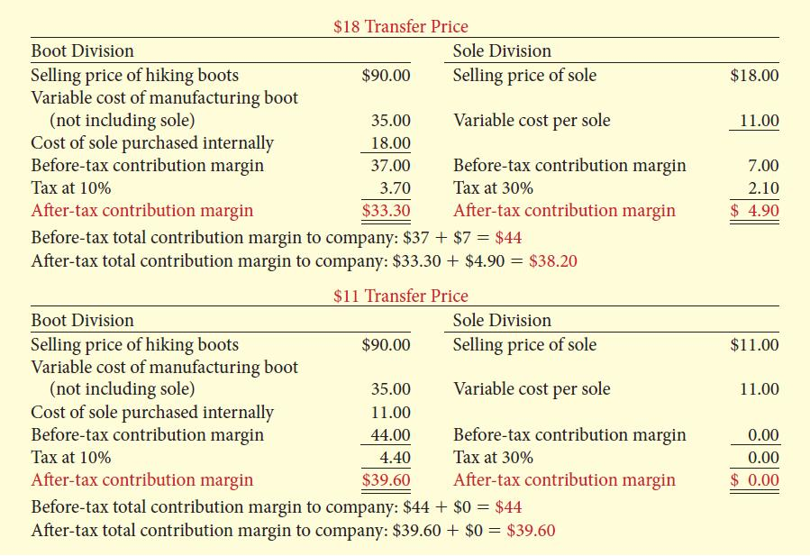
Transfers between Divisions in
Different Countries
Alberta Company – Example: Continued

Slide 61
Let’s Review
Transfers between divisions located in countries with different tax rates
  simplify the determination of the appropriate transfer price.
  are decreasing in number as more companies "localize" operations.
  encourage companies to report more income in countries with low tax rates.
  all of these are correct.

Slide 62
Let’s Review: Solution
Transfers between divisions located in countries with different tax rates
  simplify the determination of the appropriate transfer price.
  are decreasing in number as more companies "localize" operations.
  encourage companies to report more income in countries with low tax rates.
  all of these are correct.

Slide 63

Copyright
Copyright © 2012 John Wiley & Sons Canada, Ltd. All rights reserved. Reproduction or translation of this work beyond that permitted by Access Copyright (The Canadian Copyright Licensing Agency) is unlawful. Requests for further information should be addressed to the Permissions Department, John Wiley & Sons Canada, Ltd. The purchaser may make back-up copies for his or her own use only and not for distribution or resale. The author and the publisher assume no responsibility for errors, omissions, or damages caused by the use of these programs or from the use of the information contained herein.
9

