Slide 1
Weygandt-Kimmel-Kieso-Aly
8

Slide 2
8
Alternative Inventory Costing Methods:
A Decision-Making Perspective
Study Objectives
Explain the difference between absorption costing and variable costing.
Discuss the effect that changes in the production level and sales level have on net income measured under absorption costing versus under variable costing.
Discuss the advantages of variable costing versus absorption costing for management decision-making.
Discuss the effect of a normal costing method on income reported under absorption costing and variable costing.
Discuss the effect of the throughput costing method on income reported under variable costing.
8

Slide 3
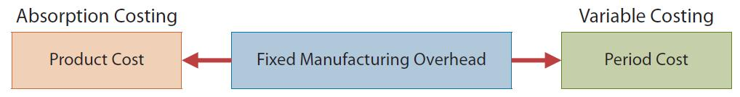
Absorption Costing versus
Variable Costing
Full or Absorption Costing
  Assigns all variable and fixed manufacturing costs to the product
  Required for external reporting
Variable Costing
  Assigns only variable manufacturing costs to the product
  Direct material, direct labour, variable Manufacturing overhead

Slide 4
Absorption Costing versus
Variable Costing: Comparison
Primary Difference
  Under variable costing, fixed manufacturing overhead is an expense in the current period

Slide 5
Absorption Costing versus
Variable Costing:
Comparison: Continued
Variable costing does not defer fixed manufacturing overhead to the future - i.e., they are not inventoried
Net income under absorption costing compared to net income under variable costing:
  Higher when units produced exceed units sold
  Lower when units produced are less than units sold
  Equal when units produced and sold are the same:
    There is no ending inventory so fixed costs are not deferred into the future

Slide 6
Absorption Costing versus
Variable Costing – Example
Premium Products
  Manufactures Fix-it, a sealant for car windows
  Relevant data for the first month of production:
Selling price: $20 per unit
Units: produced, 30,000; sold 20,000; beginning inventory zero.
Variable unit costs: manufacturing $9 (direct materials $5, direct labour $3, and variable overhead $1); selling and administrative expenses $2
Fixed costs: manufacturing overhead, $120,000; selling and administrative expenses, $15,000

Slide 7
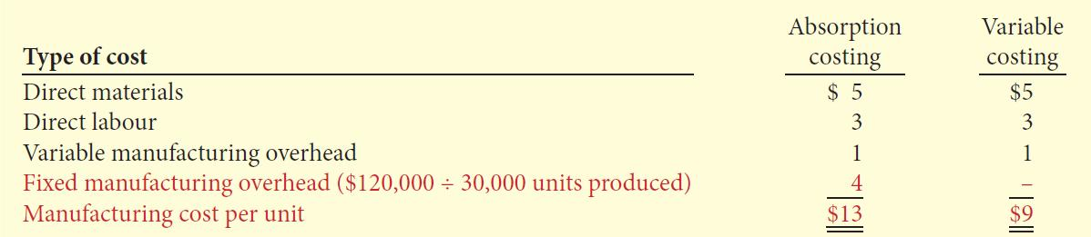
Absorption Costing versus
Variable Costing –
Example: Continued
Per unit manufacturing cost under each approach:
Manufacturing costs are $4 ($13 - $9) higher for absorption costing because fixed manufacturing costs are product costs.

Slide 8
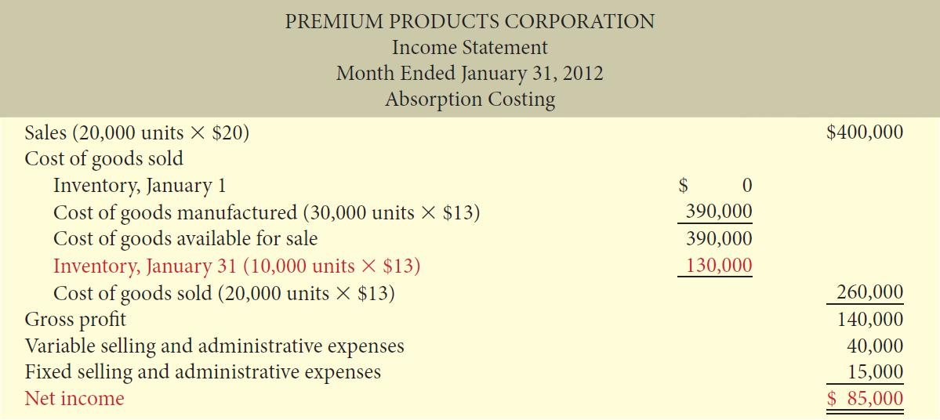
Absorption Costing versus
Variable Costing:
Absorption Costing Income Statement

Slide 9
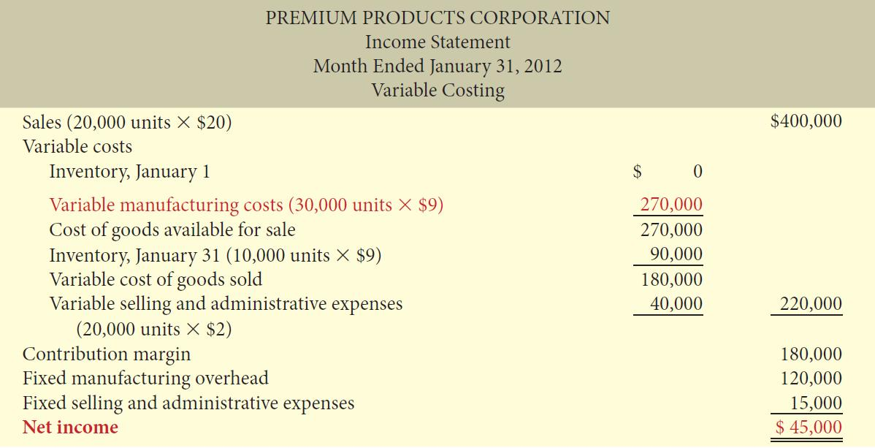
Absorption Costing versus
Variable Costing
Variable Costing Income Statement

Slide 10
Let’s Review
Which of the following would NOT be considered to be a period cost on an absorption costing income statement?
  Both variable and fixed manufacturing overhead costs
  Fixed marketing and sales costs
  Administration costs
  Variable marketing and sales costs

Slide 11
Let’s Review: Solution
Which of the following would NOT be considered to be a period cost on an absorption costing income statement?
  Both variable and fixed manufacturing overhead costs
  Fixed marketing and sales costs
  Administration costs
  Variable marketing and sales costs

Slide 12
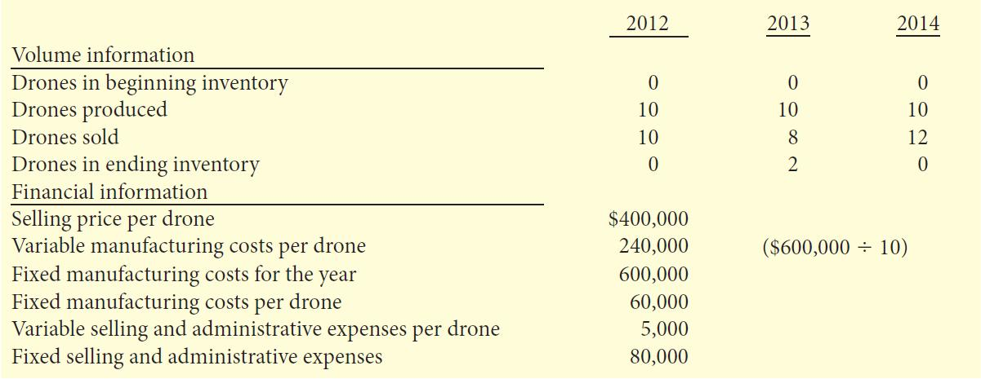
Absorption versus Variable Costing
Overbay Inc.– Example
Manufacturing cost per airplane drone $300,000:
$240,000 variable and $60,000 fixed
Selling and administrative costs $130,000:
$5,000 variable and $80,000 fixed

Slide 13
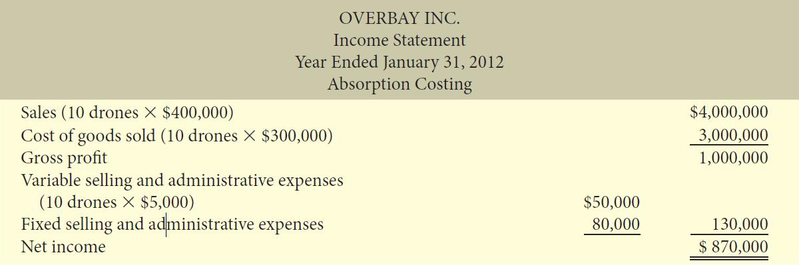
Absorption versus Variable Costing
Overbay Inc. – Example: Continued
Absorption Costing Income Statement – 2012

Slide 14
Absorption versus Variable Costing
Overbay Inc. – Example: Continued
Variable Costing Income Statement
Follows CVP format
Manufacturing costs include only the variable manufacturing costs - $240,000 in 2012
Expense all fixed manufacturing cost – $600,000 in 2012
Reports same net income in 2012 as the Absorption Costing Income Statement

Slide 15
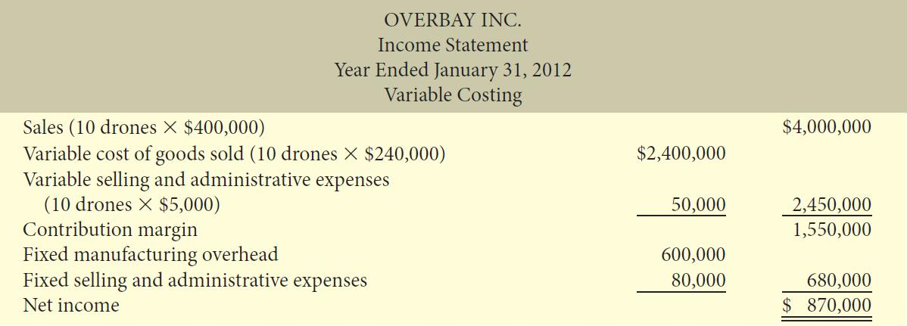
Absorption versus Variable Costing
Overbay Inc. – Example: Continued
Variable Costing Income Statement – 2012

Slide 16
Absorption versus Variable Costing
Overbay Inc. – Example: Continued
Absorption Costing – 2013
10 drones produced; 8 drones sold; 2 drones in ending inventory
Each unit in ending inventory includes $60,000 of fixed manufacturing overhead
$120,000 ($60,000 X 2) of fixed manufacturing costs are deferred until a future period

Slide 17
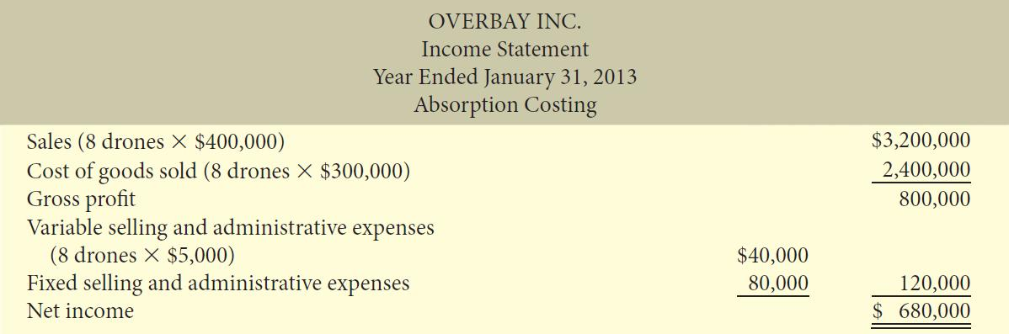
Absorption versus Variable Costing
Overbay Inc. – Example: Continued
Absorption Costing Income Statement – 2013

Slide 18
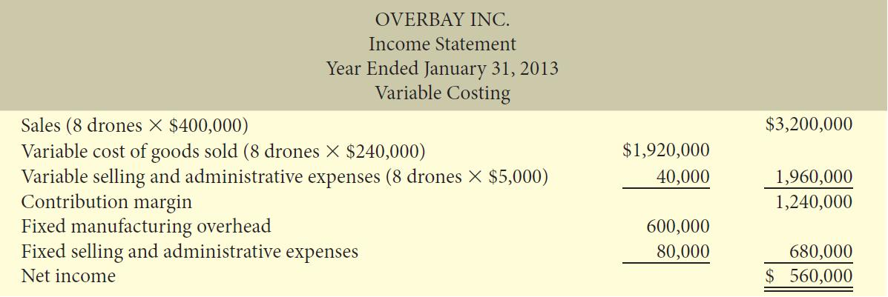
Absorption versus Variable Costing
Overbay Inc. – Example: Continued
Variable Costing Income Statement – 2013

Slide 19
Absorption versus Variable Costing
Overbay Inc. – Example: Continued
  2013 Conclusions
When units produced (10) exceeds units sold (8), net income under absorption costing ($680,000) is higher than net income under variable costing ($560,000)
Why?
Cost of ending inventory is higher under absorption costing than under variable costing

Slide 20
Absorption versus Variable Costing
Overbay Inc. – Example: Continued
Absorption Costing - 2014
10 drones produced; 12 drones sold - 10 from current year production and 2 from inventory
Fixed manufacturing overhead of $ 720,000 expensed
  $120,000 from 2013 and included in beginning inventory
  $600,000 incurred in 2014
When units produced (10) are less than units sold (12), net income under absorption costing is less than net income under variable costing by the amount of fixed manufacturing costs included in beginning inventory.

Slide 21
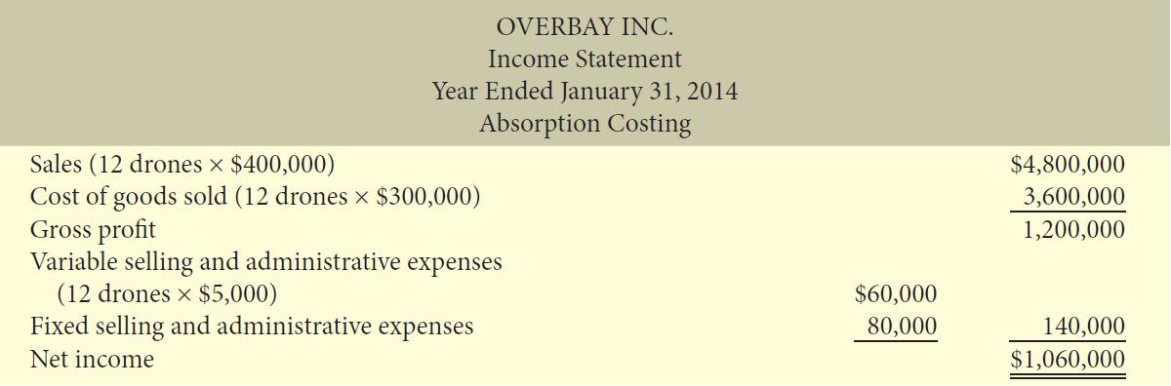
Absorption versus Variable Costing
Overbay Inc. – Example: Continued
Absorption Costing Income Statement – 2014

Slide 22
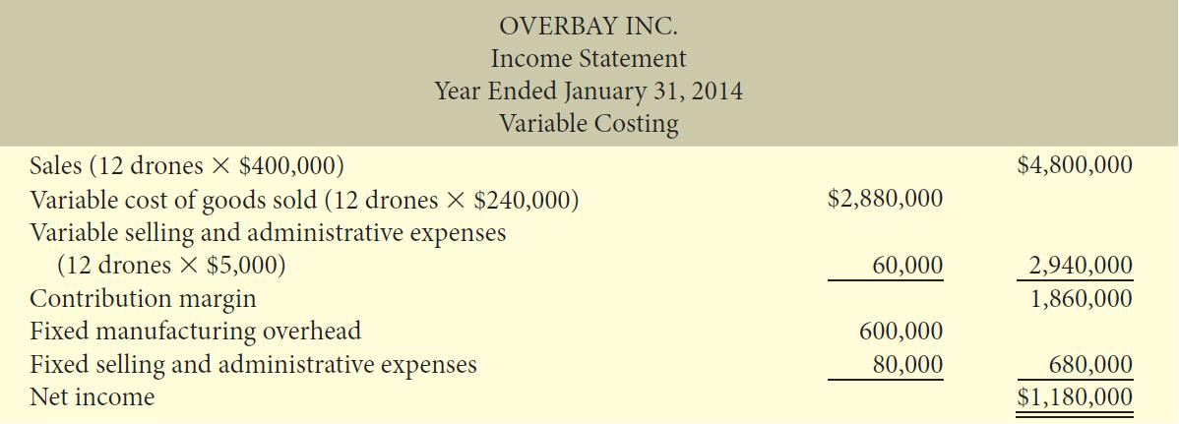
Absorption versus Variable Costing
Overbay Inc. – Example: Continued
Variable Costing Income Statement – 2014

Slide 23
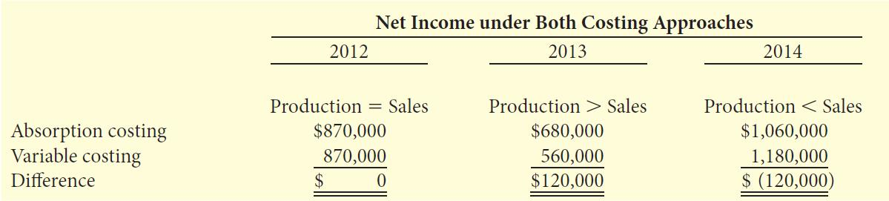
Absorption versus Variable Costing
Overbay Inc. – Example: Continued
Comparison of Net Income under the Two Approaches

Slide 24
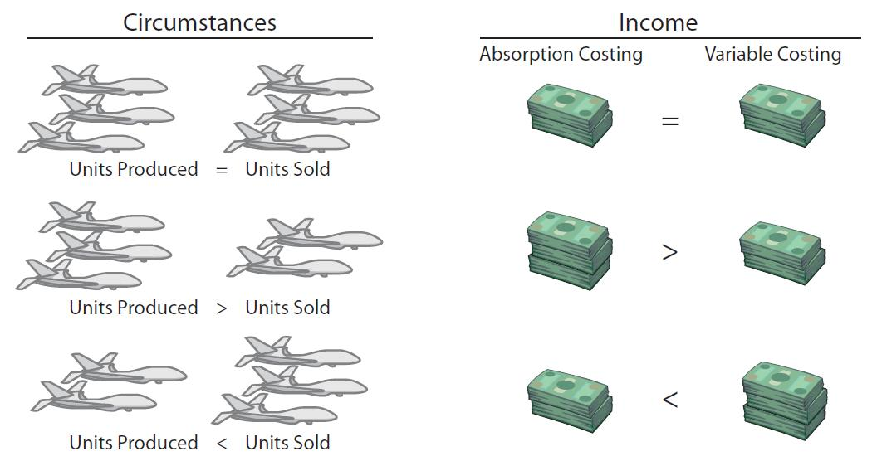
Absorption versus
Variable Costing
Summary of Income Effects

Slide 25
Let’s Review
If a company produces more units than it sells in a period, net operating income under variable costing will:
  be the same as it would be under absorption costing.
  be less than it would be under absorption costing.
  be equal to the net operating income using absorption costing plus selling and administrative costs.
  be equal to the net operating income using absorption costing less fixed manufacturing costs

Slide 26
Let’s Review: Solution
If a company produces more units than it sells in a period, net operating income under variable costing will:
  be the same as it would be under absorption costing.
  be less than it would be under absorption costing.
  be equal to the net operating income using absorption costing plus selling and administrative costs.
  be equal to the net operating income using absorption costing less fixed manufacturing costs

Slide 27
Decision-Making Concerns
Generally Accepted Accounting Principles (GAAP)
  Must be followed for external reporting
  Requires absorption costing for inventory
  Does not differentiate between fixed and variable costs
Poor business decisions may result
Thus, variable costing used for internal decision-making

Slide 28
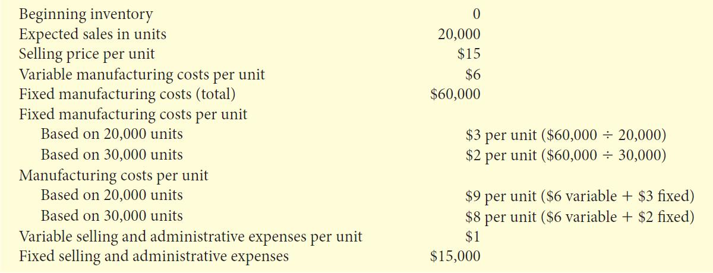
Decision-Making Concerns
Lighting Division Basic Data – Example
Decision: Produce 20,000 or 30,000 units?

Slide 29
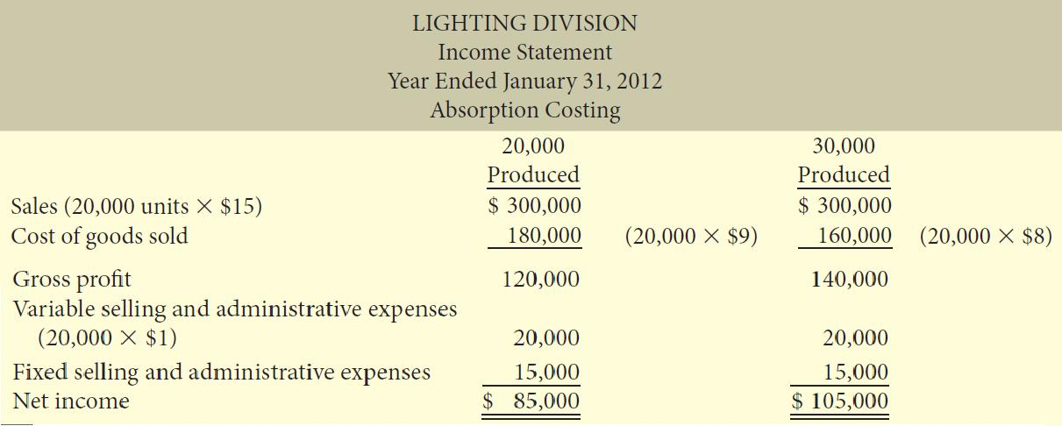
Decision-Making Concerns
Lighting Division – Example: Continued
Comparative Absorption Costing Income Statements
Based on these statements, Should production be increased?
Difference in income due to $20,000 fixed costs assigned to ending inventory.

Slide 30
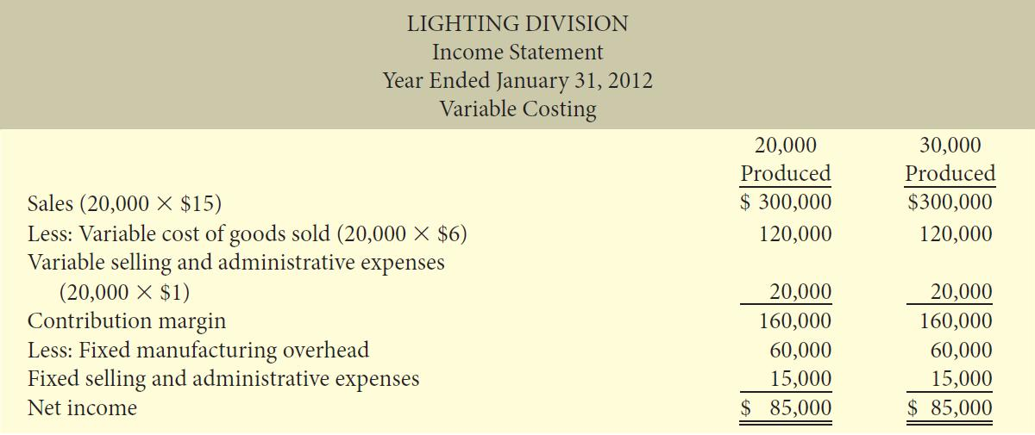
Decision-Making Concerns
Lighting Division – Example: Continued
Comparative Variable Costing Income Statements
Fixed costs treated as a period expense.
10,000 units of ending inventory include only variable costs.
Based on these statements, should production be increased?

Slide 31
Advantages of Variable Costing
Consistent with CVP and incremental analysis
Net income unaffected by changes in production levels
Net income closely tied to changes in sales levels – not production levels
Easier to identify fixed and variable costs and their effect on company

Slide 32
Let’s Review
Firms must prepare income statements and balance sheets in accordance with financial accounting standards which require firms to use:
  variable costing.
  absorption costing.
  cost-based reporting.
  variance analysis.

Slide 33
Let’s Review: Solution
Firms must prepare income statements and balance sheets in accordance with financial accounting standards which require firms to use:
  variable costing.
  absorption costing.
  cost-based reporting.
  variance analysis.

Slide 34
The Normal Costing Method
Normal costing is a method for allocating overhead costs using an estimated allocation rate and actual quantity of the allocation base.
  Normal costing uses an estimated, rather than an actual, denominator level for the overhead cost allocation base.
  If an actual denominator level is used, information is not timely.

Slide 35
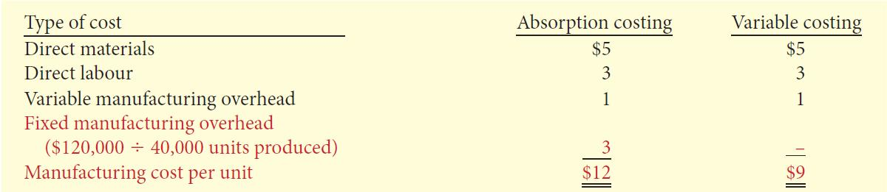
The Effect of Normal Costing Methods on
the per-unit manufacturing cost –
Example
The manufacturing cost per unit is $3 higher under absorption costing because:
  Fixed manufacturing costs are based on a pre-determined overhead rate under absorption costing
  Whereas under variable costing fixed manufacturing costs are treated as a period cost and are therefore expensed

Slide 36
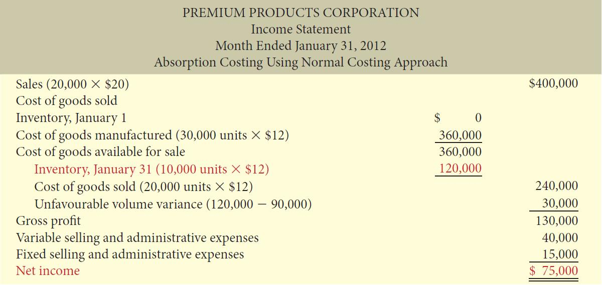
Absorption and Normal Costing Example

Slide 37
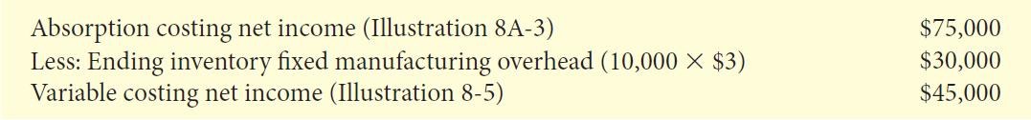
Absorption and Normal Costing Example
We can reconcile the absorption costing net income to the variable costing net income by concentrating on the fixed manufacturing overhead in ending inventory:

Slide 38
Let’s Review
The production volume variance under the normal costing method is calculated as:
  the difference between actual production from budgeted production.
  the sum of budgeted fixed manufacturing overhead costs and allocated fixed manufacturing overhead costs.
  the difference between budgeted fixed manufacturing overhead costs and actual fixed manufacturing overhead costs.
  the difference between actual fixed manufacturing overhead costs and assigned fixed manufacturing overhead costs.

Slide 39
Let’s Review: Solution
The production volume variance under the normal costing method is calculated as:
  the difference between actual production from budgeted production.
  the sum of budgeted fixed manufacturing overhead costs and allocated fixed manufacturing overhead costs.
  the difference between budgeted fixed manufacturing overhead costs and actual fixed manufacturing overhead costs.
  the difference between actual fixed manufacturing overhead costs and assigned fixed manufacturing overhead costs.

Slide 40
Throughput Costing
Under throughput costing, all manufacturing costs except direct materials are period costs.
Throughput costing income statements are used internally only; useful when most manufacturing costs are not variable in the short run.
Throughput costing income statements are prepared using a new format.
  Sales – cost of goods sold (direct materials only) = throughput margin

Slide 41
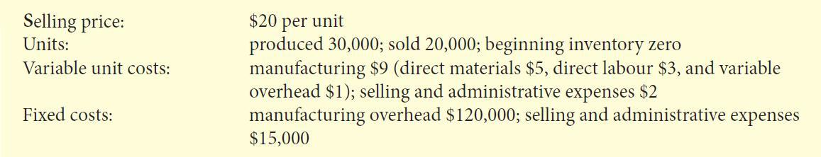
The Effect of Throughput Costing Methods on the per-unit manufacturing cost – Example
Let us use the same data as Premium Product Corporation for Fix-it’s first month of production, January 2012

Slide 42
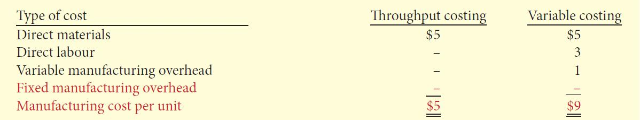
The Effect of Throughput Costing Methods on the per-unit manufacturing cost – Example
The per-unit manufacturing cost under each costing.

Slide 43
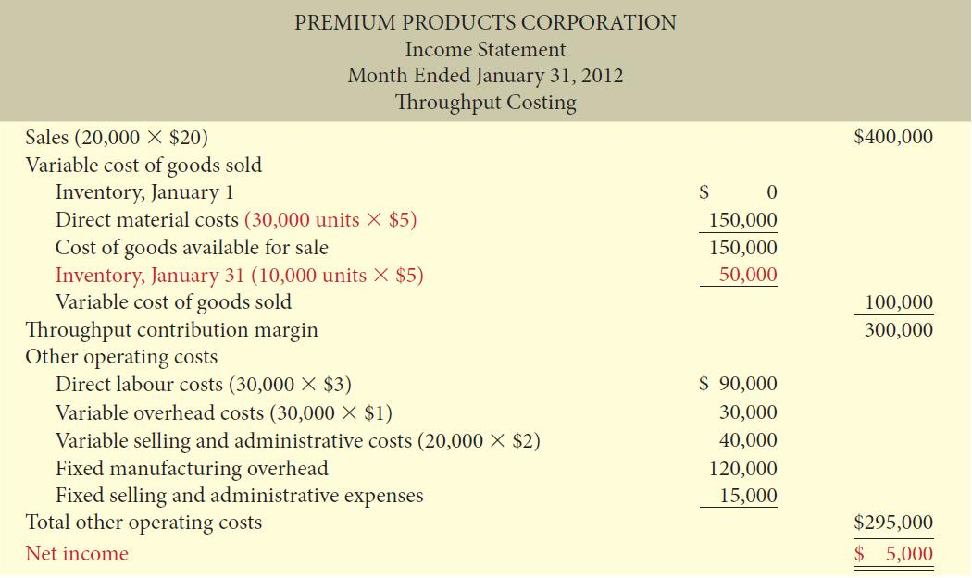
Throughput Costing –
Example

Slide 44
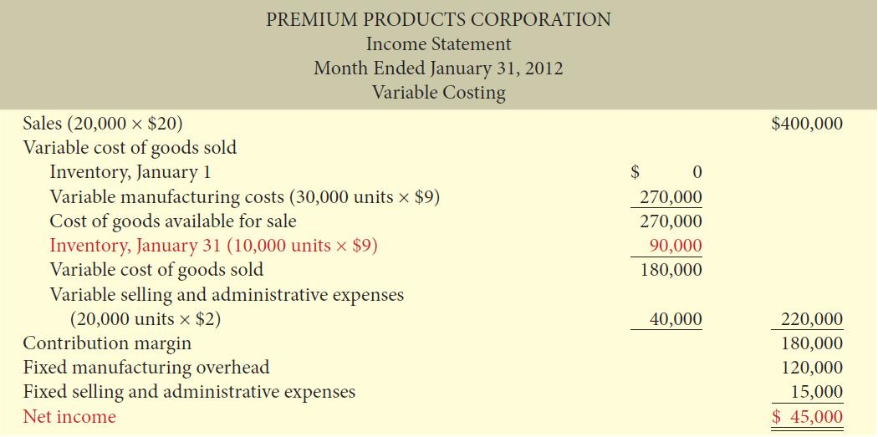
Throughput Costing –
Example

Slide 45
Throughput Costing –
Example
Throughput-costing operating income is $40,000 less than variable-costing operating income.
This difference is the amount of direct labour and variable manufacturing overhead costs (10,000 units $4 per unit).
They are included in the ending inventory under variable costing and expensed as a period cost under throughput costing.

Slide 46
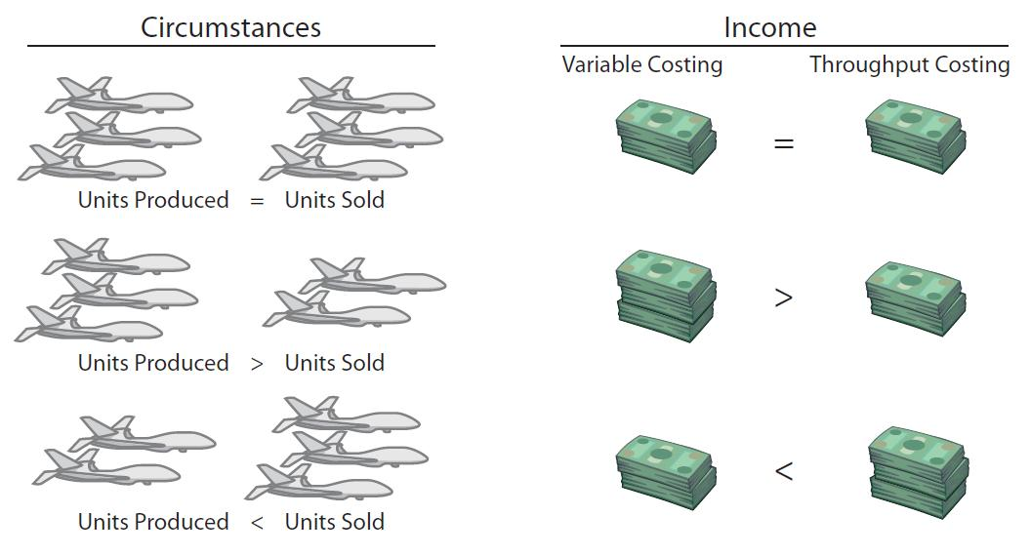
Summary of Income Effects
This illustration shows the relationship between production and sales and its effect on net income under the variable costing and throughput costing approaches.

Slide 47
Advantages of Throughput Costing
Reduces build up of excess inventories in order to spread fixed manufacturing costs over a larger number of units.
Encourages managers to reduce operating costs such as direct labour and variable overhead, which are treated as period and not product costs.

Slide 48
Let’s Review
Throughput costing is also known as:
  super-variable costing.
  direct costing.
  absorption costing.
  variable costing.

Slide 49
Let’s Review: Solution
Throughput costing is also known as:
  super-variable costing.
  direct costing.
  absorption costing.
  variable costing.

Slide 50

Copyright
Copyright © 2012 John Wiley & Sons Canada, Ltd. All rights reserved. Reproduction or translation of this work beyond that permitted by Access Copyright (The Canadian Copyright Licensing Agency) is unlawful. Requests for further information should be addressed to the Permissions Department, John Wiley & Sons Canada, Ltd. The purchaser may make back-up copies for his or her own use only and not for distribution or resale. The author and the publisher assume no responsibility for errors, omissions, or damages caused by the use of these programs or from the use of the information contained herein.
8

