Slide 1
Weygandt-Kimmel-Kieso-Aly
5

Slide 2
5
Activity-Based Costing
Study Objectives
Recognize the difference between traditional costing and activity-based costing (ABC) and understand the nature of ABC.
Identify the steps in the development of an activity-based costing system and compare unit costs.
Understand the benefits and limitations of activity-based costing.
Differentiate between value-added and non–value-added activities.
Understand the value of using activity levels in activity-based costing.
Apply activity-based costing to service industries.
5

Slide 3
Activity-Based Costing Versus
Traditional Costing
Traditional Costing System allocates overhead using a single predetermined rate.
  Job order costing: direct labour cost is assumed to be the relevant activity base.
  Process costing: machine hours is the relevant activity base.
The Traditional Costing System was satisfactory when:
  Direct labour was a major portion of total manufacturing costs.
  There was a wide acceptance of a high correlation between direct labour and overhead costs.
5

Slide 4
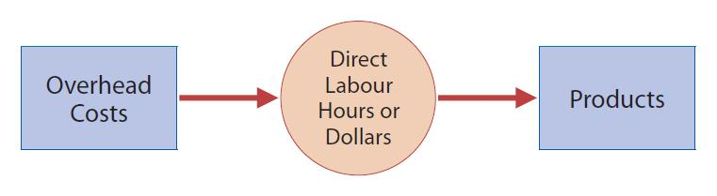
Traditional Costing Systems:
Continued
  Direct labour is still often the appropriate basis for assigning overhead costs when:
    Direct labour constitutes a significant part of total product cost and a high correlation exists between direct labour and changes in overhead costs.
5

Slide 5
Need for a New Approach
Tremendous change in manufacturing and service industries.
Decrease in amount of direct labour usage.
Significant increase in total overhead costs.
Often inappropriate to use plant-wide pre-determined overhead rates based on direct labour or machine hours when a lack of correlation exists.
Complex manufacturing processes may require multiple allocation bases; this approach is called Activity-Based Costing (ABC).
5

Slide 6
The Reasoning Behind ABC
Products consume Activities
and
Activities consume Resources
5

Slide 7
Activity-Based Costing (ABC)
Activity-Based Costing (ABC) is:
  An overhead cost allocation system that allocates overhead to multiple activity cost pools
and
  Assigns the activity cost pools to products or services by means of cost drivers that represent the activities used.
5

Slide 8
Activity-Based Costing (ABC)
Terms
Activity:
  Any event, action, transaction, or work sequence that causes a cost to be incurred in producing a product or providing a service.
Activity Cost Pool:
  A distinct type of activity. For example, ordering materials or setting up machines.
Cost Drivers:
  Any factors or activities that have a direct cause-effect relationship with the resources consumed.
5

Slide 9
Activity-Based Costing (ABC)
Allocation of Overhead Costs
ABC allocates overhead costs in two stages:
  Stage 1: Overhead costs are allocated to activity cost pools.
  Stage 2: The overhead costs allocated to the cost pools is assigned to products using cost drivers.
The more complex a product’s manufacturing operation, the more activities and cost drivers likely to be present.
5

Slide 10
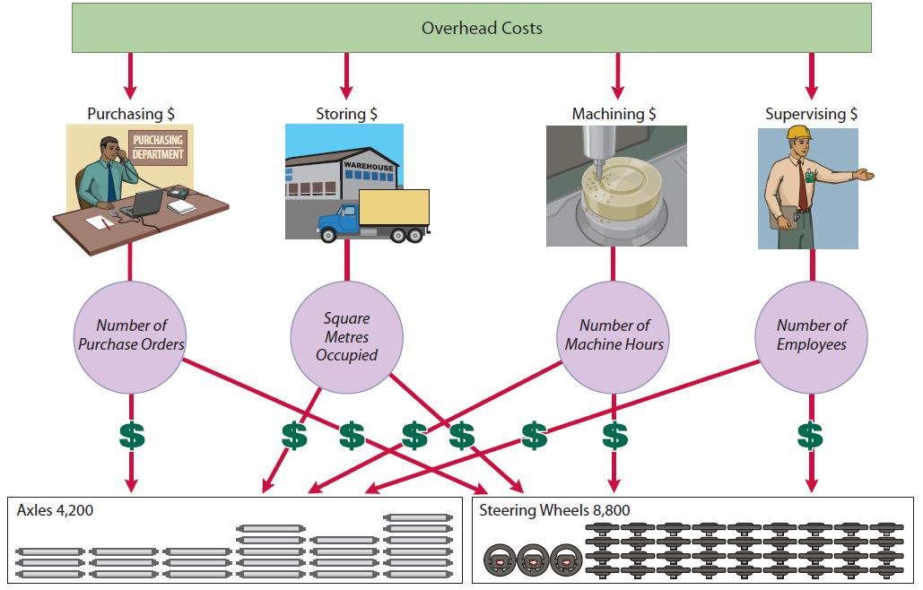
Activities and Related Cost Drivers
Activity Cost Pools
Cost Drivers
Products
5

Slide 11
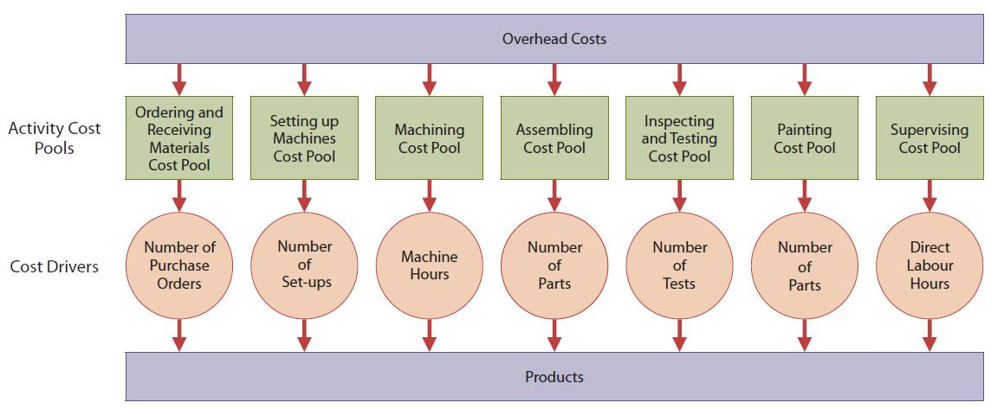
ABC System Design
Example - Lift Jack Company
5

Slide 12
Traditional Costing vs. ABC
ABC does not replace an existing job order/process cost system.
ABC does segregate overhead into various cost pools to provide more accurate cost information.
ABC, thus, supplements – it does not replace – the traditional cost system.
5

Slide 13
Traditional Costing vs. ABC
An Example
Atlas Company produces two automotive anti-theft devices:
  The Boot: a high volume item with sales totaling 25,000 per year
  The Club: a low volume item with sales totaling 5,000 per year
Each product requires 1 hour of direct labour
  Total annual direct labour hours (DLH) 30,000
  The Boot 25,000 — The Club 5,000
  Direct labour cost $12 per unit for each product
Expected annual manufacturing overhead costs $900,000
Direct materials cost:
  The Boot - $40 per unit — The Club - $30 per unit
5

Slide 14
Unit Costs under Traditional Costing
Products
Manufacturing Costs The Boot The Club
Direct Materials $40 $30
Direct Labour 12 12
Overhead 30* 30*
Total unit cost $82 $72
* Predetermined overhead rate: $900,000/30,000 DLH = $30 per DLH
Overhead = predetermined overhead rate times direct labour hours ($30 X 1 hr. = $30)
5

Slide 15
Let’s Review
As the complexity of a product's manufacturing operation increases, the number of activities and cost drivers used in an activity-based cost system will likely:
Increase
Stay about the same
Decrease
Vary randomly
5
15
Copyright John Wiley & Sons Canada, Ltd.

Slide 16
Let’s Review: Solution
16
5
Copyright John Wiley & Sons Canada, Ltd.
As the complexity of a product's manufacturing operation increases, the number of activities and cost drivers used in an activity-based cost system will likely:
Increase
Stay about the same
Decrease
Vary randomly

Slide 17
Unit Costs under ABC
Step 1: Identify and Classify Activities and Allocate Overhead to Cost Pools
Activity Cost Pools
Setting up machines
Machining
Inspecting
Total
Estimated Overhead
$300,000
500,000
100,000
$900,000
5

Slide 18
Unit Costs under ABC
Step 2: Identify Cost Drivers
Expected Use of Cost Drivers
Activity Cost Pools
Setting up machines
Machining
Inspecting
Cost Drivers
Number of setups Number of Inspections
Machine hours
Per Activity
1,500
50,000
2,000
5

Slide 19
Unit Costs under ABC
Step 3: Calculate Overhead Rates
Formula for Calculating Activity-Based Overhead Rate:
Estimated Overhead Per Activity - Based =
Expected Use of Cost Drivers Per Activity Overhead Rate
Activity Cost Pools | Estimated Overhead | Expected Use of Cost Drivers per Activity | Activity-Based Overhead Rates
Setting up machines | $300,000 | 1,500 setups | $200 per setup
Machining | $500,000 | 50,000 machine hrs. | $10 per mach. hour
Inspecting | $100,000 | 2,000 inspections | $50 per inspection
Total | $900,000
5

Slide 20
Unit Costs under ABC
Step 4: Assign Overhead Costs to Products
Part 1: Expected Use of Cost Driver Per Product
Pools | Cost Driver | Expected Use of Cost Drivers Per Activity | Expected Use of Cost Drivers per Product:
 |  |  | The Boot | The Club
Setting up machines | Number of setups | 1,500 setups | 500 | 1,000
Machining | Machine hours | 50,000 Hours | 30,000 | 20,000
Inspecting | Number of inspection | 2,000 Inspections | 500 | 1,500
5

Slide 21
Unit Costs under ABC:
Step 4: Assign Overhead Costs to Products
Part 2: Assign Cost Pools to Products – The Boot
Activity Cost Pools | Expected Use of Cost Drivers per Product | Activity-Based Over-head Rates | Cost Assigned
Setting up machines | 500 | $200 | $100,000
Machining | 30,000 | 10 | 300,000
Inspecting | 500 | 50 | 25,000
Total costs assigned |  |  | $425,000
Units produced: 25,000
Overhead cost per unit : $17
5

Slide 22
Unit Costs under ABC:
Step 4: Assign Overhead Costs to Products
Part 2: Assign Cost Pools to Products – The Club
Activity Cost Pools | Expected Use of Cost Drivers per Product | Activity-Based Over-head Rates | Cost Assigned
Setting up machines | 1,000 | $200 | $200,000
Machining | 20,000 | 10 | 200,000
Inspecting | 1,500 | 50 | 75,000
Total costs assigned |  |  | $475,000
Units produced : 5,000
Overhead cost per unit: $95
5

Slide 23
Comparison Of Unit Costs
Traditional vs. ABC
 | The Boot |  | The Club
Manufacturing Costs | Traditional Costing | ABC Costing | Traditional Costing | ABC Costing
Direct Materials | $40 | $40 | $30 | $30
Direct Labour | 12 | 12 | 12 | 12
Overhead | 30 | 17 | 30 | 95
Total Cost per Unit | $82 | $69 | $72 | $137
 | Overstated $13 |  | Understated $65
5

Slide 24
Let’s Review
Which of the following is NOT one of the four steps involved in calculating unit costs under activity-based costing?
Assign manufacturing overhead costs for each cost pool to products, using the overhead rates
Identify the cost driver that has a minor correlation to the costs accumulated in the activity cost pool
Identify and classify the major activities involved in the manufacture of specific products, and allocate manufacturing overhead costs to the appropriate cost pools
Calculate the overhead rate per cost driver
5
24
Copyright John Wiley & Sons Canada, Ltd.

Slide 25
Let’s Review: Solution
Which of the following is NOT one of the four steps involved in calculating unit costs under activity-based costing?
Assign manufacturing overhead costs for each cost pool to products, using the overhead rates
Identify the cost driver that has a minor correlation to the costs accumulated in the activity cost pool
Identify and classify the major activities involved in the manufacture of specific products, and allocate manufacturing overhead costs to the appropriate cost pools
Calculate the overhead rate per cost driver
5
25
Copyright John Wiley & Sons Canada, Ltd.

Slide 26
Activity-Based Costing:
A Closer Look
More accurate product costing through:
  Use of more cost pools to assign overhead costs
  Better control over overhead costs
  Better management decisions
5

Slide 27
Activity-Based Costing
Limitations of ABC
  Can be expensive to use
  Some arbitrary allocations continue
5

Slide 28
Activity-Based Costing
When to Use
Use ABC When One or More of the Following Exist:
Products differ greatly in volume/manufacturing complexity
Products lines are
    Numerous
    Diverse
    Require different degrees of support services
Overhead costs are a significant portion of total costs
Significant change in manufacturing process or number of products
Managers ignore data from existing system and instead use “bootleg” costing data
The scale of the business is large enough to support the high upfront cost of the system soft ware and ongoing support costs.
5

Slide 29
Let’s Review
The presence of any of the following factors would suggest a switch to ABC except when
product lines differ greatly in volume.
overhead costs constitute a minor portion of total costs.
the manufacturing process has changed significantly.
production managers are ignoring data provided by the existing system.
5

Slide 30
Let’s Review: Solution
The presence of any of the following factors would suggest a switch to ABC except when
product lines differ greatly in volume.
overhead costs constitute a minor portion of total costs.
the manufacturing process has changed significantly.
production managers are ignoring data provided by the existing system.
5

Slide 31
Value-Added vs.
Non-Value-Added Activities
Activity Based Management (ABM):
An extension of ABC from a product costing system to a management function that focuses on reducing costs and improving processes and decision making
A refinement of ABC used in ABM classifies activities as either value-added or non-value-added.
5

Slide 32
Value-Added vs.
Non-Value-Added Activities
Value-Added Activity
An activity that increases the worth
of a product or service such as:
Manufacturing Company Service Company
  Engineering design Performing surgery
  Machining Legal research services
  Assembly Delivering packages
  Painting Packaging
5

Slide 33
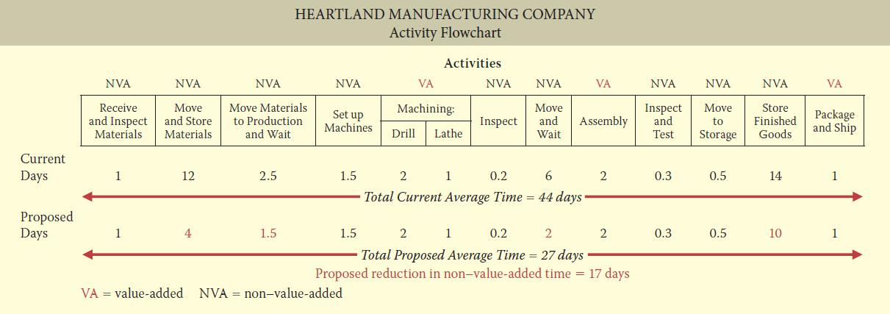
Activity Flowcharts
Activity flowcharts are often used to help identify the activities that will be used in ABC costing.
5

Slide 34
Value-Added vs.
Non-Value-Added Activities
Non-Value-Added Activities
An activity that adds cost to, or increases the time spent on, a product/service without increasing its market value such as:
Manufacturing Company
Repair of machines
Storage of inventory
Moving of raw materials, assemblies, and finished goods
Building maintenance
Inspections
Service Company
Taking appointments
Reception
Bookkeeping/billing
Traveling
Ordering supplies
Inventory Control
5

Slide 35
Let’s Review
The following activity is value added:
Storage of raw materials
Moving parts from machine to machine
Shaping a piece of metal on a lathe
All of the above
35
Copyright John Wiley & Sons Canada, Ltd.
5

Slide 36
Let’s Review: Solution
The following activity is value added:
Storage of raw materials
Moving parts from machine to machine
Shaping a piece of metal on a lathe
All of the above
36
Copyright John Wiley & Sons Canada, Ltd.
5

Slide 37
Classification of Activity Levels
Unit-level activities:
Performed for each unit of production
Batch-level activities:
Performed for each batch of product
Product-level activities:
Performed in support of an entire product line, but not always performed every time a new unit or batch is produced
Facility-level activities:
Required to support or sustain an entire production/process
5

Slide 38
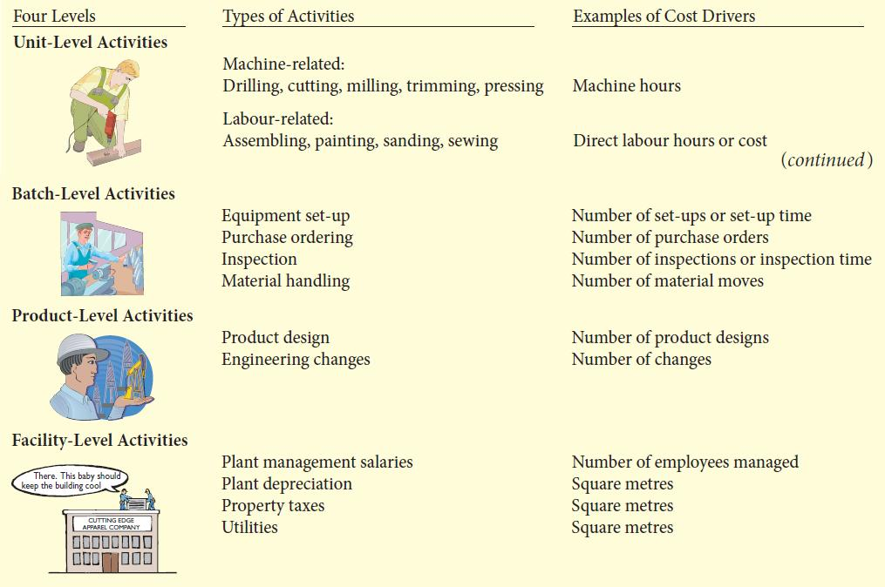
Hierarchy of Activity Levels
5

Slide 39
Let’s Review
A relevant facility-level cost driver for heating costs is:
Machine hours
Direct material
Floor space
Direct labour cost
39
Copyright John Wiley & Sons Canada, Ltd.
5

Slide 40
Let’s Review: Solution
A relevant facility-level cost driver for heating costs is:
Machine hours
Direct material
Floor space
Direct labour cost
40
Copyright John Wiley & Sons Canada, Ltd.
5

Slide 41
Activity-Based Costing
In Service Industries
Similarities with Manufacturing Firms
Overall objective:
  Identify key cost-generation activities and keep track of quantity of activities performed for each service provided
General approach is to identify activities, cost pools, and cost drivers
Labeling of activities as value-added or non-value-added
Reduction of non-value-added activities
5

Slide 42
Activity-Based Costing
In Service Industries
Major difficulty in implementing ABC:
A larger proportion of overhead costs are company-wide costs that cannot be directly traced to specific services.
5

Slide 43
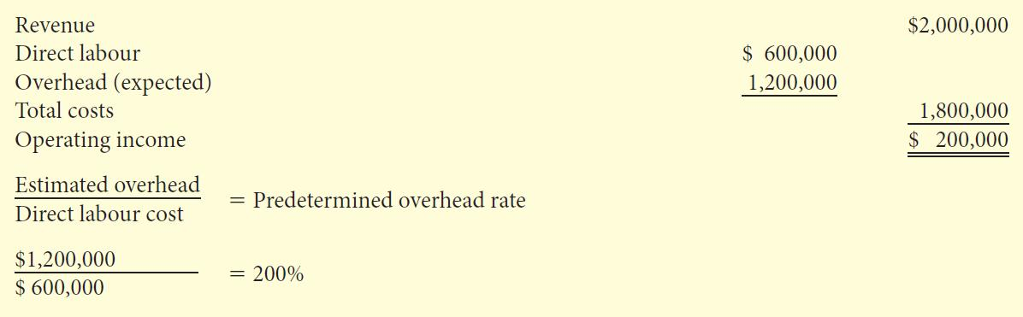
Activity-Based Costing in Service Industries:
Traditional Costing Example
Annual Budget
5

Slide 44
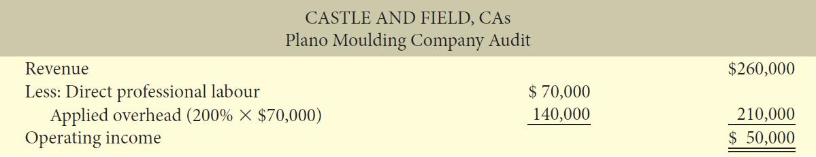
Activity-Based Costing in Service Industries:
ABC Costing Example
5

Slide 45
Activity-Based Costing in Service Industries:
ABC Costing Example
CA’s Annual Overhead Budget
Activity Cost Pools | Cost Drivers | Estimated Overhead | Expected Use of Cost Drivers Per Activity | Activity-Based Overhead Rates
Secretarial support | Direct Prof. hours | $ 210,000 | 30,000 | $7 per hour
Direct labour Fringe benefits | Direct labour cost | 240,000 | $ 600,000 | $0.40 per $1 labour
Printing and photocopying | Working paper pages | 20,000 | 20,000 | $1 per page
Computer support | CPU minutes | 200,000 | 50,000 | $4 per minute
Telephone and postage | None (traced directly) | 71,000 | $71,000 | Based on usage
Legal support | Hours used | 129,000 | 860 | $150 per hour
Insurance | Revenue billed | 120,000 | $2,000,000 | $0.06 per $1 rev
Recruiting and training | Direct Prof. Hours | 210,000 | 30,000 | $7 per hour
 |  | $1,200,000
5

Slide 46
Activity-Based Costing in Service Industries:
ABC Costing Example
Annual Overhead Budget
Activity Cost Pools | Cost Drivers | Actual Use of Drivers | Activity Based Overhead Rates | Costs Assigned
Secretarial support | Direct Prof. hours | 3,800 | $ 7.00 | $ 26,600
Direct labour Fringe benefits | Direct labour cost | $ 70,000 | $ 0.40 | 28,000
Printing and photocopying | Working paper pages | 1,800 | $ 1.00 | 1,800
Computer support | CPU minutes | 8,600 | $ 4.00 | 34,400
Telephone and postage | None (traced directly) |  |  | 8,700
Legal support | Hours used | 156 | $150.00 | 23,400
Insurance | Revenue billed | 260,000 | $ 0.06 | 15,600
Recruiting and training | Direct Prof. Hours | 3,800 | $ 7.00 | 26,600
 |  |  |  | $165,100
5

Slide 47
Activity-Based Costing in Service Industries:
ABC Costing Example
Plano Molding Company Audit
 | Traditional Costing |  | ABC Costing
Revenues | $ | 260,000 | $ | 260,000
Expenses
Direct professional labour | $ 70,000 |  | $70,000
Applied overhead | 140,000 |  | 165,100
Total expenses |  | 210,000 |  | 235,100
Operating income | $ | 50,000 | $ | 24,900
Profit Margin |  | 19.2% |  | 9.6%
5

Slide 48
Let’s Review
Activity-based costing has been found to be useful in each of the following service industries except
hotels
hospitals
telephone companies
ABC has been useful in any of these industries
5

Slide 49
Let’s Review: Solution
Activity-based costing has been found to be useful in each of the following service industries except
hotels
hospitals
telephone companies
ABC has been useful in any of these industries
49
Copyright John Wiley & Sons Canada, Ltd.
5

Slide 50

Copyright
Copyright © 2012 John Wiley & Sons Canada, Ltd. All rights reserved. Reproduction or translation of this work beyond that permitted by Access Copyright (The Canadian Copyright Licensing Agency) is unlawful. Requests for further information should be addressed to the Permissions Department, John Wiley & Sons Canada, Ltd. The purchaser may make back-up copies for his or her own use only and not for distribution or resale. The author and the publisher assume no responsibility for errors, omissions, or damages caused by the use of these programs or from the use of the information contained herein.
5

