Slide 1
Weygandt-Kimmel-Kieso-Aly
4

Slide 2
4
Process Cost Accounting
Study Objectives
Understand who uses process cost systems and explain the similarities and differences between job-order cost and process cost systems.
Explain the flow and assignment of manufacturing costs in a process cost system.
Calculate equivalent units using the weighted-average method.
Explain the four necessary steps to prepare a production cost report.
4

Slide 3
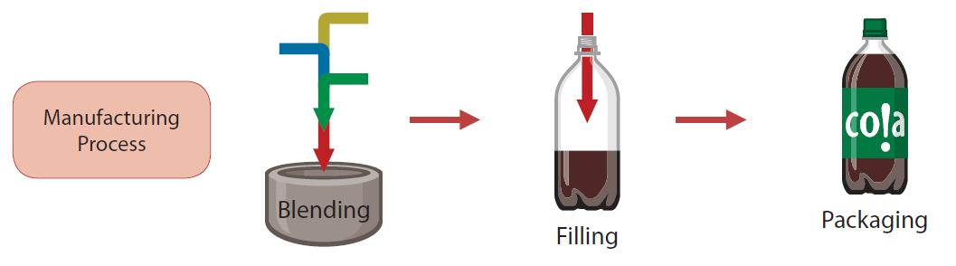
Nature of Process Cost Systems
Uses of Process Cost Systems
Used to apply costs to similar products that are mass produced in a continuous fashion
Examples include the production of cereal, paint, and soft drinks
4

Slide 4
Nature of Process Cost Systems
Uses of Process Cost Systems
Costs in a job order cost system are assigned to a specific job
Examples include:
  Building a customized home
  Making a motion picture
  Making specialized machines
4

Slide 5
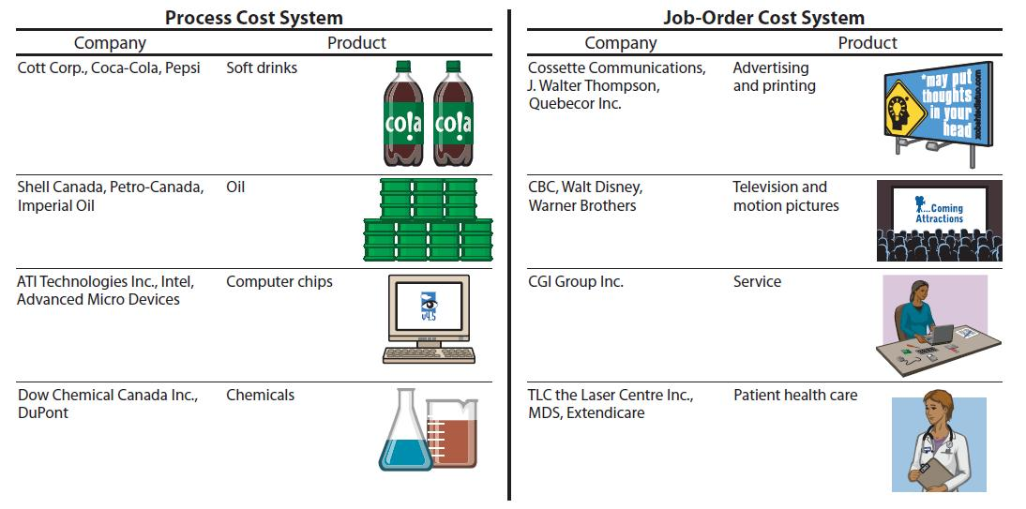
Comparison of Process Cost and Job Order Cost
4

Slide 6
Nature of Process Cost Systems
Similarities and Differences
    In job order cost systems:
      Costs are assigned to each job.
      The products have unique characteristics.
    In process cost systems:
      Costs are tracked through a series of connected manufacturing processes or departments.
      The products are uniform or relatively homogeneous and produced in a large volume.
4

Slide 7
Nature of Process Cost Systems
Similarities and Differences
Job-Order Cost Flow
Direct Materials
Direct Labour
Manufacturing
Overhead
Work in Process Inventory
Job No. 101
Job No. 102
Job No. 103
Finished Goods
Inventory
Cost of Goods
Sold
Process Cost Flow
Direct Materials
Direct Labour
Manufacturing
Overhead
Work in
Process—
Department A
Work in
Process—
Department B
Finished Goods
Inventory
Cost of Goods
Sold
4

Slide 8
Nature of Process Cost Systems
Similarities Between Systems
Job order and process cost systems are similar in 3 ways:
Same manufacturing cost elements
  Direct Materials, Direct Labour, and Manufacturing Overhead
Similar accumulation of costs
  Debit raw materials costs to Raw Material Inventory
  Debit factory labour costs to Factory Labor
  Debit manufacturing overhead costs Manufacturing Overhead
4

Slide 9
Nature of Process Cost Systems
Similarities Between Systems, contd.
Same accounts for flow of costs
  Work in Process, Finished Goods Inventory, and Cost of Goods Sold; however, the methods of assigning the costs differ significantly.
4

Slide 10
Nature of Process Cost Systems
Differences Between Systems
Job order and process cost systems differ in four ways:
Features
Work in process accounts
Documents used
Point at which costs totalled
Unit cost calculations
Job-Order Cost System
• one for each job
• job cost sheets
• when job is complete
• cost of each job ÷ units produced for the job
Process Cost System
• one for each process
• production cost reports
• end of a period of time
•total manufacturing costs ÷ units produced during the period
4

Slide 11
Operations Costing
Operations costing is a combination of a process cost and a job-order cost system
It is similar to process costing since companies use standardized methods to manufacture a product.
At the same time, the product may have some
customized, individual features that require the use of a job-order cost system.
4

Slide 12
Let’s Review
Which of the following companies would be most likely to use process costing?
  A catering company
  A custom yacht maker
  A tire manufacturer
  An attorney’s office
4

Slide 13
Let’s Review: Solution
Which of the following companies would be most likely to use process costing?
  A catering company
  A custom yacht maker
  A tire manufacturer
  An attorney’s office
4

Slide 14
Nature of Process Cost Systems
Process Cost Flow
Example – Tyler Company
Manufacturing of automatic can openers consists of two processes:
      Machining – raw materials are shaped, honed, drilled
      Assembly – parts assembled and packaged
Materials, labour, and manufacturing overhead added in both departments
4

Slide 15
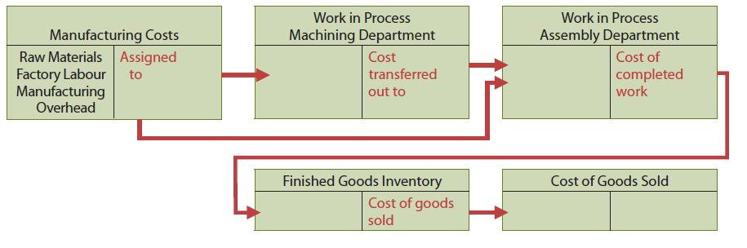
Nature of Process Cost Systems
Process Cost Flow
4

Slide 16
Nature of Process Cost Systems
Assignment of Manufacturing Costs
Accumulation of materials and labour costs is the same as in job order costing.
    Debit Raw Materials Inventory for all purchases of raw materials
    Debit Factory Labour for all factory labour incurred
However, assignment of the three manufacturing cost elements to Work in Process is different.
4

Slide 17
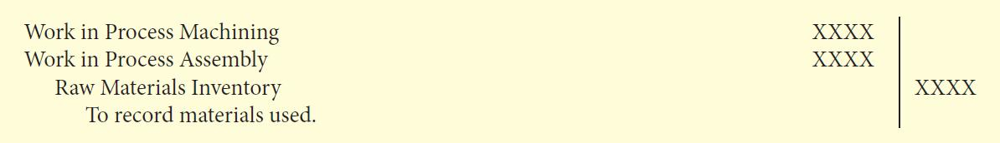
Nature of Process Cost Systems
Assignment of Manufacturing Costs
Materials Costs
A process cost system requires fewer materials requisitions than a job order cost system.
    Materials are used for processes not specific jobs
    Requisitions are for larger quantities of materials
The entry to record the materials used:
4

Slide 18
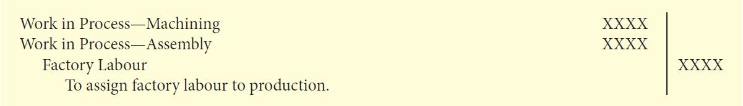
Nature of Process Cost Systems
Assignment of Manufacturing Costs
Factory Labour Costs
Time tickets used in both systems
All labour costs incurred within a production department are a cost of processing
The entry to assign these costs:
4

Slide 19
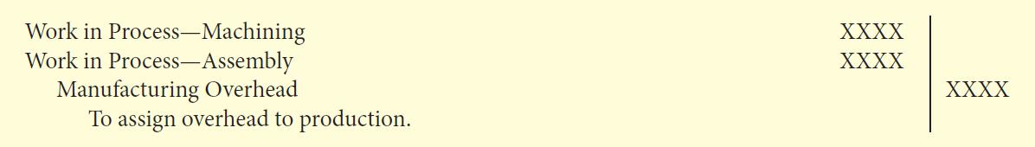
Nature of Process Cost Systems
Assignment of Manufacturing Costs
Manufacturing Overhead Costs
Objective of assigning overhead – allocate overhead to departments on an objective and equitable basis
      Use the activity that “drives” or causes the costs
      Machine time used – primary driver in continuous manufacturing operations; widely used
The entry to allocate overhead to the two processes:
4

Slide 20
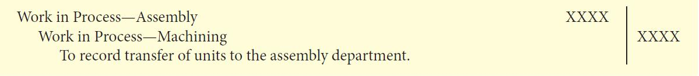
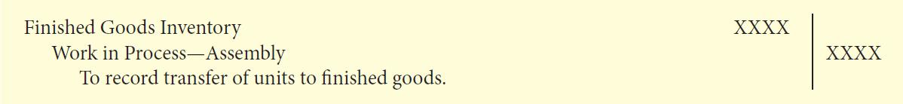
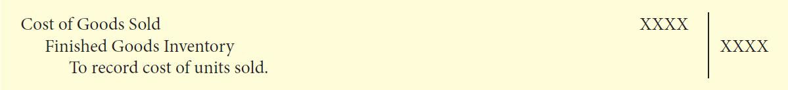
Nature of Process Cost Systems
Assignment of Manufacturing Costs
Entries to Transfer Costs Through System
Monthly entry to transfer goods to next department:
Entry to transfer completed goods to Finished Goods:
Entry to record Cost of Goods Sold at the time of sale:
4

Slide 21
Let’s Review
Which of the following items is not a characteristic of a process cost system?
  Once production begins, it continues until the finished product emerges.
  The focus is on continually producing homogenous products.
  When the finished product emerges, all units have precisely the same amount of materials, labour, and overhead.
  The products produced are heterogeneous in nature.
4

Slide 22
Let’s Review: Solution
Which of the following items is not a characteristic of a process cost system?
  Once production begins, it continues until the finished product emerges.
  The focus is on continually producing homogenous products.
  When the finished product emerges, all units have precisely the same amount of materials, labour, and overhead.
  The products produced are heterogeneous in nature.
4

Slide 23
Equivalent Units
A measure of the work done during the period, expressed in fully completed units
Used to determine the cost per unit of the completed product
4

Slide 24
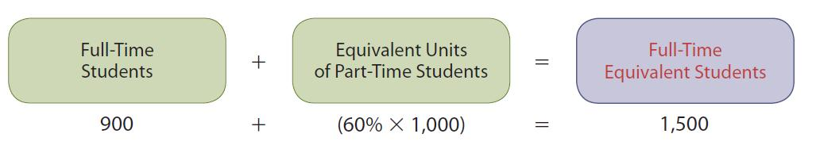
Equivalent Units
Example
Calculate the cost of instruction at XYZ college per full-time equivalent student based on the following information:
  Total cost of instruction is $9,000,000
  Student population consists of 900 full-time and 1,000 part-time students
  Part-time students take 60% of the classes of a full-time student
Cost of instruction per full-time equivalent student
$9,000,000 / 1,500 = $6,000
4

Slide 25
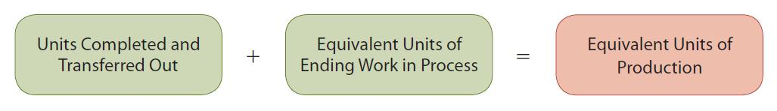
Equivalent Units
Weighted-Average Method
Considers the degree of completion (weighting) of units completed and transferred out and units in ending work in process
Most widely used method
Beginning work in process not part of calculation of equivalent units
4

Slide 26
Equivalent Units ― Refinements
Weighted-Average Method: Example
The Kellogg Company uses three departments (Mixing, Baking, and Freezing/Packaging) to produce waffles
  Physical units for Mixing Department:
    Beginning work in process 100,000
    Started into production during period 800,000
    Transferred out to Baking Department 700,000
    Ending work in process 200,000
4

Slide 27
Equivalent Units Refinements:
Weighted-Average Method Example (Continued)
Mixing Department Raw Materials Information
  All ingredients (materials) are added at the beginning of the mixing process.
  All units, regardless of degree of completion, are 100% complete as to materials.
Equivalent Units for Materials:
Units Transferred Out 700,000 100% Complete 700,000
Ending Work in Process 200,000 100% Complete 200,000
Total Equivalent Units 900,000
4

Slide 28
Equivalent Units Refinements:
Weighted-Average Method Example (Continued)
Mixing Department Conversion Cost Information
  Conversion costs – sum of labour costs and overhead costs
  Incurred uniformly throughout the mixing process.
    Beginning work in process – 70% complete as to conversion costs.
    Ending work in process – 60% complete as to conversion costs
Equivalent Units for Conversion Costs:
Units Transferred Out 700,000 100% Complete 700,000
Ending Work in Process 200,000 60% Complete 120,000
Total Equivalent Units 820,000
4

Slide 29
Let’s Review
What do the Equivalent Units of Production measure?
    Units that are similar to each other
    Units that are homogenous
    Measure units that are 100% complete
    Measure the work done during the period expressed in fully completed units
4

Slide 30
Let’s Review: Solution
What do the Equivalent Units of Production measure?
    Units that are similar to each other
    Units that are homogenous
    Measure units that are 100% complete
    Measure the work done during the period expressed in fully completed units
4

Slide 31
Production Cost Report
Key document used to understand activities
Prepared for each department and shows:
  Production quantity
  Cost data
Four preparation steps
    Calculate physical unit flow
    Calculate equivalent units of production
    Calculate unit production costs
    Prepare a cost reconciliation schedule
4

Slide 32
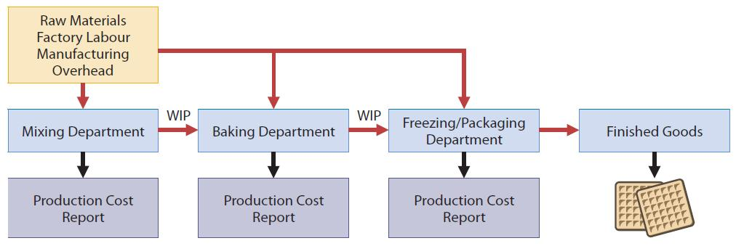
Flow of Costs in Process System
Example: Production of Waffles
4

Slide 33
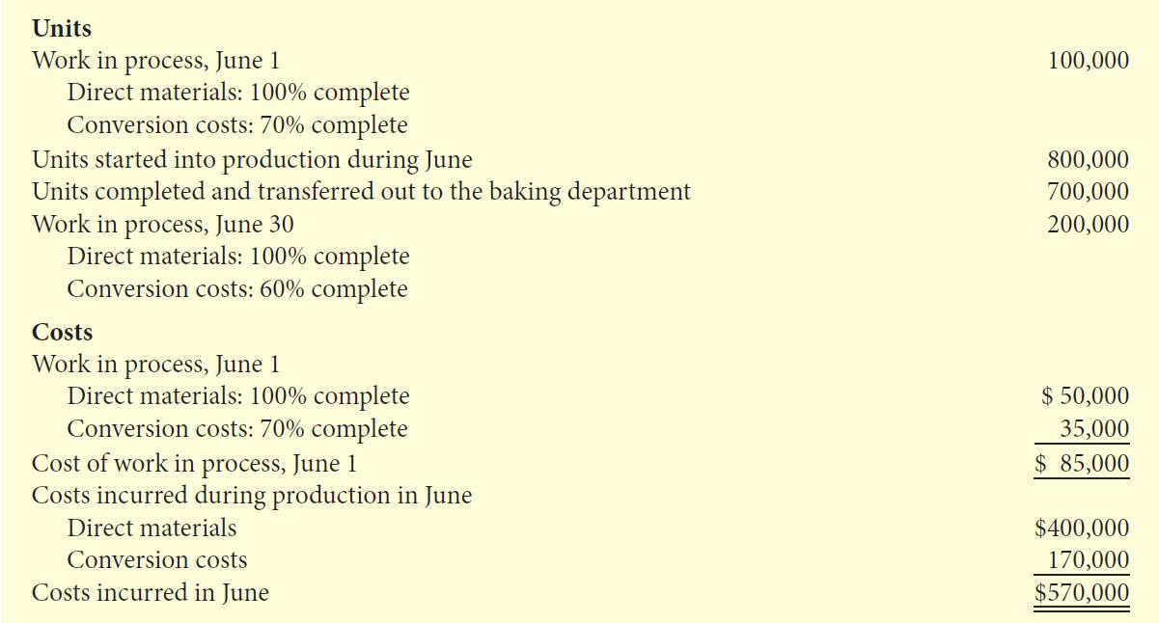
Comprehensive Example of Process Costing Using the Weighted-Average Method
4

Slide 34
Comprehensive Example
Continued
Step 1: Calculate Physical Unit Flow
  Physical units
    Actual units to be accounted for during a period, regardless of work performed
  Total units to be accounted for
    Units started (or transferred) into production during period + units in production at beginning of period
  Total units accounted for
    Units transferred out during period + units in production at end of period
4

Slide 35
Comprehensive Example
Continued
Step 2: Calculate Equivalent Units of Production
  Measure of a department’s productivity
  Two calculations required: one for materials and one for conversion costs
  Beginning work in process is ignored
4

Slide 36
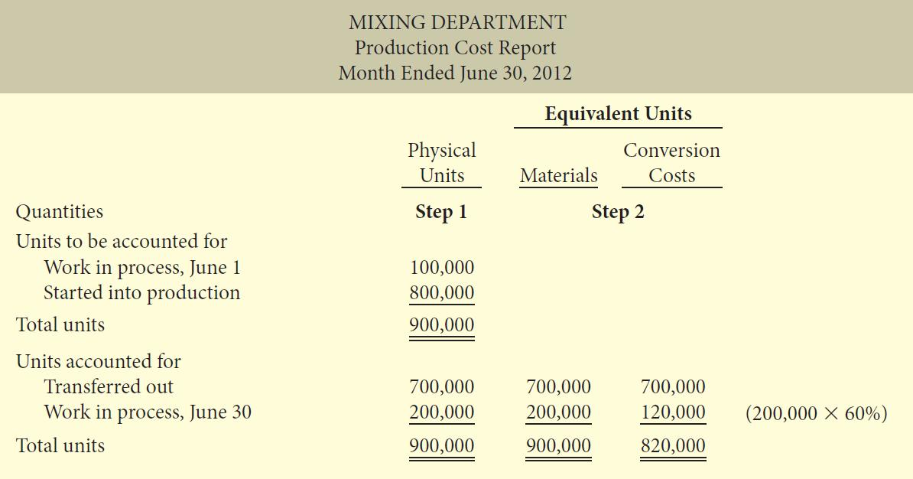
Comprehensive Example
Continued
4

Slide 37
Comprehensive Example
Continued
Step 3: Calculate Unit Production Costs
  Costs expressed in terms of equivalent units of production
  When equivalent units of production are different for materials and for conversion costs, three unit costs are calculated:
    materials
    conversion
    total manufacturing
4

Slide 38
Comprehensive Example
Continued
Step 3: Calculate Unit Production Costs (Continued)
  Materials
  Direct Materials
  Cost in Beginning Work in Process $ 50,000
  Direct Materials added to
  Production during Month $ 400,000
    Total Materials Cost $ 450,000
4

Slide 39
Comprehensive Example
Continued
    The calculation of unit materials cost:
Total Materials Cost | ÷ | Equivalent Units of Materials | = | Unit Materials Cost
$450,000 | ÷ | 900,000 | = | $0.50
4

Slide 40
Comprehensive Example
Continued
Step 3: Calculate Unit Production Costs (Continued)
  Conversion Costs
  Conversion Costs
  in Beginning Work in Process $ 35,000
  Conversion Costs added to Production
  during Month $170,000
    Total Conversion Costs $205,000
4

Slide 41
Comprehensive Example
Continued
    The calculation of unit conversion cost:
Total Conversion Cost | ÷ | Equivalent Units of Conversion Cost | = | Unit Conversion Cost
$205,000 | ÷ | 820,000 | = | $0.25
4

Slide 42
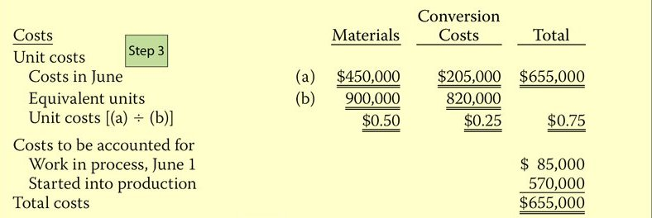
Comprehensive Example
Continued
Step 3: Calculate Unit Production Costs (Continued)
  Total Manufacturing Cost Per Unit
Unit Material Cost | + | Unit Conversion Cost | = | Total Manufacturing Cost per Unit
$0.50 | + | $0.25 | = | $0.75
4

Slide 43
Comprehensive Example
Continued
Step 4: Prepare a Cost Reconciliation Schedule
  Determines cost of goods transferred to the next department
  Assigns total costs to units transferred out and to ending work in process
  Shows that total costs accounted for equal total costs to be accounted for
4

Slide 44
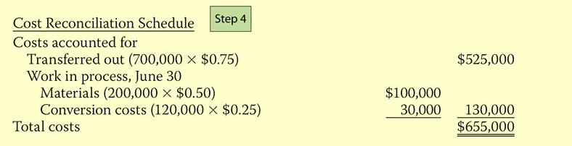
Comprehensive Example
Continued
Step 4: Prepare a Cost Reconciliation Schedule (Cont’d)
Costs charged to Mixing Department
  Cost of beginning Work in Process $ 85,000
  Costs started into production during period $570,000
    Total costs to be accounted for $655,000
4

Slide 45
The Production Cost Report
An internal document for management
Shows production quantity and cost data for a department
Presents results of the four steps in system
Uses of Production Cost Report:
  Basis for evaluating productivity of each department
  Helps assess reasonableness of unit costs and total costs
  Aids in judging whether planned objectives are met
4

Slide 46
The Production Cost Report
Continued
There are four steps in preparing a production cost report:
  Prepare a physical unit schedule.
  Calculate the equivalent units.
  Calculate the unit costs.
  Prepare a cost reconciliation schedule.
4

Slide 47
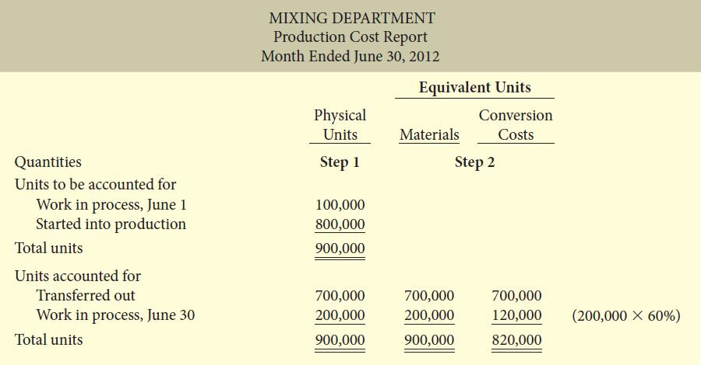
The Production Cost Report
Continued
4

Slide 48
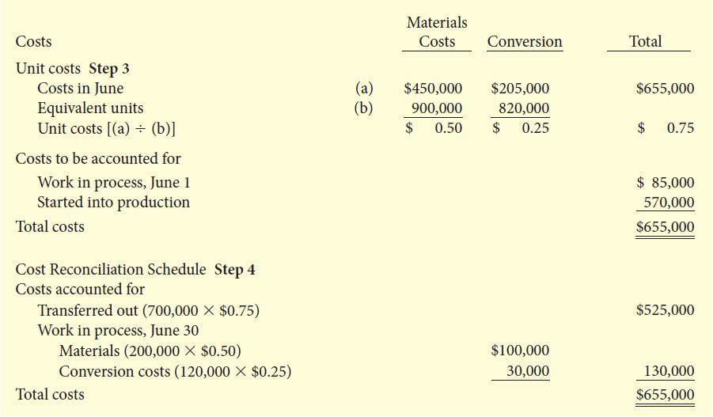
The Production Cost Report
Continued
Continued –
4

Slide 49
Calculate Equivalent Units For A Sequential Process Setting
A sequential process where goods are transferred from one department to another requires an additional cost component called transferred in.
Features of this cost component:
  Percentage of completion factor of 100%
  Treated the same way as any other cost component in the calculation of equivalent units of production and the cost per equivalent unit of production
4

Slide 50
Let’s Review
Which is not one of the five steps in a process-costing report?
    Compute equivalent units
    Allocate costs
    Calculate the rate per equivalent
    Collect revenues to allocate
4

Slide 51
Let’s Review: Solution
Which is not one of the five steps in a process-costing report?
    Compute equivalent units
    Allocate costs
    Calculate the rate per equivalent
    Collect revenues to allocate
4

Slide 52
Appendix 4A
Production Cost Report:
FIFO Method
Study Objective
Calculate equivalent units using the FIFO method

Slide 53
Equivalent Units
FIFO Method
Calculates equivalent units on a first-in, first-out basis
Corresponds to actual physical flow of goods
Assumes that beginning work in process is completed before new work is started
Sum of work performed to:
  Finish beginning work in process
  Complete units started during the period, called units started and completed
  Start, but only partially complete, ending work in process

Slide 54
Equivalent Units
FIFO Method: Comprehensive Example
Mixing Department
Units
Work in process, June 1 100,000
Direct materials: 100% complete
Conversion costs: 70% complete
Units started into production during June 800,000
Units completed and transferred out to Baking Department 700,000
Work in process, June 30 200,000
Direct materials: 100% complete
Conversion costs: 60% complete
Costs
Work in process, June 1
Direct materials: 100% complete $50,000
Conversion costs: 70% complete 35,000
Cost of work in process, June 1 $85,000
Costs incurred during production in June
Direct materials $400,000
Conversion costs 170,000
Costs incurred in June $570,000

Slide 55
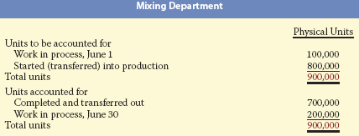
Comprehensive Example
FIFO Method (Continued)
Step 1: Calculate Physical Unit Flow
  Reports beginning work in process and units started and completed

Slide 56
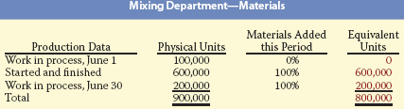
Comprehensive Example
FIFO Method (Continued)
Step 2: Calculate Equivalent Units of Production
Materials:
Added at beginning of process
No additional materials cost to complete beginning work in process
100% of material costs incurred on ending work in process
4

Slide 57
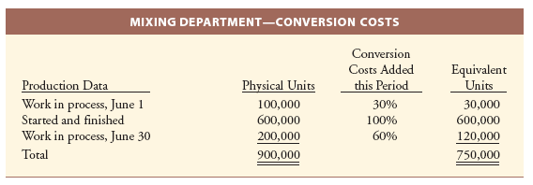
Comprehensive Example
FIFO Method (Continued)
Step 2: Calculate Equivalent Units of Production (Continued)
  Conversion Costs:

Slide 58
Comprehensive Example
FIFO Method (Continued)
Step 3: Calculate Unit Production Costs (Continued)
Production costs incurred during current period:
  Direct Materials $400,000
  Conversion Costs 170,000
  Total Costs $570,000
4

Slide 59
Comprehensive Example
FIFO Method (Continued)
  Calculation of unit costs:
Total Material Cost | ÷ | Equivalent Units of Materials | = | Unit Materials Cost
$400,000 | ÷ | 800,000 | = | $0.50
Total Conversion Cost | ÷ | Equivalent Units of Conversion Cost | = | Unit Conversion Cost
$170,000 | ÷ | 750,000 | = | $0.227 (R)
Unit Materials Cost | + | Unit Conversion Cost | = | Total Manufacturing Cost per Unit
$0.50 | + | $0.227 | = | $0.727
4

Slide 60
Comprehensive Example
FIFO Method (Continued)
Step 4: Prepare a Cost Reconciliation Schedule
  Assigns total costs to units transferred out and to ending work in process
  First goods to be completed are units in beginning work in process
  Cost of the beginning work in process is always assigned to the goods transferred to the next department (or to finished goods)
  Ending work in process includes only production costs incurred in the current period

Slide 61
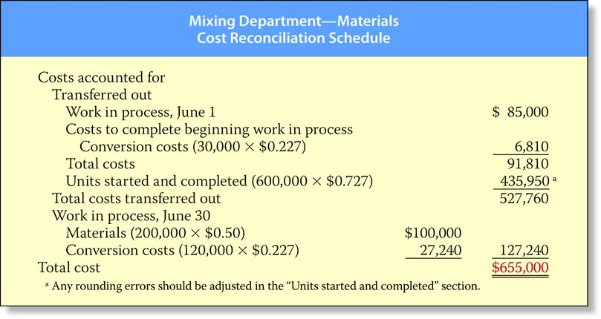
Comprehensive Example
FIFO Method (Continued)

Slide 62
FIFO and Weighted Average
The weighted-average method has one major advantage:
  Simple to understand and to apply
When prices do not fluctuate significantly, the weighted-average method is very similar to the FIFO method.
Conceptually, the FIFO method is superior because:
  Current performance is measured using only costs incurred in the current period
  The FIFO method provides current cost information which leads to more accurate pricing strategies

Slide 63

Copyright
Copyright © 2012 John Wiley & Sons Canada, Ltd. All rights reserved. Reproduction or translation of this work beyond that permitted by Access Copyright (The Canadian Copyright Licensing Agency) is unlawful. Requests for further information should be addressed to the Permissions Department, John Wiley & Sons Canada, Ltd. The purchaser may make back-up copies for his or her own use only and not for distribution or resale. The author and the publisher assume no responsibility for errors, omissions, or damages caused by the use of these programs or from the use of the information contained herein.
4

