Slide 1
Weygandt-Kimmel-Kieso-Aly
3

Slide 2
Job-Order Cost
Accounting
3
Study Objectives
Explain the characteristics and purpose of cost accounting.
Describe the flow of costs in a job-order cost accounting system.
Distinguish between under- and over-applied manufacturing overhead and discuss the methods of adjusting overheads.
3

Slide 3
Cost Accounting Systems
Cost accounting involves:
  The measuring
  The recording, and
  The reporting of product costs
Consists of the various manufacturing costs that are fully integrated into the general ledger system.
An important feature is the use of a perpetual inventory system to provide immediate, up-to-date information on the cost of a product.
3

Slide 4
Cost Accounting Systems
There are two basic types of cost accounting systems:
    Job-order cost system
    Process cost system
3

Slide 5
Cost Accounting Systems
Job Order Cost System
Costs are assigned to each job or batch
A job may be for a specific order or inventory
A key feature: Each job or batch has its own distinguishing characteristics
The objective: to calculate the cost per job
Measures costs for each job completed not for set time periods
3

Slide 6
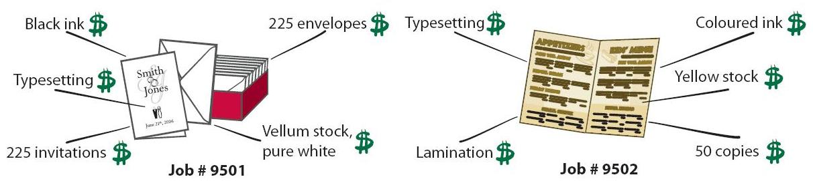
Cost Accounting Systems
Job Order Cost System
Dollco Printing Job-Order Cost System
Two Jobs: Wedding Invitations and Menus
Each Job has distinguishing characteristics and related costs.
3

Slide 7
Cost Accounting Systems
Process Cost System
Used when a large volume of similar products are manufactured
  Cereal
  Automobiles
  Compact Discs
  Paint
Cost are accumulated for a specific time period (a week or a month)
Costs are assigned to departments or processes for a set period of time
3

Slide 8
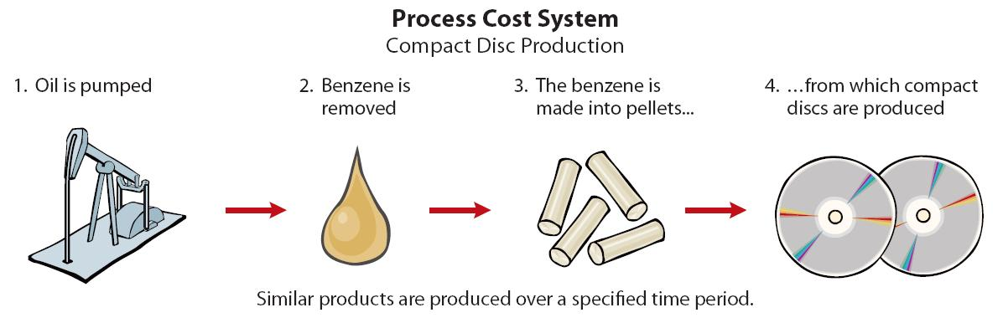
Cost Accounting Systems
Process Cost System
3

Slide 9
Let’s Review
The most logical business which would use job order costing would be:
  an oil refinery.
  a paper company.
  a custom-home builder.
  a car dealership.
3

Slide 10
Let’s Review: Solution
The most logical business which would use job order costing would be:
  an oil refinery.
  a paper company.
  a custom-home builder.
  a car dealership.
3

Slide 11
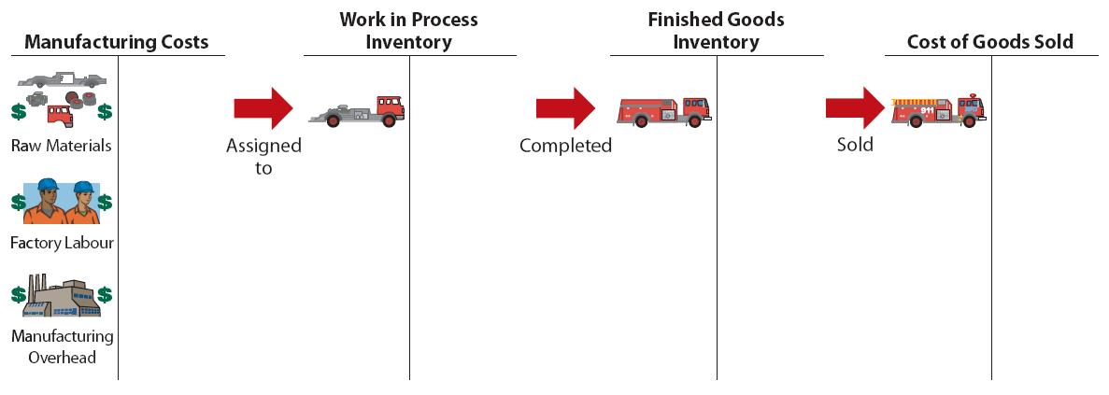
Job-Order Cost Flows
The cost flow parallels the physical flow of the materials as they are converted into finished goods.
  Manufacturing costs are assigned to Work in Process
  Cost of completed jobs is transferred to Finished Goods Inventory
  When units are sold, the cost is transferred to Cost of Goods Sold.
3

Slide 12
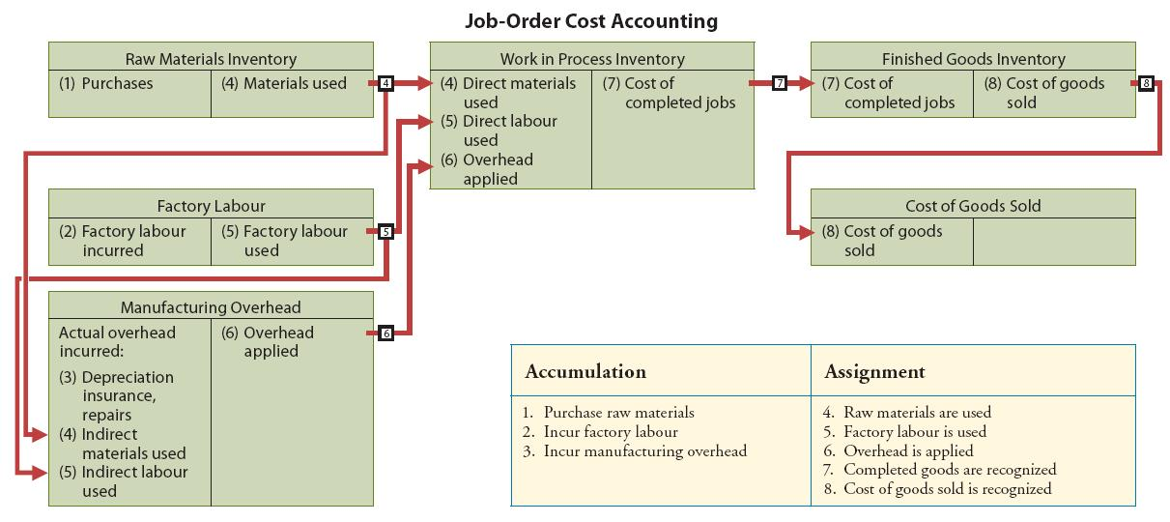
Job-Order Cost Flows
3

Slide 13
Two Major Steps in Flows of Costs
1. Accumulate the manufacturing costs incurred
  Raw materials
  Factory Labour
  Manufacturing Overhead
2. Assign the accumulated costs to the work done
3

Slide 14
Accumulating Manufacturing Costs
Raw Materials Costs
Raw materials are debited to Raw Materials Inventory when purchased
At this point, the cost of materials is not assigned to specific jobs or orders
3

Slide 15
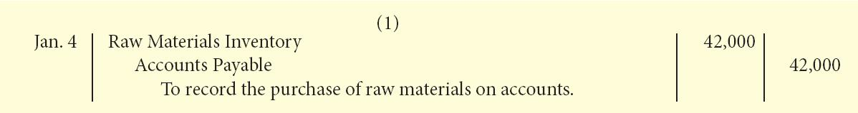
Accumulating Manufacturing Costs
Raw Materials Costs: Continued
Example:
  On January 4, Wallace Manufacturing purchases 2,000 handles at $5 per unit ($10,000) and 800 modules at $40 per unit ($32,000) for a total cost of $42,000
3

Slide 16
Accumulating Manufacturing Costs
Raw Materials Costs: Continued
  Raw Materials Inventory
    a general ledger account
    a control account that summarizes the detailed data regarding specific inventory accounts in the subsidiary ledger
Raw Materials
Inventory Control Account
Material A
Material B
Material C
General Ledger
Subsidiary Ledger
3

Slide 17
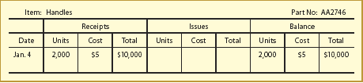
Accumulating Manufacturing Costs Raw Materials Costs: Continued
The subsidiary ledger consist of individual records for each item of raw materials
  May be accounts or manually/mechanically prepared cards
  May be kept as computer data files
The records are referred to as materials inventory records or stores ledger cards
3

Slide 18
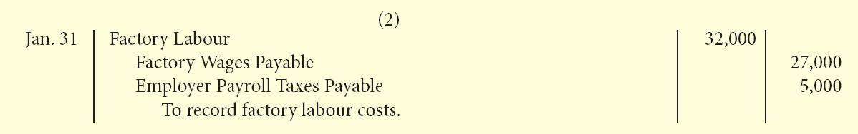
Accumulating Manufacturing Costs
Factory Labour Costs
Consists of:
  gross earnings of factory workers
  employer payroll taxes on such earnings
  fringe benefits incurred by the employer
Debited to Factory Labour when incurred.
Example:
Wallace Manufacturing incurs $32,000 of factory labour costs, of which $27,000 relates to wages payable and $5,000 relates to payroll taxes payable in January
3

Slide 19
Accumulating Manufacturing Costs: Manufacturing Overhead Costs
May be recognized daily
    For example, machinery repairs , indirect materials, and indirect labour.
May also be recorded periodically through adjusting entries
    For example, property taxes, amortization, and insurance.
    The summary entry for Wallace Manufacturing Company is:
3

Slide 20
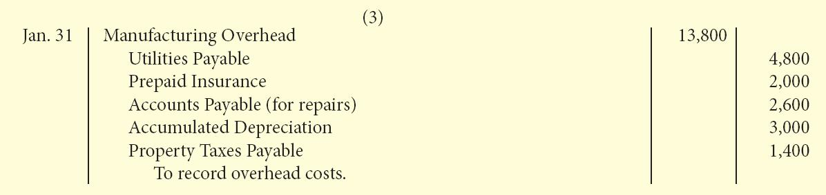
Accumulating Manufacturing Costs
Manufacturing overhead is a Control Account
3

Slide 21
Assigning Manufacturing Costs to Work in Process
Manufacturing costs are assigned to work in process
with
    Debits to Work in Process Inventory
    Credits to:
      Raw Materials Inventory
      Factory Labour
      Manufacturing Overhead
Entries assigning costs to work in process are usually
made monthly
3

Slide 22
Assigning Manufacturing Costs to Work in Process
Job cost sheet:
  Used to record the costs of a specific job
  Used to determine the total and unit costs of a completed job
  Postings to job cost sheets are made daily
3

Slide 23
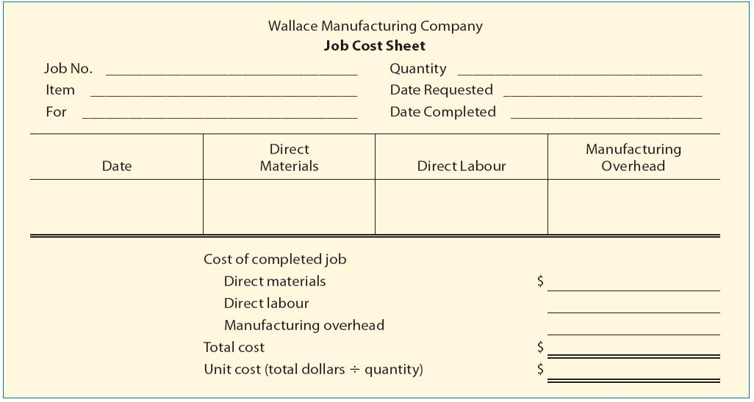
Assigning Manufacturing Costs to Work in Process
3

Slide 24
Assigning Manufacturing Costs
to Work in Process
Raw Materials Cost
Assigned to a job when materials are issued
A materials requisition slip – the written authorization for issuing raw materials
May be either directly used on a job or may be considered indirect materials
3

Slide 25
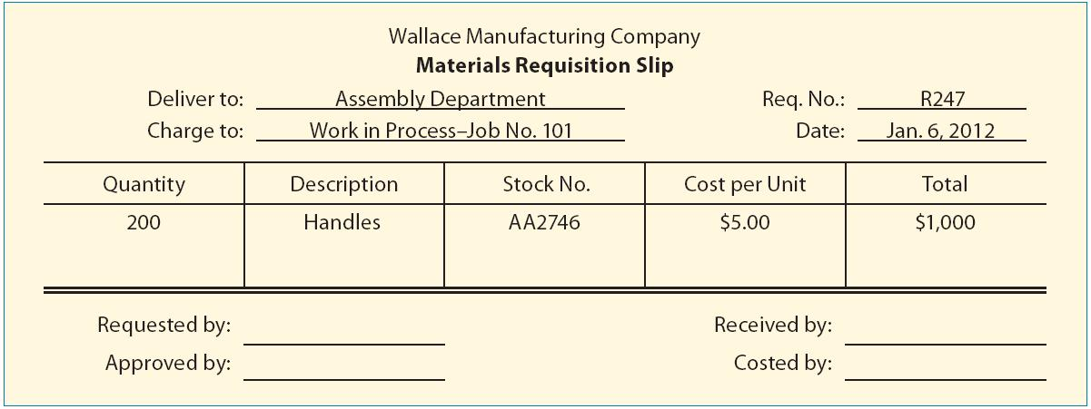
Assigning Manufacturing Costs to Work in Process
3

Slide 26
Assigning Manufacturing Costs to
Work in Process
Raw Materials Cost
Requisition is prepared in duplicate
  One copy stays in the storeroom as evidence of
  materials released
  The original goes to accounting to determine the cost
  per unit and total cost of materials used
Posted daily to individual job cost sheets and periodically journalized
3

Slide 27
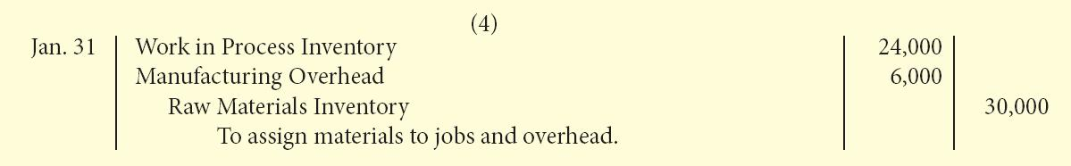
Assigning Manufacturing Costs to
Work in Process
Raw Materials Cost
Example:
If $24,000 of direct materials and $6,000 of indirect materials are used in January, the entry is:
3

Slide 28
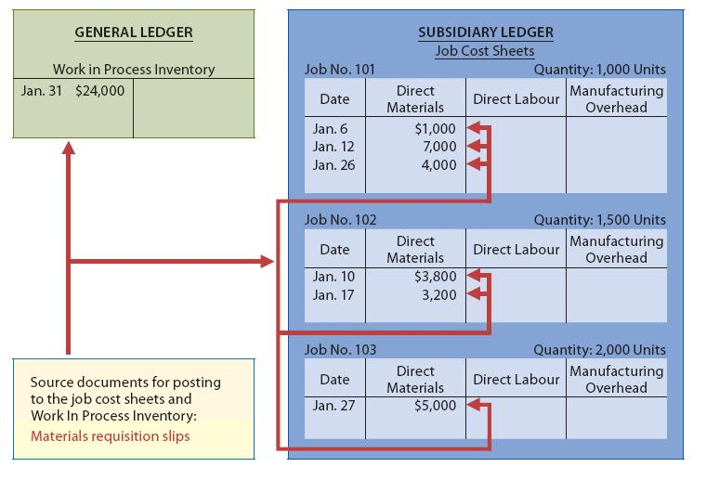
Assigning Manufacturing Costs to Work in Process
The sum of the direct materials should equal the direct materials debited to Work in Process Inventory.
3

Slide 29
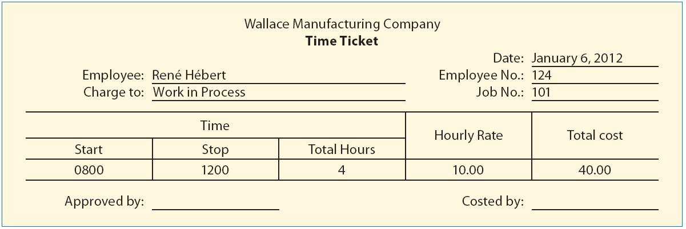
Assigning Manufacturing Costs to Work in Process
Factory Labour Cost
Assigned to jobs on the basis of time tickets
3

Slide 30
Assigning Manufacturing Costs to
Work in Process
Factory Labour Cost
    Account and job charged
Assigned to jobs on the basis of time tickets
Employee
    Hours worked
    Total labour cost
3

Slide 31
Assigning Manufacturing Costs to
Work in Process
Factory Labour Cost
Time tickets are sent to payroll to be sorted, totaled, and journalized
Work in Process is debited for direct labour costs
Manufacturing overhead is debited for indirect labour costs
Factory Labour is left with a zero balance
3

Slide 32
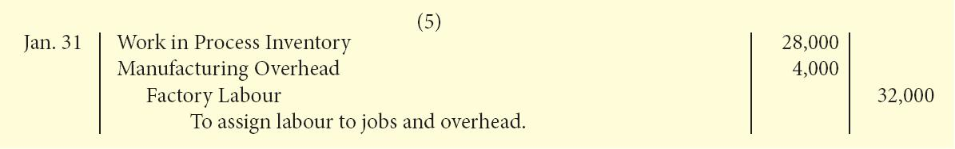
Assigning Manufacturing Costs to
Work in Process
Factory Labour Cost
Example:
If the $32,000 total factory labour cost incurred consists of $28,000 of direct labour and $4,000 of indirect labour, the entry is:
3

Slide 33
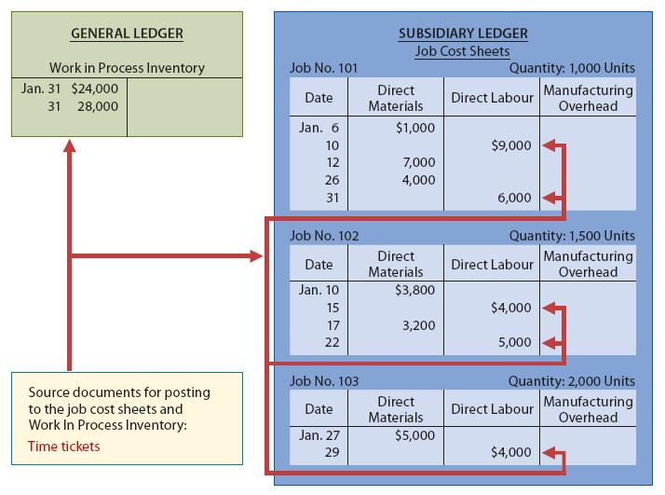
Assigning Manufacturing Costs to
Work in Process
Factory Labour Cost
The sum of the direct labour columns of the job cost sheets should equal the direct labour debited to Work in Process Inventory.
3

Slide 34
Assigning Manufacturing Costs to Work in Process
Manufacturing Overhead
Relates to production operations as a whole
Cannot be assigned to specific jobs based on actual costs incurred
Must be assigned to work in process and to specific jobs on an estimated basis through the use of a Predetermined Overhead Rate
3

Slide 35
Assigning Manufacturing Costs to Work in Process
Predetermined Overhead Rate
Based on the relationship between estimated annual overhead costs and expected annual operating activity
Expressed in terms of an activity base such as
  Direct labour costs
  Direct labour hours
  Machine hours, or
  Any other activity that is an equitable base for applying overhead costs to jobs
The current trend is to use machine hours as the activity base due to increased automation in manufacturing operations
3

Slide 36
Assigning Manufacturing Costs to Work in Process
Predetermined Overhead Rate
Established at the beginning of the year
May use a single, company-wide predetermined rate
May use a different rate for each department and each department may have a different activity base
The formula for a predetermined overhead rate is:
Estimated Annual Overhead Costs | ÷ | Expected Annual Operating Activity | = | Predetermined Overhead Rate
3

Slide 37
Assigning Manufacturing Costs to Work in Process
Predetermined overhead rate is used to assign overhead to different jobs in process during the period
The object is to get timely information about the cost of a completed job
Work in Process (All Jobs)
is
Assigned
to
Actual Activity
Based Used
Predetermined
Overhead rate
X
Job 1 |  |  | Job 2 |  |  | Job 3
3

Slide 38
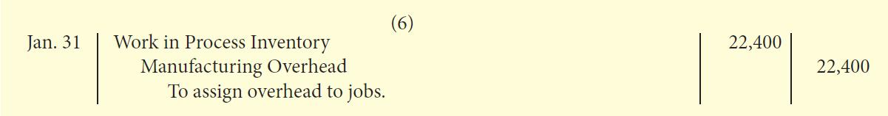
Assigning Manufacturing Costs to Work in Process
Example:
At Wallace Manufacturing, direct labour cost is the activity base
Estimated annual costs:
Overhead costs $280,000
Direct labour costs $350,000
The overhead rate is $280,000 ÷ $350,000 = 80% of direct labour cost. Overhead applied for January is $22,400 ($28,000 X 80%) and is recorded through the following entry:
3

Slide 39
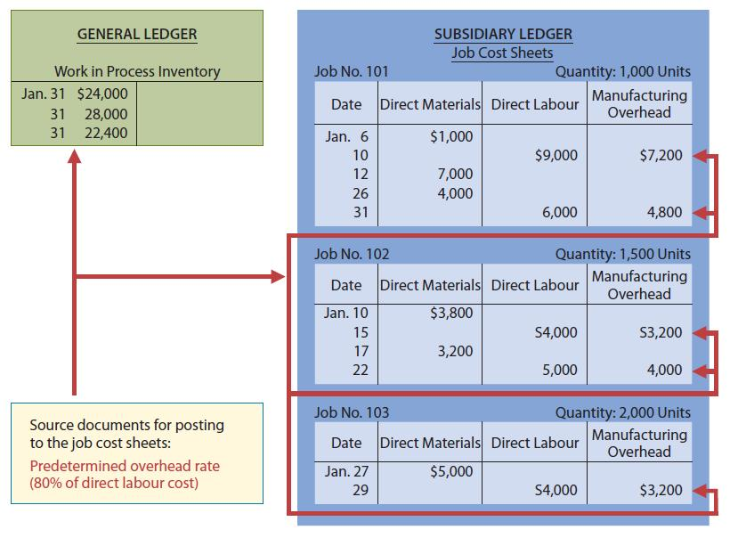
Assigning Manufacturing Costs to Work in Process
The sum of the manufacturing overhead columns of the job cost sheets should equal the manufacturing overhead debited (i.e., applied) to Work in Process Inventory.
3

Slide 40
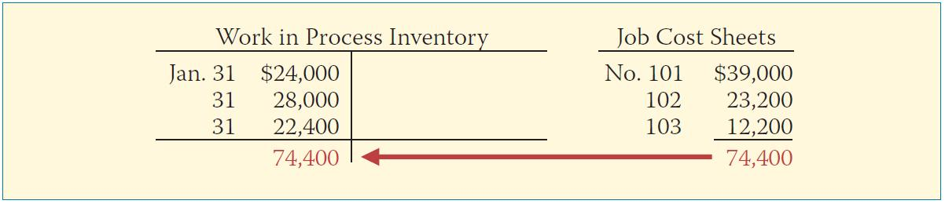
Assigning Manufacturing Costs to Work in Process
At the End of Each Month
The balance in Work in Process Inventory should equal the sum of the costs shown on the job cost sheets of unfinished jobs.
3

Slide 41
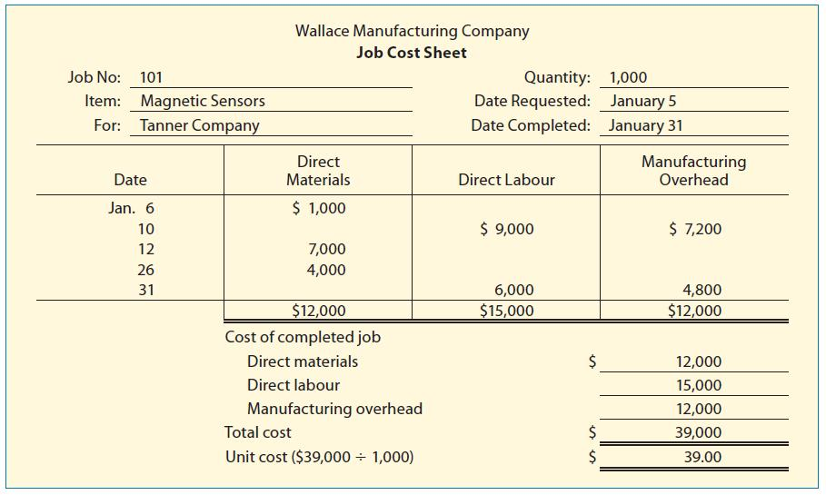
Assigning Costs to Finished Goods
When a job is completed, the costs are summarized and the job cost sheet is completed.
3

Slide 42
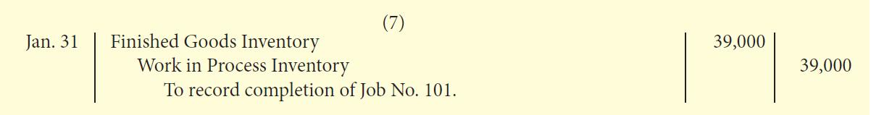
Assigning Costs to Finished Goods
The entry for Wallace Manufacturing to transfer its total cost to finished goods is:
3

Slide 43
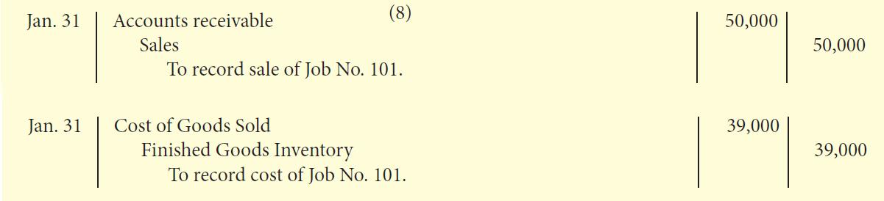
Assigning Costs to Finished Goods
Inventory remains in Finished Goods Inventory until it is sold
Cost of goods sold is recognized when a sale occurs
Example:
On January 31 Wallace Manufacturing sells Job No. 101, costing $39,000, for $50,000. The entries are:
3

Slide 44
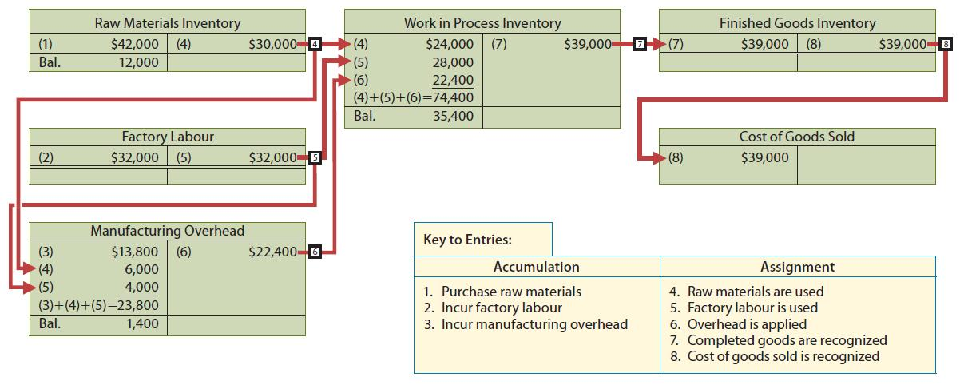
Summary of Job-Order Cost Flows
3

Slide 45
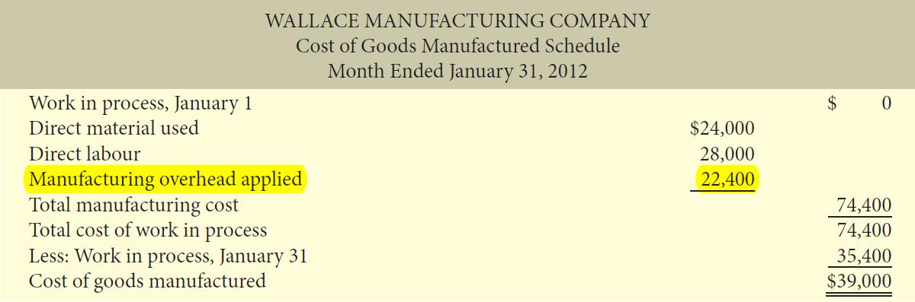
Reporting Job Cost Data
The cost of goods manufactured schedule now shows manufacturing overhead applied rather than actual overhead costs.
Applied overhead is added to direct materials and direct labour to determine total manufacturing costs.
3

Slide 46
Let’s Review
The cost of items finished and transferred from work in process inventory to finished goods inventory is:
  cost of goods sold.
  work in process.
  cost of goods manufactured.
  materials inventory.
3

Slide 47
Let’s Review: Solution
The cost of items finished and transferred from work in process inventory to finished goods inventory is:
  cost of goods sold.
  work in process.
  cost of goods manufactured.
  materials inventory.
3

Slide 48
Underapplied or Overapplied Manufacturing Overhead
A debit balance in manufacturing overhead means that overhead is underapplied.
    Overhead assigned to work in process is less than overhead incurred.
A credit balance in manufacturing overhead means that overhead is overapplied.
    Overhead assigned to work in process is greater than overhead incurred.
3

Slide 49
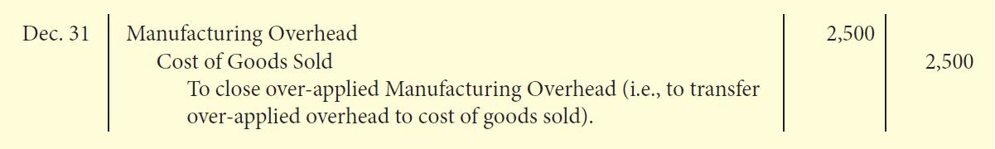
Underapplied or Overapplied Manufacturing Overhead
Any year-end balance in Manufacturing Overhead is eliminated by adjusting cost of goods sold
    Underapplied overhead is debited to CGS
    Overapplied overhead is credited to CGS
Cost of Goods Sold Method – Example:
Wallace Mfg. has a $2,500 credit balance in Manufacturing Overhead at December 31. The adjusting entry for the overapplied overhead is:
3

Slide 50
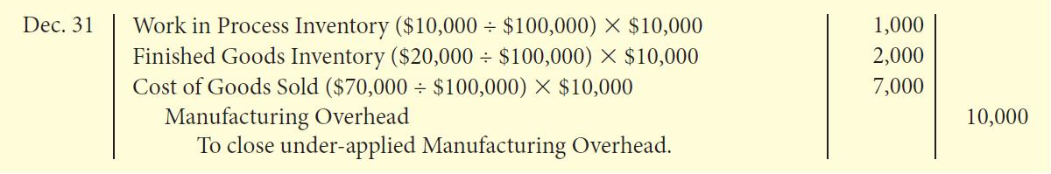
Proration Method
The underapplied or overapplied overhead is pro-rated among Work in Process Inventory, Finished Goods Inventory and Cost of Goods Sold.
As a result of this method, the total of these ending account balances equals the actual costs incurred.
Example:
Wallace Mfg. has $10,000 of underapplied overhead in Manufacturing Overhead at December 31. The adjusting entry to close the account would be:
3

Slide 51
Let’s Review
Suppose a firm has under-applied overhead at year-end. Which accounts are affected when using the proration approach?
  Cost of goods sold
  Work in process
  Finished goods
  All of the above
3

Slide 52
Let’s Review: Solution
Suppose a firm has under-applied overhead at year-end. Which accounts are affected when using the proration approach?
  Cost of goods sold
  Work in process
  Finished goods
  All of the above
3

Slide 53

Copyright
Copyright © 2012 John Wiley & Sons Canada, Ltd. All rights reserved. Reproduction or translation of this work beyond that permitted by Access Copyright (The Canadian Copyright Licensing Agency) is unlawful. Requests for further information should be addressed to the Permissions Department, John Wiley & Sons Canada, Ltd. The purchaser may make back-up copies for his or her own use only and not for distribution or resale. The author and the publisher assume no responsibility for errors, omissions, or damages caused by the use of these programs or from the use of the information contained herein.
3

