Slide 1
Weygandt-Kimmel-Kieso-Aly
1

Slide 2
Managerial
Accounting
1
Study Objectives
Explain the distinguishing features of managerial accounting.
Identify the three broad functions of management and the role of management accountants in an organizational structure.
Explain the importance of business ethics.
Identify changes and trends in managerial accounting.
1

Slide 3
Managerial Accounting Basics
Definition of Managerial Accounting:
A field of accounting that provides
economic and financial information
for managers and other internal users.
Also called Management Accounting.
1

Slide 4
Managerial Accounting Basics
Managerial Activities
Explain the field and substance of managerial accounting (Chapter 1).
Explaining various managerial cost concepts that are useful in planning, directing, and controlling. We also present cost flows and the process of cost accumulation in a manufacturing environment and costs and how they are reported in the financial statements (Chapter 2).
Calculate the cost of providing a service or manufacturing a product (Chapters 3, 4 and 5).
1

Slide 5
Managerial Accounting Basics
Managerial Activities: continued
Analyzing cost-volume-profit relationship within a company (Chapter 6).
Accumulating and presenting relevant data for management decision-making (Chapter 7).
Evaluating the impact on decision-making of alternative approaches for costing inventory (Chapter 8).
Determining prices for external and internal transactions (Chapter 9).
1

Slide 6
Managerial Accounting Basics
Managerial Activities: continued
Assisting management in profit planning and formalizing these plans in budgets (Chapter 10).
Providing a basis for controlling costs and expenses by comparing actual results with planned objectives and standard costs (Chapters 11 and 12).
Accumulating and presenting data for capital expenditure decisions (Chapter 13).
1

Slide 7
Managerial Accounting Basics
Distinguishing Features
Applies to all types of businesses – service, merchandising, and manufacturing
Applies to all forms of businesses – proprietorships, partnerships, and corporations
Applies to not-for-profit and profit-oriented companies
More responsible for strategic cost management
Team includes members from production, marketing, engineering, etc.
Aid in making critical decisions
1

Slide 8
Comparing Managerial and Financial Accounting
Similarities:
  Both deal with economic events of a business
  Both require that economic events be quantified and communicated to interested parties
1

Slide 9
Comparing Managerial and Financial Accounting
Differences:
Financial Accounting |  | Managerial Accounting
• External users: shareholders, creditors, and regulators • Financial statements • Quarterly and annually • General-purpose • Pertains to business as whole • Highly aggregated (condensed) • Limited to double-entry accounting and cost data • In accordance with generally accepted accounting principles • Audit by independent Accountant | Primary Users of Reports Types of Reports Frequency of Reports Purpose of Reports Content of Reports Verification Process | • Internal users: officers and managers • Internal reports • As frequently as needed • Special-purpose for specific decisions • Pertain to subunits of the business • Very detailed • Extends beyond double-entry accounting to any relevant data • Standard is relevance to decisions • No independent audits
1

Slide 10
Let’s Review
All of the following are distinguishing features of managerial accounting except:
internal users.
independent audits.
reports pertaining to subunits of the entity.
to provide special-purpose information.
1
10
Copyright John Wiley & Sons Canada, Ltd.

Slide 11
Let’s Review: Solution
All of the following are distinguishing features of managerial accounting except:
internal users.
independent audits.
reports pertaining to subunits of the entity.
to provide special-purpose information.
11
1
Copyright John Wiley & Sons Canada, Ltd.

Slide 12
Management Functions
Management's activities and responsibilities can be classified into the following three broad functions:
Planning
Decision-Making
Controlling
Directing
1

Slide 13
Management Functions:
Planning
Future Oriented – Looking ahead
Establish objectives such as
    Maximize short-term profit
    Long-term sustainability/growth
    Commit to environmental protection
Key Objective: Add value to the business
    Value measured by trading price of stock and by potential selling price of the company
1

Slide 14
Management Functions:
Directing
Coordinate diverse activities and human resources
Implement planned objectives
Provide incentives to motivate employees
Hire and train employees including executives, managers, and supervisors
1

Slide 15
Management Functions:
Controlling
Keep activities on track
Determine whether goals are met
Decide on the changes needed to get back on track
Typically use a formal system of evaluation
Good decision-making is the outcome of good judgment in planning, directing, and controlling.
1

Slide 16
Organizational Structure:
Organizational Chart
Prepared by most companies
Organizational charts identify the interrelationships of activities, the delegation of authority and the delegation of responsibility
Responsibilities within the company are frequently classified as either line or staff positions
  line positions are directly involved in the company's main revenue-generating operating activities
  staff positions are involved in activities that support the efforts of the line employees
1

Slide 17
A Typical Company's Organizational Chart
Shareholders
Chairperson
and
Board of Directors
President and
Chief Executive Officer
General Counsel
and Secretary
Vice-President
Marketing
Vice-President
Finance/ Chief
Financial Officer
Treasurer
Controller
Vice-President
Operations
Vice-President
Human
Resources
1

Slide 18
Let’s Review
The officer responsible for all of the accounting and finance issues a company faces is the:
Chief executive officer.
Chief financial officer.
Controller.
Treasurer.
1

Slide 19
Let’s Review: Solution
The officer responsible for all of the accounting and finance issues a company faces is the:
Chief executive officer.
Chief financial officer.
Controller.
Treasurer.
1

Slide 20
Good Ethics – Good Business
Business Ethics
Business scandals cause massive investment losses and employee layoffs
Corporate fraud has increased 13% in last five years
Employee fraud makes up 60% of all fraud, expense account abuse, theft of assets, etc.
Intentional misstatement of financial reports, or financial reporting fraud, is the most costly to companies
1

Slide 21
Good Ethics – Good Business
Creating Proper Incentives
Monitoring and evaluating employees may produce incentives to act unethically; for example, overly ambitious budgets may produce unethical management actions to meet targets
Employees may feel that they must succeed no matter what
Ineffective and unrealistic controls may result in declining quality of product
Good ethics add value to a company's image
1

Slide 22
Code of Professional Ethics
Competence
Confidentiality
Integrity
Objectivity
1

Slide 23
Accounting Organizations in Canada
Society of Management Accountants in Canada (SMAC)
Canadian Institute of Chartered Accountants (CICA)
Certified General Accountants' Association of Canada (CGA-Canada)
1

Slide 24
Let’s Review
Which of the following is not one of the categories in Standards of Ethical Conduct for Practitioners of Management Accounting and Financial Management?
Confidentiality
Competence
Integrity
Independence
1

Slide 25
Let’s Review: Solution
Which of the following is not one of the categories in Standards of Ethical Conduct for Practitioners of Management Accounting and Financial Management?
Confidentiality
Competence
Integrity
Independence
1

Slide 26
Managerial Accounting Today:
Service Industry Trends
North American economy in general has shifted toward an emphasis on providing services
Today, over 50% of U.S. and Canadian workers are employed by service companies
Trend is expected to continue in the future
1

Slide 27
Managerial Accounting Today:
Service Industry Trends: Continued
Managerial accounting has responded to the need for new systems to measure the cost of services
New operating controls have been designed to improve the quality and efficiency of specific services
Many of the techniques developed for manufacturing firms have been applied to service companies
1

Slide 28
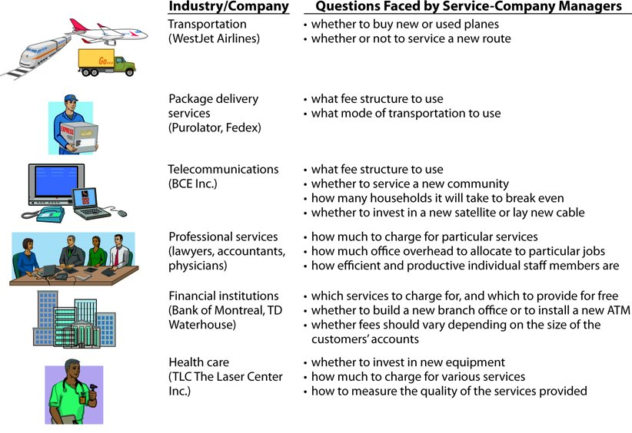
Managerial Accounting Today

Slide 29
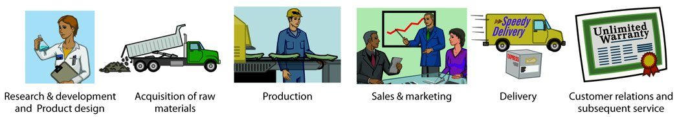
Managerial Accounting Today:
Managerial Accounting Practices
Value Chain
Refers to all activities associated with providing a product or service: From R&D and Product/Service design to after-sale service and Environmentally Responsible Disposal [ERD*]
For a manufacturing firm, these include:
1

Slide 30
Managerial Accounting Today:
Managerial Accounting Practices: Continued
Technological Change
Enterprise resource planning (ERP)
  Software systems that manage the value chain
  In large companies, an ERP system might replace as many as 200 individual software packages
Internet and business-to-business (B2B)
e-commerce
Computer-integrated manufacturing (CIM)
  Makes products untouched by human hands
1

Slide 31
Managerial Accounting Today:
Managerial Accounting Practices: Continued
Just-In-Time (JIT) Inventory Methods
  Inventory system in which goods are manufactured or purchased just in time for use
Quality/TQM
  Increased emphasis on product quality because goods are produced only as needed
  Total Quality Management (TQM) - a philosophy of zero defects; all employees participate in managing quality
1

Slide 32
Managerial Accounting Today:
Managerial Accounting Practices: Continued
Activity-Based Costing (ABC)
  Overhead is allocated based on each product's use of economic resources as it undergoes various activities (number of orders or number of machine set ups)
  Results in more accurate product costing and scrutiny of all activities in the value chain
Theory of Constraints
  Used to identify and manage constraints or “bottlenecks”
  Helps achieve overall goals of the company, particularly profits
1

Slide 33
Managerial Accounting Today:
Managerial Accounting Practices: Continued
Lean manufacturing
  Today most products require little direct labour to complete, due in large part to advancements in automation. Customers now dictate requirements to suppliers and often look for smaller quantities of individualized products. Lean manufacturing was developed in response to this changing manufacturing environment.
  Researchers have highlighted five basic principles that are crucial to the lean thinking process: 1. Define value 2. Identify the value stream 3. Make the value stream flow 4. Implement a pull system 5. Strive for perfection.
1

Slide 34
Managerial Accounting Today:
Managerial Accounting Practices: Continued
Balanced Scorecard
  A performance-measurement approach to evaluate operations in an integrated fashion
    Uses both financial and non-financial measures
  Links performance measures to overall company objectives
1

Slide 35
Let’s Review
All activities associated with providing a product or service is referred to as:
the value chain.
total quality management systems.
just-in-time inventory methods.
activity-based costing.
1

Slide 36
Let’s Review: Solution
All activities associated with providing a product or service is referred to as:
the value chain.
total quality management systems.
just-in-time inventory methods.
activity-based costing.
1

Slide 37

Copyright
Copyright © 2012 John Wiley & Sons Canada, Ltd. All rights reserved. Reproduction or translation of this work beyond that permitted by Access Copyright (The Canadian Copyright Licensing Agency) is unlawful. Requests for further information should be addressed to the Permissions Department, John Wiley & Sons Canada, Ltd. The purchaser may make back-up copies for his or her own use only and not for distribution or resale. The author and the publisher assume no responsibility for errors, omissions, or damages caused by the use of these programs or from the use of the information contained herein.
1

