Slide 1
ANP1105C Respiratory Anatomy 2013
Nov 26, 29 Dec 3 + exam review
Dr Staines

Slide 2
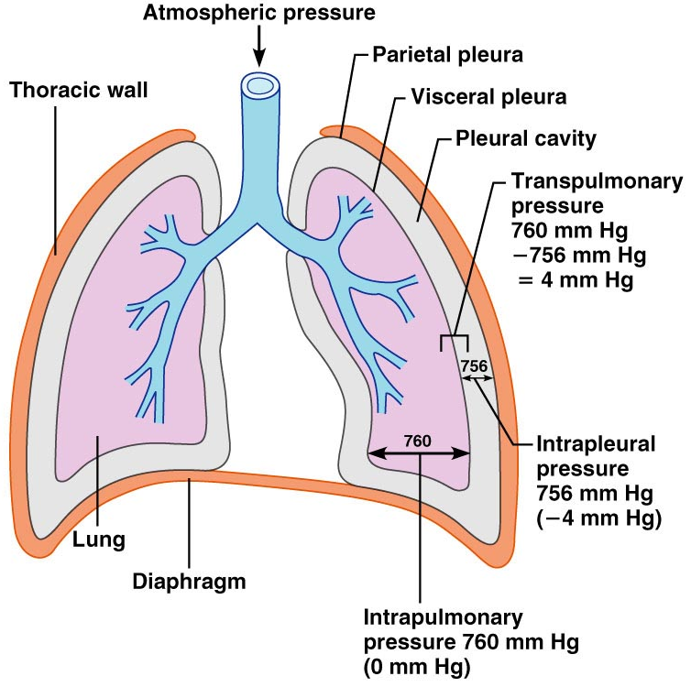
6.3 Define & explain the following: intrapulmonary, intrapleural and transpleural pressures
• breathing (pulmonary ventilation) = inspiration + expiration
• atmospheric pressure = pressure exerted by air around body (760mm Hg @ sea level)
respiratory pressures described relative to atmospheric pressure
eg: -4 mm Hg respiratory pressure = 760-4 = 756 mm Hg
Intrapulmonary pressure
• = pressure within alveoli of lungs
• rises & falls with breathing but always eventually equalizes with atmospheric
Fig. 22.12

Slide 3
Intrapleural Pressure
• pressure within pleural cavity
~4 mm Hg less than pressure in alveoli (less than atmospheric)
Interaction of 3 factors:
(i) natural tendency of lungs to recoil
(ii) surface tension of alveolar fluid
(iii) surface tension of pleural fluid + elasticity of chest wall
• net result is negative intrapleural pressure
Any condition equalizing intrapleural pressure with intrapulmonary (or atmospheric) pressure causes immediate lung collapse!
lungs in separate pleural cavities »» one can collapse & not the other
transpleural pressure = intrapulmonary minus intrapleural pressure

Slide 4
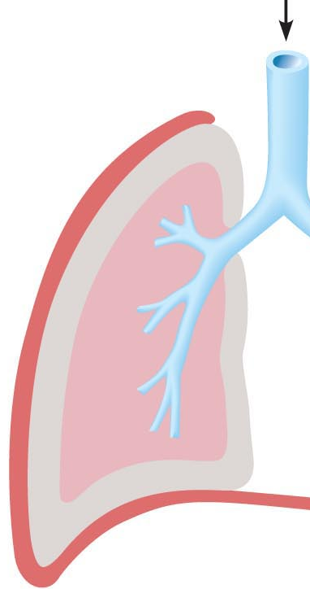
6.4 Explain the roles of the diaphragm & accessory muscles during inspiration and expiration (quiet & forced)
diaphragm & intercostal muscles
increase volume of thoracic cavity » decrease pressure of gas inside » air rushes in through only opening (trachea)
Quiet Inspiration:
(i) diaphragm contracts to increase height of thoracic cavity
(ii) intercostals contract to lift rib cage up & pull sternum forward to increase thorax diameter
• mm changes in each direction but overall increase in volume of about 0.5 L and drop in intrapulmonary pressure of about 1 mm Hg
• air rushes in; inspiration ends when intra-pulmonary pressure = atmospheric pressure
• at same time, intrapleural pressure drops to about -6 mm Hg

Slide 5
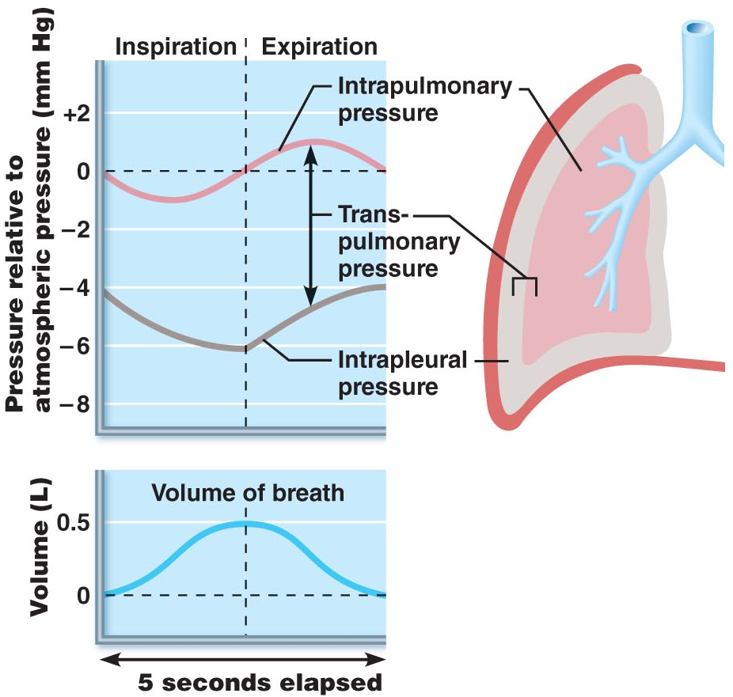

Quiet Expiration:
passive; depends more on elastic recoil of lungs than on muscle contraction
inspiratory muscles relax ➢ rib cage descends & lungs recoil ➢ thoracic & intrapulmonary volumes decrease ➢ alveoli compress/intrapulmonary pressure to +1 mm Hg ➢ gas out
Deep/forced inspiration
accessory muscles (neck & chest) raise ribs more; extend back by straightening spine
Forced expiration:
(i) contract abdominal wall muscles: increase intra-abdominal pressure
(ii) depress rib cage
Fig. 22.14
J. Carnegie, UofO

Slide 6

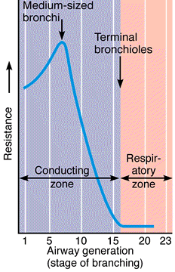
6.5 Explain the 3 factors that influence pulmonary ventilation
6.5.1: Resistance
gas flow = pressure gradient / resistance
• resistance determined by diameters of conducting tubes
• usually insignificant in healthy individuals because:
(i) airway diameters at beginning are large
(ii) gas flow stops at terminal bronchioles (diffusion)
• greatest resistance at level of medium bronchi
Neural influences:
(i) parasympathetic (eg: inhaled irritants,histamine): constricts bronchioles
also occurs during acute asthma attack
(ii) sympathetic: dilates bronchioles
• disease: eg: mucus, infectious material, solid tumours = sources of airway resistance
Resistance
J. Carnegie, UofO
Fig. 22.15

Slide 7
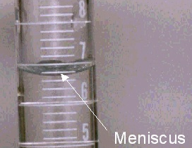

6.5.2 Alveolar Surface Tension
surface tension: at any gas/liquid boundary, molecules of liquid more strongly attracted to each other than to the gas »» tension at liquid surface
(a) liquid molecules drawn closer; reduce contact with dissimilar gas molecules
(b) resists any force to increase surface area
• water has a very high surface tension - water only in alveoli would cause collapse
• surfactant: detergent-like lipoprotein produced by type II cells; interferes with cohesiveness of water molecules »» less energy to overcome surface tension
Infant respiratory distress syndrome (IRDS): premature babies produce too little surfactant; alveoli must be re-inflated with every breath (positive pressure respirators, surfactant spray)

Slide 8
6.5.3 Lung Compliance
• ease with which lungs can be distended
C_{L} = V_{L} / P
• the more a lung expands for a given increase in transpulmonary pressure, the greater its compliance
• depends on: (a) distensibility of lung tissue
(b) alveolar surface tension
• compliance is diminished by any factor that:
(i) reduces natural resilience of lungs (eg: fibrosis)
(ii) increases surface tension of alveolar fluid
(iii) impairs flexibility of thoracic cage (ossification of costal cartilages with aging)
• elasticity of lungs important for both inspiration & expiration
J. Carnegie, UofO

Slide 9
6.6 Describe how lung volumes and capacities are measured and indicate their physiological significance
1. Respiratory Volumes:
below are shown normal values for healthy, 20 yr male (70 kg)
a) tidal volume: ~500 ml/breath; quiet breathing
b) inspiratory reserve volume: volume forcibly inspired after tidal volume
c) expiratory reserve volume: volume forcibly expired after tidal volume
d) residual volume: ~1200 ml remains in lungs even after forceful expiration (maintains alveolar patency)
6000
Inspiratory reserve volume - 3100 ml
Inspiratory capacity - 3600 ml
Vital capacity 4800 ml
Total lung capacity 6000 ml
3000
Tidal volume - 500 ml
2400
Expiratory reserve volume - 1200 ml
Functional residual capacity - 2400 ml
1200
Residual volume-1200ml
0

Slide 10
2. Respiratory Capacities:
always consist of 2 or more lung volumes
a) inspiratory capacity: air that can be inspired after tidal expiration
b) functional residual capacity: amount of air still in lungs after tidal expiration
c) vital capacity: total amount of exchangeable air
d) total lung capacity: sum of all lung volumes - can we measure this???
J. Carnegie, UofO
6000
Inspiratory reserve volume - 3100 ml
Inspiratory capacity - 3600 ml
Vital capacity 4800 ml
Total lung capacity 6000 ml
3000
Tidal volume - 500 ml
2400
Expiratory reserve volume - 1200 ml
Functional residual capacity - 2400 ml
1200
0
Residual volume-1200ml

Slide 11
6.7 Define dead space and indicate its importance in minute and alveolar ventilation
air that fills passageways - doesn’t participate in gas exchange (~150 ml or body weight in lb)
500 ml tidal volume = 150 ml dead space + 350 ml alveolar ventilation
Note: if some alveoli no longer functional: total dead space = 150 ml + alveolar dead spaces
What happens to the relative contribution of dead space to lung ventilation if volume of air exchange/breath increases?

Slide 12
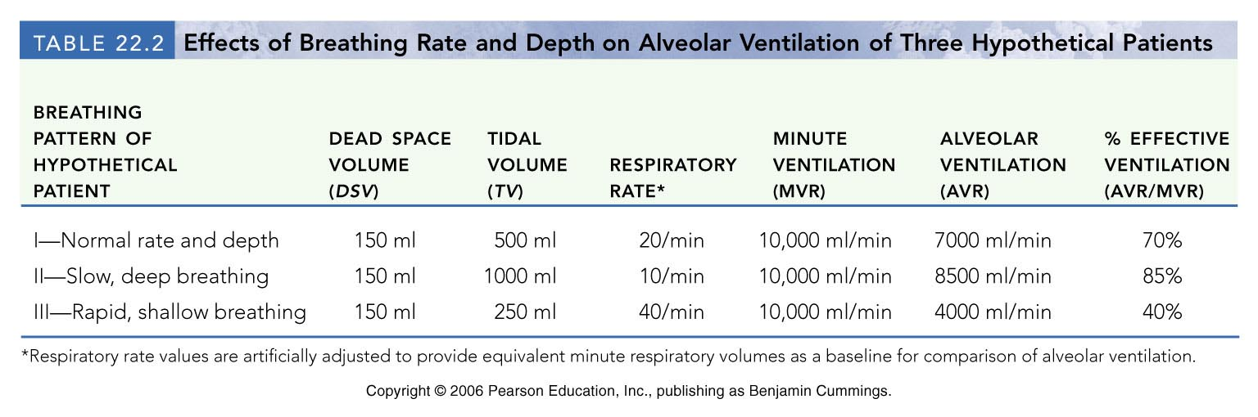
• AVR is a better index of effective ventilation
• takes into account volume of air wasted in dead space areas & measures flow of fresh gases in and out of alveoli/unit time
AVR (ml/min) = frequency (breaths/min) x (TV-dead space) (ml/breath)
• if healthy: AVR = 12 x (500-150) = 4200 ml/min
• to increase AVR, better to increase volume of each inspiration rather than increase respiration rate - why?? Look at table 22.2

Slide 13


6.8 explain the mechanisms underlying some of the non-respiratory air movements
hiccups: spasms of diaphragm; irritation of phrenic nerve; air hits vocal folds of closing glottis
yawn: very deep inspiration that ventilates all alveoli; not believed to be triggered by oxygen or carbon dioxide levels in blood
cough: blast of air shot out from lungs through briefly opened glottis – to dislodge foreign particles, mucus from lower respiratory tract
sneeze: like a cough but air forced through nasal cavity to clear upper respiratory passageways
J. Carnegie, UofO

Slide 14
6.9 State Dalton’s Law and use it to describe the composition of atmospheric & alveolar air
Dalton’s Law of Partial Pressures:
• total pressure exerted by a mixture of gases = sum of pressures exerted by each gas (partial pressure) in mixture »» partial pressure of each gas directly proportional to its % in mixture
ATMOSPHERE (sea level) ALVEOLI
GAS % PP (mm Hg) % PP (mm Hg)
N₂
O₂
CO₂
H₂O
78.6
20.9
0.04
0.46
597
159
0.3
3.7
74.9
13.7
5.2
6.2
569
104
40
47
• high altitude: all partial pressures decrease in direct proportion
• below sea level: atmospheric pressure increases by 1 atmosphere (760 mm Hg) for every 33 feet down (in water); partial pressures increase accordingly
J. Carnegie, UofO

Slide 15
B. Composition of Alveolar Gas
• different from atmospheric (more CO₂, H₂O; less O₂)
• these differences are because:
(i) O₂ from air to blood & CO₂ from blood to air in lungs
(ii) conducting zone passageways have humidified the air
(iii) alveolar gas mixed with new “atmospheric” gas with every breath
• increased depth of breathing increases alveolar PO₂ & decreases PCO₂
ATMOSPHERE (sea level) ALVEOLI
GAS % PP (mm Hg) % PP (mm Hg)
N₂
O₂
CO₂
H₂O
78.6
20.9
0.04
0.46
597
159
0.3
3.7
74.9
13.7
5.2
6.2
569
104
40
47
J. Carnegie, UofO

Slide 16
6.11 List and describe 3 factors that influence the exchange of oxygen and of carbon dioxide at the level of the lungs (external respiration)
• rate of exchange of O₂ and CO₂ in lungs dependent on:
(1) PP gradients & gas solubilities
(2) structural characteristics of respiration membrane
(3) ventilation/perfusion coupling
1. PP Gradients & Gas Solubilities (see Fig. 22.17)
• steep gradient for O₂ pick-up at lungs: ~104 mm Hg vs ~40 mm Hg
• equilibrium (104 mm Hg on both sides of respiratory membrane) in ~0.25 sec (1/3 time RBC is in pulmonary capillary); What does this mean about level of oxygenation with a faster rate of blood flow??
• CO₂ gradient much flatter: 40 mm Hg vs 45 mm Hg
• equilibrium at 40 mm Hg & gradually expelled during expiration
note that equal amounts of CO₂ and O₂ exchanged (even though PP gradients very different) because CO₂ 20X more soluble in plasma & alveolar fluid than O₂!!
J. Carnegie, UofO

Slide 17
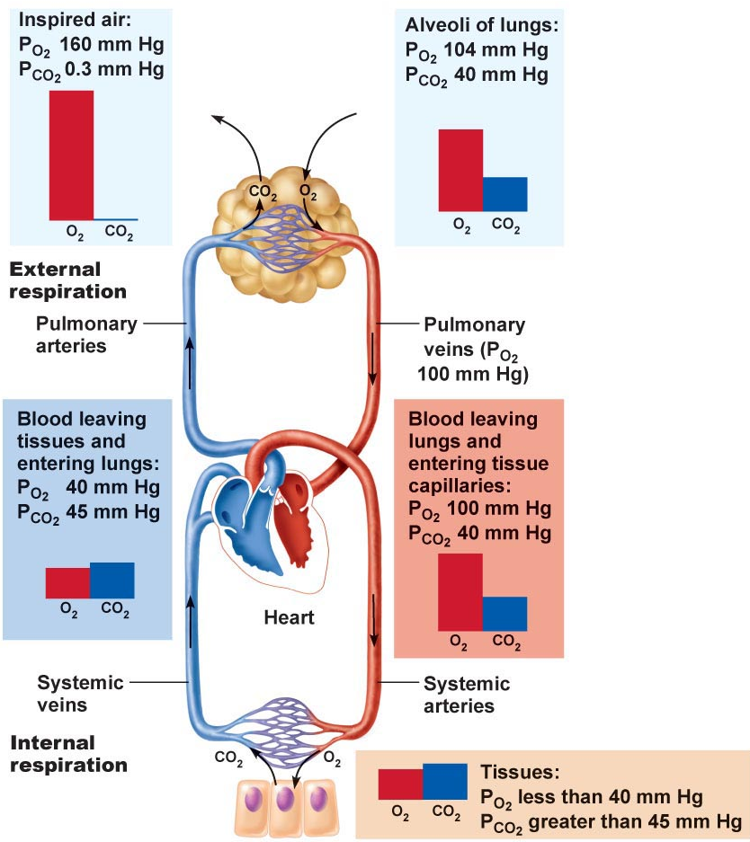
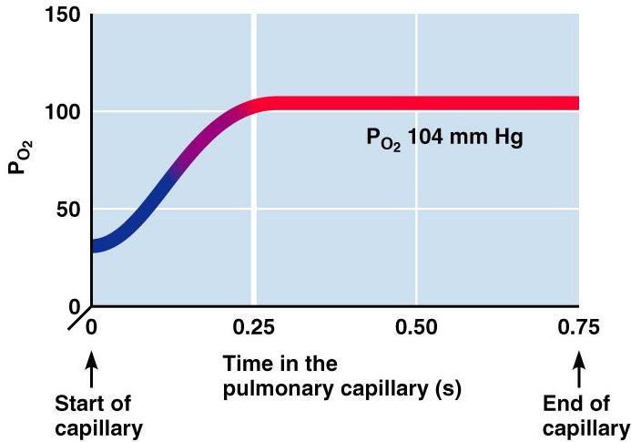
Fig. 22.18
Fig. 22.17

Slide 18
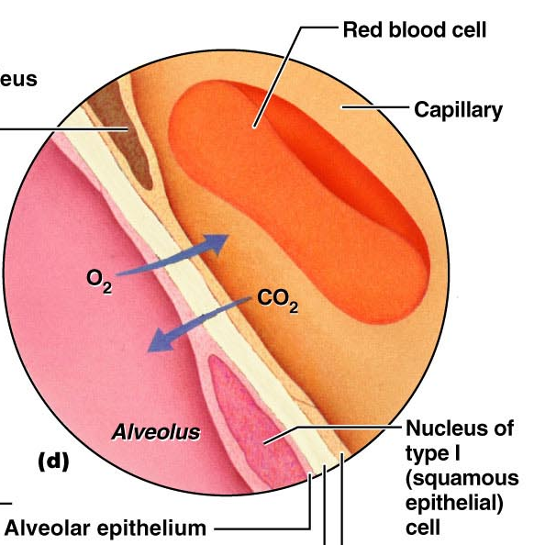
2. Structural Characteristics of Respiratory Membrane
Thickness: 0.5-1 μm (healthy lungs); pneumonia »» fluid uptake, increasing thickness and decreasing rate of gas exchange
Surface area: huge (~140 m² if healthy, 40x SA of skin!); reduced markedly in emphysema, by tumors, mucus, inflammatory material

Slide 19
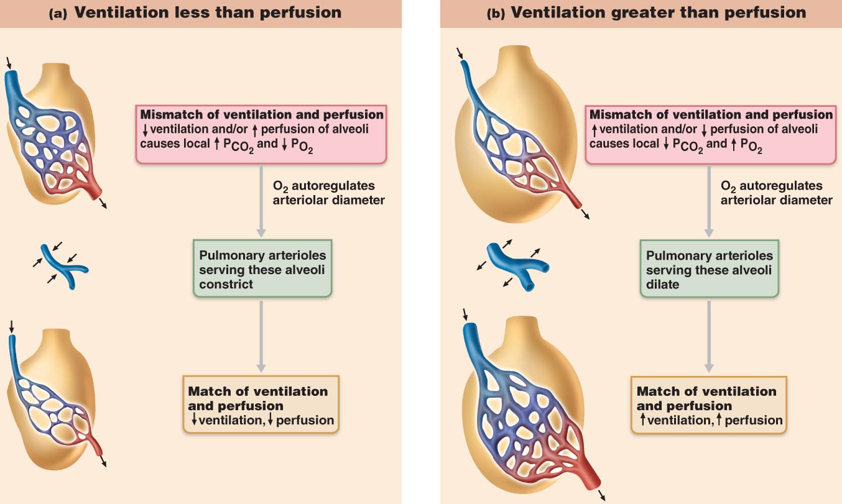
3. Ventilation-perfusion coupling
• = coupling between amount of gas reaching alveoli & blood flow in pulmonary capillaries; local autoregulation
• arteriole diameter based on PO₂: in alveoli where ventilation is poor, PO₂ is low and arterioles constrict »» blood redirected to where PO₂ is high (arterioles dilate)
• bronchiole diameter influenced by PCO₂: high alveolar PCO₂ causes bronchioles to dilate »» CO₂ eliminated more rapidly; where PCO₂ low, bronchioles constrict
Fig. 22.19

Slide 20
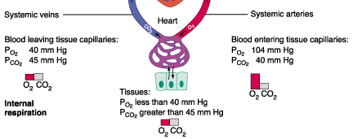
6.12 Describe the partial pressure gradients that drive oxygen and carbon dioxide movements at the level of the tissues (internal respiration)
• same sort of PP gradients at work, but in other direction
in tissues: PO₂ < 40 mm Hg (104 arterial) & PCO₂ > 45 mm Hg (40 arterial)
• exchanges occur & venous blood draining tissues has PO₂ of 40 mm Hg and PCO₂ of 45 mm Hg (like that entering lungs!)
external & internal respiration: diffusion driven by PP gradients!!
J. Carnegie, UofO

Slide 21
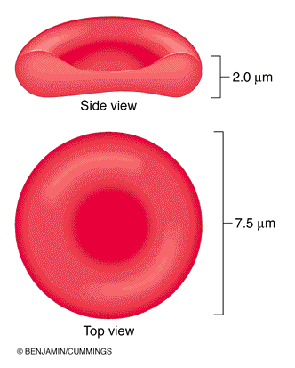
6.13 Describe completely the transport of oxygen in the blood
Oxygen Transport
• carried in blood in 2 ways:
(i) bound to hemoglobin within RBCs
(ii) dissolved in plasma (~1.5%; O₂ poorly soluble in water)
• note that biconcave shape of erythrocytes makes them excellent O₂ transport & exchange vehicles
• hemoglobin is composed of 4 polypeptide chains; each chain has an iron-containing heme group (binds O₂)
• oxyhemoglobin = HbO₂; reduced hemoglobin = HHb
HHb + O₂ HbO₂ + H⁺
Fig. 17.3

Slide 22
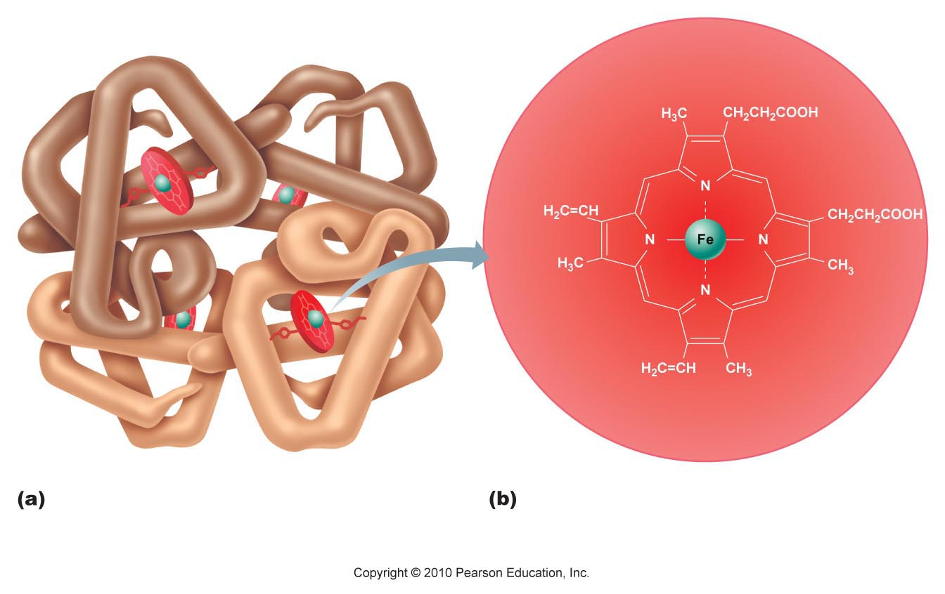
• O₂ is loosely bound; transported to tissues as molecular oxygen
• cooperation between 4 polypeptides for O₂ loading and unloading
• affinity of Hb for O₂ depends on its level of saturation
• fully saturated hemoglobin: all 4 hemes have bound O₂
• partially saturated hemoglobin: 1, 2 or 3 hemes have bound O₂
•rate of O₂ binding/release depends on:
(i) PO₂
(ii) temperature
(iii) blood pH
(iv) PCO₂
(v) [BPG] in blood
Fig. 17.4
J. Carnegie, UofO

Slide 23
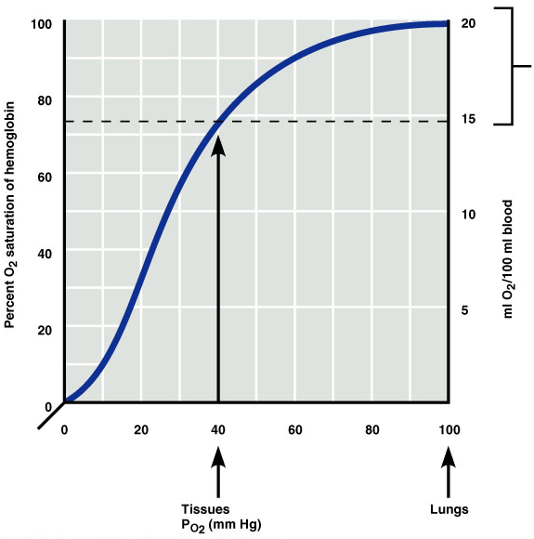
6.14 Explain the sigmoidal nature of the oxygen-hemoglobin dissociation curve
steep slope at 10 to 50 mm Hg; plateaus at 70-100 mm Hg
Hb in blood leaving lungs (PO₂=104 mm Hg) is 98% saturated
at level of tissues (PO₂<40 mm Hg) Hb ~ 75% saturated (how many ml O₂/100 ml blood released??)
Hb almost completely saturated at PO₂ of 70 mm Hg; (significance wrt high altitude, cardiopulmonary disease?)
venous reserve: only 25% O₂ unloaded during first pass thru tissues; (significance in terms of vigorous exercise??)
Fig. 22.20

Slide 24
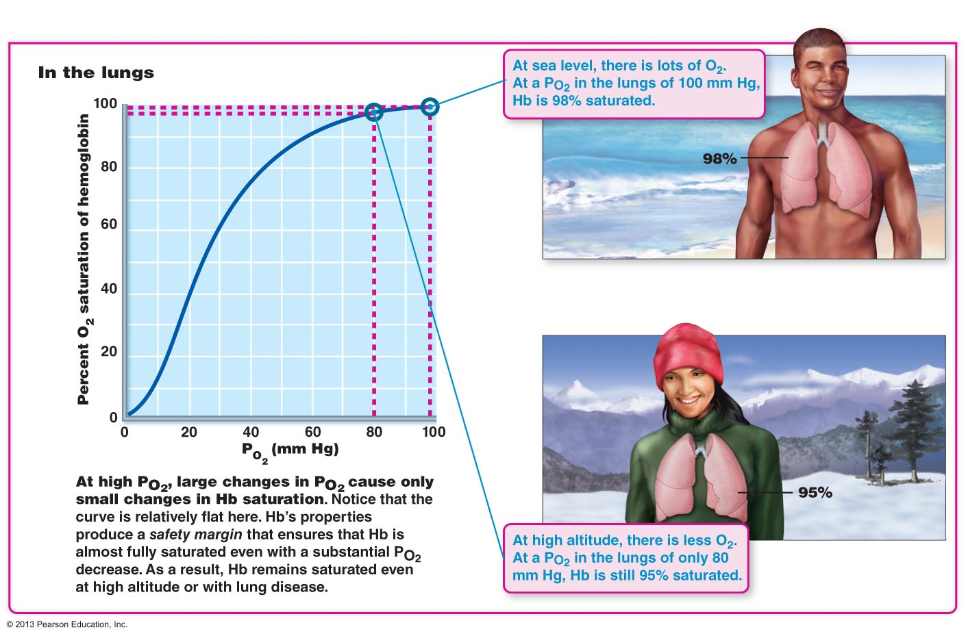

Slide 25
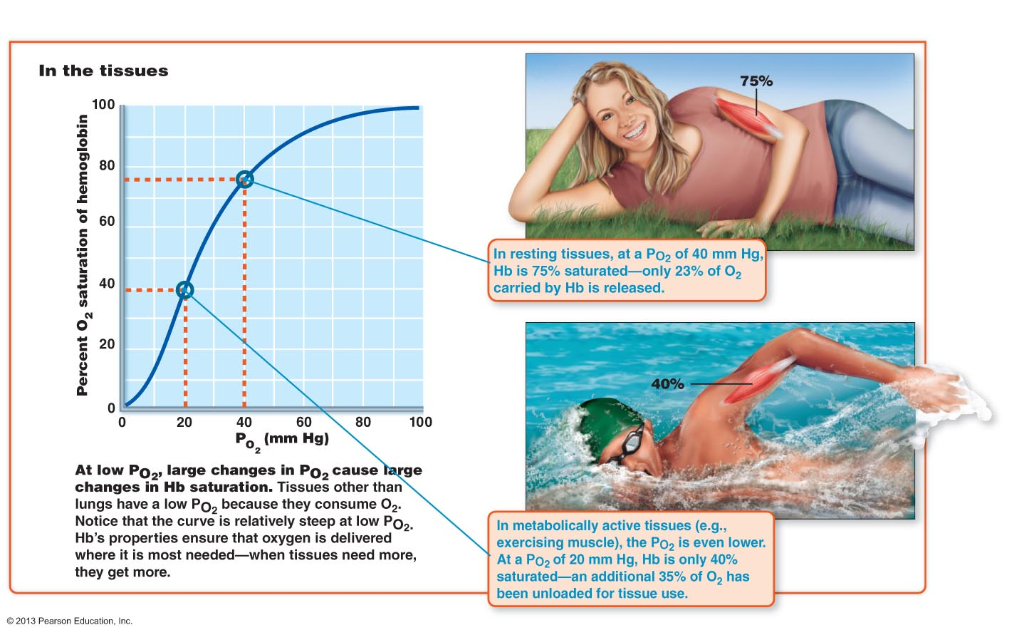

Slide 26
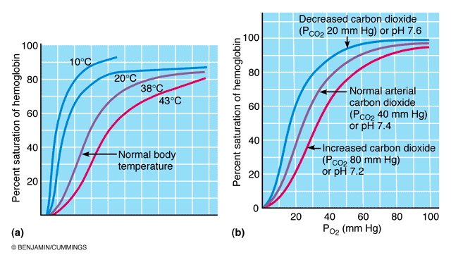
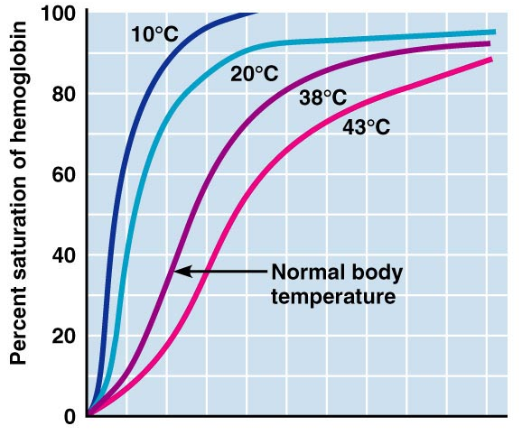
Fig. 22.21
Temperature, pH, PCO₂, BPG & Hb Saturation
• BPG: 2,3-biphosphoglycerate - produced by RBCs when they metabolize glucose anaerobically; binds reversibly to Hb
• influence Hb saturation by altering 3-D structure - modifying affinity for O₂:
a) an increase in temp, PCO₂, H⁺, BPG »» decreases affinity of Hb for O₂ (curve shifted to right) »» increases O₂ unloading from blood
b) decrease these factors increases Hb affinity for O₂ (curve shifted to left)

Slide 27
Makes sense because:
a) CO₂ highest at level of tissues
b) CO₂ release  H⁺ content of blood
CO₂ + H₂O H₂CO₃ HCO₃⁻ + H⁺
Note: weakening of Hb-O₂ bond by acidosis is called the Bohr effect ⇒ ensures that O₂ is released quickly where most needed
c) heat is a by-product of metabolic activity » temp is direct (RBC metabolism) and indirect (RBC synthesis of BPG)
J. Carnegie, UofO

Slide 28
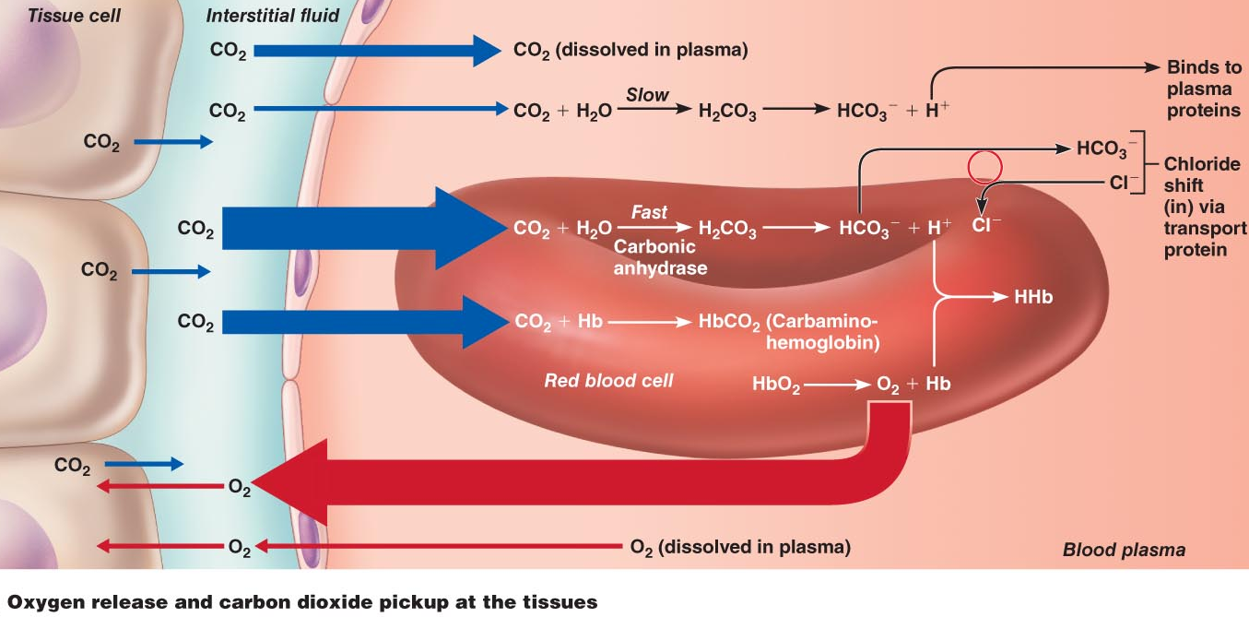
6.15 Describe completely the 3 ways in which CO₂ is transported in the blood
• normal active body cells produce ~200 ml CO₂/min = amount excreted by lungs/min
• transported in blood from tissues to lungs in 3 ways
Fig. 22.22a

Slide 29
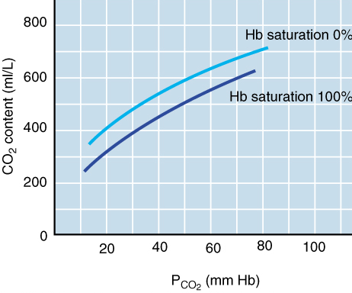
1) Dissolved in plasma: 7-10%
2) Bound to Hb: 20-30%; carbaminohemoglobin; note that CO₂ binds to amino acids of Hb, not the heme part, so no competition for O₂ binding sites!
• loading & unloading of CO₂ to and from Hb dependent on:
(a) PCO₂: (low in lungs »» dissociates; high in tissues »» binds)
(b) Hb saturation: HHb (tissues) binds more CO₂than HbO₂ (lungs) - Haldane effect
3) Bicarbonate ion in plasma: conversion to H₂CO₃ (unstable) and then HCO₃⁻ + H⁺ occurs in RBCs (contain carbonic anhydrase)
chloride shift: bicarbonate ions diffuse quickly to plasma; neg charge balanced by movement of Cl⁻ into RBCs
Fig. 22.23: Haldane effect
J. Carnegie, UofO

Slide 30
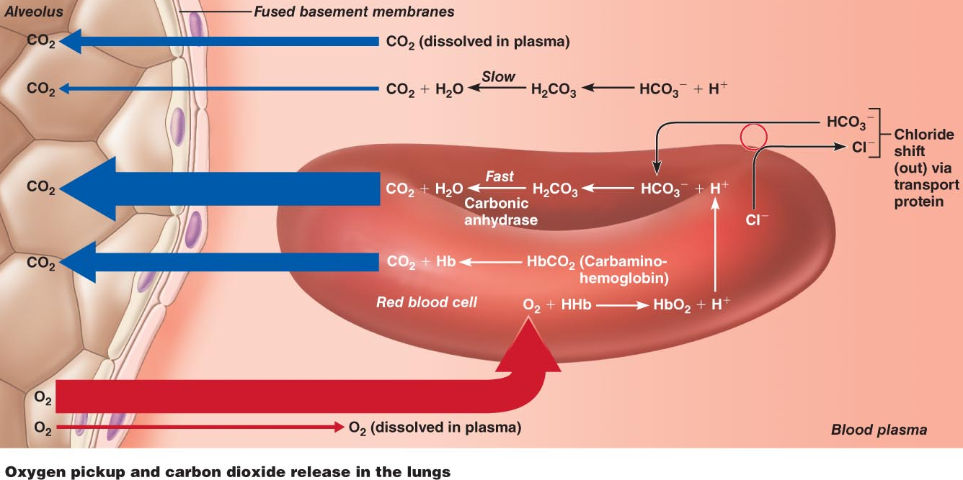
2. Process is reversed in the lungs:
1) Dissolved in plasma: moves out
2) Bound to Hb: released and moves out
3) Bicarbonate ion: back into RBC, back to CO₂ and H₂O and moves out
Fig. 22.22b

Slide 31
6.17 Associate carbon dioxide levels with blood pH; explain how respiration can regulate blood pH
CO₂ + H₂O H₂CO₃ HCO₃⁻ + H⁺
• H⁺: buffered by Hb or proteins in RBCs/plasma
• HCO₃⁻: diffuses into plasma »» alkaline reserve part of carbonic acid-bicarbonate buffer system
a) slow, shallow breathing »» CO₂ accumulates in blood »» carbonic acid accumulates and blood pH drops
b) rapid, deep breathing »» CO₂ flushed out of blood »» carbonic acid levels drop & blood pH rises
respiratory ventilation provides a fast-acting system to adjust blood pH and plays a major role in blood acid/base balance
J. Carnegie, UofO

Slide 32
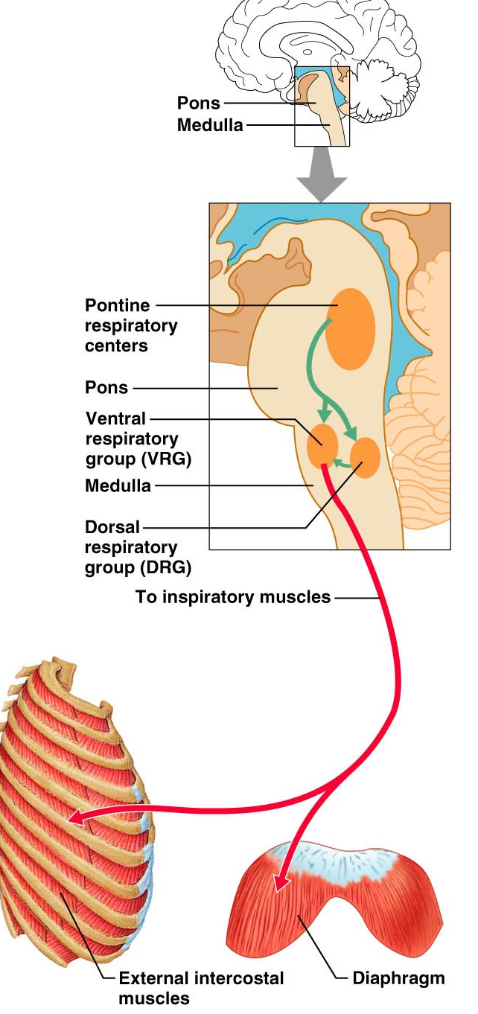
6.18 Describe how respiration is controlled by the nervous system
for control of breathing: neurons in medulla & pons
2 areas in medulla oblongata:
ventral respiratory group (VRG): network in ventral brain stem- upper end of spinal cord to pons/medulla junction
(2) dorsal respiratory group (DRG): cluster of neurons located dorsally near root of cranial nerve IX
Ventral Respiratory Group (VRG)
pacesetting resp centre = inspiratory centre
• via phrenic and intercostal nerves, stimulates contraction of ??? »» thorax expands ⇒ inspiration
• then VRG becomes dormant »» passive expiration (muscles relax, lungs recoil)
• eupnea = 12-15 breaths/min (2 sec in/3 sec out)
• overdose of sleeping pills, morphine, alcohol »» complete suppression of VRG »» What happens to respiration??
Fig. 22.24
J. Carnegie, UofO

Slide 33
6.20 Indicate the influences of PCO₂, PO₂ & arterial pH on respiration rate
• most important: changing levels of CO₂, O₂, H⁺
• chemoreceptors: (i) bilaterally in medulla (central)
(ii) great vessels of neck (peripheral)
CO₂ (and pH):
• most potent/closely controlled (arterial PCO₂ + 3 of 40 mm Hg)
• peripheral receptors only weakly influenced by PCO₂; regulation is via medullary chemoreceptors
• CO₂ to cerebrospinal fluid »» hydrated to carbonic acid »» liberates H⁺ (CS fluid cannot buffer) »» pH of CS fluid drops, exciting central chemoreceptors »» increased rate & depth of breathing
hypercapnia = increased PCO₂
hyperventilation = increased rate/depth of breathing
• hyperventilation is self-limiting: ends when PCO₂ back to normal
Note that H+ is trigger for chemoreceptors (even tho initiated by increased CO₂); “. . . control of breathing during rest is aimed primarily at regulating [H+] in brain”

Slide 34
Influence of PO₂:
• arterial oxygen sensors in aortic bodies (aortic arch) & carotid bodies
• small changes just increase sensitivity of receptors to PCO₂
• need large drop in PO₂ (to < 60 mm Hg) before a major stimulus for increased ventilation (Hb saturated at PO₂ > 60 mm Hg)
Clinical application: emphysema, chronic bronchitis: chronically elevated PCO₂ »» chemoreceptors become nonresponsive & PO₂ takes over (what is hypoxic drive??)
Dorsal Respiratory Group (DRG)
• DRG used to be thought of as the inspiratory centre – now VRG recognized to have that function
• role in integrating incoming information from peripheral stretch and chemoreceptors
• still not completely understood

Slide 35
1 Why does a stab wound to the chest cause the lung to collapse?
a) the injury increases surface tension within the alveoli
b) the intrapleural pressure increases
c) pressure within the lung increases
d) surface tension within the alveoli increases
3. How is most carbon dioxide transported in the blood?
a) by hemoglobin
b) as bicarbonate
c) by pulmonary surfactants
d) dissolved in plasma
4. Which group is incorrect?
a) pulmonary volumes: tidal, inspiratory reserve, expiratory reserve
b) paranasal sinuses: frontal, maxillary, sphenoidal, ethmoidal
c) parts of the pharynx: oropharynx, nasopharynx, laryngopharynx
d) none of the above
J. Carnegie, UofO

Slide 36
6.19 Indicate the effects of the following factors on respiration: Hering Breuer reflex, hypothalamus, cortex
Hering Breuer Reflex (Inflation Reflex)
stretch receptors in visceral pleurae & conducting passages stimulated when lungs inflate strongly
send inhibitory impulses to medullary respiratory centres to terminate inspiration and allow expiration
lungs recoil, stretch receptors become quiet; inspiration initiated again
• reflex thought to be more protective (overstretching of lungs) than a feature of normal regulation because threshold in humans is very high
Hypothalamic Controls
• involuntary: strong emotions/pain (eg gasp, breath-holding when angry,. . )
Cortical Controls
• instances of conscious control over rate/depth of breathing (eg: holding breath, deciding to take a deep breath)
• bypass medullary centres: direct signals from cerebral motor cortex to motor neurons that stimulate respiratory muscles
• when [CO₂] in blood too high, respiratory centres take over
J. Carnegie, UofO

Slide 37
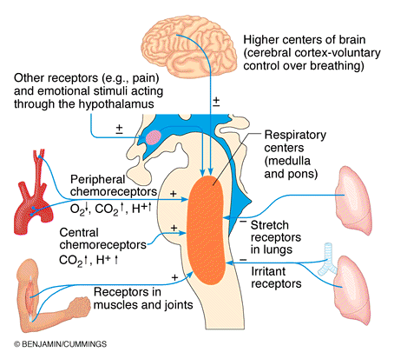
Fig. 22.25: Neural and chemical influences on brain stem respiratory centres
Some consequences:
1) Anxiety attacks: hyperventilate involuntarily ⇒ hypocapnia ⇒ cerebral vessels constrict ⇒ cerebral ischemia ⇒ dizzy, faint (how to handle this??)
Low PCO₂: respiration inhibited (hypoventilation) »» can have periods of apnea ⇒ increased PCO₂ stimulates respiration

Slide 38
Arterial pH:
• pH can alter breathing even if PCO₂ & PO₂ are normal (eg: lactic acid, ketone bodies)
• H⁺ diffuses poorly into CS fluid; effects of low pH mediated by increased PCO₂
• increased respiration in response to blood pH via peripheral receptors
In summary:
(i) body’s need to get rid of CO₂ is driving factor
(ii) normal conditions: low PO₂ just augments effect of hi PCO₂ & high PO₂ decreases effectiveness of PCO₂ stimulation
(iii) PO₂ < 60 mm Hg »» hypoxic drive via peripheral chemoreceptors
(iv) arterial pH acts via peripheral receptors; no direct influence in central receptors
J. Carnegie, UofO

Slide 39
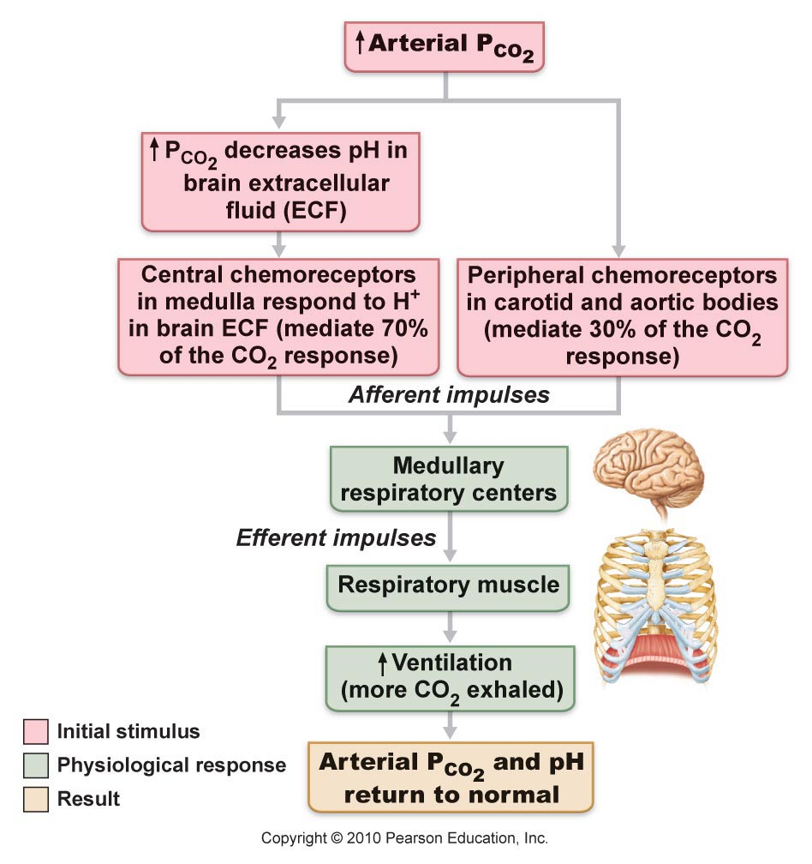
Fig. 22.25

Slide 40

6.21 Discuss the mechanisms controlling respiration during intense exercise
• geared to intensity & duration of exercise
• tremendous increase in O₂ consumption & CO₂ production
How does hyperpnea differ from hyperventilation???
• respiratory changes not elicited by increased PCO₂/ decreased PO₂ or pH:
(i) ventilation increases abruptly, then gradual rise to steady state; post-exercise, decreases abruptly then gradual decline to pre-exercise levels
(ii) venous levels change, but arterial PO₂ & PCO₂ remain ~constant

Slide 41
Our present understanding:
1) abrupt increase = psychic stimuli (anticipation) + cortical motor activation of skeletal muscles & respiratory centres + proprioceptors in moving muscles, tendons & joints stimulate respiratory centres
2) gradual increase to steady state: likely due to rate of CO₂ delivery to lungs
3) abrupt decline: shutting off of neural mechanisms
4) gradual decline to baseline: repayment of oxygen debt
Why is inhaling pure O₂ by football players to quickly replenish O₂-starved bodies not helpful??
Respiration Rates:
Newborns 40-80/min
Infants ~30/min
5 years ~25/min
adults 12-18/min
old age >12-18/min
J. Carnegie, UofO

