Slide 1
MOS 1021A
Consumer Behaviour

Slide 2
Consumer Behaviour
Actions a person takes when purchasing and using products and services

Slide 3
The Consumer Purchase Decision Process
The consumer purchase decision process is influenced by:
  Situational influences
  Psychological influences
  Socio-cultural influences

Slide 4
The Consumer Purchase Decision Process
2.
Information Search: seeking value
1.
Problem Recognition: perceiving a need
3.
Evaluation of Alternatives: assessing value
4.
Purchase decision: buying value
5.
Post-Purchase Behaviour: value in consumption or use

Slide 5
1. Problem Recognition
Perceiving a need – 2 criteria need to be met:
  Someone realizes there is a difference between what they have and what they would like to have
  Something triggers them to do something about it
Good marketing can trigger consumers to want to take action
  i.e. you see an ad that makes you feel that your clothes are outdated

Slide 6
2. Information Search
Information Sources
Internal Search – scan your memory for previous experiences with products/brands
External Search – if you do not have past experience
Personal Sources – relatives and friends
Public Sources – online research, product-rating organizations
Marketer-Dominated Sources – advertising, company websites, salespeople

Slide 7
3. Evaluation of Alternatives
Evaluative Criteria
  During the information search phase a consumer learns various criteria that can be used to evaluate the alternatives
Evaluative criteria can represent both:
  Objective attributes (can be measured/quantified): i.e. buying a smartphone: number of apps, download speed, battery life
  Subjective attributes (based on personal feelings): i.e. buying a smartphone: Apple is the “cool” brand to own
These criteria will determine your Evoked Set
  The group of brands a consumer will consider buying from the product class i.e. you will consider an iPhone or a Android, but not a Blackberry
  the consumer develops a “shortlist” of brands they’ll consider

Slide 8
4. Purchase Decision: Buying Value
3 decisions:
  Which brand – based on your evoked set
  Who to buy from
  When to buy

Slide 9
5. Post-Purchase Behaviour
Consumer compares the value received from the product to their expectations
  How satisfied someone is with their purchase
  Affects future purchase behaviour
  A dissatisfied customer will tell more people about it vs. a satisfied customer
    This effect is amplified with social media
Cognitive Dissonance
  Post-purchase feeling that you didn’t make the right choice
  To deal with this consumers look for information that confirms their decision and discredits the other alternatives
    Have you ever done this before?

Slide 10
Problem-Solving Variations
Depending on the level of involvement, sometimes consumers will skip or put little effort into some of the steps
  This will happen for low-involvement purchases (i.e. buying a pack of gum)
  High-involvement purchases will go through all the steps (i.e. buying a car)
High involvement purchases have at least one of these characteristics:
  Expensive
  Bought infrequently
  Could reflect on one’s social image

Slide 11
Problem-Solving Variations
Routine Problem Solving
  Little effort seeking external information and evaluating alternatives
  Low involvement decision making
Limited Problem Solving
  Low involvement but significant perceived differences among brands
  Tendency to rely more on past experience than external information
Extended Problem Solving
  Use each of the 5 stages – considerable time and effort

Slide 12
Problem-Solving Variations
Low Consumer Involvement High
Characteristics of Purchase Decision | Routine Problem Solving | Limited Problem Solving | Extended Problem Solving
Number of brands examined | One | Several | Many
Number of sellers considered | Few | Several | Many
Number of product attributes evaluated | One | Moderate | Many
Number of external information sources used | None | Few | Many
Time spent searching | Minimal | Little | Considerable

Slide 13
Situational Influences on Consumer Behaviour
Purchase Task
  Reason for engaging in the decision – i.e. for yourself or a gift?
Social Surroundings
  Other people present during purchase – i.e. 2 people together spend more time in the store than if they were alone
Physical Surroundings
  Décor, music, crowding, smell – i.e. crowding can be both good and bad
Temporal Effects
  Time related: time of day, time available – i.e. more shopping is done on the weekend
Antecedent States
  Something already in place before purchase process starts – i.e. your mood or the amount of money you have to buy

Slide 14
Psychological Influences on Consumer Behaviour
Marketers need to understand how consumers think and why they behave as they do
To gain an understanding of we must look at:
  Motivation
  Personality
  Perception
  Learning
  Values, beliefs, and attitudes
  Lifestyle

Slide 15
Motivation
Marketers need to understand what a consumer’s motivations are
  Motivations are driven by needs
  Marketers must analyze consumer needs and determine which need(s) they are trying to satisfy with a product

Slide 16
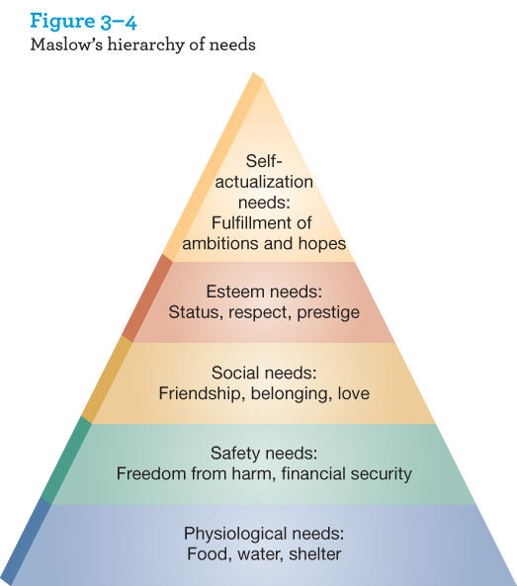
Maslow’s Hierarchy of Needs

Slide 17
Personality
Character traits that influence behavioural responses
  Extraversion/introversion, compliance/dominance, etc.
Self-concept: they way people see themselves and they way they believe others see them
Ideal self-concept: how people would like to see themselves
  Marketers attempt to convince you that their product will fill this gap help you achieve your ideal-self concept
  This is one reason why models are used so often in advertising

Slide 18
Perception
Process by which someone selects, organizes, and interprets information to create a meaningful picture of the world
Selective Perception: we filter the information around us so that only some of it us understood or remembered
  Shortcut taken by our brains so that we can make decisions without having to interpret all the information available
  Marketers deal with this by constantly reinforcing messages – i.e. giving you a brochure to read
Perceived Risk: anxiety felt when a consumer cannot anticipate possible negative outcomes of a purchase
  Marketers use various strategies to make consumers at ease – free trials, endorsements, warranties, etc.

Slide 19
Learning
Behaviours that result from repeated experience or reasoning
Behavioural Learning
  Developing automatic responses to situation build through repeated exposure
Cognitive Learning
  Learning without direct experience – thinking and mental problem solving
Brand Loyalty
  Favourable attitude toward a consistent purchase of a single brand

Slide 20
Behavioural Learning
Drive ➔
Hungry
Cue ➔
Billboard
Response ➔
Buy a burger
Reinforcement ➔
“Tastes great!”

Slide 21
Behavioural Learning
Negative Reinforcement ➔
“I feel sick!”

Slide 22
Values, Beliefs, and Attitudes
Attitude: a learned predisposition to respond in a favourable or unfavourable way
  Shaped by our values and believes
Values affect attitudes by influencing what we determine is important
  i.e. if saving money is a value you will have a favourable attitude towards a fuel efficient car
Beliefs are a person’s perception of how a product performs on different attributes
  Based on personal experience, advertising, or discussions with others
  i.e. you test drive the car and determine that it’s fuel efficient

Slide 23
Attitude Change
Marketers use 3 approaches to change attitudes:
  Changing beliefs about the extent to which a certain brand has certain attributes
    - i.e. McDonald’s repositioning to be perceived as a healthy food option
  Changing the perceived importance of attributes
    - i.e. mattress company emphasises sleep quality so that you focus on that attribute and not price
  Adding new attributes to the product
    - i.e. red wine health benefits

Slide 24
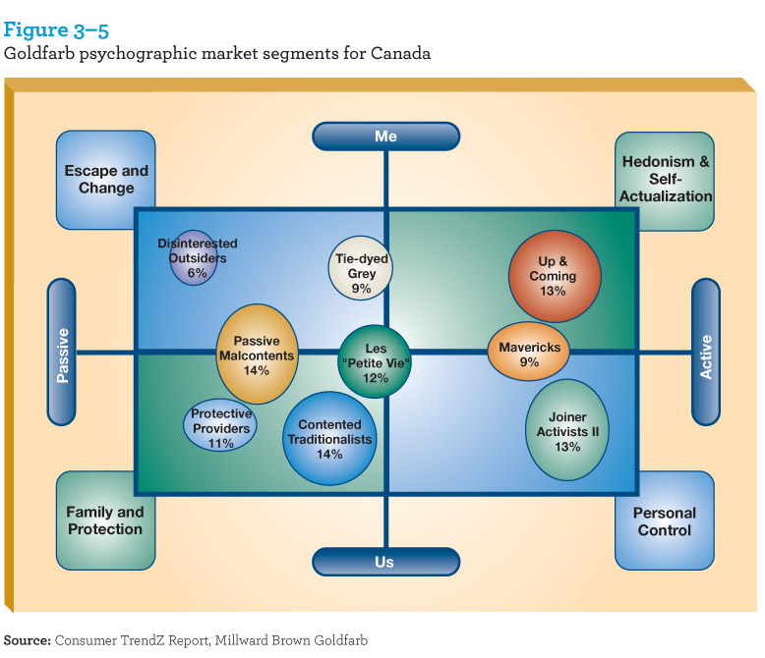
Lifestyle
Activities, interests, opinions

Slide 25
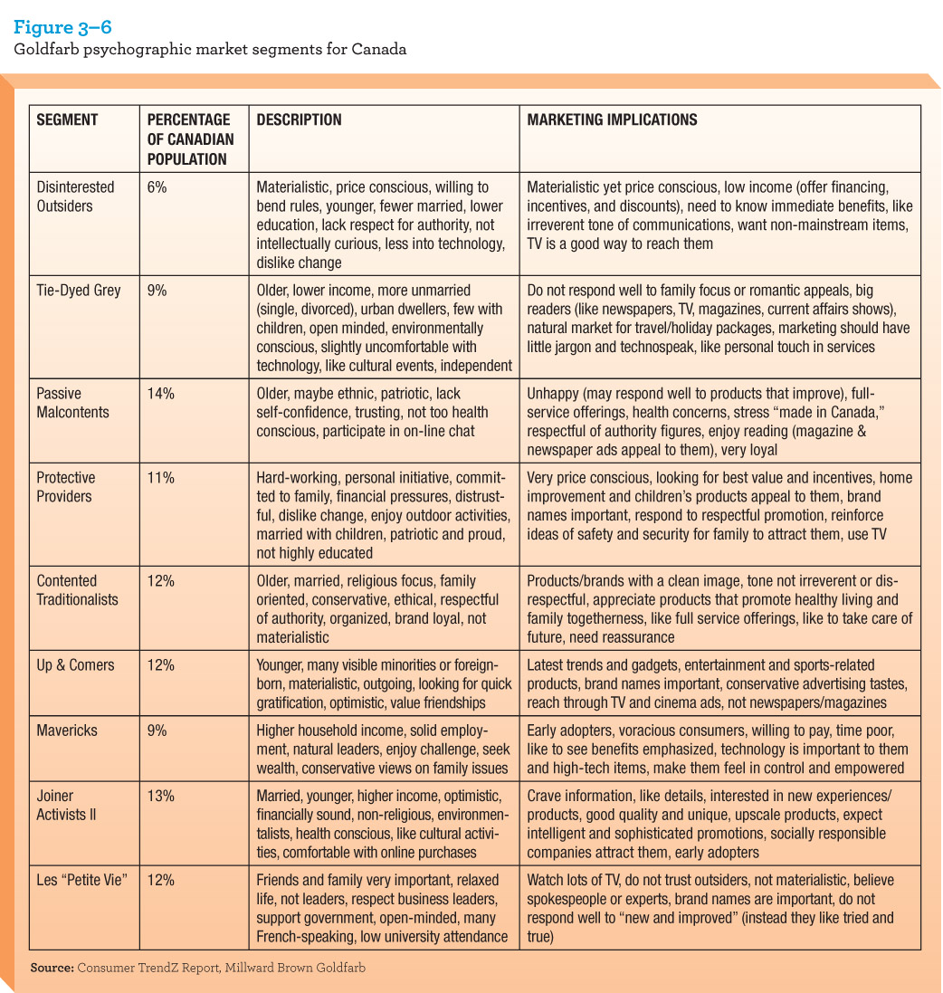
Lifestyle: Goldfarb Psychographic Market Segments for Canada

Slide 26
Socio-Cultural Influences on Consumer Behaviour
Socio-Cultural Influences
Personal Influence
Reference Groups
Family Influence
Culture and Subculture

Slide 27
Personal Influence
Purchases are often influenced by:
  Opinion leaders
    Individuals who have social influence over others
      Business people, celebrities, athletes, experts
    Most likely to be important for products of self-expression
  Word of Mouth
    Comes from trusted sources: friends/family
    Buzz marketing
    Viral marketing – social media

Slide 28
Reference Groups
A group of people who influence a person’s attitude, values and behaviour
  Membership Group
    Group one actually belongs to (i.e. family, sports teams, social clubs)
  Aspiration Group
    Group one wishes to be identified with (i.e. NHL)
  Dissociative Group
    Group one wants does not want to be associated with because of differences in values or behaviours

Slide 29
Family Influences
Consumer Socialization
  Process by which people acquire the ability to function as consumers
    Children show signs of brand preference as early as 2 (i.e. Happy Meal)
Family Life Cycle
  Family’s progression from formation to retirement
    Each phase has different purchasing behaviours
Family Decision-Making
  How household decisions are made: spouse-dominant vs. joint decision-making

Slide 30
Culture and Subculture
Culture
  A set of values, ideas, and attitudes that are learned and shared among the members of a group
Subculture
  Subgroups within a larger culture that have unique values, ideas and attitudes
  The most prominent subcultures are often racial or ethnic.

Slide 31
Canada
Canada encourages diversity – many ethnic groups continue their unique traditions, languages and values
  French-Canadian: 30% of population
  Chinese-Canadian: 3.5% of population
Each ethnic group can exhibit different consumer behaviour
  Marketers may have to modify elements of the marketing mix to deal with this

Slide 32
Global Cultural Diversity
Canada is one of the most diverse countries in the world – cultural mosaic
Marketing must include cross-cultural analysis
  Study of similarities/differences among consumers in 2 or more societies

Slide 33
Cross-Cultural Analysis
Values
  Socially preferable modes of conduct or states of existence
Customs
  Norms and expectations
Cultural Symbols
  Objects, ideas, or processes that represent a group or society
Language
  Sometimes translations can have unintended meanings

Slide 34
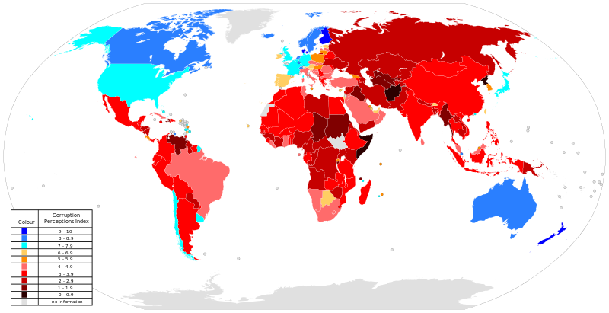
Customs – 2012 Corruption Perceptions Index

Slide 35
Next Class
Chapter 4 – Market Research

Slide 36
Thank You!

