Slide 1
MOS 1021A
Market Research

Slide 2
Agenda
Marketing Information Systems & Market Research
The 6 Step Market Research Approach
The Future of Market Research

Slide 3
Why Market Research?
Information can be an important competitive advantage for firms
  Challenge is to determine which information is most reliable, accurate, and relevant
  Digital technology and the internet allow unprecedented info capture
    Quantity makes it more difficult to identify what is useful and relevant
“Big data”

Slide 4
Marketing Information Systems and Market Research
Marketing Information System (MIS)
  procedures and processes for gathering, sorting, and analyzing data on an ongoing basis
  Can come from both internal and external sources
Market Research
  answers specific questions not answered by MIS
Notes:
Benchmarking yourself relative to market

Slide 5
Market Research
A tool that clarifies marketing problems and opportunities and provides information for marketing decision-making
  Is difficult to obtain valid and accurate information
Questions are planned to try and deal with these difficulties and get the required insights

Slide 6
Research Classifications
3 categories of Market Research :
  Exploratory
    Preliminary research that clarifies the scope and nature of a marketing issue
    Subsequent more detailed research usually follows
  Descriptive
    Research to describe basic characteristics of a population or to clarify usage and attitudes
    Already have a general understanding and seeking more conclusive data
  Causal
    Explaining a cause-and-effect relationship among variables
    Generally comes after exploratory and descriptive research

Slide 7
The Six-Step Market Research Approach
1. Define problem/issue/opportunity
2. Design the research plan
3. Conduct exploratory and qualitative research
Exploratory secondary data
Exploratory primary data
4. Collect quantitative primary research
5. Compile, analyze, and interpret data
6. Generate reports and recommendations

Slide 8
Step 1: Define the Problem/Issue/Opportunity
  Clearly define the problem, issue or opportunity, and to clarify the objectives
    Question that needs to be answered
  Requires clarifying research objectives
    Specific, measurable goals that the decision maker seeks to achieve

Slide 9
Step 2: Design the Research Plan
Identifying what information is needed, how it will be collected, and whether a sampling plan is needed
  Information Requirements
    Specific to avoid irrelevant data
  Collection Methods
    How to collect the data
    Choose the method that maximize the results of accuracy

Slide 10
Step 2: Design the Research Plan
Sampling
  The process of gathering data from a subset of the total population rather than from all members of that particular group
    Who is being sampled?
    How big should the sample be?
    How should the sample be selected?
  Probability Sampling
    Precise rules used to select
  Non-probability sampling
    Use of arbitrary judgment

Slide 11
Step 3: Conduct Exploratory and Qualitative Research
Clarifies the scope and nature of the problem
Qualitative research
  Provides insightful and directional information to the researcher- more open ended questions, more broad
Secondary data
  Already available and have been recorded through a third party
Primary data
  Original and specifically collected for a project

Slide 12
Secondary Data
Secondary Data
Internal Data
External Data
Secondary data collected before primary data

Slide 13
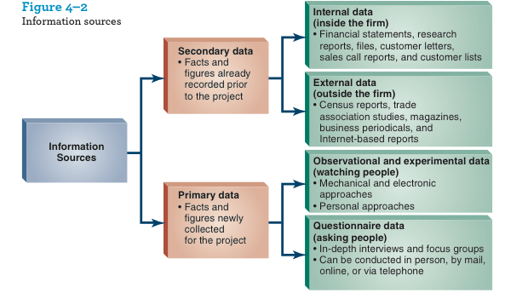
Sources of Secondary Data

Slide 14
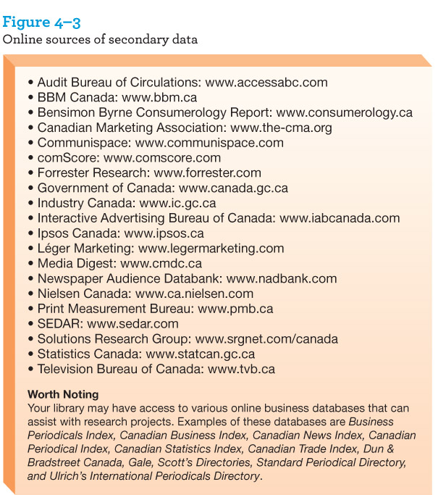
Online Sources of Secondary Data

Slide 15
Primary Data
Focus Groups
  Informal interview session, small groups
  Watched by observers, sessions recorded
In-depth Interviews
  One-on-one interviews
  Free-flowing conversations
Online Research
  Online research communities
  Online research bulletin boards
  Social listening

Slide 16
Step 4: Collective Quantitative Primary Research
Quantitative Research’s main advantage is to be statically accurate and it is less open to interpretation
Observational Research
  Watching how people behave in person and recording
Surveys
  Standardized questions through surveys that are conducted
Experiments
  Changing a variable involved in a customer purchase to find out what happens, test market

Slide 17
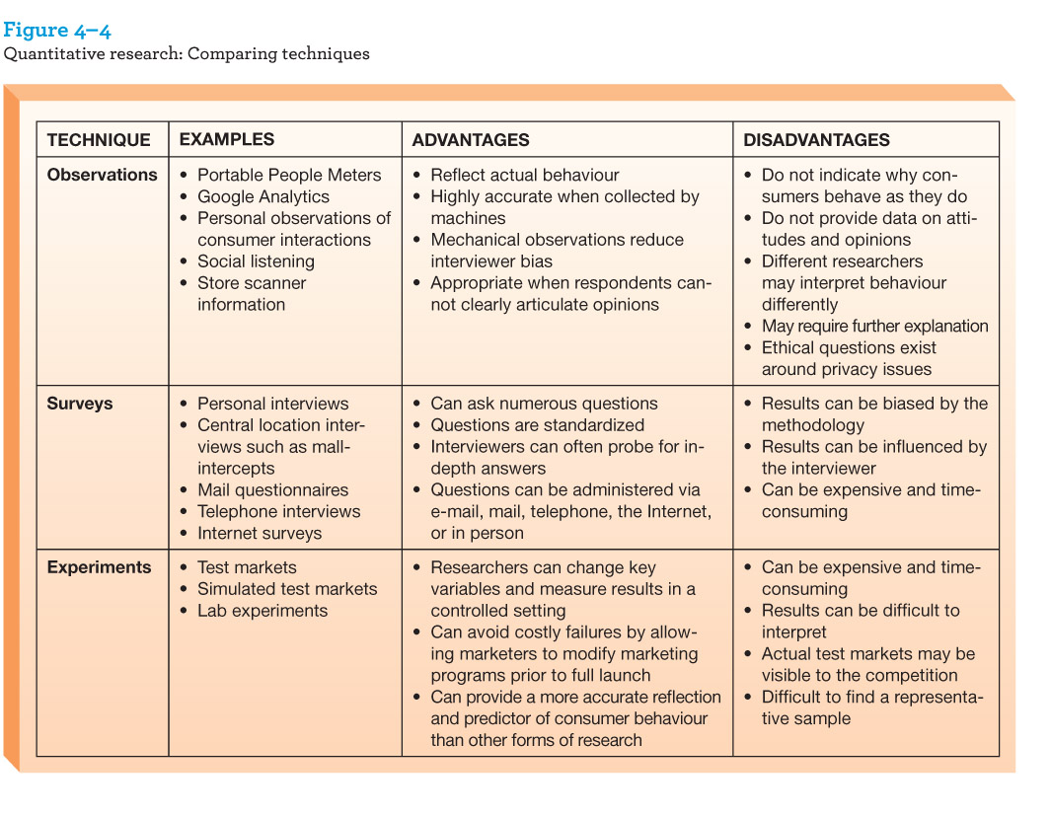
Quantitative Research: Comparing Techniques

Slide 18
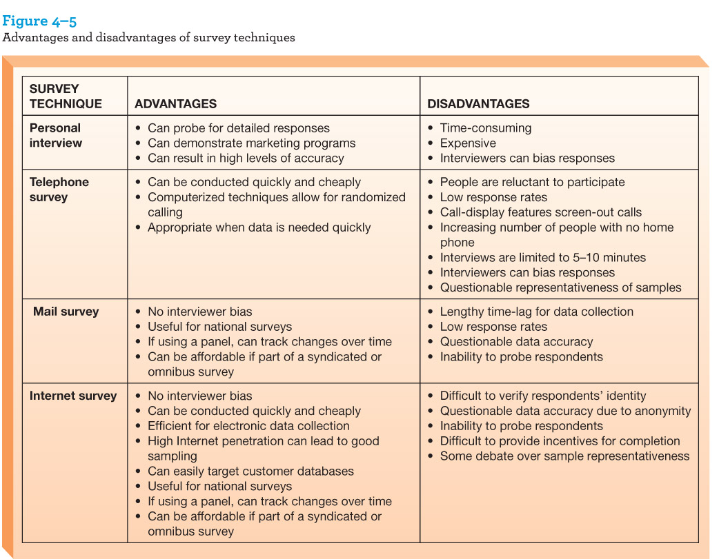
Advantages and Disadvantages of Survey Techniques

Slide 19
Step 5: Compile, Analyze and Interpret Data
After data has been collected, it must be compiled, analyzed and summarized to be turned into actionable information
Marketers must synthesize and simplify large amounts of data into something that can be used for decision making
  Need implications: “so what?”

Slide 20
Step 6: Generate Reports and Recommendations
Prepare reports to communicate the research findings
Managers prefer clear, concise reports with the key findings highlighted

Slide 21
The Future of Market Research
Technology is facilitating the gathering of this information
  Key skill will be the ability to distinguish what is relevant and draw meaningful implications
  Adopt strategies and approaches to filter out unreliable and useless information from actionable facts
Notes:
Big data marketing internet and mobile devices enable mass capture of transactional and

Slide 22
“BIG DATA”
Internet and mobile devices enable mass capture of transactional and behavioral data
-will it allow for perfectly targeted marketing or just hype
-gathering and storing large volumes of data is expensive
-privacy issues

Slide 23
The Future of Market Research
Regulatory environment – consumer privacy developments
  Personal Information Protection and Electronic Documentation Act (PIPEDA)
    Limits an organization’s collection of personal information – need consent
    Needs to be stored securely

