Slide 1
MOS 1021A
Strategies, Trends and Challenges in Human Resource Management

Slide 2
Mid-Term #2
Mid-term Exam #2 – November 14th, 2013
  In-class, 7pm to 9 pm, NCB 101
  Covers material from sessions 6 to 8 (Oct. 17th to Nov. 7th 2013)
  Chapters 3 & 4 from the Marketing textbook, chapter 1 from the Human Resource textbook
  Worth 33% of final grade
What to bring?
  Student card
  Pencils
  Eraser

Slide 3
Makeup Exam
Social Science Academic Counselling
  All requests for make-up exams must be approved by Academic Counselling
  http://counselling.ssc.uwo.ca/

Slide 4
Office Hours Next Week
Day | Time
Sunday, November 10th | 3pm – 6pm
Tuesday, November 12th | 1pm – 3pm
Wednesday, November 13th | 1pm – 3pm
Thursday, November 14th | 4:30pm – 6:15pm

Slide 5
What is Human Resources?
Human Resource Management centres on the practice, policies, and system that influence employees’ behavior, attitudes and performance
“A practical application of psychology, sociology, economics, and communications”

Slide 6
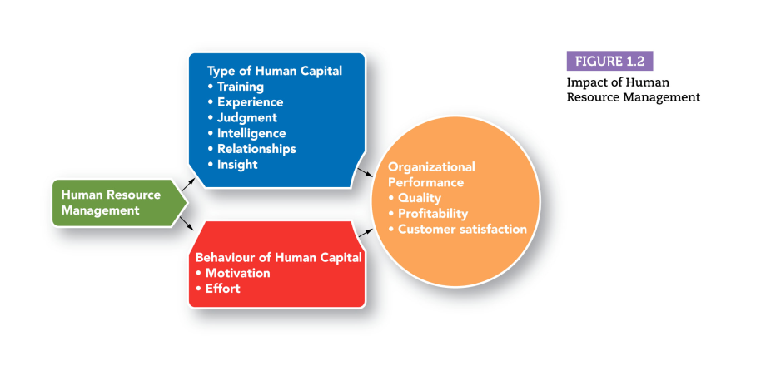
Why Are People So Valuable?
Notes:
Barrier to expansion- people constraints, more constraints, constrained on how they can grow

Slide 7
What is Strategic HRM?
Human resources as a means of achieving an organization’s strategic goals
Talent Retention- helps drive growth and achieve organizational goals, specialized workforce
Human capital can be a source of a competitive advantage
Competitive advantage characteristics: valuable, rare, can not be imitated, no good substitutes
Strategic HRM

Slide 8
What is Strategic HRM?
Analysis and design of work
Training and development
Performance management
Compensation and rewards
Recruitment and selection
Employee and labour relations
Workforce planning
Strategic HRM

Slide 9
High Performance Work System
An organization in which technology, organizational structure, people and processes all work together to give an organization an advantage in the competitive environment (working from home, video conferencing- technology)

Slide 10
HR Responsibilities
Administrative services and transactions- handling admin tasks, expertise in specific tasks
Business partner transactions- develop HR systems, understanding of overall business
Strategic partner- execute company's strategy, knowledge of biz, industry, competitors 1HR EMPLOYEE TO 95 WORKERS
.

Slide 11
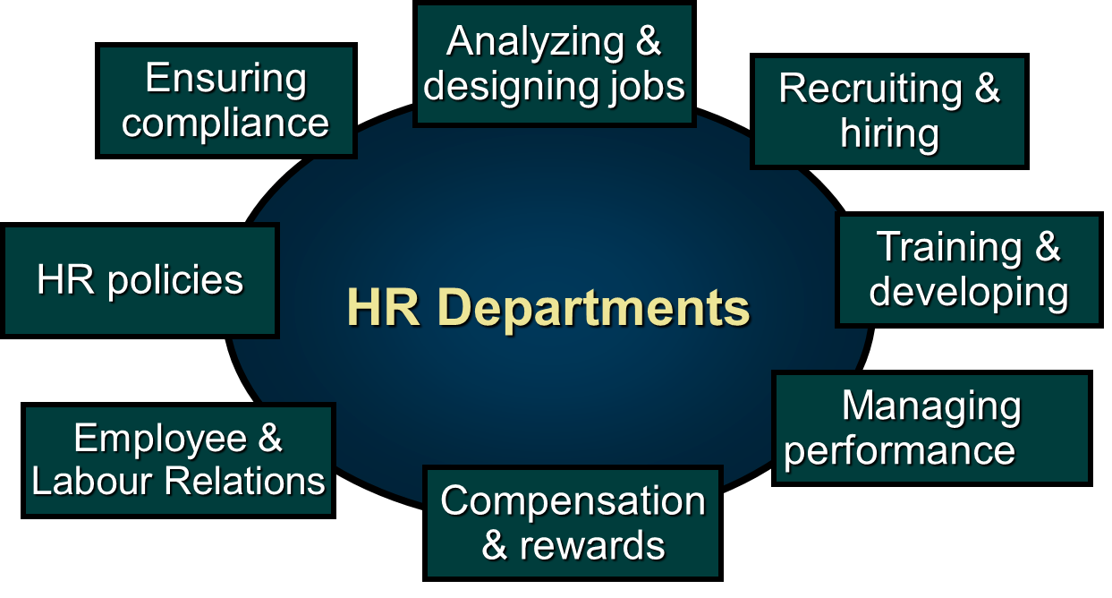
What Are the Responsibilities of HR Department?

Slide 12
Analyzing and Designing Jobs
Job Analysis- the process of getting a detailed information about jobs
Job Design- how work will be performed and what task are required

Slide 13
Recruiting and Hiring Employees
Based on the Job Analysis and Design
Recruitment- the process through an organization seeks applicants
Selection- identifying applicants with the necessary knowledge, skills, abilities, and other characteristics that help organization achieve its goals

Slide 14
Training and Developing Employees
Training- planned effort to enable employees to learn job related knowledge
Development- acquisition of skills, knowledge that improve an employees ability- move on to a senior position in the company

Slide 15
Managing Performance
Performance Management
  The process of ensuring that employees’ activities and outputs match the organizational goals
  Timely feedback and coaching
  Comparing the employees performance with the desired performance over time
  Rewards are aligned to encourage good behaviour

Slide 16
Compensation and Rewards
Play a vital role in motivation when properly aligned with individual or team performance
Decisions: salaries, bonuses, commissions and other performance pay, types of benefits to offer
Administering the compensation systems (payroll) and ensuring legislation is complied with

Slide 17
Employee and Labour Relations
Maintaining positive relations with employees
Unionized environments- also includes collective bargaining to negotiate an employment contract with union members
Maintain communication with the union representatives to ensure issues are resolved

Slide 18
Human Resources Polices
Polices related to hiring, discipline, promotions, benefits
Formal policies ensure objectivity and fairness
Collecting information from the employees requires safeguards in place to protect sensitive information

Slide 19
Compliance with Legislation
Laws and regulations concerning treatment of employees
Human rights
Employment equity
Employee health and safety
Employee privacy
HR departments must keep current with a rapidly changing legal and regulatory landscape

Slide 20
What Competencies do HR Professionals Need ?
Credible Activist
Cultural
Steward
Talent Manager/
Organizational Designer
Strategic
Architect
Business Ally
Operational Executor

Slide 21
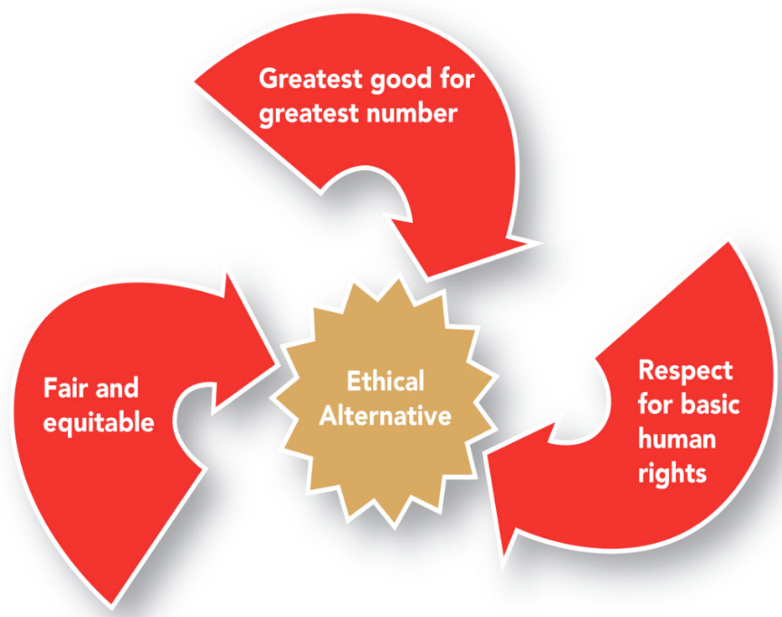
Ethics in HRM
Organizational strategy- productivity improvement, expanding a global market, outsourcing, mergers/acquisitions
Strategy often involves large change- HR helps to manage this change process, workforce planning- number of workers needed to meet strategic objectives, evidence based HR collecting data to show how HR actions impact earnings
Notes:
Organizational strategy- productivity improvement, expanding a global market, outsourcing, mergers/acquisitions
Strategy often involves large change- HR helps to manage this change process, workforce planning- number of workers needed to meet strategic objectives, evidence based HR collecting data to show how HR actions impact earnings

Slide 22
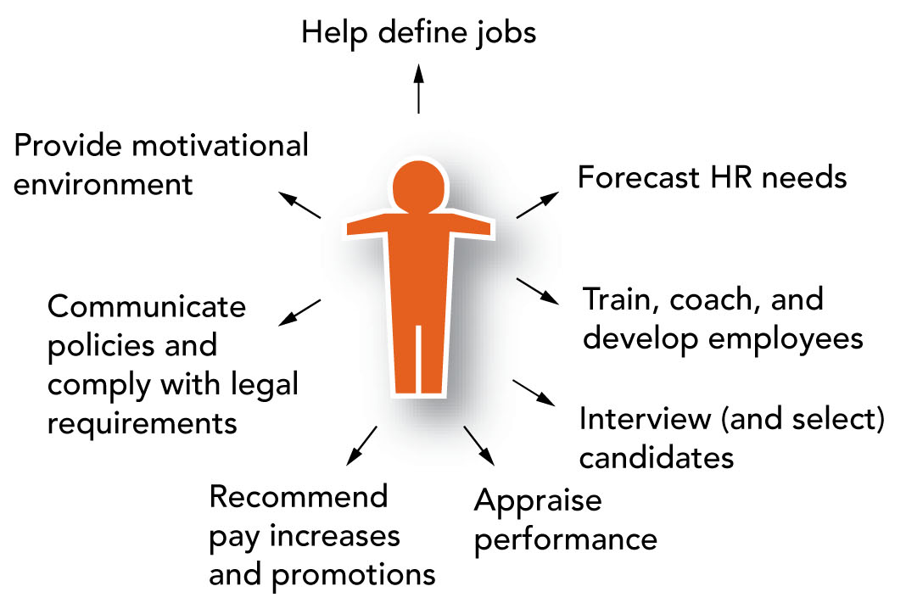
HR Responsibilities of Supervisors and Managers

Slide 23
Trends Impacting HRM
Changes in the labour force aging workforce, diverse workforce, skill deficiencies
High-performance work systems: knowledge workers, employee engagement, increased teamwork, increasing education
Technological change: internet economy, E HRM
Employee relationships: new psychological contract, flexibility

Slide 24
How is the Labour Force Changing?
HR needs to consider:
  Internal labour force- organizations own workforce
  External labour market- those seeking employment, number and skills of people determine the human resources available and their cost
  * Economics- supply and demand of labour

Slide 25
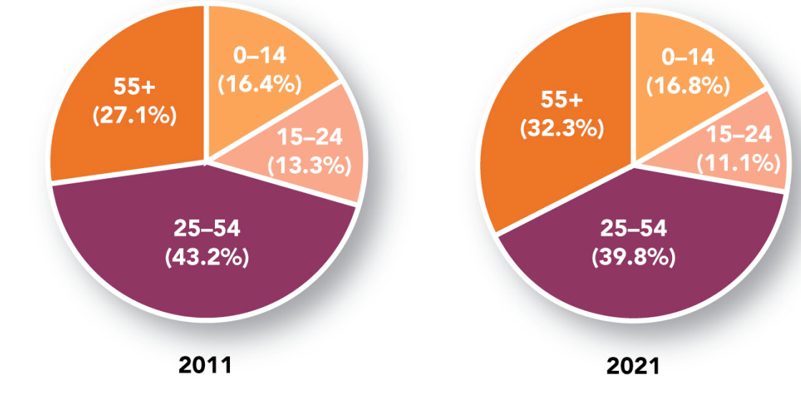
Age Distribution Projection

Slide 26
An Aging Workforce
HR professionals must manage:
Multi-generational workforce: generational friction
Planning retirement and re-skilling workers; succession planning
Controlling cost of health related benefits
Finding ways to attract, retain, and train younger generations of employees

Slide 27
Diversity and Skills Deficiencies
A diverse workforce- one of the most diverse multicultural countries
Employment equity- women, aboriginal, persons with disabilities, minorities
Skill deficiencies of the workforce
Canada is shifting to a service economy
Shift needed changing from physical strength to mathematical, verbal and interpersonal skills
Required technical skills relate to technology

Slide 28
What is a High-Performance Work System?
Competitive advantage- getting the best possible fit between an organizations social and technical system
Trends in high performance work systems
Reliance on knowledge workers- specialized knowledge
Employee engagement- extent employees are satisfied, commitment to achieve organ goals
Teamwork- teams with various skills, increasing levels of education

Slide 29
HR and Technological Change
Human resource information system (HRIS)
Used to acquire store manipulate, analyze retrieve and distribute HR info
HR dashboard- display of a series of HR- related measures i.e easy to scan review
The Internet economy
e-HRM applications
Sharing of HR information
Self-service

Slide 30
Changes in the Employment Relationship
The Psychological Contract
  Unspoken expectations
  What an employee expects to contribute and what the employer will provide in exchange
Employee expectations- job security, promotion opps (traditional), work life balance, more control over how work is accomplished, training and development(modern)
Employer expectations- time, skills, loyalty (traditional), work life balance, more control over how work is accomplished, training and development(modern) flexibility staffing levels, high productivity (modern)
Notes:
Employee expectations- job security, promotion opps (traditional), work life balance, more control over how work is accomplished, training and development(modern)
Employer expectations- time, skills, loyalty (traditional), work life balance, more control over how work is accomplished, training and development(modern) flexibility staffing levels, high productivity (modern)

Slide 31
Changes in the Employment Relationship
Flexible staffing levels- use of alternative work arrangements (on-call workers, temporary workers)
Flexible work schedules
Provide more flexible work schedules
Productivity > presence
Used to recruit and retain employees and increase employee satisfaction

Slide 32
Legislation – The Accessibility for Ontarians with Disabilities Act (AODA)
Passed in 2005 with an overall goal of an accessible Ontario by 2025
Accessibility Standards developed for five key areas of daily living
  Customer service
  Information and communications
  Employment
  Transportation
  Built environment

Slide 33
1. Customer Service
Accessible customer service is not about ramps or automatic door openers
Understanding that people with disabilities have different needs- how can I help and making small changes to serve our customers

Slide 34
2. Information and Communication
Organizations will be required to:
Make their websites and web content accessible
Provide accessible formats and communications
Make feedback processes accessible by providing accessible formats
Make public emergency info accessible when requested

Slide 35
3. Employment
Make accessibility a regular part of finding, hiring and supporting employees with disabilities
Organizations will be required to:
Let job applicants know the recruitment and hirinng processes will be modified to accomadate their disabilities
Build the accessibility needs of employess into their HR practices
Create a written process for developing and documenting individual accomadation plans for employees with disabilities
Stay safe in emergency individiaulized emergency plans

Slide 36
4. Transportation
The Accessibility Standard for Transportation will make it easier for al Ontarians to travel
Must comply to
Conventional transportation services
Municipalities specific requirements for taxicabs

Slide 37
5. Built Environment
The Accessibility Standards focus on removing barriers
Public spaces, buildings
Enhancements to accessibility in buildings will happen at a later date through Ontario’s Building code
Governs new construction and renovations

Slide 38
Careers in HRM
Specialists and generalists
CHRP designation
Certified human resource professional; bachelors degree, experience requirement and professional exam (NKE)
Canadian Council of Human Resources Associations (CCHRA)- represents member associations

Slide 39
HRM Careers
Human Resources
Human Resources Generalist
Specialist
Workforce planning and Recruitment
HR Development
Total Rewards
Risk Management
Employee and Labour Relation
Salary/Benefits Administrators
Recruiter
Health and Safety
Labour Relations Officer
Trainer
Organizational Development
Compensation Analyst

Slide 40
Next Class
Mid-term #2

Slide 41
Thank You!

