Slide 1
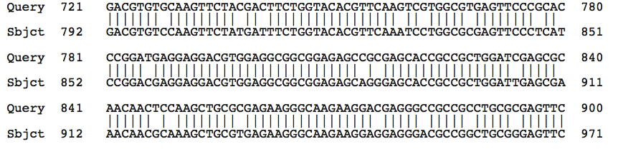
Lecture 20 - Molecular Convergence
Chlamy
Volvox
Chlamy
Volvox
Chlamy
Volvox
Chlamy
Volvox
Conserved or not
Synonymous mutations
Notes:
-Chlamy is the query and volvox is the subject but it can be switched
-The changes in nucleotides do not change the amino acid sequence and this is called a synonymous mutation
-However there are nonsynonmous mutations so basically the change in nucleotides changes the sequence of amino acids
-The alterations in the nucleotide sequence appears to be neutral

Slide 2
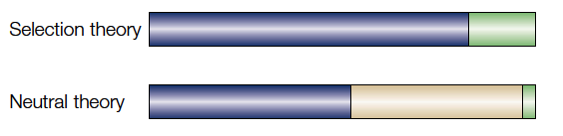
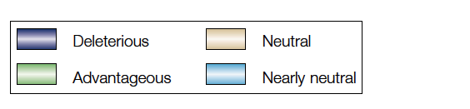
Neutral theory of molecular evolution
All mutations would affect fitness
Notes:
-The selection theory was that all mutations would affect fitness
-But the neutral theory says most mutations are neutral, than deleterious and than advantageous

Slide 3
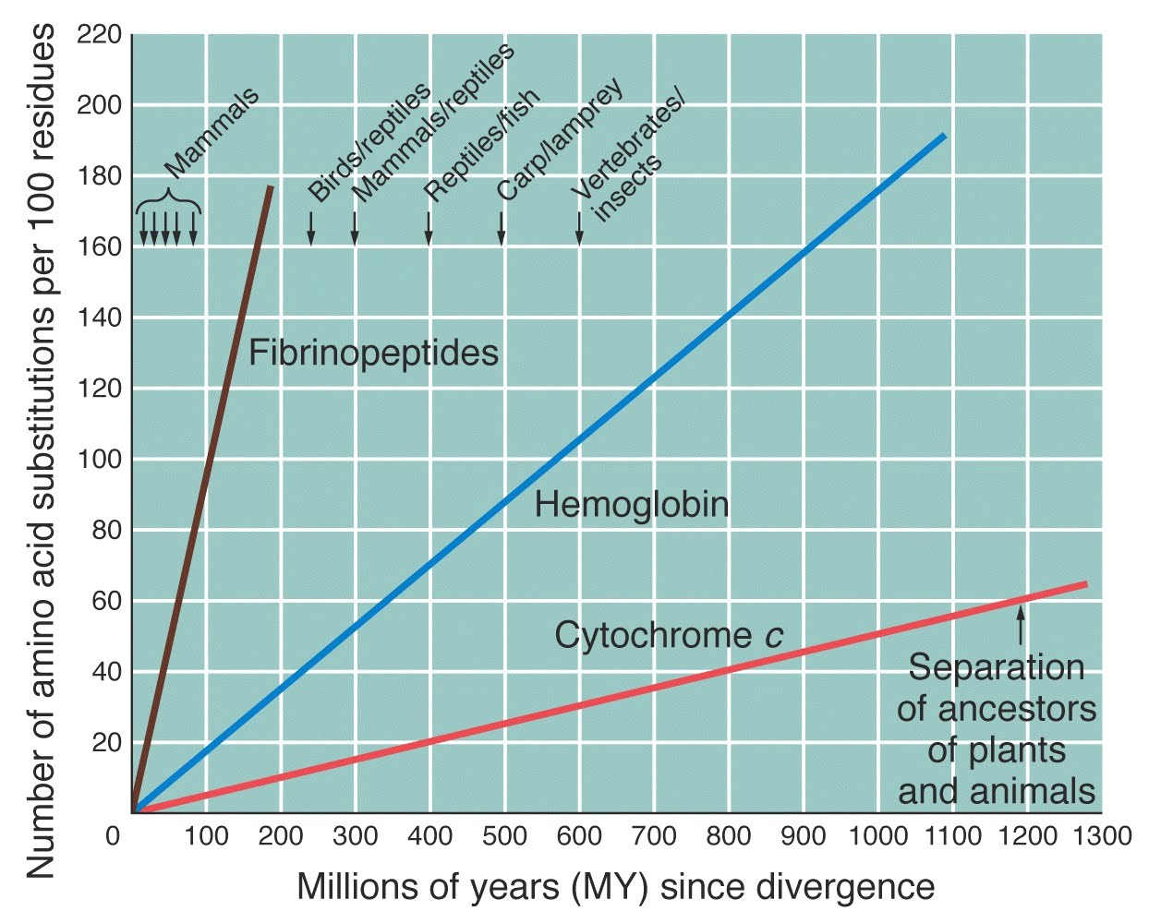
Neutrality and the idea of a molecular clock
Notes:
-Fossils and geological record allows us to find common ancestors of certain organisms
-the number of differences of the amino acid sequence between two organism is proportional to the number of years since divergence from common ancestor
-The remarkable thing is that lines are so linear which indicates a constant rate which means there is a constant rate of mutation(molecular clock)
-This supports the neutral hypothesis
-Fibrinopeptides are involved in blood clotting
-Missed note

Slide 4
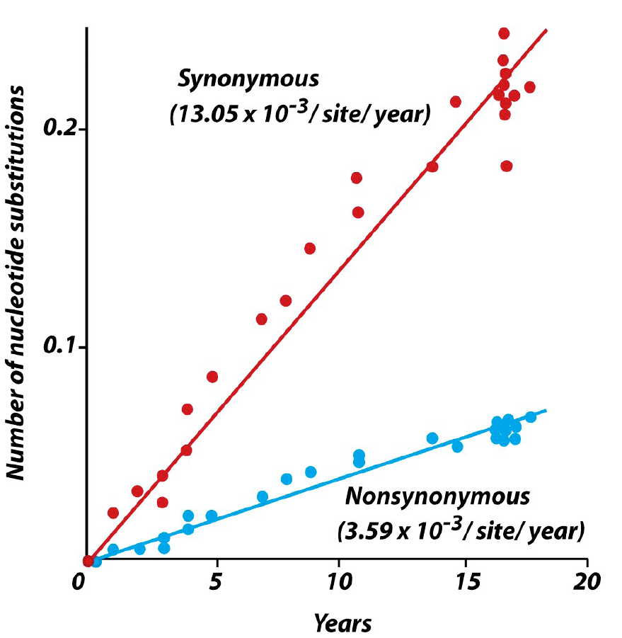
Synonymous vs nonsynonymous rate
Notes:
-For the rate change for the synonymous mutations(silent substitution) are faster than nonsynonymous mutation(replacement substitution)

Slide 5
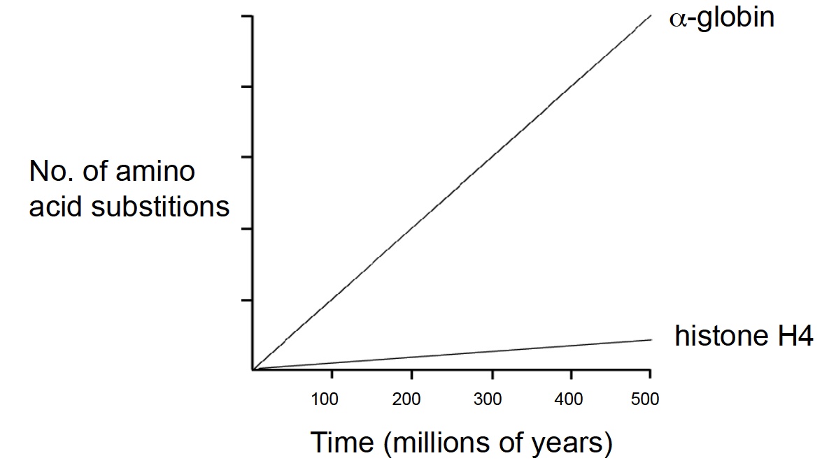
Degree of constraint dictates rate of evolution
Notes:
-Histone H4 is highly constrained becausee if there are many amino acid substitutions, the cell will die because histones are important to keep the stucture of DNA
-a-globin can still function with many amino acid substitutions
-The question is that can the substance tolerate the amino acid substitution

Slide 6
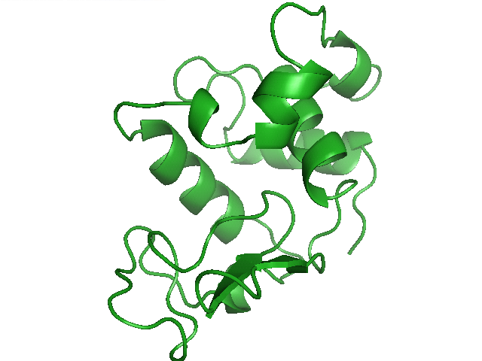
Molecular convergence
Why is similarity between sequences considered to be evidence of homology?

Slide 7
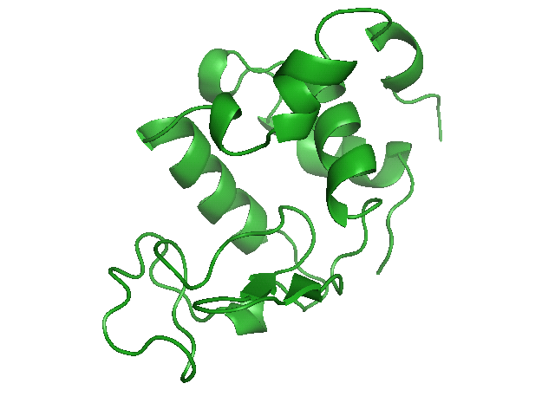
Functional convergence
There is no reason for two proteins to share high identity across their entire sequences... is there?
-Location of cysteins(disulfide (S-S) bonding)
-Amino acids necessary for catalysis
-DNA binding domains, receptor binding sites….
Notes:
-Proteins that form complexes to catalyze a reaction, you would expect them to have regions of the same nucleotide sequence

Slide 8
Lysozyme: a case study of convergent evolution
Small (130 aa) enzyme, antibacterial activity.
Attacks peptidoglycan
Found in blood, tears, mucus, egg white.
Enzyme has been recruited as a stomach enzyme in ruminants (e.g. cows).
Notes:
-It attacks the bacterial cells wall which is made from peptidoglycan
-The gene was duplicated and the other form evolved and for its own new function
-This other enzyme was recuited as a stomach enzyme in ruminants(eg.cows)
-What’s a ruminant?
-Something that eats grass
-There is bacteria in the grass which have the enzyme that breaks down the cellulose, so the bacteria has the enzyme not the cow
-The cow does not waste the nutrients from the bacteria so it uses it’s lysozyme to break it down
-This enzyme is much more different than the usual lysozyme
-Has to be able catalzye reactions in low pH and must be resistant to breakdown by pepsin

Slide 9
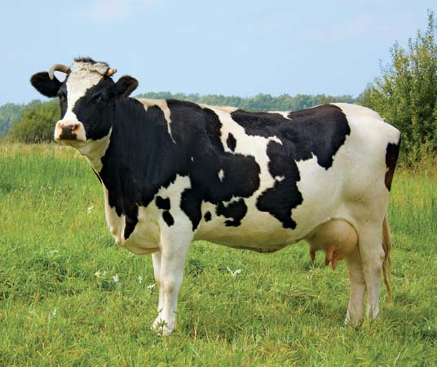
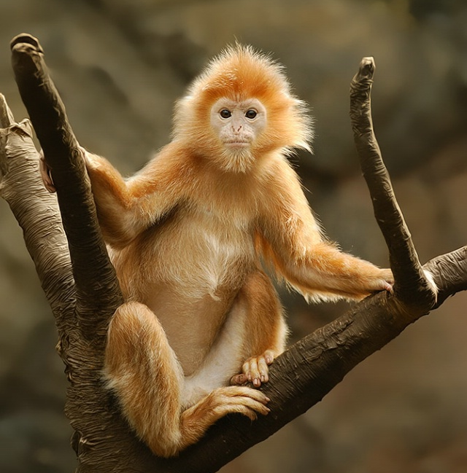
Picture of a cow and a monkey
Cow
Human
Langur
Phylogenetic tree
Horse
Rat
Baboon
Notes:
-They are not evolutionary related at all

Slide 10
Lysosyme in different species
Comparision of lysozyme amino acid sequences of different species
  Above diagonal = number of amino acid difference
  Below diagonal = number of amino acids uniquely shared
SPECIES | Langur | Baboon | Human | Rat | Cow | Horse
Langur |  | 14 | 18 | 38 | 32 | 65
Baboon | 0 |  | 14 | 33 | 39 | 65
Human | 0 | 1 |  | 37 | 41 | 64
Rat | 0 | 1 | 0 |  | 55 | 64
Cow | 5 | 0 | 0 | 0 |  | 71
Horse | 0 | 0 | 0 | 0 | 1

Slide 11
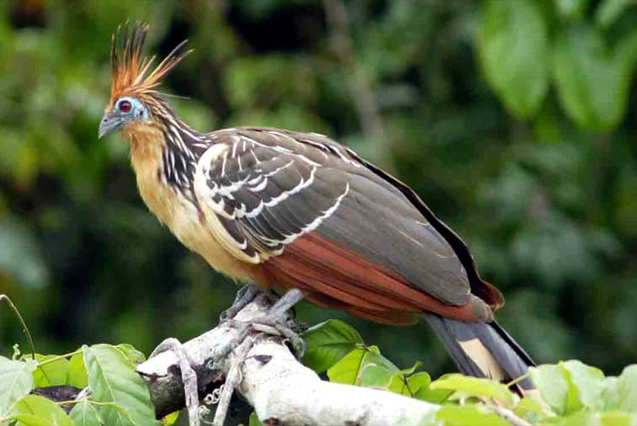
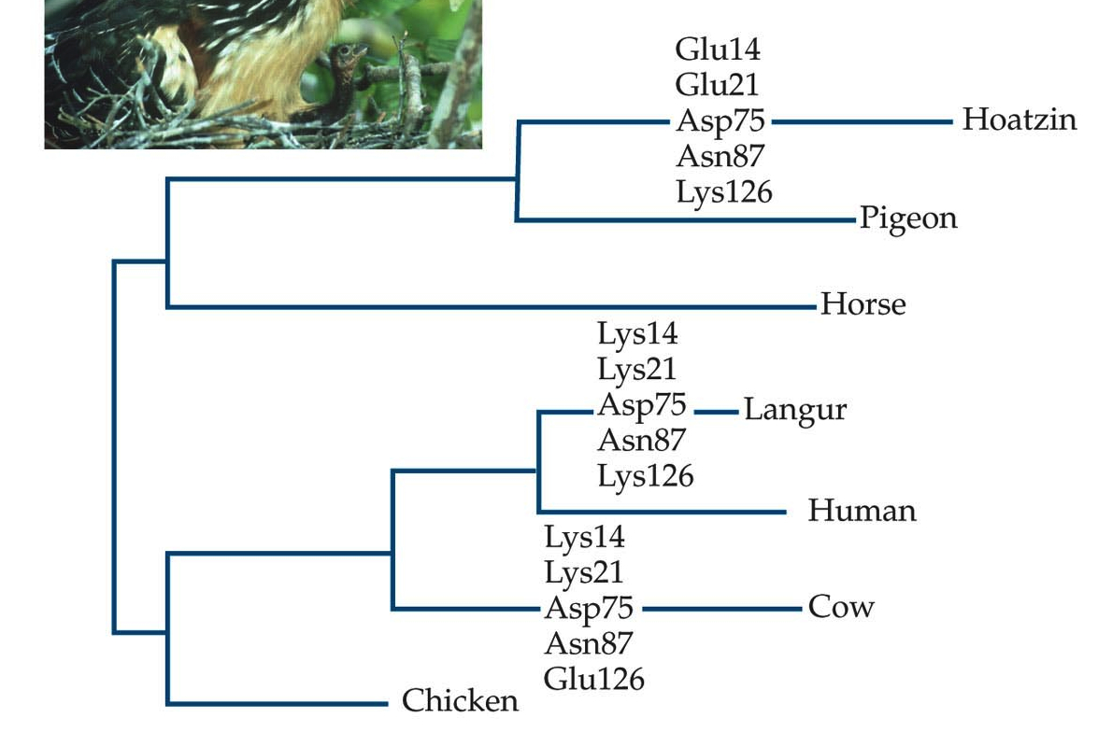
Convergence to same amino acids
Calcium-binding
lysozyme
Conventional
lysozyme
Notes:
-This bird also has the lysozyme and all these species got the lysozyme independently of each other so convergent evolution
-As one can see from the tree the organisms are very different but they still aquired the enzyme individual because of convergence

Slide 12
Amino acid substitutions at specific sites
14 21 41 75 76 83 87 126
Human
Langur
Baboon
Rat
Cow
Chicken
Pigeon
Hoatzin
Horse
R R R N A A D Q
K K E D A A N K
R R Q N A A D Q
R Y Q N A A D R
K K K D G E N E
R R Q N L A S R
R V T N A K D R
E E E D G E N K
A G R N A K E A
Notes:
-The whole sequence is not identical but…

Slide 13
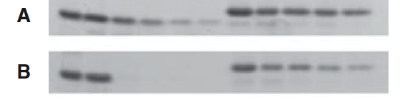
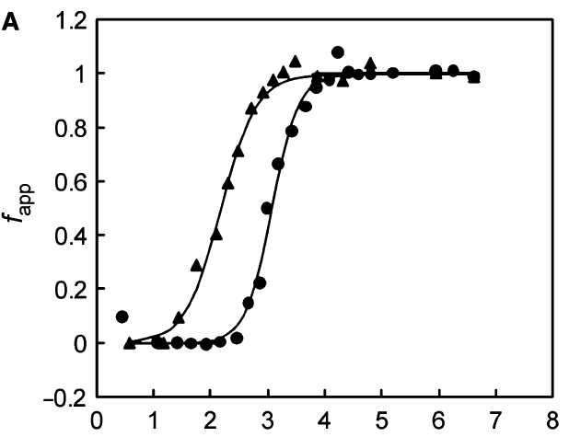

Biochemical consequences
Non-digestive
Digestive
Unfolding
ND
D
Urea (M)
Notes:
-The digestive enzyme is more resistant to the urea treatment

Slide 14
Biochemical consequences
Notes:
-Digestive enzyme
-Greater structural stability prevents pepsin access
-Lack of Aspartic acid – Proline bond (acid labile)
-Negative charged surface repels pepsin
A great example of convergent evolution is the digestive enzyme

