Slide 1
Chapter 1
The Canadian Financial Reporting Environment
September 11/13, 2013

Slide 2
Why do we need financial accounting?
In Canada, private and public companies rely extensively on debt and/or equity markets to fund their daily operations and future growth. Hence, there arises the need for financial information.
Other stakeholders may also require information about a company’s financial health: unions, government, suppliers, employees etc.
Financial information may come from:
  Annual reports: including Management Discussion and Analysis and Financial Statements
  Prospectus
  Press releases: selective information released by management
  Forecasts and Analysts’ Reports

Slide 3
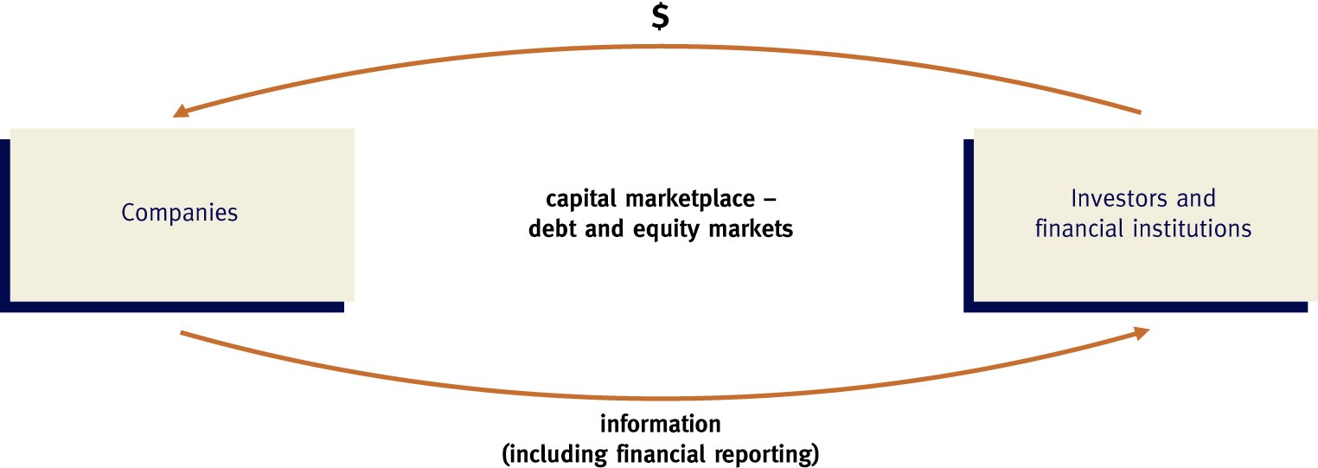
Capital Allocation Process
Possess insider information
Resource is scarce

Slide 4
Information Asymmetry
If we live in an ideal world where a company’s financial information is known to everyone, there will be no market for financial information. However, we live in a world with Information Asymmetry.
There are two types of information asymmetry:
  Adverse Selection
  Moral Hazard

Slide 5
Adverse Selection in Financial Reporting and Capital Markets
Absence of regulations, firms choose to disclose information to the market that varies in form, detail, and content.
Firms may choose to disclose less information:
  Afraid of releasing information that will benefit competitors
  Afraid of releasing bad news that will affect the company in a negative way.
There are two effects:
  Investors are unable to distinguish between good firms from bad firms and may stay away from investing in the market.
  Bad firms are more likely to seek capital from the market because they are treated the same as the good firms; whereas good firms are less likely to seek capital from the market for the same reason.

Slide 6
Example
Innovate Inc. and Copycat Inc. are two software companies. In 2013, they both spent $300,000 in research and development on new software. Innovate Inc. is ready to sell the product early 2014, whereas Copycat Inc. is still in the early research phase. Assume that there are no rules on how research and development spending be recorded, and both companies have recorded the $300,000 as assets. No other information is available to investors on the new software.
How do investors evaluate the future performance of these two companies?
If both companies seek capital from the equity market, who will be able to raise more money?
How can accounting rules help investors to distinguish the quality between these two companies?

Slide 7
Moral Hazard in Financial Reporting and Capital Markets
Managers are hired to maximize shareholders’ wealth by efficiently and effectively using the firms’ resources.
Financial reporting serves as a monitoring device of manager performance, especially when ownership is disperse.
Absence of regulations, managers can introduce bias in financial reporting, i.e. inflate net income and/or net assets to achieve personal gains.

Slide 8
Motivations for Management Bias
Evaluation of management performance
Compensation structures
Access to capital markets and meeting financial analysts’ expectations
Contractual obligations, e.g. debt covenants

Slide 9
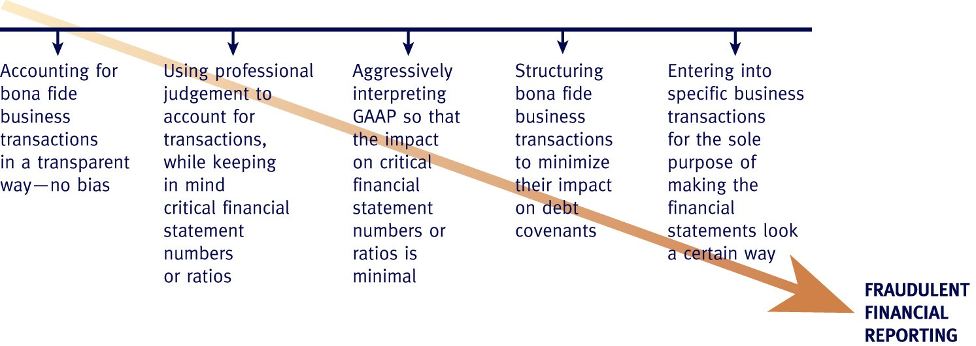
Financial Engineering

Slide 10
CA 1-3
The national credit rating agency downgraded the credit rating of Grand Limited by 2 levels from BB to B+. The credit rating agency was concerned about the company’s ability to refinance portions of its debt. Both BB and B+ are considered “junk” bonds and are below the BBB category, which is the lowest grade that many pension and mutual funds are allowed to hold.
Financial statement analysts said that the company’s financial profile had weakened due to tight covenants and resulting cash flow restrictions.
Who are the stakeholders from Grand Limited’s perspective and what bias Grand might have when it issues its financial statements?

Slide 11
The Objective of Financial Reporting
Reduce information asymmetry by providing financial information about the reporting entity that is useful to present and potential equity investors, lenders, and other creditors in making decisions about providing resources to the entity (IFRS Conceptual Framework OB2)

Slide 12
What is considered “Useful” information?
Investors need information about the returns (including dividends) of their investment and creditors need information about the entity’s ability to repay interest and principal.
Therefore information is useful if it can help investors and creditors to assess the amount, timing and uncertainty of future net cash flows to entity (IFRS Conceptual Framework OB3)

Slide 13
Cash vs. Accrual Accounting
Assessing cash flow prospects does not mean that cash basis accounting is preferred over accrual accounting.
Example #1: Selling goods on credit gives rise to Accounts Receivable (A/R) and will not be reported as an asset under cash basis accounting. However, A/R represents an economic resource that can be converted into future cash inflow to the entity. Hence, it is useful to report it as an asset in the financial statements.
Example #2: Purchasing supplies on account gives rise to Accounts Payable (A/P), again will not be reported as a liability under cash basis accounting. However, A/P represents a claim against the entity’s resource that entails future cash outflow from the entity. Hence, it is useful to report it as a liability in the financial statements.

Slide 14
Useful Financial Information
In order to assess the amount, timing, and uncertainty of future net cash flows to the entity, investors and creditors need information about:
  1 a. Resources of the entity;
  1 b. Claims against the entity; (Balance Sheet)
  2. How efficiently and effectively the entity's management has discharged their responsibilities to use the entity's resources (Income Statement)
  (IFRS Conceptual Framework OB5)

Slide 15
The Need for Different Accounting Standards
Given different entities have different stakeholders:
  E.g. Publicly listed companies: investors, credit rating agencies, creditors
  E.g. Private companies: investors, banks
  E.g. Pension plans: existing and future pensioners
  E.g. Not-for-Profits organizations: donors, government.
  There exists different reporting needs and hence different accounting and reporting standards.

Slide 16
Parties involved in Standard Setting
Canadian Accounting Standards Board (AcSB):
  GAAP for private companies (Accounting Standards for Private Enterprises or ASPE)
  GAAP for pension plans
  GAAP for Not-for-Profit entities
International Accounting Standards Board (IASB)
  GAAP for publicly listed companies (International Financial Reporting Standards or IFRS)
Financial Accounting Standards Board (FASB)
  GAAP for U.S. entities (US GAAP)
Securities Commission (SEC in the US; OSC in Ontario)
  Additional disclosure requirements

Slide 17
Generally Accepted Accounting Principles (GAAP)
ASPE GAAP hierarchy:
  Primary source: CICA Handbook Part II
    Sections 1400 t 3870
    Accounting guidelines
  Other sources:
    Background information and basis for conclusion (also found in the Handbook)
    Pronouncements by accounting standard bodies in other jurisdictions.
    Exposure drafts where no primary sources apply
    Other sources must be consistent with the Conceptual Framework.

Slide 18
Rules based vs. Principles based Accounting Standards
Both ASPE and IFRS are considered principles based accounting standards:
  Focus on substance of the transaction, rather than its form.
US GAAP also has a conceptual framework similar to IFRS, however, there are a lot of interpretations by FASB and SEC that become rules and pushed US GAAP toward a rules based system.

Slide 19
Pros and Cons
Rules based:
  Pros: Easy to apply, less judgment involved, easier to audit
  Cons: can tweak a transaction to fit the rules, even though the substance of the transaction is vastly different from its form.
Principles based:
  Pros: based on principles, therefore difficult to manipulate by management
  Cons: requires professional judgment, not as easy to apply and audit.

Slide 20
Ethics
Since financial statements are only one form of information to aid investors for decision making, it is important that they are accurate and free of bias, otherwise, the role of financial statements in the capital allocation process may diminish.
E.g. Post Enron and WorldCom scandals, market lost confidence in financial reporting and the auditing profession, which prompted more government intervention (Sarbanes Oxley Act) to regulate the financial reporting process.

