Slide 1

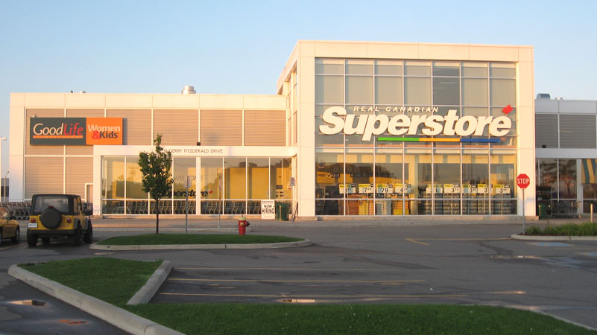
Born in Canada

Slide 2

Megan Li, Vice President of International Business Development
Loblaw

Slide 3
Agenda
Target Market
Benefits
Implementation

Slide 4
Target Market
Middle to lower middle class
On a budget
Searching for convenience

Slide 5
Benefits
Increased Sales
Opportunity to further expand

Slide 6
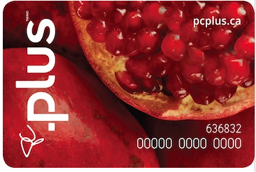
Implementation
Loyalty Points
Increased consumer expenditure
Reoccurring customers
Increased customer lifetime value

Slide 7


A Few Options

Slide 8
A Final Thought
The Real American Superstore

