Slide 1
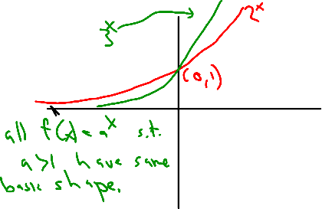
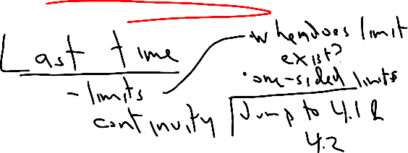
Lecture4­1300.notebook
September 17, 2013
Sep 16­2:26 PM
Sep 16­2:26 PM
Sep 16­2:46 PM
Sep 16­2:36 PM
Sep 16­2:39 PM
Sep 16­2:41 PM
1

Slide 2
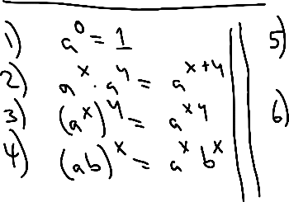
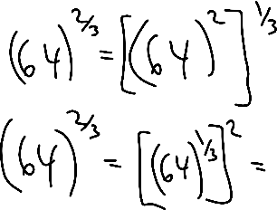
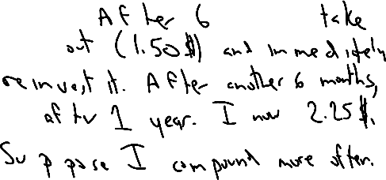
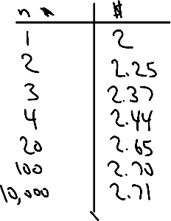
Lecture4­1300.notebook
September 17, 2013
Sep 16­2:50 PM
Sep 16­2:52 PM
Sep 16­2:55 PM
Sep 16­2:58 PM
Sep 16­3:00 PM
Sep 16­3:02 PM
2

Slide 3
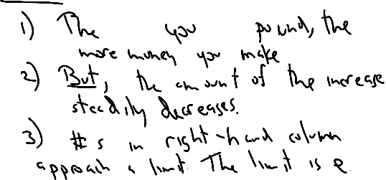
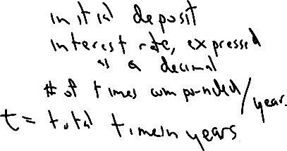
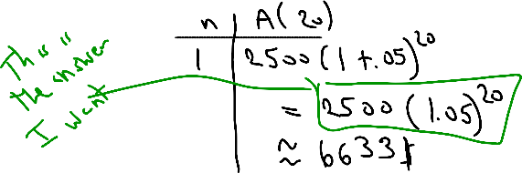
Lecture4­1300.notebook
September 17, 2013
Sep 16­3:05 PM
Sep 16­3:09 PM
Sep 16­3:11 PM
Sep 16­3:14 PM
Sep 16­3:16 PM
3

Slide 4
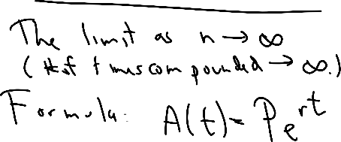
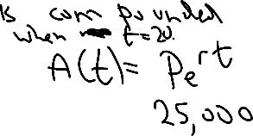
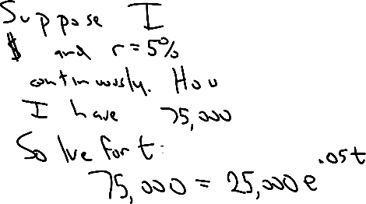
Lecture4­1300.notebook
September 17, 2013
Sep 16­3:22 PM
Sep 16­3:24 PM
Sep 16­3:27 PM
Sep 16­3:30 PM
Sep 16­3:32 PM
4

Slide 5
Lecture4­1300.notebook
September 17, 2013
Sep 16­3:39 PM
Sep 16­3:41 PM
Sep 16­3:43 PM
5

