Slide 1
14
International Macroeconomics
Macroeconomics
Curtis, Irvine © 2013

Slide 2
In this chapter we explain:
The balance of payments accounts
The foreign exchange market
Flexible vs. fixed exchange rates
Monetary & fiscal policy with flexible exchange rates.
Monetary & fiscal policy with fixed exchange rates

Slide 3
Exchange rates and Macroeconomic Policy:
With flexible exchange rates monetary policy is powerful
but fiscal policy is weak.
With fixed exchange rates fiscal policy is powerful but
monetary policy is ineffective

Slide 4
The Balance of Payments
Balance of Payments Accounts
  Current account (CA)
    Trade in goods and services & transfer payments
  Capital account (KA)
    Trade in real & financial assets
  Official Reserves Account (OR)
    Govt holdings of foreign exchange reserves
Table 14.1 gives recent Canadian data

Slide 5
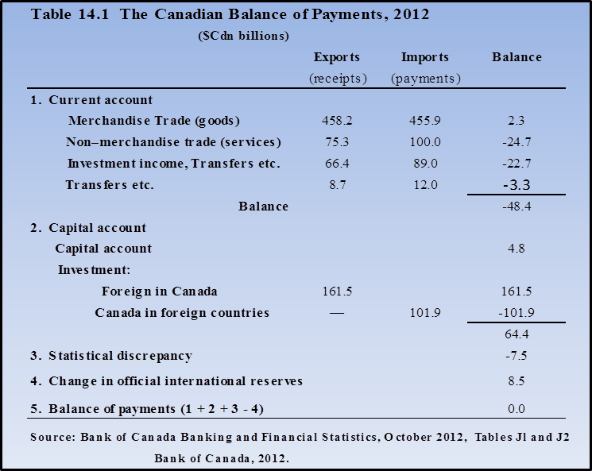

Slide 6
The Balance of Payments
  The sum of:
  current account balance
  plus capital account balance
  minus change in official reserve holdings
  = 0
  e.g. B of P = CA + KA - ∆OR = 0
  A numerical example:
    If CA balance = – 5, and
    KA balance = 3
    C A + KA = ∆OR → CA + KA - ∆OR = 0
    – 5 + 3 = - 2 – 5 + 3 + 2 = 0

Slide 7
The Balance of Payments
Determinants of the current account:
Exports and imports of goods and services based on:
                incomes, foreign & domestic
                tastes, foreign & domestic
                relative prices
  The real exchange rate measures relative prices
Where er = CDN$ price of US$

Slide 8
The Balance of Payments
The real exchange rate combines:
  The domestic price level eg P_{CAN}
  The foreign currency price of imports eg P_{US}
  The nominal exchange rate er ≡ domestic currency price of foreign currency
Real exchange rate gives the prices of goods & services from different countries measured in a common currency.
  If er = $1.05 Cdn/$1US, P_{US} = 115.4 & P_{CDN} = 118.0,
Real exch rate = (1.05 x 115.4)/118.0 = 1.027
In Canadian dollars, US goods and services cost 2.7% more than domestic goods and services

Slide 9
Determinants of the Current Account (ie NX)
The Balance of Payments
Exports (X):
  Depend on world income & real exchange rate
  Domestic exports are imports of foreign countries
    X = X(Y_{f}, P_{f}, P_{Cdn}, er),
Imports (IM)
Depend on domestic income & real exchange rate
IM = IM(Y_{Cdn}, P_{f}, P_{Cdn}, er)
Net Exports (NX)
  If P_{f} & P_{Cdn} constant →real er depends on nominal er
∆X/∆er > 0, ∆IM/∆er < 0, ∆NX/∆er >0

Slide 10
The Capital Account
©2013 Curtis-Irvine Macroeconomics
Chapter 14
10
The Balance of Payments
International trade in real and financial assets
Portfolio decisions:
  Managers seek highest expected returns/risk
  → mixed portfolios of domestic & foreign assets
Perfect capital mobility
  Small i_{d} ≠ i_{f} → very large intn’l capital flows
Realized returns depend on i_{d} – i_{f} and ∆er
------ → Illustrate

Slide 11
The Capital Account: Portfolio choice
©2013 Curtis-Irvine Macroeconomics
Chapter 14
11
The Balance of Payments
In Canada buy CDN bond @ 4% yields $1000 x 1.04 = $1040.00
i_{us}> i_{Cdn} → to buy US bond buy US$ = $1000/1.03 = $970.87US
At yr end $970.87US @ 5% = 970.87 x 1.05 = $1019.41US
In Cdn $ → $1019.41US @ 1.009Cdn/US = 1019.41 x 1.009 =$1028.50Cdn
∆er → offset i_{us}- i_{Cdn}

Slide 12
The Capital Account
The Balance of Payments
Total return on foreign asset
  Total return on foreign asset = i_{f} + %Δer
Capital flow

Slide 13
The Foreign Exchange Market
The foreign exchange market:
Currencies of different countries bought & sold
→ er ≡ Cdn $ price of foreign currency (US$)
Demand for foreign currency D_{fe} from:
  demand for IM of goods & services & securities
  ∆er > 0→ ↑P_{IM} → ↓IM → downward sloping D_{fe} curve
Supply of foreign currency S_{fe} from:
  X of goods, services & securities
  ∆er > 0 → ↓P_{X} → ↑X → upward sloping S_{fe} curve
Foreign exchange market equilibrium
            → er → B of P = 0

Slide 14
The Foreign Exchange Market
Assume i_{d}, i_{f}, Y_{D}, Y_{F,} P_{d}, P_{f} constant
er =CDN$/US$
↓er → ↓P_{IM} → ↑IM = ↑US$ demanded
D_{fe} downward sloping
↑er → ↓ foreign P_{X} & ↑X profits
→ ↑X
→ ↑US$ supplied
S_{fe} upward sloping
S_{fe} = D_{fe} → equil er₀
S_{fe}
er₀=1.05
D_{fe}
∆i_{d}, ∆i_{f} , ∆Y_{D}, ∆Y_{F}, ∆P_{d}, ∆P_{f}
→shift D_{fe} and/or S_{fe}
U₀
US Dollars

Slide 15
The Foreign Exchange Market
Currency depreciation:
  ≡ fall in the external value of the national currency
  If the Canadian dollar depreciates
  er ≡ Cdn $ price of foreign currency increases
Currency appreciation:
  ≡ rise in the external value of the national currency
    If the Canadian dollar appreciates
  er ≡ Cdn $ price of foreign currency decreases

Slide 16
Effect of a Recession in the U.S.
The Foreign Exchange Market
er
Initial equil at A with er₀
U.S. recession ≡ ↓Y_{US} →↓IM_{US} =↓X_{CDN}
S_{fe} shifts to the left to B at er₀
Excess D_{fe} at B → ↑er₁ at C
Cdn $ has depreciated
S₁
S₀
er₁
C
er₀
A
B
D₀
U₁
U₀
US $
Adjustment to equil in foreign
exchange market maintains
B of P = 0

Slide 17
The Foreign Exchange Market
A cut in foreign interest rates
er
Initial equil at A with er₀
↓ i_{US} → ↓IM of U.S. bonds → ↓ D_{fe}
D_{fe} shifts to the left to D₁
↓i_{US} → i_{Cdn} > i_{US} → ↑X of Cdn bonds
→ ↑S_{fe} so shifts to the right S₁
Excess S_{fe} at er₀ → ↓er → er₁
Cdn $ has appreciated
S₀
S₁
A
er₀
er₁
D₀
D₁
Adjustment to equil in foreign exchange
market maintains
B of P = 0
U₁
U₀
US $

Slide 18
Flexible vs. Fixed Exchange Rates
Flexible Exchange rates
  er determined by market S & D
  ∆er provides some automatic stabilization re external AD & AS shocks
  Independent domestic Monetary Policy →Y_{P} &/or π* stabilization
Fixed Exchange rates
  er set at er*
  Monetary Policy committed to er* – not available for AD management
  er operations change Monetary Base → ∆M & ∆i

Slide 19
Central Bank Intervention to Fix the Exchange Rate
Flexible vs. Fixed Exchange Rates
Buy Excess Supply
Official exchange rate set at er*
er
Central bank → buys/sells foreign
currency to fix er = er*
At E market S_{fe} = market D_{fe}
no intervention needed
At A, S_{fe} > D_{fe} → central bank buys
AE US$ → ↑MB→ ↑M & ↓i
At C, D_{fe} > S_{fe} → central bank sells
EC US$ → ↓MB → ↓M & ↑i
S₁
Sell = Excess Demand
A
E
C
er₁
er*
D₂
D₁
D₃
U₃
U₀
U₂
US $
Foreign exchange ops drive M policy

Slide 20
Flexible vs. Fixed Exchange Rates
Canada’s exchange rate experience
Canada adopted flexible exchange rates in 1970
Over the period 1990 – 2012 real exchange rates were driven primarily by nominal exchange rates
∆er from ( i_{d} – i_{f}) & (expected ∆er) → capital flows, and from commodity price movements
The ∆er/∆i link in the monetary transmission mechanism is important for effective monetary policy
∆er helped with adjustment to large changes in commodity prices over the past 10 yrs.
….Canadian exchange rate changes →

Slide 21
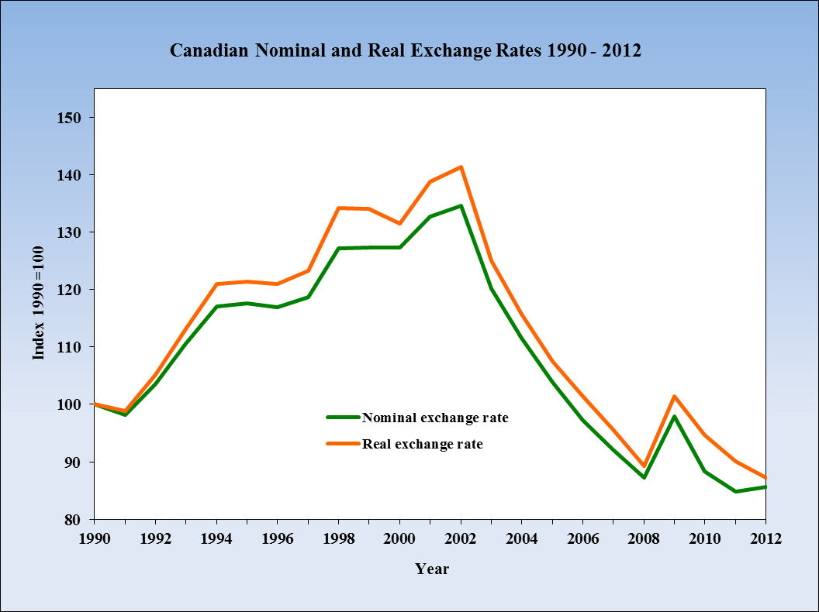
The depreciation of the C$
from 1990 to 2003 increased
import prices and increased
the profitability of Canadian
exports.
The appreciation of the C$
starting in 2003 lowered
import prices and reduced
the profitability of Canadian
exports

Slide 22
Monetary & Fiscal Policy with Flexible Exchange Rates
Monetary policy:
  can be a strong AD management tool
  Independent choice of policy target eg. π*
  Policy instrument is short term interest rate eg. onr
  Transmission mechanism through both interest rates & exchange rates
But:
  Limited by interest rate and exchange rate elasticities of expenditure
  Limited by ‘zero lower bound’ on interest rate

Slide 23
Monetary & Fiscal Policy with Flexible Exchange Rates
Fiscal policy:
  a weak AD management tool re Y_{P} target
  fiscal stimulus crowded out A(i) without monetary
  accommodation
  budget balance & debt ratio targets (austerity)
But:
debt management enhanced by monetary policy
inflation targeting
strong AD management tool re Y_{P} when monetary
policy hits ‘zero lower bound’

Slide 24
Monetary & Fiscal Policy with Flexible Exchange Rates
Policy coordination examples:
Fiscal adjustment 1995-2000
Cuts in G and increases in t aimed initially at
↑ BB - 5.3% → - 3.0% of GDP to stabilized debt ratio
Monetary policy aimed at π = 2.0
Fiscal austerity → GDP gaps ↑ 0.0% → 2.0%
Monetary stimulus from ↓bank rate 7.3% → 3.5%
Exchange rate increased from $1.36Cdn/$1US to 1.49Cdn/$1US
Strong growth in US GDP → ↑X
BB = + 0.6 in 1999 and GDP gap = 0.0 in 1999Q3

Slide 25
Monetary & Fiscal Policy with Flexible Exchange Rates
Policy coordination examples:
2. The recession of 2008 – 2009:
  Monetary stimulus: reductions in onr 4.0% → 0.25%
  Announcements re low future interest rates
  Also plans for ‘quantitative easing’ & ‘credit easing’
  Fiscal stimulus through increased G and reduced net taxes: (The Economic Action Plan)
  → ↓BB from 0.6%GDP to – 3.5%GDP
  Coordinated monetary and fiscal stimulus:
  Output gap reduced from:
  – 3.2% in 2009Q2 → – 0.4% in 2011Q1

Slide 26
Monetary & Fiscal Policy with Fixed Exchange Rates
Monetary policy:
  ineffective AD management tool
  committed to er* target
  cannot pursue an independent domestic policy target: π or Y_{P}
  interest rate or money supply growth driven by er* target and foreign monetary policy
Fiscal policy:
  a strong AD management tool
  fiscal stimulus does not ‘crowd out’ A(i) with i & M determined by er* target
But
  fiscal austerity effects on AD cannot be not offset by monetary policy stimulus or currency depreciation
  e.g. EU type sovereign debt problems

Slide 27
Chapter Summary
Balance of payments measures international transactions classified to the current and capital accounts
International trade in goods & services is recorded in the current account
International trade in financial assets is recorded in the capital account
Perfect international capital mobility means different expected asset returns across countries cause large international flows of funds
The interest rate parity condition: when capital mobility is perfect, the interest rate differentials across countries are offset by expected exchange rate changes.
In the foreign exchange market supplies and demands for currencies of different countries are bought and sold and exchange rates are determined

Slide 28
Chapter Summary
Sources of demand and supply in the foreign exchange market are transactions recorded in the balance of payments accounts
Floating or flexible exchange rates increase the independence and power of monetary policy as a tools for AD management. Fiscal policy power limited.
Fixed exchange rate regime requires central bank intervention and monetary policy coordinated with international financial conditions. Monetary policy independence lost but fiscal policy power enhanced.

