Slide 1
13
Economic Growth
Macroeconomics
Curtis, Irvine © 2013

Slide 2
In this chapter we explain:
Growth in potential output
Growth in per capita real GDP
Technology and growth in per capita output
Neoclassical growth theory and the convergence hypothesis
Recent growth theories and policy issues

Slide 3
Three Important Questions
1. What is long-term economic growth?
2. What are the sources and causes of growth?
3. Can economic policies affect growth?

Slide 4
Growth in Potential Output (Y_{P})
The analytical time frame: the very long run
- time for ∆Capital stock, ∆labour force & ∆ technology
Recall the production function:
  Y = A_{t} x F(N_{t}, K_{t})
  A is total factor productivity (proxy for contribution of technology)
Potential Output: Y_{P} = A_{t} x F(N_{F}, K_{t})
  A_{t} = current state of knowledge & technology
  N_{F} =full employment equilibrium labour input
  K_{t} = plant and equipment operating at designed capacity

Slide 5
Growth in Potential Output (Y_{P})
Growth accounting:
  Measuring the sources of growth in Y_{P}
Growth in Real GDP
Effect of Growth in TFP
Effect of Growth in Labour Inputs
Effect of Growth in Capital Inputs
=
+
+
Weights on ∆N/N and ∆K/K are shares of labour income and
non-labour income in national income

Slide 6
Growth in Potential Output (Y_{P})
Growth in potential output:
Contribution of improved technology ∆A/A:
  Cannot be calculated directly
  Measured by the Solow Residual: ∆A/A

Slide 7
Growth in Potential Output (Y_{P})
A numerical example:
  Observed growth rates (%):
∆Y/Y ∆N/N ∆K/K
5.0 2.4 3.9
  Calculating the Solow residual:

Slide 8
Growth in Potential Output (Y_{P})
Another numerical example:
  Assume labour income share(W/Y) = 70% & capital income share (BI/Y) = 30%.
  Assume : ∆Y/Y = 3%, ∆N/N = 2% & ∆K/K = 2%.
  Then growth of total factor productivity was 1%.
∆A/A = 3.0% – 0.7 x 2% − 0.3 x 2%
= 3.0% − 1.4% − 0.6%
= 1.0%

Slide 9
Growth in Per Capita GDP
Growth in Y_{P} measures expansion in the aggregate economy
Standards of living depend on per capita GDP: Y/Population
Sustained growth in per capita GDP depends on growth in productivity driven by improvements in technology
The nature of the production function provides the explanation

Slide 10
Growth in Per Capita GDP
The Production Function:
  Assume A = 1
  Y = N^{⅔} x K^{⅓}
  ⅔ and ⅓ are the elasticities of Y with respect to N & K
Marginal products of labour and capital are diminishing:
    %∆Y/%∆N = ⅔ and Y/N declines as N increases
    %ΔY/%ΔK = ⅓ and Y/K declines as K increases
Scale economies are constant:
    If ∆N/N = ∆K/K = x% then ∆Y/Y = x%
    Y/N and Y/K are constant as Y grows

Slide 11
Growth in Per Capita GDP
Per capita (worker) production function:
  Per capita real GDP ≡ Y/N ≡ y
  Then if:
  Defining y ≡ Y/N and k ≡ K/N then:
  Per capita real GDP
  y = Ak^{⅓}

Slide 12
Growth in Per Capita GDP
With y = Ak^{⅓}
Growth in output per worker, ∆y/y, depends on:
1. Improvements in technology, ∆A, and/or
2. Growth in ∆k (ie ∆K/K > ∆N/N)
Effects of ∆A and ∆k on y:
      ∆A = 10% → ∆y = 10%
      ∆k = 10% → ∆y = 1/3(10%) = 3.33%
Constant y requires constant k
In a diagram……..

Slide 13
The effects of ∆k > 0 & ∆ A > 0 on y
Growth in Per Capita GDP
y
y = A₁ x k^{1/3}
y₃
E
Δy from ΔA
y = A₀ x k^{1/3}
y₂
D
Δy from Δk
y₁
C
∆k →∆y from C to D
but (∆y/∆k) <1
∆A → ∆y from D to E
with (∆y/∆A) = 1
Δk
k₁
k₂

Slide 14
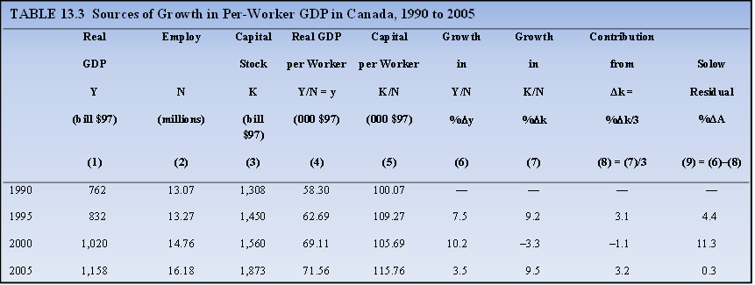
Growth in Per Capita GDP
Source: Adapted from Statistics Canada CANSIM Database Table 380-0002 Series V1992067, Table 031-0002 Series V4419841, and Table 282-0087 Series V2062811, and author’s calculations.
Three different experiences:
1.1990-1995, ∆k/k = 9.2%, ∆y/y = 7.5% & Solow residual = 4.4%.
2.1995-2000, ∆k/k = – 3.3%, ∆y/y = 10.2% & Solow residual = 11.3%.
3. 2000-2005, ∆k/k = 9.5%, ∆y/y = 3.5% & Solow residual = 0.3%.

Slide 15
Technology and Growth in per Capita Output
  Sustained growth in y depends on:
  Improvements in technology (∆A):
Improvements in technology (∆A) come from:
  R&D → invention and innovation
  Education → improvements in labour force quality
  Investment that increases capital stock and growth in labour force may both embody improvements in A

Slide 16
Neoclassical Growth Theory & the Convergence Hypothesis
Neoclassical growth theory:
  Assume Y = Y_{P}
  Assume labour force grows at a constant rate n = ∆N/N
  Assume a constant saving rate S/Y and s/y
  Assume I = S
  Assume constant technology A = A₀

Slide 17
Neoclassical Growth Theory & the Convergence Hypothesis
Neoclassical steady-state growth:
  Constant capital per worker (k) → constant y :
    ∆Y/Y = n
  Output, capital, and labour grow at the same rate
  Capital stock grows at the same rate as the labour force
  Investment per worker = growth in capital stock required
  to maintain capital stock per worker
  Steady state condition: → sy = nk
  In a diagram………..

Slide 18
Steady-State Neoclassical Growth
Neoclassical Growth Theory & the Convergence Hypothesis
Output per worker
y
At k*: sy = nk → constant y*
y*
y = F(k)
y₁
nk
sy₁
sy
E
nk₁
At k₁: sy₁ > nk₁ → ↑k & ↑y →k* & y*.
k₁
k*
Capital per worker

Slide 19
Steady-State Output per Worker
Neoclassical Growth Theory & the Convergence Hypothesis
A numerical example:
Per worker production function: y = k^{0.5}
Labour force growth rate: n = 2.0%
National saving rate: s = 10%
Steady state condition:
Growth in capital stock = growth in labour force
sy/k = n → sy = nk
0.1k^{0.5} = 0.02k
0.1 = 0.02k^{0.5}
k^{0.5} = 5
k = 25
y = 5

Slide 20
Neoclassical Growth Theory & the Convergence Hypothesis
From Neoclassical growth model:
Steady state output per worker (y) determined by: Technology (A),
Labour force growth (n), &
Savings rates (s)
Convergence hypothesis:
Countries with similar: A, n & s → converge on same y.
Countries with lower y will grow faster than those with higher y → convergence of y across countries
Empirical evidence……

Slide 21
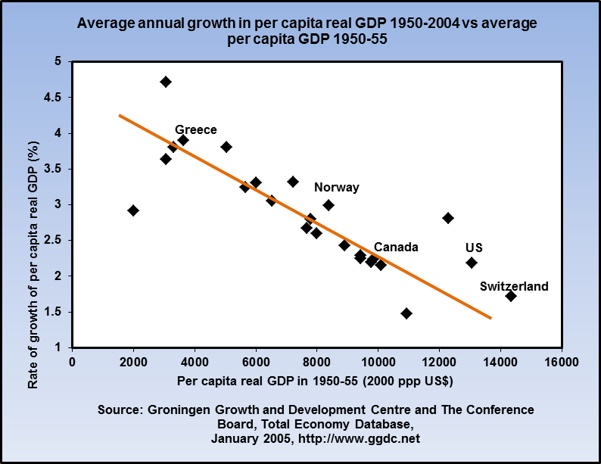
Neoclassical Growth Theory & the Convergence Hypothesis
For convergence of per capita real GDP across countries:
Countries with lower per capita GDP s in 1950-55 must have higher growth rates from 1950 – 2004 than countries with higher per capita GDPs in 1950-55

Slide 22
Recent Growth Studies and Policy Issues
Recent Growth Studies:
Extend growth accounting methodology and refine total
factor productivity measured by the Solow residual
Capital stock increases are disaggregated by investment in:
    Info & communications technology
    Machinery & equipment
    Physical structures
Labour force changes include indicators of quality:
    Educational qualifications
    Age structure
    Gender structure

Slide 23
Recent Growth Studies and Policy Issues
More detail on the sources of productivity growth
R. Dion, “Interpreting Canada’s Productivity Performance in the Past Decade:
Lessons from Recent Research.” Bank of Canada Review, Summer 2007.

Slide 24
Recent Growth Studies and Policy Issues
Policy influences on productivity growth:
Tax policy designed to encourage investment in technology
Support for invention and innovation through grants &
legal protections
Infrastructure investment to support transport & communications
Education and human resource policy to enhance labour
qualifications , skills flexibility & mobility

Slide 25
Recent Growth Studies and Policy Issues
Endogenous Growth Theory:
  Endogenous growth – determined within the model
  Assume externalities to ∆K
  Aggregate economy faces constant returns to ∆K
  Aggregate per worker production function:
  y = Ak
Neoclassical model with ∆A = 0:
∆s → no effect on steady state
∆Y/Y = n & ∆y/y = 0,
Endogenous growth with ∆A = 0:
    y = Ak
    ∆s → permanent ↑∆y/y

Slide 26
Recent Growth Studies and Policy Issues
An example of a y = Ak model
The saving rate > rate of investment
(nk) needed for a constant k
Capital per worker k increases and
increases output per worker
Externalities from the growing
aggregate capital stock offset any
tendency for diminishing returns.
An increase in the saving rate s
Would increases growth in Y and y

Slide 27
Recent Growth Studies and Policy Issues
Neoclassical growth model:
    Homogeneous capital and labour
    Diminishing returns to increased capital/labour
    Exogenous technology
New growth theory:
    Y = Ak model
    ∆k externality gives constant returns to capital/labour ratio
    R&D, education, ‘learning by doing’ → endogenous ∆A
Suppose ∆N & ∆K embody new knowledge & technology
    Integrated ∆A and ∆N and ∆K →
      y = Ak^{⅓} shifts up with ∆N and ∆K
In a diagram……

Slide 28
Recent Growth Studies and Policy Issues
The y = Ak line traces the locus
of ∆y/∆k
∆K & ∆N embody ∆A.
As a result ∆k > 0 shifts
y = A.F(k) up
Externalities from ∆K & ∆N > 0 offset diminishing returns.
The economy appears to grow
along y = Ak.

Slide 29
The Costs of Growth:
Recent Growth Studies and Policy Issues
Pollution, congestion, and a hectic lifestyle
Distorted measurement of ‘true’ GDP and per capita GDP
A role for government intervention and policy?
‘Zero growth’ locks in current costs
Sustainable growth balances costs and benefits

Slide 30
Chapter Summary
Economic growth defined as annual percentage increase in real GDP or per capita real GDP
Growth in potential output is determined by growth in labour force, growth in capital stock and growth in factor productivity
Growth accounting is a way of measuring the sources of economic growth
Growth in per capita real GDP has two main sources:
    Growth in the ratio of capital to labour
    Improvements in technology
Sustained growth in per capita real GDP depends on productivity growth from improvements in technology

Slide 31
Chapter Summary
Neoclassical growth theory argues that in the absence of technological change a country will have a steady state growth rate in total GDP equal to the rate of population growth and zero growth in per capita GDP.
Convergence hypothesis says similar countries will move toward and converge on the same level of per capita real GDP
New or endogenous growth theory is based on positive externalities to the growth of capital stock that overcome diminishing returns to factor inputs
The cost of growth create a role for government policy

