Slide 1
8
Money, Banking &the Money Supply
Macroeconomics
Curtis, Irvine © 2013

Slide 2
In this chapter we explain:
Money and the functions of money
Measures of the Canadian money supply
Banking in Canada today
Money created by banks
The monetary base and the money supply

Slide 3
Money & the Functions of Money
A Medium of Exchange:
Money as a medium of exchange:
  Anything generally accepted for making payments
  Money prices for goods and services
  Lower costs and increased efficiency of trade
Barter economy without money:
  Goods trade directly for goods.
  Trade requires a double coincidence of wants
  Trade involves multiple ‘exchange ratios’

Slide 4
Money & the Functions of Money
Other Functions of Money:
  Unit of account
    Prices quoted & accounts kept in monetary units ($ or ¥)
  Store of value
    Carry purchasing power forward in time
  Standard of deferred payment
    Unit of account for future payments

Slide 5
Money & the Functions of Money
The evolution of money
Commodity money
Token Money
Legal tender
Fiat Money
Credit Money
Money supply ≡ stock of medium of exchange in circulation

Slide 6
Measures of the Canadian Money Supply
Monetary base:
Legal tender made up of notes and coin in circulation
plus cash held by banks
Money supply:
The means of payment ie notes and coin outside the banks
plus bank deposits

Slide 7
Measures of the Canadian Money Supply
The Canadian Money Supply in June 2012¹
($ billions)
Monetary base MB 65.0
Currency in circulation 60.4
M1B = currency + chequable bank deposits 592.4
M2 = M1B + notice and saving deposits in banks 1,122.7
M2+ = M2 + deposits in other financial institutions 1,477.5
Note: ¹ Seasonally adjusted June 2012
Source: Statistics Canada, CANSIM Table 176-0025
The importance of bank deposits:
Deposits account for about 97% of the money supply
Banks operations are the sources of loans and deposits

Slide 8
Banking in Canada Today
Canadian Banking System in 2012
Banking Institution Number
Central bank
The Bank of Canada 1
Chartered banks
Schedule I domestic banks 22
Schedule II foreign bank subsidiaries 26
Schedule III foreign bank branches 23
Total 72
Source: Canadian Bankers Association www.cba.ca

Slide 9
Banking in Canada Today
Banks are financial intermediaries
  Bring borrowers & lenders together
Bank of Canada: Canada’s central bank
  Not profit oriented
  Regulates money & supports financial markets
  Responsible for Monetary Policy
  Banker for commercial banks
  ‘Lender of last resort’
  Banker for Govt

Slide 10
Banking in Canada Today
Commercial Banks:
  Profit oriented businesses
  Provide banking services for public
  Issue bank deposits & lend to customers
  Create deposits by their lending activity
  Deposits are medium of exchange
  The consolidated balance sheet for the commercial banks
  illustrates their banking operations

Slide 11
Banking in Canada Today
Banks hold small cash reserves against deposit liabilities
Loans and mortgages are major assets

Slide 12
Banking in Canada Today
Bank Operations & Profits:
Banking Profits ≡ Interest income from assets – interest cost of deposits
= Net interest income x financial assets
May be stated:
  In absolute $ terms, or
  As a % of assets, or
  As a % of shareholders’ equity
Reported net interest income 2012
Scotiabank Third Quarter Report 2012 2.23 %
BMO Third Quarter Report 1.70 %

Slide 13
Money Created by Banks
Four key conditions for deposit (money) creation:
Non-bank public has confidence in banks, holds & uses bank deposits as money
Non-bank public borrows from the banks
The banks operate with fractional cash reserve ratios
The banks accept risks involved in lending to the non- bank public

Slide 14
Money Created by Banks
Two key factors in deposit money creation:
Currency ratio (cr)
  Ratio of cash balances to deposit balances the public chooses to hold
Reserve ratio (rr)
  Ratio of bank cash reserves to deposit liabilities the banks choose to hold

Slide 15
Money Created by Banks
Banks create money by issuing deposits when:
  making loans to customers
  buying financial securities
An example of deposit creation, assume:
  A reserve ratio of 10 percent, rr = 0.10
  A currency ratio of 0, cr = 0
  Public holds cash = 1000 dollars

Slide 16
Money Created by Banks
Banks |  | Non-Bank Private Sector
Assets | Liabilities | Assets | Liabilities
1. Initial Position
Cash 0 | Deposits 0 | Cash $1,000 | Bank loans 0
2. People deposit their cash in the banks.
Cash $1,000 | Deposits $1,000 | Cash 0 | Bank loans 0
 |  | Deposits $1,000
3. Banks lend $9,000 by creating $9,000 new customer deposits
Cash $1,000 | Deposits $10,000 | Cash 0 | Bank loans $9,000
Loans $9,000 |  | Deposits $10,000

Slide 17
Money Created by Banks
Profit oriented banks expand lending & create new deposits when:
  They have excess reserves, &
  They can find credit-worthy borrowers
  They are willing to accept ‘banker’s risk’ of lending & issuing deposits
  Provided the non-bank public:
  Has confidence in the safety of bank deposits, and
  Is willing to borrow from banks

Slide 18
Money Created by Banks
Limits on deposit creation by banks
Bank Behaviour
Higher rr → lower bank lending & deposit creation
Caution over risks of lending & withdrawals of deposits?
Non-Bank Behaviour
Higher cr → lower bank lending & deposit creation
Uncertainty about safety of bank deposits?
Uncertainty about future stability of financial markets?

Slide 19
Money Created by Banks
Financial Panics
A financial panic sequence:
  Public losses confidence in bank deposit safety →
  Customers rush to withdraw deposits → ‘Run on the bank’
  Bank calls for central bank support →
  Central bank ‘lender of last resort’ action →
  Govt take-over &/or orderly liquidation of bank
  Customers may be protected by deposit insurance

Slide 20
The Monetary Base & the Money Supply
Money supply (M)
  ≡ notes & coin in circulation outside banks + bank deposits
Monetary Base (MB)
  ≡ notes & coin in circulation & cash held by banks
Money Supply Function
  M ≡ money multiplier x MB

Slide 21
The Monetary Base & the Money Supply
The Money Multiplier:
≡ ∆M caused by ∆MB, given cr & rr
Assume: cr = 0.1 & rr = 0.05
In this example: ∆MB = $1 → ∆M = $7.33.

Slide 22
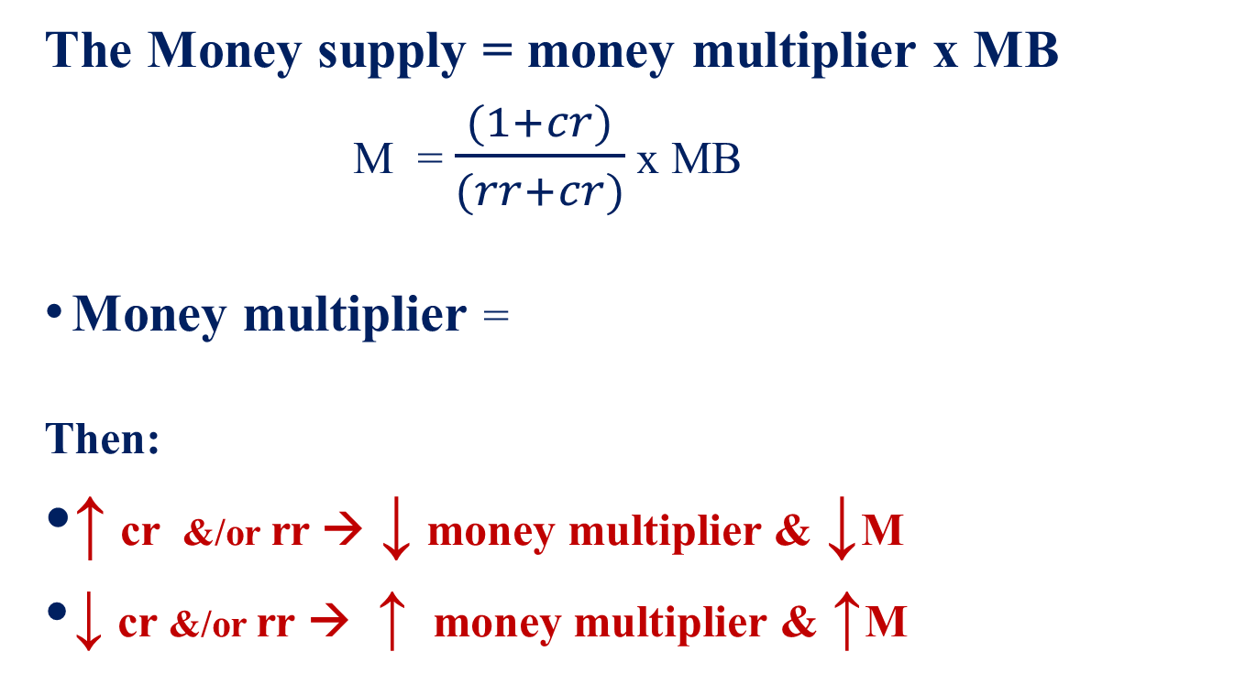
The Monetary Base & the Money Supply
The Money supply = money multiplier x MB
M = $\frac{(1+cr)}{(rr+cr)}$ x MB
Money multiplier =
Then:
↑ cr &/or rr → ↓ money multiplier & ↓M
↓ cr &/or rr → ↑ money multiplier & ↑M

Slide 23
The Monetary Base & the Money Supply
How big is the money multiplier in Canada?
Using mid-2012 data
Monetary Base (MB) = $65.0 billion
Money Supply (M1B) = $592.4 billion
The money multiplier was:
∆MB = $100 → ∆M = $911.

Slide 24
The Monetary Base & the Money Supply
Bank lending and deposit
creation expands RR into
the deposit part of M1B
The ‘inverted pyramid’ shape
shows the fragility of the system.
Small changes in CR or RR have
high large effects on M

Slide 25
The Monetary Base & the Money Supply
The money supply function:
Money supply M depends on three variables:
  MB, the monetary base
  rr, the banks’ reserve ratio
  cr, the public’s cash ratio
Money supply
If the central bank controls
MB it controls M,
provided rr and cr are constant

Slide 26
The Money Supply Function
MB & money multiplier
determine M
∆MB x money multiplier →
∆M → shift M function
∆M/∆ interest rate = 0

Slide 27
The Monetary Base & the Money Supply
Monetary Policy
Assume:
Constant rr & cr :
Money supply function: M = M(rr, cr, MB)
Central bank control of MB→ control of M or i
Monetary Policy Objective:
∆MB → ∆M or ∆i → ∆AD →Y = Y_{P} and/or P = P*

Slide 28
Chapter Summary
Money has four functions: as a medium of exchange, a store of value, a unit of account, & a standard of deferred payment.
In a barter economy trade requires a double coincidence of wants.
A token money is a convertible claim on a commodity money
Fiat money is money the government has declared legal tender. The central bank controls the supply of legal tender.
Banks create money by making loans and creating deposits based on a fractional cash reserve ratio.
Banks are financial intermediaries.

Slide 29
Chapter Summary
Monetary base (MB) is currency in circulation plus banks’ cash reserves.
Money multiplier is ∆M/∆MB
The money supply

