Slide 1
7
The Government Sector
Macroeconomics
Curtis, Irvine © 2013

Slide 2
In this chapter we explain:
Government in Canada
Government expenditure, taxes and equilibrium real GDP
The government’s budget & budget balance
Fiscal policy and government budgets
Automatic and discretionary fiscal policy
The public debt and the budget balance
Aggregate demand, and equilibrium real GDP

Slide 3
Government in Canada

Slide 4
Government in Canada
The financial crisis and recession of 2008 – 2010 reduced government revenues, increased government transfers and led to discretionary
fiscal stimulus. Budget balances declined and debt and debt ratios increased in Canada and the G7

Slide 5
Government Expenditure, Taxes and Equilibrium GDP
Govt expenditure G = G₀ is an autonomous part of AE
Then A₀ = C₀ + I₀ + G₀ + X₀ – IM₀
Net tax, NT = tY, where t is the net tax rate = ∆NT/∆Y
Disposable income YD = Y - NT
∆NT induced by ∆Y→ ∆slope AE → ∆multiplier ∆Y/∆A

Slide 6
Net Taxes & Consumption
Government Expenditure, Taxes and Equilibrium GDP
Net Taxes (NT = tY) reduce YD at every Y
YD = Y – NT = Y - tY = (1 – t)Y
Then C = C₀ + cYD
→ C = C₀ + c(Y – tY)
→ C = C₀ + c(1 – t)Y
C is lower at every Y when t > 0
∆t → ∆C at every Y, ∆C/∆t < 0

Slide 7
Net Taxes & Consumption
Government Expenditure, Taxes and Equilibrium GDP
A Numerical example: ∆C/∆t < 0
Assume: NT = tY = 0.15Y,
→YD = Y – NT = Y – 0.15Y
Then: C = 20 + 0.8YD
C = 20 + 0.8(Y – 0.15)Y
C = 20 + 0.68Y
Now ∆C/∆Y = 0.68
Slope of C function = 0.68

Slide 8
Net Taxes & Consumption
Government Expenditure, Taxes and Equilibrium GDP
C
C = 20 + 0.8Y, assuming t = 0
Increase t to t = 0.15
C = 20 + 0.68Y,
260
Taxes ∆C at every Y by – ctY
224
∆C = 0.8(tY) = 0.8(0.15 x 300) = 36
ΔC/ΔY = MPC(1-t) = 0.8 x 0.85 = 0.68
20
300
Y

Slide 9
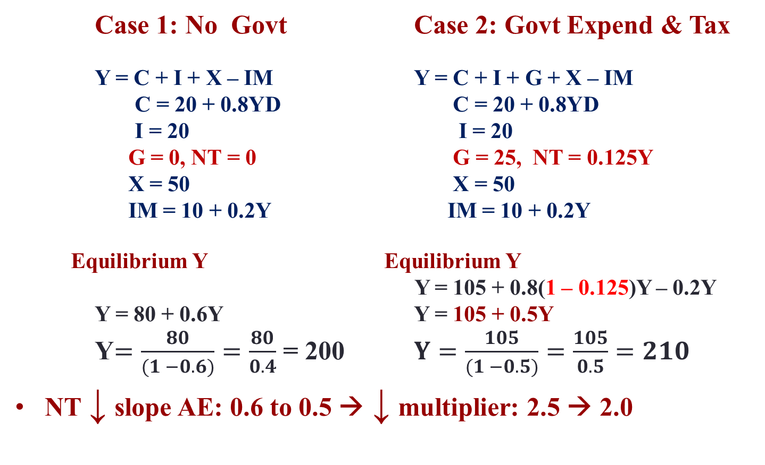
Government Expenditure, Taxes and Equilibrium GDP
    Case 1: No Govt Case 2: Govt Expend & Tax
    Y = C + I + X – IM Y = C + I + G + X – IM
      C = 20 + 0.8YD C = 20 + 0.8YD
      I = 20 I = 20
    G = 0, NT = 0 G = 25, NT = 0.125Y
    X = 50 X = 50
    IM = 10 + 0.2Y IM = 10 + 0.2Y
Equilibrium Y Equilibrium Y
Y = 105 + 0.8(1 – 0.125)Y – 0.2Y
    Y = 80 + 0.6Y Y = 105 + 0.5Y
    Y$=\frac{80}{(1 −0.6)}=\frac{80}{0.4}$ = 200 $Y=\frac{105}{(1 −0.5)}=\frac{105}{0.5}=210$
NT ↓ slope AE: 0.6 to 0.5 → ↓ multiplier: 2.5 → 2.0

Slide 10
Government Expenditure, Taxes and Equilibrium GDP
Effect of ∆G on equilibrium Y
Assume NT = 0, ∆G =25
Then increase in G, is an increase in A,
Increase in G → ∆Y = ∆A x multiplier
AE
Y = AE
AE’ = 105 + 0.6Y
AE = 80 + 0.6Y
∆G = 25
→∆A = 25
→∆Y = 25 x (1/(1-0.6) = 62.5
∆G=25
105
80
∆Y = 62.5
45⁰
Y
200
262.5

Slide 11
Government Expenditure, Taxes and Equilibrium GDP
Effect on equilibrium Y
of adding NT = tY = 0.125Y
to finance G.
Y = AE
AE’ = 105 + 0.6Y
∆t =0.125
AE
AE’’ = 105 + 0.5Y
∆t →∆YD →∆C
→(∆AE/∆Y) ≡ ∆ slope of AE
  ∆Multiplier
∆Y_{e}
105
∆Y_{e}
o
45⁰
210
262.5
Y

Slide 12
Government Expenditure, Taxes and Equilibrium GDP
The Multiplier revisited:
m & t reduce the slope of AE
Lower AE slopes → smaller Multipliers

Slide 13
The Govt Budget and Budget Balance
Government revenue & spending:
Net tax revenue: NT = tY
Expenditure on goods & services: G
Govt budget balance: BB = revenue - expenditure
  BB = tY – G

Slide 14
The Govt Budget and Budget Balance
The BB depends on three things:
Net tax rate (t) set by the govt
Govt expenditure (G) set by the govt
GDP (Y) determined by AE and AD

Slide 15
The Govt Budget and Budget Balance
Assume:
G₀ & t₀ set by govt’s Budget Plan
Then BB is determined by Y, ∆Y → ∆BB
G, NT
NT = t₀Y = 0.2Y
Deficit
Balanced
Surplus
200
G₀ = 200
600
1500
Y

Slide 16
The Govt Budget and Budget Balance
A numerical example:
The Govt’s Fiscal Plan sets t₀ & G₀:
NT = t₀Y, G = G₀
Budget Function: BB₀ = t₀Y - G₀
E.g. if BB₀ = 0.2Y – 200
Y NT G BB
200 40 200 -160
600 120 200 - 80
1000 200 200 0
1600 320 200 120
For this fiscal plan the budget balance depends on Y.
If Y rises from 200
to 1000 the budget
balance increases from
a deficit of 160 to a surplus of 120
A fall in Y would reduce
The budget balance

Slide 17
The Govt Budget and Budget Balance
A Govt Budget Function: BB₀ = 0.2Y - 200
+BB
BB₀ = 0.2Y-200
+80
600
0
1000
1400
Y
-80
-200
This fiscal program with t = 0.2 & G = 200
The BB depends on Y
∆BB/∆Y > 0

Slide 18
Fiscal Policy & Govt Budget Balance
Fiscal policy objectives:
Stabilize equilibrium Y = Y_{P} &/or,
Manage budget deficits & public debt
Fiscal policy instruments:
Set net tax rate (t), both taxes & transfers
Set government expenditure (G)
∆ Fiscal Policy ≡ ∆Fiscal Plan → ∆BB function

Slide 19
Fiscal Policy & Govt Budget Balance
Fiscal stimulus to close a recessionary gap
∆G > 0 → shift AE up
∆Y = ∆G x multiplier
Y = AE
Y_{P}
AE₁
AE
AE₀
A₀ + ∆G
ΔG > 0
A₀
∆Y
Gap
0
45⁰
Y₀
Y_{P}
Y

Slide 20
Fiscal Policy & Govt Budget Balance
Fiscal austerity to close an inflationary gap
∆t > 0 → reduces slope of AE and the multiplier
∆t → lowers Y_{e}
Y = AE
Y_{P}
AE₂
AE
Δt > 0
AE₃
A₀
∆Y < 0
gap
45⁰
0
Y_{p} Y₂ Y

Slide 21
Fiscal Policy & Govt Budget Balance
The Structural Budget Balance
An indicator of Fiscal Policy Stance
Actual BB: an ambiguous fiscal indicator
  ∆Y &/or ∆Fiscal program → ∆BB
Structural budget balance (SBB) ≡ BB estimated @ Y_{P}
  SBB = t₀Y_{P} – G₀
∆Fiscal program (∆t₀ &/or ∆G₀) → ∆SBB
∆SBB → shift BB function ≡ ∆Fiscal Policy Stance

Slide 22
Actual & Structural Budget Balances
Fiscal Policy & Govt Budget Balance
The budget plan: BB₀ = t₀Y – G₀
The structural balance SBB₀ = t₀Y_{P} – G₀
BB₀ = t₀Y – G₀
+ BB
C
+BB₂
Actual BB > 0
SBB₀
A
Y₁
0
Y_{p}
Y₂
Y
Actual BB < 0
-BB₁
B
-G₀
∆BB/∆Y > 0
∆SBB/∆Y = 0
– BB

Slide 23
Automatic & Discretionary Fiscal Policy
Fiscal Policy & Govt Budget Balance
Automatic fiscal stabilizers
  Reduce slope of AE → reduce ∆Y/∆A (the multiplier)
  NT = tY → (∆AE/∆Y) = [(1 – t)(c – m)]
  Built into budget program by setting t in NT = tY
  → ∆BB changes with ∆Y moving along BB function
Discretionary fiscal policies
  ∆t &/or ∆G → shift BB function → ∆SBB
  Shift AE & AD functions & ∆slopes → AE →∆Y

Slide 24
Automatic and Discretionary Fiscal Policy
The budget plan sets t₀ and G₀ to give BB = t₀Y – G₀
Automatic fiscal stabilization: the net tax rate t reduces the size
of the multiplier and the effects of transitory fluctuations
in autonomous expenditures on equilibrium GDP
Discretionary fiscal policy: changes in net tax rates ∆t
  & government
expenditure ∆G introduced in a new budget plan
to offset persistent autonomous expenditure
shifts and stabilize equilibrium GDP at Y_{P}

Slide 25
Automatic and Discretionary Fiscal Policy
Initial budget plan is BB₀
Suppose BB₁ has
t₁ > t₀ and G₁ < G₀
Discretionary Policy: ∆t or ∆G →Shift BB line to BB₁→∆SBB
BB₁ = t₁ – G₁
+BB
BB₀ = t₀Y – G₀
SBB₁
BB₂
C
SBB₀
A
BB₁
B
0
Y₁
Y₂
Y
– G₁
Y_{p}
Automatic Stabilization: ∆Y → ∆BB along BB line
-G₀
– BB

Slide 26
The Public Debt and the Budget Balance
Public Debt (PD) ≡ govt bonds issued to finance BB < 0
The outstanding PD = ∑ (past BB, + & - )
Annual ΔPD = - BB
Public Debt Ratio ≡ PD/Y

Slide 27
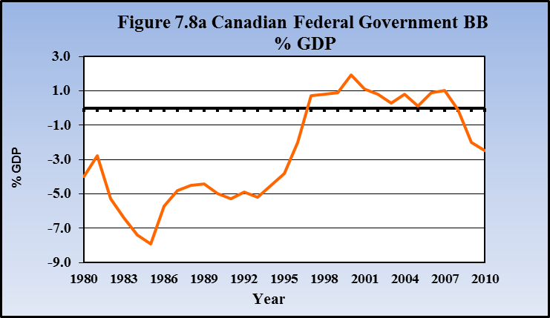
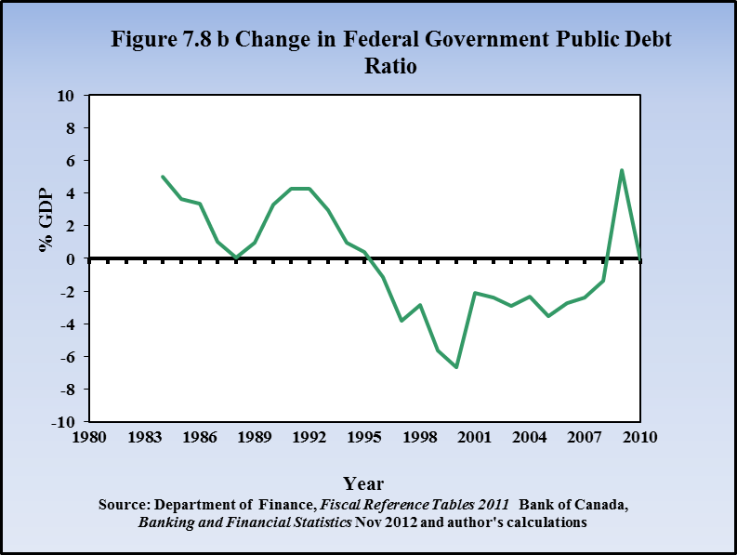
Federal Govt Budget Balances & Changes in Public Debt Ratios
Canada 1980/83 - 2010

Slide 28
Aggregate Demand & Equilibrium Output
Equil Y = AE
AE = A₀ + [c(1 – t) – m]Y
Y = A₀/ (1 - c(1 – t) + m)
Equil Y & P: AD = AS
P
AE
Y = AE
A₀+[c(1-t)-m]Y
∆Y
A₁+[c(1-t)-m]Y
P₀
AS
A₀
∆A
A₁
AD₀
∆Y
∆Y
AD₁
45⁰
Y₁
Y₀ Y
Y₁
Y₀ Y
∆A → Shift AE → ∆Y → Shift AD = ∆Y → ∆Y_{e} @ P₀

Slide 29
The Multiplier in Canada
Estimates for Canada:
c(1-t) = 0.54
m = 0.34
The Multiplier for Canada

Slide 30
Summary
Government expenditure G is a policy variable and part of autonomous expenditure (A) in AE & AD.
Net tax revenue, NT = tY, is tax revenue net of transfer payments. The net tax rate (t) is a policy variable
Disposable income (YD) is national income minus net taxes (Y – NT). ∆YD → ∆C
Government expenditure & net taxes affect equilibrium Y through both A and the multiplier
The Government Budget describes government expenditure plans and sources of funds to pay for expenditures

Slide 31
Summary
The government budget balance is the difference between net revenues and government expenditures. The actual budget balance is determined by the budget plan and the level of national income
The structural budget balance (SBB) is an estimate of the budget balance at potential output : SBB = tY_{P} – G
Automatic (fiscal) stabilizers reduce the effects of transitory fluctuations in A on Y_{e}
Discretionary fiscal policy changes the net tax rate t and G to offset persistent shifts in A that cause output gaps
Public debt (PD) is the outstanding stock of government bonds issued to finance past deficits minus the net retirement of bonds in times of budget surpluses

Slide 32
Summary
The public debt ratio (PD/Y) is the ratio of outstanding government debt to GDP
The sovereign debt crisis in several European countries provide examples of the importance of controlling public debt ratios
The government sector and fiscal policies are important determinants of aggregate expenditure (AE) and aggregate demand (AD)

