Slide 1
6
Aggregate Expenditure & Aggregate Demand
Macroeconomics
Curtis, Irvine © 2013

Slide 2
In this Chapter we will explain:
Short run aggregate demand and output
Consumption, saving, & investment
Exports and imports
Aggregate expenditure and equilibrium real GDP
The multiplier
The position of the AD curve

Slide 3
Short run Aggregate Demand and Output
  Assume:
  All prices & wages are fixed
  Business produces output demanded and labour accepts opportunities to work
  Money supply, interest rates & exchange rates are fixed

Slide 4
AE, AD, & Output with Constant Prices
P
AE
Y = AE
AE(P₀)
P₀
E
AS₀
E
AE₀
A₀
AD₀
45º
Y
Y
Y₀
Y₀
The equality Y = AE determines
The position of the AD curve to
Give planned expenditure = output
at P₀Y₀
At E current output Y₀ is equal to
Planned expenditure AE₀= output

Slide 5
Aggregate Expenditure (AE)
AE is planned aggregate expenditure
Components of AE:
From National Accounts (without govt):
  AE ≡ C + I + X - IM
With P constant:
    (Y = AE) → equilibrium real GDP

Slide 6
Consumption, Saving, and Investment
Consumption Expenditure (C):
  C is the largest component of AE
C ≡ planned expenditure by households on current output
Consumption Function:
  Relationship between C & disposable income (YD)
  Assuming no govt → YD = Y
C Function argues that:
  Changes in Y cause changes in C, e.g.
  ↑Y → ↑C & ↓Y →↓C, and 0 <∆C/∆Y < 1

Slide 7
The Consumption Function
Example of the C function:
Let C₀ = constant > 0
Let 0 < c < 1 (a positive fraction)
Then explain: C = C₀ + cY,
C₀≡ autonomous consumption
(consumption not related to current Y)
c = marginal propensity to consume
c = ∆C/∆Y ≡ MPC
cY = induced consumption determined by Y

Slide 8
The Consumption Function
A numerical example:
C = C₀ + cY, and S = − C₀ + (1− c)Y
C = 20 + 0.8 Y and S = − 20 + 0.2Y
Y C ∆C/∆Y S = Y – C ∆S/∆Y
0 20 -- – 20 --
50 60 0.8 – 10 0.2
100 100 0.8 0 0.2
150 140 0.8 10 0.2
200 180 0.8 20 0.2
Autonomous C = 20
MPC = ∆C/∆Y = 0.8

Slide 9
The Consumption Function
A diagram to illustrate C = 20 + 0.8Y
C
C = 20 + 0.8Y
100
∆C = 40
60
∆Y = 50
∆C/∆Y = 40/50 = 0.8
C₀ = 20
50
100
Y

Slide 10
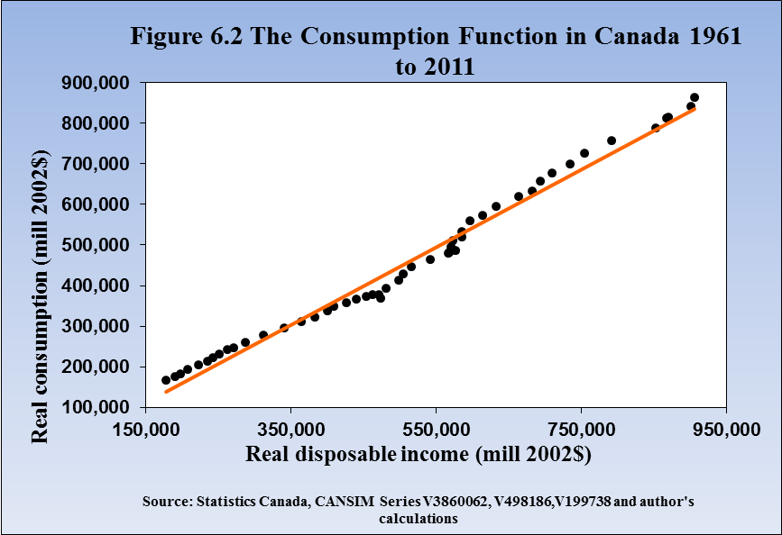
A Consumption Function for Canada
Regression line slope
= MPC ≈ 0.90

Slide 11
The Saving Function
Saving (S)
C = 20 + 0.8Y
S = Y – C
S = Y – (20 + 0.8Y)
S = -20 + 0.2Y
+
S = -20 + 0.2Y
50
100
0
Y
-10
-20
MPS = ∆S/∆Y = 10/50 =0.2
–

Slide 12
Investment Expenditure
Investment (I) planned business spending on plant, equipment & inventories
I = I₀ – bi₀ (assuming i constant)
Investment is autonomous,
Based on business expectations of demand for output & profit
∆i &/or ∆Expectations → shift I function
Investment
I = I₀ – bi₀
I₀
Real GDP Y

Slide 13
The Export and Import Functions
Exports (X):
Spending by residents of foreign countries on domestic output
Exports are autonomous expenditure: X = X₀
X depends on: foreign Y,
domestic & foreign P
foreign exchange rates
tastes and preferences
etc

Slide 14
The Export and Import Functions
Imports (IM):
Domestic spending on foreign output
IM is embedded in C, I & X
IM = IM₀ + mY
IM₀ = autonomous imports
m = ∆IM/∆Y, marginal propensity to import
IM depends on: domestic income Y,
          domestic & foreign P,
          foreign exchange rates
          tastes and preferences
          etc

Slide 15
The Export and Import Functions
X, IM
Suppose:
X₀ = 100
IM = 40 + 0.2Y
IM = 40 + 0.2Y
X < IM
100
X₀=100
X > IM
40
150
300
450
Y

Slide 16
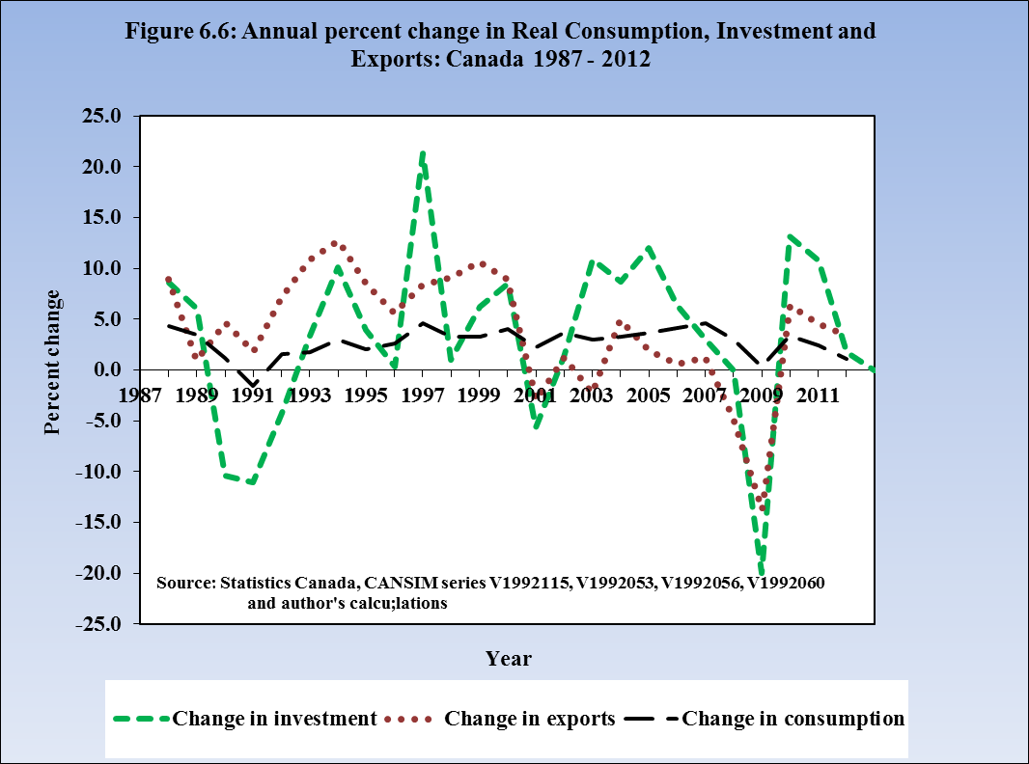
Volatility of AE Components
Consumption is the largest &
most stable part of AE
Investment & exports are
volatile parts of AE

Slide 17
The Aggregate Expenditure (AE) Function
AE = C + I + X – IM
Suppose: C = 20 + 0.8Y
I = 20
X = 50
IM = 10 + 0.2Y
AE = 80 + 0.6Y
Y C I X IM AE ∆AE/∆Y
0 20 20 50 10 80 -
100 100 20 50 30 140 0.6
150 140 20 50 40 170 0.6
200 180 20 50 50 200 0.6

Slide 18
The Aggregate Expenditure (AE) Function
AE = C + I + X - IM
C = C₀ + cY
I = I₀
X = X₀
IM = IM₀ + mY
AE = C₀ + cY + I₀ + X₀ − IM₀ − mY
AE = A₀ + (c – m)Y
AE
AE = A₀ + (c – m)Y
AE₁
∆AE
∆Y
AE₀
∆AE/∆Y = (c – m)
= slope of AE
A₀
Y₀
Y₁
Y

Slide 19
The Aggregate Expenditure (AE) Function
A numerical example
C = 20 + 0.8Y AE = 20 + 20 + 50 – 10 + 0.8Y – 0.2Y
I = 20
X = 50
IM = 10 + 0.2Y
AE = 80 + 0.6Y
AE
AE = 80 + 0.6Y
∆AE = - 60
230
∆Y = - 100
170
∆AE/∆Y = - 60/ - 100 = 0.6
80
150
250
Y

Slide 20
Equilibrium Output
Short-run equilibrium:
Y = AE
Current output = planned expenditure on current output
Business revenues cover costs & expected profit
No unplanned ∆ inventories

Slide 21
Equilibrium Output: the 45º Diagram
Equil: Y = AE
45⁰ line plots all
Y = AE
AE = A₀ + (c – m)Y
At intersection
AE & 45⁰ line
Y = AE
Y ≠ Y_{e} → unwanted
∆ inventories → ∆Y
AE
Y = AE
Equilibrium
AE = A₀ + (c – m)Y
AE_{e}
AE₁ > Y₁ →
Unplanned ↓ inventories
↑ Y → Y_{e}
AE₁
Y₁
A₀
45⁰
Y₁
Y_{e}
Y

Slide 22
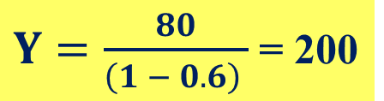
Equilibrium Output
Finding equil Y with basic algebra:
The Model: Consumption: C = 20 + 0.8Y
  Investment: I = 20
  Exports: X =50
  Imports: IM = 10 + 0.2Y
Agg Expend: AE = 80 + 0.6Y
Equilibrium: Y = AE
Y = 80 + 0.6Y
Y – 0.6Y = 80
(1 – 0.6)Y = 80
$Y=\frac{80}{\left(1 − 0.6\right) }$ = 200

Slide 23
Adjusting to Short-Run Equilibrium
  Suppose Y ≠ AE
  →Unplanned ∆ inventories
  Y > AE → unplanned inventory ↑→ ↓Y
  Y < AE → unplanned inventory ↓ →↑ Y
  ∆Y → Y = AE

Slide 24
Equilibrium Output and Employment
In equilibrium Y_{e} = AE
However if:
(Y_{e} < Y_{P}) ≡ Recessionary gap & high unemployment
(Y_{e} > Y_{P}) ≡ Inflationary gap & low unemployment
(Y_{e} = Y_{P}) ≡ ‘full employment’

Slide 25
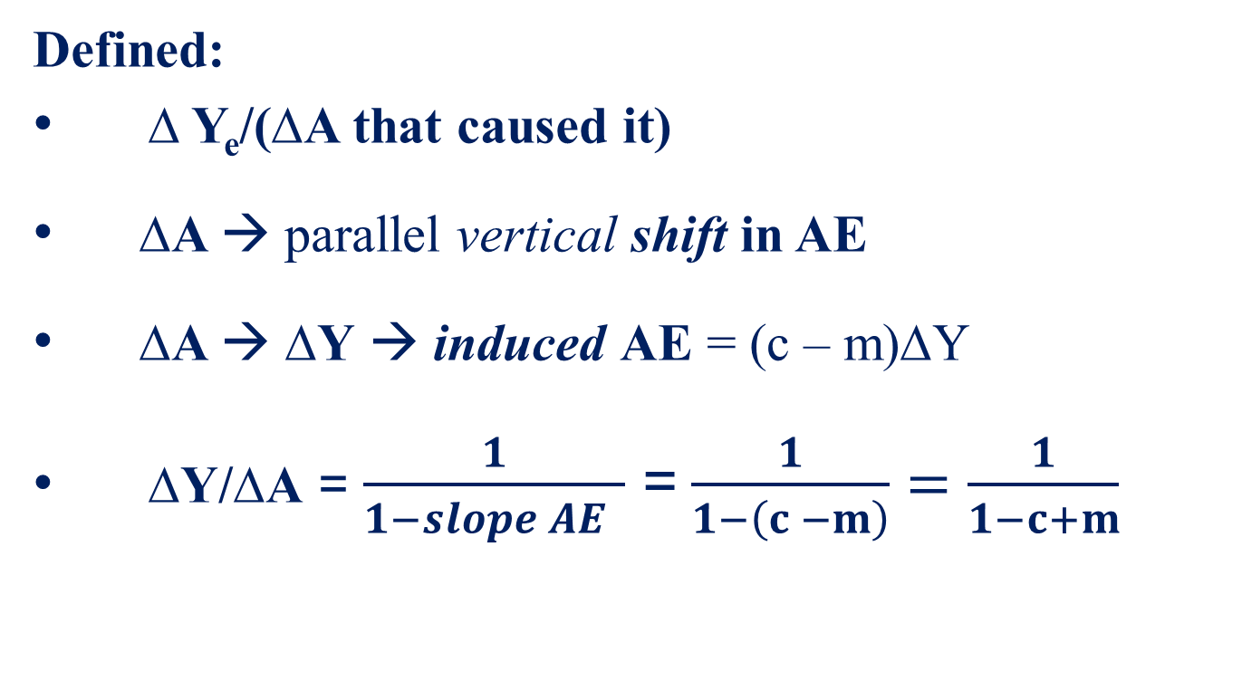
The Multiplier
Defined:
∆ Y_{e}/(∆A that caused it)
∆A → parallel vertical shift in AE
∆A → ∆Y → induced AE = (c – m)∆Y
∆Y/∆A = $\frac{1}{1−slope AE }$ =$\frac{1}{1−\left(c −m\right)}=\frac{1}{1−c+m}$

Slide 26
The Multiplier: ∆Y_{e} /∆A
Example ∆ A₀ = ∆(C₀ + I₀ + X₀ - IM₀)
Y=AE
AE
A₀ + (c – m)Y
A₁ + (c – m)Y
ΔA
A₀
∆Y_{e} = ∆A/(1 – c + m)
= ∆A x multiplier
A₁
ΔY_{e}
45
o
Y_{e}’
Y_{e}
Y

Slide 27
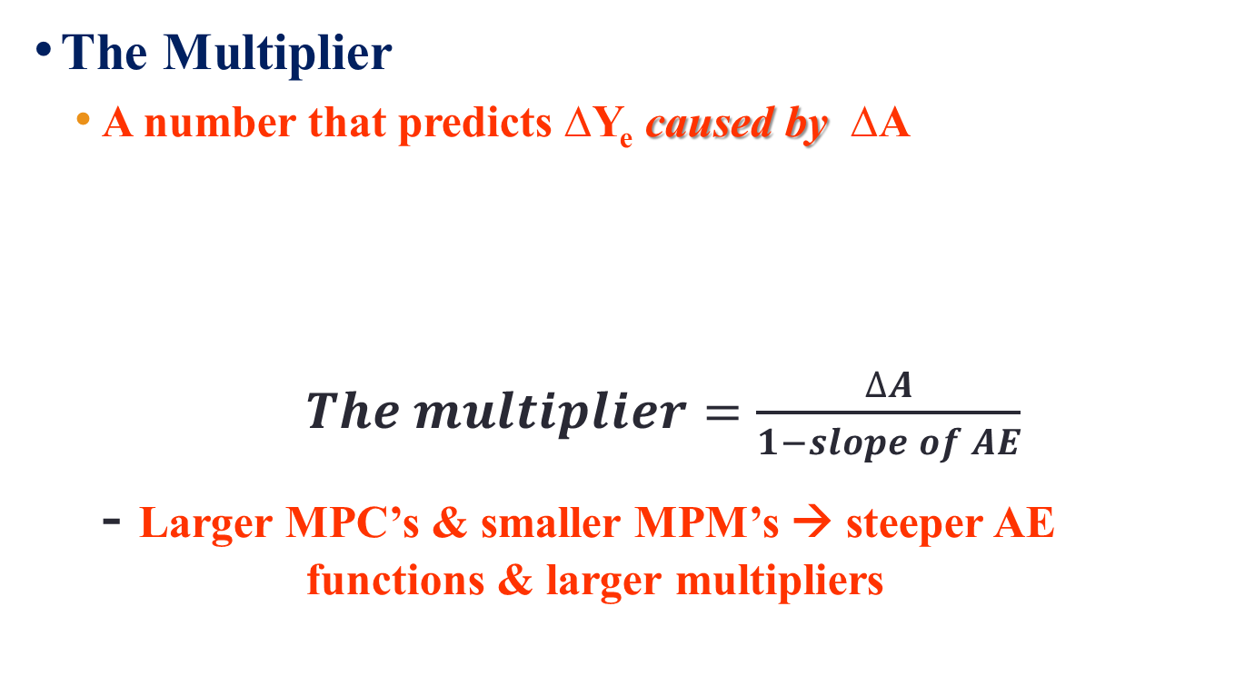
Multipliers
The Multiplier
  A number that predicts ∆Y_{e} caused by ∆A
  $The multiplier=\frac{∆A}{1−slope of AE}$
  - Larger MPC’s & smaller MPM’s → steeper AE functions & larger multipliers

Slide 28
The Size of the Multiplier
A Numerical example:
Initial case Increased A: ∆X = 10
Consumption: C = 20 +0.8Y C = 20 +0.8Y
Investment: I = 20 I = 20
Exports: X = 50 X = 60
Imports: IM = 10 + 0.2Y IM = 10 + 0.2Y
Equilibrium: Y = 80 + 0.6Y Y = 90 + 0.6Y
Y_{e}= 200 Y_{e}= 225
∆Y/∆A = 25/10 = 2.5 = 1/(1 – 0.6)

Slide 29
Leakages & Injections
An alternative view of equilibrium Y:
From Y = AE
  Y = C + I + X – IM, which gives
  Y – C = I + X – IM , but Y – C = S
  Therefore S + IM = I + X also gives Y_{e}
S & IM are leakages from AE
I & X are injections into AE
Injections = Leakages → equilibrium Y
Paradox of Thrift

Slide 30
Leakages & Injections
Equilibrium Y: S + Z = I + X
S + IM, I + X
S + IM
I₀ + X₀
I + X
S₁ + IM₁
0
Y₁
Y_{e}
Y
At Y_{e}: S + IM = I + X
At Y₁: S₁ + IM₁ < I₀ + X₀
Leakages < planned I + X
Unwanted ↓ Inventories → ↑Y
S₀ + IM₀
Paradox of Thrift: An increase in S at every Y → ↓ Y_{e} but no change in S

Slide 31
Aggregate Expenditure, Equilibrium GDP & Aggregate Demand
Key model concepts:
Autonomous expenditure:
  Independent of current income
  A₀ = C₀ + I₀ + X₀ + IM₀
Induced expenditure:
Spending decisions based on current income
MPC & MPM → (c – m)∆Y = ∆AE

Slide 32
Aggregate Expenditure, Equilibrium GDP & Aggregate Demand
Key model concepts:
Equilibrium Y = A₀ x multiplier
Induced expenditure → multiplier
∆A x multiplier → ∆Y > ∆A
Volatility in A → Business cycles in Y

Slide 33
Aggregate Expenditure, Equilibrium GDP & Aggregate Demand
The AD function:
Y_{e} from Y = AE positions the AD curve
ΔA → ∆Y_{e} → horizontal shift in AD = ΔA x multiplier
Fluctuations in AD from fluctuations in A → business cycles in Y_{e}
A diagram to illustrate

Slide 34
Aggregate Expenditure, Equilibrium GDP & Aggregate Demand
AE
Y=AE
P
AE₁
AE₀
ΔA
A₁
P₀
AS
AD’
A₀
ΔY
ΔY
AD₀
45⁰
Y_{e}
Y_{e}’
Y
Y_{e}
Y_{e}’
Y
∆A →∆Y = ∆A x multiplier → shift AD = ∆A x multiplier
Notes:
Start in equilibrium then ∆A → shift in AD

Slide 35
Chapter Summary
Aggregate demand determines Y at constant P
Equilibrium Y = AE positions AD
AE ≡ planned aggregate expenditure (C + I + X – Z)
AE = autonomous expenditure + induced expenditure
C linked to YD by MPC = ∆C/∆YD, 0 < MPC < 1
S = Y – C, MPS = ∆S/∆Y, MPS = 1 – MPC

Slide 36
Chapter Summary
Imports (IM) linked to Y: MPM = ∆IM/∆Y. 0 < ∆IM/∆Y <1
Equilibrium Y = AE → equivalently, S + IM = I + X.
AE > Y → unplanned fall in inventories → ↑ Y
AE < Y → unplanned rise in inventories → ↓ Y
The multiplier ≡ ∆Y_{e}/∆A = 1/(1 – slope AE)
∆A → ∆Y → shift AD → ∆Y_{e} in AD/AS
∆A → ∆AD → business cycles in Y

