Slide 1
5
Output, Business Cycles, Growth and Employment
Macroeconomics
Curtis, Irvine © 2013

Slide 2
In this chapter we will explain:
1. An Aggregate Demand and Supply Model
2. Equilibrium output and potential output
3. Growth in potential output
4. Business cycles and output gaps
5. Output gaps and unemployment rates
6. Adjustments to output gaps

Slide 3
A Short-Run AD/AS Model
Introducing the AD/AS model developed in detail in the chapters that follow
Short run assumptions:
Constant factor-prices esp. money wage rates
Fixed labour force, capital stock & technology
As a result:
∆output → ∆employment & ∆capital utilization

Slide 4
The AD/AS Model in a Diagram
Price level
AD = (C+I+G+X-IM) at different P levels.
AS = P at different rates of real output
AS reflects unit costs of production with constant input prices and producer price setting
P = general price level
P
AS₀
Equilibrium output
and price level P₀Y₀
P₀
AD₀
Y₀
Y
Real GDP

Slide 5
Aggregate Demand (AD)
Downward sloping AD from three effects of ∆P:
  Interest rate effect
    ↑P → ↑i → ↑ finance cost → ↓Expenditure
  Substitution effect
    ↑P → ↑P_{CAN}/P_{US} → ↓X + ↑IM →↓Expenditure
  Wealth effect
    ↑P → ↓(Nominal Wealth)/P → ↓ Expenditure

Slide 6
Aggregate Demand (AD)
The AD curve:
  Shows: ∆expenditure caused by ∆P
  Assumes: all determinants of expenditure except price are constant
  Slope of AD = ─ ∆P/∆Y
  Position of AD: factors other than P that affect expenditure

Slide 7
The Aggregate Demand Curve
The AD curve: Planned aggregate expenditure: (C+I+G+X-IM) at different prices, ceteris paribus
∆P → i effect
    + Substitution
    effect
    + Wealth effect
  → ∆Y/∆P < 0
P
∆P causes movement
along the AD curve
P₀
A
P₁
B
AD
Y₀
Y₁
Y

Slide 8
Aggregate Supply (AS)
The AS Curve:
  Shows relationship between ∆Output & ∆P
  Assumes money wage rates & other input prices are constant
  Slope of AS = ∆P/∆Y > 0
  Position of AS: input prices & other production conditions

Slide 9
Aggregate Supply (AS)
Upward sloping AS curve:
From national accounts:
Price = P(unit cost of production, producer price decisions…..)
Increase in GDP
→ decrease in labour productivity (Y/N)
→ increase in unit labour costs (fixed wage rate )
→ higher prices needed to cover costs
∆Y → ∆(Y/N) → ∆(W/Y) → ∆P, ∆P/∆Y > 0

Slide 10
The Aggregate Supply Curve
The AS curve:
shows prices (P) businesses would require to produce outputs (Y)
↑Y →↑unit costs → ↑P
∆P/∆Y > 0
P
AS
P₃
P₂
↑Y → costs → ↑P
Y₂
Y₃
Y

Slide 11
Equilibrium Real GDP and Price
Unplanned ↑ in inventories
Equilibrium: AD = AS
At P₀,Y₀: AD = AS
Planned expenditure on current output = business sector current production
At P₁: AD < AS
Y₁ < Y₂ → unplanned
↑ inventory →↓Y
P
AS
B
C
P₁
P₀
A
AD
Y₁
Y₀
Y₂
Y

Slide 12
Stability of AD/AS Equilibrium
Equilibrium AD = AS
  Planned expenditure buys current output
  Business revenues = costs including profit
  No ∆Y
Disequilibrium AD ≠ AS
  Unplanned ∆ in inventories
  Business revenues ≠ costs including profit
  ∆Y → AD = AS → Equilibrium

Slide 13
Equilibrium Real GDP and Price
A Numerical Example:
AD: Y = 1000 – 2P
AS Y = -200 + 10P
In Equilibrium AD = AS
1000 – 2P = -200 + 10P
12P = 1200
P = 100
Y = 800

Slide 14
Equilibrium Output vs. Potential Output
Potential output:
≡ real GDP the economy can produce on a sustained basis without generating inflationary pressure
Equilibrium output:
≡ actual real GDP determined by AD = AS
Equilibrium output = Potential output
≡ benchmark for macroeconomic performance

Slide 15
Potential GDP
Potential GDP:
Determined by the economy’s:
Labour force,
Capital stock &
Technology.
Potential GDP (Y_{P})
P
Y_{P} is independent of P
P₁
Changes in labour force
capital stock or technology
change Y_{P} & shift Y_{P} line
P₀
Y_{P}
Y

Slide 16
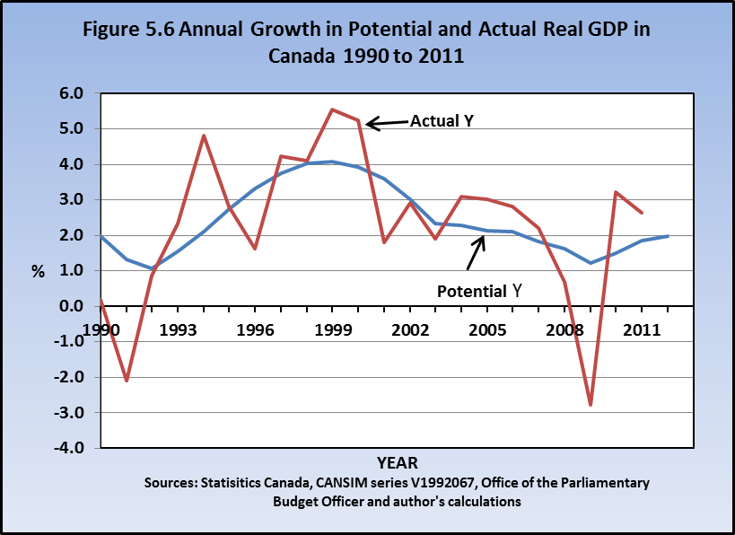
Growth in Potential Output
Potential output grows as
the labour force grows and
labour productivity increases
Actual output increases or
decreases as short run AD
& AS fluctuate
Unemployment rates rise when
actual output grows more slowly
than potential output and fall
when actual GDP grows more
quickly than potential output

Slide 17
Business Cycles and Output Gaps
Business cycles ≡ fluctuations in Y growth
  Caused by fluctuations in AD/AS conditions
Business cycles → Y ≠ Y_{P} → Output Gaps
Output Gap ≡ Y – Y_{P}, or in a growing economy:

Slide 18
Business Cycles and Output Gaps
Output gaps are indicators of macro performance
Y – Y_{P} < 0 → recessionary gap
  High unemployment, low inflation pressure or deflation
Y – Y_{P} > 0 → inflationary gap
  Low unemployment, inflationary pressure
Y =Y_{P} : ‘full employment’, stable inflation

Slide 19
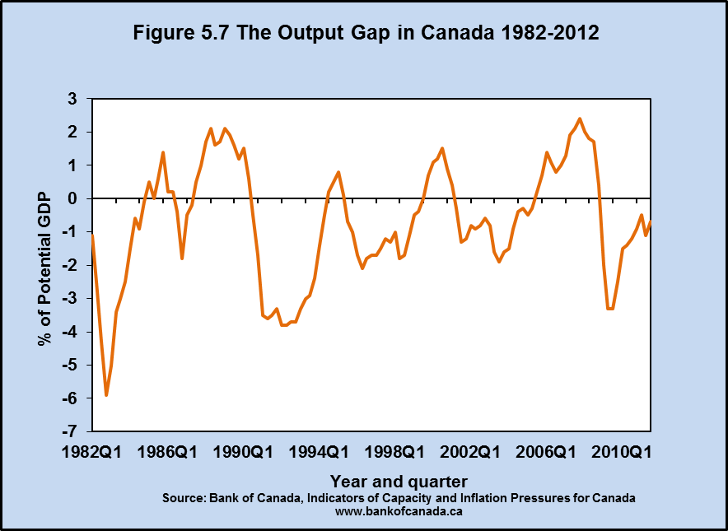
The Output Gap in Canada, 1982-2012
Booms
Fluctuations in the
Output Gap illustrate
the timing and size of
business cycles in
Canadian real GDP and
employment.
Recessions

Slide 20
Output Gaps in AD/AS diagrams
Y_{P}
Given Y_{P} and AS₀
Recessionary gap:
AD₀ → P₀Y₀ ,
Y₀< Y_{P}
Inflationary gap:
AD₁ > AD₀ → P₁Y₁
Y₁>Y_{P}
P
AS₀
P₁
P₀
AD₁
Recessionary gap
Inflationary gap
AD₀
Y₀
Y_{P}
Y₁
Y

Slide 21
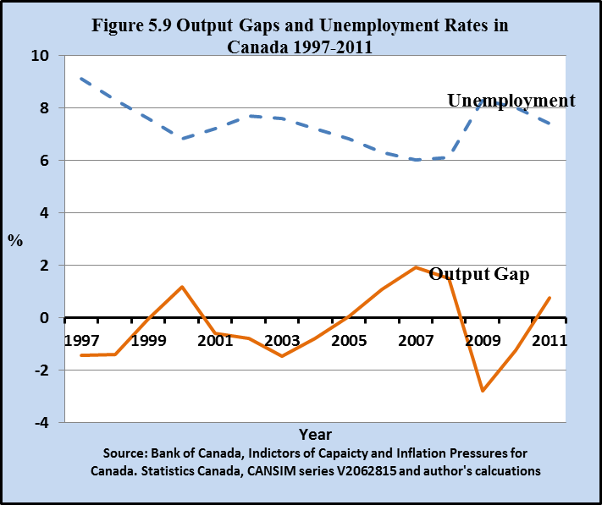
Output Gaps & Unemployment Rates
Potential GDP grows faster than equil GDP
Employment grows faster than labour force
→ Unemployment rate falls
Equil GDP grows faster than
potential GDP
Employment grows faster than
labour force
→ Unemployment rate falls

Slide 22
Adjustment to Output Gaps
P Y_{P}
Initial equilibrium AD/AS₁ involves inflationary gap
Y₁ > Y_{P} > 0
Low unemployment and
labour shortages
→↑ money wage
→↑ unit labour costs
→↑ shift in AS, AS₁ → AS₂
→ Equil with Y = Y_{P,} P = P₂
AS₂
P₂
∆w
AS₁
P₁
gap
AD
Y_{P}
Y₁
Y

Slide 23
Adjustment to Output Gaps
Initial equil AD/AS₁
involves recessionary gap
Y₀ < Y_{P}
High unemployment
→↓ money wage, w
→↓ unit labour costs
→↓ shift in AS → AS₁
Equil with Y = Y_{P} and P = P₁
Y_{P}
P
P₀
AS₀
∆w
AS₁
P₁
gap
AD
Y₀ Y_{P} Y

Slide 24
The Role for Macroeconomic Policy
Two roles for macroeconomic policy:
1. Moderate short term transitory fluctuations
to stabilize output and employment
2. Change AD and AS to offset persistent output
gaps
These objectives are pursued through a combination
of policy design and policy changes

Slide 25
The Role for Macroeconomic Policy
Monetary policy
→ sets short term interest rate to achieve medium term
inflation control target
→ responds strongly to offset persistent output gaps
in setting its interest rate
Fiscal policy
→ sets annual budget plan to control deficits and
debt ratios
→ tax and transfer programs provide built-in short
term AD stabilization
→ change structural budget balances to offset
persistent recessionary gaps

Slide 26
Chapter Summary
Introduce an Aggregate Demand & Supply model as
  the framework for theory, models and policy in later chapters
The Aggregate Demand & Supply model explains determination of equilibrium real GDP (Y), employment and the price level (P)
Equilibrium real GDP fluctuates as AD & AS conditions change.
Potential output (Y_{P}) is the economy’s real GDP at full employment. Unemployment rate = natural rate

Slide 27
Chapter Summary
Business Cycles are short-run fluctuations of equilibrium real GDP around Potential GDP
Business cycles create Output Gaps: Y_{e} ≠ Y_{P}
  Inflationary Gaps: Y > Y_{P}
  Recessionary Gaps: Y < Y_{P}
Internal adjustment to output gaps depends on factor price flexibility
Fiscal and Monetary policy stabilize and manage equilibrium Y by changing AD to reduce output gaps

